Slide 1
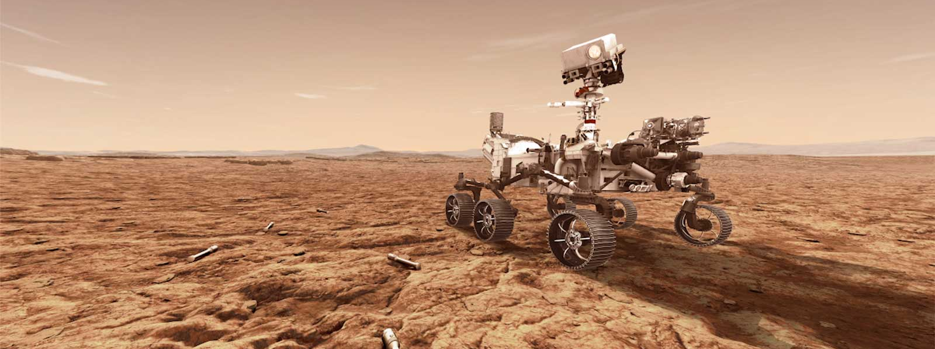

What’s really hitching a ride to Mars:
De-noising Perseverance Rover’s Biodiversity!
2020 Postdoc Research Day Presentation Conference
Chiranjit Mukherjee
Organization: 352N
Advisor: Brian Clement (352N)
Postdoc Program: JPL Postdoctoral Program

Slide 2
Introduction
M2020 Genetic Inventory (GI) Task Goals: Implements a DNA-based metagenomic approach to fulfill M2020 project requirements related to identification and quantification of terrestrial biological contamination sources such as bacteria, archaea, fungi and viruses
Challenge:
Hardware samples from cleanrooms have Ultra-low Biomass (very little DNA) - difficult to discriminate between true hardware-associated species (signal/true positives) & contaminants (noise/false positives) originating from collection & processing of the samples
Solution:
Include all possible controls (handling/template free) samples
Develop strategy to subtract “noise” from data to generate true signal
Schematic Overview of the GI Task
Description of all GI Sample Types

Slide 3
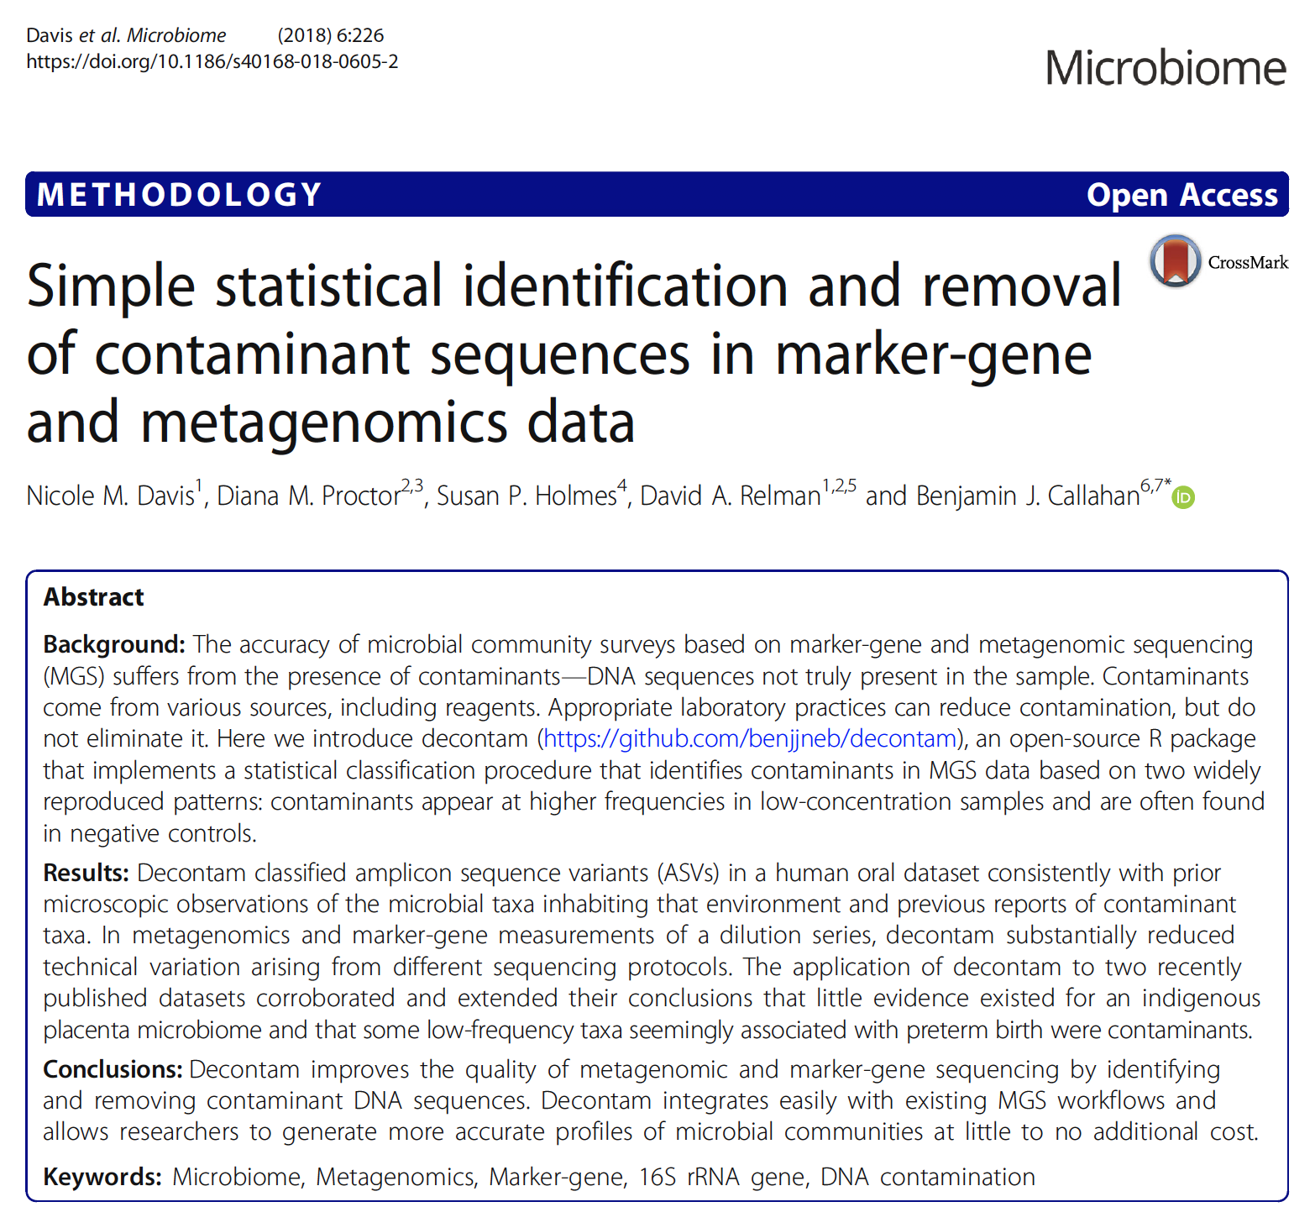
Methods: “Noise” Removal Strategy
Open source software tool ‘Decontam’ can classify species present in samples as true positive vs contamination originating from process using information from controls
Current Goals:
Validate Decontam for our specific ultra-low biomass samples
  Using Zymo MMC samples (positive controls), and Dilution water & Sequencing NTC (negative controls)
Optimize individual tool parameters using positive control data
Implement validated, optimized method to actual hardware samples
Decontam Publication
All work was done in R statistical computing environment. R package Decontam was used for building the denoising pipeline. Visualizations were built using R package ggplot2.

Slide 4
Results I (Validation & Optimization)
Original Data
Model Microbial Community (MMC, known bacterial composition) samples at two dilutions (2.5 & 0.25 ng/µL) were included as positive controls
Dilution water & Sequencing Blanks (Fulgent NTC) were used as negative controls
% of Expected Species in Positive Control Dilutions increased considerably after removal of contaminant species as detected using Decontam
Non-Metric Multidimensional Scaling (NMDS) ordination plots showed significantly better separation between positive & negative control samples after noise removal
After Denoising

Slide 5
Results II (Implementation)
Original Data
Decontam-based denoising method previously developed was applied to hardware samples, using handling controls (swabs/wipes used to collect DNA from the hardware) & NTCs, as negative controls
NMDS ordinations showed that ecological profiles of hardware samples & controls were significantly different from each other after denoising, for both the wipe and swab samples
Handling controls (swabs/wipes) were virtually indistinguishable from NTCs, suggesting that these do not significantly contribute to the overall biodiversity of the samples
Swabs
Wipes
After Denoising

Slide 6
Conclusions & Future Work
Bioinformatic De-noising pipeline for ultra-low biomass samples validated & optimized
Strategy successfully deployed to remove false positive species from the Perseverance rover’s hardware metagenomic samples
Hardware samples could be distinguished from controls with high statistical significance
Future work will focus on detailed investigation of individual species associated with the hardware samples, to establish a core rover microbiome

Slide 7
Acknowledgements
Current M2020 GI Team members:
Lisa Guan: CAM, Sample collection, DNA extraction, Metadata management
Contact:
chiranjit.mukherjee@jpl.nasa.gov
Dr. Nitin Singh: Sequence Data Pre-processing
Past GI Team members:
Dr. Parag Vaishampayan: Project conceptualization and technical guidance.
Dr. Brian Clement: Post-doctoral advisor & 352N Group Supervisor

