Slide 1
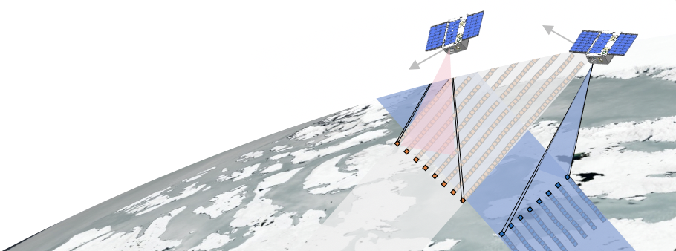

Ground Calibration Procedures for the PREFIRE CubeSat Spectrometer
Phased Antenna Array Design for a Scalable Ka-band Digital Beamforming Array Receiver
2020 Postdoc Research Day Presentation Conference
Lavanya Periasamy
Organization: 329H
Advisor: Brian Drouin (329H), Sidharth Misra (386G)
Postdoc Program: JPL
Notes:
31.50

Slide 2
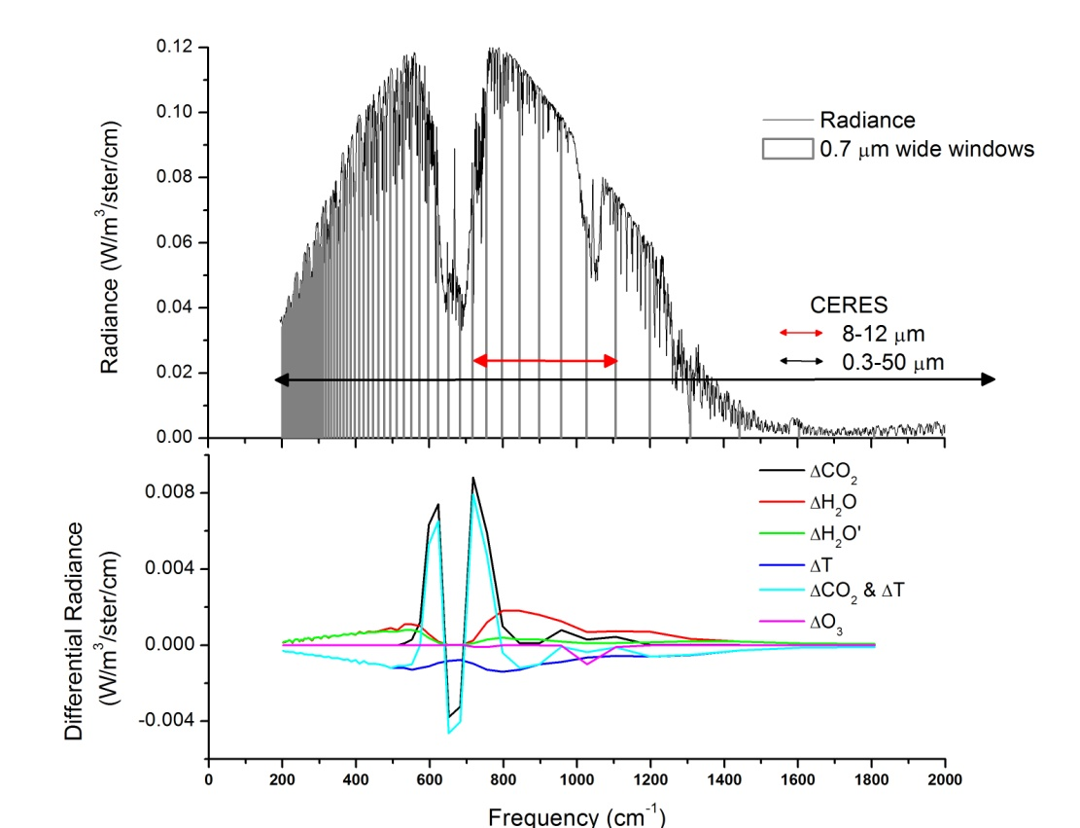
The PREFIRE CubeSat Mission
Polar Radiant Energy in the Far InfraRed Experiment
The PREFIRE mission will launch two CubeSats in low earth, near polar inclination orbits.
PREFIRE will measure variations in FIR emissivity and greenhouse effect via thermal radiometric sampling at the top of the polar atmosphere.
  Measurements will be integrated into climate models to understand the role of FIR radiation in Arctic climate.
The payload in each CubeSat is a Thermal (far) InfraRed Spectrometer (TIRS) that can detect emission between 5 and 45 um with:
  0.85 um spectral resolution
  <1.3º spatial resolution with 8 cross-track pixels
  0.6 K sensitivity.
The spectrometer has heritage from the Mars Climate Sounder, the Diviner Lunar Radiometer Experiment, and the Moon Mineralogy Mapper.
The instrument uses a flip mirror to switch between an internal blackbody and cold space for two-point radiometric calibration.
Nearly 60% of polar emission occurs at wavelengths longer than 15 µm that have never been systematically measured.
PREFIRE science data will determine seasonal variations in:
Snow and ice FIR emissivity
FIR green house effect
Arctic spectral surface emission
Notes:
19.07

Slide 3
Laboratory Calibration of a Spectrometer
Prelaunch characterization of the FIR spectrometer includes three calibration procedures:
Spectral calibration
  Determines spectral response of the instrument across all channels
  Uses a FIR source with a monochromator
Radiometric calibration
  Determines instrument gain and offset corrections due to thermal drift or fluctuations
  Uses two external hot and cold temperature controlled blackbody targets
Spatial calibration
  Determines field of view of each detector, relative alignment between detectors
  Uses a tunable laser source in conjunction with a monochromator
Calibration procedures have similarity with those of the MCS and DLRE spectrometers’.
This work focuses on developing the laboratory setup for spatial calibration and includes
  determining optical requirements and procurement of the new PREFIRE monochromator including the collimated FIR ceramic emitter source, condensing optics, gratings, and filter wheel.
  developing a mathematical model for determining monochromator throughput based on the optics
  understanding the MCS legacy monochromator and associated calibration procedures
  development of a chopper stabilized instrumentation amplifier for integrating with the monochromator reference detector and for laser alignment
Notes:
120

Slide 4
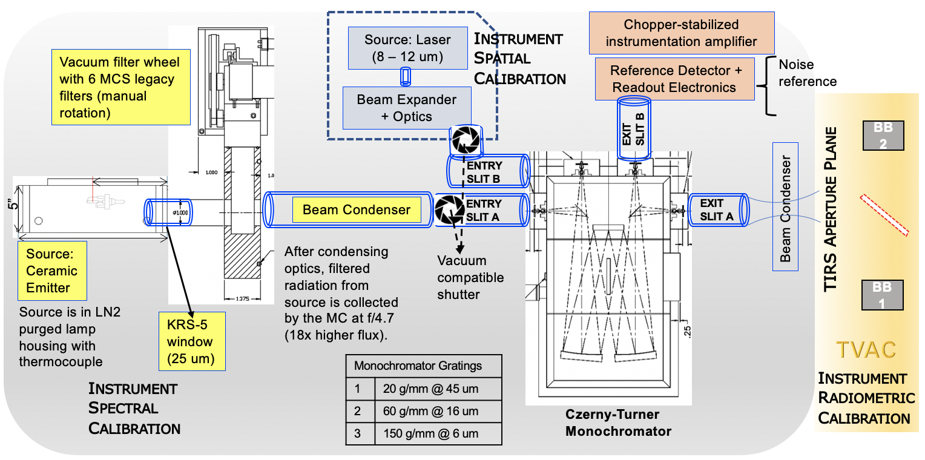
TIRS Prelaunch Calibration
Notes:
58

Slide 5
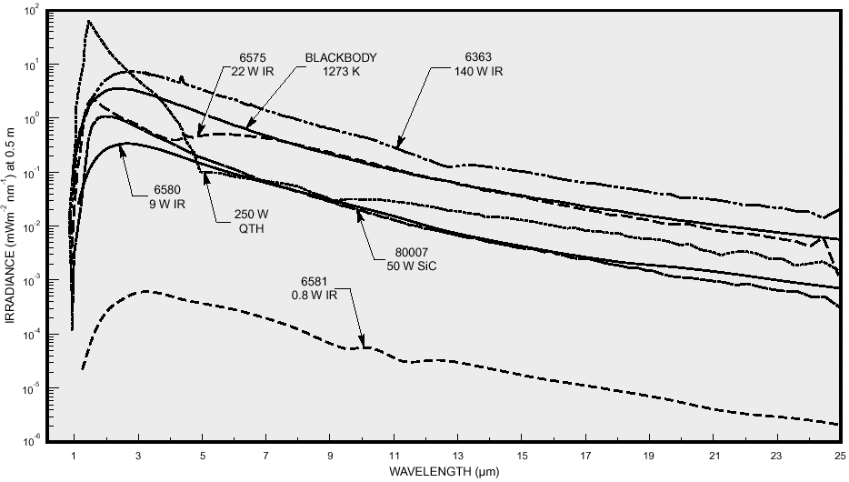
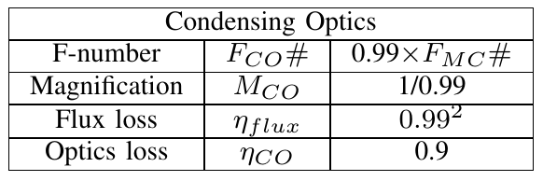
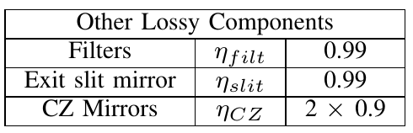
Monochromator Throughput Model
Product of the etendue and bandpass with source exitance (irradiance) and corresponding efficiency factors gives an estimate of the expected output power from the monochromator.
Expected monochromator output power with ceramic emitter and blocking filter for 2 mm and 4 mm slit widths
Irradiance curve for the 22 W 3x10 mm² ceramic emitter source (1600-2000 K) after optimization with condensing optics for the monochromator.
*Image source: Manufacturer specification document
Approx. losses:
Notes:
52.26

Slide 6
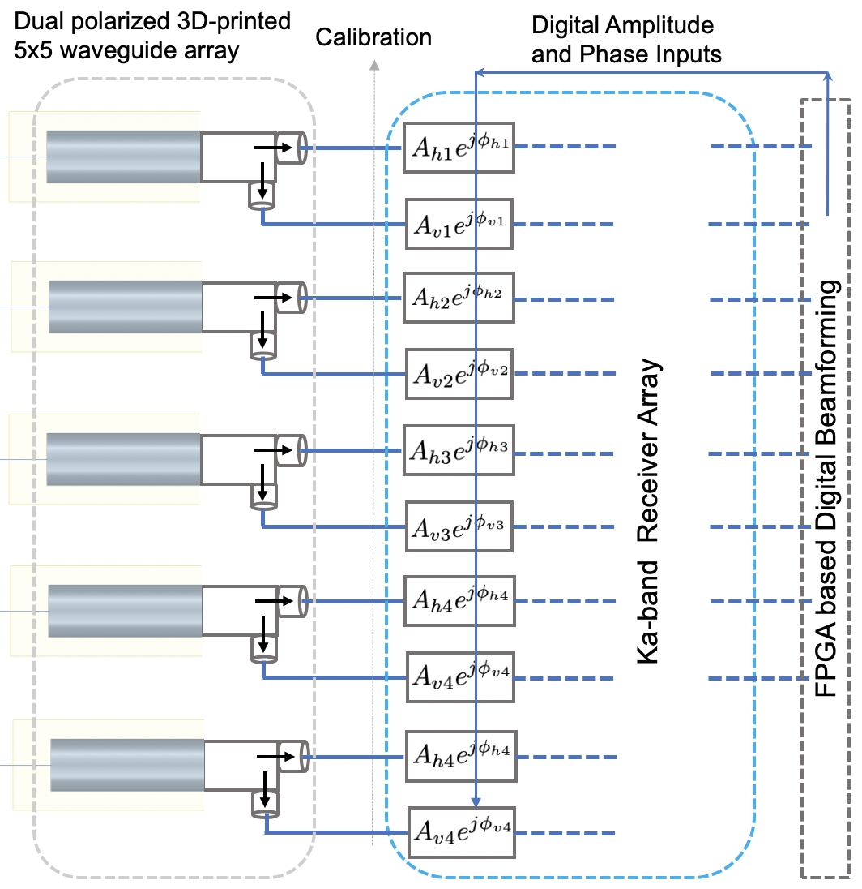
Ka-band Active and Passive Digital Array Receiver
This SRTD intends to demonstrate an airborne-ready scalable and multi-functionality Ka-band multi-channel combined active/passive RF array system, with digitally re-configurable antenna beams.
  Active band: 35.5 – 36.0 GHz
  Passive band: 36.0 – 37.0 GHz
Receiver development includes miniaturization of system components either through custom built options or leveraging commercial 5G chipsets in the spectral band of interest.
The digital signal processing chain includes a FPGA based digital beam forming algorithm, and phase and gain equalization between the multiple receivers required for achieving digital beamforming.
The antenna systems consists of 5x5 planar array of dual-polarized circular waveguides.
  The amplitude and phase at the input of each element is modified by the digital beamformer.
  Development keeping in mind low cost, light weight, ease of portability for airborne experiments, and ease of scalability.
The key science observing priorities at this band are clouds, convection and precipitation.
Notes:
28

Slide 7
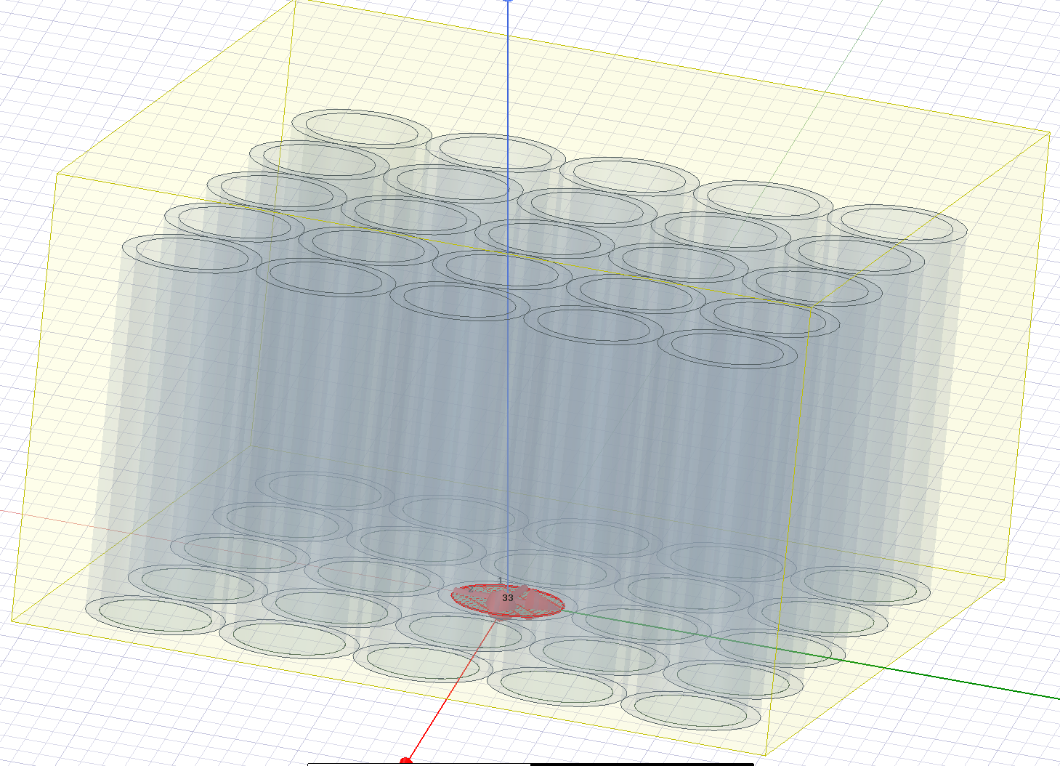
3D Printed Planar Antenna Array Design
Design Parameters:
  radius
  wall thickness
  inter-element spacing
  impedance matching
  ground plane edge diffraction
  lattice type i.e. square vs triangular
  amplitude tapering e.g. Taylor for beam shaping
Active |S₁₁| > -15 dB for larger waveguide radii; however inter element spacing > λ/2 in such cases.
3D printing using JPL facilities
~8 um surface roughness << λ/100
Antenna element design requirements for radiometry:
  Dual polarization
  Low cross polarization
  Low side lobe level
  E and H plane symmetry
  High phase efficiency
  Low radiation and ohmic loss
  Possibly use structural elements that can be 3D printed (scalable, low cost)
Antenna array design requirements:
  >18 dB directive gain, ~12º 3-dB beamwidth
  High beam efficiency
  Sidelobe and grating lobe levels below -15 dB for |20º| elevation scan
  Very low mutual coupling between elements
=> 5x5 uniformly spaced planar array of circular waveguides was chosen
  Triangular spacing lattice is also being considered.
Notes:
62

Slide 8
Simulated Farfield Radiation Patterns (uniform amplitude excitation)
Fullwave HFSS Simulation (red) vs Array Factor times CWG HFSS Element Pattern (blue)
The following issues are being addressed in the array design in order to improve beam efficiency:
Azimuthal plane cuts around the 45º plane are broader with higher side lobes
Cross polarization levels for the HFSS fullwave simulation are at -8 dB below peak directivity
Sidelobe levels are at -12 dB below maximum
Grating lobes during scanning
Boundaries and meshing requirements in HFSS
E-Plane
D-Plane
H-Plane
Co- and Xo- Polar Fullwave HFSS Simulation (blue, red) vs
Co- and Xo- Polar Array Factor times CWG HFSS Element Pattern (cyan, magenta)
E-Plane
D-Plane
H-Plane
Notes:
19

Slide 9
Acknowledgements
PREFIRE TIRS CALIBRATION SETUP
Brian Drouin
Sharmila Padmanabhan
Mary White
Ka BAND ANTENNA ARRAY
Sidharth Misra
Richard Hodges
Xavier Bosch
Mehmet Ogut
Notes:
7.5

