Slide 1
O
R
OH
+
-
+
O
+
R
N
H
Images: NASA/JPL
Towards analysis of fatty acids in ocean world samples
Miranda Kok
Organization: 389U
Advisor: Peter Willis (389U)
Postdoc Program: JPL

Slide 2
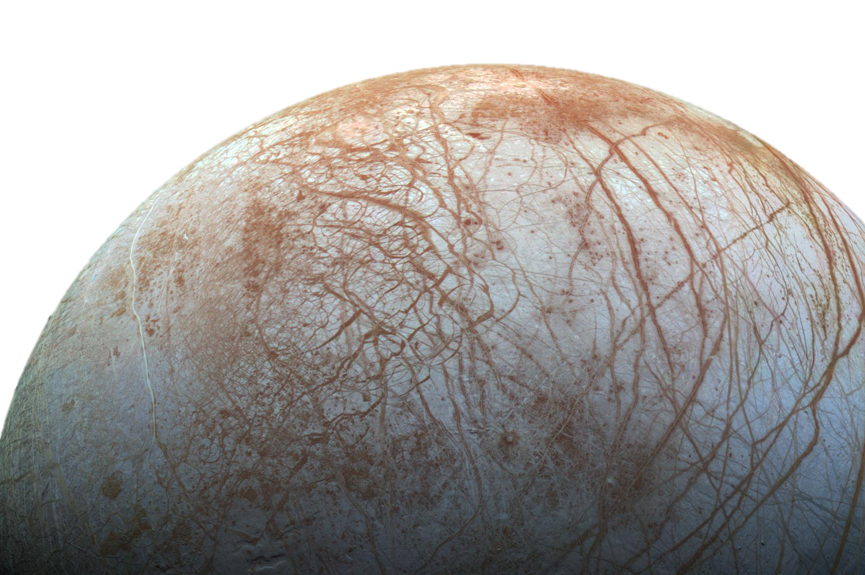
Ocean Worlds Life Surveyor (OWLS)
The ultimate goal of the OWLS project is to built the first integrated, portable instrument capable to search for life in ocean worlds at the level of cells and molecules
building and testing of hardware
development of analytical methodologies
demonstration of its functionality in field trips
search
for life
Image: NASA/JPL

Slide 3
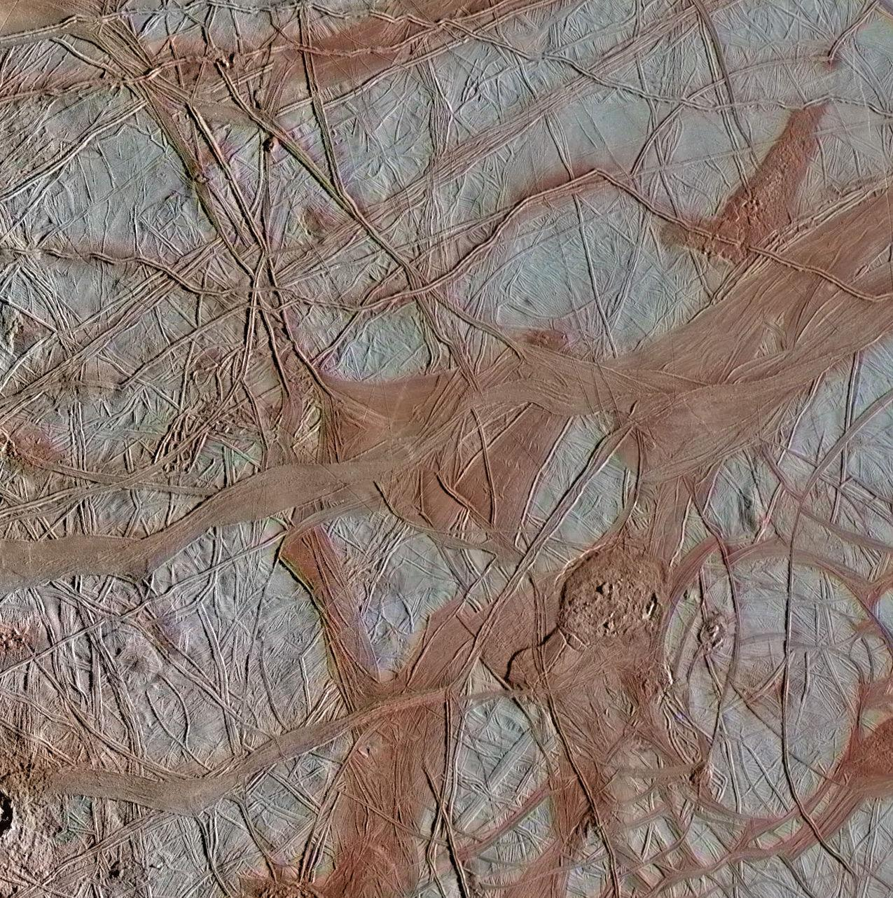
microorganisms
cells
cell membranes
lipids, fatty acids
search for life
DNA
nucleotides, nucleosides, nucleobases
proteins
peptides, amino acids
O
OH
metabolism
carboxylic acids, sugars, alcohols, phosphate, ...

Slide 4
microorganisms
cells
cell membranes
lipids, fatty acids
search for life
DNA
nucleotides, nucleosides, nucleobases
proteins
peptides, amino acids
O
OH
metabolism
carboxylic acids, sugars, alcohols, phosphate, ...

Slide 5
CE-MS analysis
mass spectrometry (MS)
detection and identification of separated compounds
-
+20 kV
++
-
+
--
--
--
++
+
-
-
-
-
-
++
intensity
N
+
+
-
+
N
-
+
+
--
-
N
++
++
--
-
+
N
++
+
+
--
--
-
+
-
++
N
+
N
N
-
+
+
+1.2 kV
capillary electrophoresis (CE)
separation of compounds based on charge-to-size ratio
time

Slide 6
Analysis of fatty acids (C₄ - C₂₂)
O
OH
Challenges:
huge variety in composition
chain length
straight vs. branched
saturated vs. unsaturated
low solubility in water
negative ion mode mass spectrometry
corona discharge
low detection sensitivity

Slide 7
Sample processing
1. subcritical water extraction
cell lysis and hydrolysis of complex molecules at high temperature and under pressure
2. liquid-liquid extraction
isolation of fatty acids from other molecules
3. derivatization
labelling fatty acids with a positively
charged reagent
O
organic phase
(fatty acids)
O
AMPP
+
R
OH
+
water phase
(polar compounds)
R
N
H
-
+
fatty acid
optimum: hexane
mix of fatty acids, EDC, HOBt and AMPP
60°C for 30 min

Slide 8
CE-MS of derivatized fatty acids
C₈
C₉
10
C₄
C₁₀
C₆
8
C₁₂
6
C₁₈
intensity (x10⁶)
C₁₆
C₂₀
C₂₂
4
C₁₄
2
0
18
20
22
24
26
28
30
32
time (min)

Slide 9
CE-MS of derivatized fatty acids
mass spectrum, t = 25.3 min
C₈
7
C₁₆-AMPP
C₉
10
C₄
C₁₀
423
C₆
6
8
C₁₂
5
6
C₁₈
4
intensity (x10⁶)
C₁₆
C₂₀
C₂₂
intensity (x10⁵)
C₁₄
3
4
2
2
1
0
0
18
20
22
24
26
28
30
32
100
200
300
400
500
time (min)
mass-to-charge ratio (m/z)

Slide 10
CE-MS/MS of derivatized palmitic acid (C₁₆)
7
C₁₆-AMPP
AMPP
423
5
183
6
5
4
4
fragmentation
169
3
intensity (x10⁵)
intensity (x10⁴)
3
239
2
2
-14 Da (-CH₂)
1
1
156
423
0
0
100
200
300
400
500
100
200
300
400
mass-to-charge ratio (m/z)
mass-to-charge ratio (m/z)

Slide 11
Concluding remarks
CE-MS allows the efficient separation, quantification and identification of fatty acids
Sample processing is essential to overcome solubility and detection issues
Future work
further optimization of sample processing procedures
verification and validation of the method
analysis of ocean world analogue samples
Acknowledgements
This research project is funded by the JPL Next program
contact: miranda.g.kok@jpl.nasa.gov

