Slide 1
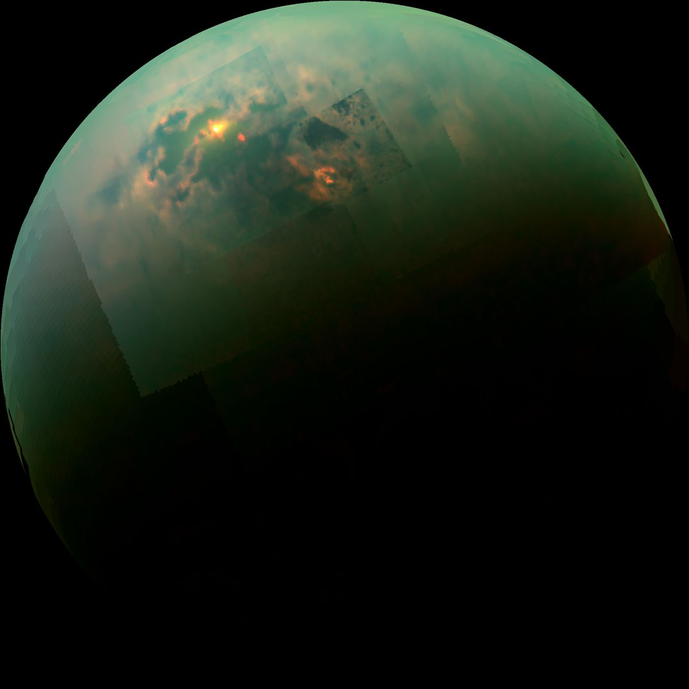

Surface-atmosphere interactions on Titan : Earth’s cooler cousin!
Rajani Dhingra (3224)
R = 5µm, G = 2µm, B = 1.3µm
Image credit : University of Idaho/Univ of Arizona, JPL Caltech/NASA
Organization: Planetary Science
Advisor: Dr. Bonnie Buratti (3222)
Postdoc Program: NPP
2020 Postdoc Research Day
Presentation Conference

Slide 2

Observation:
T120, 07 June 2016
Specular reflection
R = 5µm, G = 2µm, B = 2.7µm

Slide 3
Observation :
Broadly reflecting feature
Overlays Land
R = 5µm, G = 2µm, B = 2.7µm

Slide 4
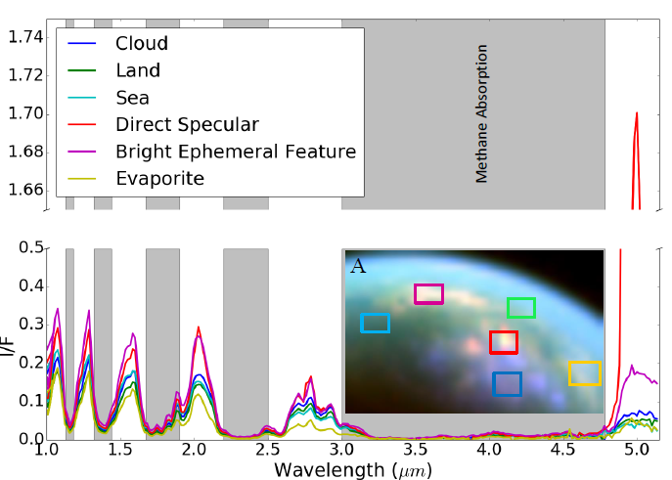
Methodology : Feature is Brighter than other regions

Slide 5
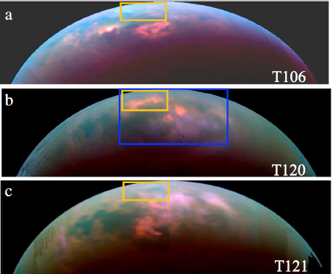
Results : Bright feature is ephemeral
Dhingra et al., 2018, GRL

Slide 6
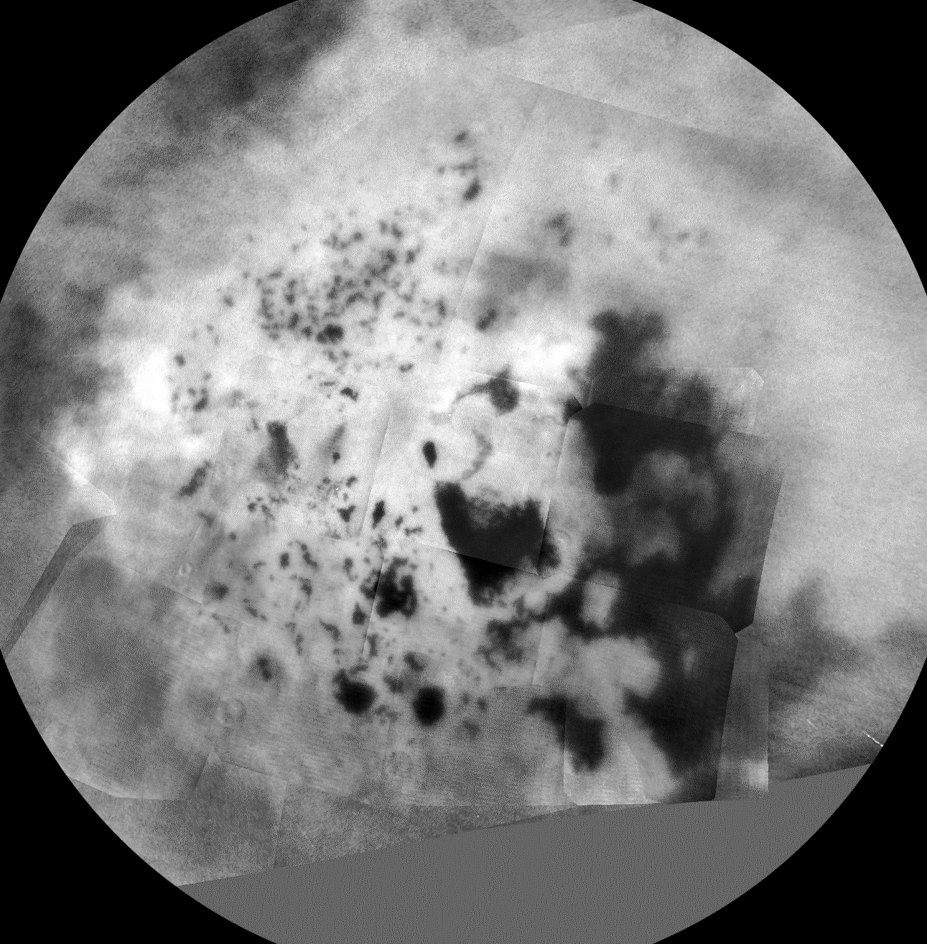
Ephemeral features move spatially and temporally
180ºW
90ºW
270ºW
Dhingra et al., 2020, PSJ
0ºW
T119
(05)
T101
(05)
T103
(07)
T105
(09)
T120
(06)
T122
(08)
T123
(09)
T124
(11)
T125
(11)
T102
(06)
T104
(08)
T106
(10)
T121
(07)
No North Polar Observation
(2014)
(2016)
Notes:
In the ISS basemap here, we have our four best observations. One thing to notice here is, our observations are closer to the seas.
There is no repititon over the same region. Although, T106 and T121 in green and cyan are at similar places and then T120 and T119 in red and magenta are in similar regions.
Is it more likely to rain at some places?

Slide 7
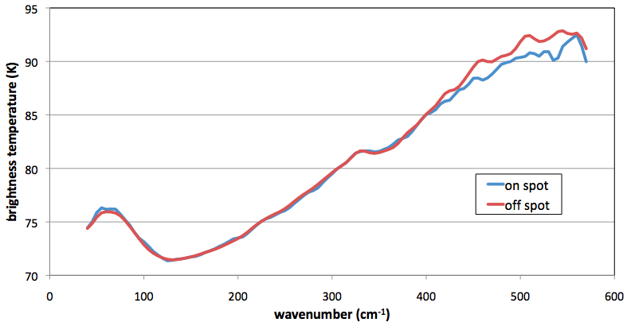
CIRS detects Temperature drop
Manuscript under preparation

Slide 8
Summary
Broad specular reflections on Titan’s north pole indicate atmosphere-surface interaction.
Inform about how seasons change across the hemispheres.
Provide new input parameters to the General Circulation Models (GCMs) to better predict Titan’s seasonal weather and long-term climate.

