Slide 1
Ice Sheet Surface Melting Detection using SMAP Radiometry
Mohammad Mousavi
Organization: 386G
Advisor: Andreas Colliander (386G)
Postdoc Program: JPL

Slide 2
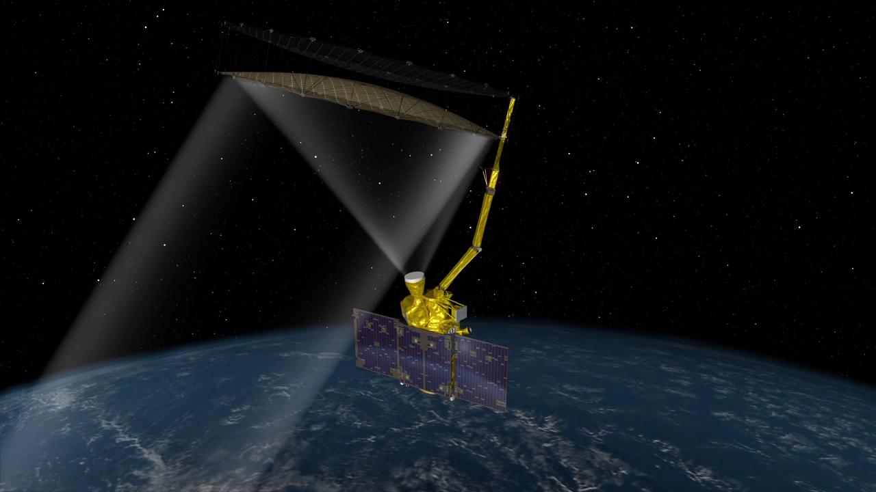
Introduction
NASA Soil Moisture Active Passive (SMAP) Satellite
Objective:
To remotely detect surface melt events over Antarctica ice sheets using SMAP L-band microwave radiometry
Method:
By comparing daily polarization ratios of the measured brightness temperature with a reference value, melt event can be detected.
Benefits:
Passive Microwave
Low power (low cost) for space/air borne instruments
All weather operation capability
Still operational
Longer period in L-band (2015-2020)
Snow Wetness% over Antarctica (2015-2016)

Slide 3
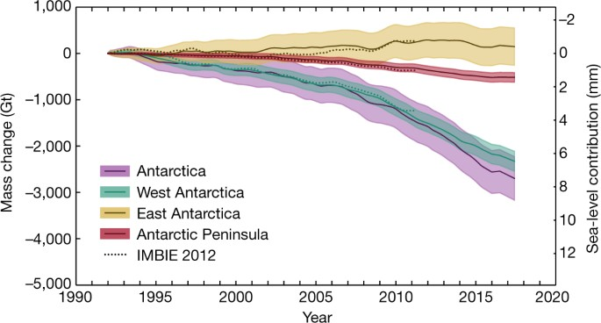
Problem Description
Cumulative Antarctic Ice Sheet mass change (Shepherd et al. 2018)
The polar ice sheets have undergone unprecedented melt events in the recent past years:
Several major ice shelf collapses over the Antarctic Peninsula (Datta, et al., 2019)
Mean sea level rise of 7.6 mm due to the Antarctic ice loss during 1992-2017 (Shepherd et al. 2018)
So, monitoring the melt extent and duration over the Antarctica is important!
Past Studies: using 19 GHz and 37 GHz frequencies available from several satellite sensors, such as the Scanning Multichannel Microwave Radiometer (SMMR)
New Approach: using SMAP L-band (1.4 GHz) radiometer observations; more comprehensive information on the polar ice sheets due to the larger characteristic ice penetration and sensing depth at lower microwave frequencies (up to hundreds of meter)
Our Algorithms:
Empirical Threshold Algorithm
Geophysical Model-Based Algorithm; Snow Wetness Retrieval (SnoWR) Algorithm

Slide 4
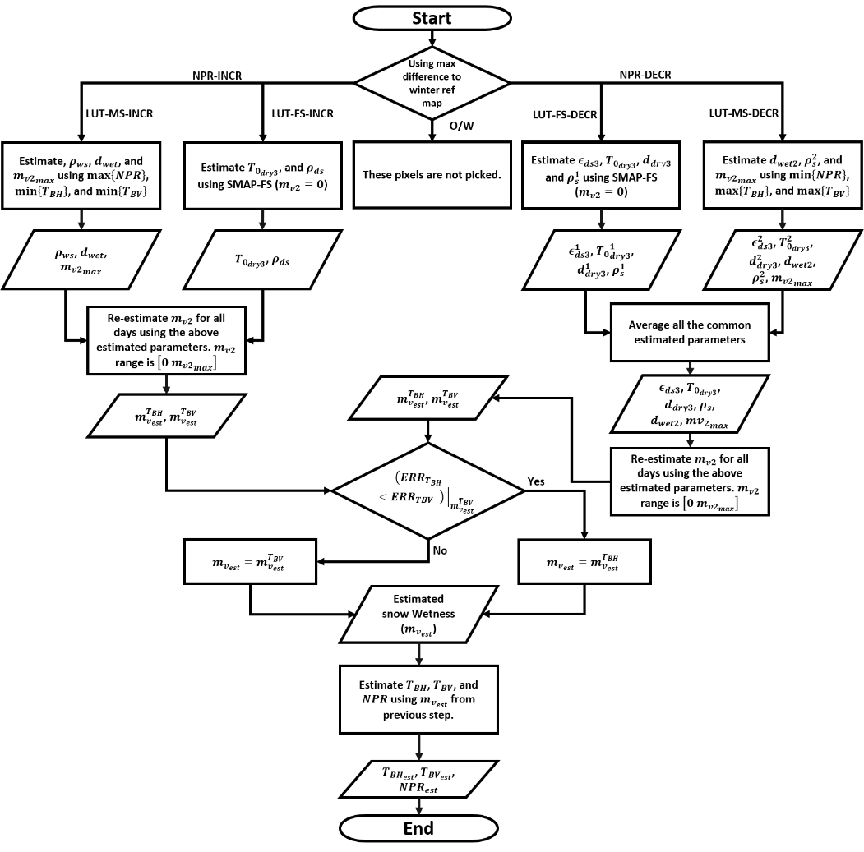
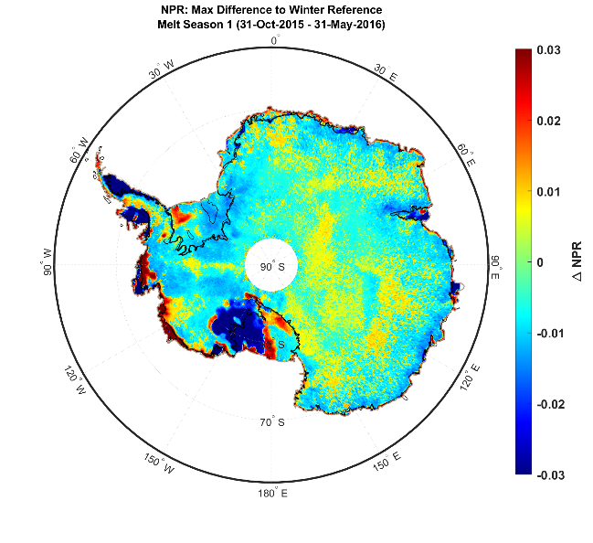
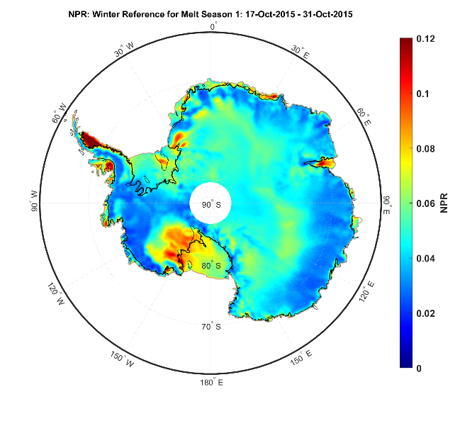
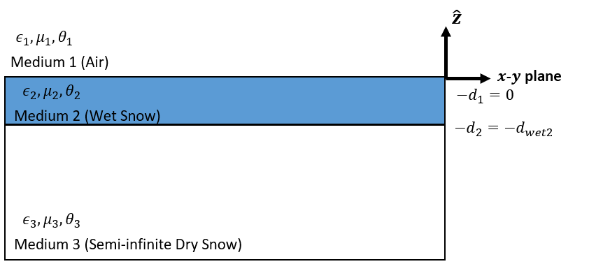
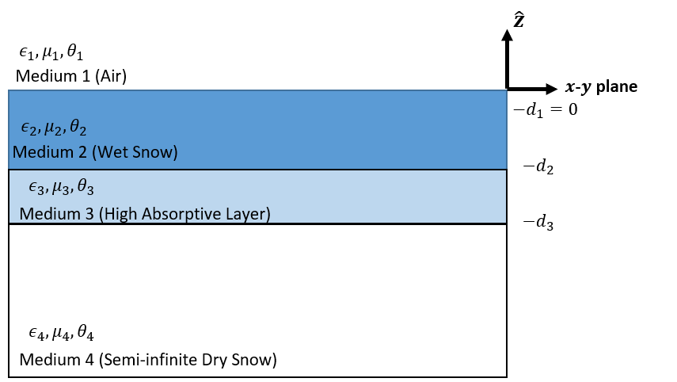
Methodology
Empirical Threshold Algorithm:
SnoWR Algorithm (Model-Based):
Melt: if both $m_{1}(t)$ and $m_{2}\left(t\right)$ indicate True (AND operation)
$$m_{1}\left(t\right)=\left\{\begin{matrix}1 (True) & \left|NPR_{daily}−NPR_{ref}\right|≥Z_{npr}×E{\left[SD\left[NPR\right]{\left.​\right|}_{WREF}\right]}_{All Pixels} \\ 0 (False) & otherwise\end{matrix}\right.$$
$$m_{2}\left(t\right)=\left\{\begin{matrix}1 (True) & \left|T_{BV_{daily}}−{T_{BV}}_{ref }\right|≥Z_{tbv}×E{\left[SD\left[T_{BV}\right]{\left.​\right|}_{WREF}\right]}_{All Pixels} \\ 0 (False) & otherwise\end{matrix}\right.$$
$$NPR_{ref}=E\left[NPR_{daily}\right]{\left.​\right|}_{Nov 1−15}$$
$$NPR=\frac{T_{B_{v}}−T_{B_{h}}}{T_{B_{v}}+T_{B_{h}}}$$
$${T_{BV}}_{ref}=E\left[{T_{BV}}_{ref}\right]{\left.​\right|}_{Nov 1−15}$$
$Z$ determines false alarm rate (FAR):
$FAR=\frac{1}{2}\left(1−\operatorname{erf}\left(\frac{Z}{\sqrt{2}}\right)\right)$
NPR Increasing
(NPR-INCR)
NPR Decreasing
(NPR-DECR)

Slide 5
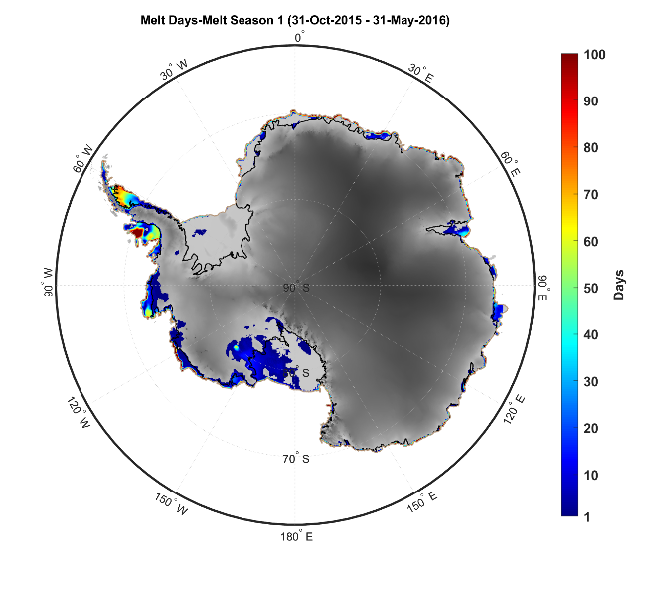
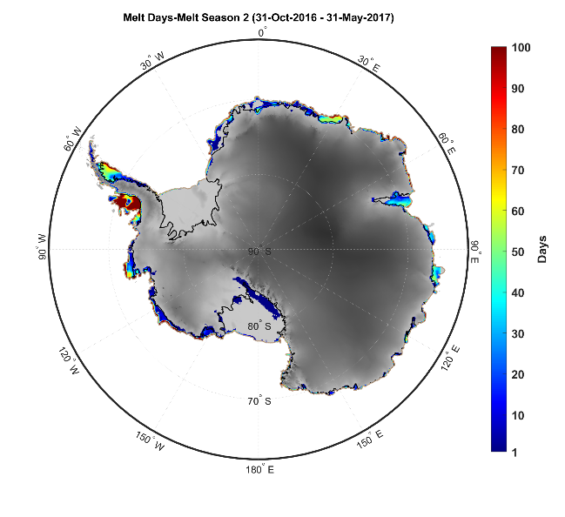
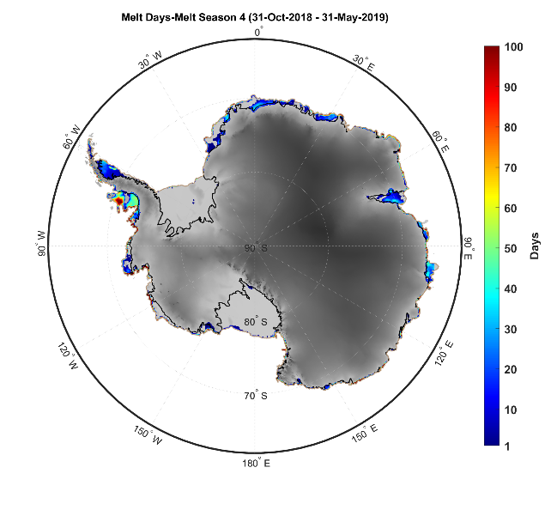
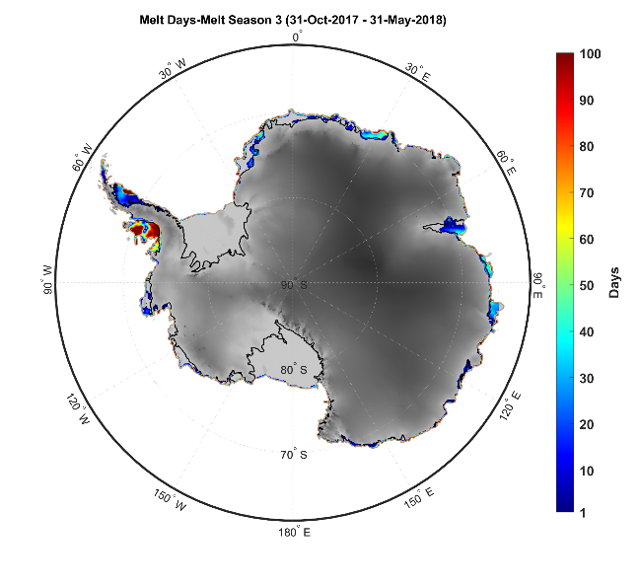
Results
Empirical Algorithm (number of melt days overlaid on the recent Antarctica digital elevation model [Howat et al. 2019]):

Slide 6
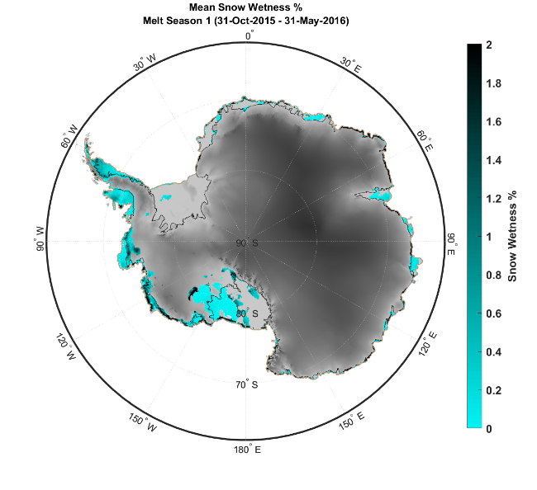
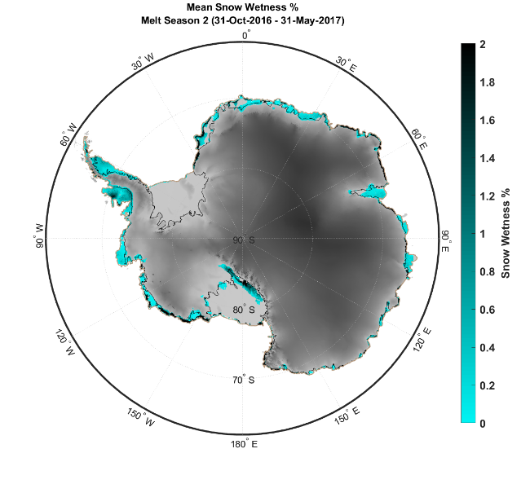
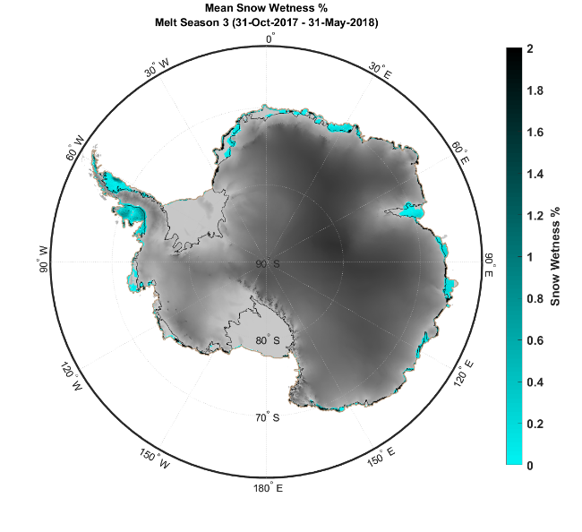
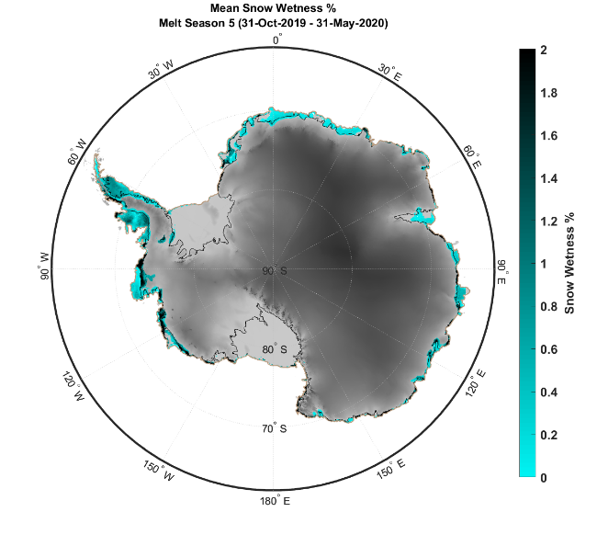
Results
SnoWR Algorithm (snow wetness% overlaid on the recent Antarctica digital elevation model [Howat et al. 2019]):

Slide 7
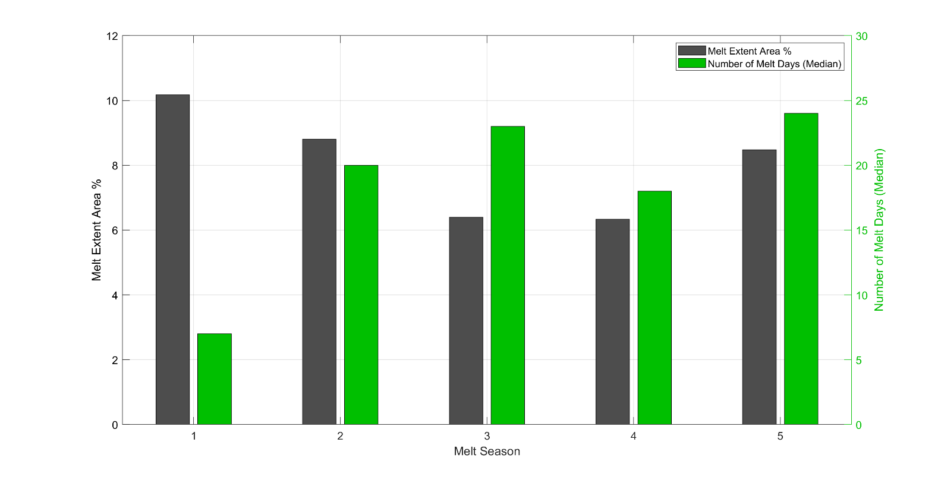
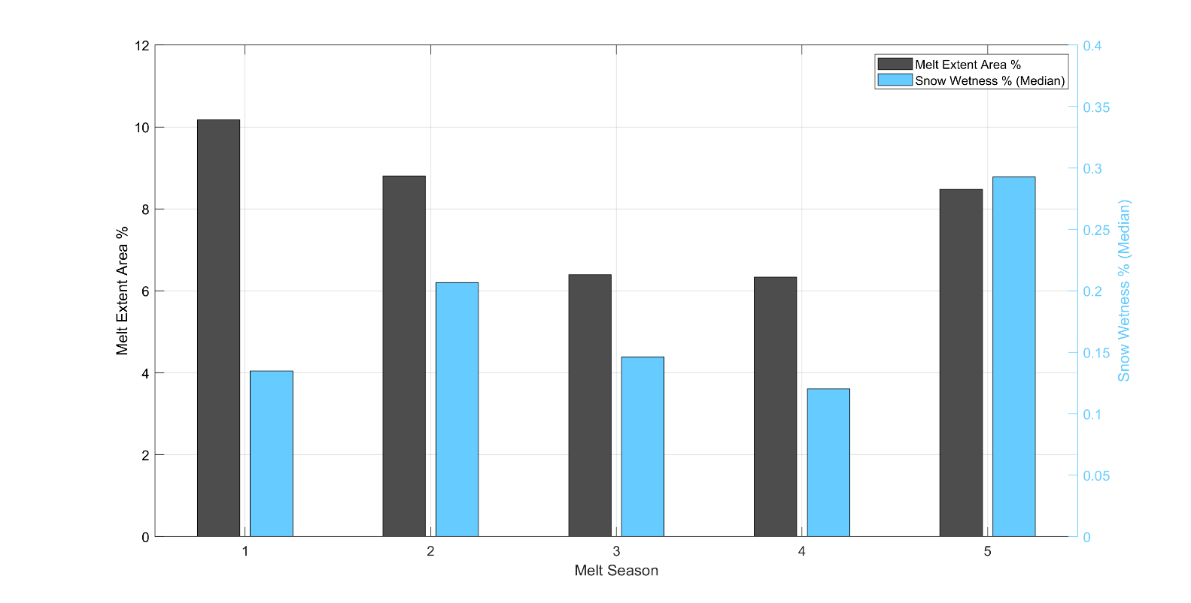
Results
Empirical Threshold Algorithm:
SnoWR Algorithm (Model-Based):
Most extensive melt season austral melt season 1 (Oct 31, 2015 – May 31, 2016)
Melt extent area (~10%) using both the empirical and the SnoWR algorithms
Most intensive melt season austral melt season 5 (Oct 31, 2019 – May 31, 2020)
Median of the number of melt days (24 days) using the empirical algorithm
Median of the snow wetness (~0.3%) using the SnoWR algorithm

Slide 8
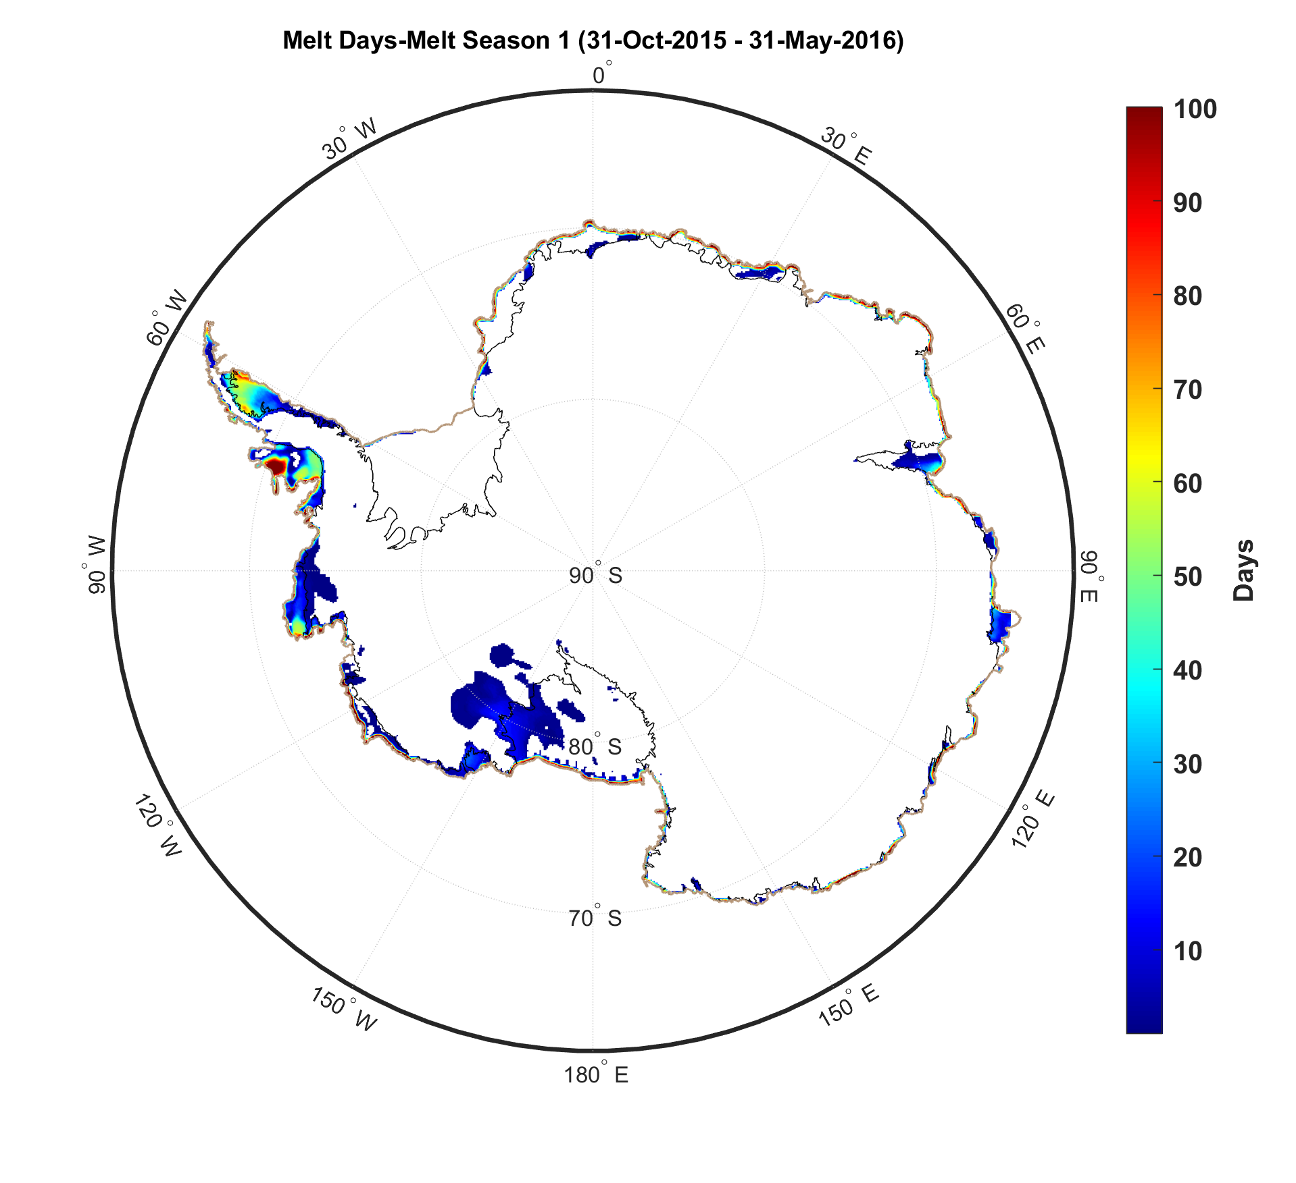
Next Steps
Apply both the empirical and the SnoWR algorithms to the Greenland ice sheet.
Combine the SMAP L-band with higher frequency microwave TB measurements from overlapping satellite records (e.g. SMAP and AMSR2) to detect ice sheet melt extent and intensity with better performance
Using machine learning (ML) algorithms for further improvements and evaluation:
Preliminary result from a neural network with only one-hidden layer (number of melt days during 2015-2016 austral melt season):
Output of a Neural Network with One-Hidden Layer
Empirical Threshold Algorithm

Slide 9
Publications and Acknowledgements
Journal:
S. Mousavi, A. Colliander, J. Miller, and J. Kimball, “A novel approach to map the intensity of surface melting on the Antarctica ice sheet using SMAP L-band microwave radiometry,” in The Cryosphere (submitted, Oct 2020).
Conferences:
S. Mousavi, A. Colliander, J. Miller, D. Entekhabi, J. T. Johnson, C. A. Shuman, J. Kimball, and Z. R. Courville, “Melt detection over Greenland using SMAP radiometer observations,” in 2020 IEEE International Geoscience and Remote Sensing Symposium (IGARSS) (accepted and presented).
S. Mousavi, A. Colliander, D. Entekhabi, J. T. Johnson, J. Miller, C. A. Shuman, and J. Kimball, “A new snow wetness retrieval algorithm to detect Greenland ice sheet surface melting using SMAP microwave L-band radiometry,” in 2020 Specialist Meeting on Microwave Radiometry and Remote Sensing of the Environment (MICRORAD 2020) (accepted).
Proposal:
Co-I on a NASA 2020 Cryosphere Science Proposal “Detecting Greenland and Antarctica Ice Sheet Melt Extent and Intensity with Multi-Frequency Radiometry,” PI: Dr. Andreas Colliander, other Co-Is: Dr. John Kimball and Dr. Julie Miller, 2020-2023 ($493,876/3 years) (submitted, July 2020).
Acknowledgments
The research described in this presentation was carried out at the Jet Propulsion Laboratory, California Institute of Technology, under a contract with the National Aeronautics and Space Administration.

