Slide 1
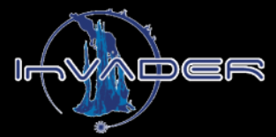
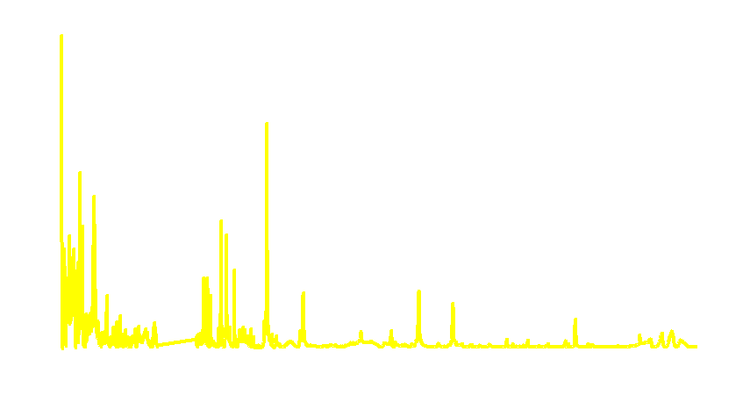
The potential for LIBS to facilitate the search for life on Ocean Worlds
2020 Postdoc Research Day Presentation Conference
Laura E. Rodriguez
Organization: 3227
Advisor: Laurie M. Barge (3227)
Postdoc Program: JPL
© 2020 California Institute of Technology. Government sponsorship acknowledged.
Notes:
Hello, my name is Laura Rodriguez and I am a JPL postdoc working w/Dr. Laurie Barge. Today I am going to be talking about my research investigating the potential for LIBS to facilitate the search for life on Ocean Worlds.
This work is part of a larger team effort whose overall goals include the deployment of an underwater divebot (dubbed InVADER) equipped to carry out in situ Raman and LIBS analysis at a hydrothermal vent.

Slide 2
Introduction
Diagram of LIBS analysis at a hydrothermal vent by InVADER
Ocean Worlds (e.g. Europa/Enceladus) are prime targets in the search for extraterrestrial life.
If their crust is sufficiently heated and porous, hydrothermal vents may exist. Vents are promising locales to search for life as they can sustain ecosystems with a rich biodiversity.
Thus, in-situ techniques to study vents are critical for life-detection missions to Ocean Worlds
InVADER aims to determine the feasibility of Laser Induced Breakdown Spectroscopy (LIBS) and Raman to characterize vents in-situ.
Initial work has focused on the potential for LIBS and machine learning to deduce geochemical trends as well as organic and CHONPS hotspots within vent precipitates
Atoms,
ions,
particles
LIBS uses a laser to generate a plasma that ablates the sample. Ablated particles interact with the laser and upon cooling, emit light with specific spectral wavelengths that are diagnostic of elements present within the sample.
Photo Credit: UW/NSF-OOI/WHOI, V18.
Notes:
Ocean worlds are prime targets in the search for extraterrestrial life as they contain large volumes of liquid water maintained by a heated interior. Notably such conditions could facilitate formation of hydrothermal vents.
Hydrothermal vents are of particular interest at they can facilitate organic synthesis and sustain a large, diverse ecosystem.
Given this, developing techniques to characterize vent structures in situ is critical for any life detection missions to Ocean Worlds
One promising mission ready technique is Laser Induced Breakdown Spectroscopy (or LIBS) as it is the only field technique that can detect the biogenic elements known as (CHONPS).
To do this, LIBS uses a laser to generate a plasma that ablates the sample into atoms. Electrons of these atoms are excited by the laser, and upon cooling, fall back to the ground state, producing unique spectral lines.

Slide 3
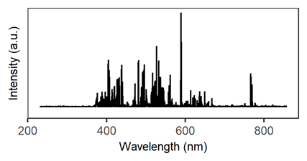
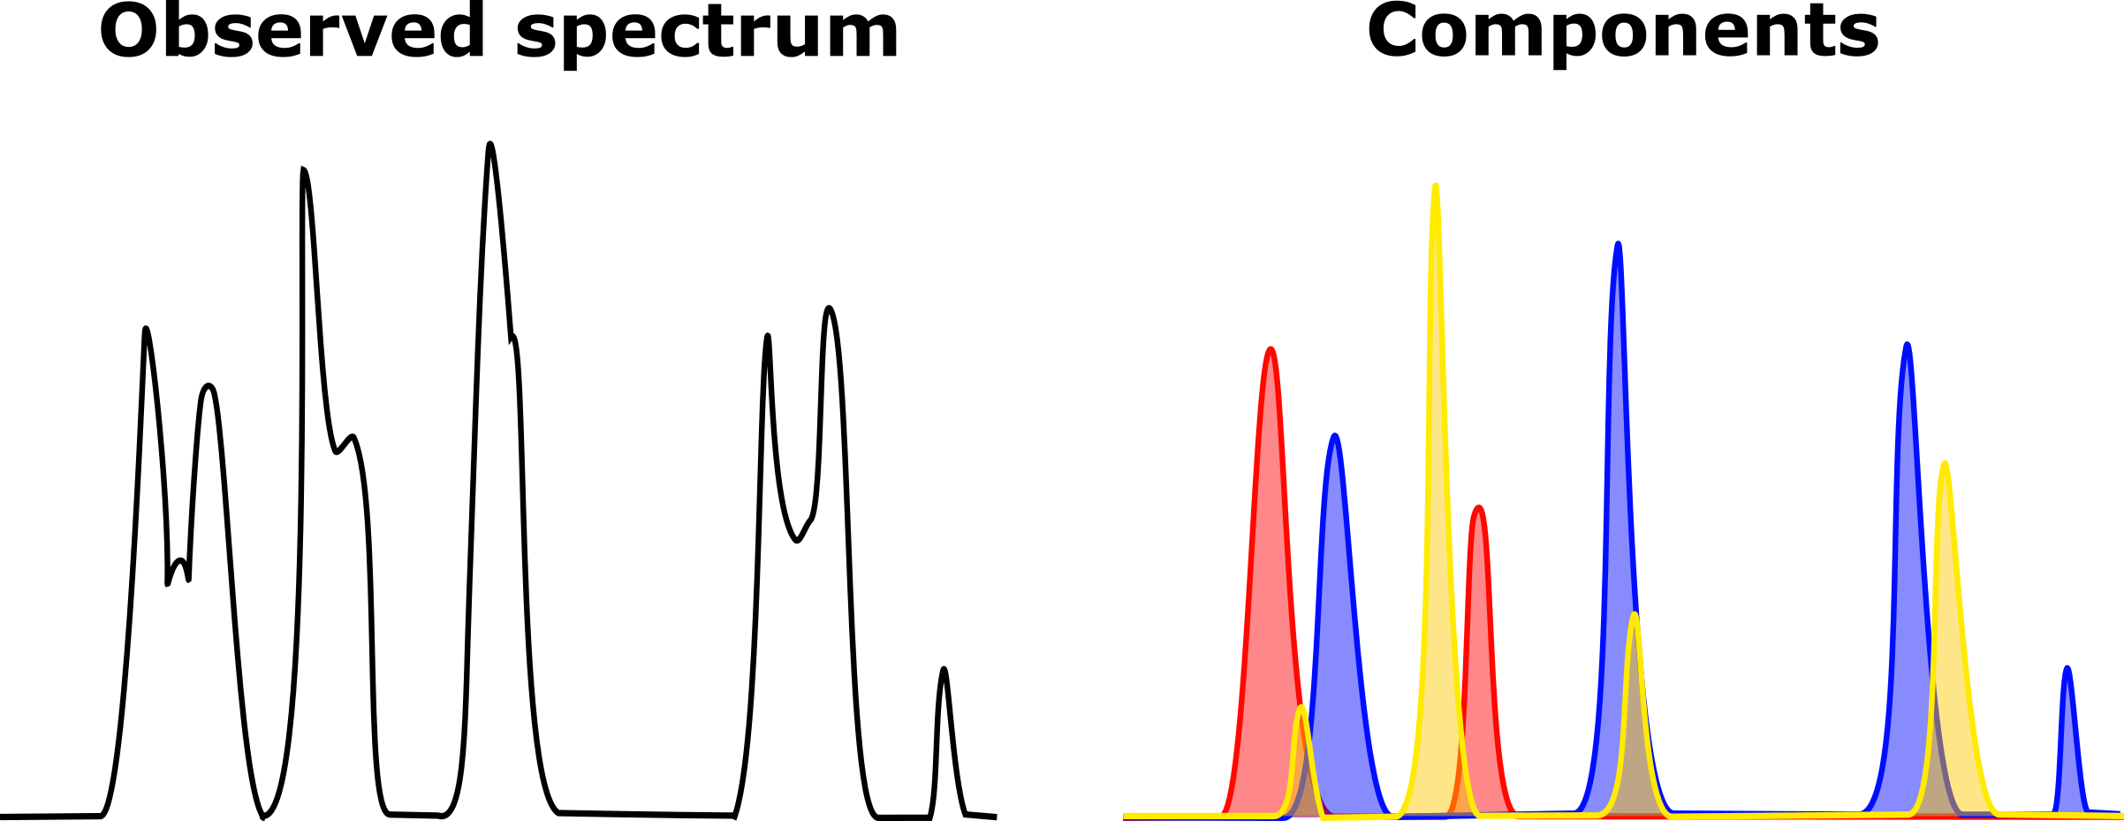
Problem Description
Problem Statement: LIBS is the only field technique capable of detecting CHONPS; however, it is sensitive to matrix effects. Moreover, the response of CNPS is relatively weak and overlaps with other elements.
Relevance: By itself LIBS cannot confirm life, however it is a powerful technique that may help elucidate which samples hold the most promise for hosting biosignatures.
Interest: As LIBS is sensitive to matrix effects, a wealth of information is captured in each spectrum. I aim to leverage these effects to deconvolute both mineral and organic components within samples.
Contributions: Originally, InVADER aimed to determine elemental trends by univariate analysis. With my background in machine learning and organic geochemistry I was uniquely suited to develop multivariate models that deconvolute mineralogical components within LIBS spectra.
A.
Univariate:
1 line = 1 element
Multivariate: whole spectrum
Ca: 393.6 nm
B.
My Contribution: New (multivariate models) in this work:
Multivariate Curve Resolution
Mineral A
Mineral B
Deconvolute
Mineral C
Components = pure mineral spectra
Mineral trends w/in sample
Removes interferants
CHONPS w/in minerals
Notes:
There are 3 major drawbacks to LIBS: (1) line intensities are sensitive to matrix effects; (2) biogenic elements generate weak lines and (3) these lines often overlap w/that of other elements
Originally, InVADER aimed to test if LIBS could, despite these issues, characterize elemental trends by univariate analysis. Figure A shows that univariate analysis of a LIBS spectrum looks for 1 spectral line diagnostic of 1 element.
However, as a geochemist w/ machine learning knowledge, I saw opportunity in the matrix effects: notably, the potential for changes in the mineral or organic content to be reflected in the LIBS spectrum and deciphered with multivariate tools.
Shown in Fig A, multivariate analysis looks at how all the peaks change relative to each other in samples.
Figure B summarizes the concept behind deconvoluting components of LIBS spectra via the technique, multivariate curve resolution.

Slide 4
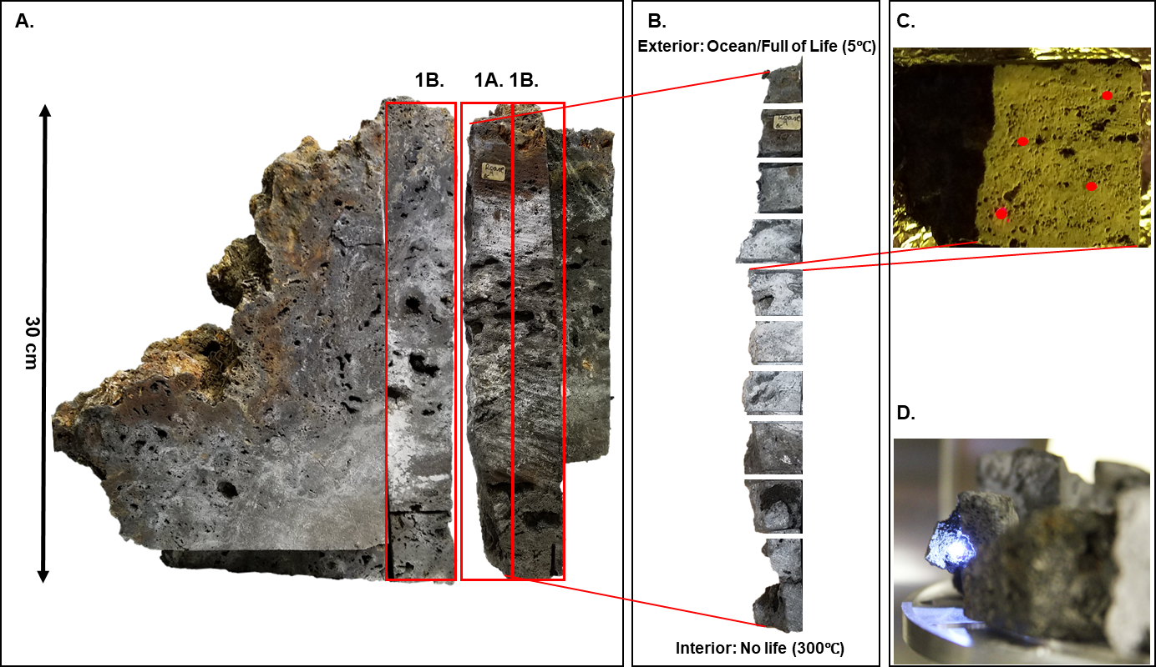
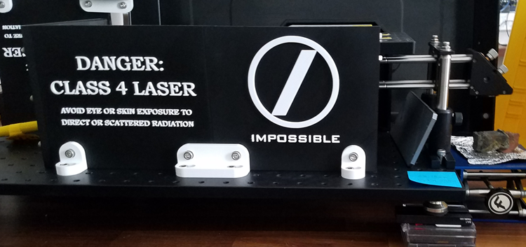
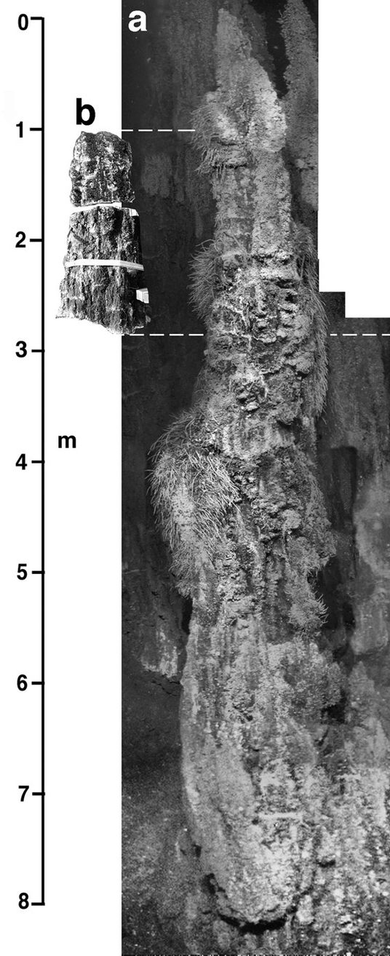
Methodology
JPL sample (A) that we cut into pieces (B) and analyzed using point LIBS (C). Also shown is a LIBS plume (D), one of the LIBS systems used (Impossible Sensing;(E)) and a typical LIBS spectra (F)
E.
F.
Experiment Description: characterize geochemical trends & organic hotspots w/LIBS
Innovation/advancement:
LIBS is used to quantify elements and oxides (e.g. MgO); can determine rock type
For this, matrix-matched or similar samples are needed (i.e. a priori knowledge)
Here, we aim to develop machine learning models to leverage matrix effects in order to deduce mineralogical and organic trends w/out a priori knowledge
Image of Roane chimney from which sample was taken. Mosaic by M. Elend in Kristall et al., 2006 G3, 7(7).
Notes:
In this work I analyzed a hydrothermal vent precipitate collected from the Juan de Fuca Ridge shown in box A
The sample was cut and analyzed using two, flight ready LIBS instruments: a novel system by Impossible Sensing and the ChemCam clone at Los Alamos National Lab.
The innovative aspect of our work is that (1) our models do not require a priori knowledge and (2) will characterize mineral and organic trends. Prior work with LIBS has relied on machine learning tools to quantify elements and oxides as well as determine rock type. However, such work relied on building models that required a priori knowledge of the sample site
Models that don’t require a priori information is critical for Ocean World exploration, where a mission to the subsurface will be stand alone and unlikely to be followed up for decades

Slide 5
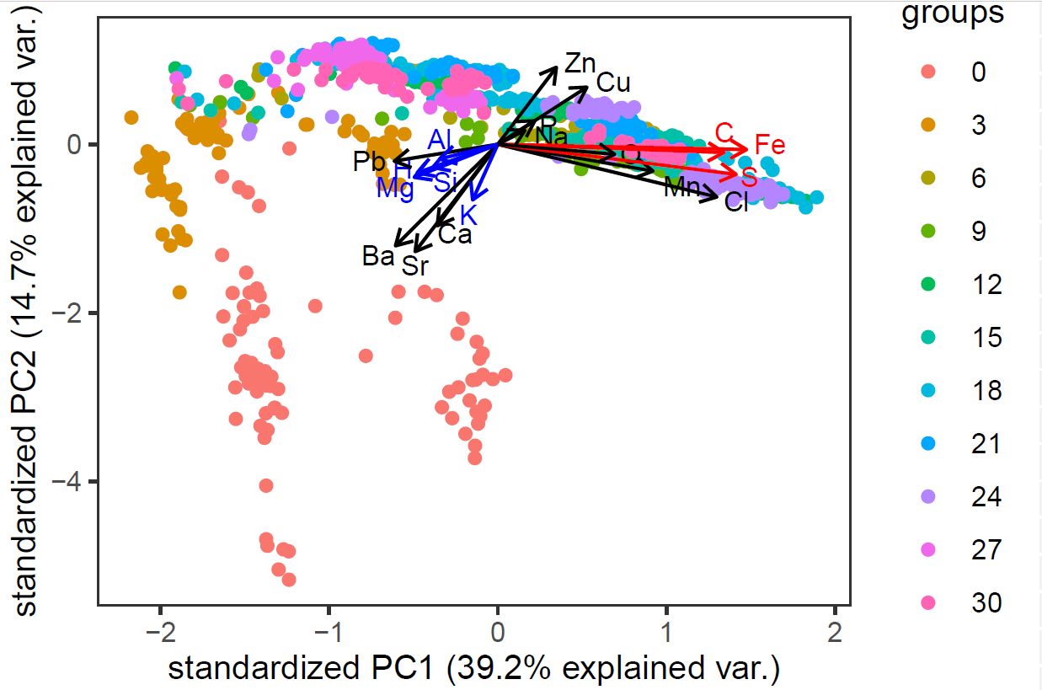
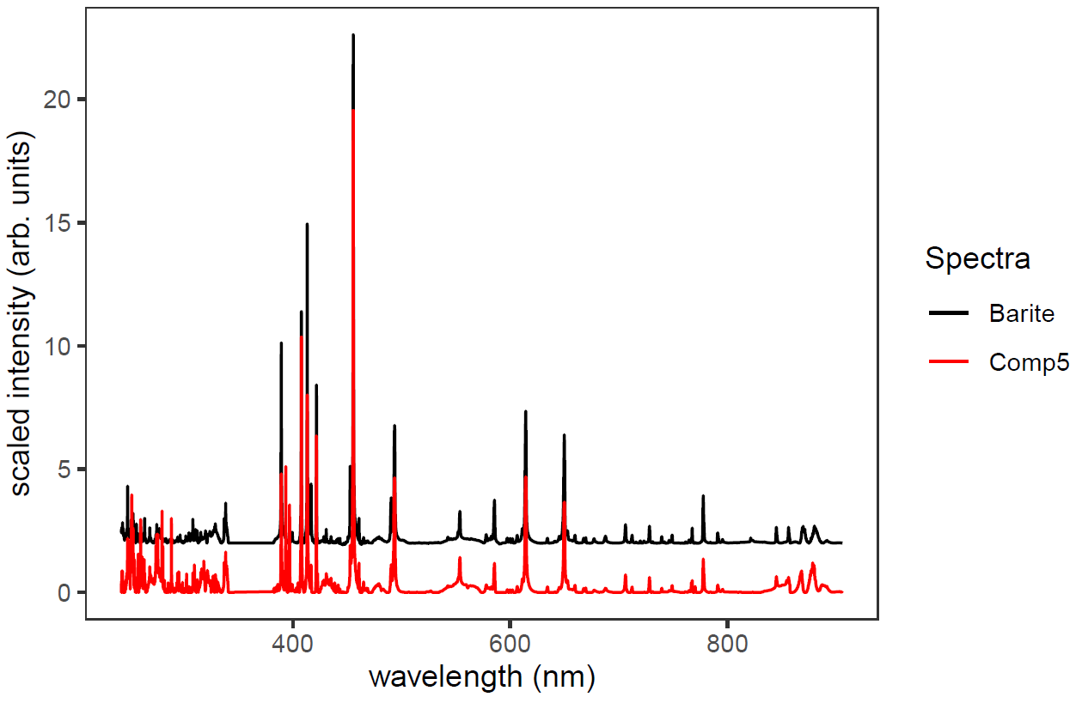
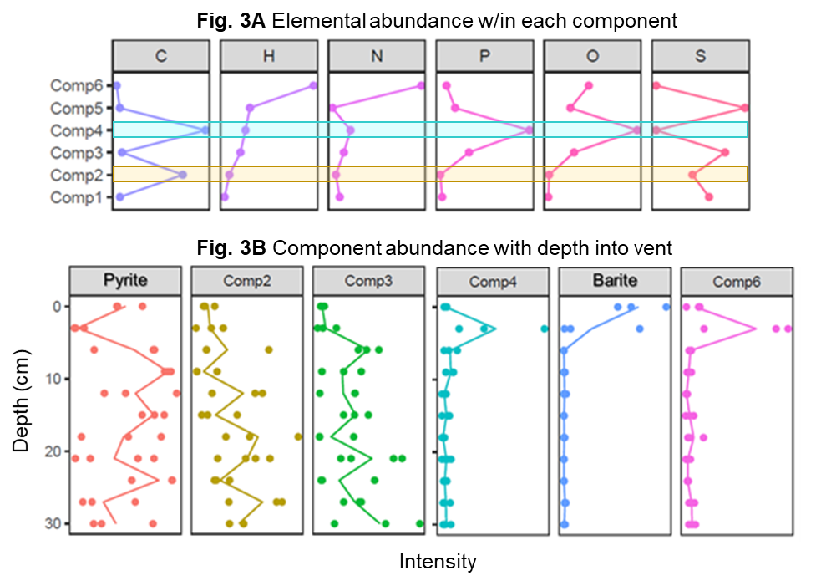
Fig. 1 Principal Component Analysis (PCA)
Fig. 2 Multivariate Curve Resolution (MCR)
Results
Depth (cm)
0 cm: Exterior (ocean) 5℃
30 cm: Interior 300℃
Fig. 1 PCA: shows which elements tracked together with depth
Elements linked w/clays (blue) track together & concentrate at 3 cm
C appears to track w/Fe, S (red); most intense in chimney interior
Fig. 2 MCR: Spectra deconvoluted to 6 components (i.e. comp)
Barite (shown) and Pyrite (not shown) confirmed w/standard
Fig. 3 MCR + univariate: comp 4 most promising for organics
Both comps 2 and 4 have a relatively high amount of C.
Comp 4 rich in CHNPO and clay elements (K, Na, Si, Al, Mg, Mn)
Comp 4 peaks at 3 cm; where we expect clay layer
Results agree w/SEM & ICP-OES/MS: Kristall et al., 2006 G3, 7(7).
Fig. 3 MCR & Univariate analysis
Notes:
Shown are some of the results from this work
Figure 1 is a PCA biplot. PCA is a technique that reduces the dimensions of the data, combining the original variables (ie wavelengths) to create new variables (known as PCs) that better capture the variance in the samples.
In the figure, every LIBS shot is plotted and colored by depth into the chimney. The arrows indicate how wavelengths of interest (labelled as elements) pull the data.
There are two main take away from this plot:
The first is that Elements in blue are affiliated w/clays: here we found they track together and concentrate at 3 cm; this agrees with work by kristall et al which described this depth as clay-rich
The second thing to note is that C appears to strongly track w/Fe and S
Figure 2 shows a mineral deconvoluted by MCR and its identification using a standard.
Figure 3 combines MCR and univariate analysis to elucidate CHONPS hotspots
Figure 3A shows that biogenic elements concentrate in component 4; which is also enriched with clay elements (not shown); Figure 3B shows that component 4 is most abundant at 3 cm, which is consistent with this depth being clay-rich
Given that clays adsorb and preserve organics, component 4 is likely an organic hotspot
Note without MCR, we would not never discovered the CHONP hotspot in the clay layer; instead we may have focused on the interior of the chimney where univariate and PCA analysis suggests C is most intense.

Slide 6
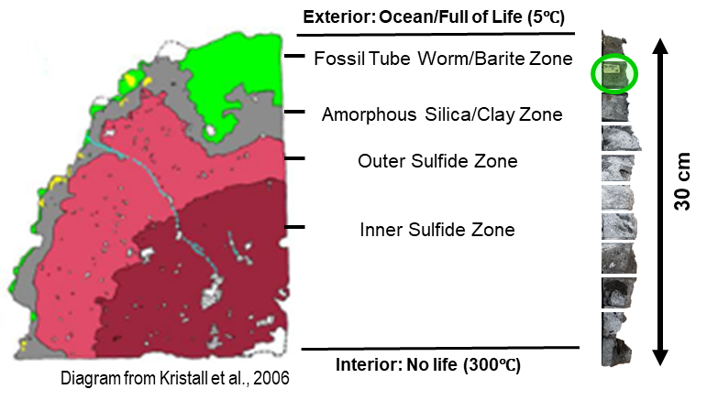
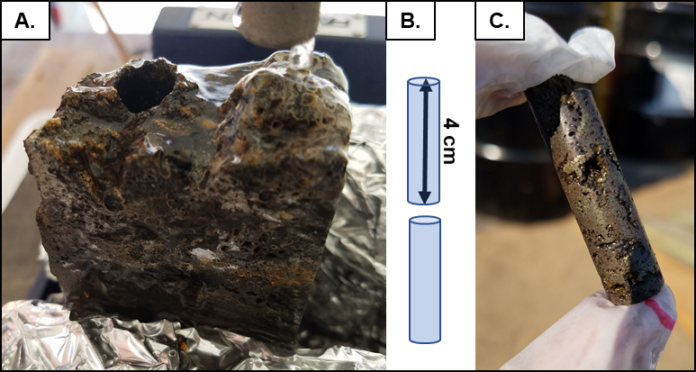
Results
Accomplishments vs goals: We made significant progress demonstrating the potential for LIBS for life detection in showing that it can be used to discern elemental, mineralogical, and organic gradients.
Significance: Without any a priori information, we can locate CHONPS and organic hotspots. As life is affiliated with both, LIBS can help guide the search for biosignatures. Notably, since LIBS is on both the Curiosity and Perseverance rovers, the techniques developed here can be applicable to those missions.
Next steps:
Build LIBS library of minerals & organics
Confirm organic gradients within the sample
Raman analysis & data fusion of Raman + LIBS
Analyze exteriors of and holes from cored samples: dry vs submerged in water
Our results suggest 3 cm into the vent (clay zone) there is a CHONP hotspot. This spot (circled in green) is the most promising portion of the vent to search for biosignatures.
Cores obtained by JPL and Honeybee for future analysis
Notes:
We have shown that LIBS can elucidate mineral trends and CHONPS hotspots without a priori information
In addition, ongoing work suggests that LIBS can be used to identify clusters of wavelengths that are affiliated with organic material
Such results are exciting as they show the potential application of LIBS in the search for life not only on Ocean Worlds, but also on Mars via the Curiosity and Perseverance rovers.
In future work we aim to build a LIBS database, confirm organic trends, and test whether fusing Raman and LIBS datasets can enable us to identify functional groups within organic content
Finally, we will analyze cores of the vent sample both dry and submerged in water. The latter is important for LIBS given that its IR laser is readily absorbed by water. We will test various strategies to mitigate this issue.

Slide 7
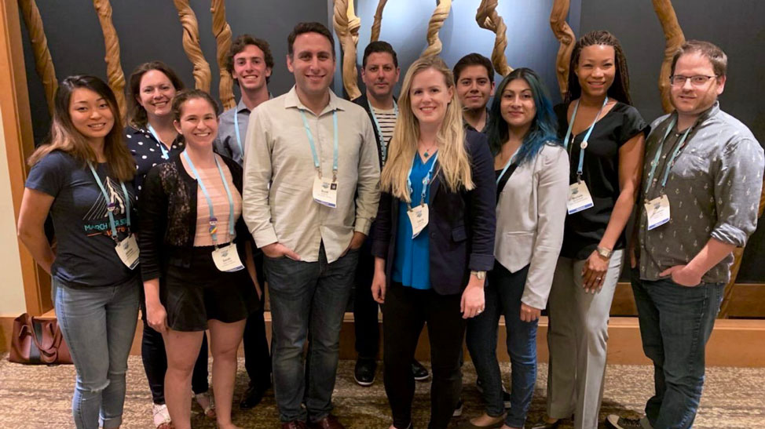
Publications and Acknowledgements
Rodriguez LE, Reyes-Newell AL, Delapp DM, Lanza NL, Clegg SM, Kelley DS, Simon KH, Eshelman E, Sobron PS, Barge LM. Novel Chemometric Analysis Elucidates Elemental and Mineralogical Gradients within Hydrothermal Vent Precipitates using Laser-Induced Breakdown Spectroscopy (LIBS): An Investigation of Analytical Techniques to Facilitate the Search for Life on Ocean Worlds. American Geophysical Union, Dec 2020 (virtual).
Rodriguez LE et al., Deconvoluting Elemental, Mineralogical, and Organic Gradients in Hydrothermal Vent Precipitates by Laser Induced Breakdown Spectroscopy and Multivariate Analysis. Journal of Geophysical Research: Planets (In Prep)
Special Thanks to:
NASA JPL: Laurie Barge (Science PI InVADER), Origins and Habitability Laboratory (OHL), Renaud Detry, Greg Peters
Impossible Sensing: Pablo Sobron (PI InVADER), Kirby Simon and Evan Eshelman
Los Alamos ChemCam Team: Adriana Reyes, Nina Lanza, Dot Delapp, Samuel Clegg
University of Washington: Deborah Kelley
Funding: NASA PSTAR
InVADER Team
OHL Lab Group
Notes:
I would like to give thanks to those that have helped me throughout this project. Especially my advisor, Laurie Barge, the OHL lab group and Pablo Sobron.
I’d also like to thank Greg Peters who cut the vent sample, Deb Kelley for lending us the sample,
as well as those at Impossible Sensing and the Los Alamos Chem Cam team for access to the LIBS instruments used in this work.
Finally, I’d like to thank everyone on the InVADER team for helping make this research a reality.
Thank you for your time and attention

