Slide 1
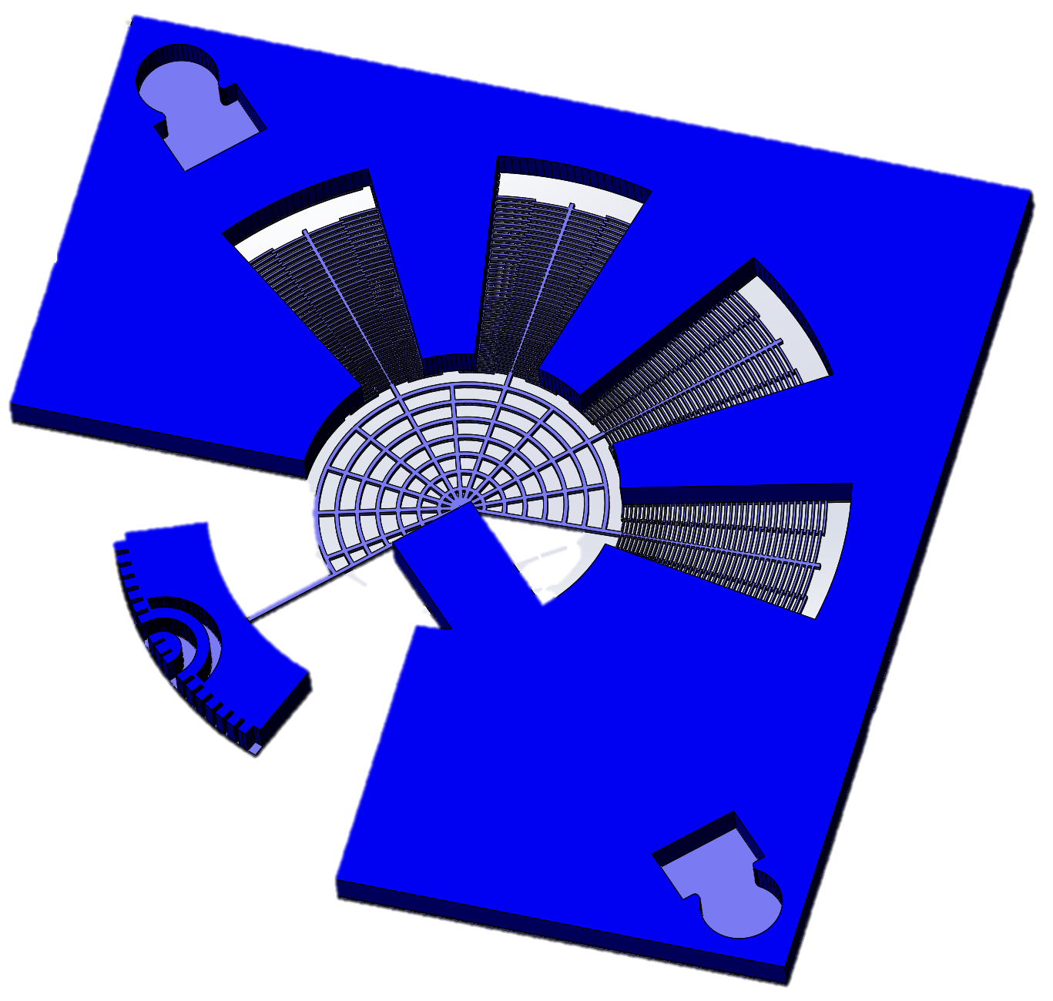
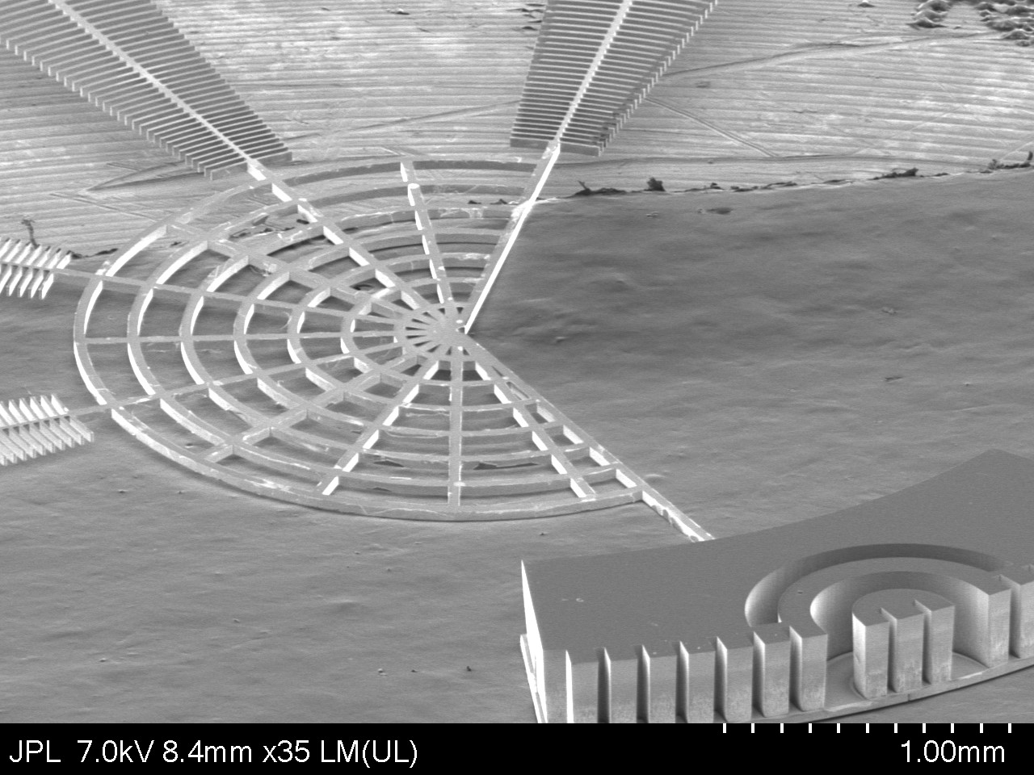
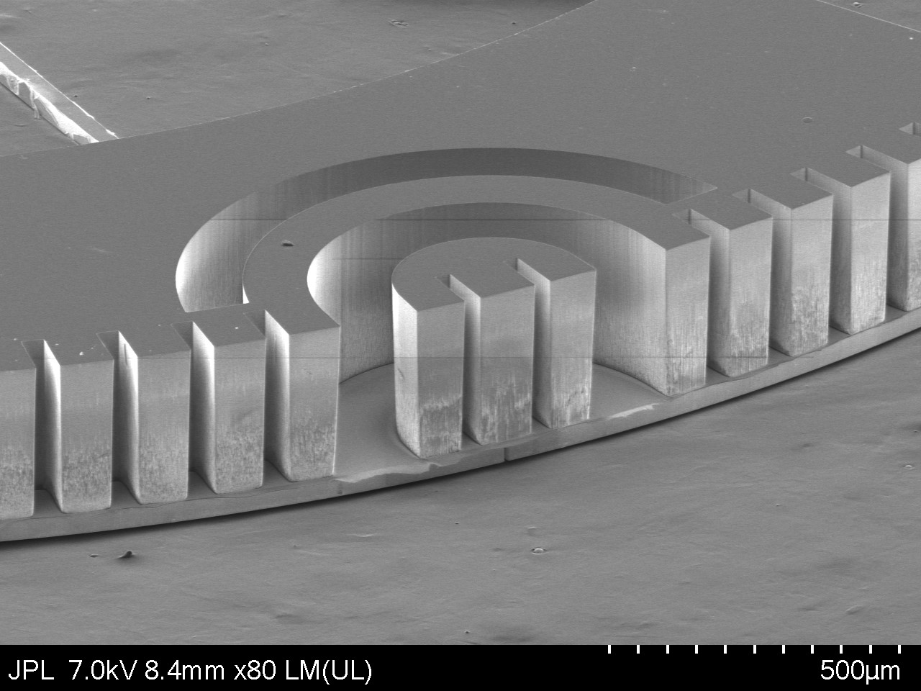
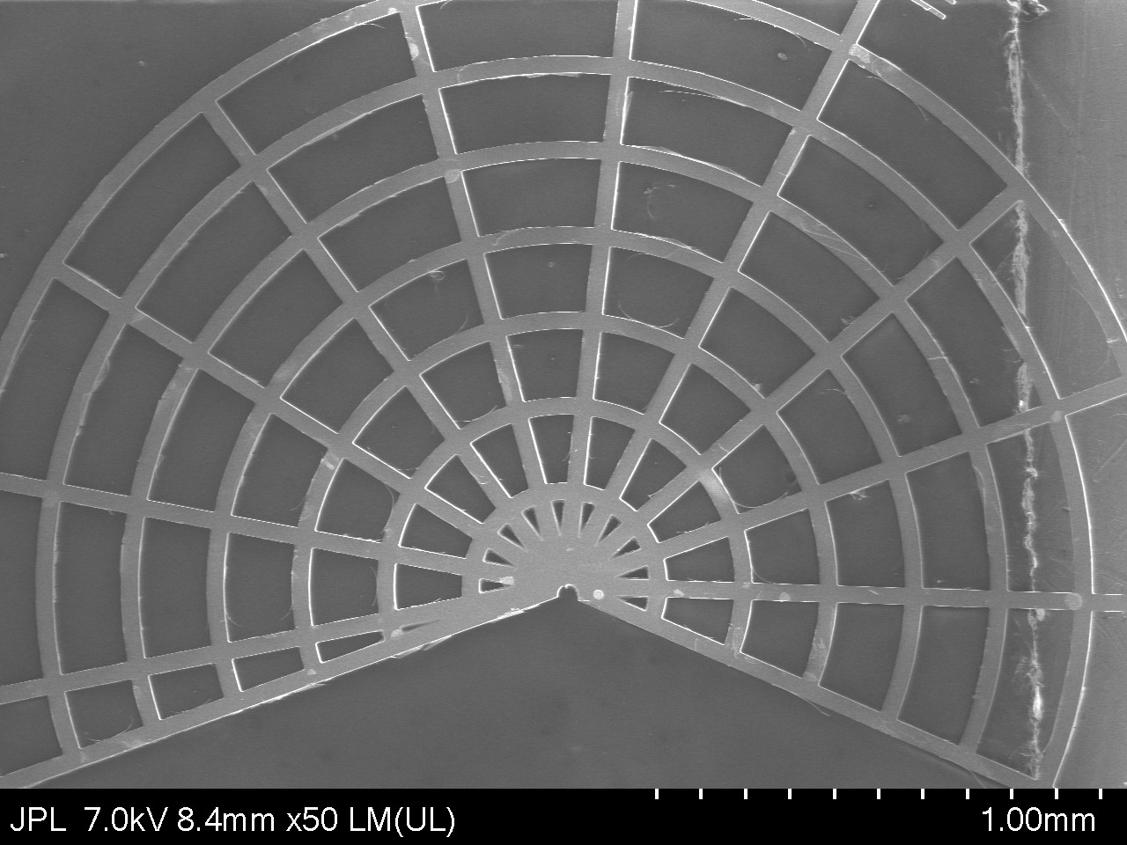
CONTACTLESS ROTATING MEMS SWITCH FOR WATER DETECTION
Sofia Rahiminejad
Organization: 389R
Advisor: Cecile Jung-Kubiak (389R) & Goutam Chattopadhyay (386H)
Postdoc Program: Visiting

Slide 2
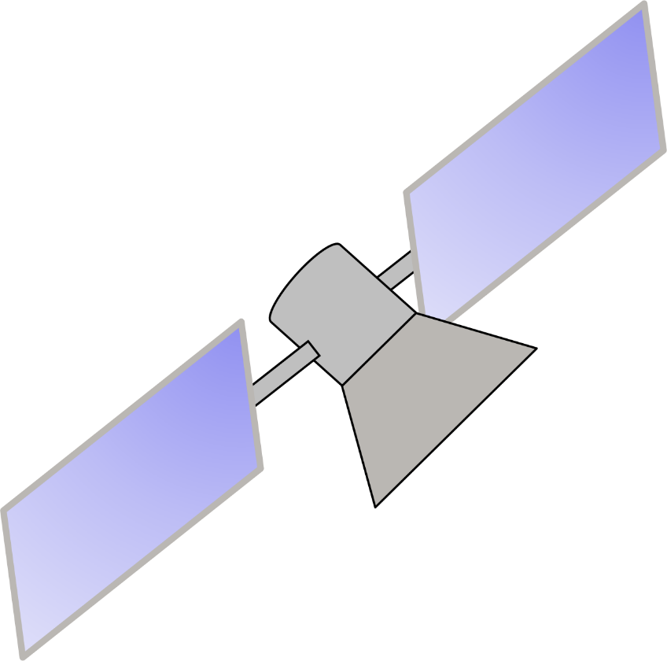
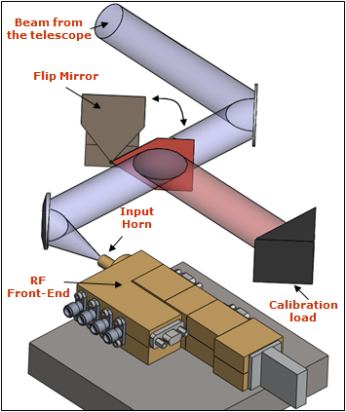
Introduction
Today high-resolution heterodyne spectrometers suited for space missions are used to detect unique molecular signatures, such as water molecules, with a high spectral resolution over a wide range of wavelengths. The radar and its antennas form a significant part of the system.
Flip mirror:
to optically redirect the radiometer to its calibration target
5cm
All of the MEMS waveguide switches developed to date need electrical and mechanical contacts to block the wave, creating issues such as mechanical stress/stiction, and if cycled many times, problems with ohmic contact resistance can arise.
In these systems, a flip-mirror is often used to switch the signal between the antenna and the load (body of a known temperature) for calibration of the receiver. Silicon-based RF–MEMS waveguide switches can be used for the same task, and take significantly less volume, mass and energy.
A contactless in-plane MEMS waveguide switch would therefore be greatly beneficial for THz applications.
State of the art beam steering system with calibration mirror

Slide 3
Problem Description
Most waveguide switches need electrical and mechanical contact to block the incoming wave.
5cm
Rectangular waveguide
Solution
A contactless in-plane MEMS waveguide switch
By replacing the flip mirror with a MEMS component will significantly reduce volume and mass of the system.
By designing the MEMS switch to be contactless, using electromagnetic bandgap surfaces, the common issues of MEMS switches can be avoided.
Flip mirror:
to optically redirect the radiometer to its calibration target
9.5cm
State of the art system, similar to what was used on MIRO

Slide 4
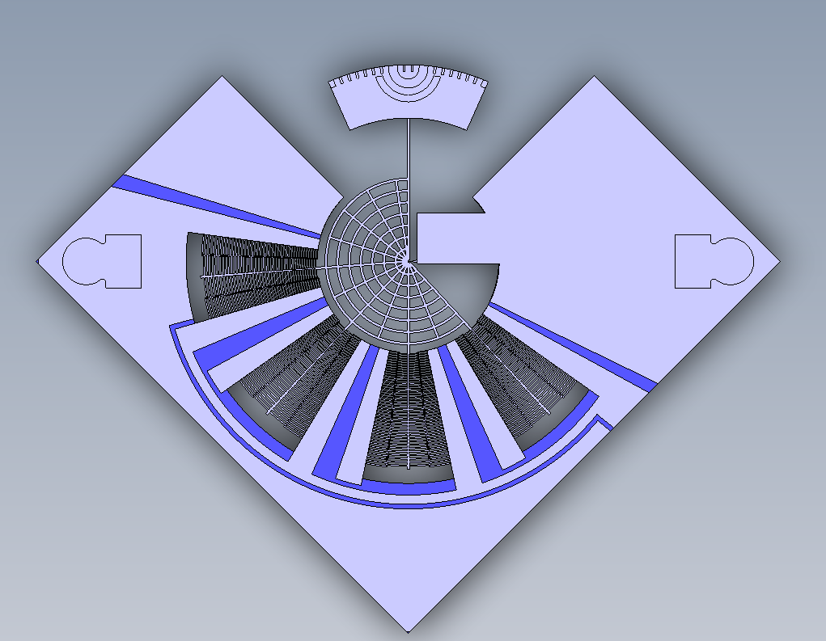
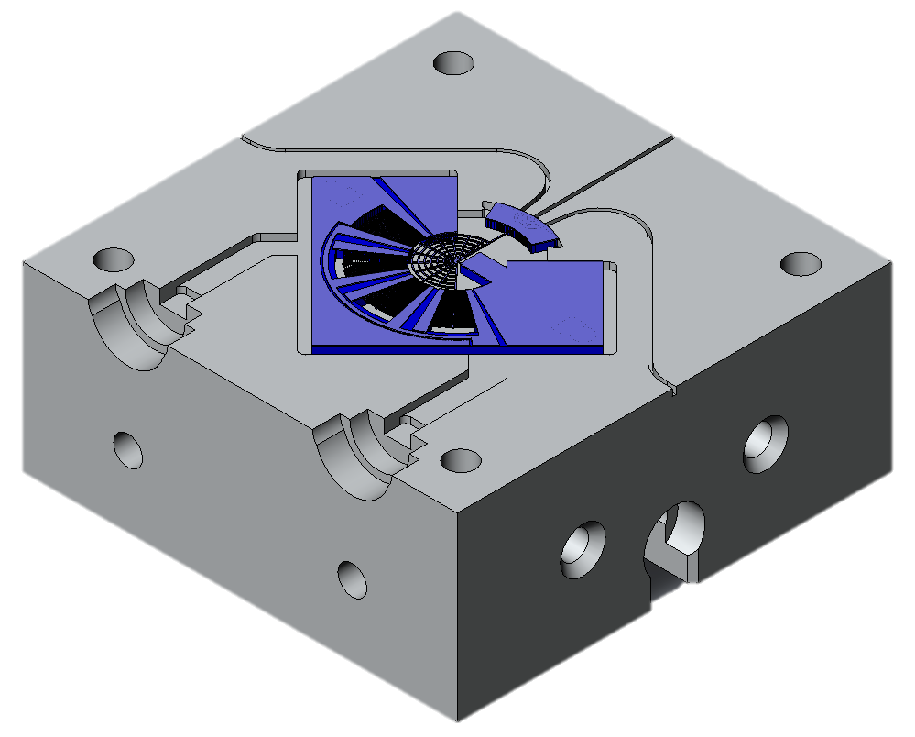
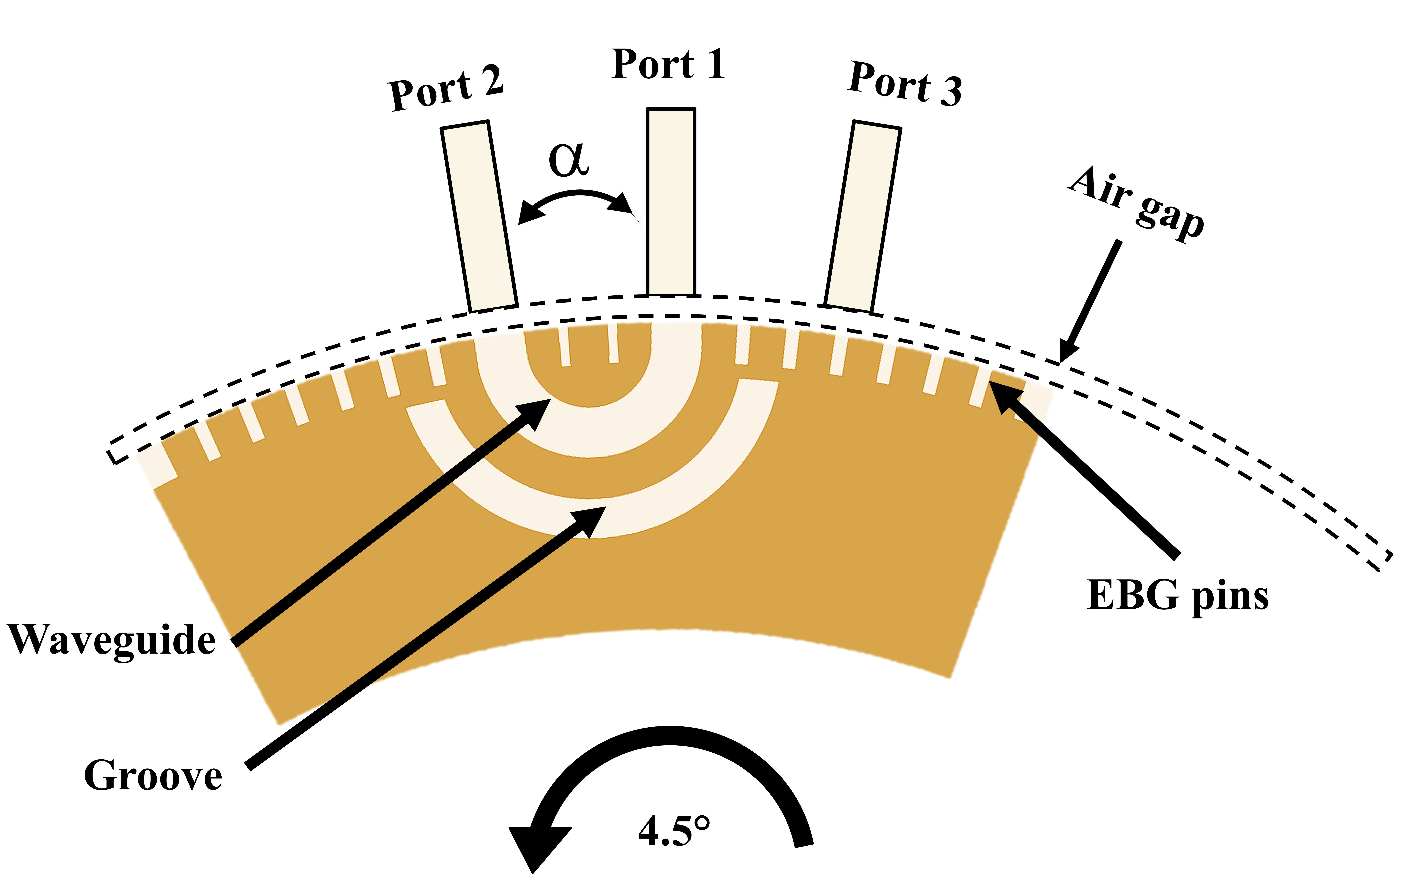
2.
Antenna
Methodology
Receiver
1.
V-
V+
Load
Designed to rotate up to +/-5°
Designed a rotating MEMS motor that can rotate +/- 5° and a brass block to connect the waveguides.
Designed a U-bend waveguide that connects two waveguide ports.
Surround the U-bend opening with an EBG surface to avoid leakage even though there is a gap.
Designed the angular spacing between the waveguide ports to so that the U-bend only needs to rotate +/- 4.5°.
Developed a fabrication process and then fabricated the contactless rotating waveguide switch using SOI wafers in the MDL cleanroom at JPL.
3.
Photoresist
Si₂O
Si
SOI
2 um
50 um
380 um
40 steps

Slide 5
Results
5°
0°
Click on the video to play if it does not start !

Slide 6
Publications and References
S. Rahiminejad, C. Jung-Kubiak, M. Rais-Zadeh and G. Chattopadhyay, “Contactless rotating MEMS waveguide switch for water detection at 557 GHz” 31st IEEE International Symposium On Space Terahertz Technology (ISSTT), Tempe, AZ, 2020.

