Slide 1
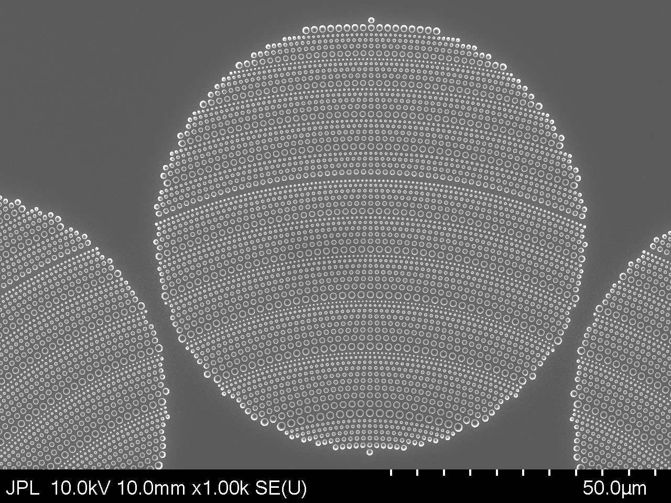
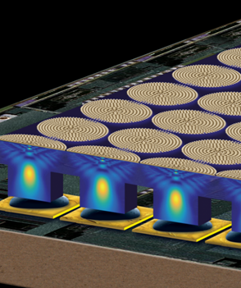
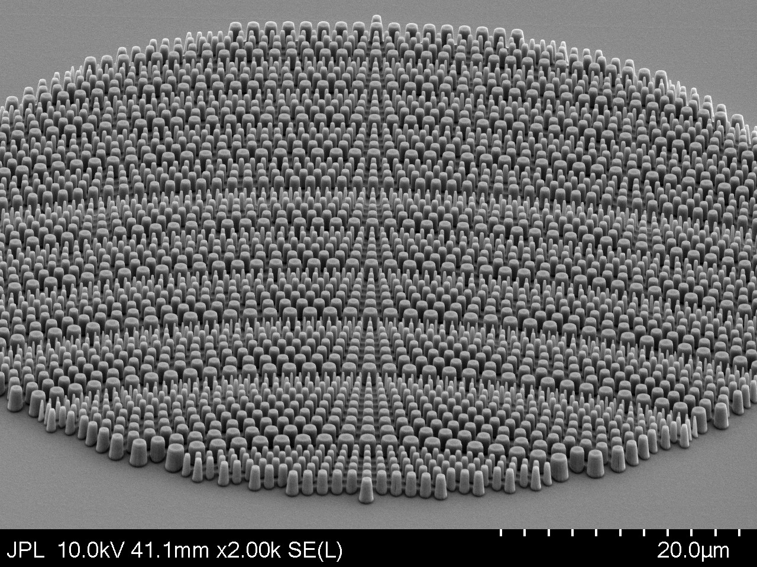
Metasurface-based optical components for advanced infrared multispectral imaging
Tobias Wenger
Organization: 389G
Advisor: Alexander Soibel (389G)
Postdoc Program: NPP

Slide 2
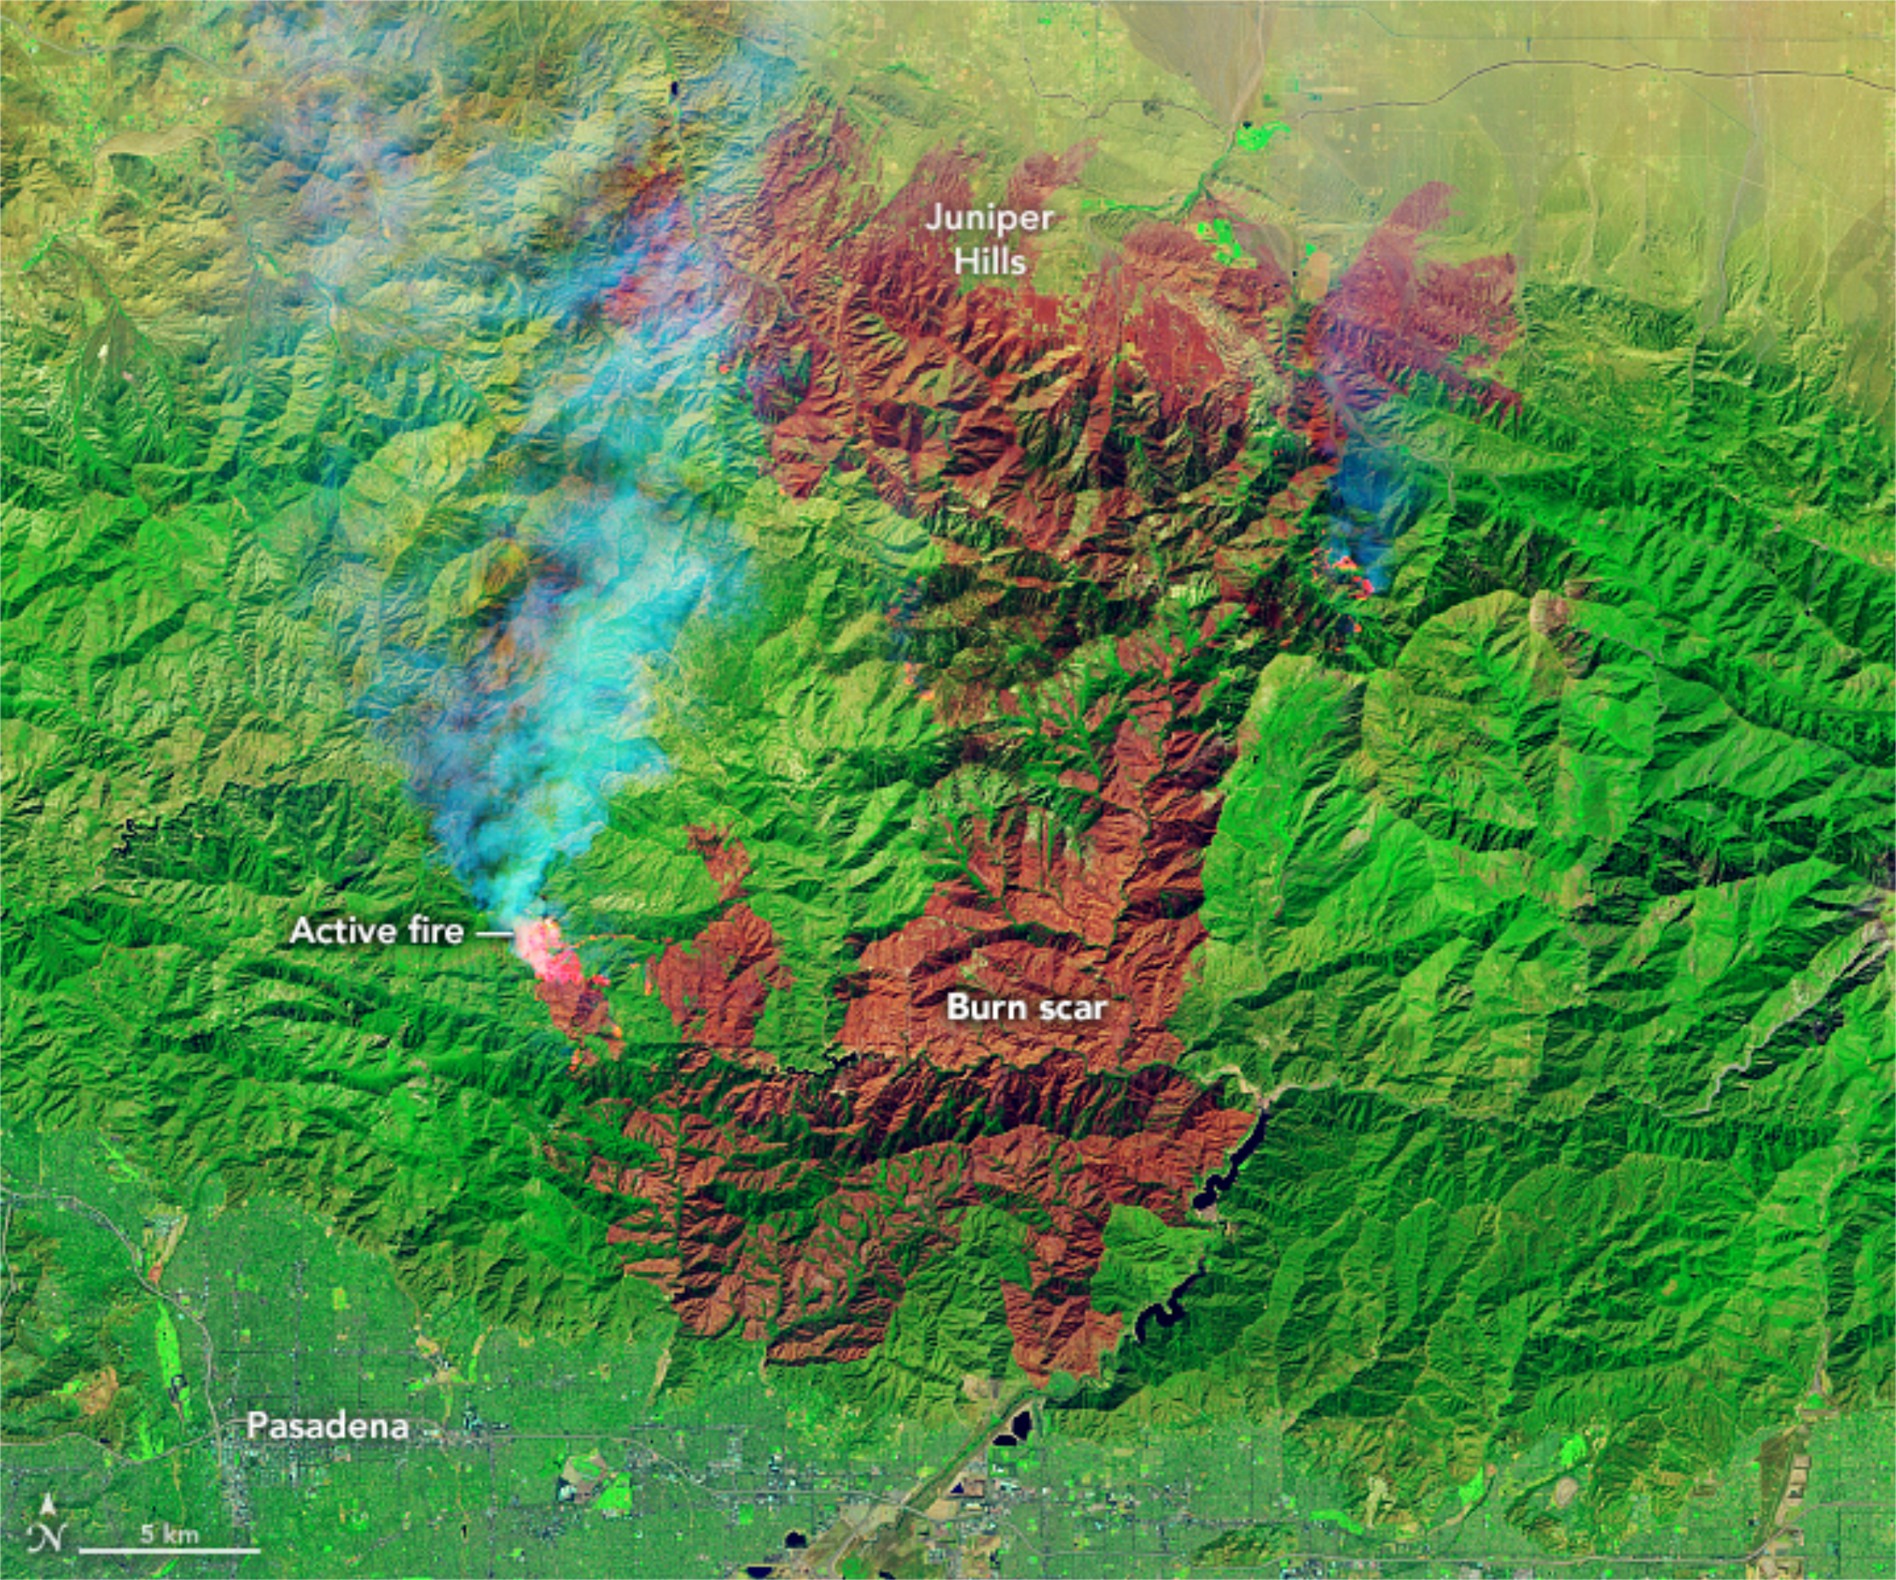
Introduction
JPL
Abstract
Metasurface technology is a new scientific development which enables highly compact optical components with novel features compared with conventional components.
Metasurfaces are composed of nanostructured surfaces and are fabricated using standard semiconductor methods. This enables integration of multiple components onto focal plane arrays (cameras).
Integrated metasurface-based optical components can be used to create multispectral instruments with very small footprints, making them suitable for small satellite missions. Can provide global coverage of satellite imagery to detect and monitor for instance wildfires and hurricanes.
Additional NASA/JPL-relevant applications where metasurfaces can provide enhancement over existing technology are wavefront sensing, lenses with metasurface correctors for high-quality imaging, and metasurface-based coronagraph masks for exoplanet detection.
Top: False-color image acquired on September 21st , 2020, showing the Bobcat fire and its burn scar in Angeles National Forest. The image was created using infrared data from Landsat 8. Credit: NASA Earth Observatory.

Slide 3
Problem Description
a)
There is a need for compact multispectral instruments which require less cooling. This is driven by an increased number of small-scale satellite missions with requirements of low size, weight and power consumption (SWAP).
Two metasurface devices we are working with are flat optical concentrators and spectral filters. Both can be integrated directly with focal plane arrays to create instruments with enhanced light collection area and increased operating temperature.
Artist’s impression of an array of metasurface-based optical concentrators (yellow circles on the top) integrated with an FPA (bottom). The cross-sectional view of the electromagnetic field shows how light incident from above is focused through the substrate onto the detector pixels below.
b)
The group I work in (389G) specializes in infrared photodetector technology.
My project is to develop metasurface devices for integration with infrared photodetectors. This includes simulation, design and cleanroom fabrication. Part of the work involved pioneering the fabrication and design at JPL. I am also working on measurement and data analysis.

Slide 4
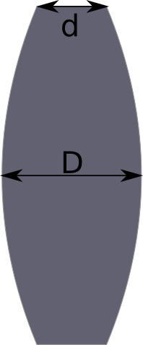
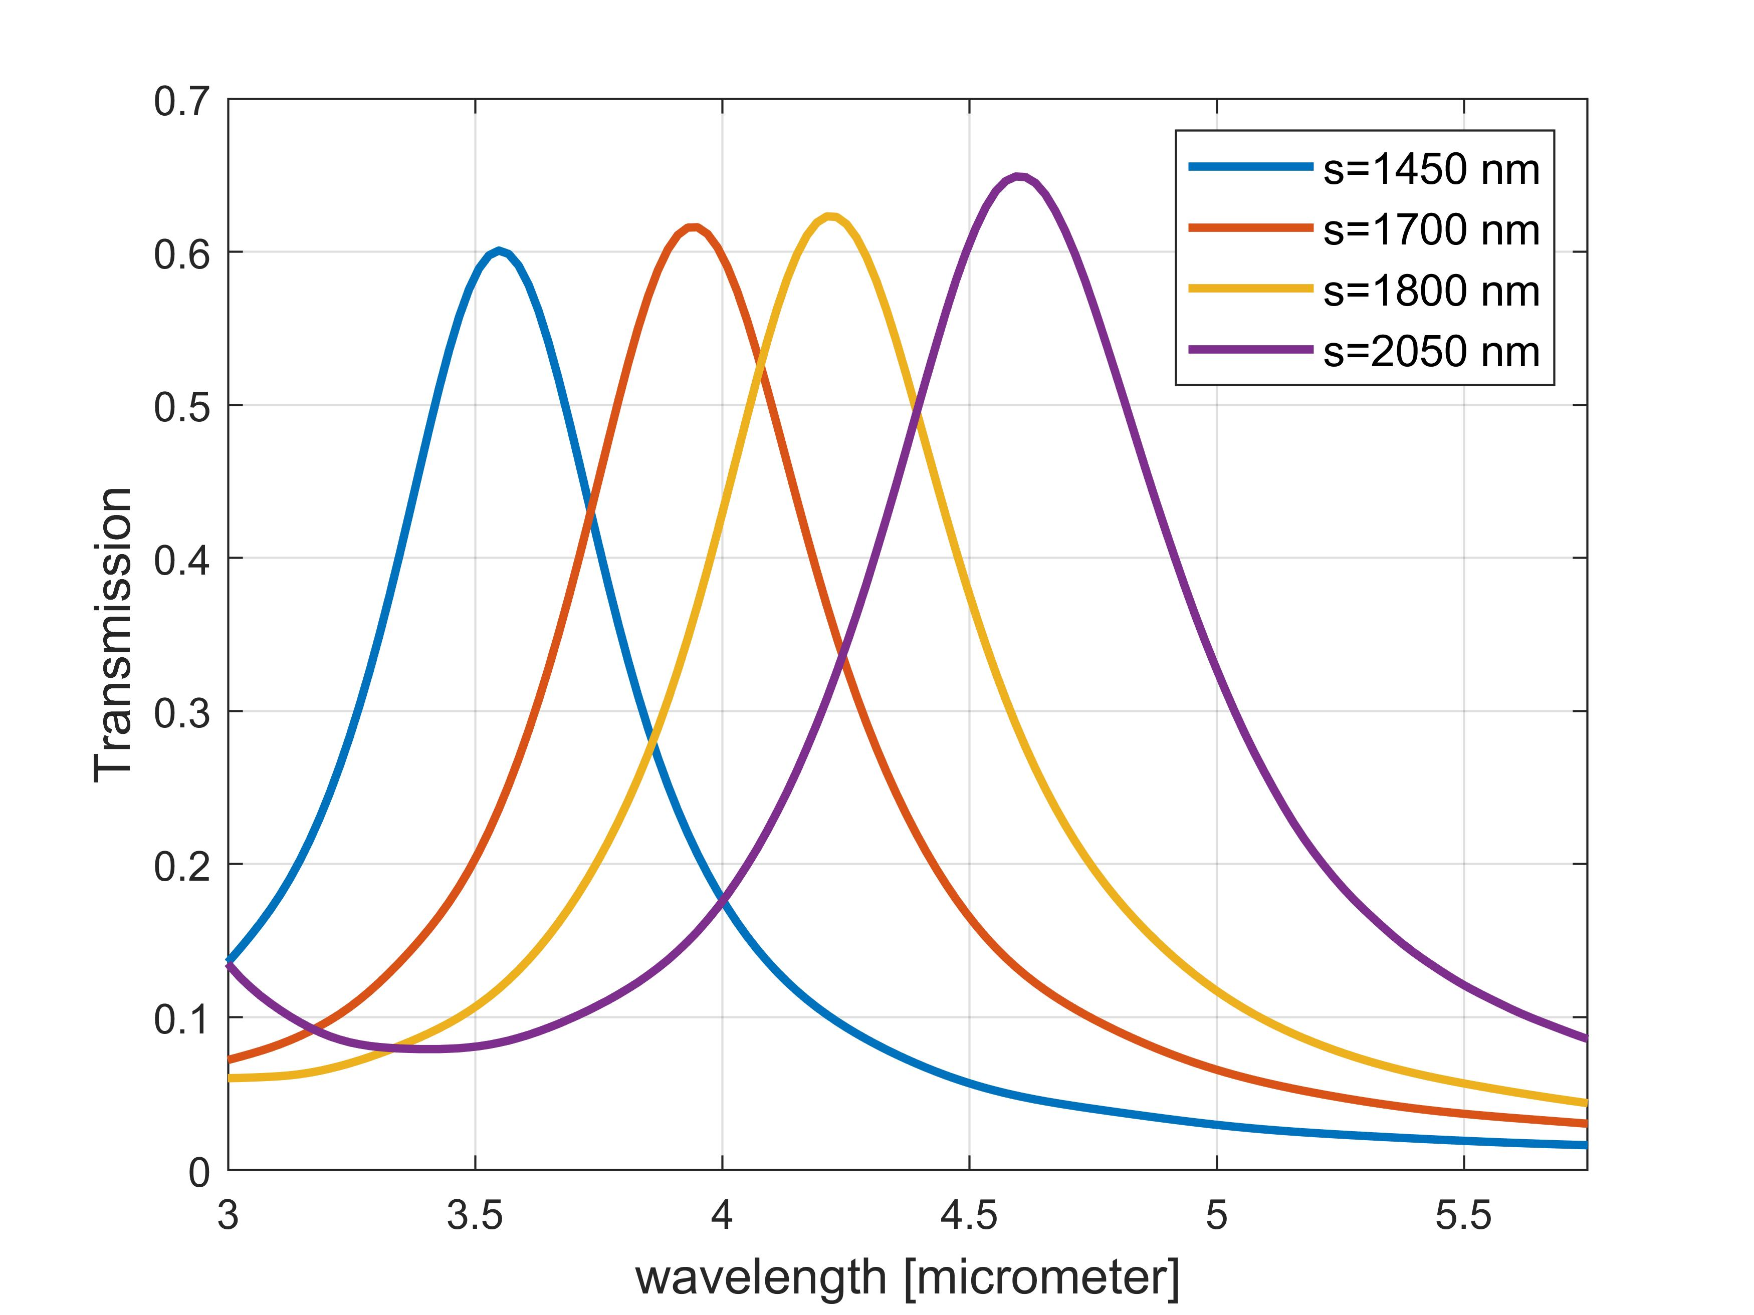
r
Right: Conventional lenses focus light by inducing a varying phase delay for transmitted light.
h=2 μm
GaSb
Methodology
Top: Nanopillar made from gallium antimonide (GaSb). By varying the radius, we can control the induced phase.
a)
Metasurfaces emulate the behavior of conventional components such as lenses by controlling the phase delay of transmitted light.
By careful placement of pillars of varying radii across a surface, we can induce a varying phase delay and thereby control the transmitted light.
b)
We have developed specialized metasurface-based optical concentrators (metalenses) for integration with photodetectors.
By increasing the light collection area, this will allow infrared photodetectors to function at elevated temperatures with larger signal-to-noise ratio.
We are also developing plasmonic filters that, when integrated with photodetectors, allow on-chip spectral selectivity.
When integrated with focal plane arrays, these filters will transform the focal plane array into a multispectral imager.
Top: Simulated transmission through four different plasmonic filters.

Slide 5
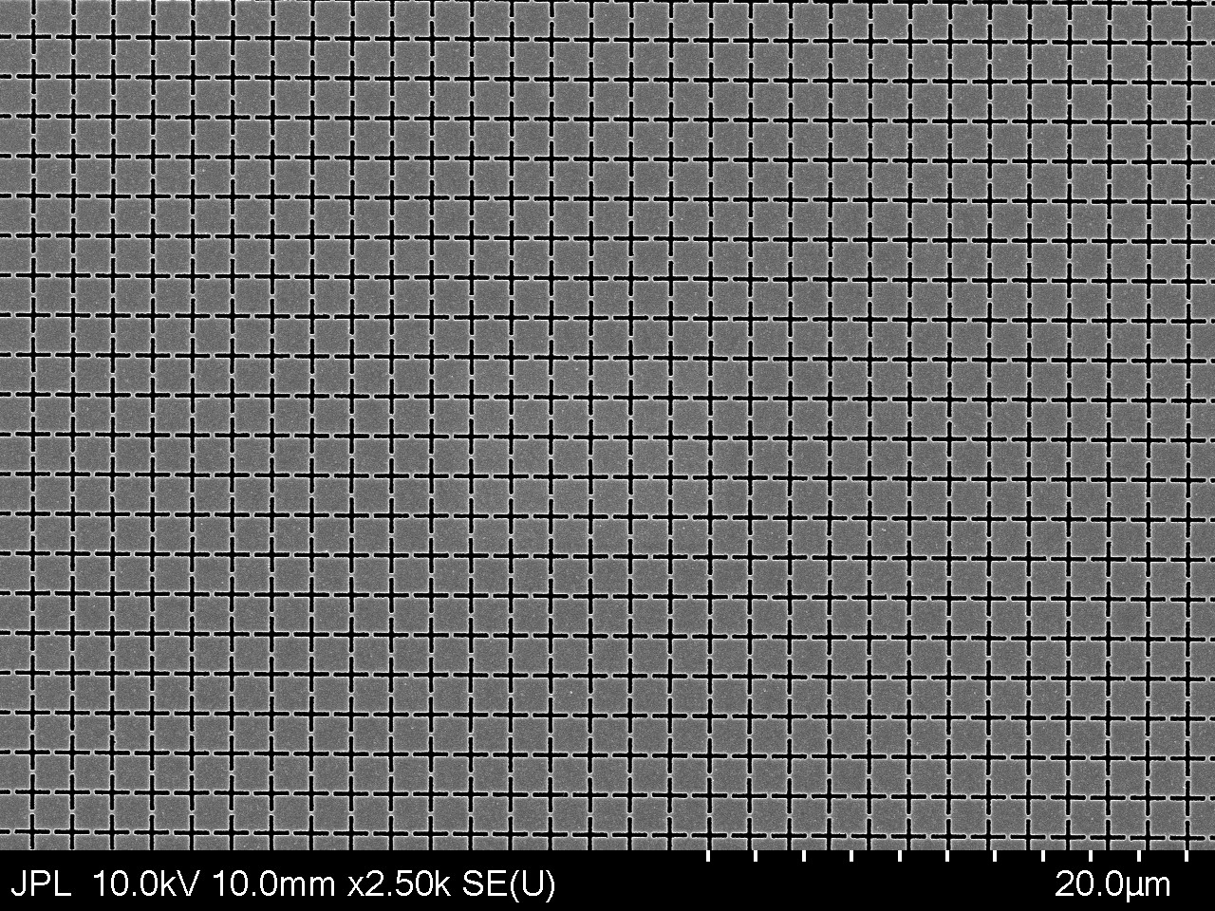
Results
a)
For the first time, we have integrated metasurface-based optical concentrators with infrared photodetectors to enhance the optical collection area by 500%.
We have also fabricated infrared plasmonic bandpass filters for future integration with photodetectors.
Top: SEM image of a fabricated metalens showing how the radius of the nanopillars change across the surface and thereby induce a different phase.
b)
The fabricated photodetectors with optical concentrators will provide enhanced signal-to-noise ratio at elevated temperatures. This paves the way for high-temperature operation of infrared focal plane arrays for small satellite missions.
The fabricated bandpass filters will help us develop highly compact on-chip multispectral imagers for global-coverage infrared monitoring.
c)
Future steps include:
Completing measurements and characterization of integrated photodetectors as well as the fabricated filters.
Integrate both metasurface concentrators and filters with FPAs to create high-temperature multispectral imagers for various Earth monitoring applications.
Top: SEM image of a fabricated plasmonic filter. The filter consists of cross-shaped openings in a gold film.

Slide 6
Publications and Acknowledgements
“Metasurface lenses monolithically integrated with infrarered nBn detectors for high-temperature operation”, T. Wenger et al, Manuscript in preparation.
A special thanks to Dan Wilson and Richard Muller at MDL for their invaluable help with electron-beam writing of the metasurface devices.

