Slide 1

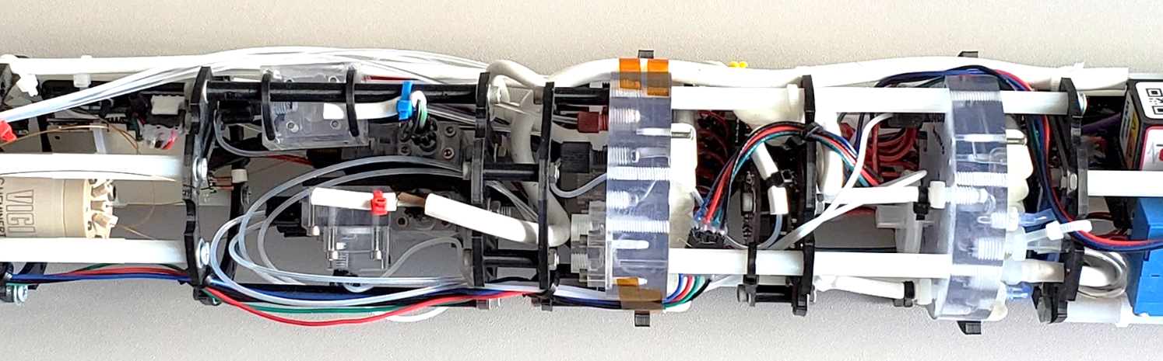
2020 Postdoc Research Day Presentation Conference.
Design of a Submersible Underwater Capillary Electrophoresis Analytical System
Tomas Drevinskas, Florian Kehl, Konstantin Zamuruyev, Peter A. Willis
Organization: Org#389
Advisor: Dr. Peter A. Willis (Org #389)
Postdoc Program: NPP

Slide 2

Introduction
Abstract
Scientists are interested in Ocean worlds because extraterrestrial life might be there. Chemical compounds themselves can hardly be treated as the bio-signature, however, their patterns can. Also, the shift of symmetry in a chirality is considered a distinguished feature that only life has. Enantiomers have the same physicochemical properties, therefore no remote sensing method can be used to detecting them. Contrary, in situ chemical analysis, is a powerful promising approach. Real samples contain a pool of various substances, therefore a separation technique should be used to detect and quantify them. To investigate water in the Ocean world, an analytical method should be capable of aqueous sample analysis. Due to instrumental simplicity, miniaturization, and integration capabilities, the first method of choice is capillary electrophoresis [1].
This work aimed to design a submersible underwater capillary electrophoresis analytical system.
Reference
1. Drevinskas T et al (2020) Complete capillary electrophoresis process on a drone: towards a flying micro-lab. Anal Methods. https://doi.org/10.1039/D0AY01220C

Slide 3
Problem Description
To design such an instrument, several problems have to be overcome:
Sample must be introduced from the outside
The system has to be high-pressure resistant
It must have closed high voltage compartments
It must have a high voltage decoupling mechanism
It has to be completely automated
It must be power efficient
A special format has to be used to ensure the small size
To our knowledge, no such system has been designed yet. Stated problems are not so easy to overcome. Such an instrument will also be useful in chemical oceanography tracking various chemical substances of biotic and abiotic origin.
I am extremely interested in designing automated and autonomous chemical analysis instruments hoping that someday they will be used to answer some important questions or at least will aid in some way.

Slide 4
Theory: capillary electrophoresis
Separation
capillary
Anode
Detector
Cathode
Sample
zone
Vials
Peaks
(detected substances)
High voltage
Power supply

Slide 5
Multiple sub-systems compose an instrument
Fluidic
High Voltage
Electronics
Pneumatic
Sample Injection
Firmware

Slide 6
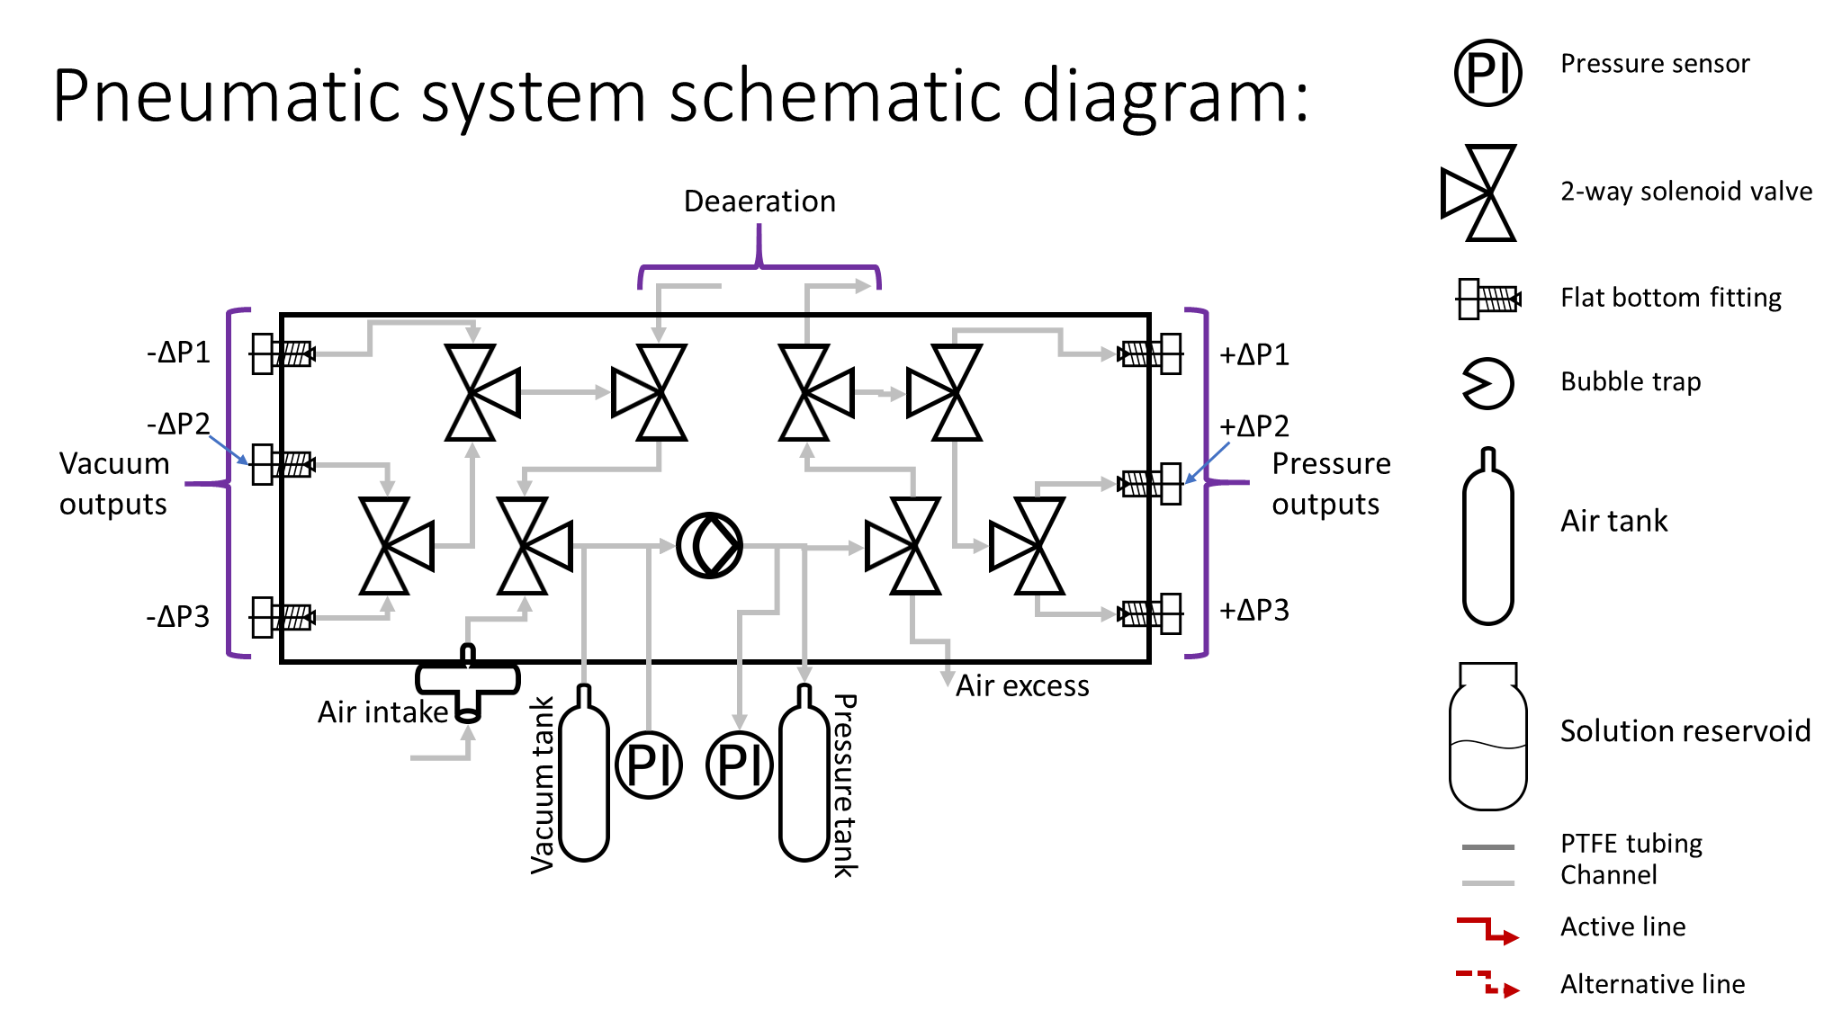
Pneumatics: solenoid valve-based pressure and vacuum distribution

Slide 7
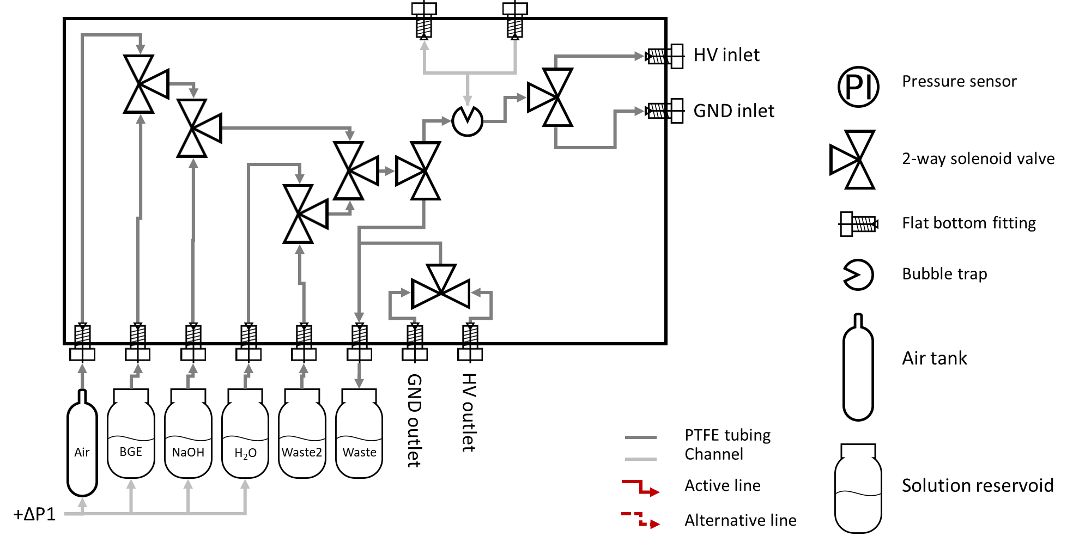
Fluidics: solenoid valve-based fluid distribution

Slide 8
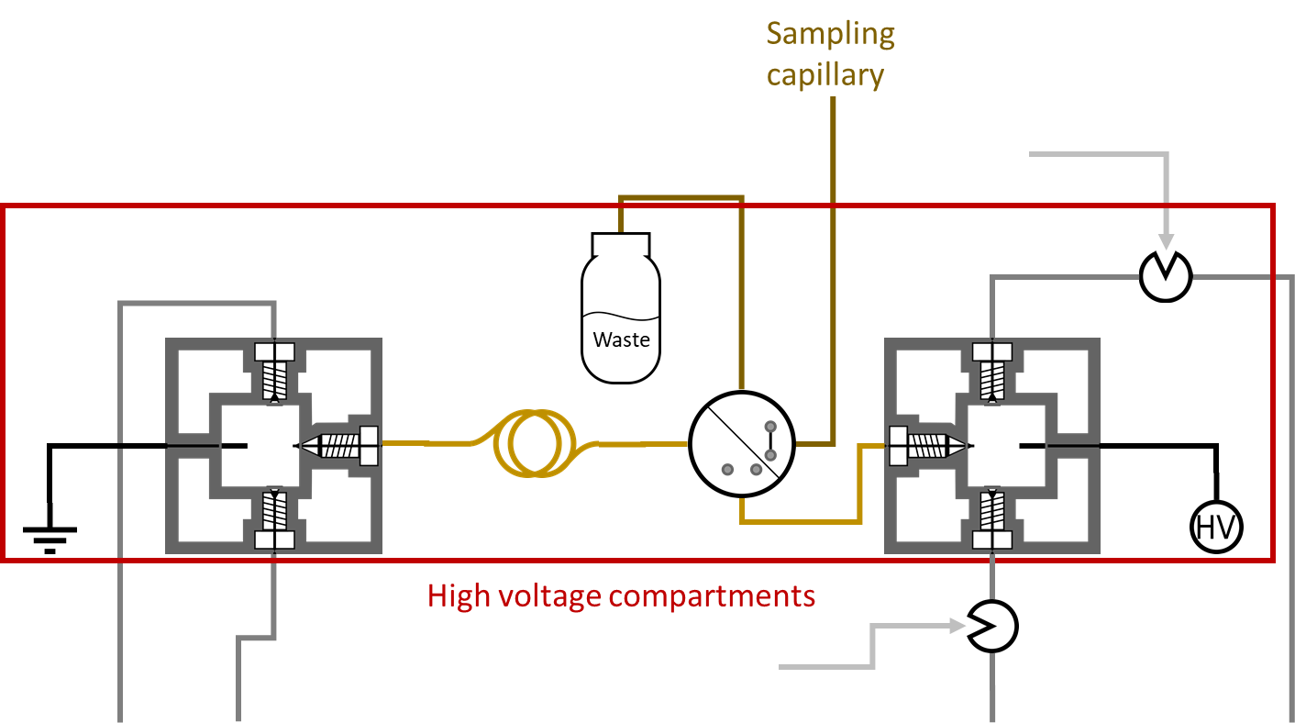
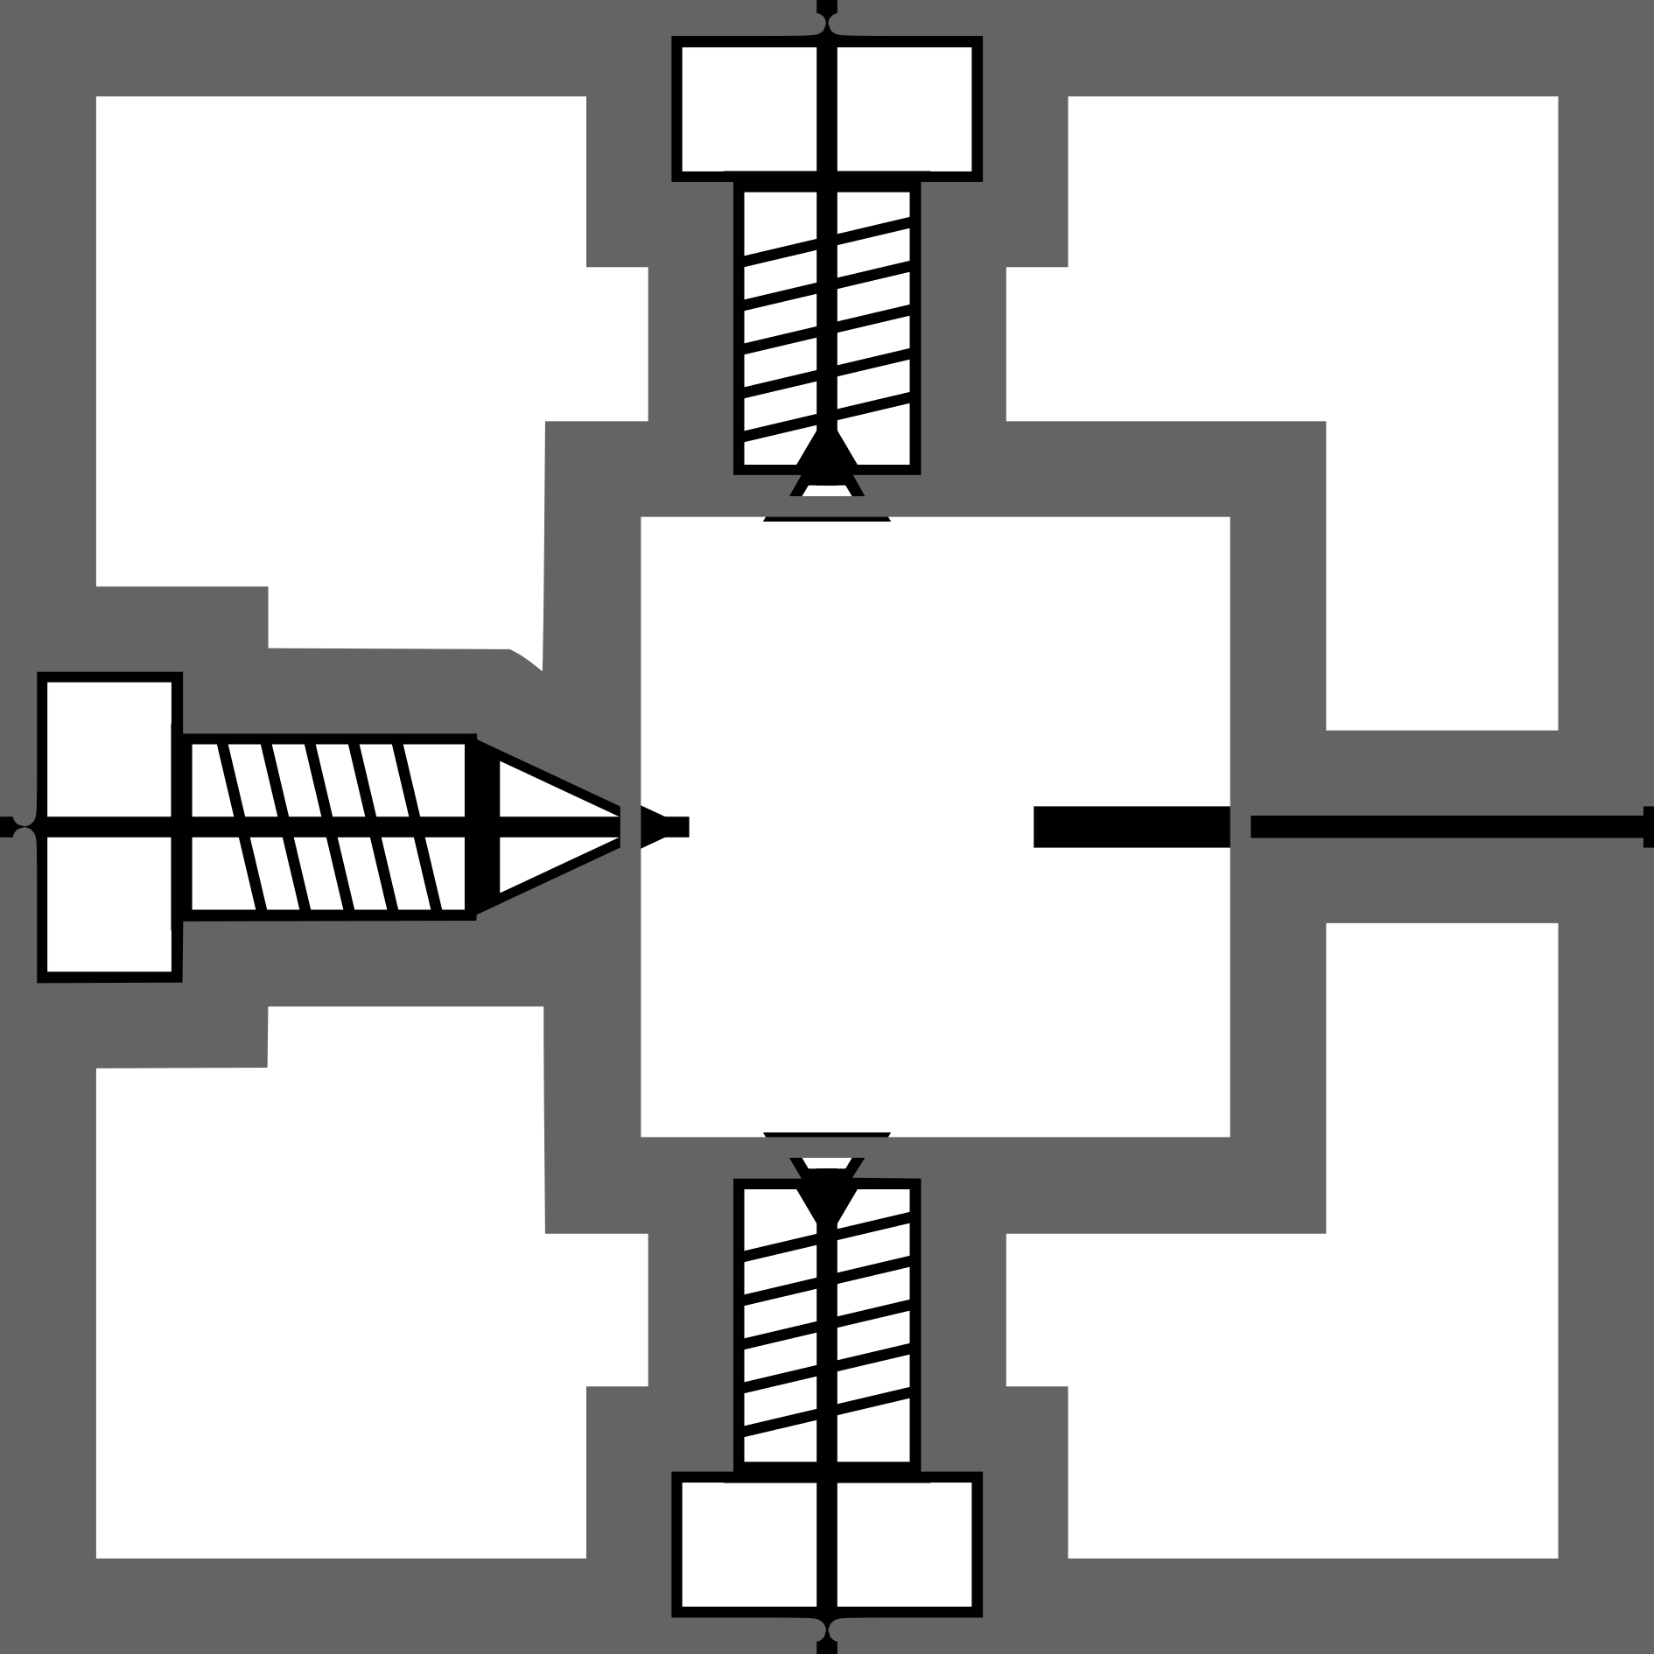








High Voltage handling
HV decoupling
Air line
High Voltage
Electrode
Compartment
Coned capillary fitting
Injector valve
HV decoupling
Air line
Separation capillary
outlet
inlet
inlet
outlet
Ground
PTFE Air line
Flat bottom fitting
75-100 µm I.D. capillary
50 µm I.D. capillary
Bubble trap
HV connection
Solution reservoid

Slide 9
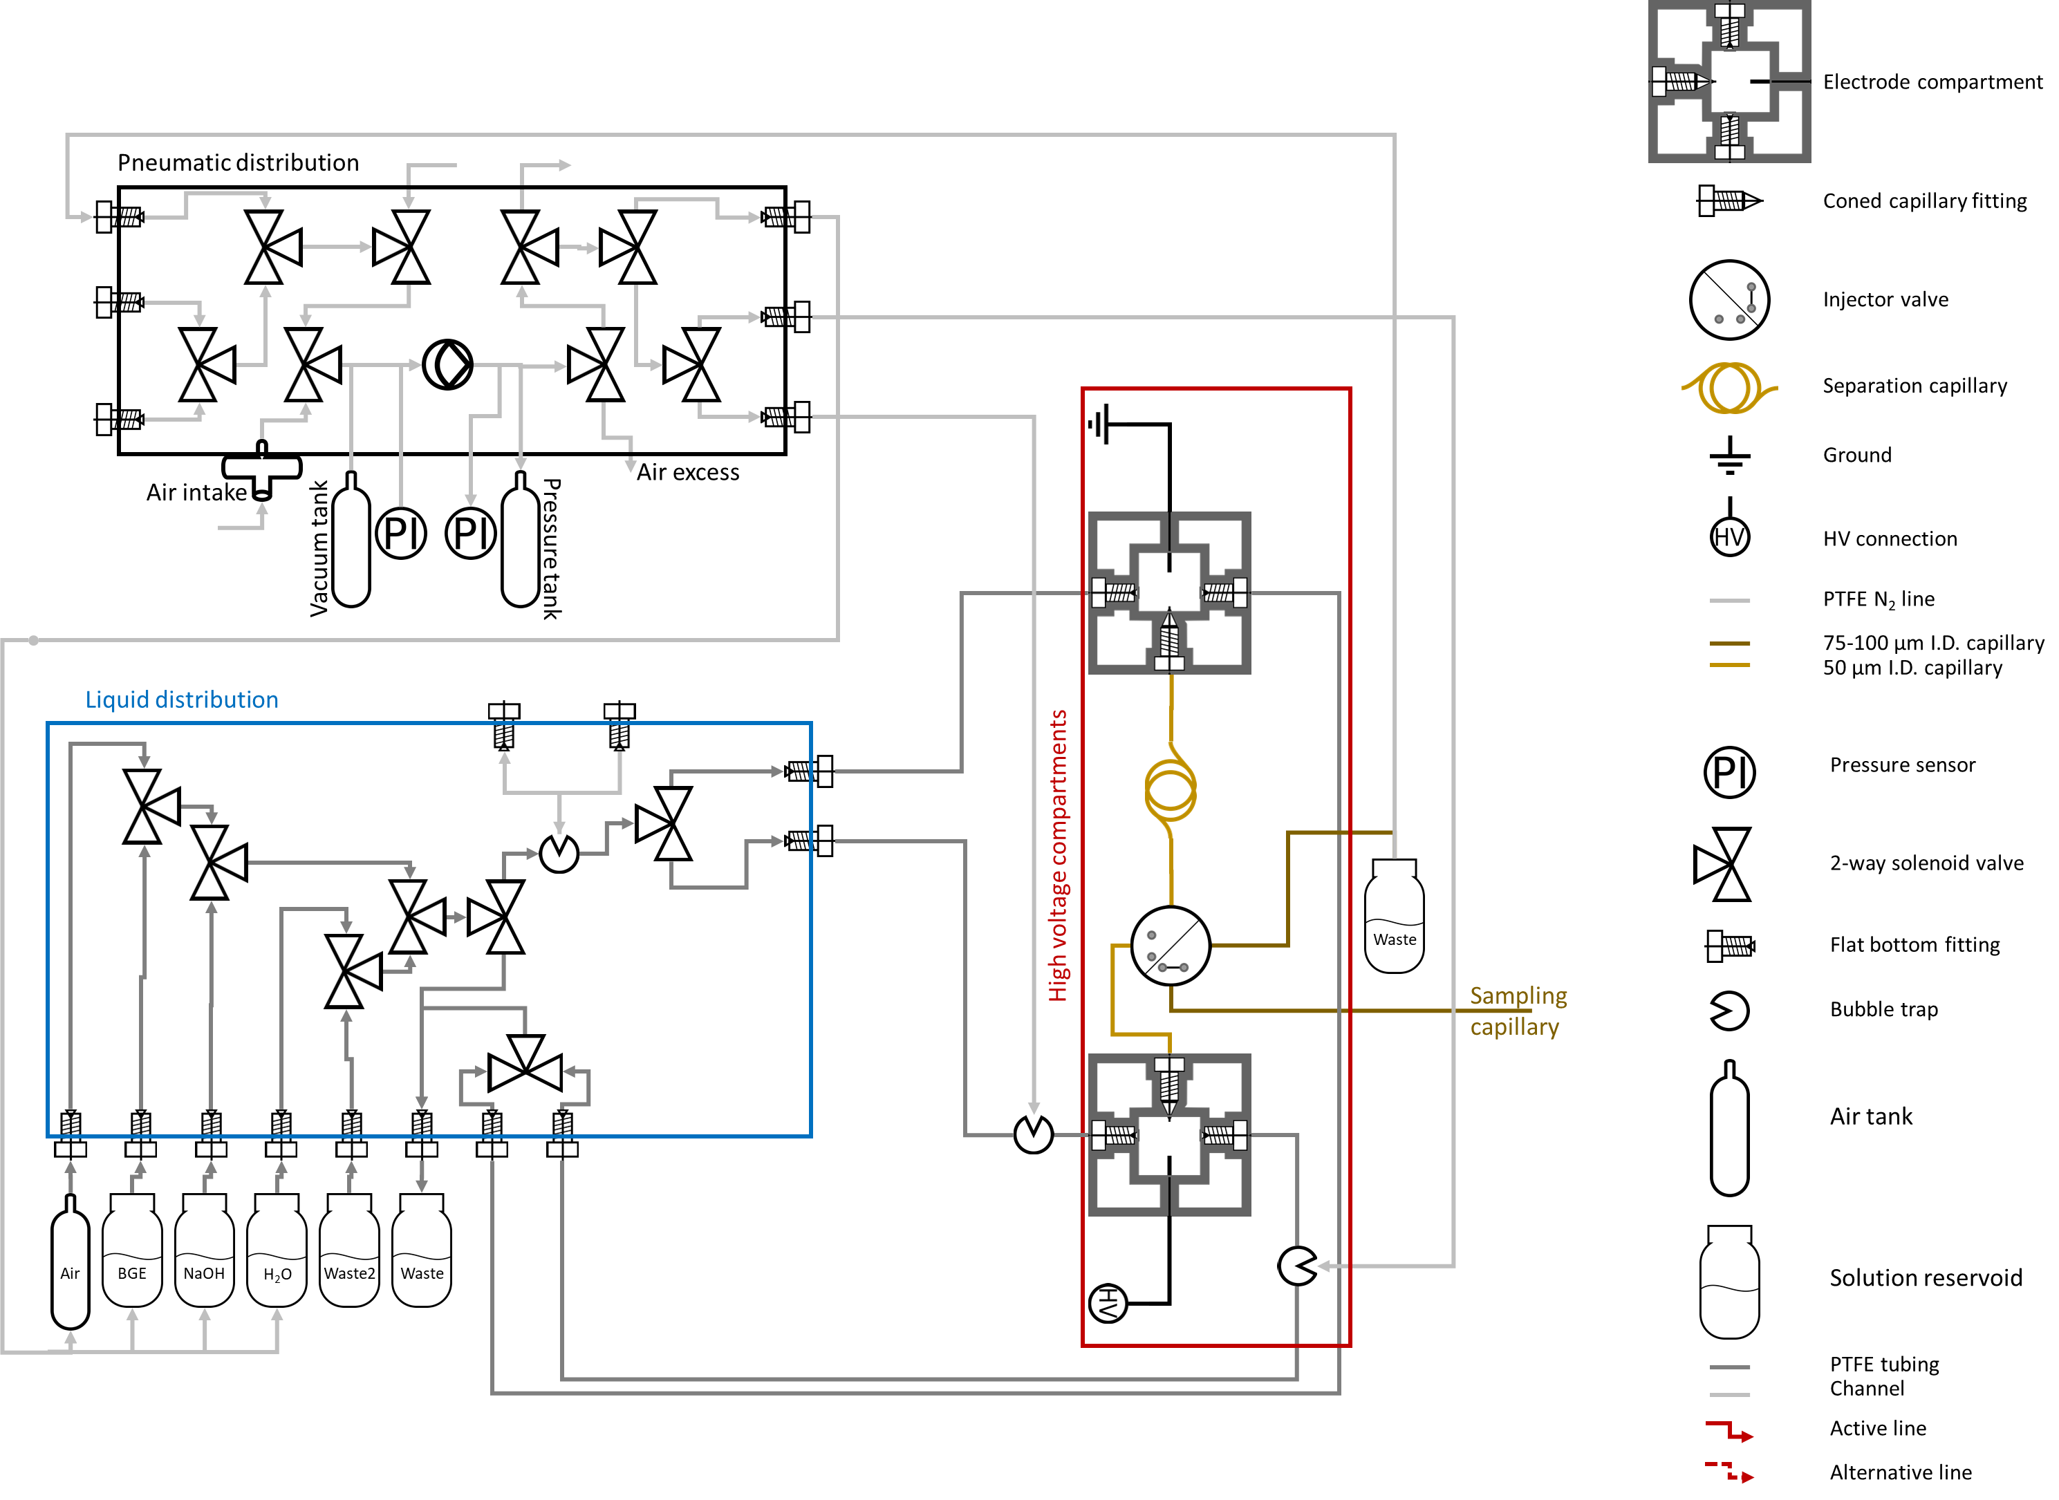
Connected sub-systems

Slide 10
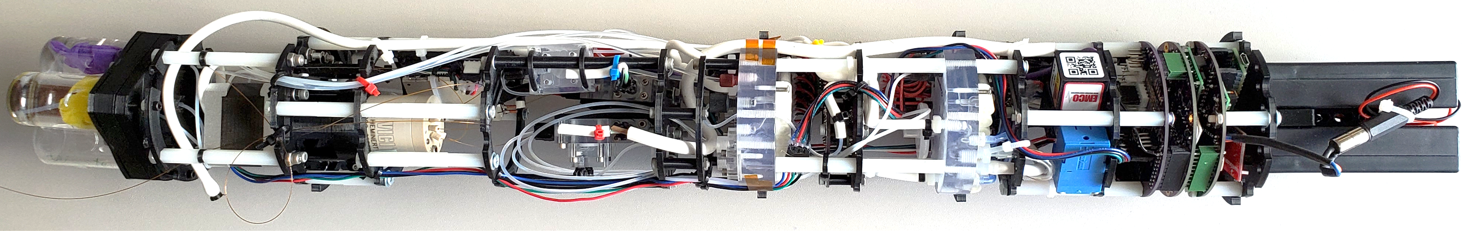
Designed instrument
Battery
Pack
Pneumatics
Electronics

Slide 11
Designed instrument
High Voltage
Compartments
Fluidics
Pneumatics

Slide 12
Designed instrument
Solution
reservoirs
Rotary injection
valve
High Voltage
Compartments

Slide 13
Actual separations
Conditions:
Background electrolyte: 0.5 M acetic acid
Separation voltage: 10 kV
Total length of the capillary 50 cm
Effective length of the capillary 40 cm
Inner diameter of the capillary 50 µm
Injection performed into rotary valve injection cavity using vacuum of 5 psi for 30 seconds
Before analysis, capillary conditioned with water and background electrolyte for 6 minutes each

Slide 14
Real Sample analysis: washings from the surface of the table
K⁺
K⁺
Ca²⁺
Na⁺
Ca²⁺
Na⁺

Slide 15
Next steps
System optimization
Development of analytical procedure in the laboratory
In situ Applications

Slide 16
Publications and Acknowledgements
Participation in a conference:
36th International Symposium on Microscale Separations and Bioanalysis. September 27-30, virtual edition. Tomas Drevinskas, Florian Kehl, Konstantin Zamuruyev, Aaron Noell, Vlad Cretu, Andrew Demartino, Peter A. Willis. Development of an Underwater Autonomous Capillary Electrophoresis Unit for Potential Future Ocean World Exploration and Terrestrial Chemical Oceanography
I would like to express my gratitude to my scientific advisor Dr. Peter. A. Willis and my Colleagues Dr. Florian Kehl and Dr. Konstantin Zamuruyev for insightful scientific discussions and support. I am also grateful to the whole research group for the support.
© 2020 California Institute of Technology. Government and NASA Postdoctoral Program sponsorship is acknowledged.

