Slide 1
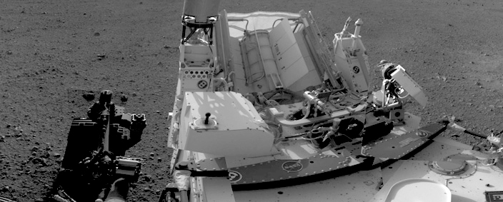

2020 Postdoc Research Day Presentation Conference
Giacomo Cerretti
Organization: 3467
Advisor: Jean-Pierre Fleurial (3460)
GS: Sabah Bux (3467)
Postdoc Program: NPP

Slide 2

Introduction
Abstract
47 RTGs successfully used in 28 US missions since 1961.
SoA RTGs have efficiencies η_{MMRTG} ~ 6.5%.
To improve η we need to improve zT.
To improve zT we need to improve thermoelectric materials (zT depends only on materials parameters).
New materials operate at high T (~1100 °C), which means more stresses.
New materials have high zT (~1.4 @1000 °C), but are mechanically fragile and brittle.
More robust and more performing materials are needed.
MMRTG
Thermoelectric power generation
Efficiency
Figure of merit
Carnot
TE Materials
$$zT=\frac{S^{2} T}{ρκ}$$
https://rps.nasa.gov/resources/56/enhanced-multi-mission-radioisotope-thermoelectric-generator-emmrtg-concept/

Slide 3
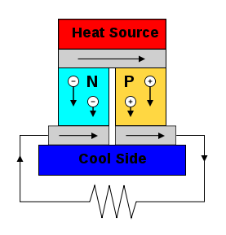
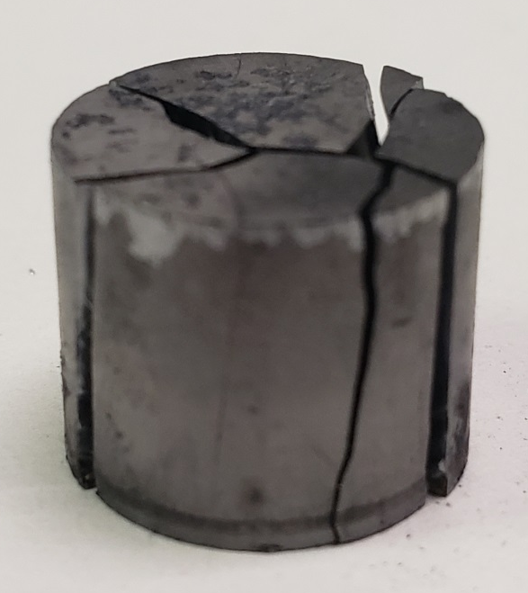
Hot side interconnect
(HSI)
Problem Description
Interface between the thermoelectric materials (TE) and hot side interconnect (HSI) is very critical part of thermoelectric couple assembly.
It operates at high T (~1100 °C), hence high stresses arise.
Mismatch between CTE (Coefficient of Thermal Expansion) of the materials is of great concern (18 for TE vs. 12 for HSI).
It can generate cracks and bring to failure of couples (and generator).
Modify mechanical properties of thermoelectric materials without deteriorating conversion efficiency is great challenge.
TE
Cracks
TE (~10mm)
HSI (~0.5mm)
HSI

Slide 4
Methodology
Purpose was to develop materials/strategies to reduce CTE of TE materials without deteriorating thermoelectric properties.
Study focused on p-type thermoelectric material Yb₁₄MnSb₁₁ (high T material for NGRTG).
Dispersing particles of compatible metal into TE material (creating a new composite material) is expected to improve mechanical properties.
Engineering the inclusion type, its density and its dispersion can retain thermoelectric properties.
After testing different materials and inclusion densities, tungsten (W) was selected because chemically, electronically, and mechanically compatible with Yb₁₄MnSb₁₁.
W Young’s modulus (E) and CTE are expected to improve mechanical stability and decrease overall CTE.
Material | M-Sb Reactivity | ρ [mΩ·cm] @25°C | E [GPa] | CTE [K⁻⁶] @25°C
Yb₁₄MnSb₁₁ | - | 2 | 68 | 18
W | None | 5.28 x 10⁻³ | 411 | 4.5

Slide 5
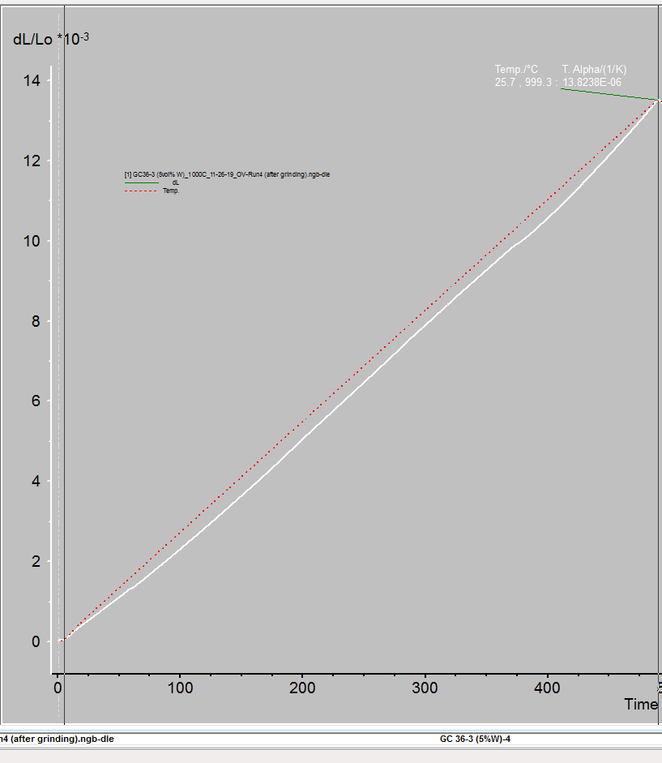
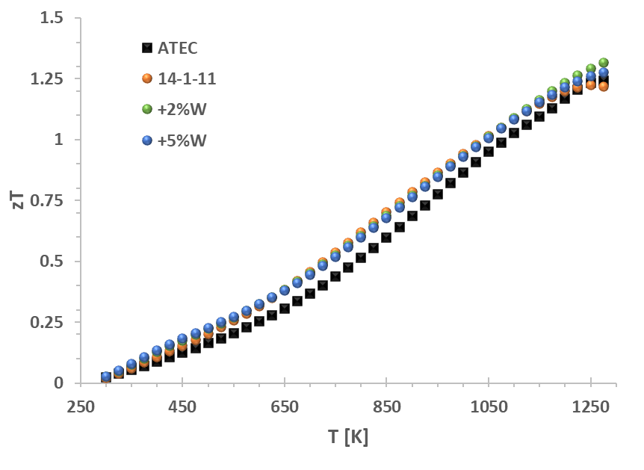
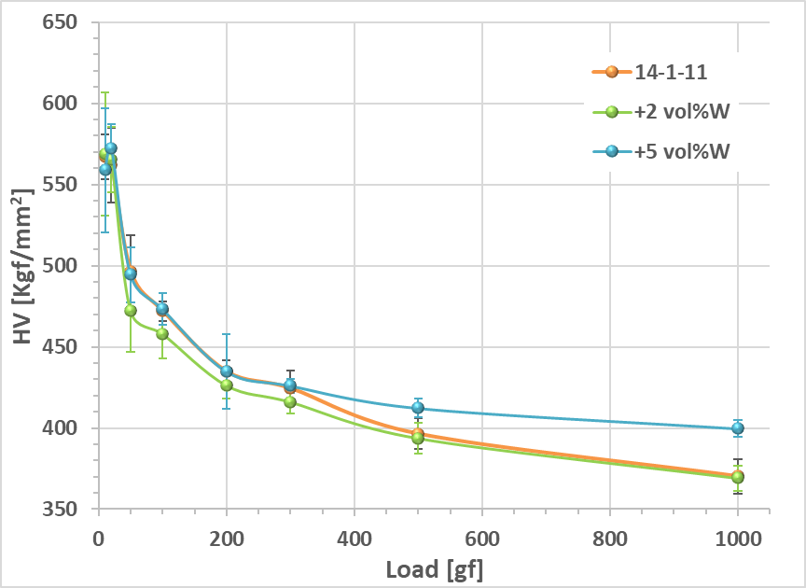
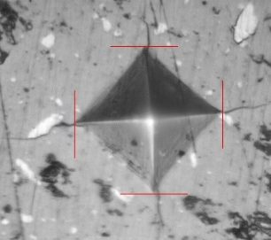
Results
The best composition resulted being Yb₁₄MnSb₁₁ + 5vol% W.
Peak zT remained unaltered zT~1.3 @1273 K.
Material harness improved, and W inclusions limit crack propagation.
CTE decreased from ~18 K⁻⁶ to ~14 K⁻⁶, expanding the material options for the HSI.
All these factors play a huge role in device fabrication by improving robustness and stability of thermoelectric couples assembly, and extending the life of generator.
CTE~13.82 K⁻⁶
zT≈ 1.3

Slide 6

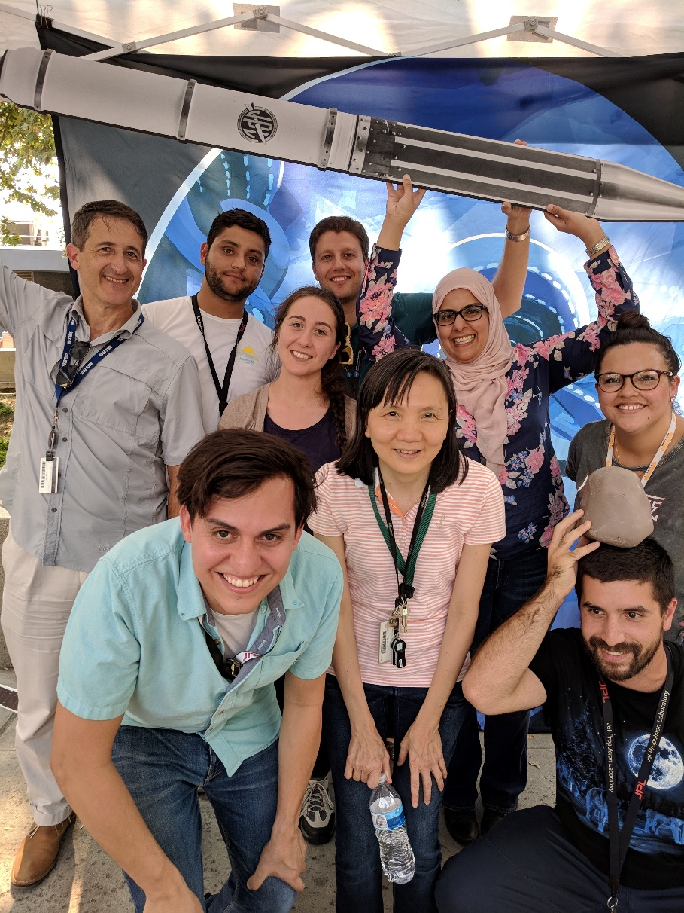
: giacomo.cerretti@jpl.nasa.gov
Publications and Acknowledgements
G. Cerretti, O. Villalpando, J.-P. Fleurial, S. K. Bux, J. Applied Physics 126 (17):175102 (2019), doi: 10.1063/1.5118227.
G. Cerretti, invited seminar, Universidad Nebrija – Madrid – Spain (2020).
G. Cerretti, invited seminar, Institute for Soldier Nanotechnologies (ISN) – MIT, Boston – Massachusetts (2019).
G. Cerretti, S. K. Bux, J.-P. Fleurial, JPL Postdoc Seminar Series, Pasadena – California (2019).
G. Cerretti, S. K. Bux, J.-P. Fleurial, presentation, Materials Research Society Fall Meeting, Boston – Massachusetts (2019).
G. Cerretti, invited seminar, Buenaventura MTT-S Chapter Meeting of the IEEE, Newbury Park – California (2019).
G. Cerretti, invited seminar, Justus Liebig Universität, Giessen – Germany (2019).
G. Cerretti, invited seminar, Johannes Gutenberg Universität, Mainz – Germany (2019).
G. Cerretti, invited seminar, University of California Davis, Davis – California (2019).
G. Cerretti’s research at the Jet Propulsion Laboratory was supported by an appointment to the NASA Postdoctoral Program, administered by Universities Space Research Association under contract with NASA.

