Slide 1
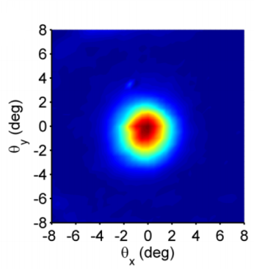
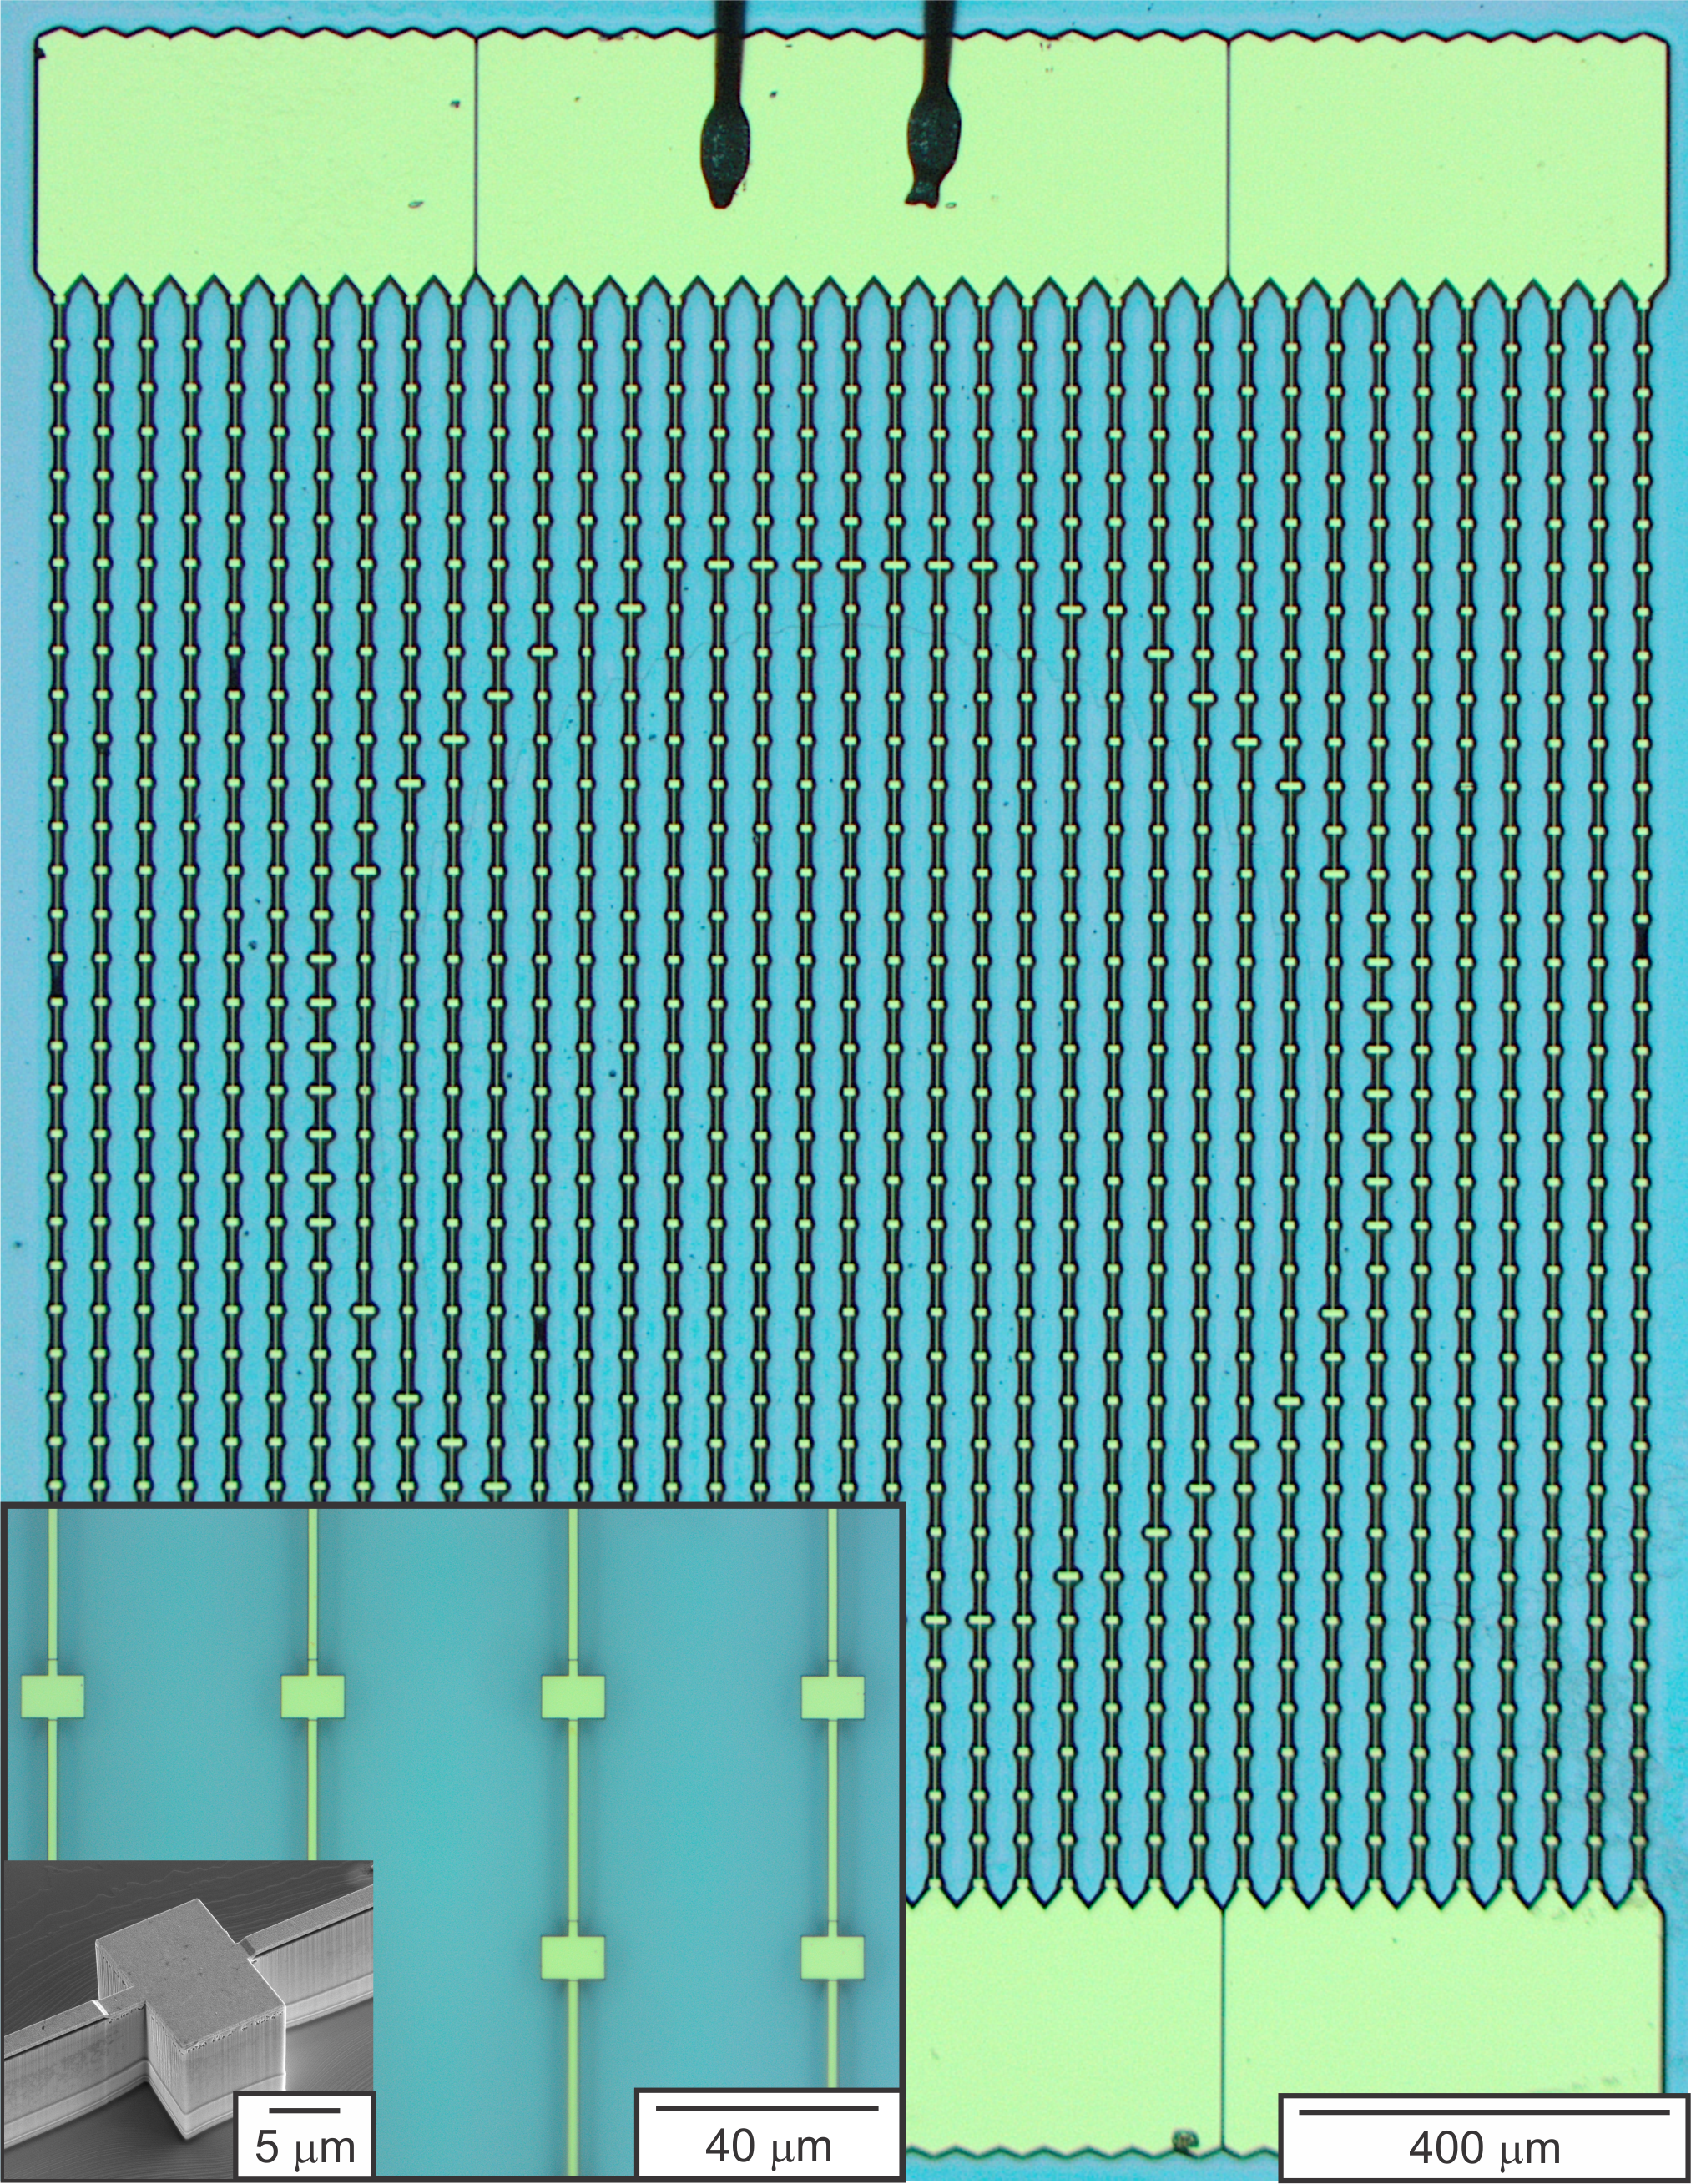
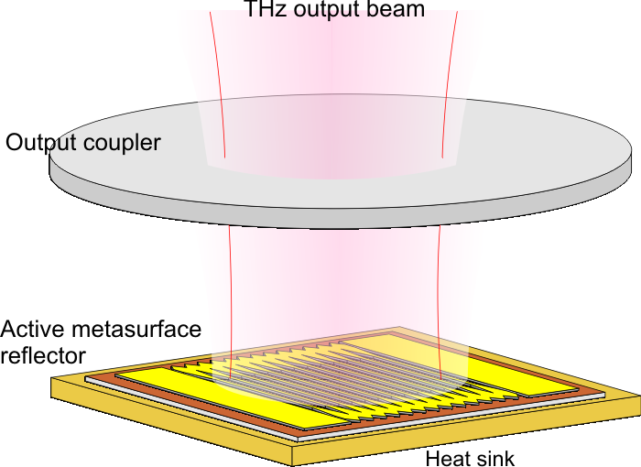
2 mm
2 mm
Phase-locking of a THz quantum-cascade VECSEL
Chris Curwen¹, Darren J. Hayton², Jonathan H. Kawamura², and Boris S. Karasik²
¹ Organization: Org#386H
Advisor: Boris Karasik (Org #386H)
Postdoc Program: NPP
² Jet Propulsion Lab, California Institute of
Technology, Pasadena, CA 91109, USA.

Slide 2
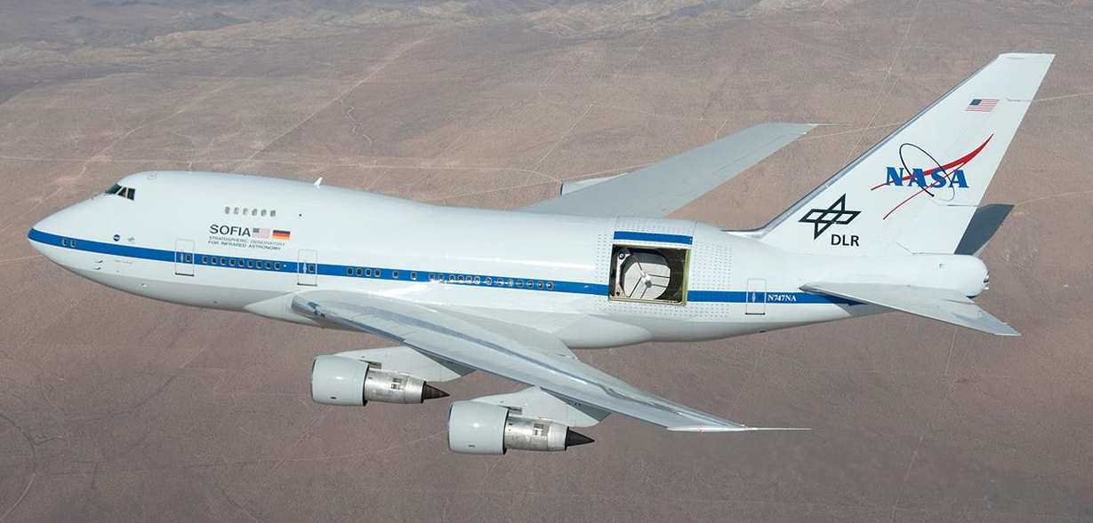
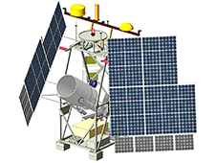
Introduction
THz (sub-millimeter) astronomy is useful for studying cold interstellar gas clouds where young stars and planets are being born, giving insight into the origins of life in our own solar system.
Heterodyne detection provides very high frequency resolution, allowing the kinematics of such clouds to be mapped via resolution of the doppler shift in the THz radiation.
There is a lack of compact, efficient local oscillators (LOs) at frequencies above ~2 THz. Quantum-cascade lasers (QCLs) are one candidate to help fill this gap.
SOFIA
Heterodyne receiver:
GUSTO
Mixer
IF amplifier
Antenna
Backend
spectrometer
Local oscillator

Slide 3
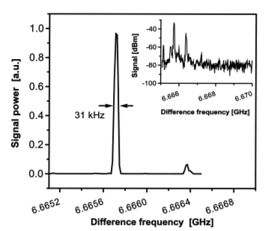
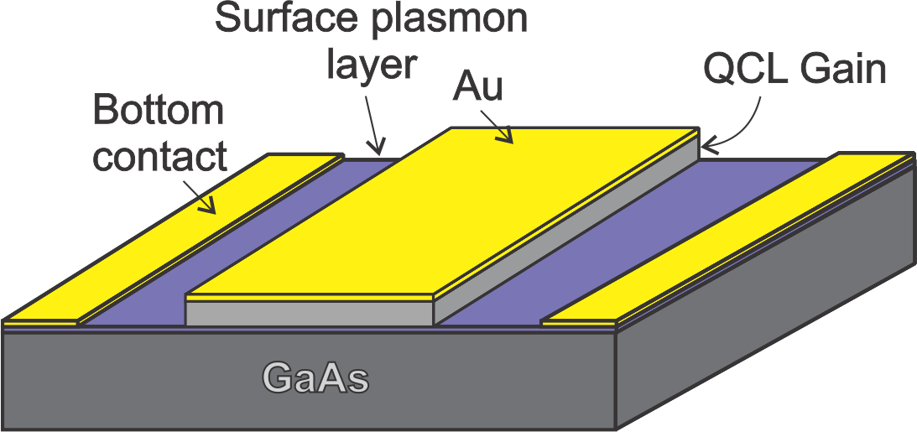
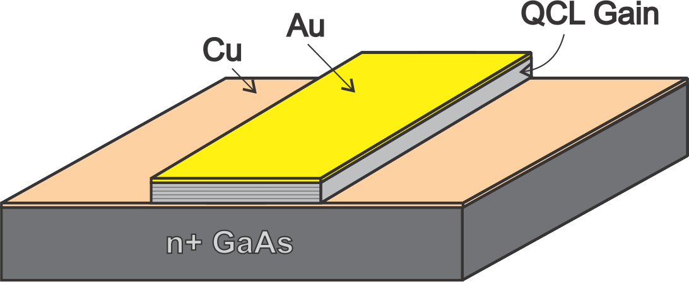
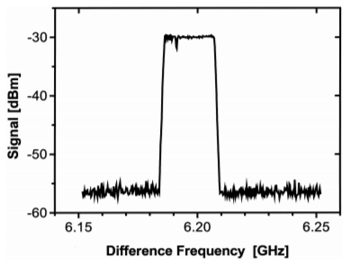
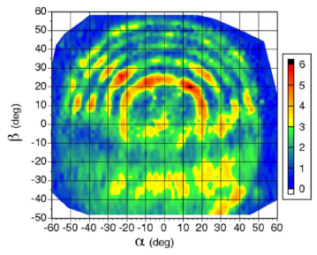
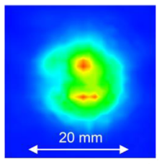
Problem description
Quantum-cascade lasers provide milliwatt level radiation in the 2-5 THz frequency range, but they have several issues that must be addressed to make a proper heterodyne receiver:
Cryogenic operating temperatures (<100 K).
Multilobed beam-patterns resulting in poor coupling of the QCL to the receiver.
Need for frequency stabilization (primary result of this work).
Linewidth:
3 ms
Metal-metal : T_{max} ~80 K
Surface-plasmon : T_{max} ~40 K
30 sec
H. Richter, et al., J. Infrared Millim. Terahz. Waves, (2014).
A. Adam, et al., Apl. Phys. Lett., 88, 2006.
A. Barkan, et al., Opt. Lett.,29 (2004).

Slide 4
Methodology
The Quantum-Cascade Vertical-External-Cavity Surface-Emitting Laser (QC-VECSEL) is a new approach for designing THz QCLs with excellent beam pattern and high operating temperature (based on metal-metal waveguide).
Phase-locking: signal from the VECSEL is down-converted to 2.85 GHz using subharmonic mixer pumped by a stable microwave reference. This intermediate frequency (IF) is fed into a phase-lock loop (PLL) that stabilizes the frequency of the QC-VECSEL via control of the bias on the device.
Signal Analyzer
QC-VECSEL:
Phase-lock loop:
Oscilloscope
3.4 THz
×33
LNAs
Coupler
QC-VECSEL
2.85 GHz
_{-10dB}
×3
IF filter
PLL
2.95 GHz
34.5 GHz
LNA
100 MHz
2 mm
2 mm
100 MHz
L. Y. Xu, et al., Appl. Phys. Lett., 107 (2015).

Slide 5
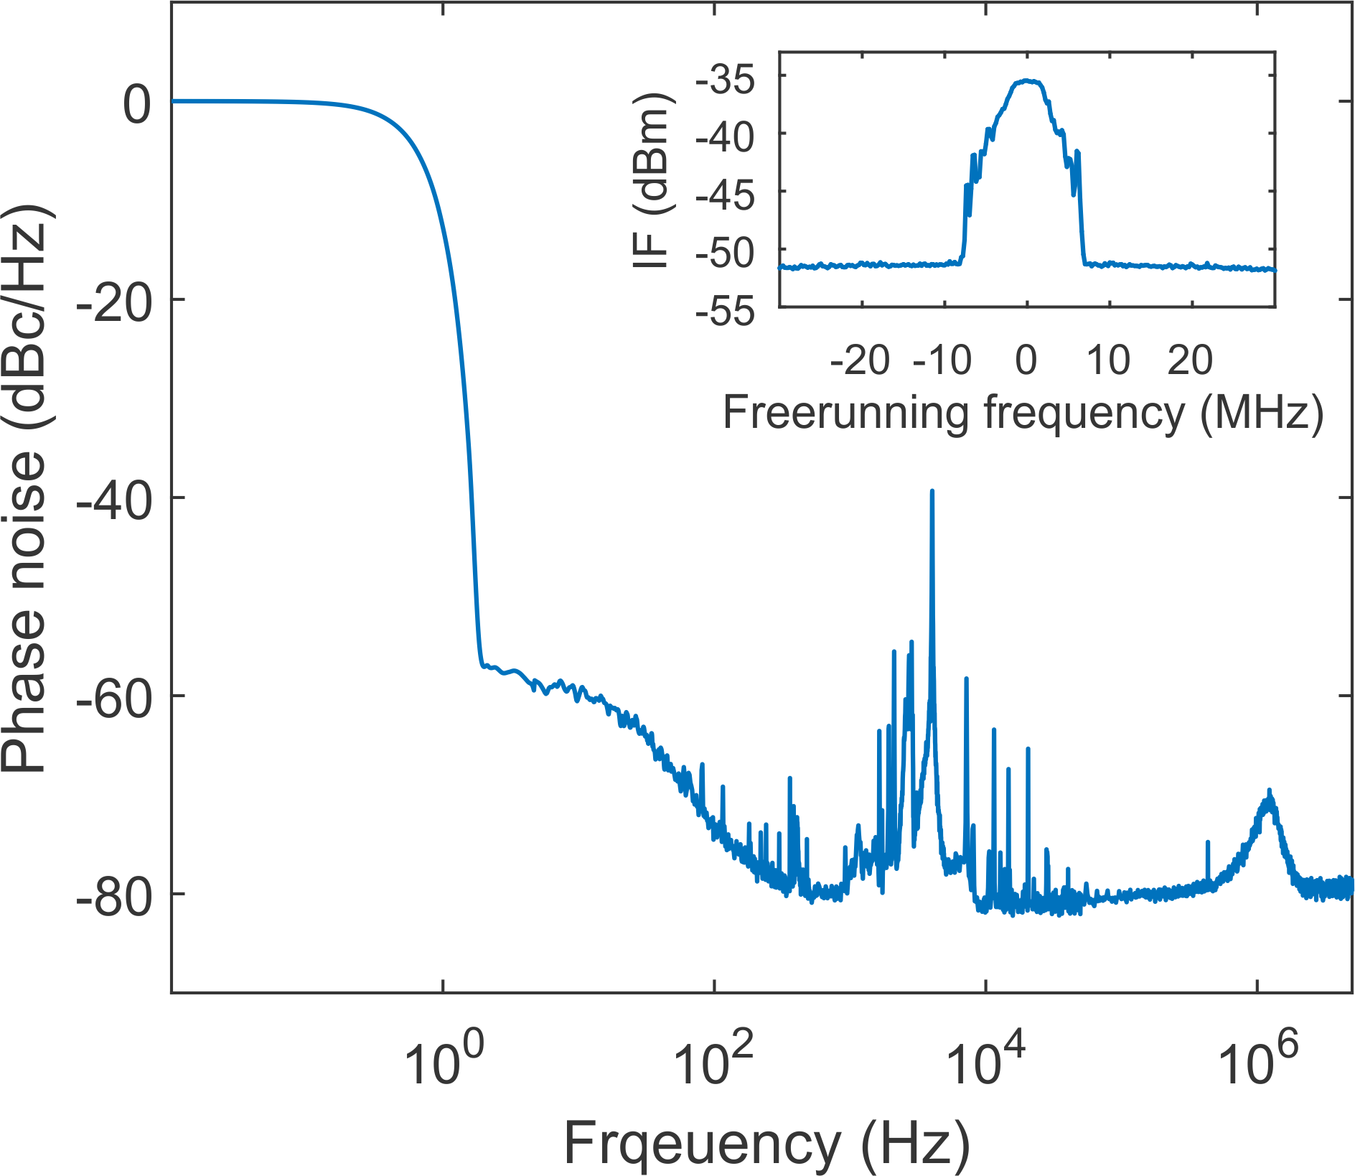
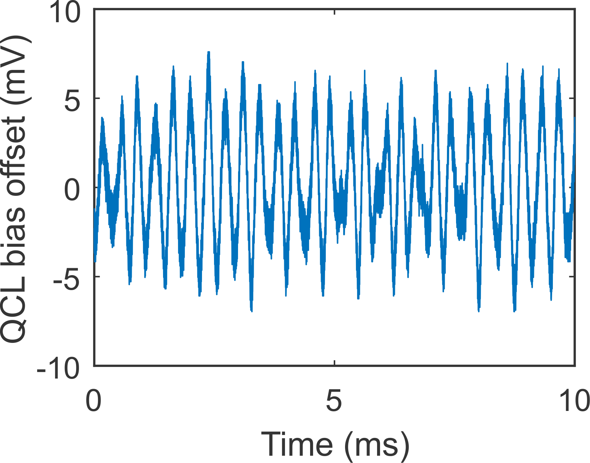
Results
Free-running linewidth >20 MHz.
Phase noise of the locked VECSEL indicates >98% of the power is locked within ±1 Hz of the reference signal.
Noise in the 100 Hz – 10 kHz range is assumed to be associated with mechanical noise in the external cavity. PLL bandwidth ~1.5 MHz
Bias fluctuation on the locked device are on the order of 10 mV, corresponding to power fluctuation on the order of 1% when at maximum bias.
Signal Analyzer
Oscilloscope
3.4 THz
×33
LNAs
Coupler
QC-VECSEL
2.85 GHz
_{-10dB}
Future work:
Investigate affect of external cavity parameters on the phase noise.
Stabilize with piezoelectric control of external cavity, fixed bias on the QCL.
Remove amplitude noise associated with stabilization.
Implement with mixer for receiver demonstration.
×3
IF filter
PLL
2.95 GHz
34.5 GHz
LNA
100 MHz
100 MHz

Slide 6
Acknowledgements
Thanks to Benjamin S. Williams¹ for providing the QC-VECSEL.
Thanks to Neil R. Erickson² for designing the subharmonic mixer.
Thanks to John L. Reno³ for providing the QC wafer material.
¹ University of California, Los Angeles, CA 90095, USA.
² University of Massachusetts, Amherst, MA 01003, USA.
³ Sandia National Laboratories, Center for Integrated Nanotechnologies, Albuquerque, NM 87158, USA.
References
Xu, L.Y., Curwen, C.A., Chen, D.G., Reno, J.L., Itoh, T., and B.S. Williams, “Terahertz metasurface quantum-cascade VECSELs: theory and performance.” IEEE J. Sel. Top. Quantum Electron., 23 (2017).
Curwen, C.A., Reno, J.L., and B.S. Williams, “Terahertz quantum-cascade VECSEL with watt-level output power,” Appl. Phys. Lett., 113 (2018).
Curwen, C.A., Reno, J.L., and B.S. Williams, “Broadband continuous single-mode tuning of a short-cavity quantum-cascade VECSEL,” Nat. Photon., 12 (2019).
Curwen, C.A., Reno, J.L., and B.S. Williams, “Terahertz quantum-cascade patch-antenna VECSELwith low power dissipation,” Appl. Phys. Lett., 116 (2020).
Curwen, C.A., Reno, J.L., and B.S. Williams, “Broadband metasurface design for terahertz quantum-cascade VECSEL,” Electron. Lett., in press.

