Slide 1
The causes of sea-level rise since 1900
Thomas Frederikse
Organization: 329C Earth Science: Sea Level and Ice
Advisor: Felix Landerer (329C)
Postdoc Program: JPL
Parts of this work have been conducted at the Jet Propulsion Laboratory, which is operated for NASA under contract with the California Institute of Technology.
© 2020. California Institute of Technology. U.S. Government sponsorship acknowledged.
Reference herein to any specific commercial product, process, or service by trade name, trademark, manufacturer, or otherwise, does not constitute or imply its endorsement by the United States Government or the Jet Propulsion Laboratory, California Institute of Technology.

Slide 2
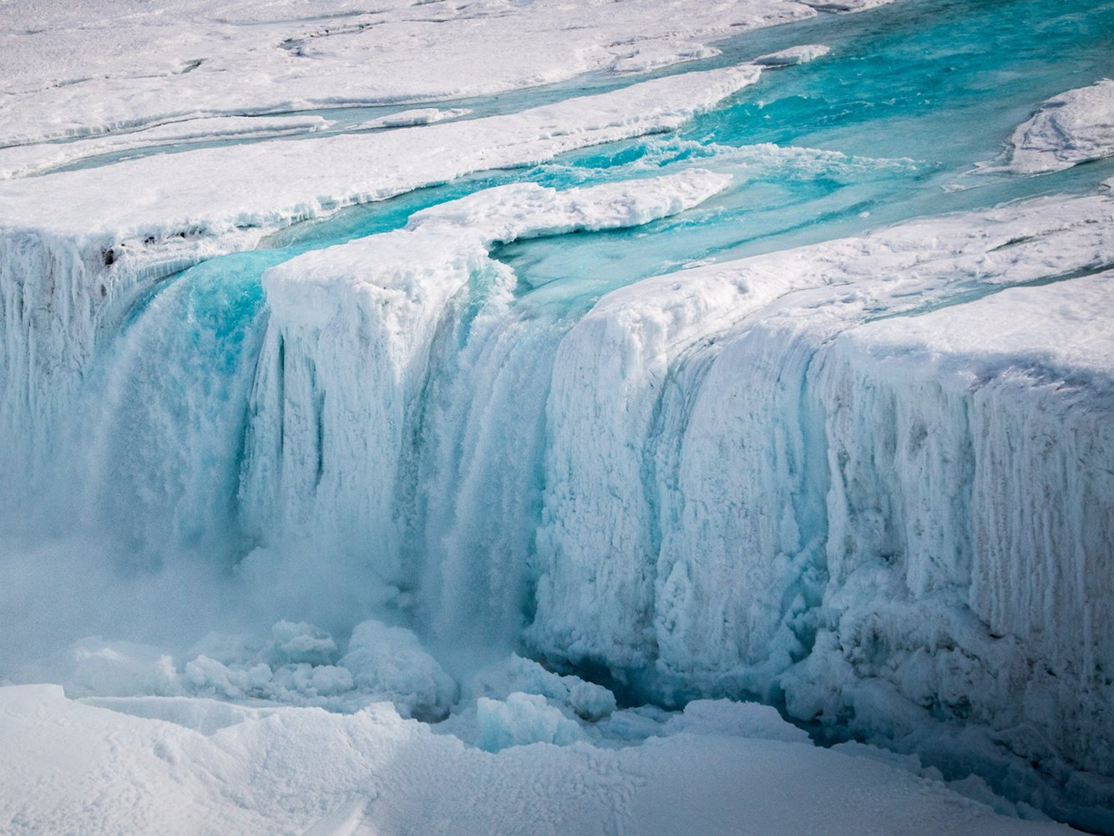
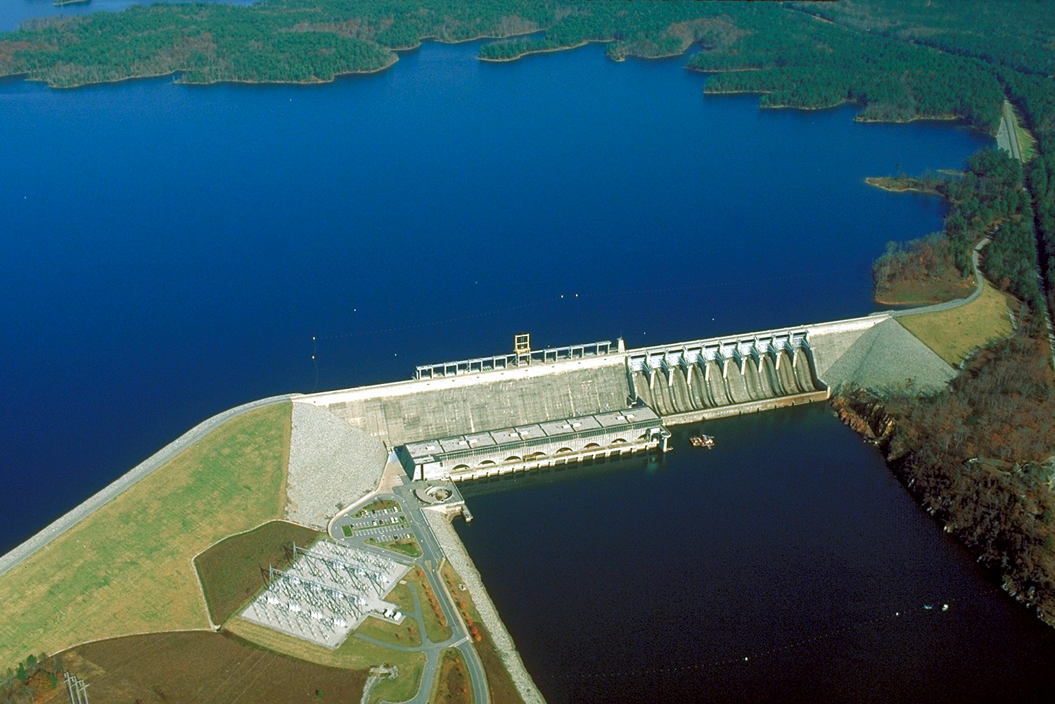
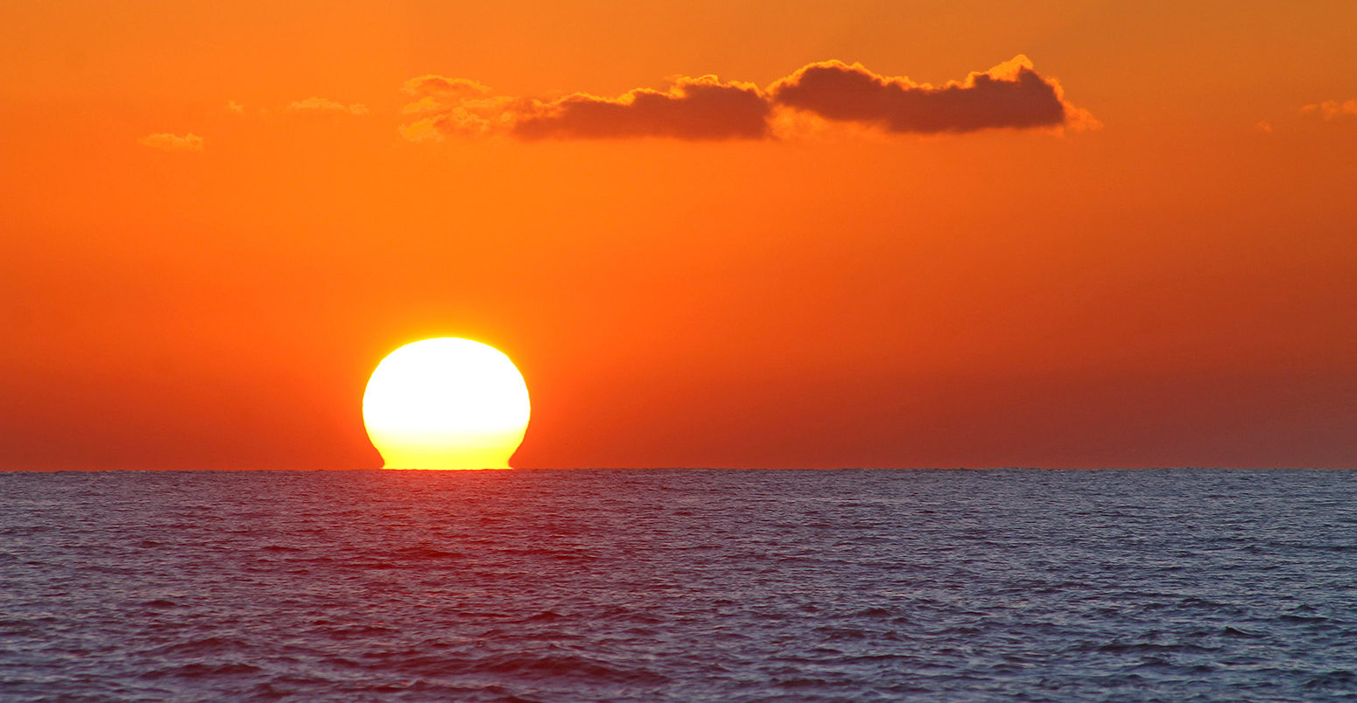
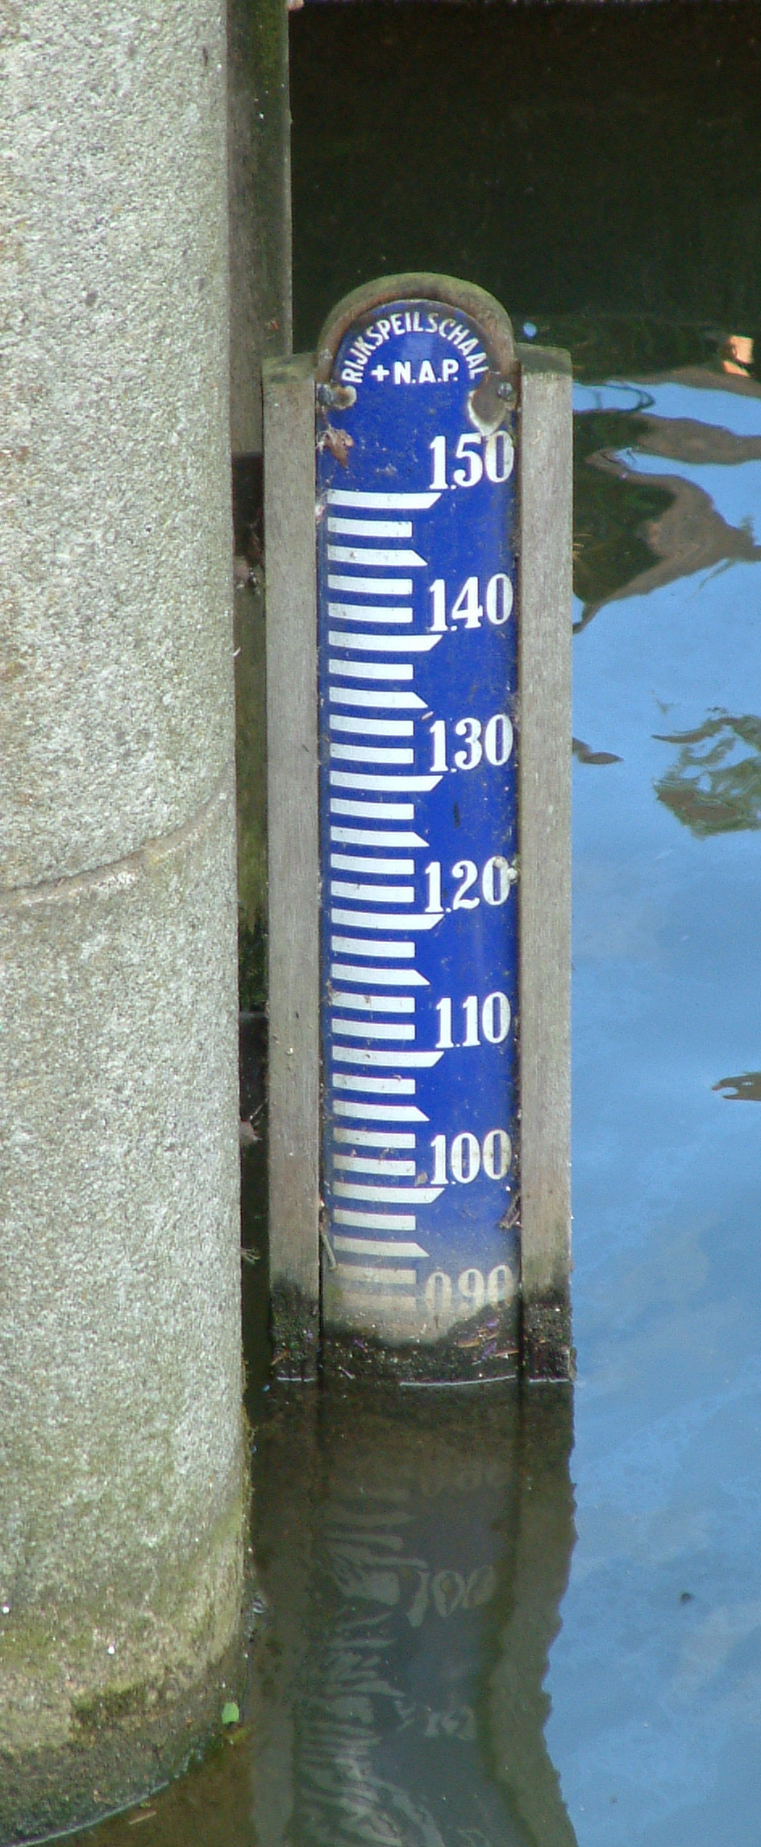
The global sea-level budget
Global sea-level changes are caused by multiple different processes with a similar order of magnitude:
Mass loss of glaciers and ice sheets
Changes in terrestrial water storage (think of groundwater changes or reservoirs behind dams)
Thermosteric expansion: thermal expansion of sea water due to rising sea water temperatures
Do estimates of the magnitudes of these processes add up to observed sea level?
+
+
=
?
Over the satellite era (1993-now), they do!
But over the 20th century, sea-level seems to have risen faster than we can explain!

Slide 3
The mystery: why did 20th-century sea level rise so fast?
Since 1900, sea level has risen by a few decimeters. In previous assessments, only 10-15 cm of this rise could be explained by ice melt, terrestrial water storage and thermal expansion.
Why is that a problem? Sea-level projections use this budget method as well: total projected sea-level rise is just the sum of projected ice melt and thermal expansion. We are projecting sea-level rise using a method that is unable to explain the past!
Can we solve this mystery?
Munk, 2002
“Sea level is important as a metric for climate change as well as in its own right. We are in the uncomfortable position of extrapolating into the next century without understanding the last.“

Slide 4
We have to answer two questions:
Question 1
How much has each process contributed to 20th-century sea-level rise?
+
+
?
Question 2
How large was 20th-century sea-level rise?
?

Slide 5
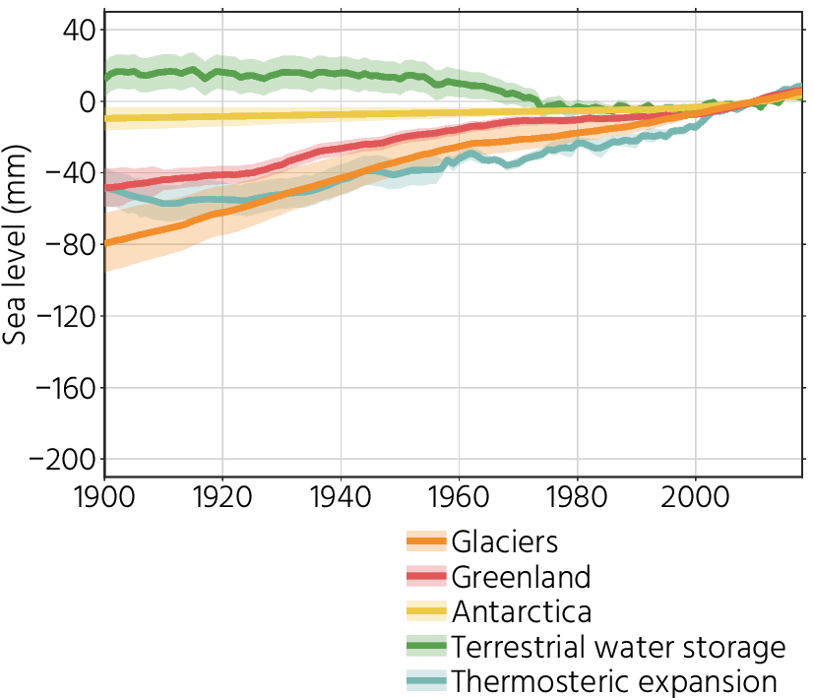
How much has each process contributed?
Ice and terrestrial water storage
Glaciers that disappeared before they were mapped were not counted, causing an underestimation of its contribution before the 1970s
By combining GRACE with estimates of precipitation and temperatures, long-term water storage changes can be reconstructed.
Thermosteric expansion
We only have direct measurements of ocean temperatures since 1960s.
Sea-surface temperature anomalies combined with the ECCO ocean state estimate allow us to estimate thermosteric sea-level rise since 1900

Slide 6
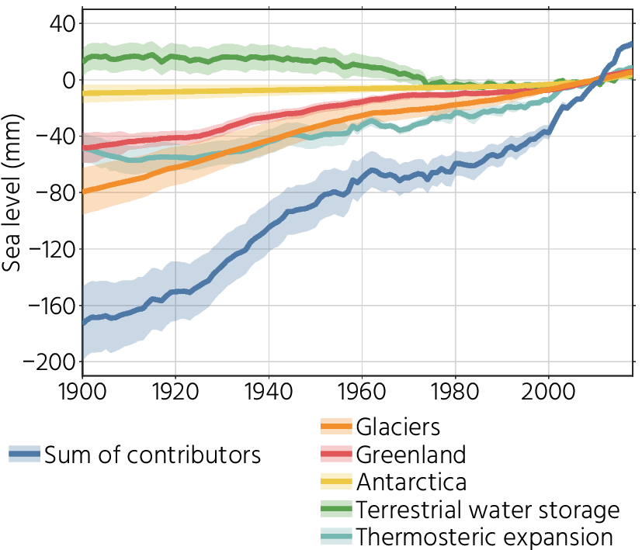
How much has each process contributed?
Taking it all together:
We expect a sea-level rise of about 20 cm since 1900.
Glaciers form the largest contributor, followed by Greenland and thermal expansion
Reservoir impoundment caused a slowdown of sea-level rise in the 1970s

Slide 7
We have to answer two questions:
+
+
=
Question 2
How large was 20th-century sea-level rise?
?

Slide 8
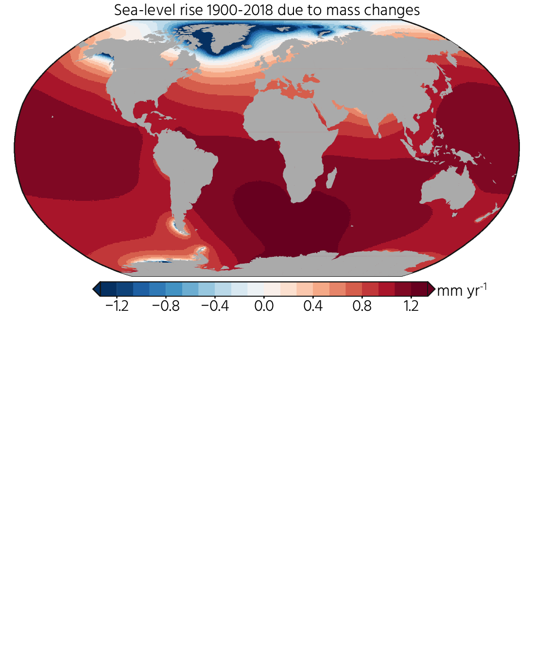
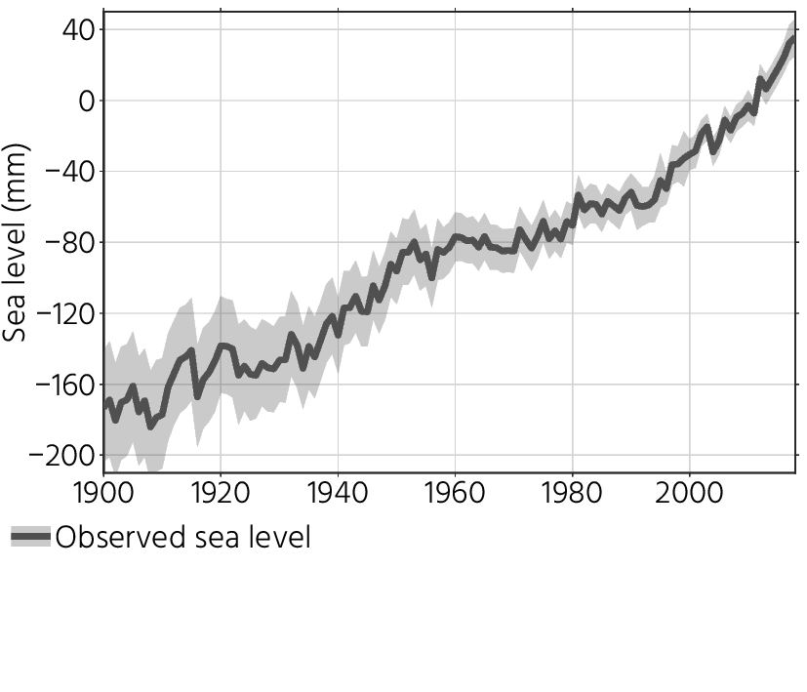
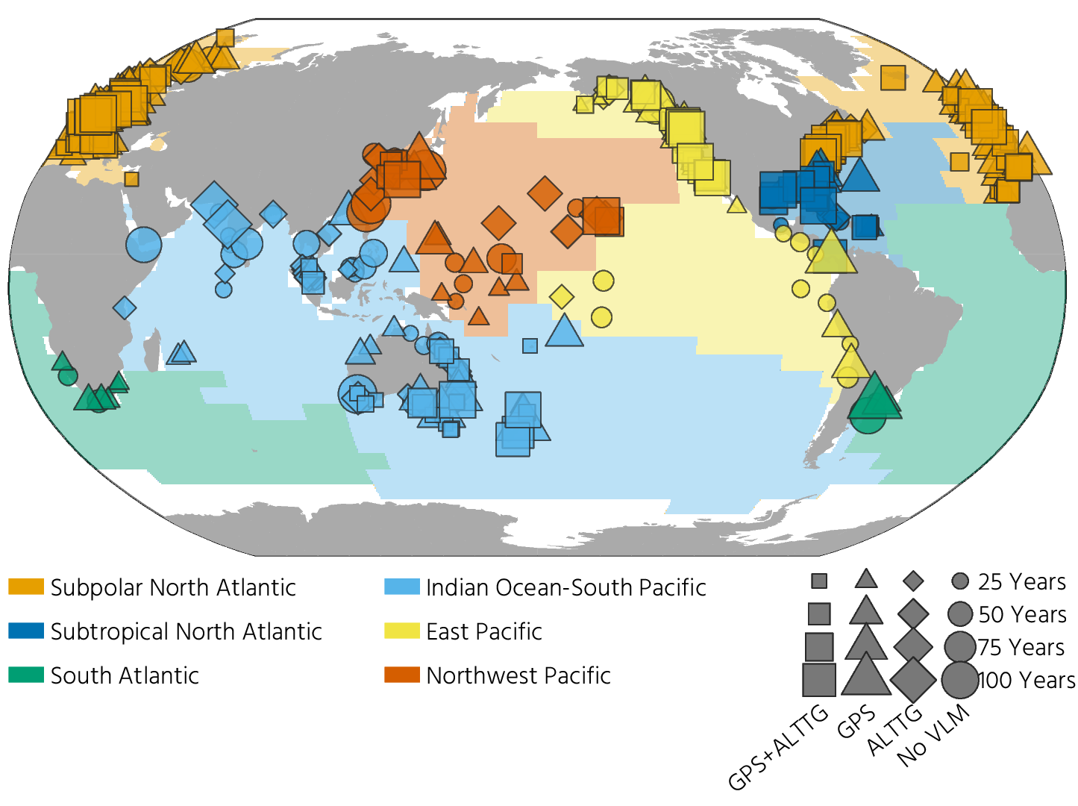
How large was 20th-century sea-level rise?
We only have global measurements since 1993 (TOPEX/Poseidon)
Before that, we have to reconstruct sea-level changes from sparse tide-gauge data. That’s challenging.
But…
Since we now ‘know’ the causes, we can correct for the associated spatial sea-level rise patterns, caused by the changing gravity field, rotation parameters, and shape of the solid Earth
We can use altimetry to find out for which region tide-gauge observations are representative
Thanks to the dense network of permanent GPS stations, we can estimate the vertical movements of the tide-gauge stations
Many data-rescue efforts have led to an increased number of available historic records

Slide 9
We have to answer two questions:
+
+
=
=

Slide 10
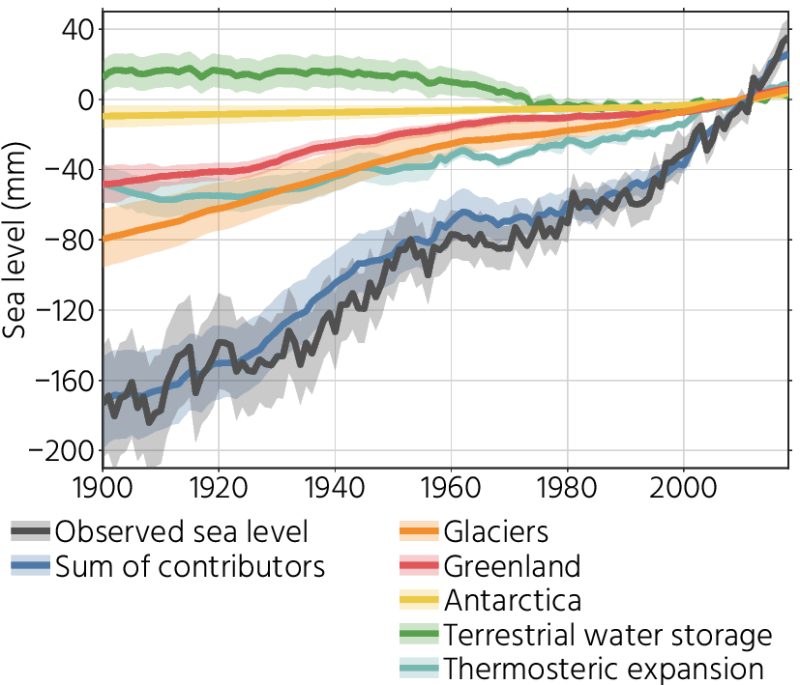
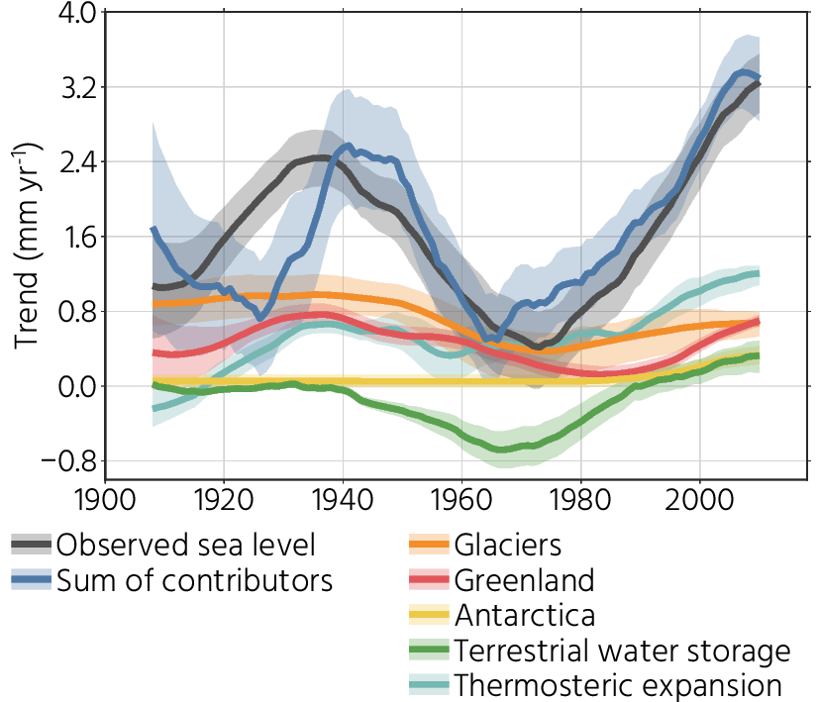
Does it match up?
We can now compare the contributing processes to the observed sea-level changes.
And it matches!
That means we can attribute global sea-level trends and variability to individual processes:
High rates in the ~1930’s due to Greenland and glaciers
Due to dam construction, sea-level rise slowed down in the 1970s
Current rates higher than over the 20th century. This is driven by thermal expansion, Greenland and Antarctica

Slide 11
Take-home messages
The 20th century sea-level budget is closed
That means that the underlying approach of sea-level projections is capable of explaining 20th century changes.
Sea-level rise now goes faster than during the 20th century, which is mostly caused by multiple processes
Glaciers form the largest contributor throughout the 20th century
Reservoir impoundment from dam construction seriously slowed down sea-level rise in the 1970s
Satellite observations are useful tools for determining long-term changes in the Earth system

Slide 12
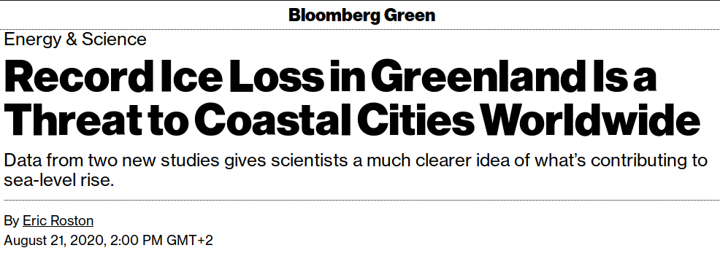
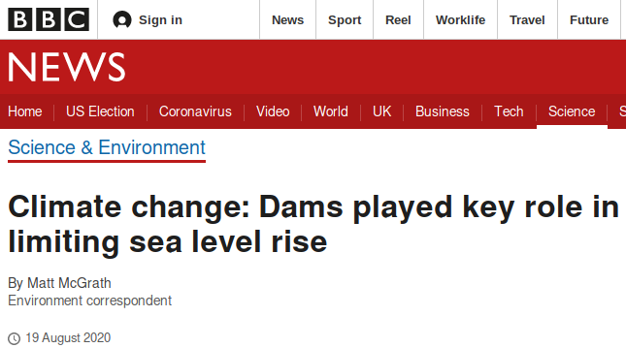
Acknowledgements and resources
Frederikse, Landerer, Caron, Adhikari, Parkes, Humphrey, Dangendorf, Hogarth, Zanna, Cheng, & Wu. (2020). The causes of sea-level rise since 1900. Nature, 584(7821), 393–397. https://doi.org/10.1038/s41586-020-2591-3 (Bold means JPL-affiliated)
Code and data
GitHub Codes and scripts
PO.DAAC Global sea level and its contributors
Zenodo Regional sea-level changes and spatial imprints of the individual components
Questions?
thomas.frederikse@jpl.nasa.gov Don’t hesitate to send me an e-mail!
Media coverage of the study

