Slide 1
Analysis of GRACE-FO LRI based attitude data
SUJATA GOSWAMI, Tamara Bandikova, Samuel P. Francis, Robert E. Spero, Dah-Ning Yuan
Organization: 335A
Advisor: Robert E. Spero (383A)
Postdoc Program: JPL Postdoc

Slide 2
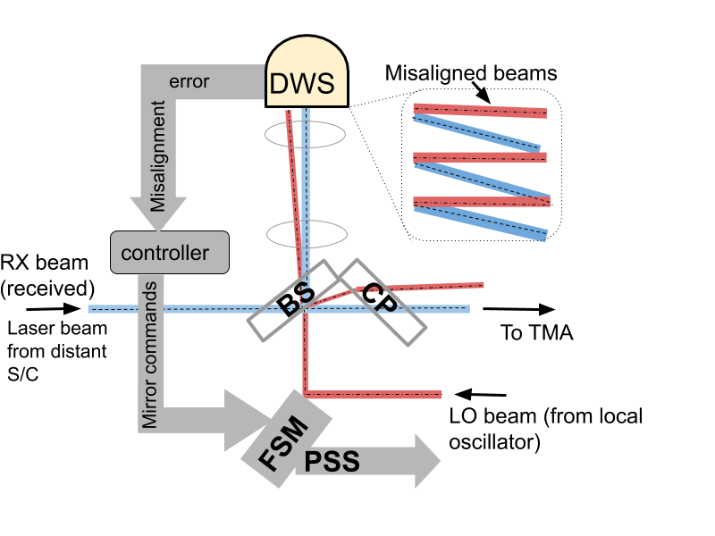
Introduction
(A.) GRACE-Follow On Mission & LRI
GRACE-Follow On (GRACE-FO) was launched on May 22, 2018 to measure the gravity field variations over the Earth
The two spacecrafts measure the gravity field variations using microwave inter-satellite ranging technology
GRACE-FO also carries the Laser Ranging Interferometer (LRI) as technology demonstrator. The LRI provides inter-satellite ranging data with nanometer precision
LRI uses Differential Wavefront Sensing (DWS) technique to minimize the mis-alignment between transmitted and received laser beams
The DWS uses FSM to zero DWS error signal. PSS encoder measures the FSM actuation angles relative to the spacecraft frame (see Fig. on the right explaining the DWS control loop)
These angles are provided as the LSM1B product
Fig. 1. Steering mirror control loop zeroing the DWS signal by rotating the steering mirror such that local (LO) and incoming beam (RX) are co-aligned. FSM: fast steering mirror, DWS: Differential wavefront sensing, BS: beam splitter, CP: compensation plate, TMA: Triple mirror assembly, PSS: Position sensing system.

Slide 3
GRACE-FO attitude datasets
LSM1B LSM1B data: represents the attitude along pitch and yaw axes of the spacecraft No roll information is provided LSM1B data: represents the relative orientation along the line-of-sight | SCA1B GRACE-FO AOCS* uses 3 star cameras (SCA) and a IMU together to determine the attitude of spacecraft The data of 3 SCAs and an IMU is combined in attitude Kalman filter This product is provided as SCA1B data It is used in the gravity field determination SCA1B data: represents attitude along roll, pitch and yaw axes of the spacecraft. It represents absolute orientation of the spacecraft
*AOCS: Attitude and Orbit Control System

Slide 4
Goal of this work
LRI based attitude, LSM1B, is a new dataset
Our aim is to explore the potential of this LRI based new attitude dataset
For this, we explore the answer to questions
How does the LSM1B pointing angles compare against the ones we get from SCA1B data?
If we combine the LRI based information with Star cameras and IMU datasets, how does the new combination would look like?
How would the attitude based on the combination with LRI pointing information impact the precision of the gravity field models?

Slide 5
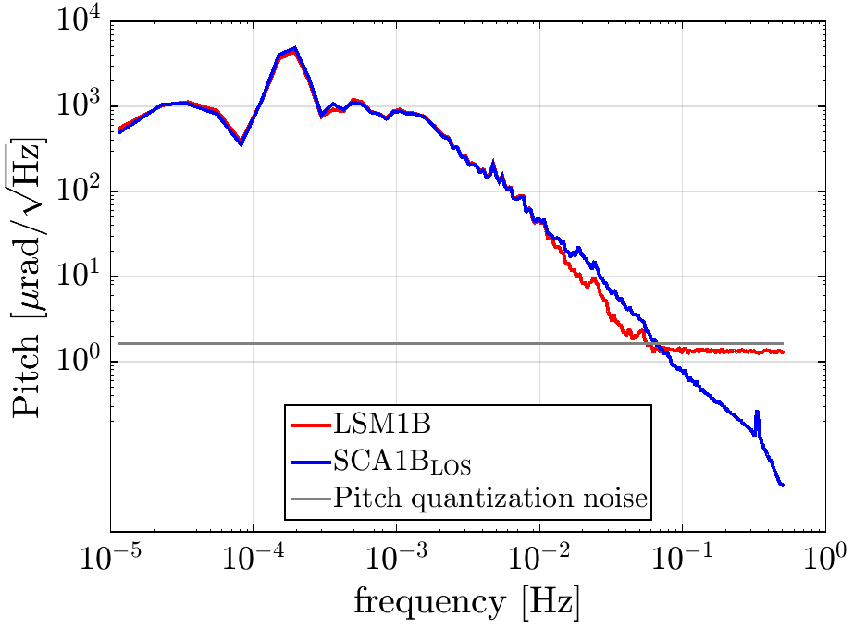
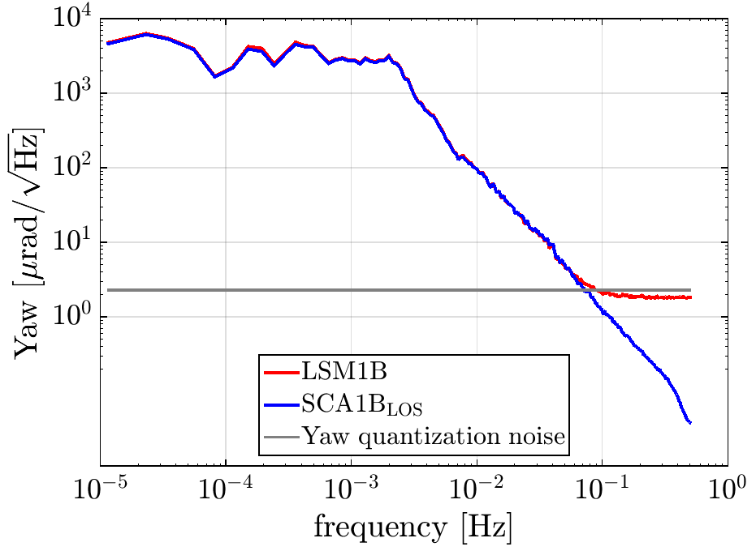
1. Comparison: LSM1B and SCA1B pointing angles
Fig. 2. Amplitude spectral density of the inter-satellite pointing pitch and yaw angles for GF1 on January 01, 2019.
Spectral characteristics are compared after computing the relative orientation from the SCA1B data
We represent the line-of-sight angles derived from SCA1B as SCA1B_{LOS} (see Fig. 2 above)
The LSM1B pitch angles has less high-frequency noise in frequencies 10-70mHz
LSM1B angles are limited by the “quantization noise” in frequencies>70mHz
We expect that combination of LSM data with SCA or SCA and IMU would reduce the noise in pitch angle in frequencies 10-70mHz

Slide 6
2. Combination of LRI based attitude with SCA/SCA&IMU
We combined the fast steering mirror data (LSM) with
Three Star cameras (SCA+LSM)
Three Star cameras and IMU (SCA+LSM+IMU)
in an attitude Kalman filter
In order to assess the quality of newly combined attitude solutions, we compare the pointing angles with the existing attitude datasets, that is, with the LSM1B angles and SCA+IMU (SCA1B_LOS) attitude solution

Slide 7
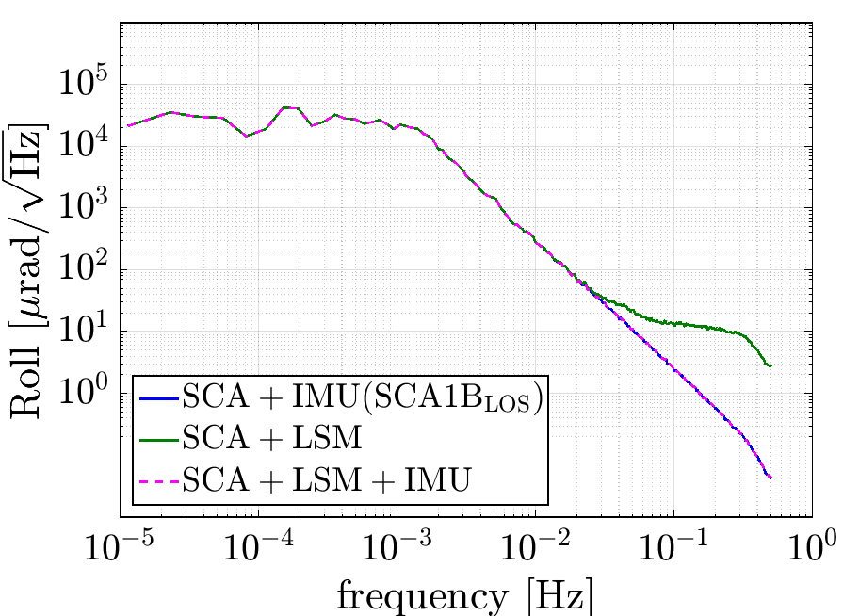
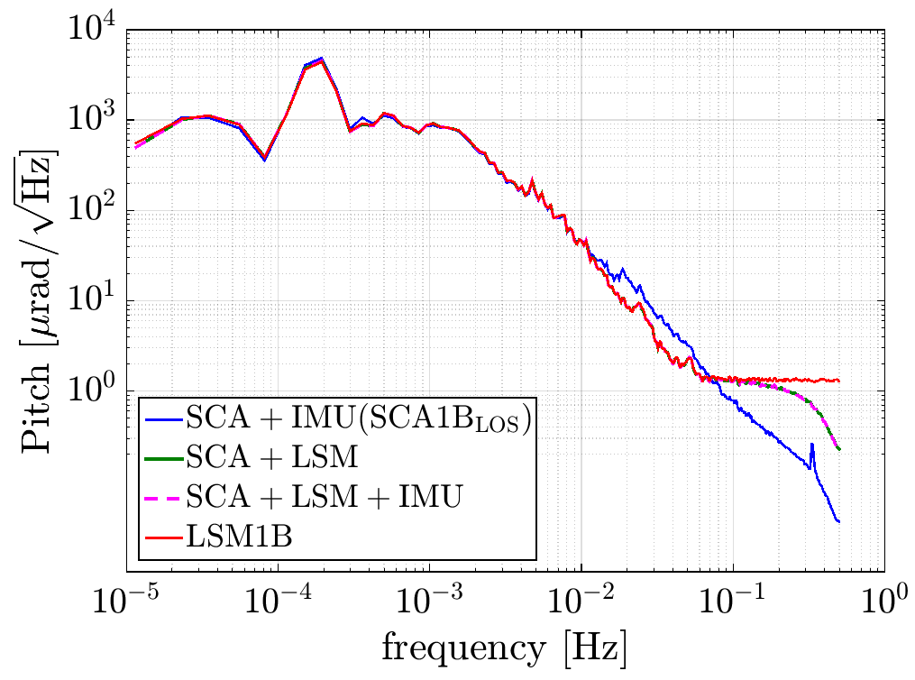
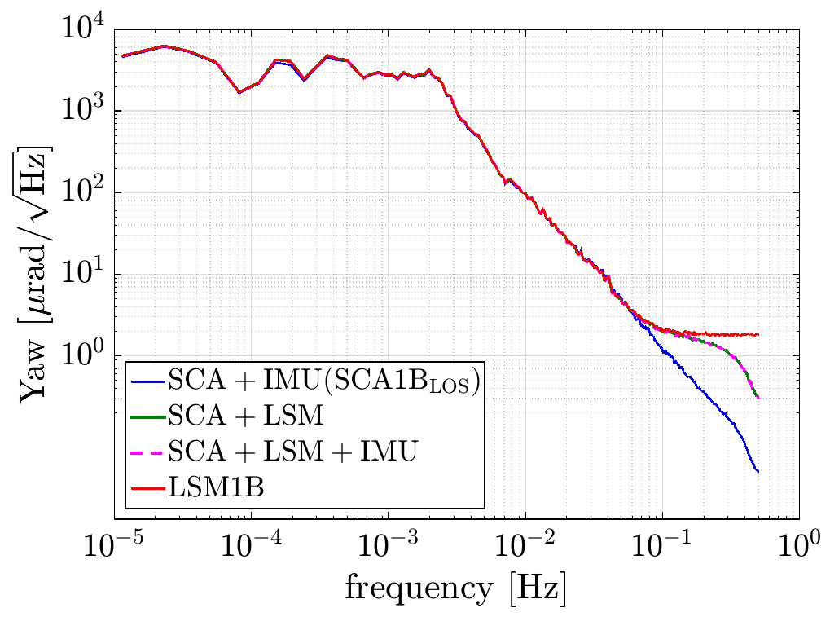
2. Assessment of attitude based on fused LRI
Roll
Pitch
Yaw
Fig.3. Comparison of inter-satellite pointing roll, pitch and yaw angles for GF1 on January 01, 2019.
High-frequency noise in (SCA+LSM+IMU) roll angles is minimized by the IMU contribution. Since LRI based attitude does not provide information about roll, its contribution is negligible which is visible in (SCA+LSM) attitude roll angles
(SCA+LSM+IMU) and (SCA+LSM) pitch contain less noise in frequencies ~10-70mHz as opposed to SCA+IMU (SCA1B) attitude data
In frequencies>70mHz, due to the quantization noise in LSM1B angles, their combination with other datasets also has limited precision as opposed to SCA+IMU attitude data

Slide 8
3. Impact on gravity field
A: SCA+IMU (SCA1B)
B: SCA+LSM
C: SCA+LSM+IMU
Differences
Fig. 4. Comparison of gravity field solutions derived from the SCA+IMU, SCA+LSM and SCA+LSM+IMU based solutions for the month of January 2019. No significant impact is visible on the gravity field solutions.
A-B
A-C
… continued

Slide 9
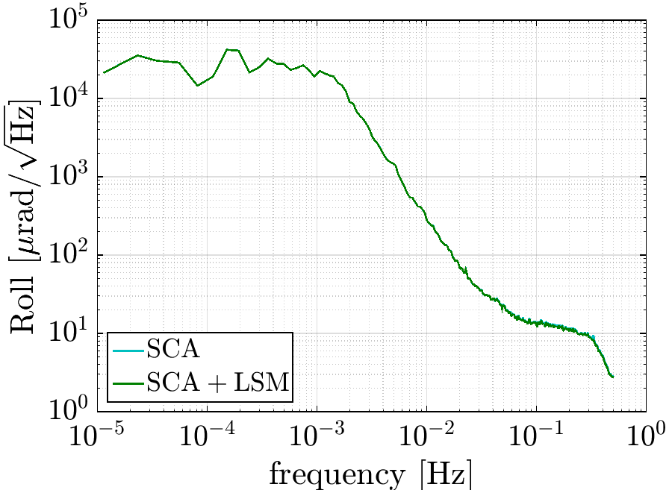
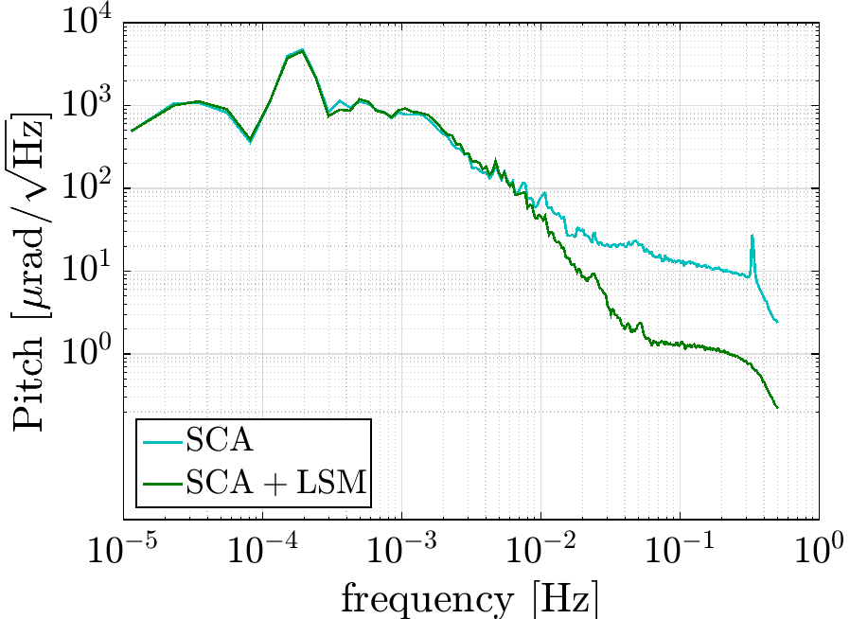
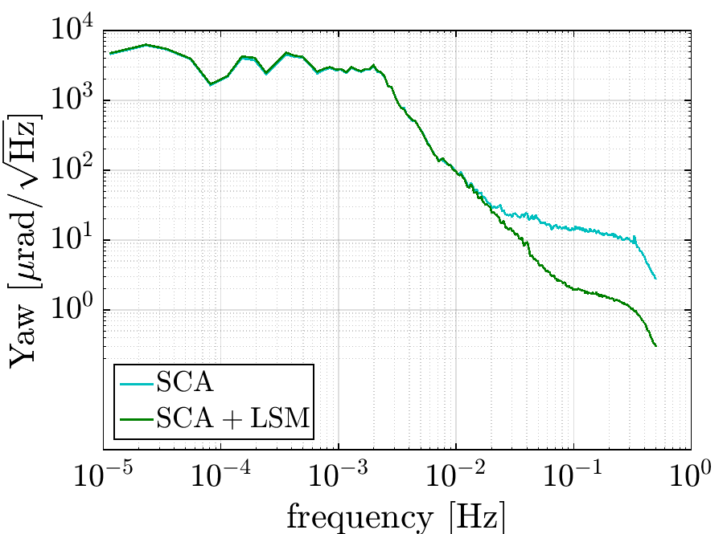
Conclusions and future steps
We have successfully implemented the LRI based data fusion in the Kalman filter
The new combined product improves the precision of pitch angles in frequencies between 10-70 mHz
SCA+IMU (SCA1B), SCA+LSM and SCA+LSM+IMU based gravity field solutions are equivalently precise
What happens when there is no IMU?
Roll
Pitch
Yaw
As above Fig. shows the pitch and yaw angles have significantly less high-frequency noise when combined with LSM data
The SCA+LSM based attitude can be of significance in circumstances when there is no IMU data available
Future step: There still remains the work to fine-tune the Kalman filter to further reduce high-frequency noise in SCA+LSM+IMU based attitude solution

Slide 10
Publications and Acknowledgements
Sujata Goswami, Tamara Bandikova, Samuel P. Francis, Robert E.Spero,​ ​GRACE-FO laser steering mirror data analysis, GRACE/GRACE-FO Science team Meeting, 08-10 Oct. 2019, Pasadena, US.
Sujata Goswami, Tamara Bandikova, Samuel P.Francis, Robert E.Spero,​ ​GRACE-FO laser steering mirror data analysis, AGU, 08-12 Dec. 2019, San Francisco, US.
Sujata Goswami, Tamara Bandikova, Dah-Ning Yuan, Samuel P.Francis, Robert E.Spero, Results of fusion of LRI based attitude data in the attitude Kalman filter, GRACE/GRACE-FO Science team Meeting, 26-29 Oct. 2020, GFZ, Potsdam, Berlin, Germany.
Sujata Goswami, Tamara Bandikova, Samuel P. Francis, Robert E. Spero, GRACE-FO laser steering mirror data analysis (in preparation).
Sujata Goswami et al. Fusion of LRI based attitude data in attitude Kalman filter (in prep.).

