Slide 1

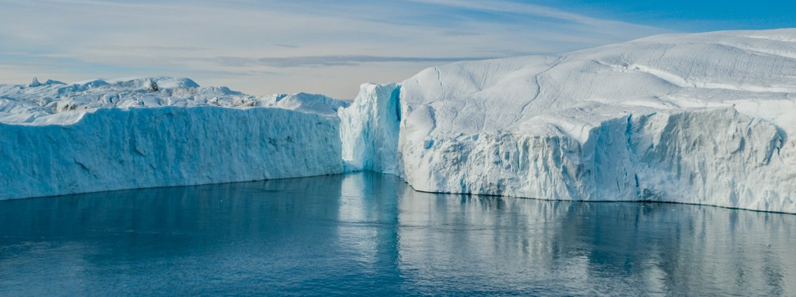

Towards robust sea-level rise projections:
Constraining the impact of basal friction in ice sheets using a Bayesian
approach to data assimilation
2020 Postdoc Research Day Presentation Conference
Kevin Bulthuis
Organization: 329C
Advisor: Eric Larour (329C)
Postdoc Program: NPP
@Copyright 2020. California Institute of Technology

Slide 2
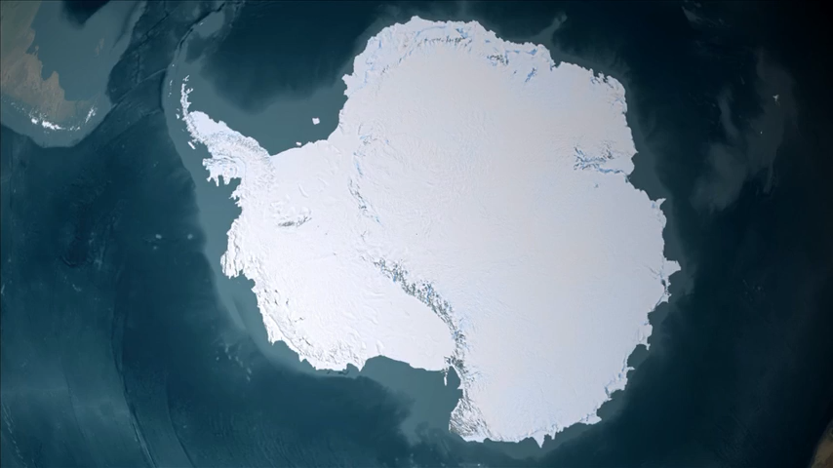
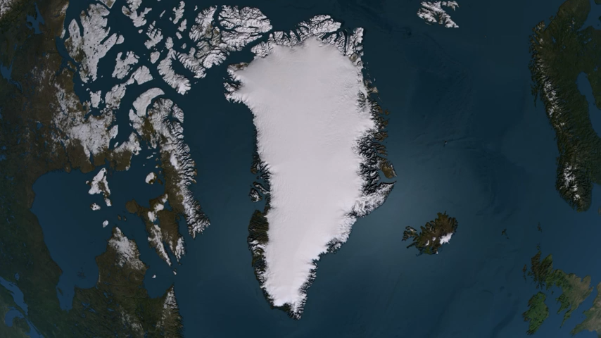
Introduction
Abstract
Predicting the future retreat of large ice sheets and their contribution to sea level rise is recognized as a source of deep uncertainty in assessing climate-change consequences (IPCC, 2019). Recently, efforts have shifted towards providing ice-sheet projections with quantified uncertainty. The dynamics of large ice sheets is mostly controlled by the motion of fast-flowing ice streams. The rate at which ice is discharged from the interior of the ice sheet to the ocean is controlled by basal resistance at the glacier-bedrock interface of these ice streams. However little is known about the basal conditions at the glacier-bedrock interface, which limits the ability of numerical ice-sheet models to provide accurate and robust projections. A large amount of data has been collected in the recent years about the state of ice sheets through ice cores, radar measurements, and gravity-field measurements. This provides new opportunities to better understand and constrain basal friction in ice-sheet models through data assimilation methods. In this presentation, we introduce a Bayesian approach to data assimilation to constrain with quantified uncertainty the basal friction coefficient used in friction laws in glaciology. We show how this approach can be used to provide new robust probabilistic ice-sheet projections and we show a few preliminary results.
[Source: Nasa]

Slide 3
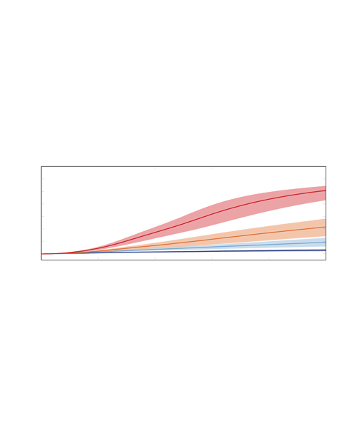
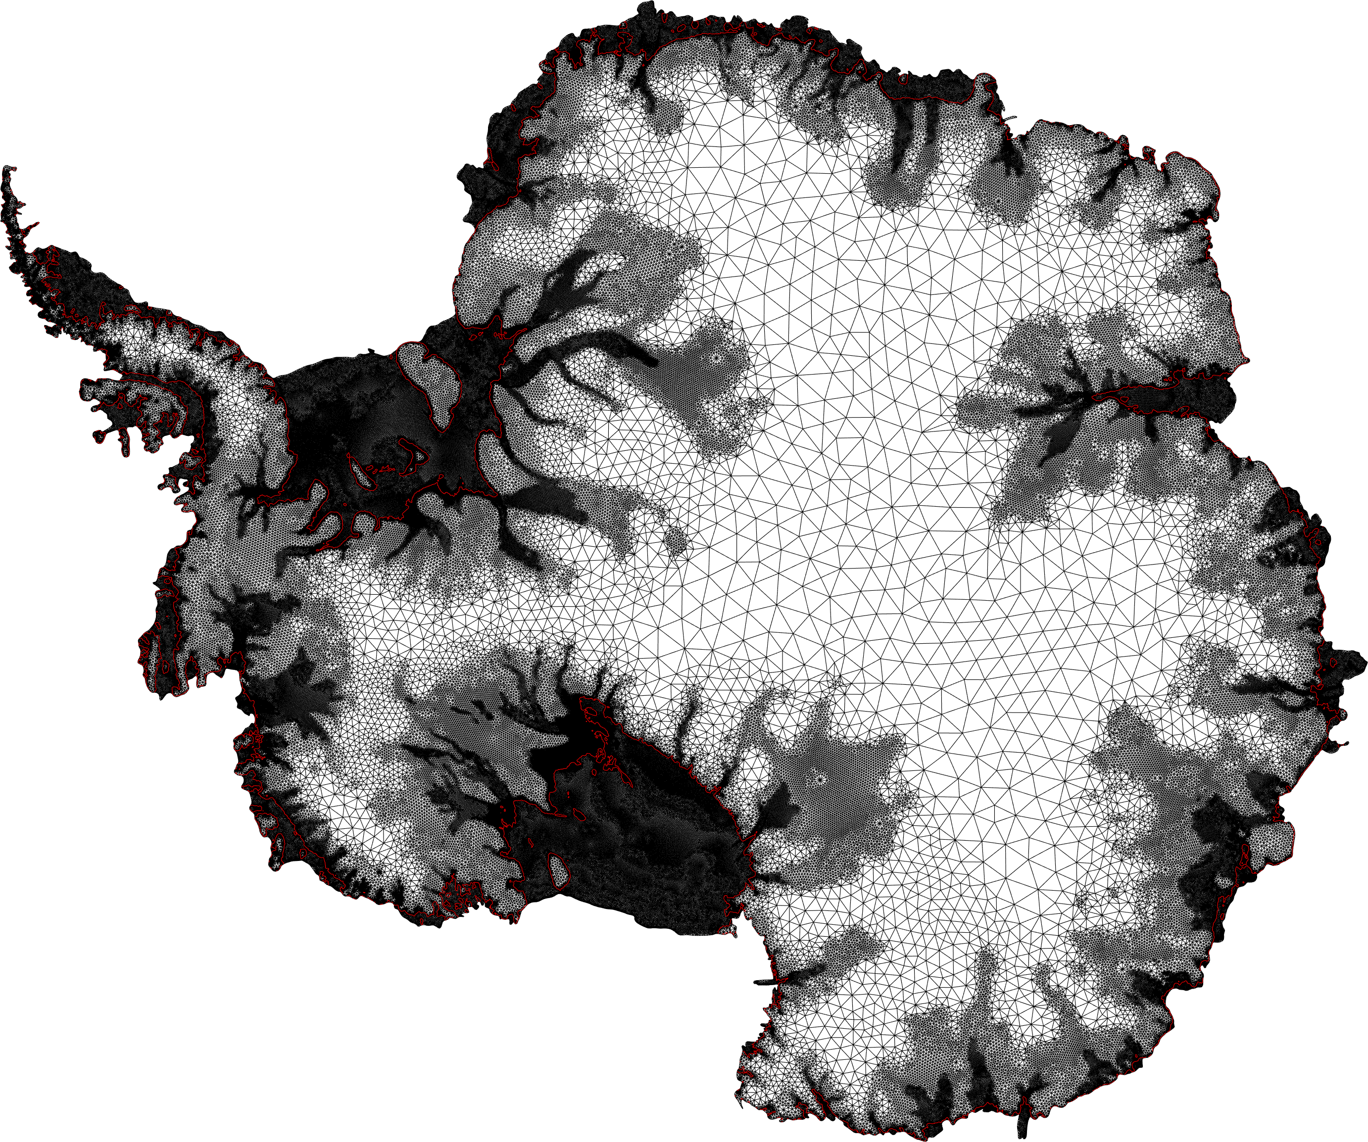
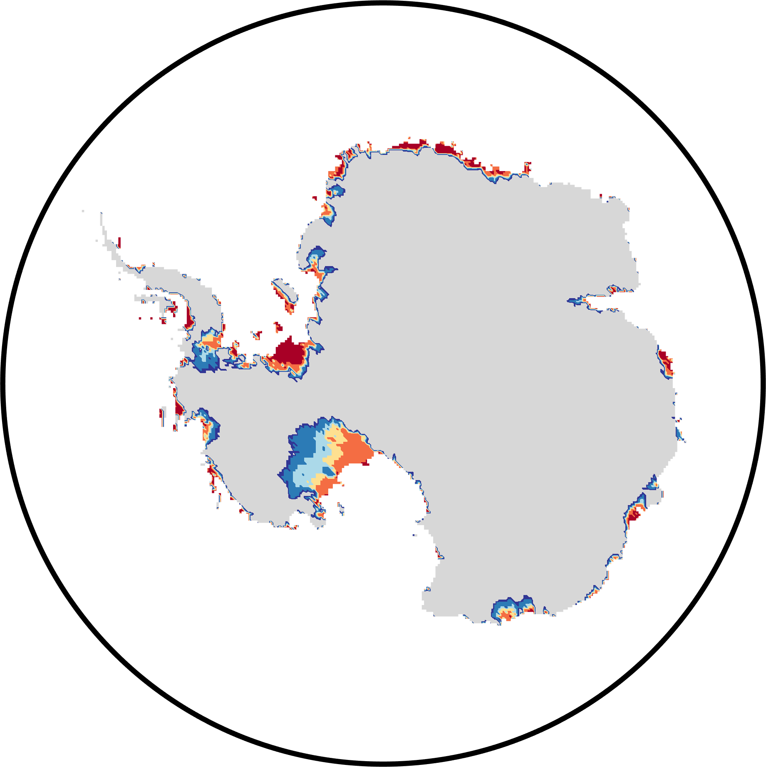
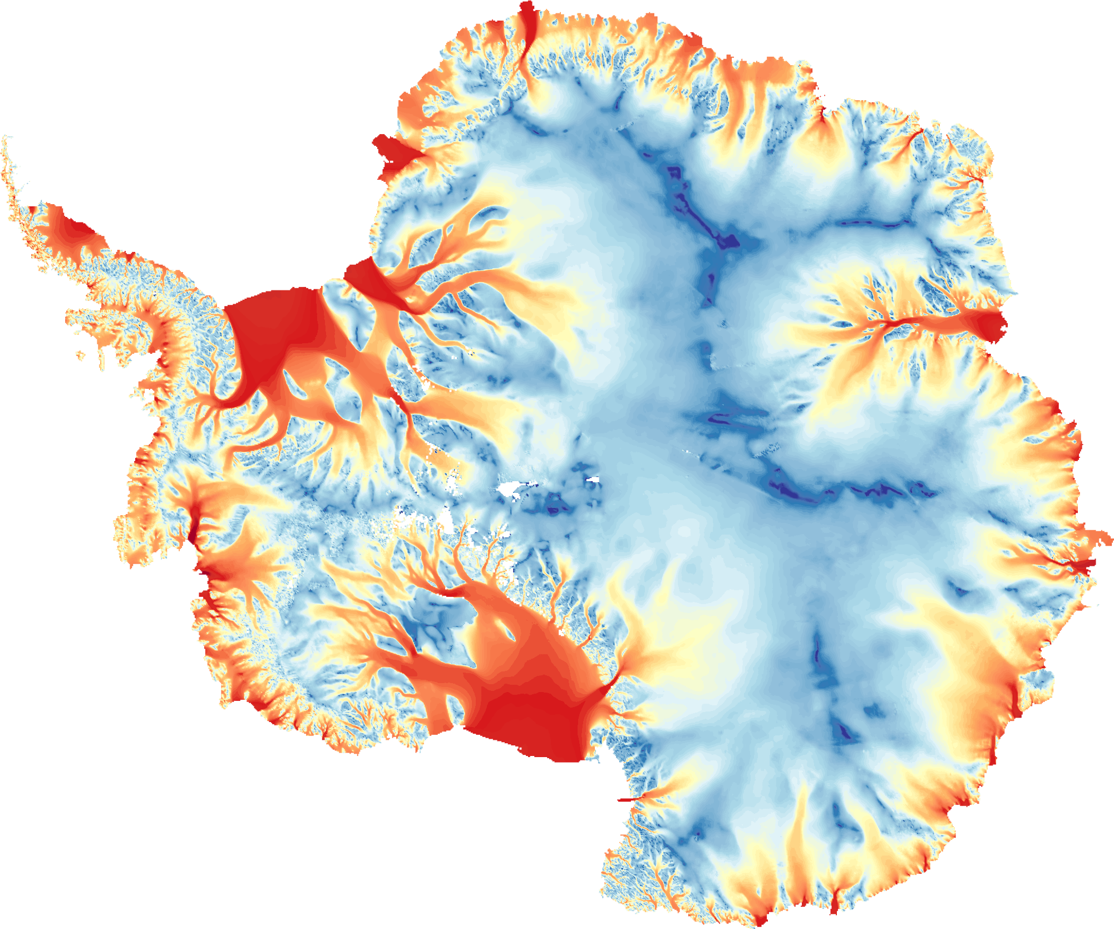

Problem Description
Characterization of uncertainty
Ice-sheet model
Probabilistic (sea- level) projections
Data assimilation
Measurements
[Bulthuis, 2019]
[Rignot, 2011]

Slide 4
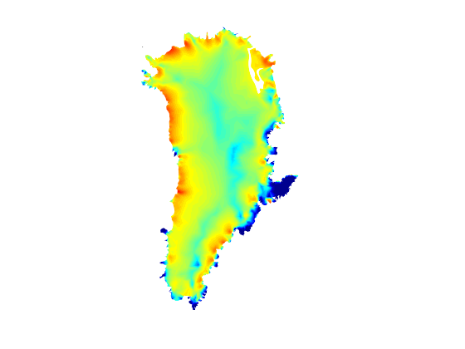
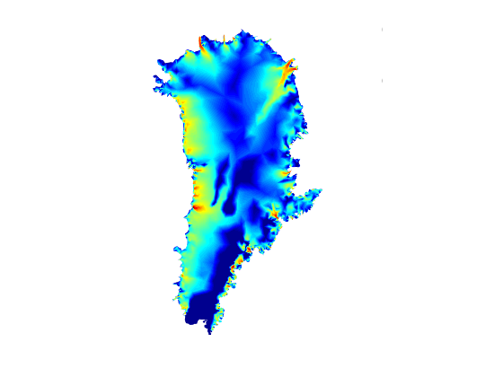
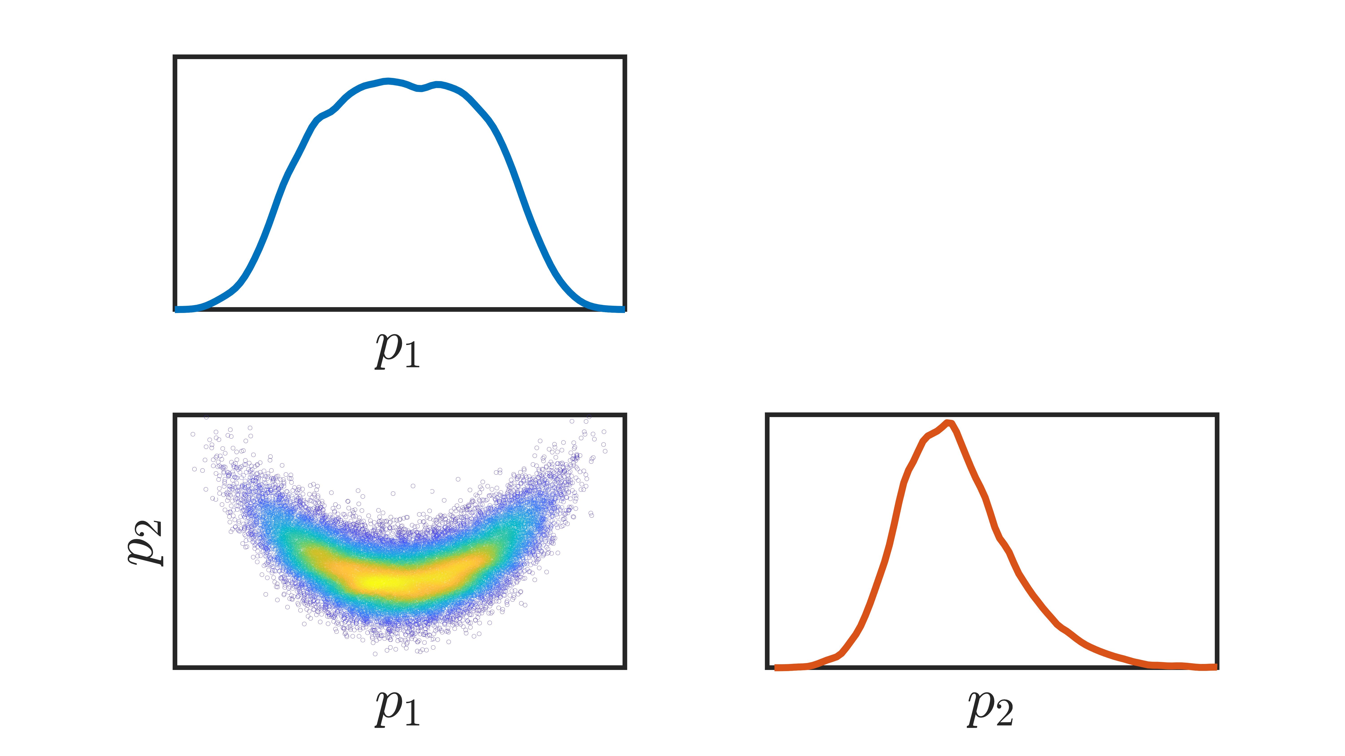
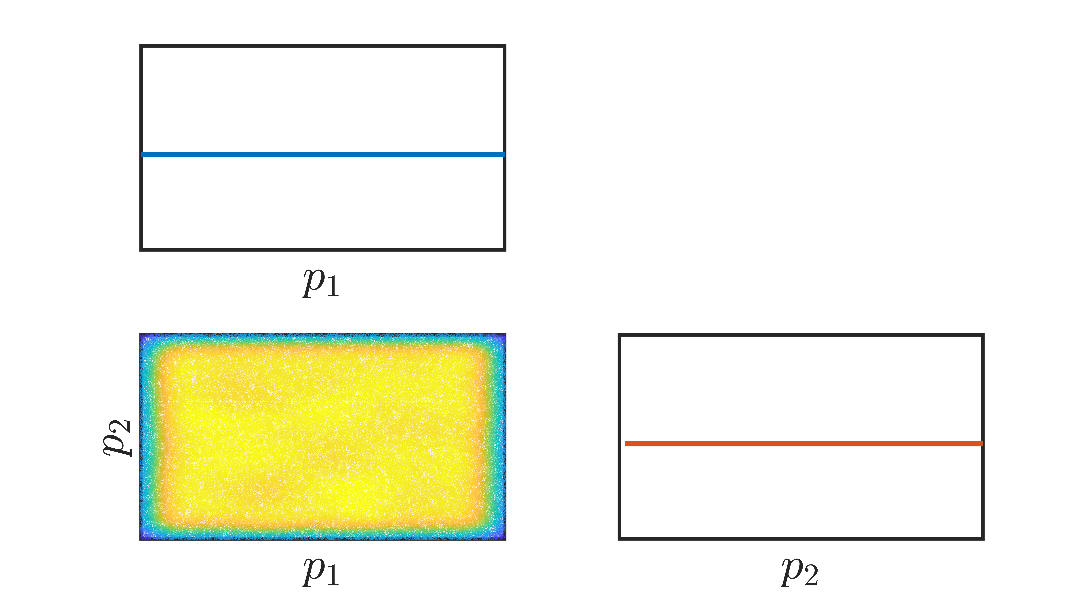


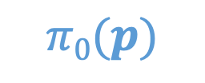
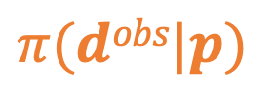
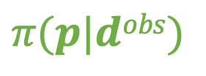
Methodology: Bayesian inference
$$π(p|dobs)$$
$$∝$$
$$π(dobs|p)$$
$$×$$
$$π0(p)$$
Posterior distribution
Likelihood function
Prior distribution
Quantify the belief about the parameters after conditioning on existing data
Quantify the misfit between the predictions and the data
Quantify our belief about the parameters before data are taken into account
Observed velocity
Predicted velocity

Slide 5
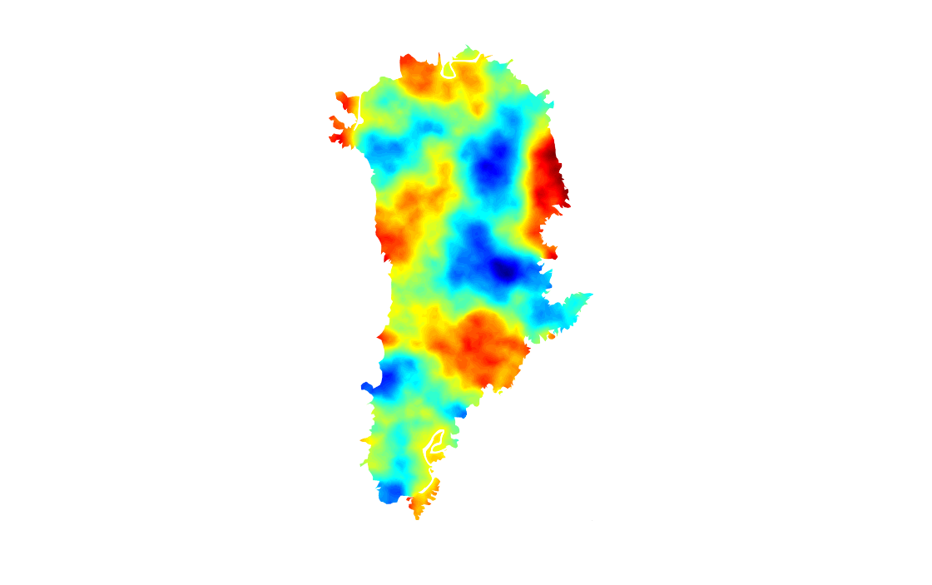
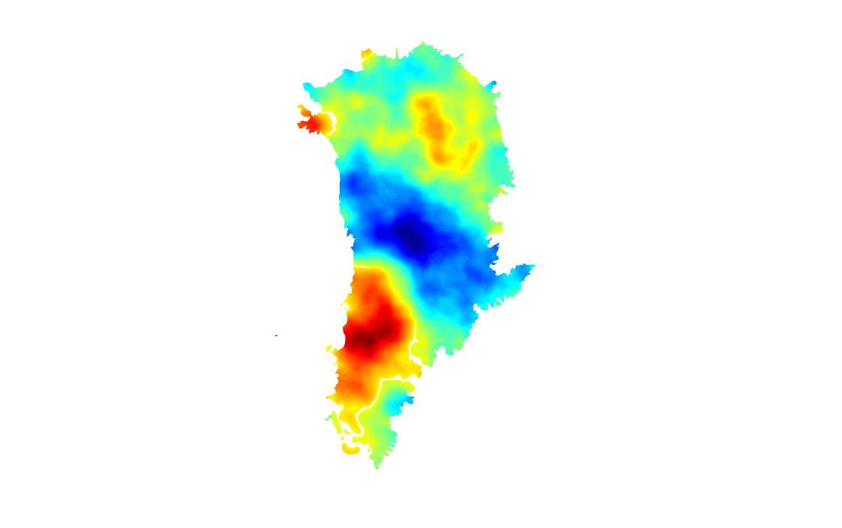
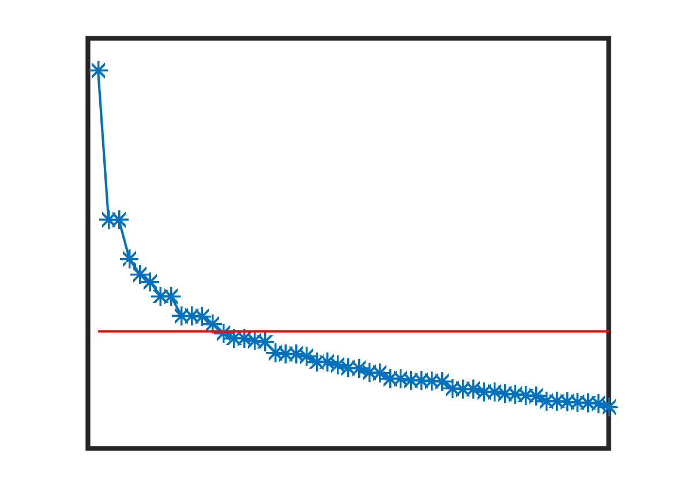
Methodology: Practical considerations
Prior sample 1
Prior sample 2
Inverting for the basal friction coefficient in ice-sheet models leads to a Bayesian inference problem in infinite dimension [Stuart, 2010]:
The prior distribution must be chosen to guarantee the well-posedness of the problem:
.Sampling from the posterior distribution can be computationally expensive with t.MCMC methods:
Here we represent the prior distribution as a Gaussian distribution with Whittle-Matérn covariance function, expressed as the inverse of a differential operator [Lindgren et al., 2011].
Typical decay of Hessian eigenvalues
Here we plan to approximate the posterior distribution as a Gaussian distribution whose mean is the maximum a posteriori (MAP) point and covariance function the Hessian of the negative log-posterior about the MAP point [Petra et al., 2014; Isaac et al., 2015].
The MAP point is determined by solving an optimization problem in infinite dimension. The Hessian is generally characterized by a few large eigenvalues corresponding to the eigenvectors that are informed by the data.
T. Isaac et al., Scalable and efficient algorithms for the propagation of uncertainty from data through inference to prediction to large-scale problems, with application to flow of the Antarctic ice sheet, J. Comput. Phys. (2015).
F. Lindgren et al., An explicit link between Gaussian fields and Gaussian Markov random fields: the stochastic partial differential equation approach, J. R. Statis. Soc. B. (2011).
N. Petra et al., Computational framework for infinite dimensional Bayesian inverse problems, Part II: Stochastic Newton MCMC with Application to ice sheet flow inverse problems, SIAM. J. Sci. Comput. (2014).
A.M. Stuart, Inverse problems: a Bayesian perspective, Acta Numer. (2010).

Slide 6
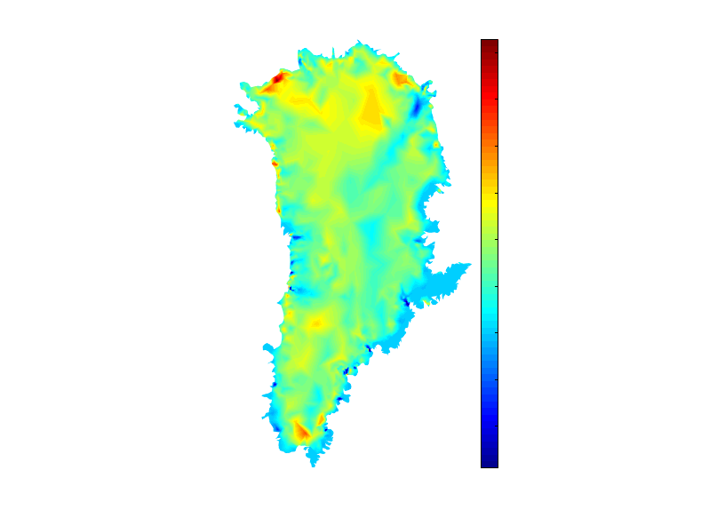
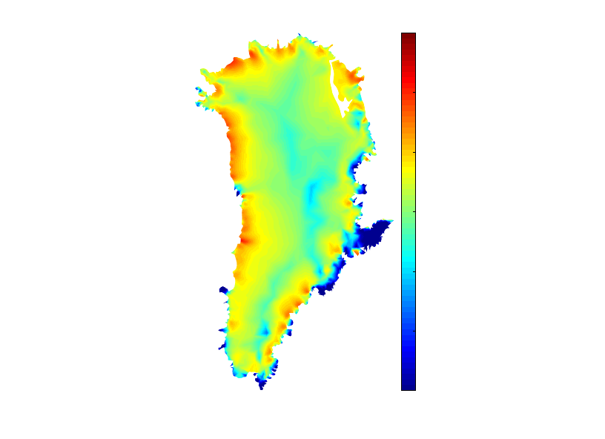
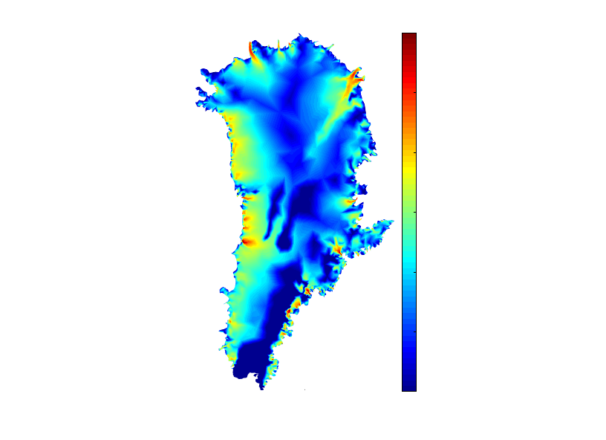
Results
Preliminary results:
Next steps:
- The proposed methodology is first being validated on test cases in glaciology.
- First results have been obtained for the inversion of the basal friction coefficient in Greenland.
MAP point
Velocity at MAP point
Observed velocity
90
4000
4000
40
290
290
10
(s/m)^{1/2}
m/yr
1.5
m/yr
1.5
- Short-term goal: Carry out the complete Bayesian inversion for the Greenland and Antarctic ice sheets.
- Medium/Long-term goal: Propagate the uncertainty in the basal friction coefficient through ISSM and aquantify its impact on ice-sheet projections.

