Slide 1
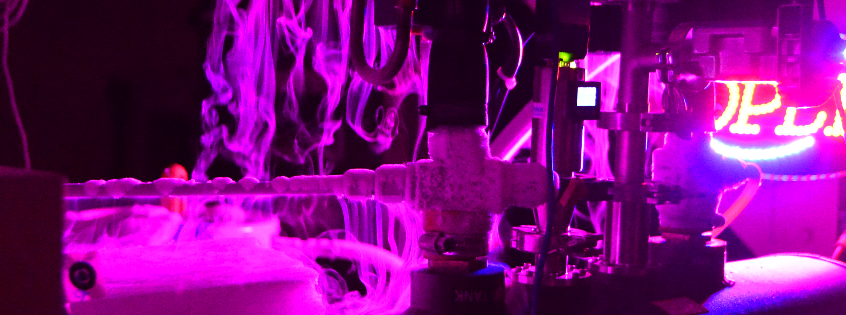

Commissioning Work on the Palomar Radial Velocity Instrument
2020 Postdoc Research Day Presentation Conference
Chris Matthews
Organization: 3262
Advisor: Gautam Vasisht (3262)
Postdoc Program: JPL

Slide 2
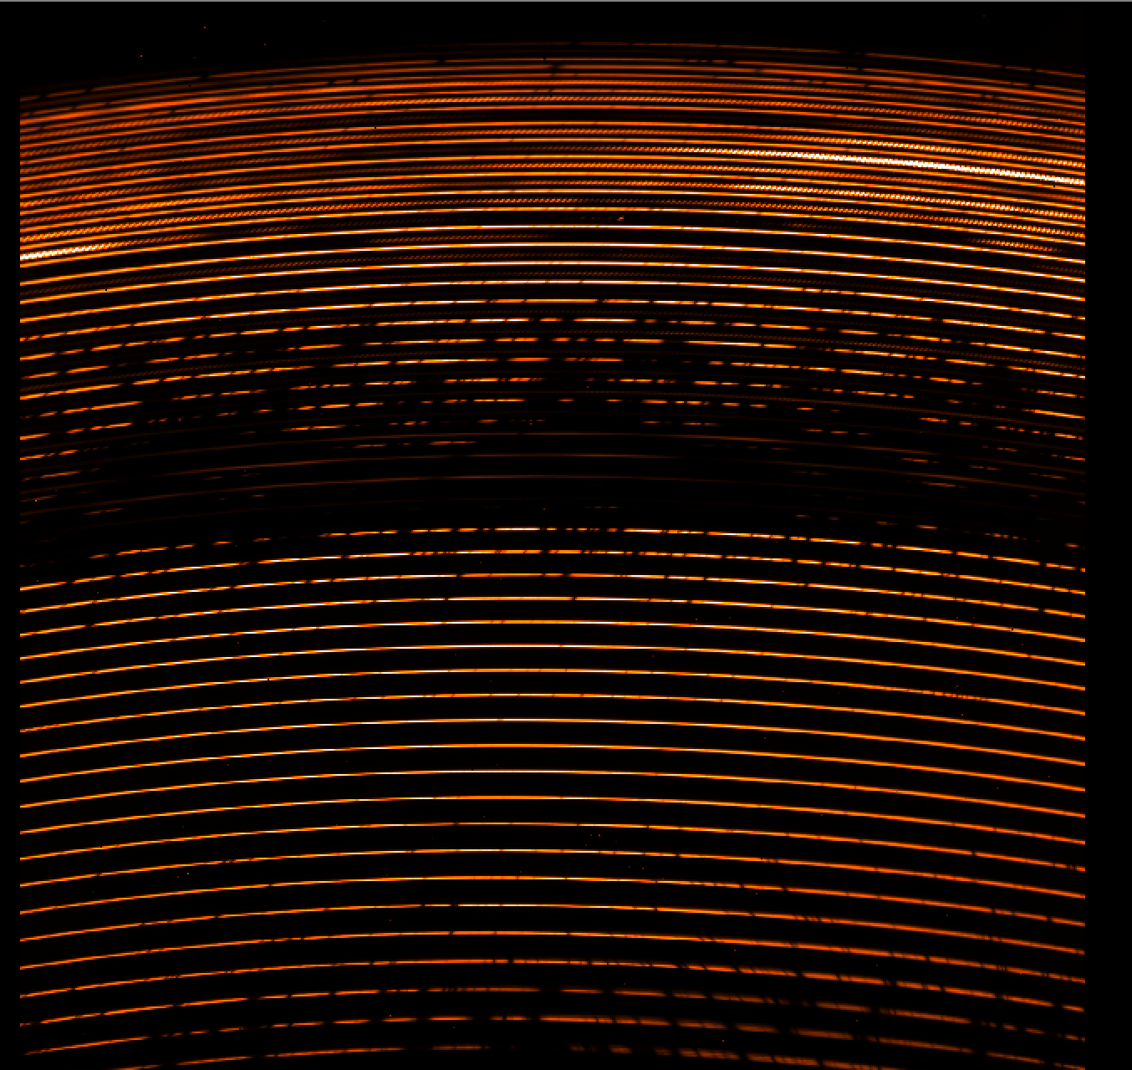
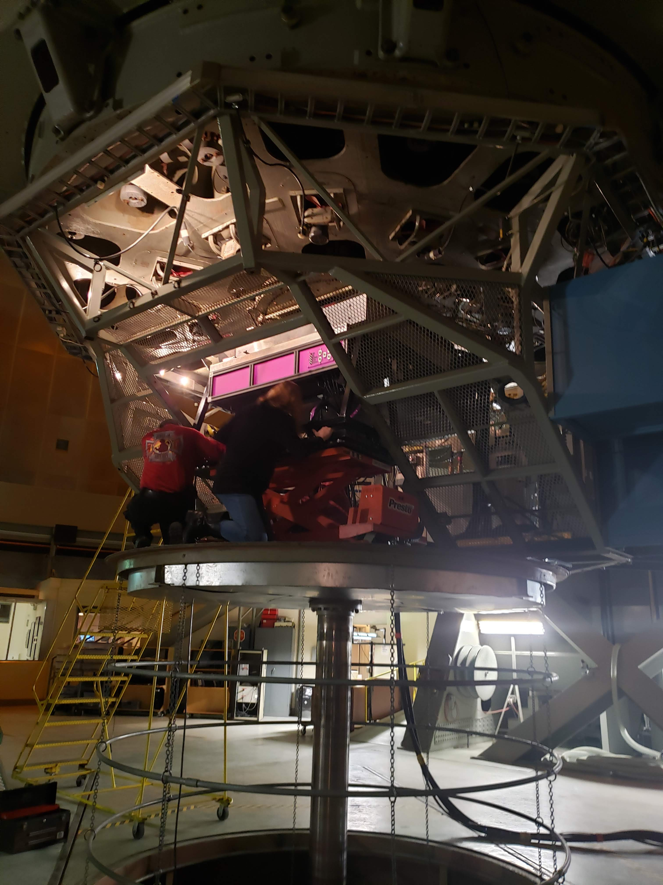
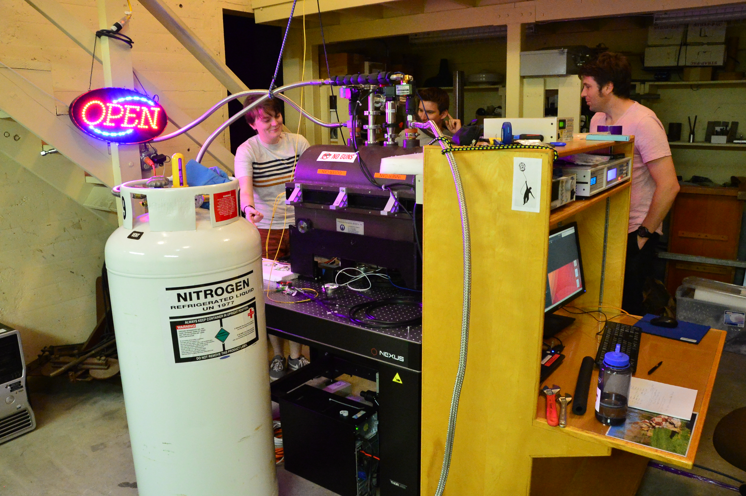
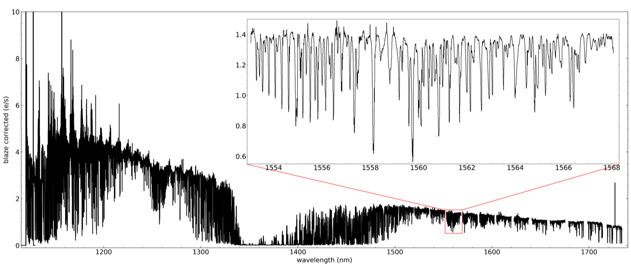
Introduction
Parvi FIU being mounted on P3K
Parvi spectrograph installed at Palomar
First Light Eschellogram and Extracted Spectra of Arcturus
Abstract
The Palomar Radial Velocity Instrument (PARVI) makes use of the 200” Hale Telescope and PALM3000 (P3K) adaptive optics system to provide precision radial velocity (RV) measurements in order to identify and characterize exoplanets. PARVI was deployed at Palomar in June of 2019, and commissioning is ongoing. My work has focused on the Fiber Injection Unit (FIU) which interfaces with P3K and couples the science light into a 9.8 μm single-mode fiber running ~100m to the compact precision spectrograph located in the lower level of the observatory. By improving the performance of the FIU we increase the number of targets we can study with our R~100,000 near-IR (1.2 – 1.8 μm) spectrograph.

Slide 3
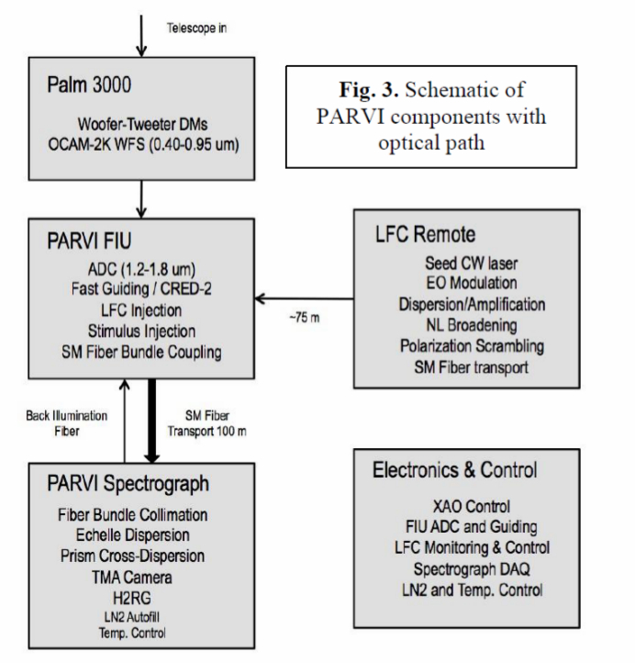
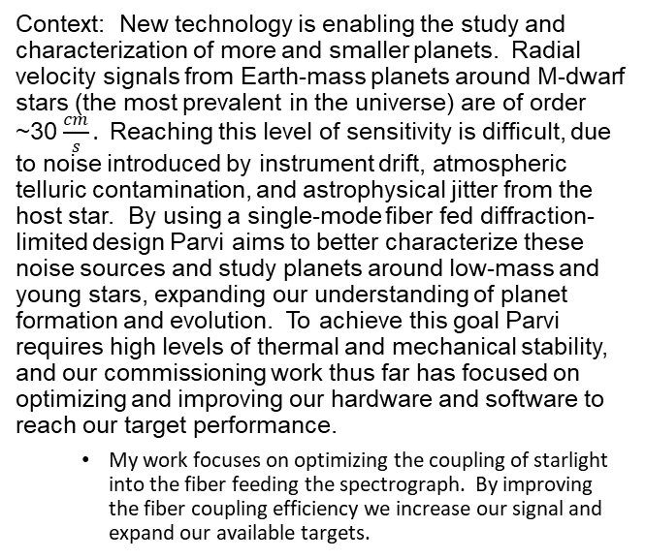
Problem Description
Context: New technology is enabling the study and characterization of more and smaller planets. Radial velocity signals from Earth-mass planets around M-dwarf stars (the most prevalent in the universe) are of order ~30 $\frac{cm}{s}.$ Reaching this level of sensitivity is difficult, due to noise introduced by instrument drift, atmospheric telluric contamination, and astrophysical jitter from the host star. By using a single-mode fiber fed diffraction-limited design Parvi aims to better characterize these noise sources and study planets around low-mass and young stars, expanding our understanding of planet formation and evolution. To achieve this goal Parvi requires high levels of thermal and mechanical stability, and our commissioning work thus far has focused on optimizing and improving our hardware and software to reach our target performance.
  My work focuses on optimizing the coupling of starlight into the fiber feeding the spectrograph. By improving the fiber coupling efficiency we increase our signal and expand our available targets.
Schematic of Parvi Sub-systems
Figure Credit: Vasisht et al 2020 (in prep)

Slide 4
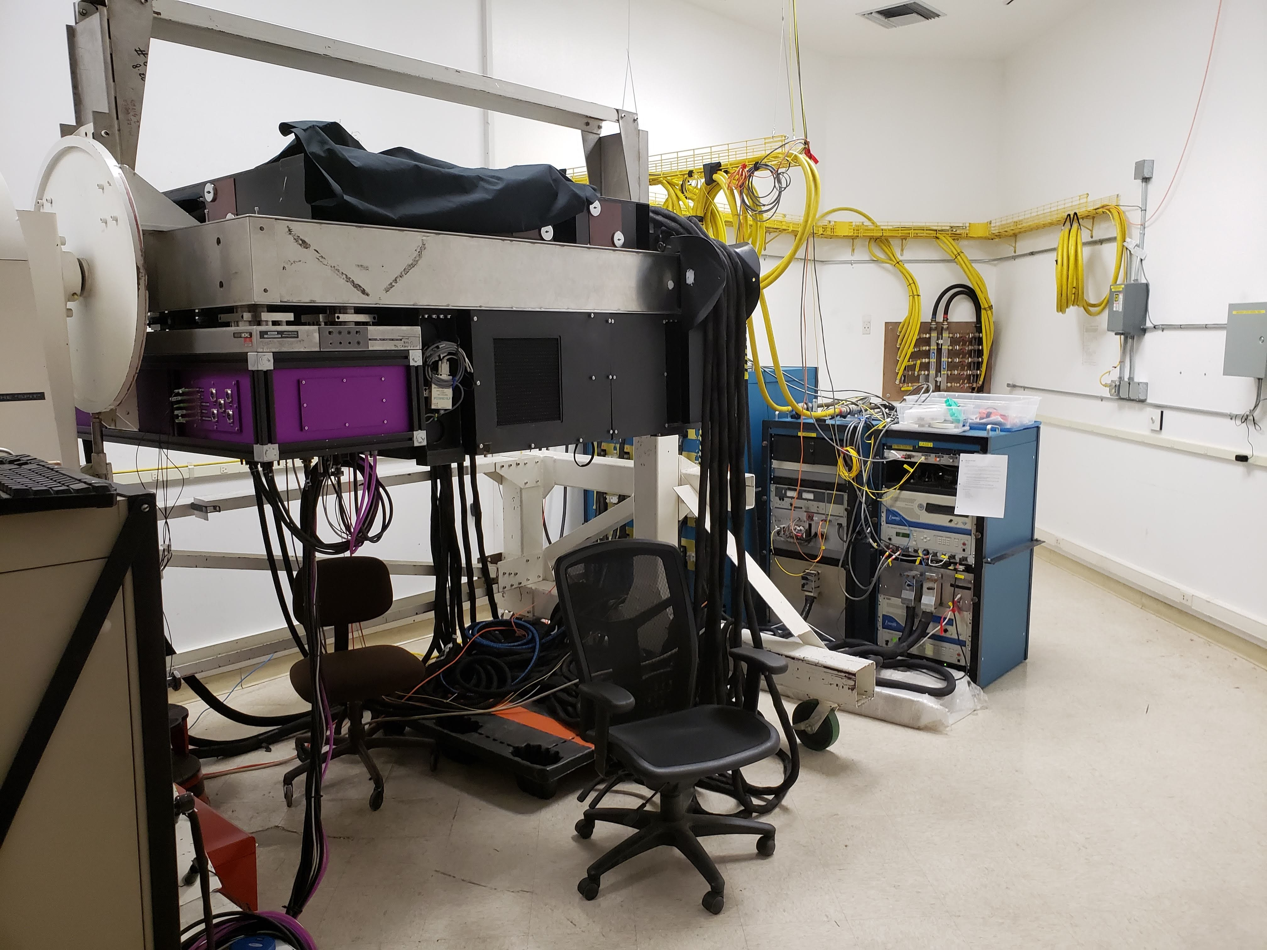
Methodology
Our efforts to improve the efficiency of the Fiber Injection Unit have focused on hardware improvements to simplify and speed up alignment, software improvements to the guide loop which keeps starlight on the spectrograph fiber, and better integration and logging of data from all subsystems.
  We have repaired a condensation issue with our First Light CRED2 guide camera which interfered with early observing runs
  We have upgraded several of our optics to ease alignment
  We have upgraded our existing control software
  We are in the process of integrating our FIU control software into our overall instrument monitoring and control software
  I have designed ADC prisms for the FIU bench. They have been manufactured and coated, and are awaiting integration and calibration at Palomar
Parvi FIU mounted on P3K in the Palomar AO Lab

Slide 5
Results
The Covid-19 situation has naturally delayed our commissioning. We have already made several improvements to our FIU, spectrograph, and Laser Frequency Comb; we have several other upgrades planned pending more access to the instrument and observatory.
Significance: Parvi is designed to provide high-precision, well calibrated RV observations over long time baselines. This is made possible by the compact, mechanically and thermally stable design. Once commissioning is complete Parvi will provide new insights into planet formation and evolution, particularly around low-mass and young stars.
Next steps: We are currently planning for our return to the telescope either late this year or early next year once procedures for safely installing and operating P3K and Parvi have been finalized. We have a number of major improvement to the instrument awaiting integration and testing, and we look forward to completing our commissioning and beginning our science observations.

Slide 6
Publications and Acknowledgements
Rose K. Gibson, Rebecca Oppenheimer, Matthews, Christopher T., and Gautam Vasisht. “Characterization of the C-RED 2: a high-frame rate near-infrared camera”. Journal of Astronomical Telescopes, Instruments, and Systems, 6:011002, January 2020.
G. Vasisht, C. Beichman, R. Oppenheimer, S. Leifer, C. Matthews, C. Paine, S. Meeker, R. Gibson, J. Fucik, D. Mawet, B. Sean, “Design and Initial Operation of the Palomar Radial Velocity Instrument (PARVI), in prep
I would like to acknowledge my advisor at JPL, Dr. Gautam Vasisht, the entire PARVI Science team, and the wonderful staff at Palomar Observatory

