Slide 1
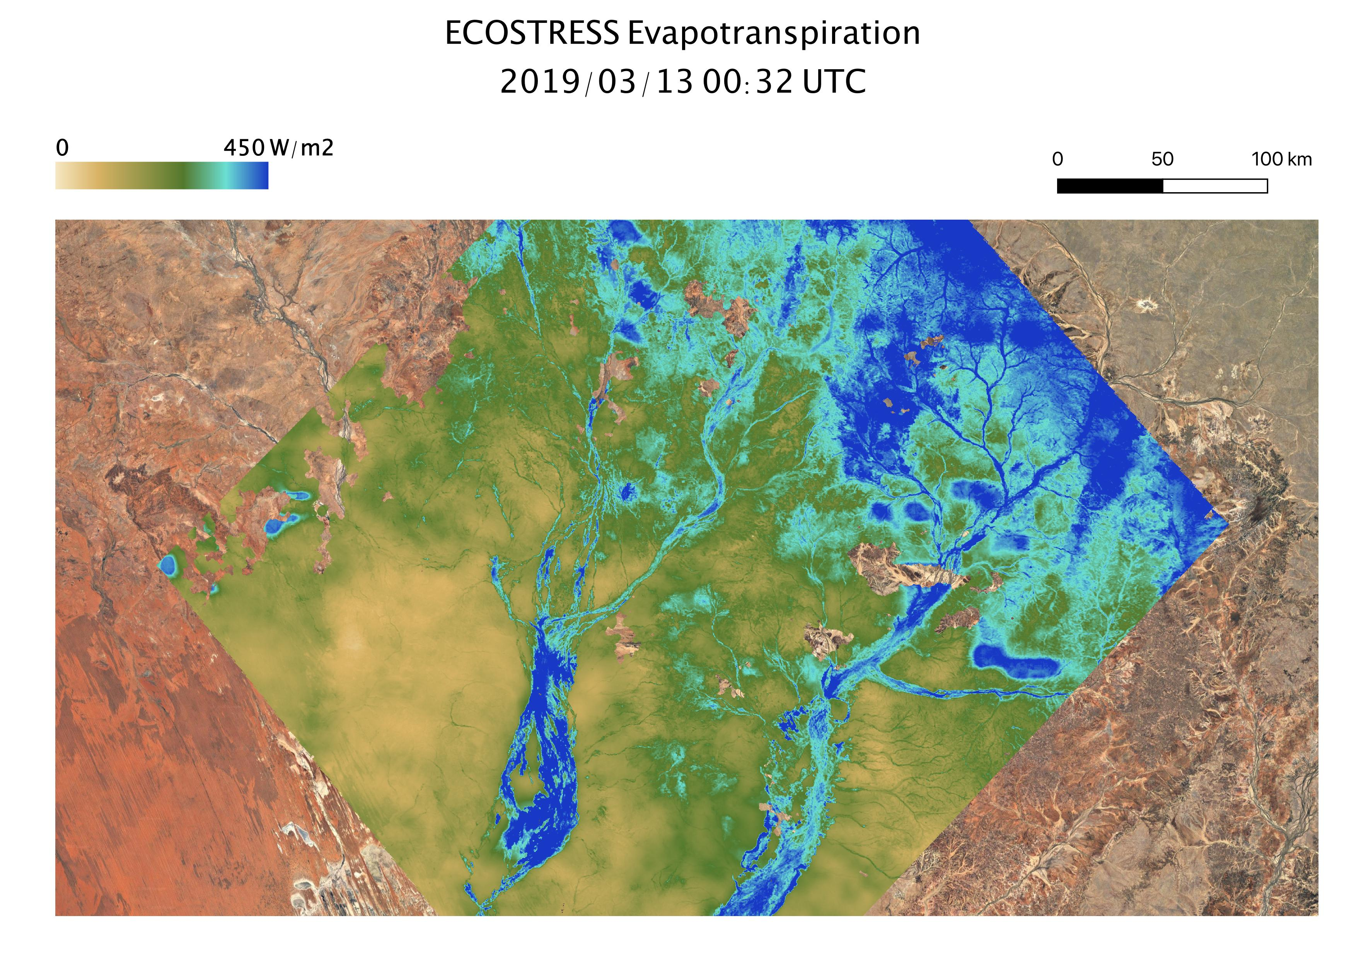
Background image: Owen Thompson
2020 Postdoc Research Day Presentation Conference
Alexander J. Norton
Organization: 329G
Advisor: Nicholas Parazoo (329G)
Postdoc Program: JPL

Slide 2
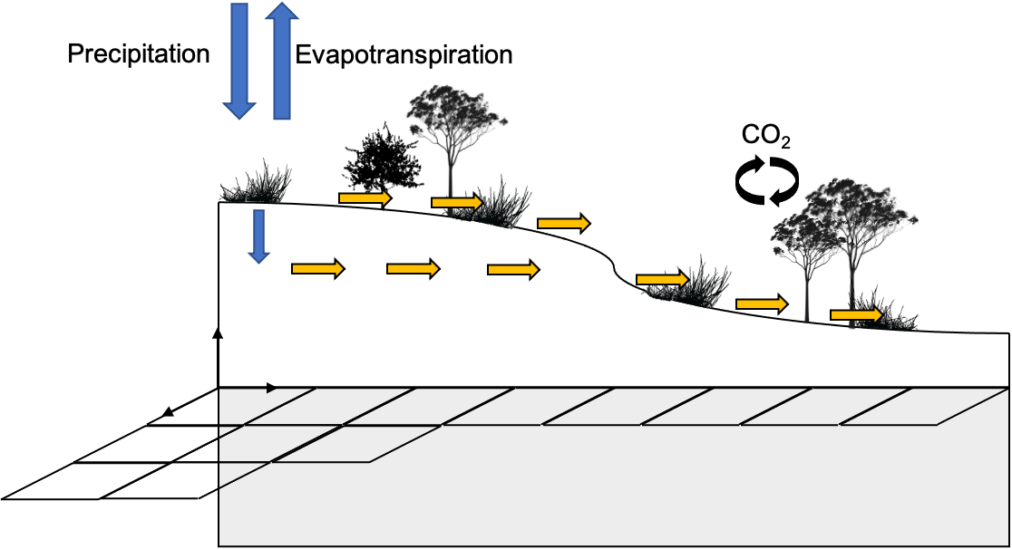
Nonlocal Effects of Precipitation on Carbon-Water Cycles
Precipitation that falls onto the land is routed through soil, plants and streams.
Hydrological connectivity – lateral movement of water, interacting with plants and soil along the way.
Empirical studies on terrestrial carbon-water dynamics often overlook this process.
Land surface models used to infer the drivers and mechanisms of terrestrial carbon sink do not consider this process.
Could we be ignoring an important mechanism of water supply for ecosystem productivity?
Background image: Owen Thompson

Slide 3
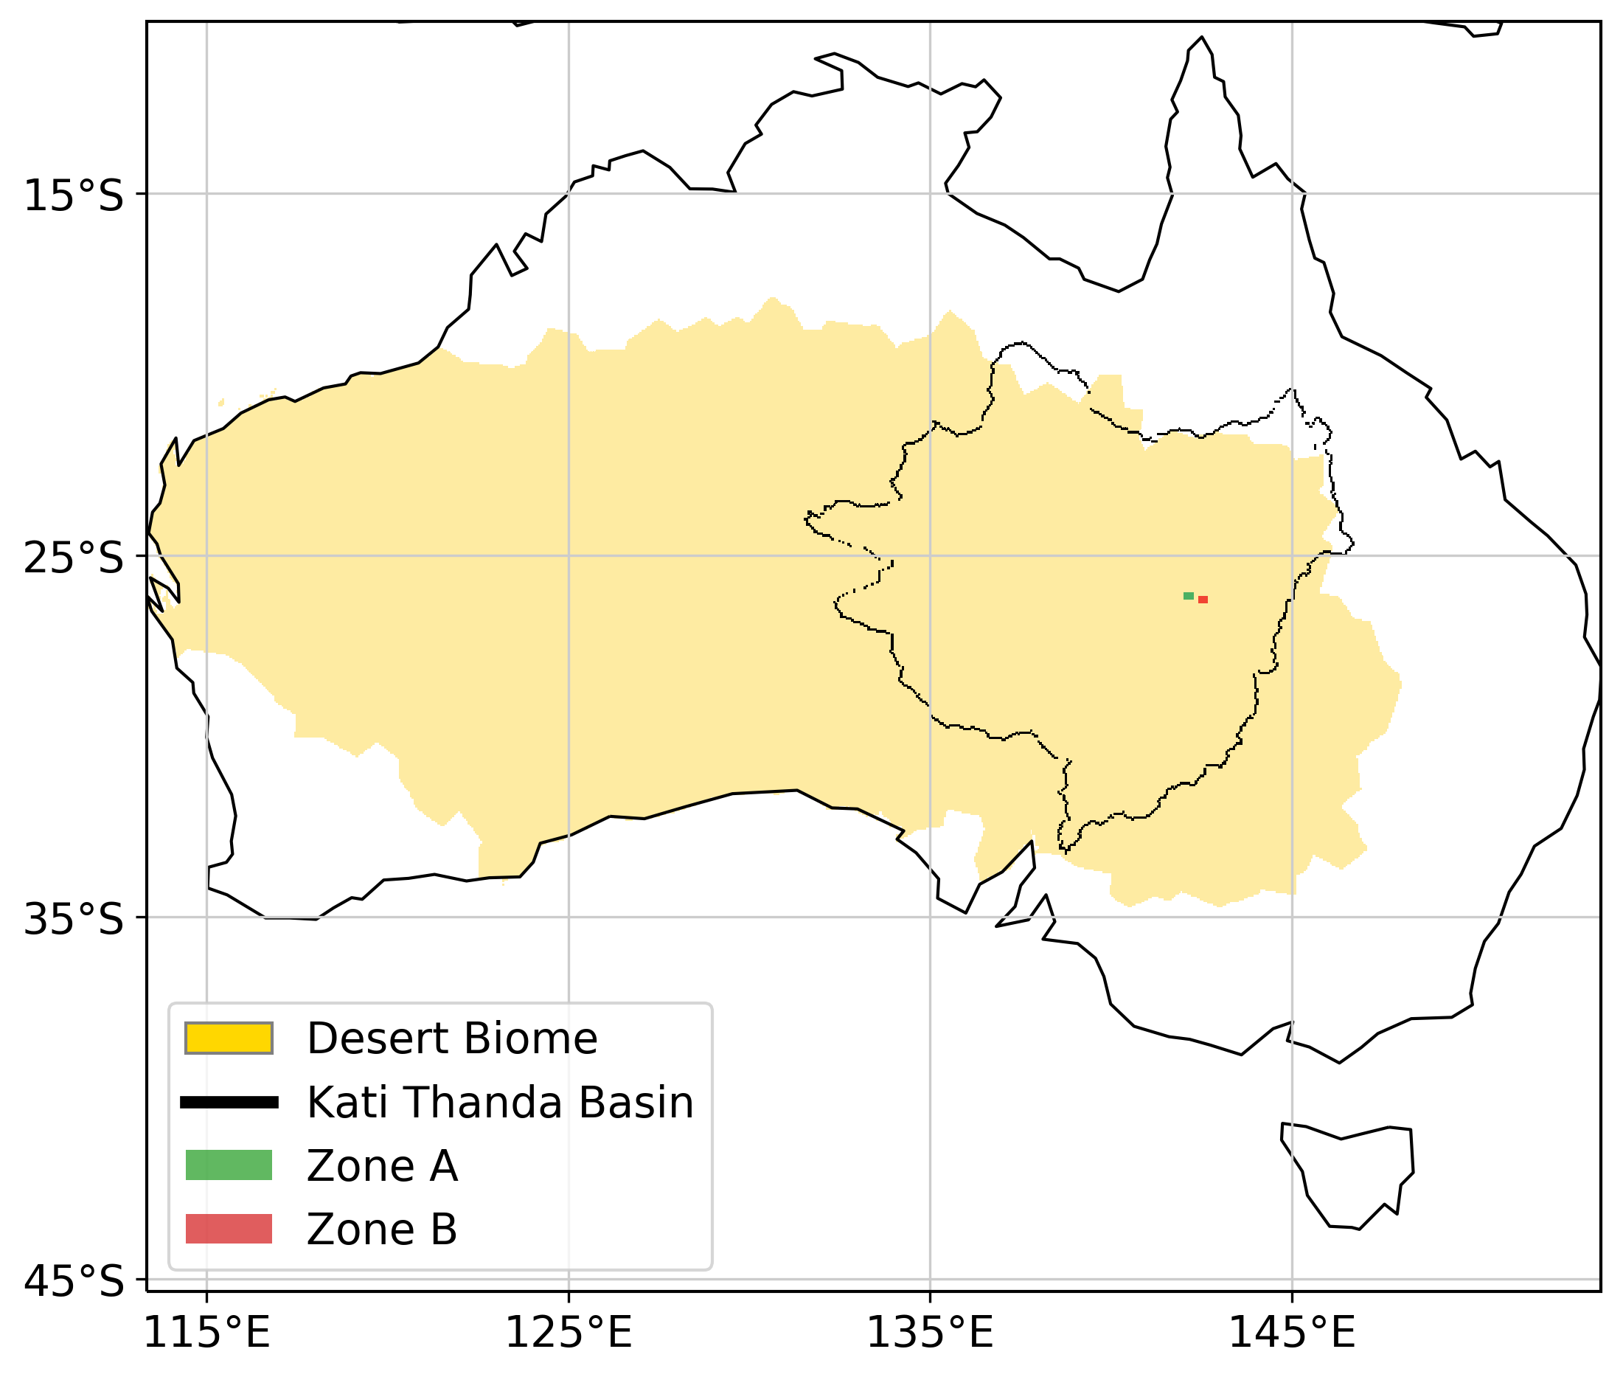
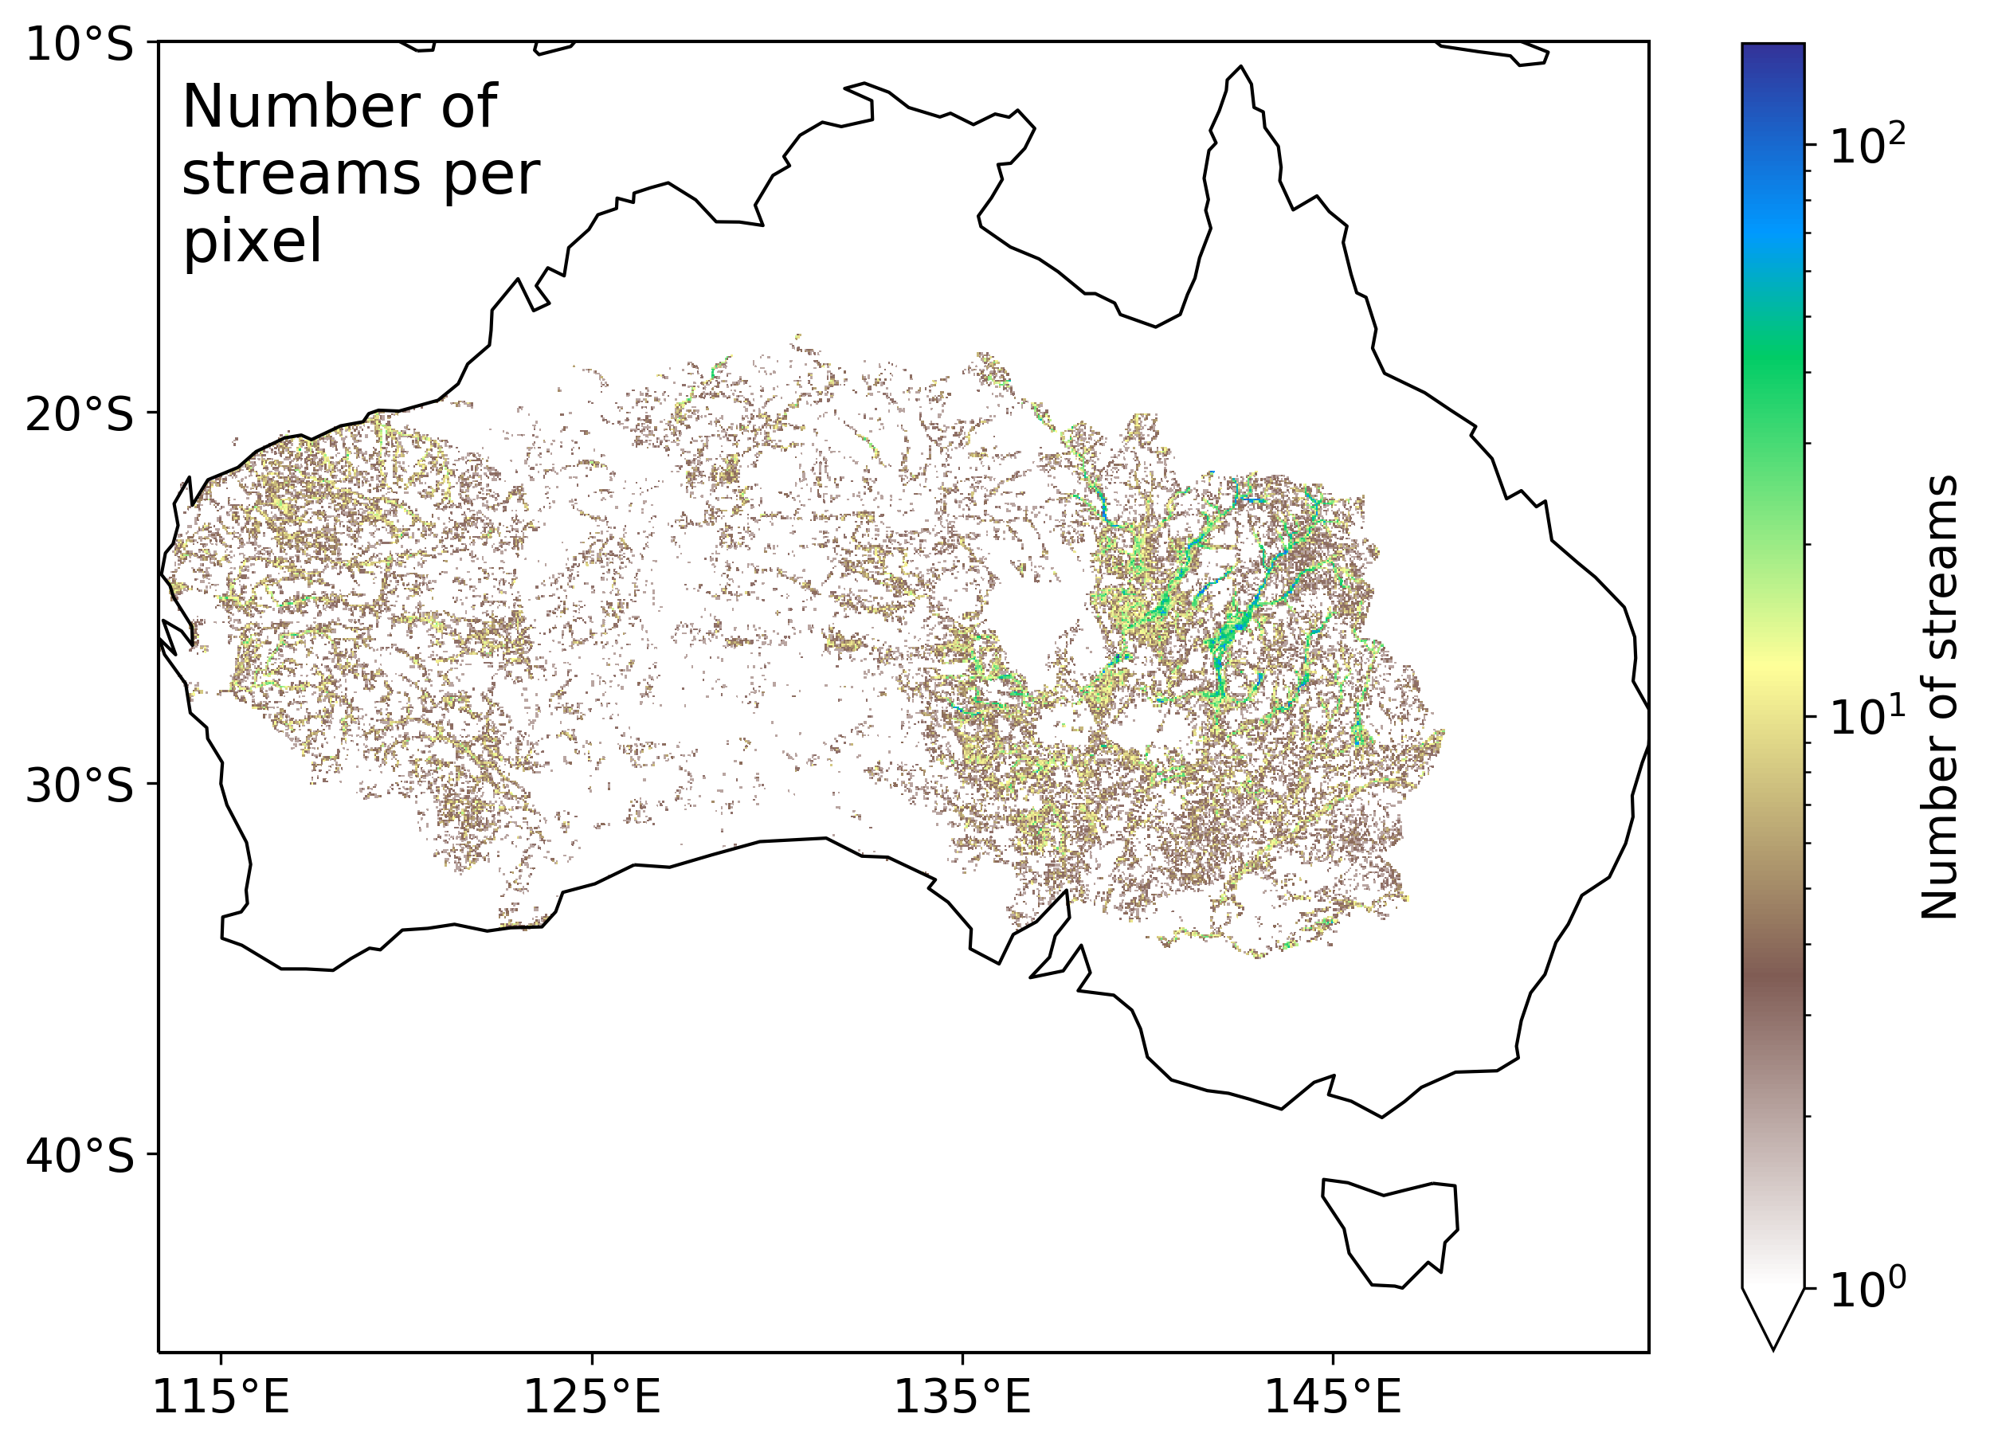
Study Region and Data
Much of Australia is arid and semi-arid.
We focus in on the Kati Thanda (Lake Eyre) drainage basin
Including two small zones for timeseries analysis
This region of Australia has numerous streams and floodplains.
To study the carbon-water dynamics of this region we use:
Evapotranspiration (ET) estimates from the ECOSTRESS thermal radiometer instrument onboard the ISS.
Solar-induced chlorophyll fluorescence (SIF) from the TROPOMI satellite¹.
Soil moisture from the Advanced SCATterometer (ASCAT) instrument onboard MetOp-A².
AVHRR satellite record of vegetation indices (GIMMS NDVI product³).
Gridded precipitation
In-situ streamflow measurements
Model estimates of carbon fluxes, gross primary production (GPP):
TRENDY⁴ multi-model average
Hydromorphology GIS data⁵ mapped onto 0.05º grid

Slide 4
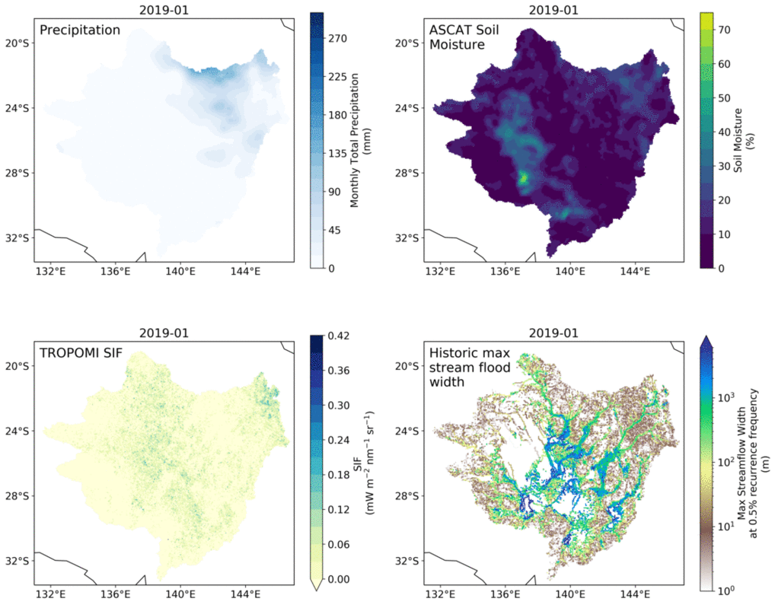
Kati Thanda Basin: 2019
In early 2019 there was high precipitation in the north of the basin due to a tropical cyclone.
This local precipitation results in local increases in soil moisture and SIF.
However, flood waters move laterally through braided streams and floodplains (bottom right panel), inducing high, sustained increases in soil moisture and SIF out to October. Despite a lack of additional precipitation.
Norton et al. (in prep)

Slide 5
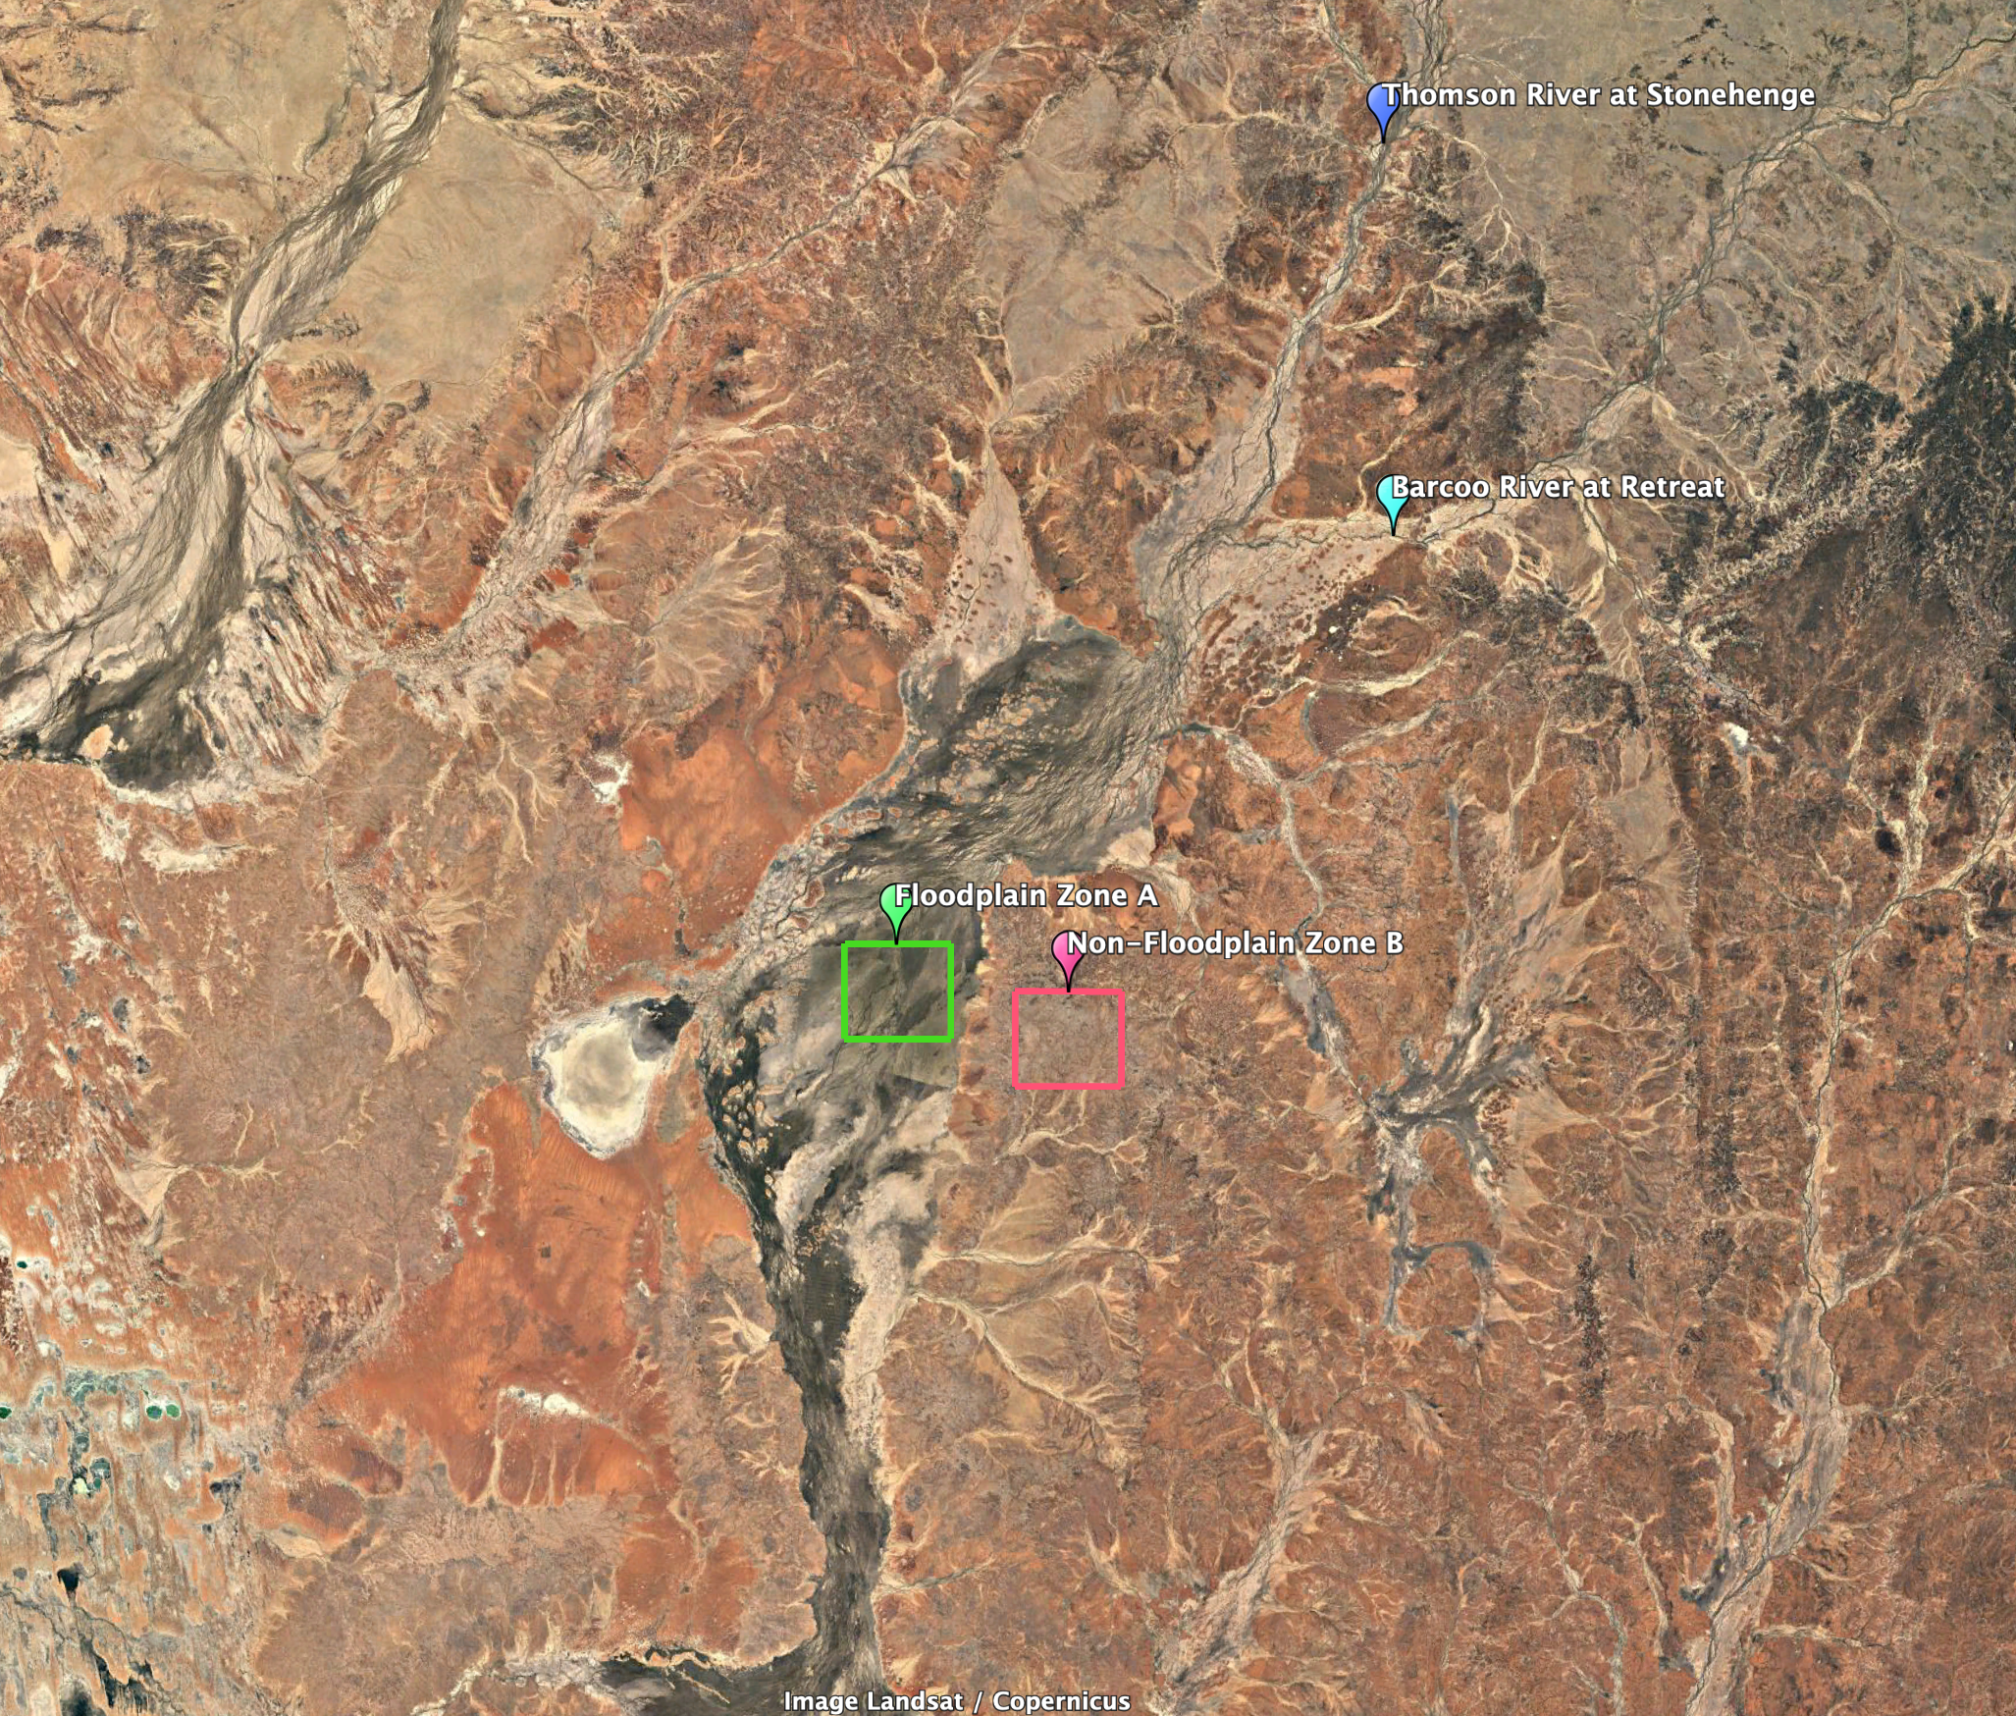
Kati Thanda Basin: 2019
Two adjacent zones (550 km²), both with similar monthly rainfall:
Zone A: located over region impacted by floodplain
Zone B: upland zone away from influence of floodplain

Slide 6
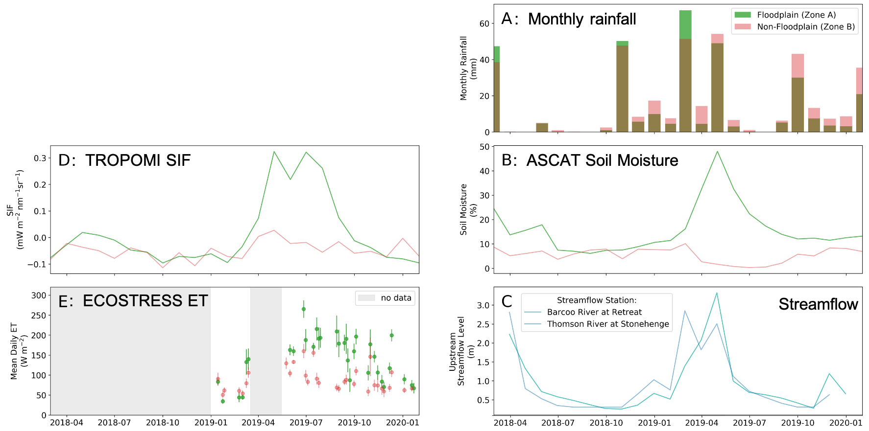
Kati Thanda Basin: 2019
Two adjacent zones (550 km²), both with similar monthly rainfall:
Zone A: located over region impacted by floodplain
Zone B: upland zone away from influence of floodplain
Markedly different patterns in SIF, ET, and soil moisture due to lateral
supply of water.
Norton et al. (in prep)

Slide 7
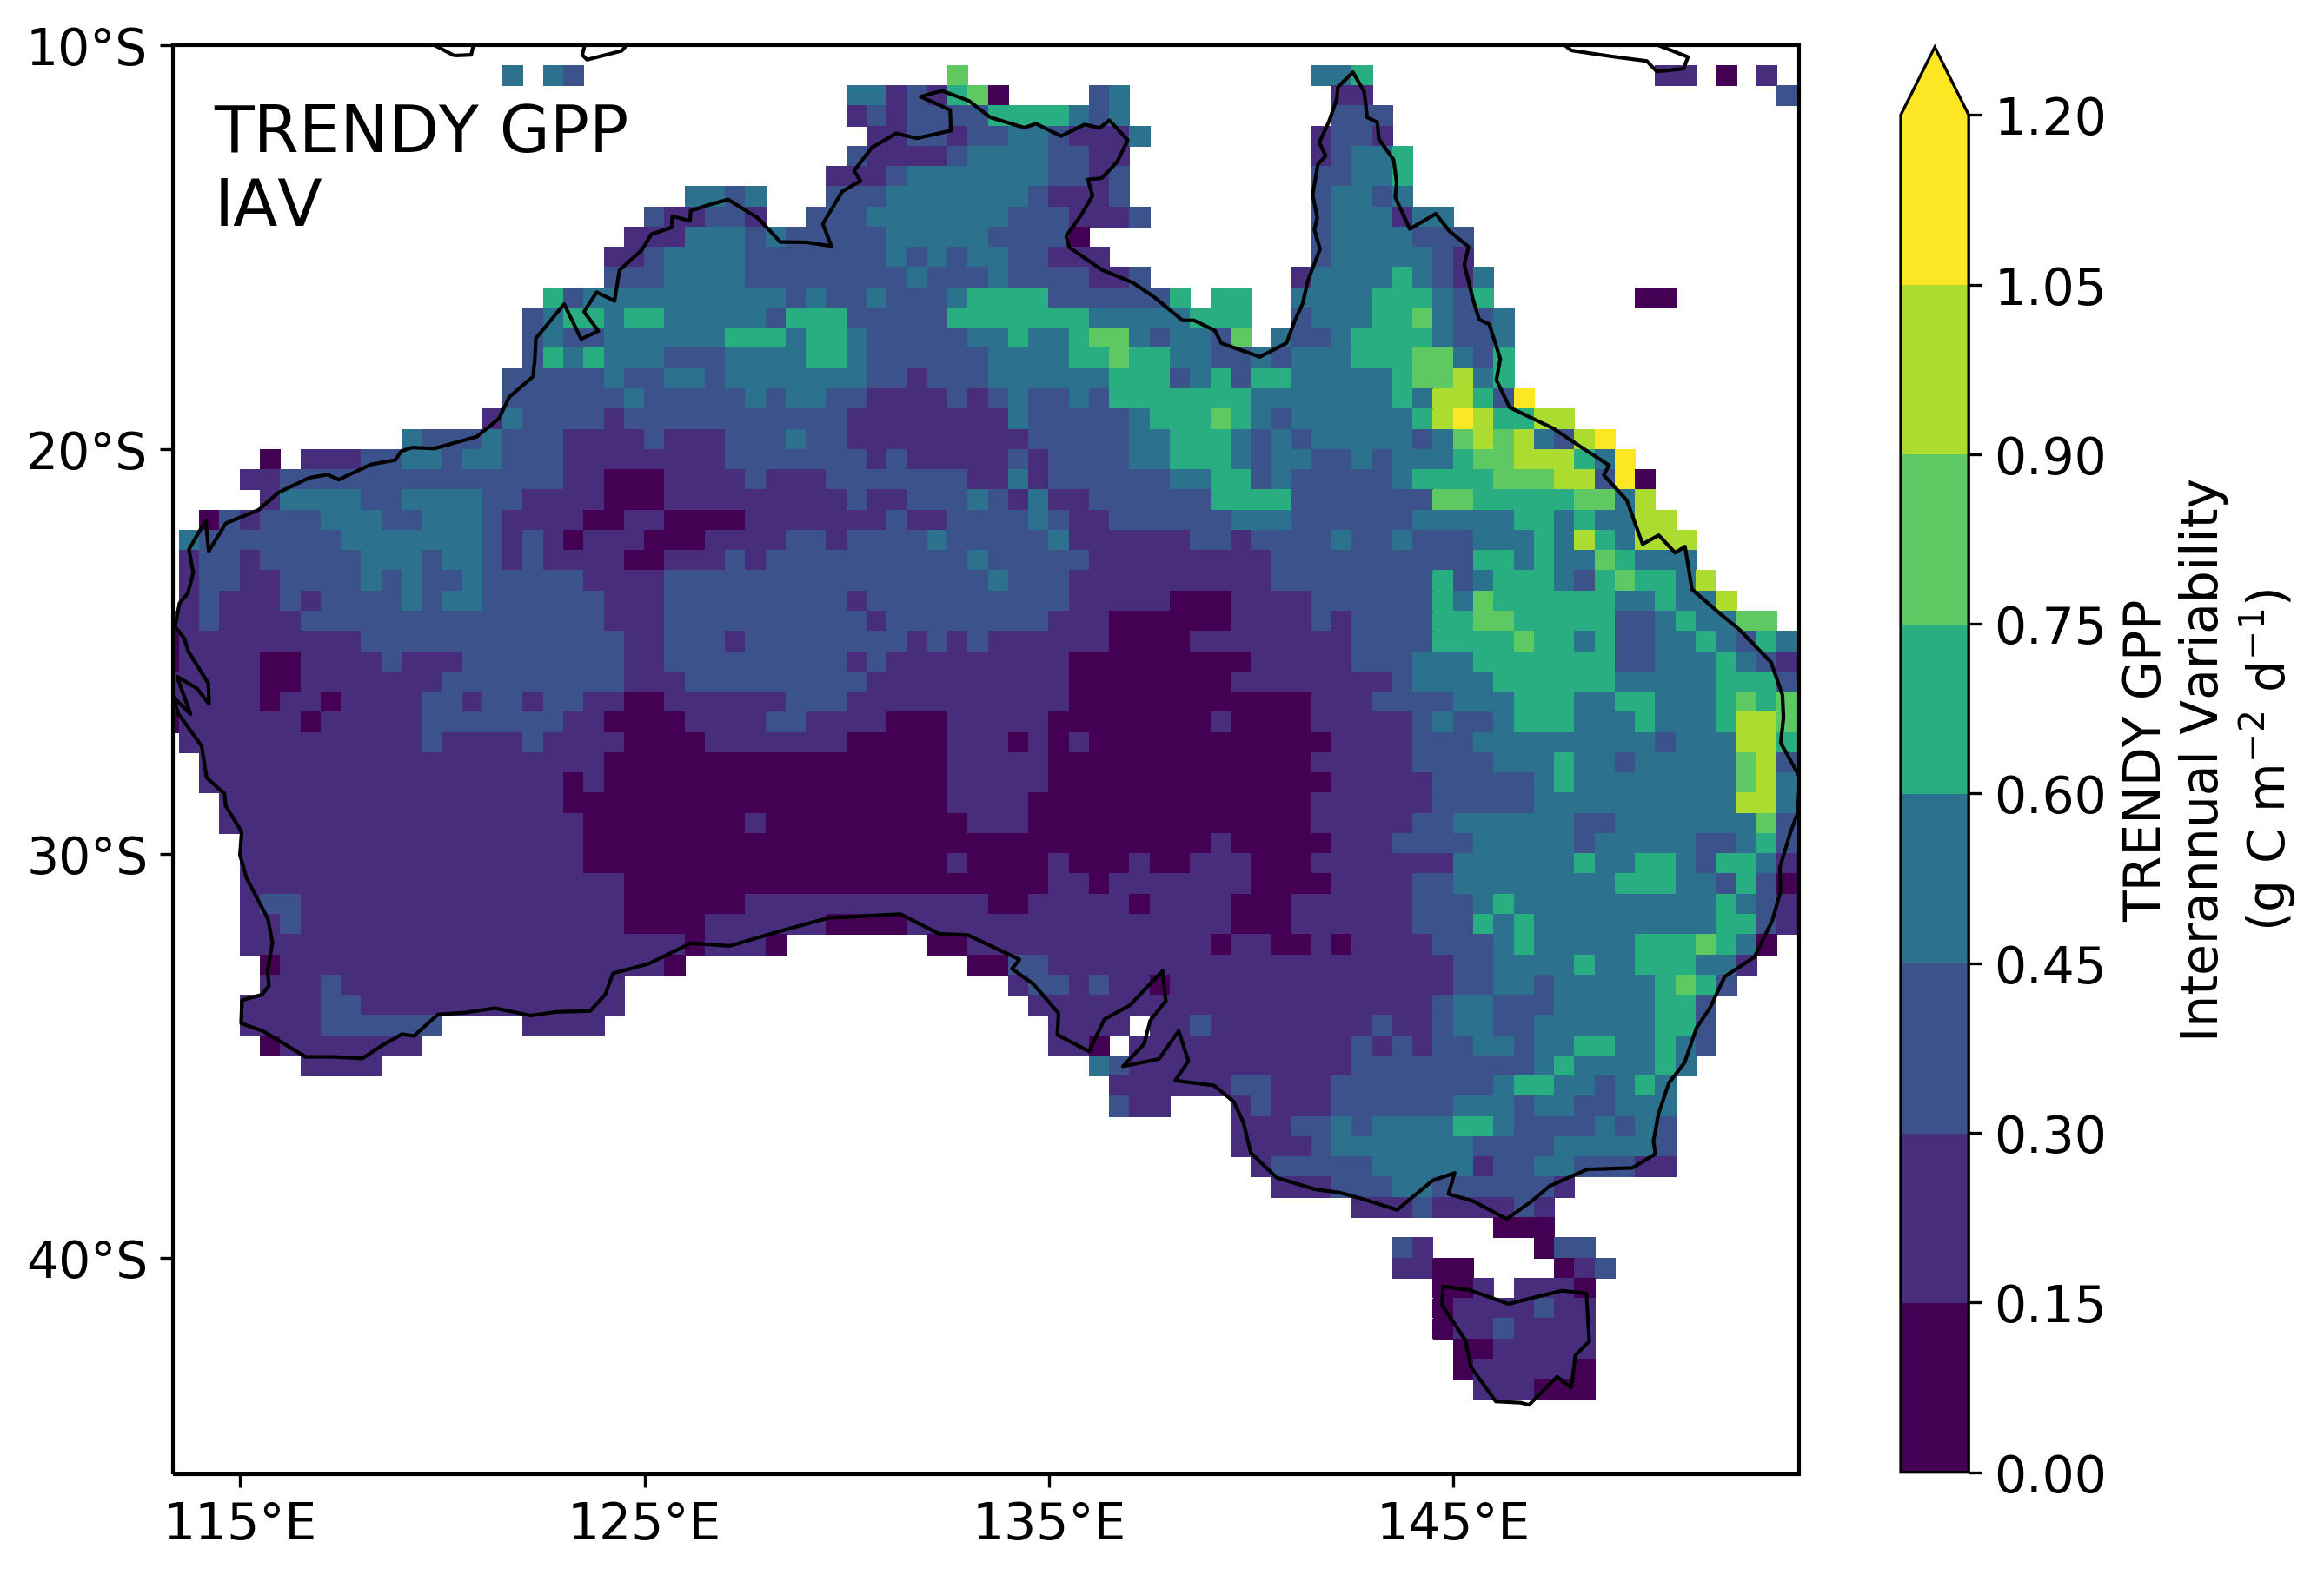
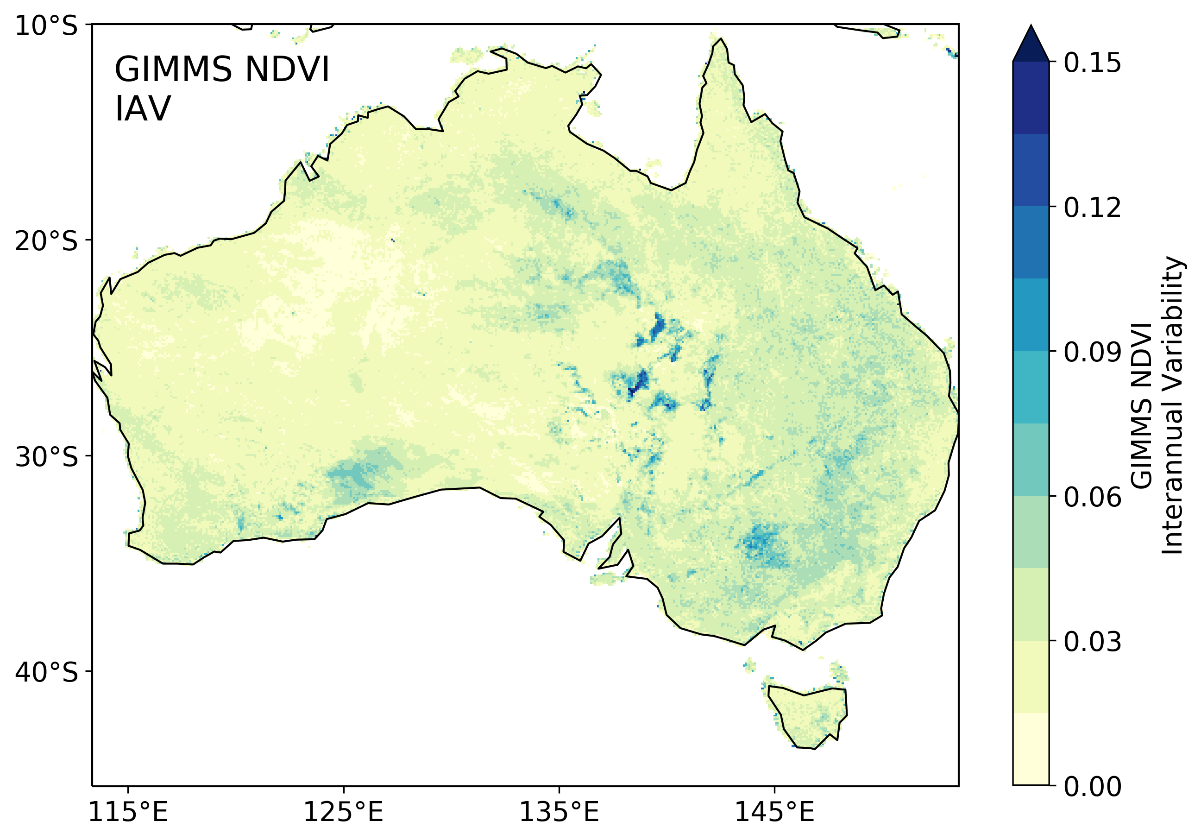
A Missing Model Mechanism
Global predictive models
The interannual variability in global land surface models shows no hot spots in carbon uptake (GPP) over this drainage basin. Yet the satellite records showing very high interannual variability in vegetation growth.
Without considering lateral transport of water, these models will not capture these carbon-water interactions.
More high-resolution measurements from instruments like ECOSTRESS will enable us to study these fine-scale, but significant carbon-water patterns.
1981-2018
Satellite observations
1981-2013
Norton et al. (in prep)

Slide 8
Acknowledgements, Publications, References
Acknowledgements:
Co-authors: P. J. Rayner, Y-P. Wang, N. C. Parazoo, V. Haverd, P.R. Briggs, K. Cawse-Nicholson, L. Baskaran, et al.
Publications:
Norton et al., (in prep), Nonlocal precipitation effects on terrestrial carbon-water cycles.
Data references:
1. Köhler et al., 2018, https://doi.org/10.1029/2018GL079031
2. ASCAT [i] Wagner et al., 1999, doi: https://doi.org/10.1016/S0034-4257(99)00036-X
[ii] Naeimi et al., 2009, doi: https://doi.org/10.1109/TGRS.2008.2011617
[iii] Naeimi et al., 2012, doi: /https://doi.org/10.1109/TGRS.2011.2177667
[iv] Product User Manual: H SAF, Product User Manual (PUM) Metop ASCAT Surface Soil Moisture Climate Data Record v5 12.5 km sampling (H115) and Extension (H116), v0.1, 2019;
[v] Algorithm Theoretical Basis Document: H SAF, Algorithm Theoretical Baseline Document (ATBD) Metop ASCAT Surface Soil Moisture Climate Data Record v5 12.5 km sampling (H115) and Extension (H116), v0.1, 2019;
[vi] Product Validation Report: H SAF, Product Validation Report (PVR) Metop ASCAT Surface Soil Moisture Climate Data Record v5 12.5 km sampling (H115) and Extension (H116), v0.3, 2019.
3. GIMMS [i] Tucker et al., 2012, Global Inventory Modeling and Mapping Studies, NA94apr15b.n11-VIg, 2.0,
[ii] Pinzon, J., Brown, M. E. and Tucker, C. J., 2005. Satellite time series correction of orbital drift artifacts using empirical mode decomposition. In: N. Huang (Editor), Hilbert-Huang Transform: Introduction and Applications, pp. 167-186.
[iii] Tucker et al., 2005, An Extended AVHRR 8-km NDVI Data Set Compatible with MODIS and SPOT Vegetation NDVI Data. International Journal of Remote Sensing, Vol 26:20, pp. 4485-4498 .
4. Sitch, S. et al., 2015, Biogeosciences 12, 653–679
5. Hou et al., 2019, https://doi.org/10.5194/essd-11-1003-2019

