Slide 1
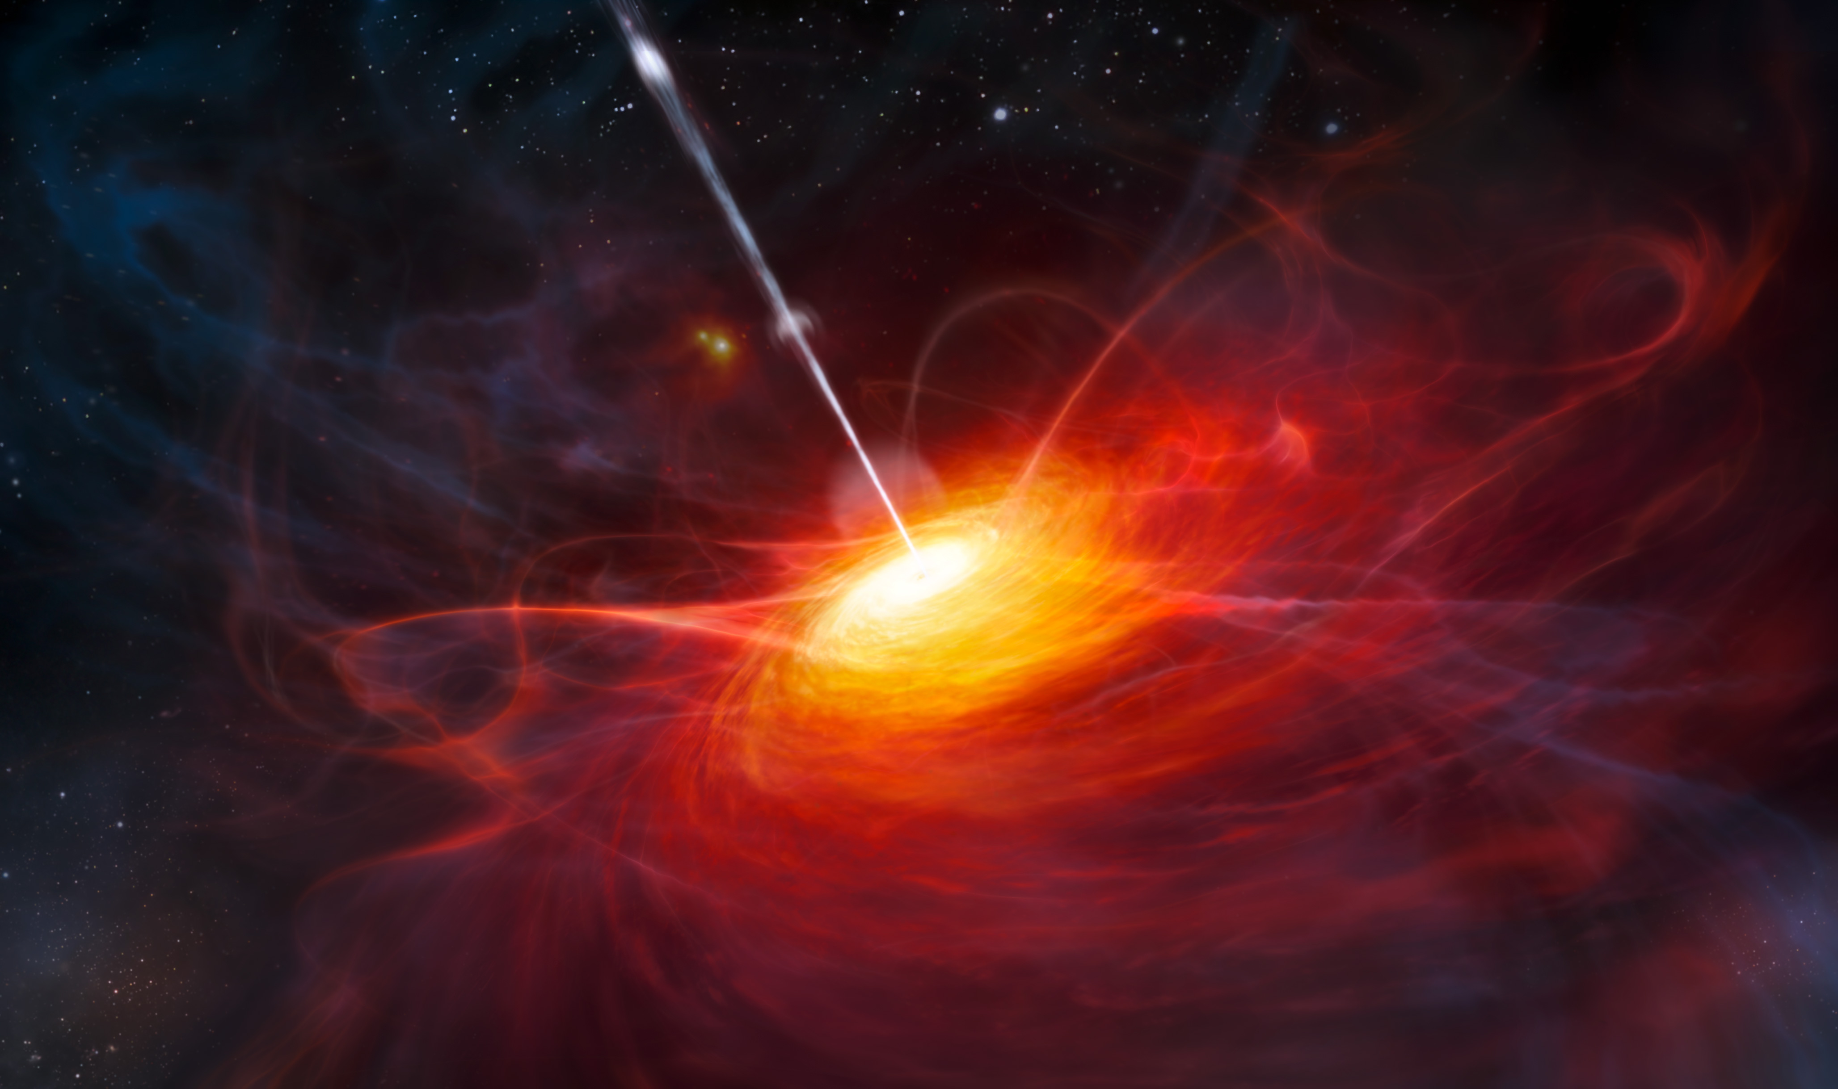

Understanding the Growth of the Earliest Supermassive Black Holes through X-ray Observations
Thomas Connor
Organization: 3266
Advisor: Daniel Stern (3266)
Postdoc Program: NPP
Image credit: ESO/M. Kornmesser

Slide 2
Introduction
Abstract
In recent years, hundreds of supermassive black holes have been discovered looking back to less than one billion years after the Big Bang. Despite having minimal time to grow, these titans already have one to ten billion times the mass of the Sun. Such growth challenges theories of the formation of these objects and of how black holes can accrete mass. I use X-ray observations of these supermassive black holes to identify mechanisms that can allow for such rapid growth, helping to align observations and cosmological theory.

Slide 3
Problem Description
This is a problem controlled by three parameters:
The mass at ~one billion years ABB (after Big Bang)
The mass and formation time of seeds
The growth rate from (1) to (2).
The first parameter is fixed by the observed population of these objects. The second is theoretical, and will require future space telescopes to detect (JWST, Euclid, Lynx, Athena). The third can be constrained by current observatories – the steeper we can allow the slope to be, the less massive seed black holes need to be to explain current observations.
Not Observed
Observed
How do seeds get that big?
Mass
How do black holes grow this fast?
Disproven by observed black holes
Time

Slide 4
Problem Description
The area around the black hole is the Active Galactic Nucleus (AGN) – here, infalling material forms an accretion disk; magnetic fields and thermal photons from this power an X-ray luminous corona. As more material tries to accrete, the thermal pressure increases, pushing things back out. The balance of these forces is the Eddington Limit, which sets a limit on how fast growth can occur. The corona is sensitive to the properties of the entire AGN, and therefore X-rays are a powerful tool to study the inner regions of black hole growth.
X-ray Corona
Black Hole
Accretion Disk
*Not to scale

Slide 5
Methodology
One idea is that these quasars can boost their mass almost instantly through mergers. These sporadic super-Eddington events allow the growth to otherwise proceed slowly to the observed population. We observed two quasars known to have nearby companions to see if both had AGN.
Not Observed
Observed
Neeleman+2019
Decarli+2019
Mass
Time

Slide 6
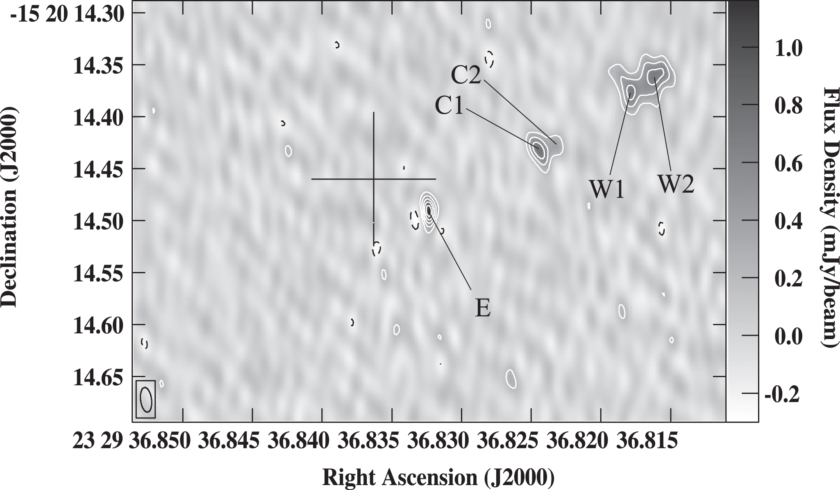
Methodology
Another proposal is that the presence of jets could allow these black holes to dump energy off of their accretion disk and therefore grow more quickly. At high redshifts, these jets could be X-ray bright through inverse Compton interactions with the Cosmic Microwave Background (IC/CMB). We observed the only quasar known in this epoch to have radio-detected jets to hunt for evidence of IC/CMB.
Not Observed
Observed
Mass
Time
Momjian+2019

Slide 7

Results
PJ231-20 (z=6.59) was observed for 140 ks. The quasar (red circle) is clearly detected, but the companion (green circle) was not. But the X-ray spectrum of the quasar is very steep ($Γ={2.6}_{−0.9}^{+1.0}$) – such steepness has been associated in lower-redshift quasars with enhanced accretion rates. While not definitive, this is perhaps suggestive that the merger is helping to funnel gas into the primary quasar.
Connor+2020a

Slide 8
Results
PJ308-21 (z=6.23) was observed for 150 ks. Not only was the quasar detected (blue circle), but we detected X-ray emission at the location of the merging companion (brown -- ALMA submillimeter; blue contours – Quasar-subtracted UV). This is the first direct evidence for a companion AGN in the early universe. Further detections are needed to clarify the frequency of these systems so as to contextualize their role in the growth of early black holes.
Connor+2019d

Slide 9
Results
P352–15 (z=5.82) was observed for 265 ks. We detect extended X-ray emission at the same position angle as the radio-detected jets. We rule out this being caused by a background fluctuation with probability P=0.9985. As this structure is ~50 kpc from the quasar, if we assume a propagation speed of 0.3c, this means the jets have been active for at least half a million years.
Connor+2020b

Slide 10

Lynx Concept Study Report
Results
Looking forward, I am conducting further X-ray studies on radio-loud AGN and AGN with known companions, all in the early universe. I am also assisting in larger efforts to find high redshift supermassive black holes. However, next generation space missions, notably Athena and Lynx, will be crucial to explore these objects in much deeper detail.

Slide 11
Publications and Acknowledgements
Papers:
“X-Ray Observations of a z ∼ 6.2 Quasar/Galaxy Merger” Connor et al. 2019d, ApJ, 887, 171
“X-Ray Observations of a [C II]-bright, z = 6.59 Quasar/Companion System” Connor et al. 2020a, ApJ, 900, 189
“Enhanced X-ray Emission from the Most Radio-Powerful Quasar in the Universe's First Billion Years” Connor et al., to be submitted to ApJ
Presentations:
“X-ray Observations of Quasars in the First Billion Years of the Universe: Searching for AGN Activity in Companions” Poster at AAS 235, Jan 2020
“​The Current Status of X-ray Observations of High-z Quasars” Presentation at Ringberg Meeting on Epoch of Reionization, Mar 2020
The work of T.C. was carried out at the Jet Propulsion Laboratory, California Institute of Technology, under a contract with NASA. T.C.'s research was supported by an appointment to the NASA Postdoctoral Program at the Jet Propulsion Laboratory, California Institute of Technology, administered by Universities Space Research Association under contract with NASA.

