Slide 1
A New Broadband Downconverter for the K-band Radio Astronomy Receiver on the NASA 70 m Canberra Antenna
Zubair Abdulla
Organization: 333M
Advisor: Joseph Lazio (9000)
Postdoc Program: JPL

Slide 2
Introduction
A New Broadband Downconverter for the K-band Radio Astronomy Receiver on the NASA 70 m Canberra Antenna
Abstract
The 70 m antenna (Tidbinbilla) at the NASA Deep Space Complex in Canberra is equipped with a dual-beam K-band (17-27 GHz) radio astronomy system. This antenna is the largest cm-wavelength antenna in the southern hemisphere, the band contains a number of key molecules (H2O, NH3) and complements ALMA Band 1 (35 GHz – 52 GHz), and the antenna can operate as part of the Australian Long Baseline Array (LBA) in Very Long Baseline Interferometry (VLBI).
A new broadband downconverter is in development to replace the current downconverter, with the goal of providing more robust and reliable performance. The new implementation will downconvert the entire 17 GHz – 27 GHz band from the dual-beam, dual-polarization receiver, providing four single side-band intermediate frequencies (IF). The four IF signals will be sent to the signal processing center at the base of the antenna with optical fiber units, and then further downconverted using an array of filters, oscillators, and mixers into DC – 1 GHz IF signals for the ROACH2 based digital signal processors.
This development will yield several major improvements. This approach greatly simplifies the signal processing that occurs in the antenna cone, replacing the array of 20 quadrature mixers and quadrature hybrids that produces 40 dual side-band IFs in the current implementation. This scheme moves components of the downconversion process from the antenna cone to the more stable signal processing center at the base of the 70 m antenna and reduces the number of required optical fiber units from 40 to four. The new downconverter will also provide a single broadband IF signal that will eventually be required for the use of broadband digitizers currently in development at JPL, thus allowing the continued operation of the currently available digital backends while being compatible with future backend developments. I present the design of the new downconverter and progress on a prototype now being assembled at JPL.
Notes:
The 70m Deep Space Network antenna in Canberra, while not tracking spacecrafts is a powerful radio astronomy tool equipped with a K-band receiver. The antenna is the largest centimeter wavelength antenna in the southern hemispheres and the instruments science band includes some key molecular lines of interest to radio astronomy and can also participates in very long baseline interferometry experiments with the LBA.
A new broadband downconverter is in development to replace the existing downconverter. The downconverter converts the radio frequency (or RF band) of interest to a lower intermediate frequency (or IF band) which is easier to digitize for signal processing. The goal is to greatly simplify the signal processing that occurs in the antenna cone, move components of the downconversion to the antenna base, be compatible with future developments in the digital signal processing backends, while address existing performance issues in the current implementation.

Slide 3
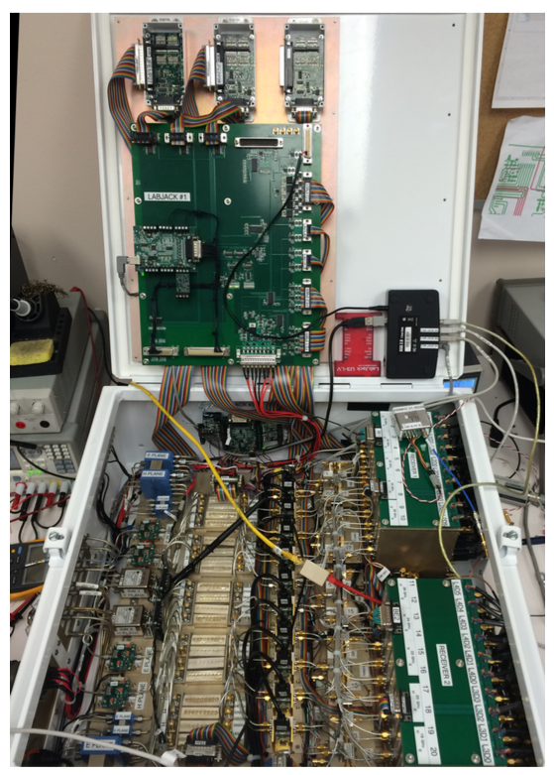
The Existing Downconverter
The existing downconversion system (shown to the right) faces several performance issues, which inform the planned redesign. Among those issues:
A dense layout completely contained in the antenna making maintenance difficult
A complex fiber patch panel in the antenna cone which has face issues with balancing fiber power (40 outputs!)
Clumsy interfacing with monitor and control
Unreliable conversion to circular polarization (required for VLBI observations) due to unaccounted gain slope and phase delay buildup through components
Does not currently operate at advertised specifications (some of the output is filtered out due to RFI, both feeds do not provide both polarization options)
Some mechanical implementations undermine performance
Why not refurbish? Would be an extended interruption to the science, and refurbishing would likely require backwards compatibility with the current implementation resulting in a kludgy system.
Why not relocate the downconverter with high-frequency RF over fiber units? Does not address the underlying issues with the downconverter, so would still require some refurbishing, and broadband high-frequency fiber units that covers the entire K-band are nearly as expensive as completely replacing the entire system
Image credit and details of current design detailed in T. Kuiper et. al. 2019 (https://doi.org/10.1142/S2251171719500144)
Notes:
The existing downconverter faces several know performance issues, which includes, but are not limited to: having a dense layout completely contained in the antenna cone making it difficult to maintain; being fully contained in the antenna cone, having complex patch panel of 40 fiber units to transfer the IFs to the signal processing center at the base of the antenna; a clumsy monitor and control system; unreliable conversion to circular polarization which is required for VLBI observations. Because the cryogenic feed of the front-end is natively linear and the existing VLBI backend cannot provide a digital derivation of stokes parameters, circular polarization must be provided in the warm electronics; there are some mechanical implementations like mismatched connectors and loose cabling which also undermines performance.
While potentially refurbishing the existing system or relocating the downconverter to the more stable signal processing center at the base of the antenna was explored, it was ultimately ruled out in favor of a complete redesign.

Slide 4
The Redesign
Cold Package Receiver
Broadband Downconverter
Filter bank downconverter
Digital Backend
Fiber runs for the four broadband IFs to the antenna base. Simplify from 40 fiber units for current downconverter – can address issues concerning balancing fiber power and complex patch panel requiring manual intervention
Four outputs, two polarization from two feeds
40 DC-1 GHz IFs for the digital backends
Broadband downconversion of 17-27 GHz RF to 2-12 GHz IF. Simplify current downconverter and minimize signal processing in the cone
Use filter bank and fixed mixer and LO system to downconvert each broadband IF into ten DC-1 GHz IFs for the digital backends.
The proposed redesign (shown in more detail in following slides) attempts to address the issues facing the current downconverter by doing broadband downconversion of the 17-27 GHz RF science band and moving several components of the signal processing the more stable antenna base. This results in four outputs (two polarizations from the two feeds) instead of 40 and a simplified single-sideband output for the existing digital backend
The new downconverter will provide a single broadband IF signal that will eventually be required for the use of broadband digitizers currently in development at JPL, allowing the continued operation of the currently available digital backends while being compatible with future backend developments
Notes:
Here you see a block diagram of the redesign, where broadband downconversion of the entire RF is done in the cone, and a further downconversion step is done in the signal processing center at the base of the antenna using a set of filters. This proposed redesign attempts to address the issues facing the current downconverter by doing broadband downconversion of the 17-27 GHz RF science band and moving several components of the signal processing the more stable antenna base. This results in four outputs instead of 40 in the antenna cone and a simplified single-sideband output for the existing digital backend.
This scheme also provides a single broadband IF signal that will eventually be required for the use of broadband digitizers currently in development at JPL, allowing the continued operation of the currently available digital backends while also being compatible with future backend developments by bypassing the filter bank.

Slide 5
Broadband Downconverter
The Broadband Downconverter in the antenna cone consists of 4 signal paths and includes polarization selection, a bandpass filter to select the RF, downconversion of the entire RF, and transfer of the IF to the antenna base over fiber units
Notes:
Here we see a more detailed look at the RF components in the broadband downconverters. Along with attenuation to avoid compression points of components and amplifiers to provide the appropriate gain for digital signal processing, you can see some key components labeled. A selectable quadrature hybrid to choose between linear and circular polarization. This will require very careful tuning of the gain and delays of the two paths going into the quadrature hybrid to ensure reliable production of circular polarization, which will be a particularly challenging task at K-band. A digital variable phase shifter will be used optimize the delays 22 GHz where VLBI observations primarily take place. A bandpass filter to reject the out of band signal before downconversion. The single sideband mixers to provide the broadband IF. And the Fiber units to send the IF signal to the antenna base.

Slide 6
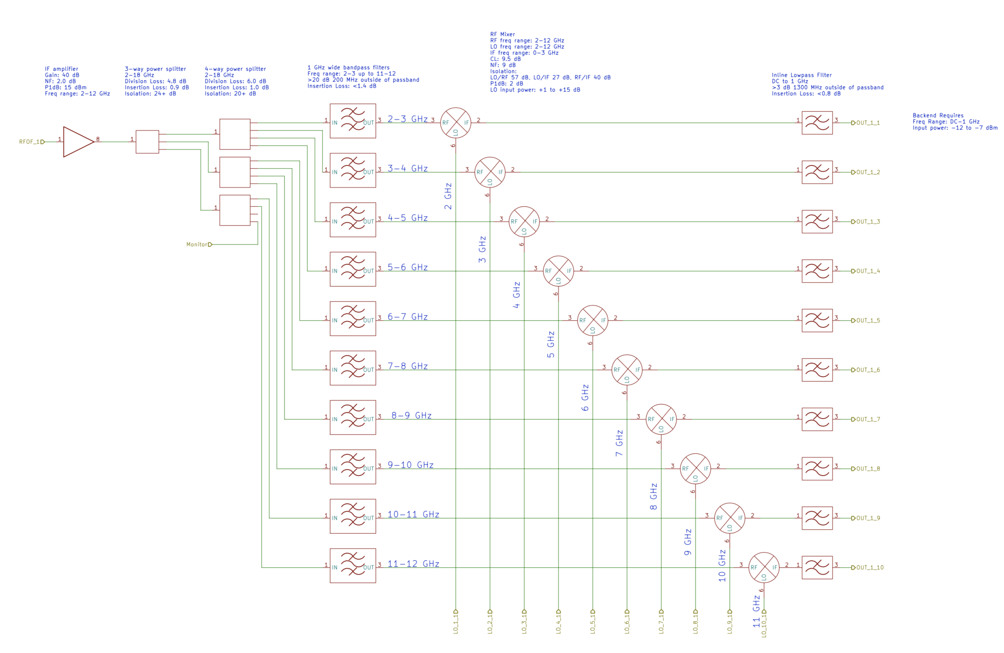
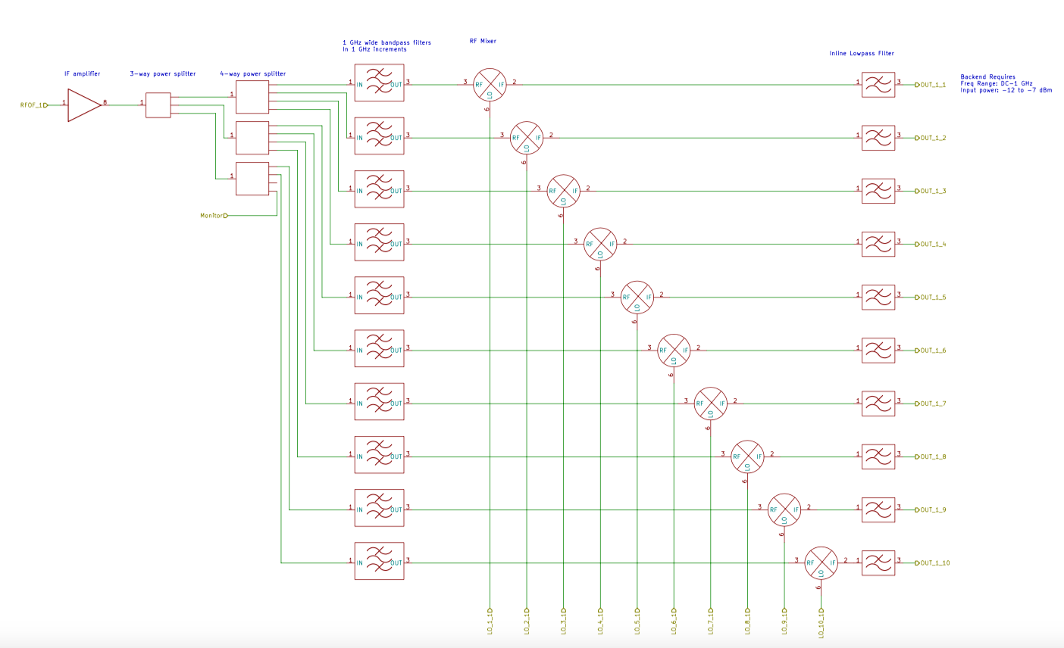
Filter Bank Downconverter
The filter bank downconverter in the signal processing center at the base of the antenna further downconverts converts each of the four 10 GHz wide IF bands into ten DC – 1 GHz single sideband IFs for the digital backends.
Notes:
Here we see the filter bank downconverter. Each of the 4 10 GHz wide IFs are divided and sent through 1 GHz wide bandpass filters and further downconverted to DC-1 GHz wide IFs which are required for the digital backends. The filter banks can eventually be bypassed when broadband digitizers which can take the full IF are implemented.

Slide 7
Results
An internal design review of the redesign was completed at JPL on June 16th, 2020
The go ahead was given to produce a prototype for two of the four signal chains of the broadband downconverter to demonstrate preliminary design feasibility and performance. In particular:
Study of the design in the lab, allowing the ability to revise design accordingly (e.g., inclusion of additional gain, isolation, or attenuation)
Study of efficacy of using variable attenuators and phase shifters in conjunction with quadrature hybrid to achieve reliable circular polarization
Preliminary development of monitor and control system, thermal control, and mechanical implementation
Prototype can be used in testing compatibility with new digital backend during their ongoing development
Several components have been procured, return-to-lab operations for this task have been approved, and initial assembly and testing are now underway
Future goals: preliminary results in December 2020 and a completed prototype assembly by February 2020
Notes:
An internal review of the redesign was successfully held at JPL on June 16th, 2020. As a result a go ahead was given to produce a prototype of two of the four IF chains of the broadband downconverter. A prototype would allow study of the design in the lab with the ability to revise the design if necessary, study of the performance of a warm polarization selector at K-band using variable attenuators and phase shifter, and to do preliminary development of the eventual monitor and control, thermal control, and mechanical implementation of an eventually fully conceived downconverter.
Several components have been procured, return-to-lab operations for this task have been approved, and initial assembly and testing is now underway

Slide 8
Publications and Acknowledgements
An abstract has been submitted and accepted for the National Radio Science Meeting (NRSM) conference to be held virtually January 4-9, 2021, to present the redesign and preliminary results over the next months
I would like to thank my advisor Joseph Lazio for his support, group 333M for helpful input, and the attendees of the design review held on June 16th for their valuable feedback

