Slide 1


©2020 California Institute of Technology. Government sponsorship acknowledged.
Increasing the resolution of mass flux products using GRACE/GRACE-FO space gravity missions
Athina Peidou (329C), Felix Landerer (329C), David Wiese (392R)
Organization: Sea Level and Ice (329C)
Advisor: Felix Landerer (329C)
Postdoc Program: JPL

Slide 2
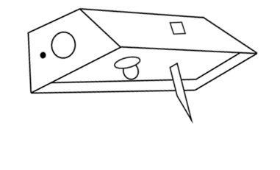
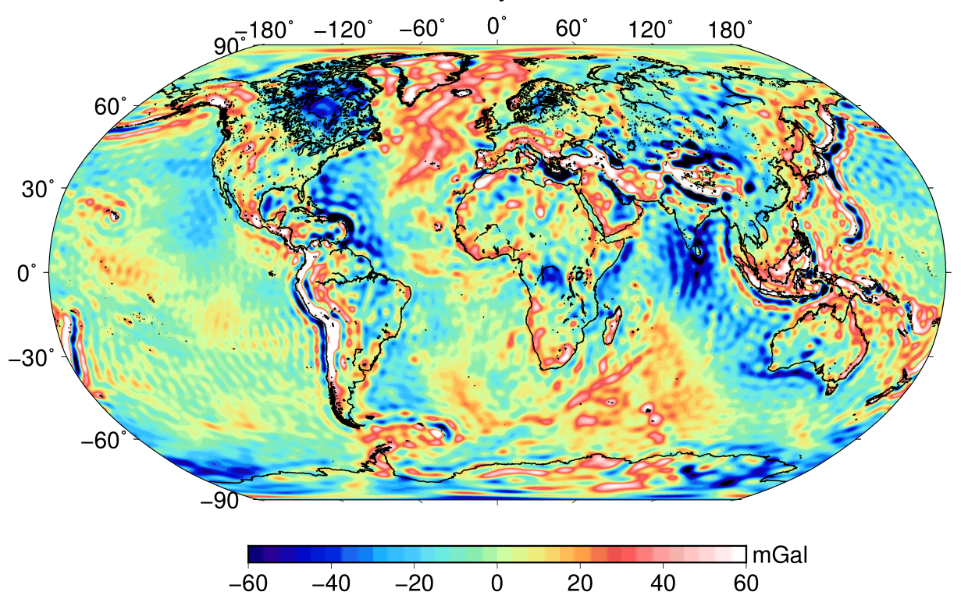
GRACE/GRACE-FO: Continuous monitoring of the Earth system
Monthly maps of the Earth’s gravity field
Gravity anomalies January 2010

Slide 3
GRACE/GRACE-FO: Open challenges
Limitations
Current mass transfer products
Spatial resolution ~300 km
Temporal resolution ~1 month
Goal: Retrieve high frequency climate signals using GRACE
Objectives
1) Space domain: Multiplatform geodetic data → Short wavelengths of the gravitational field
2) Time domain: Laser Range Interferometry (LRI) → Capture high-frequency signals

Slide 4
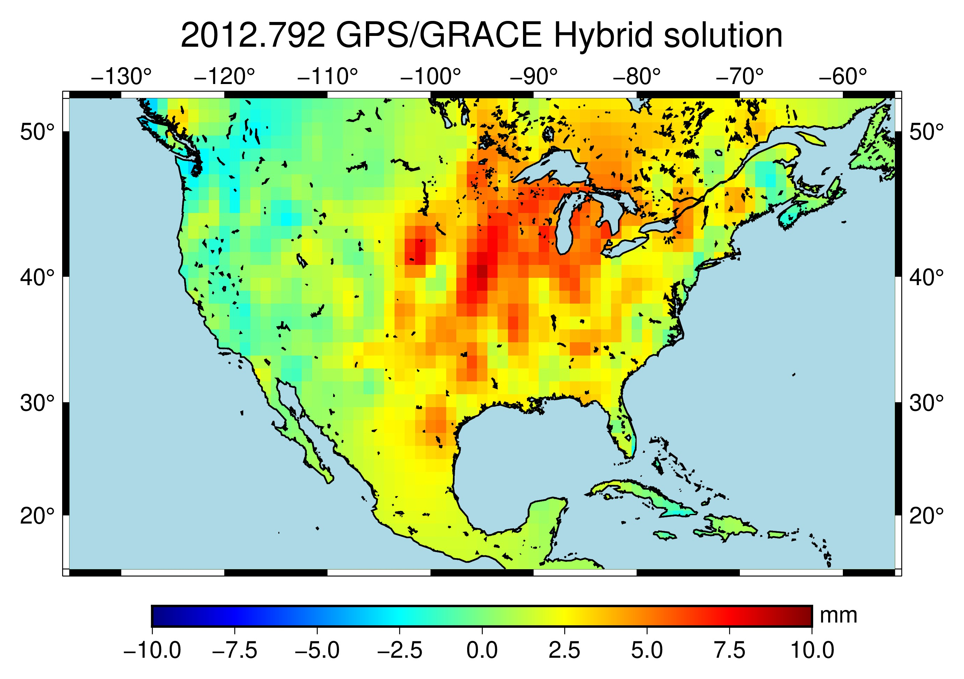
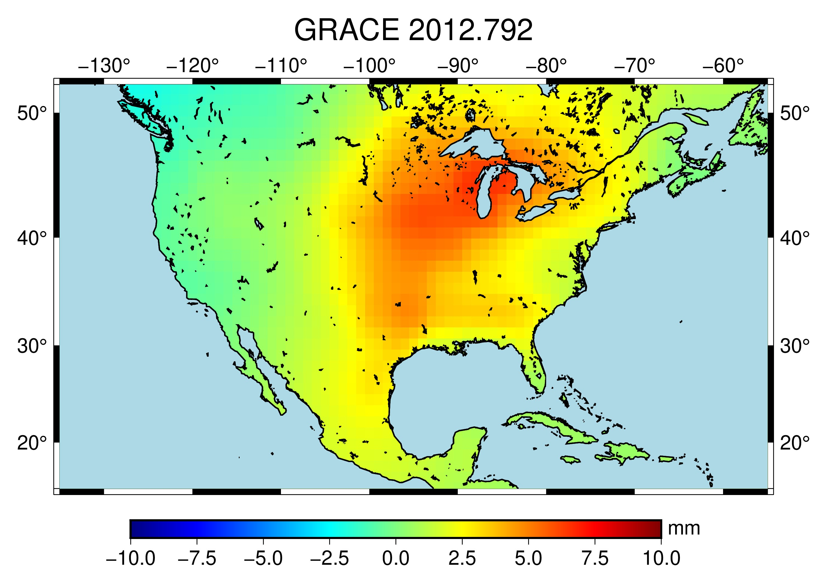
1) Multiplatform geodetic data and GRACE products
Vertical displacements of the Earth’s surface: Retrieve water, snow, ice and atmospheric signals
Hybrid solution→ Local + Regional+ Global signals
09/2012 GPS/GRACE Hybrid solution
GPS
09/2012
Local
GRACE
09/2012
Regional +Global
GPS/GRACE→ Higher spatial resolution (~100 km)
Notes:
Solid Earth deforms in elastic response to changes in the surface load of water, snow, ice, and atmosphere

Slide 5
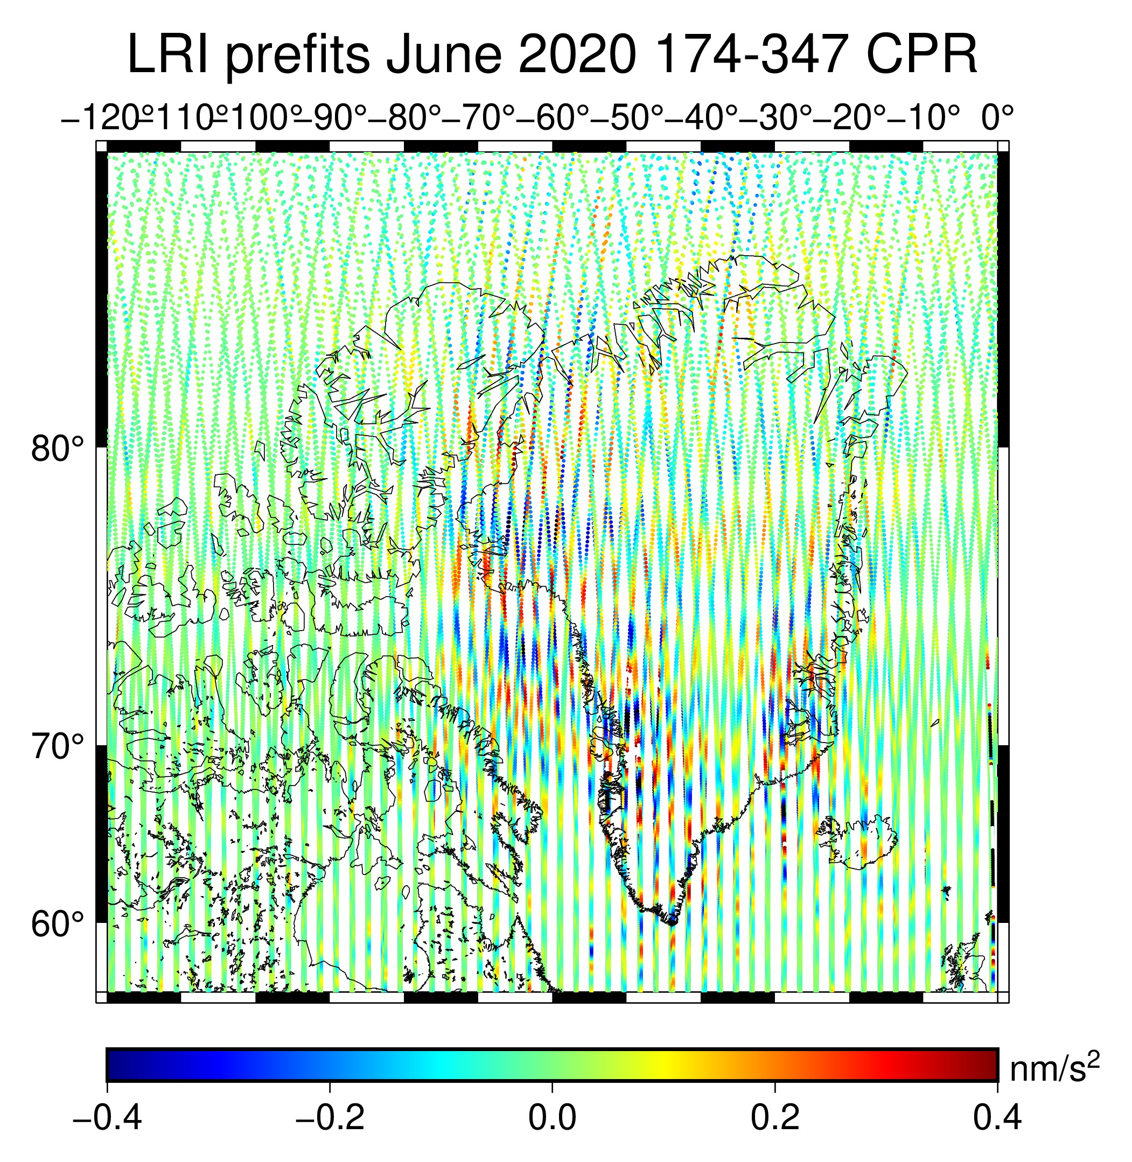
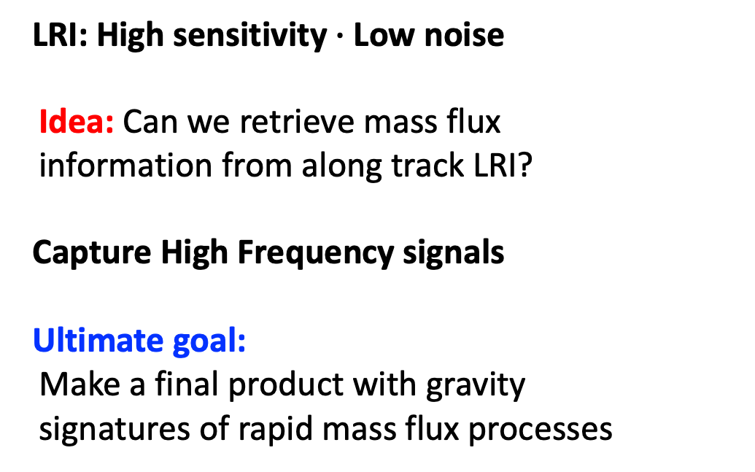
2) High frequency signals: GRACE-FO Laser Range Interferometry
LRI: Gravity changes that reflect mass loss over Greenland (June 2020)
LRI: High sensitivity $∙$Low noise
Idea: Can we retrieve mass flux
information from along track LRI?
Capture High Frequency signals
Ultimate goal:
Make a final product with gravity
signatures of rapid mass flux processes
High frequency signal up to 31 mHz

Slide 6
Original Contributions
New GRACE product: Vertical Displacements
GRACE Level-2 products: High spatial resolution (~100 km)
LRI: Detect rapid mass transfers in time domain

Slide 7
Publications and Acknowledgments
Peidou A., Wiese D., Landerer F., Argus D.: Twelve years of climate-driven changes in Earth’s surface across continental US (in prep)
Peidou A., Landerer F., Ellmer M., Wiese D.: Retrieving rapid mass transfer signals using GRACE-FO Laser Range Interferometry (in prep)
GNSS vertical displacements across US are provided by Argus D. (335N)

