Slide 1
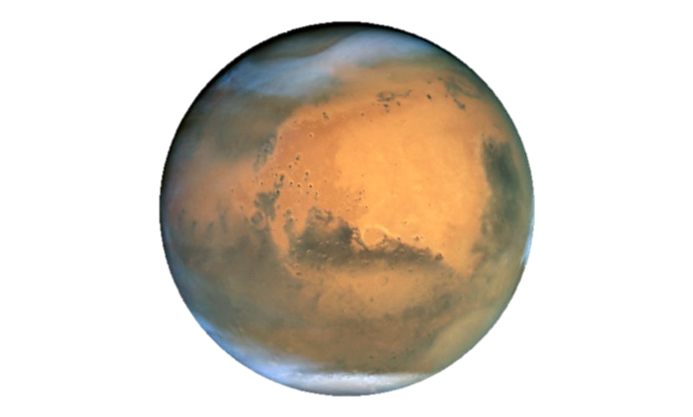
Global Surface Dust Redistribution on Mars: Constraints from Temperature Observations
2020 Postdoc Research Day Presentation Conference
Jonathan Bapst
Organization: 3222 – Planetary and Exoplanetary Atmospheres
Advisor: Sylvain Piqueux (3222)
Postdoc Program: JPL
Notes:
Introduce self, JPL postdoc
Repeat title

Slide 2
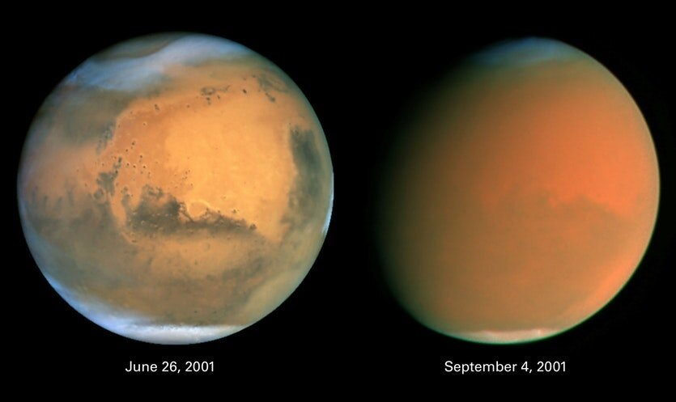
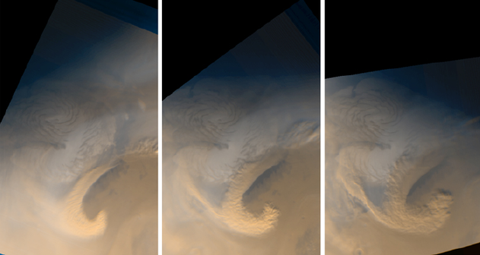
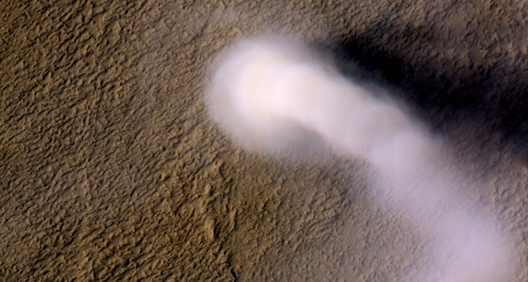
Global
NASA/Cornell/SSI/STScI/AURA
Mars Climate and the Role of Dust
Mars throughout the Amazonian period (last ~2 billion years) is viewed as having a permanently “cold and dry” climate
No liquid water
Dust and ice cycles dominate the climate system
Both exchange between the surface and atmosphere
Dust cycle involves lifting of dust into atmosphere, transportation via circulation, and deposition onto the surface
Atmospheric dust can reduces sunlight reaching the surface and increase long-wavelength radiation (i.e., greenhouse effect)
Dust deposition or removal on the surface affects:
Optical properties (e.g., brightening regolith, darkening ices)
Thermal properties (e.g., effective insulator)
Decades of observations support pervasive dust activity across Mars at multiple spatial and temporal scales (Geissler, 2005; Szwast et al., 2006)
Regional
1000 km
NASA/JPL/MSSS
Local
70 m
NASA/JPL/U. Arizona
Notes:
First ill talk about the martian climate and the major role dust plays
Read first point
A simple description of the dust cycle….
Go through points
For figure “on the right are examples of dust activity at various scales”
Global occur intermittently (5 years or so)
Regional storms occur annually
Smallest scale dust devils seen from orbit and on the ground
Dust and ice are responsible for widespread changes in surface albedo (i.e., reflectivity to sunlight)

Slide 3
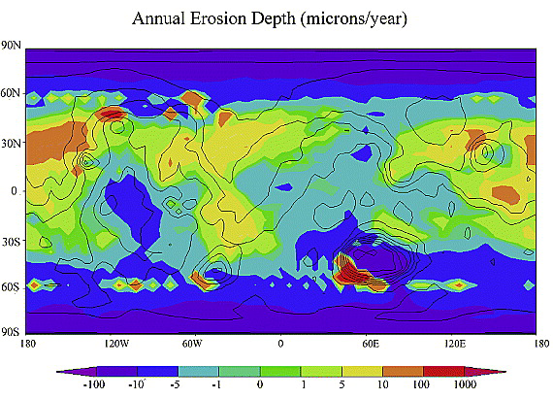
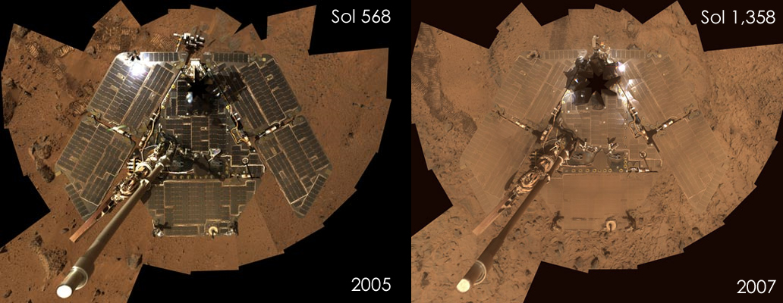
Motivation
Climate Model
The process of global dust transport is not well understood (few quantitative constraints)
How much dust is transported from region to region with time (i.e., dust flux)?
What are the locations of dust sources/sinks and how do they change with time?
Results are crucial for understanding current climate and validating climate models (top right)
Models simulate Mars at different times in geologic past
Dust redistribution is also important for surface assets that involve solar arrays (bottom right)
Important for human exploration (e.g., respiratory hazards, etc.)
Basu and Richardson, 2004
Mars Exploration Rover (Spirit) showing dust accumulation
Objective: Map year-to-year redistribution of dust using surface temperature changes (proxy for dust deposition/removal) to provide quantitative constraints
NASA/JPL-Caltech/Cornell
Notes:
I’ve shown example of dust lifting and there large collection of evidence for redistribution, but there’s a lot we don’t understand about the dust cycle (few q cosntraints)
Read into first bullet points “how much”
Validating models: important for understand the past since Mars current orbit config changes and atmosphere might also change
Context (Problem statement and relevance to the field)
The process of global dust transport is not well understood.
We do not know the actual amount of dust transported from region to region (i.e the flux), nor the locations of sources/sinks
would be pivotal in validating climate models. These models can simulate Mars at different times (orbital configurations)
Dust is important for surface assets that employ solar panels
Important for human exploration (respiratory hazard, etc.)
Why does it interest you? What are your own contributions as distinct from those of your advisor or research group?
Global scale and significant aspect of climate that shares similarities and dissimilarities to Earth
Lots of data that I have experience in analyzing
First time TES data have been used to constrain changes in dust thickness
Long baseline of TES and MCS datasets
Approaching the problem requires processing and analysis of a large amount of observations (10s of millions)
I have expertise using some of the orbital datasets employed

Slide 4
Methodology
TES Surface Temperatures MY26 | Northern Spring
Map interannual changes in surface temperature from orbit (top right)
Two thermal infrared instruments (TES and MCS; combined >10 Mars Years of observations)
Change in surface dust coverage can result in both albedo and temperature changes (Szwast et al., 2006; lower right)
TES simultaneously measured surface albedo
Use TES and thermal modeling to disentangle contributions due to albedo versus thermal insulation
Provide constraints to key question: “How much dust is transported?”
Analysis begins with TES observations before and after MY25 (2001) dust storm
Ultimately, apply relationships derived from TES towards MCS temperature maps
10+ Mars Years record of global dust redistribution
3 AM
3 PM
3 AM
3 PM
Changes from MY25 to MY26 | Northern Spring
Surface Albedo
Daytime Surface Temperature
Notes:
To capture global dust redistribution we map interannual…
Two datasets are included (TES and MCS) spanning 10+ MY
Example right shows surface temperatures at 1ppd for northern spring
Changes cause both!
However TES gives us albedo
Formulation, theory or experiment description
Map interannual changes in temperature that are associated with dust redistribution
Begin with TES data (calibrated bolometer to constrain albedo)
Focus on MY with major dust storms
Interpret MCS based on what we learn from TES analysis of MY25 storm
Innovation, advancement

Slide 5
Results
Solis
Hellas
Daedelia
Simulated three widespread regions exhibiting change (Solis Planum shown right)
Base thermal properties adopted from published maps (Putzig and Mellon, 2007)
Constrain changes due to albedo versus insulation (i.e., provide limit on thickness)
Simulated change in albedo accounts for majority of observed AM/PM temperature differences
Required dust thickness change <100 µm for all three cases
Remaining temperature differences are irreconcilable by adding or removing dust
PM
AM
MY25
Temperature (K)
MY25
MY26
MY26
L_{S}
L_{S}
Takeaway: Interannual redistribution of dust occurs as very thin layers are added or removed; thermal insulation provided by interannual dust deposition/removal is negligible
Observed Changes
Simulation Results (ΔAlbedo from TES)
Mean ΔT_{PM} = -5.3 K
Thermal Model
Mean ΔT_{AM} = -2.5 K
Mean ΔT_{PM} = -4.8 K
Mean ΔT_{AM} = -2.0 K
Mean ΔAlbedo = +0.062
Notes:
TO provide constraints and understand contributions
Next steps:
Perform additional thermal modeling to improve constraints on surface dust layers <100 µm thick
Apply relationships gleaned from TES analysis to MCS temperature maps (emphasis on MY34 global dust storm)
Accomplishments versus goals
Identified temperature changes associated with dust redistribution (TES)
By
Significance
Next steps
Finish analyzing MCS data (Apply relationships derived from TES analysis to MCS)
Confirm limits of dust thickness implied by thermal modeling

Slide 6
Thank you!
Publications and Acknowledgements
Paper in Prep:
Bapst, J., Piqueux, S., Edwards, C. S., Hayne, P. O., Kass, D. M., Kleinböhl, A. In prep. “Global Surface Dust Redistribution on Mars: Thermal Constraints on Dust Flux”.
Conference Abstracts:
Bapst, J., Piqueux, S., Edwards, C. S., Hayne, P. O., Kass, D. M., Kleinböhl, A. 2020. “Global Changes in Surface Dust Coverage using Mars Climate Sounder”. P039-04, Virtual Session at AGU Fall Meeting.
Bapst, J. and S. Piqueux. 2020. “Interannual Changes In Global Surface Dust Coverage Using Mars Climate Sounder”. Abstract 2859, 51st Lunar and Planetary Science Conference, The Woodlands, TX.

