Slide 1
Be like Taal volcano: Relieve the pressure and reduce harm
Mary Grace Bato
Organization: Org# 329A
Advisor: Name (Org #) Dr. Paul Lundgren (329A)
Postdoc Program: JPL

Slide 2
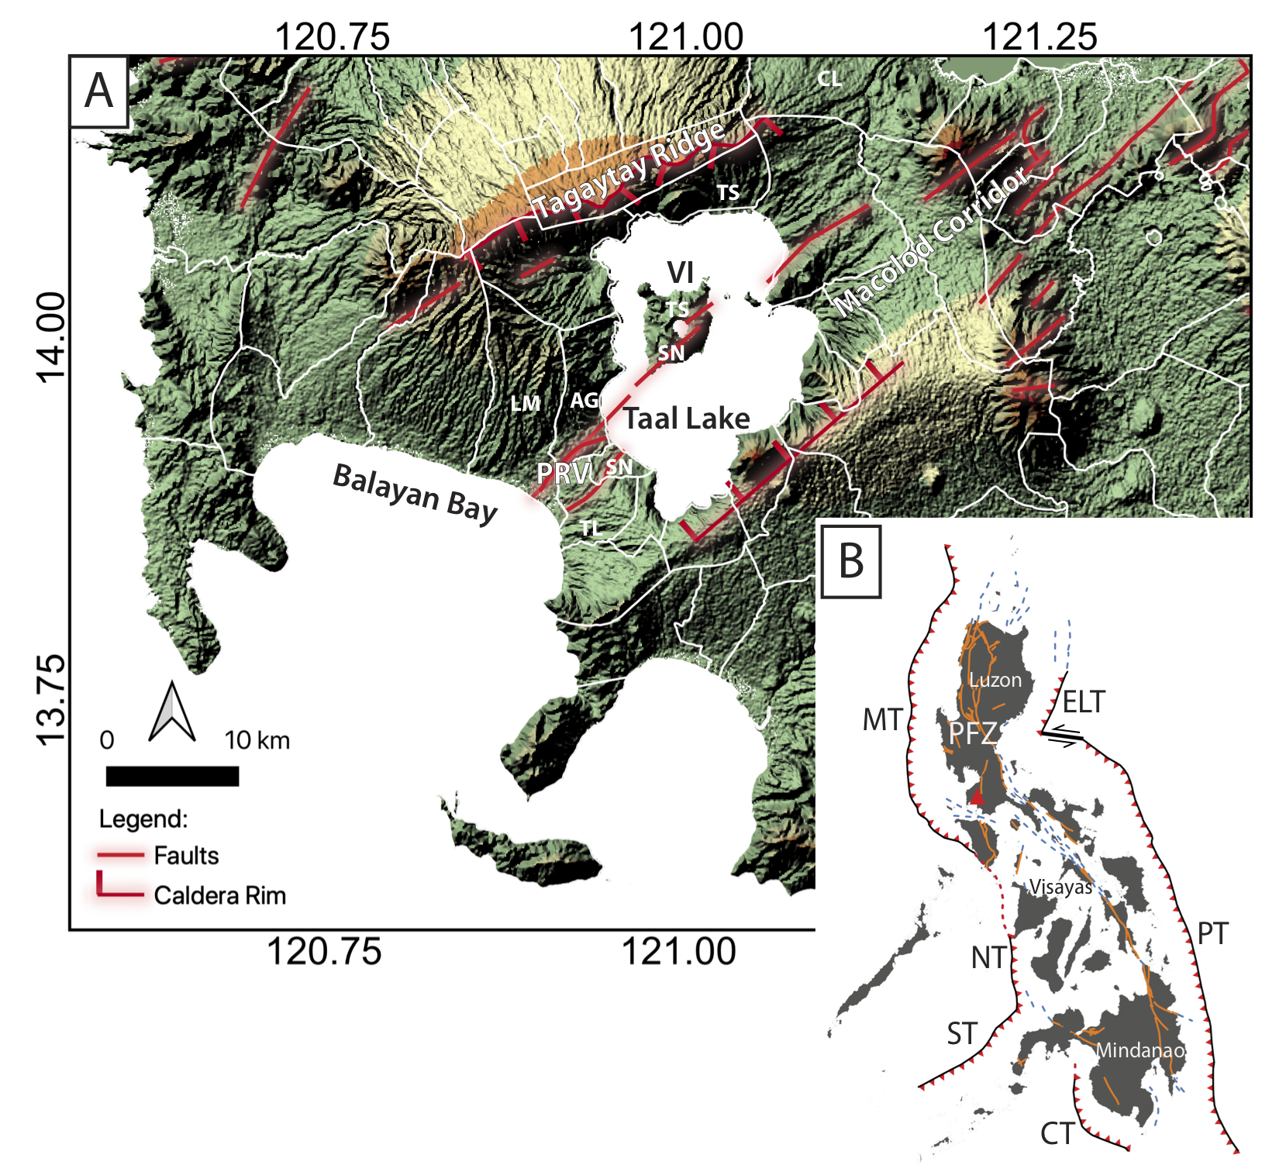
Introduction
Abstract
On 12 January 2020, Taal volcano, Philippines, erupted after 43 years of repose, affecting more than 500,000 people. Using interferometric synthetic aperture radar (InSAR) data, we present the complete pre- to post-eruption analyses of the deformation of Taal. We propose a conceptual analysis explaining the eruptive crisis and address why, despite the large volume of magma emplaced, the dike remained at depth. We also report the unique and significant contribution of low-latency InSAR data while the eruption is on-going.
This is in collaboration with Dr Virginie Pinel and the Philippine Institute of Volcanology and Seismology (PHIVOLCS).
© 2020 California Institute of Technology. All rights reserved

Slide 3
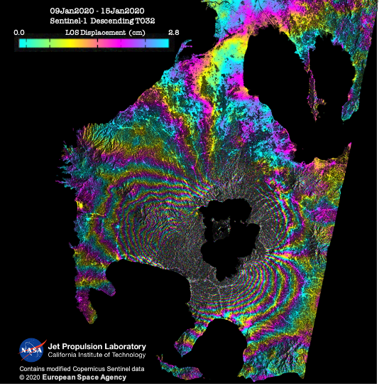
Problem Description
Context (Problem statement and relevance to the field)
When a volcanic eruption occurs, we ask the obvious however difficult fundamental questions. What drives the eruption? Why and when did the shallow magmatic storage became unstable and failed? And for Taal’s specific case, why did the magma favour lateral propagation and remain stalled at depth?
Why does it interest you? What are your own contributions as distinct from those of your advisor or research group?
One of the best gifts in life is to be able to help when you can. When Taal erupted in January 2020, most of the in-situ instruments have stopped operating. I took the initiative (with the help of Dr. Paul Lundgren) to provide low-latency InSAR data, analyses, and models to the local scientists in the Philippines while the eruption is happening to support their monitoring of the crisis and help them come up with data-driven decisions. Indeed, the role of low-latency Sentinel-1 radar data during the eruption was unprecedented!

Slide 4
Methodology
Formulation, theory or experiment description
InSAR time-series and processing
We explore pre- to post-eruptive surface deformation using SAR data from ALOS-2 and/or Sentinel-1A/B satellites between October 2014 and June 2020. We produced the interferograms using ISCE or 's processing system. The time-series were all produced using MintPy (Yunjun et al [2019]).
Geodetic modeling
Pre-eruptive state: We used the Compound Dislocation Model (CDM) implemented in the Caltech-JPL-developed AlTar v2.0 Bayesian inversion software. AlTar is based on the Cascading Adaptive Transitional Metropolis in Parallel method of Minson et al [2013]. The AlTar development at JPL for volcanic applications was supported thru SRTD.
Co-eruptive and Post-eruptive state: We performed a two-step process following Lundgren et al [2013]. (Step-1) We solve for multiple deformation source—a deflating magma reservoir beneath Taal using a CDM and a simple planar tensile dislocation (dike) model with uniform opening. (Step-2) After we fixed the parameters of the CDM and the dike, we developed a distributed opening model to further constrain the dike dimensions and opening.

Slide 5
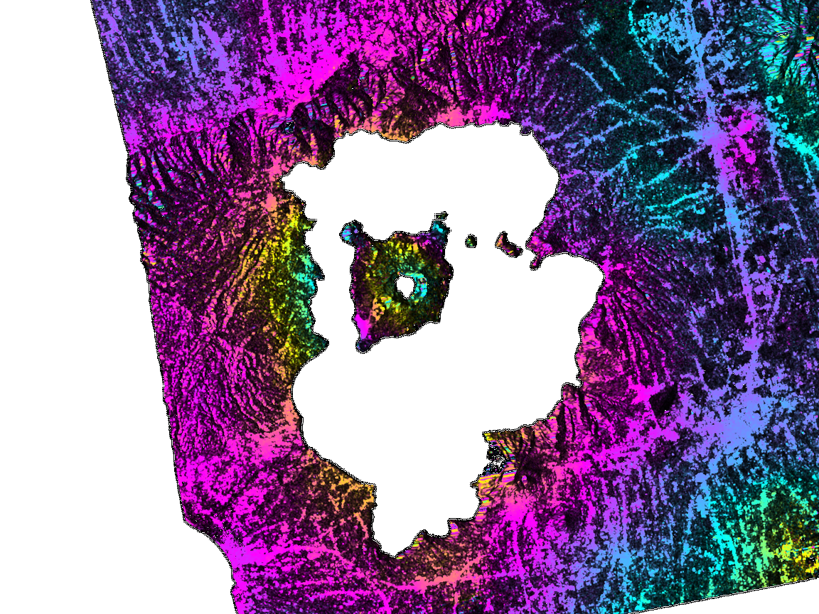
Results:
Pre-eruptive state
One of the pre-eruption ALOS-2 InSAR images of Taal that we communicated to the local observatory in the Philippines.
You can see ~1 distinct fringe pattern within the Volcano Island from 22 Jan 2019-12 Nov 2019.
Volcano Island
22Jan2019 – 12Nov2019
ALOS 2 Ascending T138
0.0 LOS Displacement (cm) 11.45

Slide 6
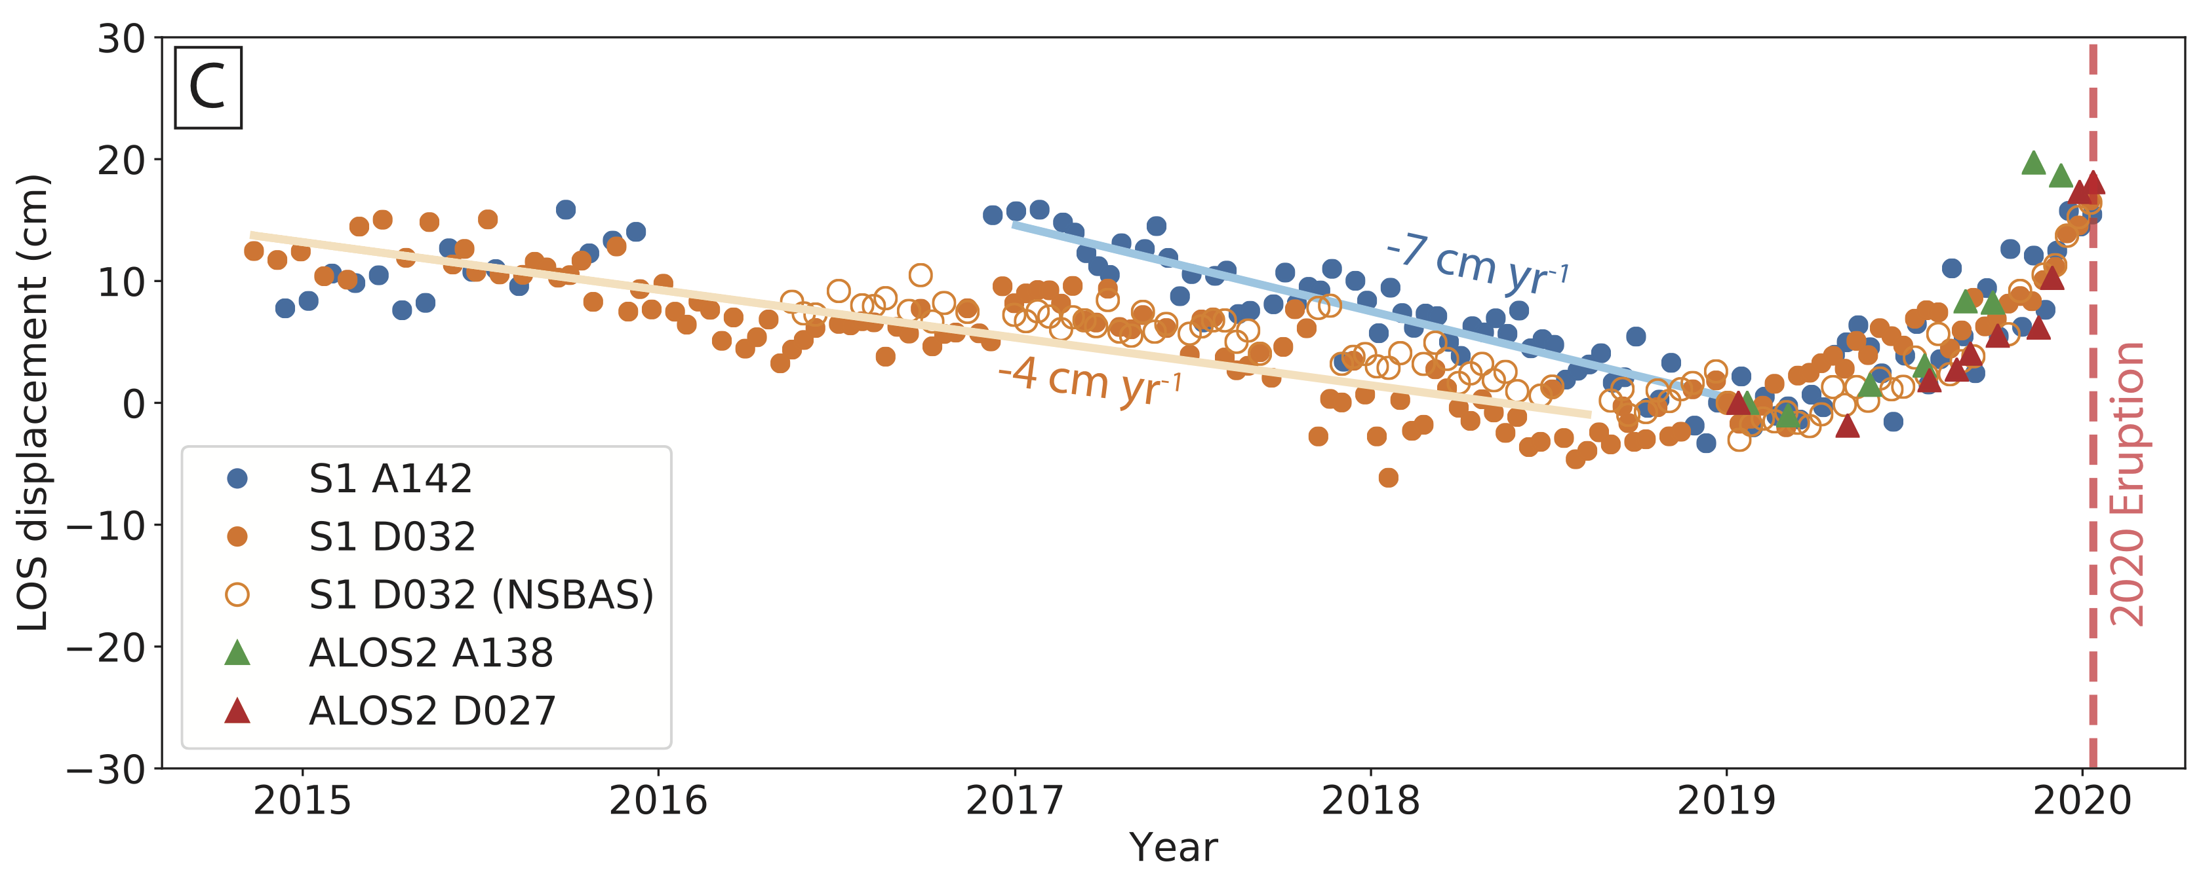
Results:
Pre-eruptive state
One of the pre-eruption ALOS-2 InSAR images of Taal that we communicated to the local observatory in the Philippines.
You can see ~1 distinct fringe pattern within the Volcano Island from 22 Jan 2019-12 Nov 2019.
Volcano Island
22Jan2019 – 12Nov2019
ALOS 2 Ascending T138
Surface LOS displacement time-series measured at the location of
0.0 LOS Displacement (cm) 11.45

Slide 7
Results:
Pre-eruptive state
Volcano Island
We modeled the inflation period of the time-series (2019-2020).
We find a NE-SW striking ellipsoidal body located at ~5 km depth beneath the Volcano Island!
Inflation period
Volume change of the magma
chamber during the inflation period
(2019-2020)
22Jan2019 – 12Nov2019
ALOS 2 Ascending T138
0.0 LOS Displacement (cm) 11.45

Slide 8
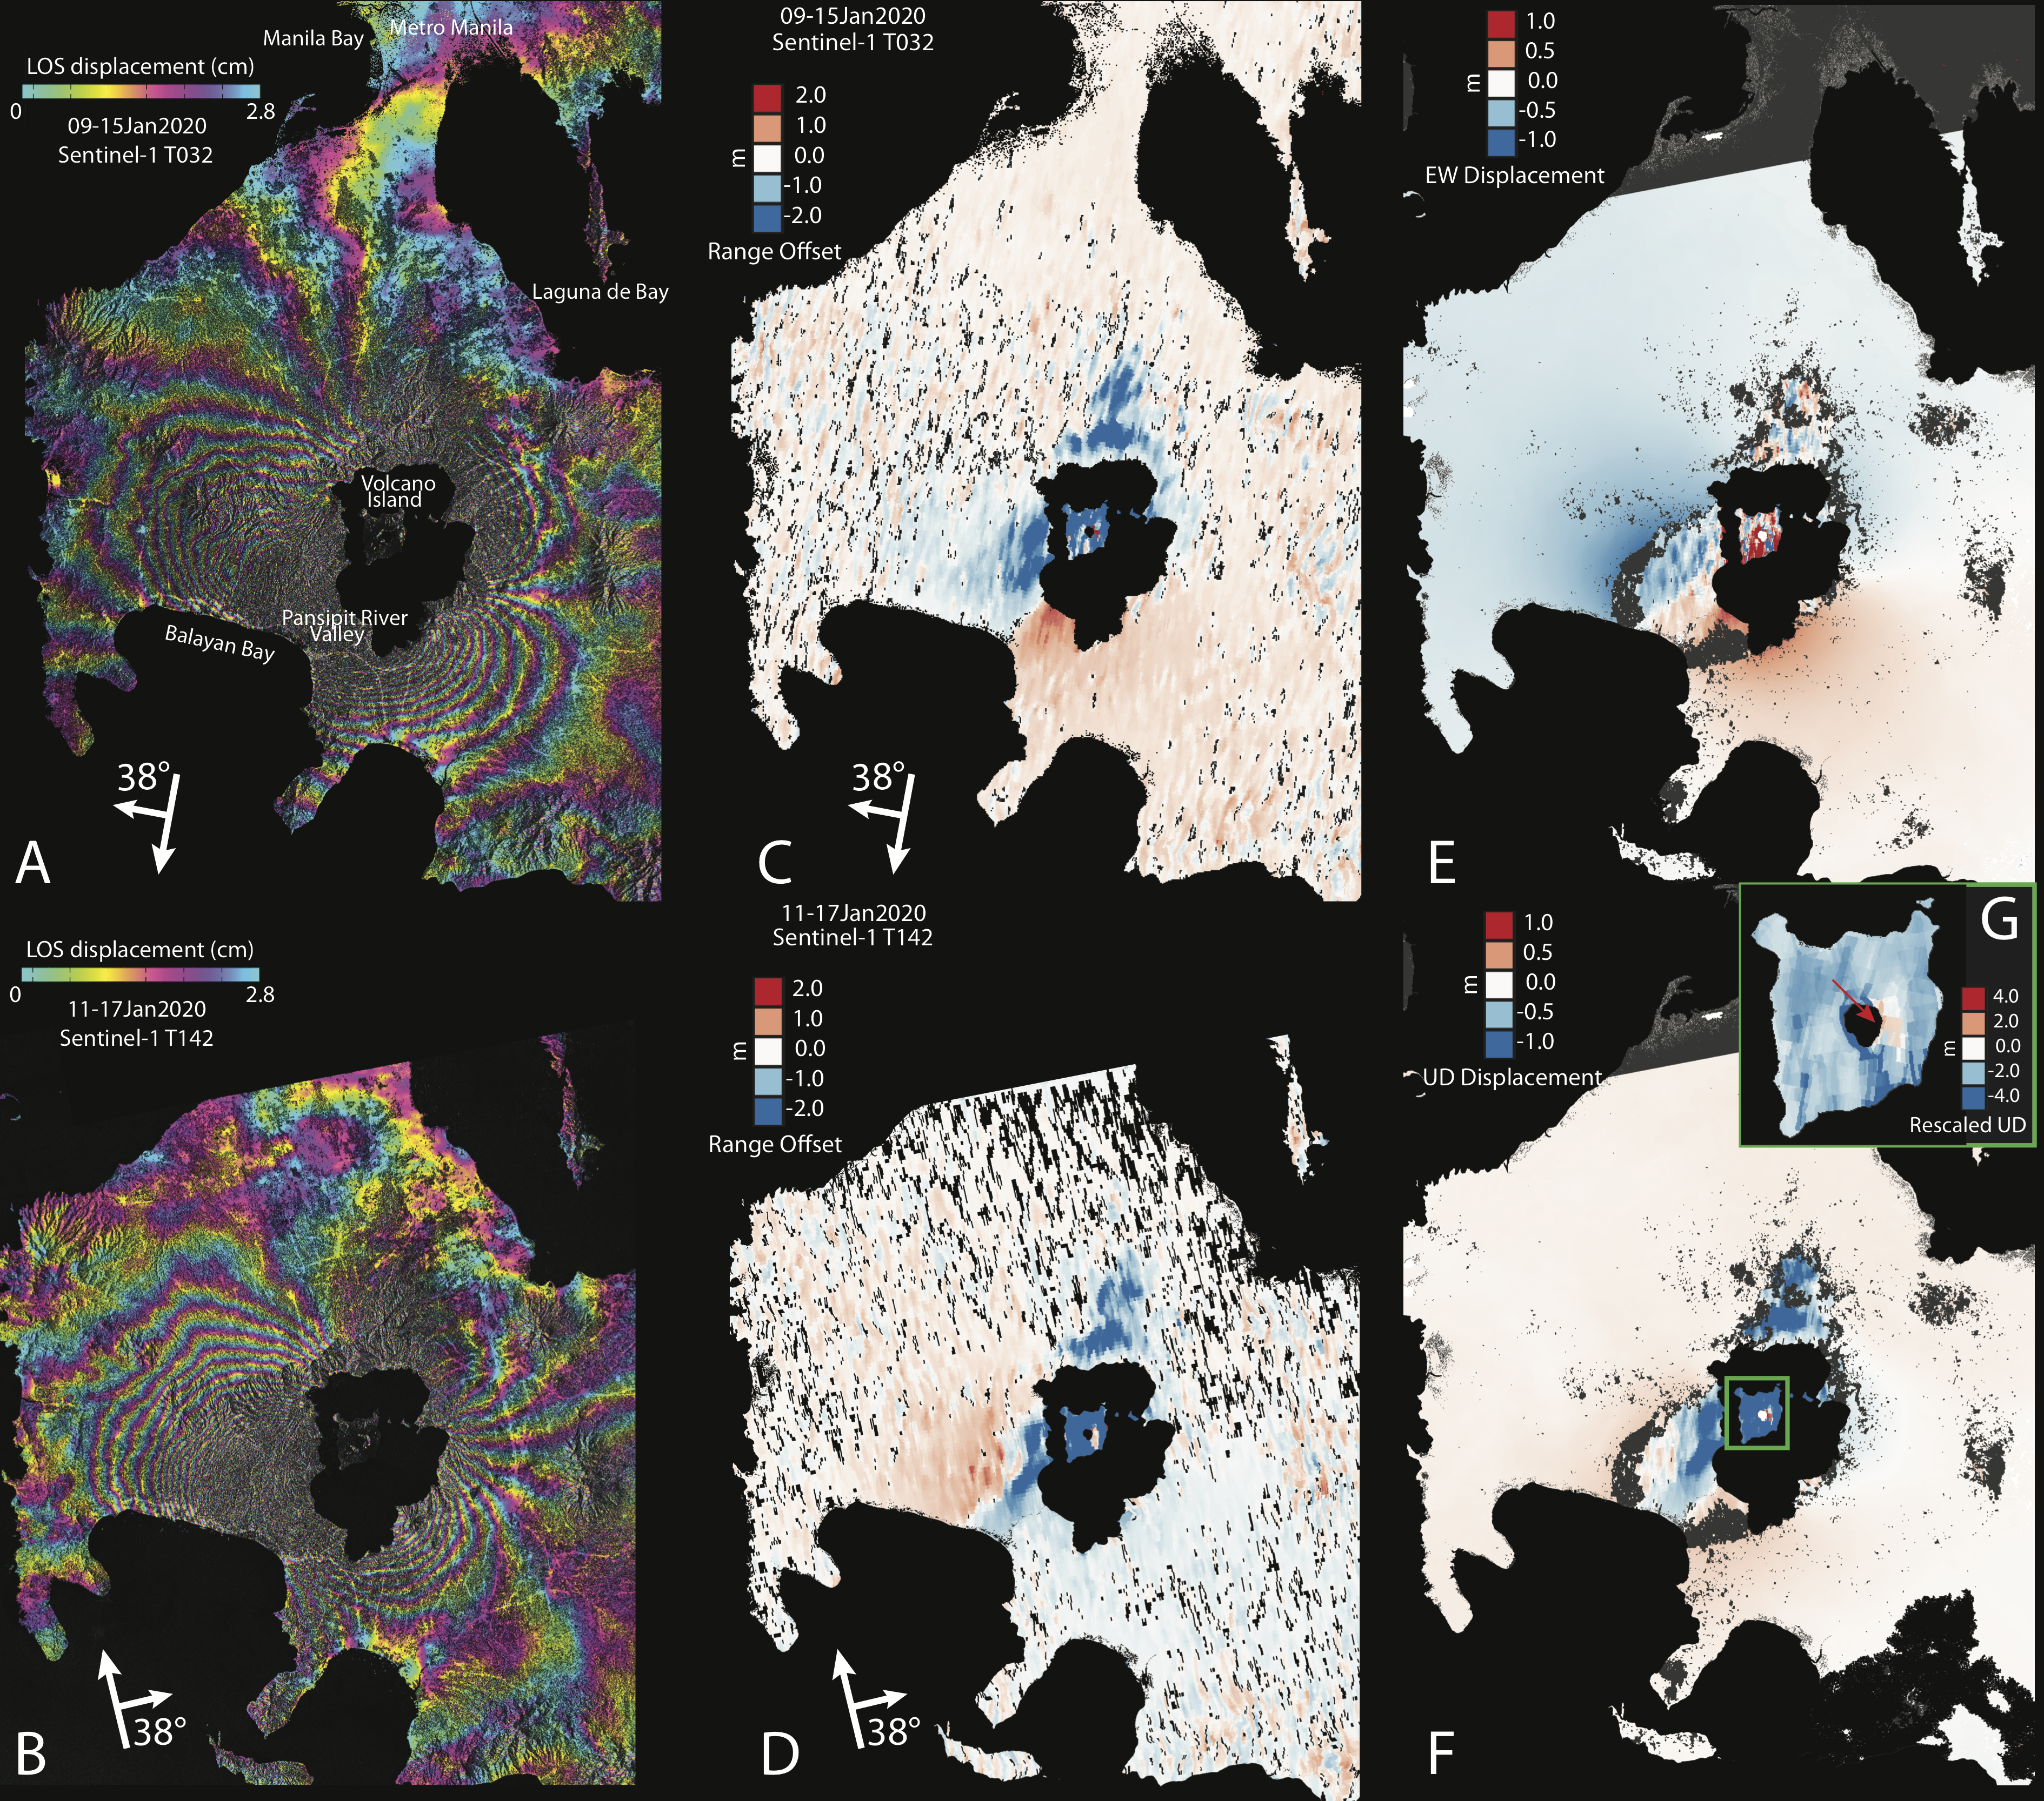
InSAR phase
Range-offset
Horizontal/Vertical
Results:
Co-eruptive state
Two distinct signals emerged: 1) The Volcano Island and the north and east portions of the Taal caldera experienced deflation of ~4m
2) The SW region from the Volcano Island towards Balayan Bay inflated (~1m) and pulled apart (~2m), with the center of the NE-SW trending rift located near the Pansipit river.

Slide 9
Results:
Co-eruptive state
= Deflating reservoir + dike
*PRV: Pansipit River Valley
VI: Volcano Island
If 50% of the dike erupted explosively, that would be a VEI 4 eruption!
Magma reservoir
Dike

Slide 10
Results:
Post-eruptive state
Post-eruption analyses reveal that the magma reservoir is re-inflating starting ~3 weeks after the main eruptive phase (January 12, 2020).

Slide 11
Results
Taal’s shallow reservoir became unstable and ruptured due to a small magma input during the short-term accumulation period. The sudden magma input might have been induced by the depressurization resulting from the degassing of the shallow storage zone, consistent with the long-term deflation preceding the short-term inflation and gas emission records.
As the magma reservoir accumulated pressure, it also interacted with the overlying hydrothermal system at approximately 2.5 km depth. The hydrothermal system may have been 1) heated, pressurized, and sealed or 2) destabilized due to the input of magma, either as small batches or through interaction with the large dike, which triggered a phreatic event and led to the failure of the magma reservoir.
Most probably, the magmatic-phreatomagmatic eruption that occurred in the Volcano Island was driven by an initial gas-rich phase which further decreased the remaining gas in the shallow storage zone. The orientation of the lateral dike is consistent with the pre-existing fault structures along the NE-SW-striking Macolod Corridor extensional zone, and appear to have played a significant role during the diking event by promoting the opening in the direction of the minimum compressive stress and the propagation along the maximum compressive stress. The fact that Taal's topography is very low could have also favored the deflection of the magma. Both the deflection of the magma path towards the edge of the caldera and the predominance of a lateral transport compared to the vertical one indicate that the magma buoyancy was reduced, probably due to the efficient gas loss at pre-eruptive and initial eruptive phases.
The Taal 2020 volcanic crisis did not result in a catastrophic eruption, despite its history and potential of creating large and destructive events, simply because there was insufficient pressure to drive the magma upward and hence remain stalled at depth.

Slide 12
Publications and Acknowledgements
Article
[1] MG Bato, P. Lundgren, V. Pinel, R. Solidum, A. Daag, and M. Cahulogan. “The 2020 eruption and mega dike emplacement at Taal volcano, Philippines: Insights from radar satellite data”, in review (GRL)
Book Chapter Contribution
[1] V Pinel, F Albino, MG Bato, JL Froger, P Lundgren. “Mesures spatiales du déplacement de surface à la compréhension et à la surveillance des volcans.” Book chapter contribution : Mesure du déplacement de surface à partir d'images de télédétection, Wiley-ISTE Editions, October 2020
Conference Abstracts
[1] MG Bato, P Lundgren, V Pinel, R Solidum, A Daag, M Cahulogan. “The 2020 Taal volcanic eruption in the Philippines: The role of satellite synthetic aperture radar data and source modeling during the crisis”, Cities on Volcanoes, Crete, Greece, 14-18 June 2021.
[2] MG Bato, P Lundgren, V Pinel, R Solidum, A Daag, M Cahulogan. “The 2020 Taal volcanic eruption in the Philippines: The role of satellite synthetic aperture radar data and source modeling during the crisis”, AGU Fall Meeting, San Francisco, California, USA, 07-11 December 2020.
Press Mention
[1] InSAR shows massive ground deformation around the erupting Taal Volcano, Temblor, January 2020

Slide 13
Publications and Acknowledgements
We thank Hook Hua, Lan Dang, and David Bekaert for activating and managing the ARIA Project Sentinel-1A/B SAR interferogram generation based on European Commission Copernicus Sentinel-1 satellite SAR data products courtesy of the European Space Agency. All the ARIA-produced interferograms used in this study are accessible via https://aria-products.jpl.nasa.gov/. We thank the Japan Aerospace Exploration Agency (JAXA) for providing ALOS-2 PALSAR-2 SAR L1.1 (SLC) data through RA6 Proposal P3024002 (PI Lundgren) used in the analyses; original L1.1 products © JAXA 2019-2020. We are also grateful to Chris Newhall and Eric Fielding for the helpful discussions during the peak of the eruption, as well as to Társilo Girona for the thermal warming time-series. Part of this research was carried out at the Jet Propulsion Laboratory, California Institute of Technology, under a contract with the National Aeronautics and Space Administration (grant 281945.02.47.04.51). AlTar software development and modeling supported through the JPL R&TD program (project number 01STCR- R.18.245.034).

Slide 14
© 2020 California Institute of Technology. All rights reserved

