Slide 1
2020 Postdoc Research Day Presentation Conference
Standing on Apollo’s Shoulders: a Microseismometer for the Moon
Ceri Nunn
Organization: Org# 3226
Advisor: Name (Org #) Mark Panning (3226)
Postdoc Program: JPL

Slide 2
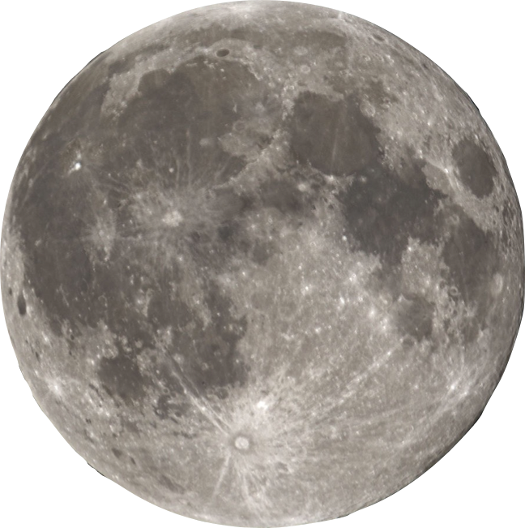
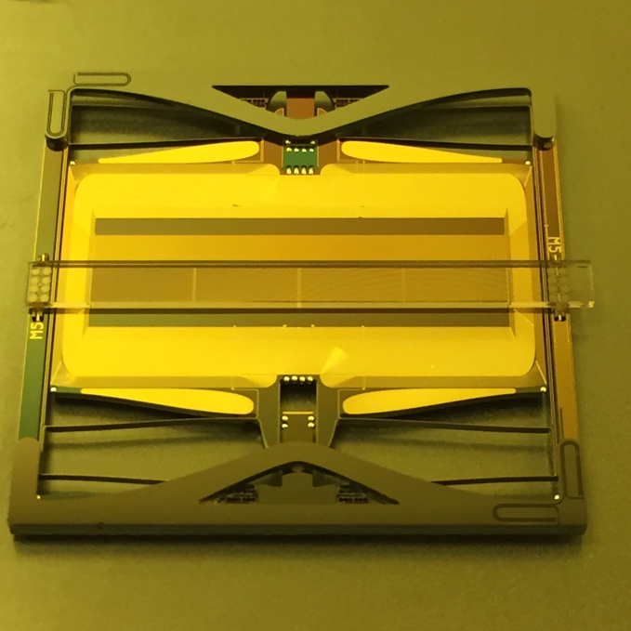
SSP Microseismometer
Silicon Seismic Package
The microseismometer has Micro-Electro-Mechanical Systems (MEMS) sensors, that are:
etched on a silicon wafer
small
lightweight
SEIS-SP is deployed on Mars
25 mm

Slide 3
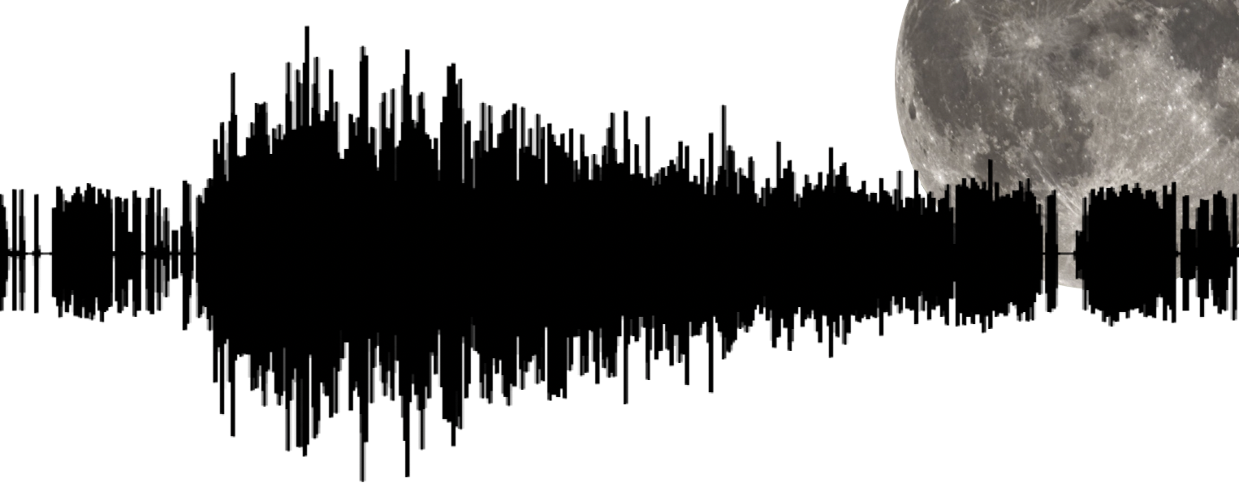
Question
13,000 seismic arrivals (moonquakes, meteoroid impacts and artificial events) were recorded by the Apollo seismometers in 8 years of operation.
Can the microseismometer be better than Apollo?

Slide 4
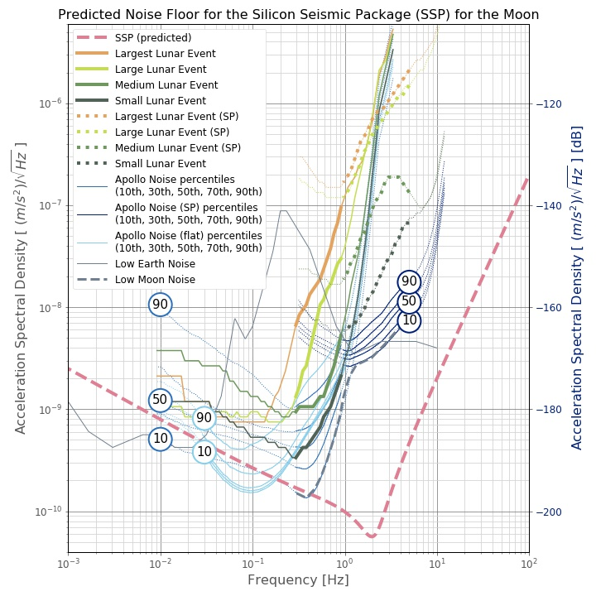
Apollo versus the SSP
Largest event
Predicted noise floor for SSP
Noise range
Short-period instrument
Smallest events
Noise range
Mid-period instrument
From: Nunn et al., submitted to Planetary Science Journal, 2020

Slide 5
Can the microseismometer be better than Apollo?
The SSP is predicted to have a:
similar noise floor to the Apollo instruments between 0.3 and 0.5 Hz
lower noise floor (better than) Apollo above 0.5 Hz

Slide 6
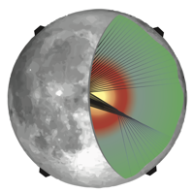
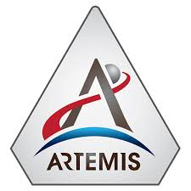
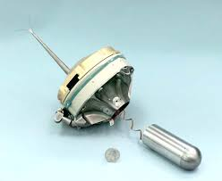
Lunar Geophysical Network?
Future Missions?
Lunar Geophysical Package?
(for Artemis)
MoonShake:
Seismic network delivered by penetrators?

Slide 7
Backup Slides

Slide 8
Publications and Acknowledgements
in review | Nunn, C., Pike, W.T., Standley, I.M., Calcutt, S., Kedar, S., Panning, M.P., submitted to Planetary Science Journal. Standing on Apollo’s Shoulders: a Microseismometer for the Moon.
2019 | Standing on Apollo’s Shoulders: MEMS seismometers for the Lunar Geophysical Network, AGU Fall Meeting 2019, eLightning talk
2019 | Scoping MEMS seismometers for the Moon, EGU, Vienna, 2019, talk
2019 | Scoping MEMS seismometers for the Moon, LPSC 50, The Woodlands, TX, poster
With thanks to Mark Panning, Steve Vance, and my co-authors Tom Pike, Ian Standley, Simon Calcutt and Sharon Kedar.

Slide 9
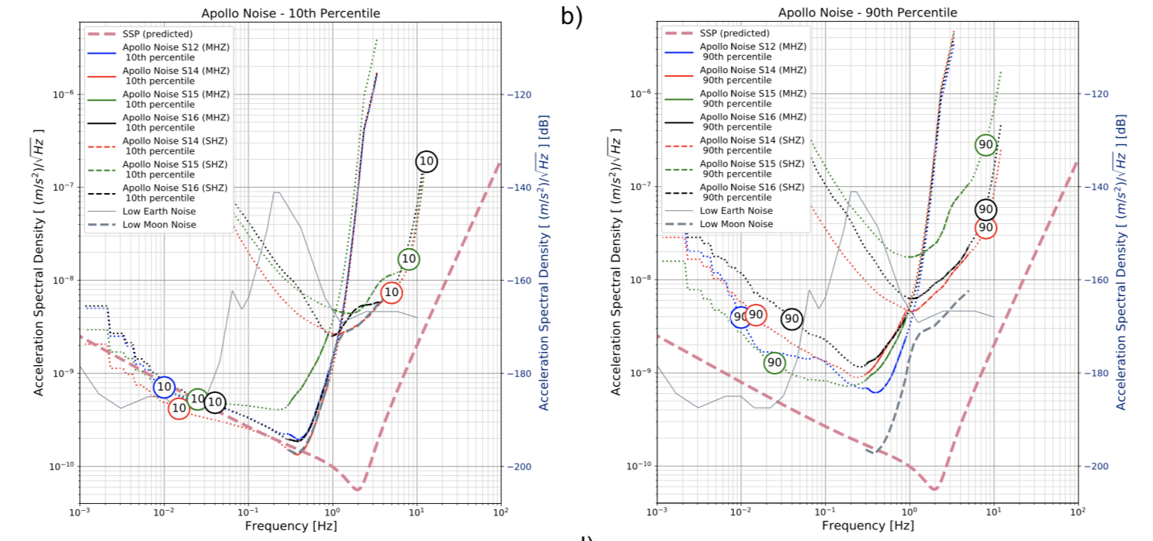
Apollo Noise
From: Nunn et al., submitted to Planetary Science Journal, 2020

Slide 10
Apollo Noise
From: Nunn et al., submitted to Planetary Science Journal, 2020

Slide 11
At each of the Apollo sites, how low was the noise environment of the Moon?
1) Wide range at each site
2) Wide range between sites
3) Different seismicity rates for different stations.
4) 2-5 digitization levels
Apollo seismometers recorded close to the noise of the Moon (we can’t say exactly how close).
We can stack signals from different seismometers to achieve a better signal-to-noise ratio.

