Slide 1
Image credit: "Dubai Sunset" by the_dead_pixel,
CC BY 2.0
The Emergence of Heat and Humidity Too Severe for Human Tolerance
Colin Raymond
Organization: 329J
Advisor: Duane Waliser (8000)
Postdoc Program: JPL

Slide 2
Introduction
Abstract
Extreme heat has emerged as one of the most certain and high-impact consequences of anthropogenic climate change. Further rapid increases are projected, which, in combination with increasing humidity, will bring us into direct conflict with the immovable human-physiological barrier of a 35ºC “wet-bulb temperature” [Tw]. Current climate-model projections suggest this will begin to happen around 2050.
Our evaluation of a global weather-station dataset reveals that in fact Tw=35ºC has already occurred, and that extreme humid heat overall has more than doubled in frequency since 1979. Broadly, these trends are closely related to tropical-mean warming -- but the highest values are very localized, helping to explain their underestimation in models and reanalysis products. These findings underscore the serious challenge posed by humid heat that is more intense than previously known and increasingly severe.

Slide 3
Problem Description
Basis: Physiological studies have shown that there is an upper thermal limit for human survivability with sustained exposure, and model-based climate studies have shown this will be reached in the hottest/most humid places on the planet around 2050. Our investigation was aimed at determining
whether station observations might bring this date forward, and
which areas are of the greatest concern.
b) Conception: This project grew from my interest in the interactions between climate extremes and regional geography, within my advisor’s general extremes-oriented group. I conceptualized the project, invited co-authors, and performed the bulk of the analysis.

Slide 4
Methodology
Data and methods: Detailed analysis of hourly air temperatures and dewpoint temperatures for ~7,500 global weather stations from HadISD, compared against ERA-Interim reanalysis, and supplemented with sea-surface temperatures and CMIP6 model projections. Analysis subparts comprised extensive quality control, regional and global trend computations, and seasonal breakdowns.
Novelty: Our study was the first to examine humid-heat extremes at a global scale, and to directly compare across regions. We also developed a unique generalized-extreme-value-based statistical method for synthesizing our results with previous ones using gridded datasets. Furthermore, this is the first attempt at characterizing and explaining model projections of future extreme humid heat.

Slide 5
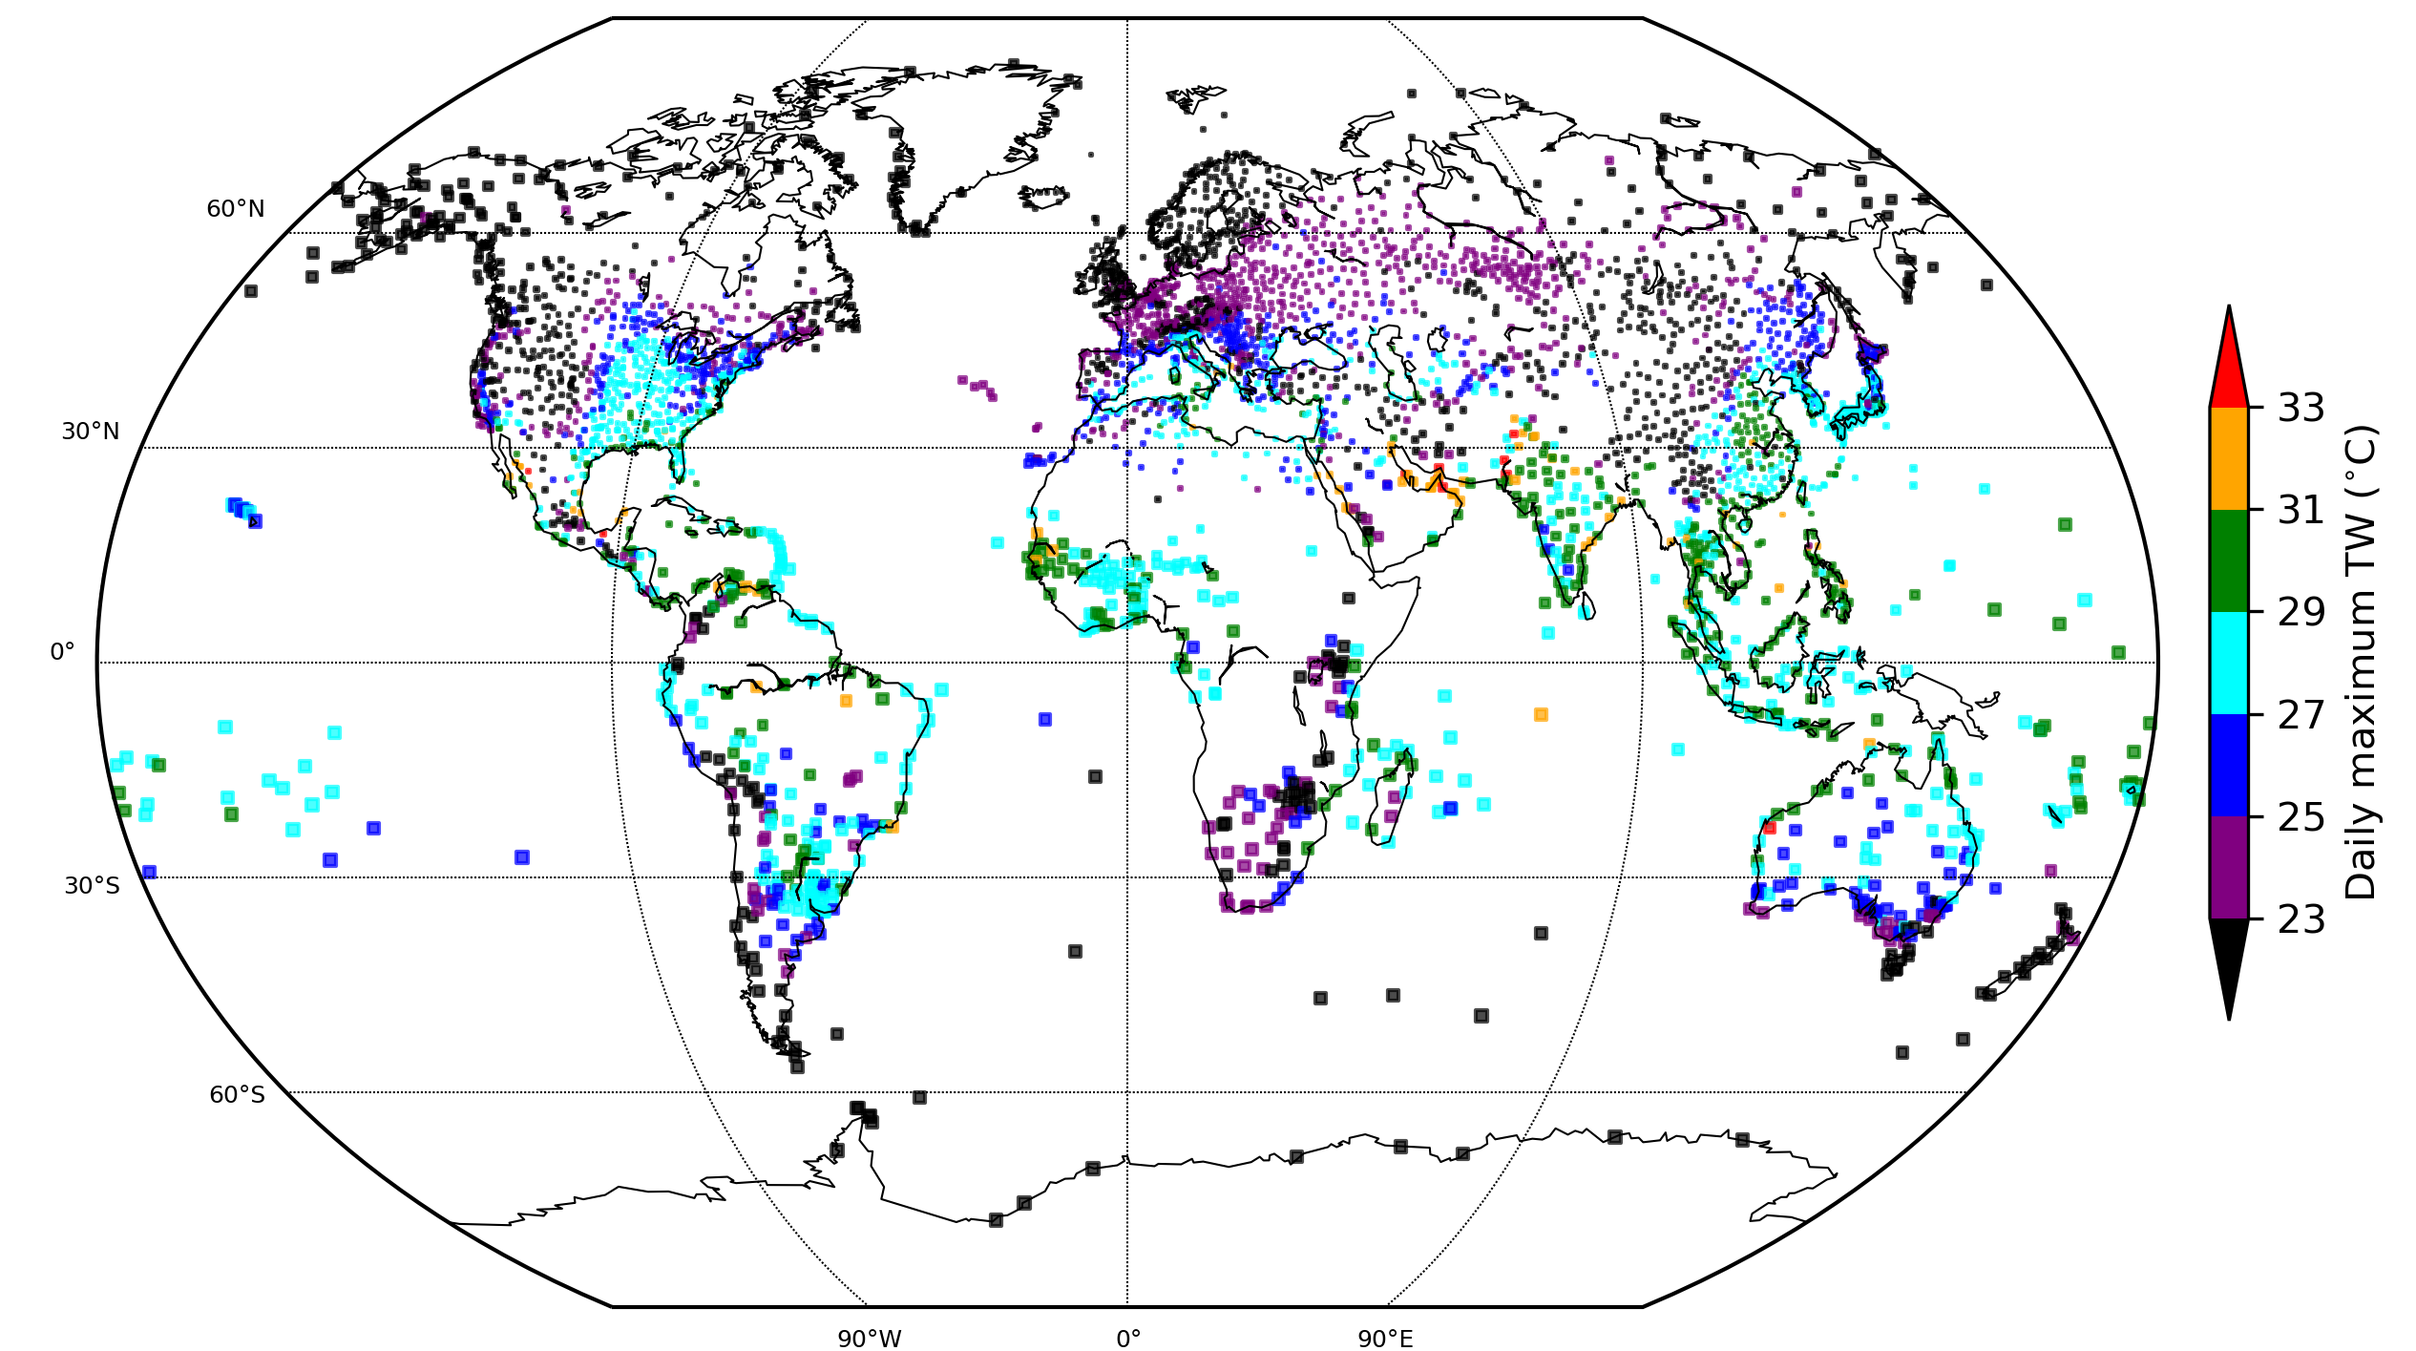
Results I
Revealing of global patterns and hotspots
Tw values higher than previously known
->14 exceedances of 35C in Persian Gulf & Pakistan
Coastlines of subtropical gulfs emerge as hotspots
Raymond et al., 2020

Slide 6
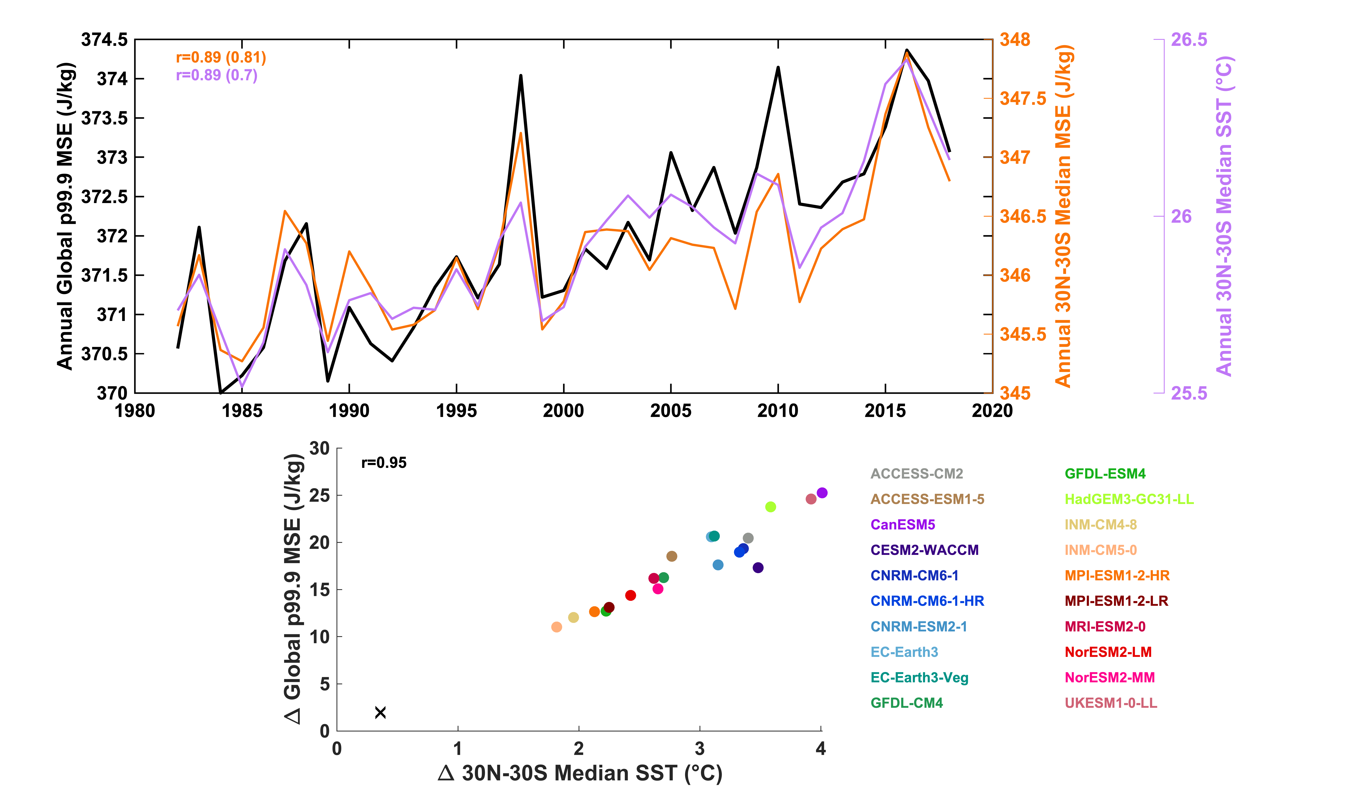
Results II
Tight connection with global tropical SST, in observations & projections
Rapid upward trends in extreme Tw
r²=0.65
r²=0.49
Count (ERA-Interim/HadISD)
Raymond et al., 2020
Raymond et al., in prep.
More than a doubling in 40 years
Highest values underestimated by gridded products
Annual tropical SST explains half of interannual variability in extreme Tw
Strong relationship also holds across CMIP6 models

Slide 7
Publications
Raymond, C., Matthews, T. K. R., and Horton, R. M. (2020). The emergence of heat and humidity too severe for human tolerance. Science Advances. doi:10.1126/sciadv.aaw1838.
Raymond, C., Fischer, E. M., Fueglistaler, S., Horton, R. M., Ivanovich, C., Matthews, T. K. R., Suarez, L., and Zhang, Y. Controlling factors for global heat-humidity extremes. In prep.
Contact Information
colin.raymond@jpl.nasa.gov
Office: 233-201C

