Slide 1
Detecting and characterizing enhanced methane emissions from coastal wetland vegetation with airborne imaging spectroscopy in Louisiana’s Terrebonne Basin
Daniel Jensen
Organization: 334F
Advisors: Marc Simard (334F), David Thompson (382B)
Postdoc Program: NASA Postdoctoral Program

Slide 2
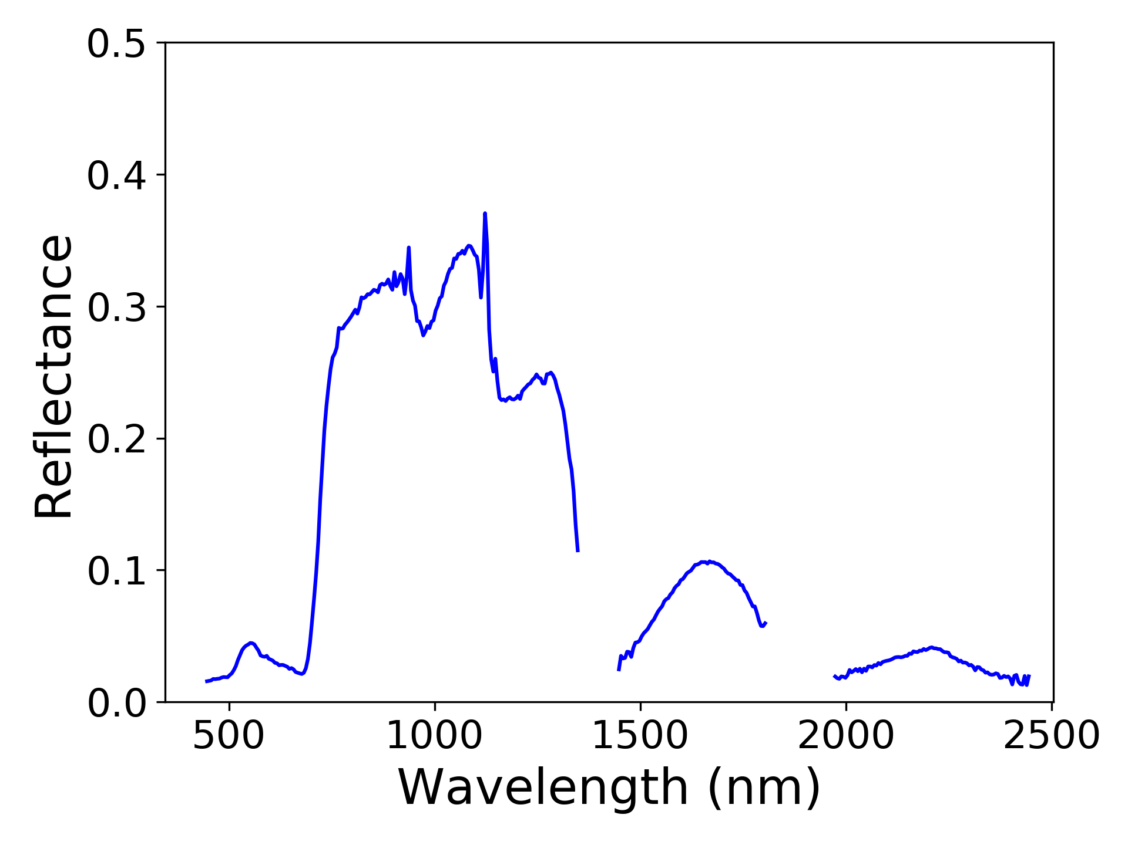
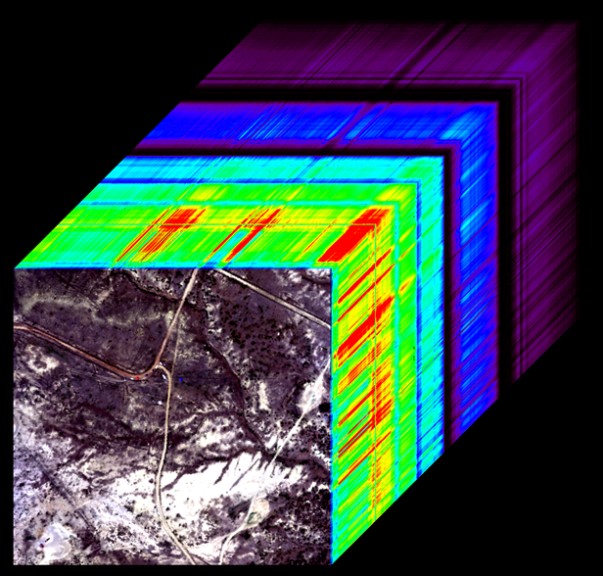
Introduction
Methane is naturally emitted in wetland ecosystems as organic matter within the soil’s aerobic zone decays
Wetlands may emit increased methane as they are degraded by relative sea level rise and anthropogenic forces
Recent airborne remote sensing campaigns have demonstrated imaging spectroscopy’s utility for detecting both point-source methane plumes and more diffuse emissions in natural environments
NASA’s Airborne Visible/Infrared Imaging Spectrometer—Next Generation (AVIRIS-NG) can investigate the distribution and spectral characteristics of methane enhancements in coastal wetlands throughout Louisiana’s degrading Terrebonne Basin
(https://aviris-ng.jpl.nasa.gov/science.html)

Slide 3
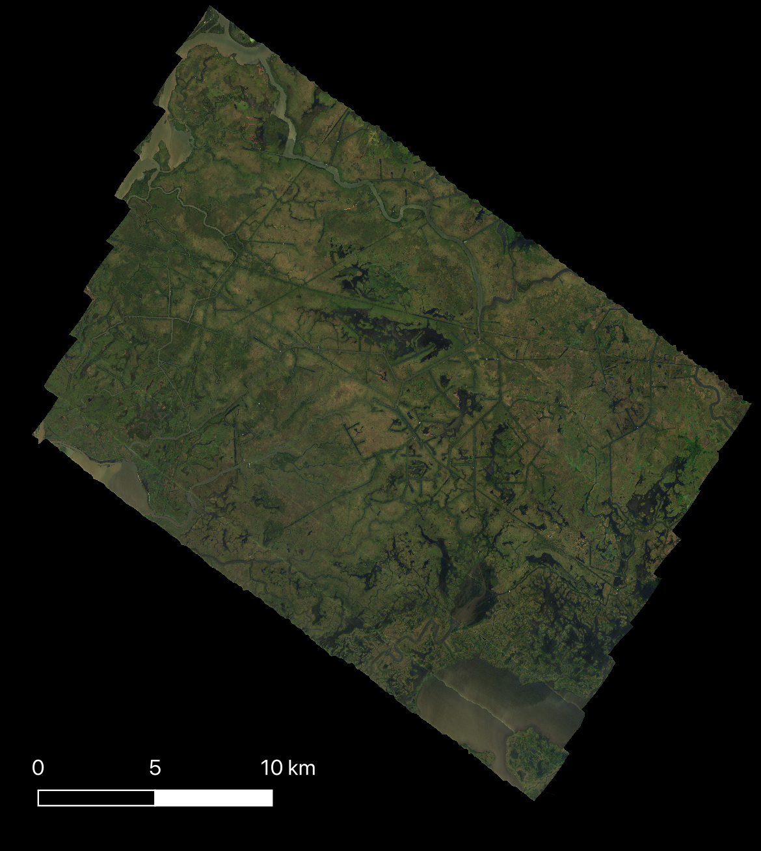
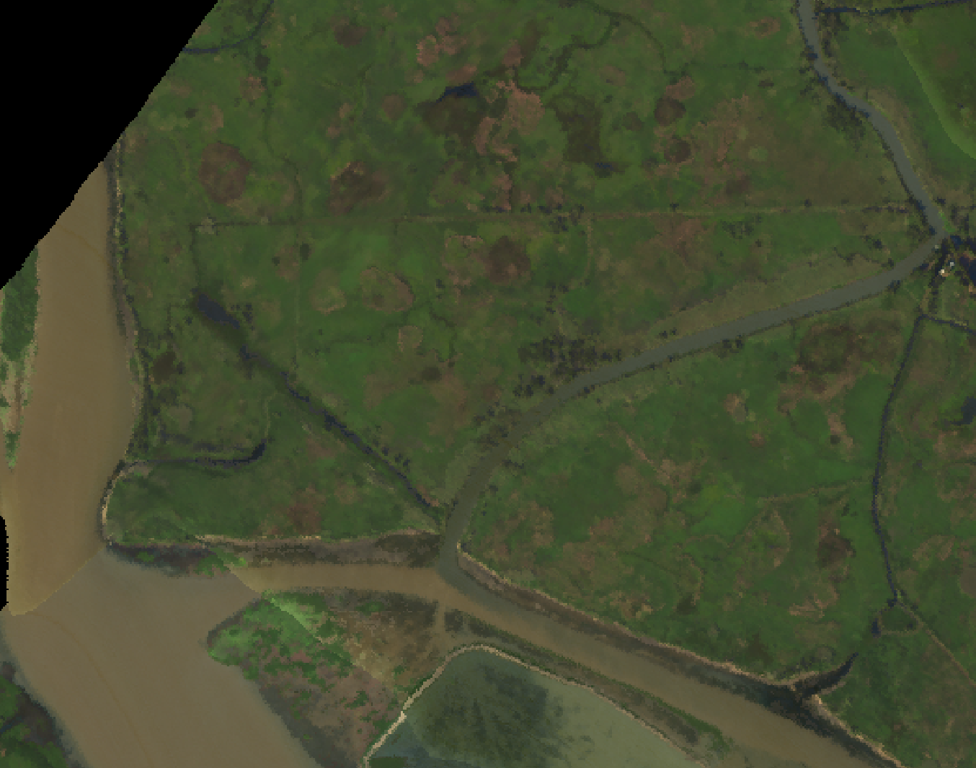
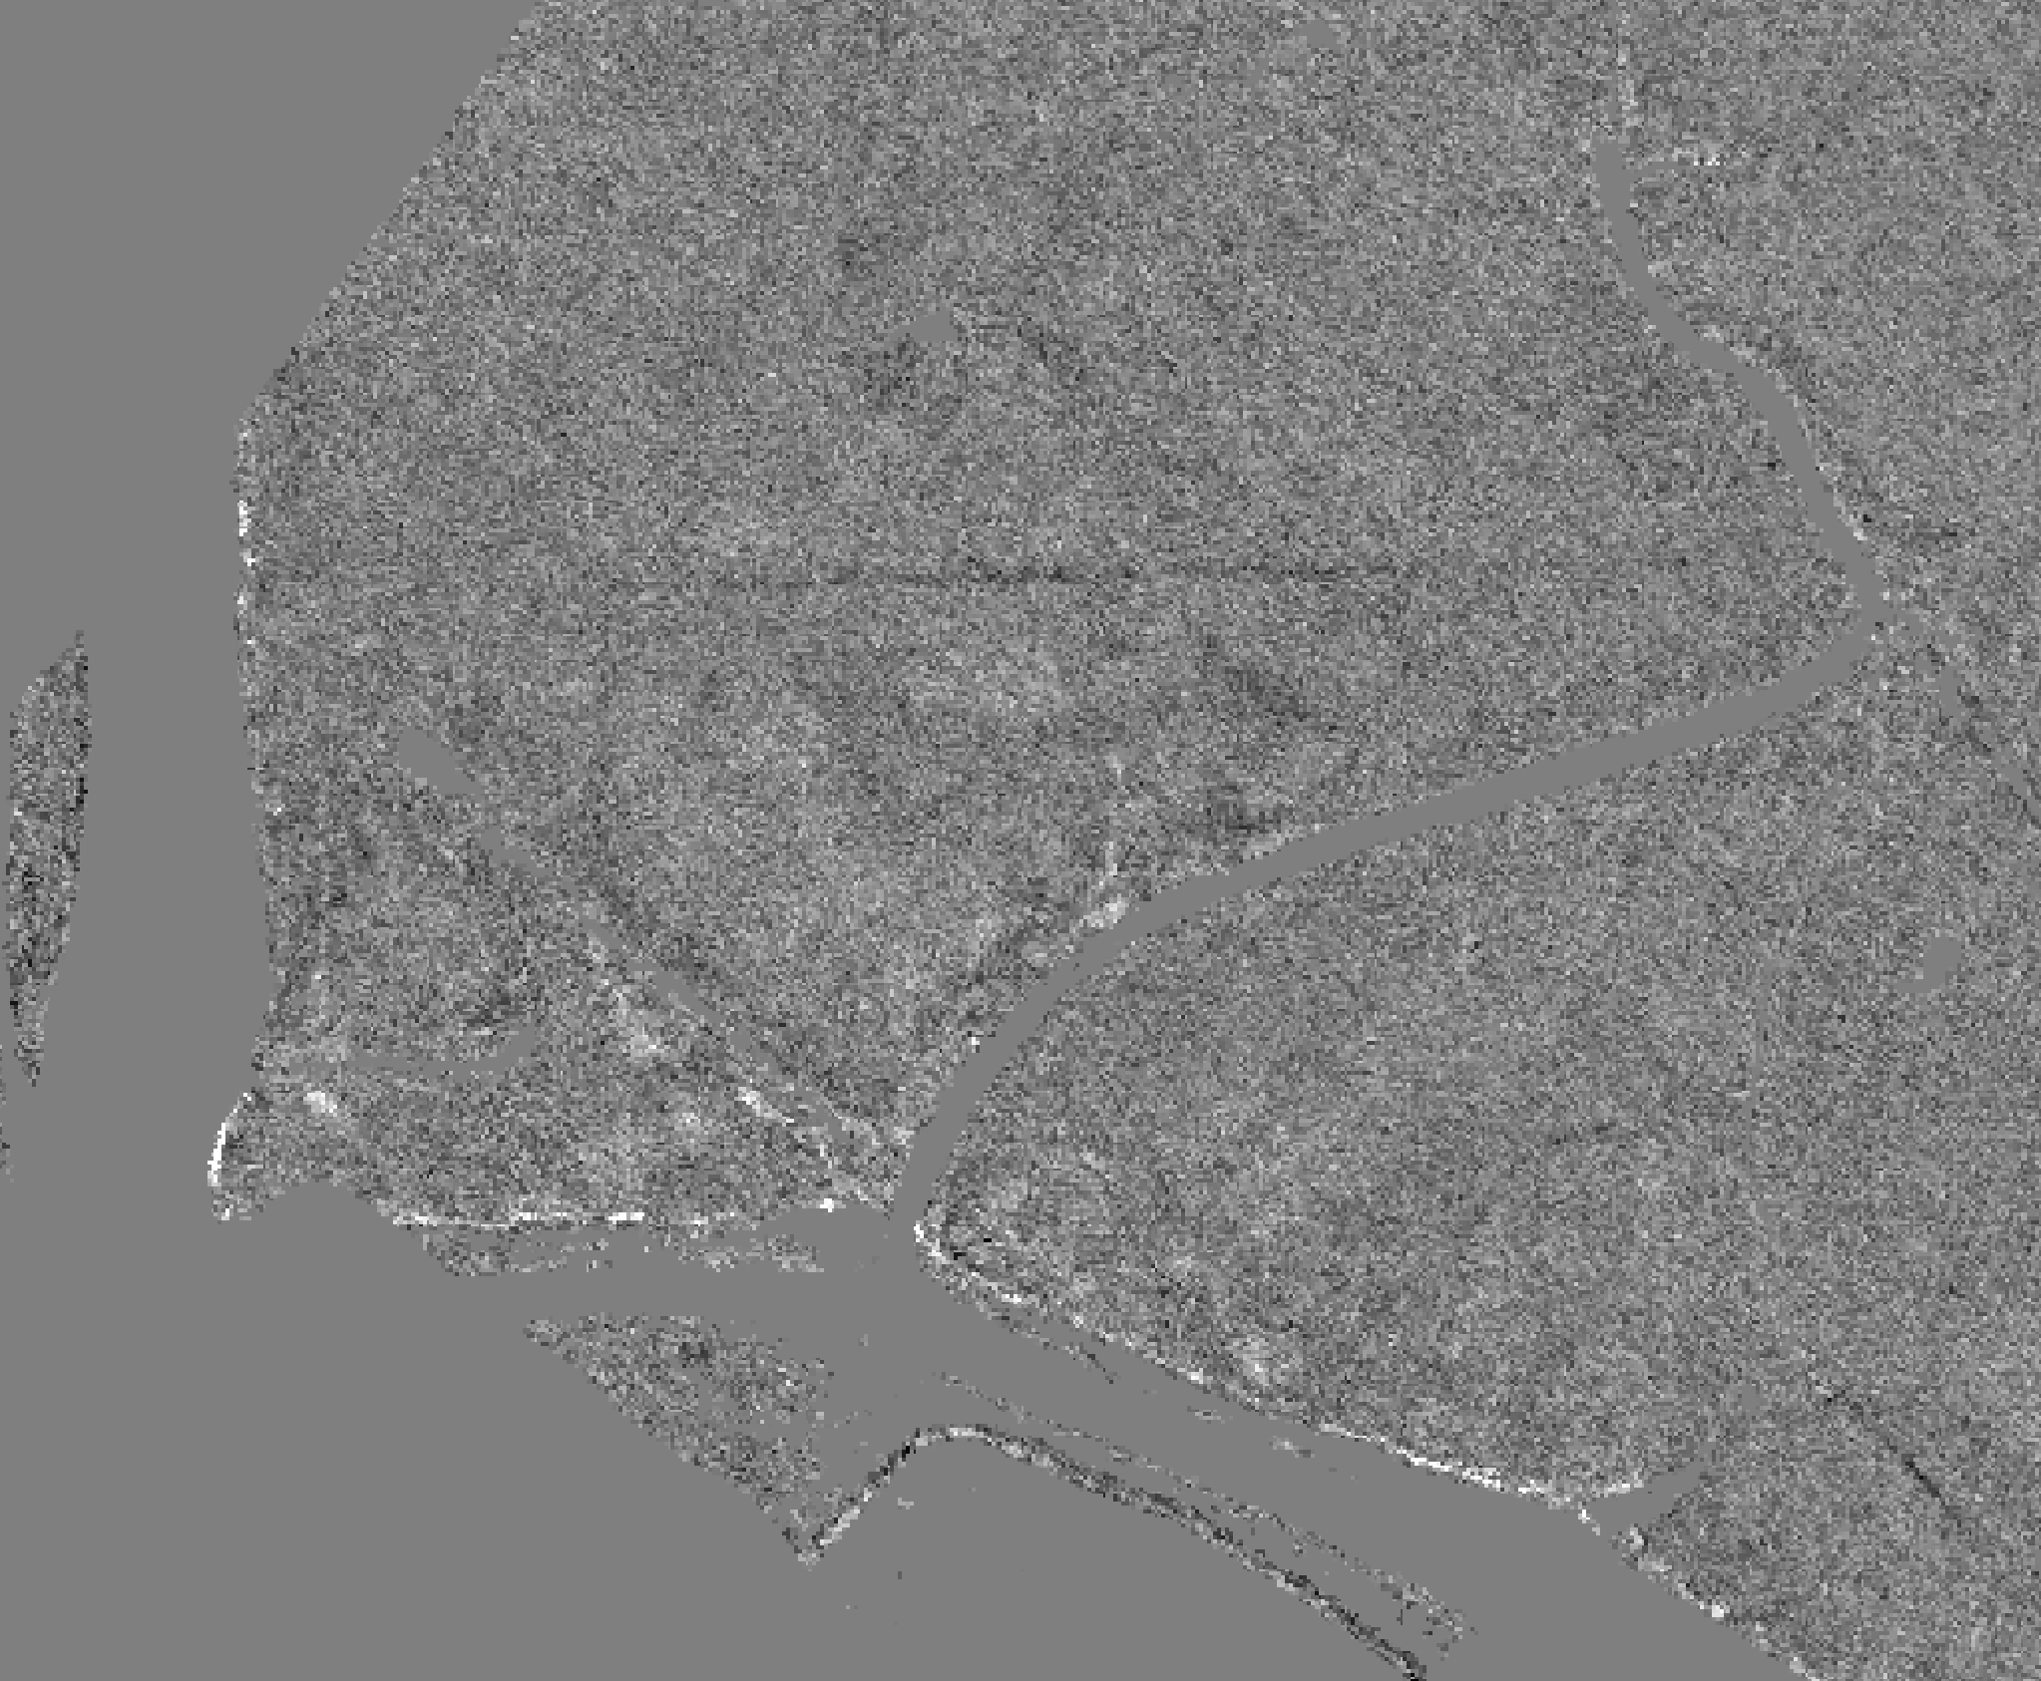
Problem Description
How does enhanced methane output vary across Louisiana’s Terrebonne Basin?
What plant types are associated with higher methane output?
What conditions are associated with enhanced methane output high-emitting plant types?
What spectral features are associated with enhanced methane output in high-emitting plants and soils?
AVIRIS-NG Methane enhancement detection
Pixels with CH₄ concentrations (ppm m) 3.5 standard deviations higher than mean
AVIRIS-NG Data → Estimated CH₄ Concentration → CH₄ Enhancement Pixels
CH₄ Concentration
(ppm m)

Slide 4
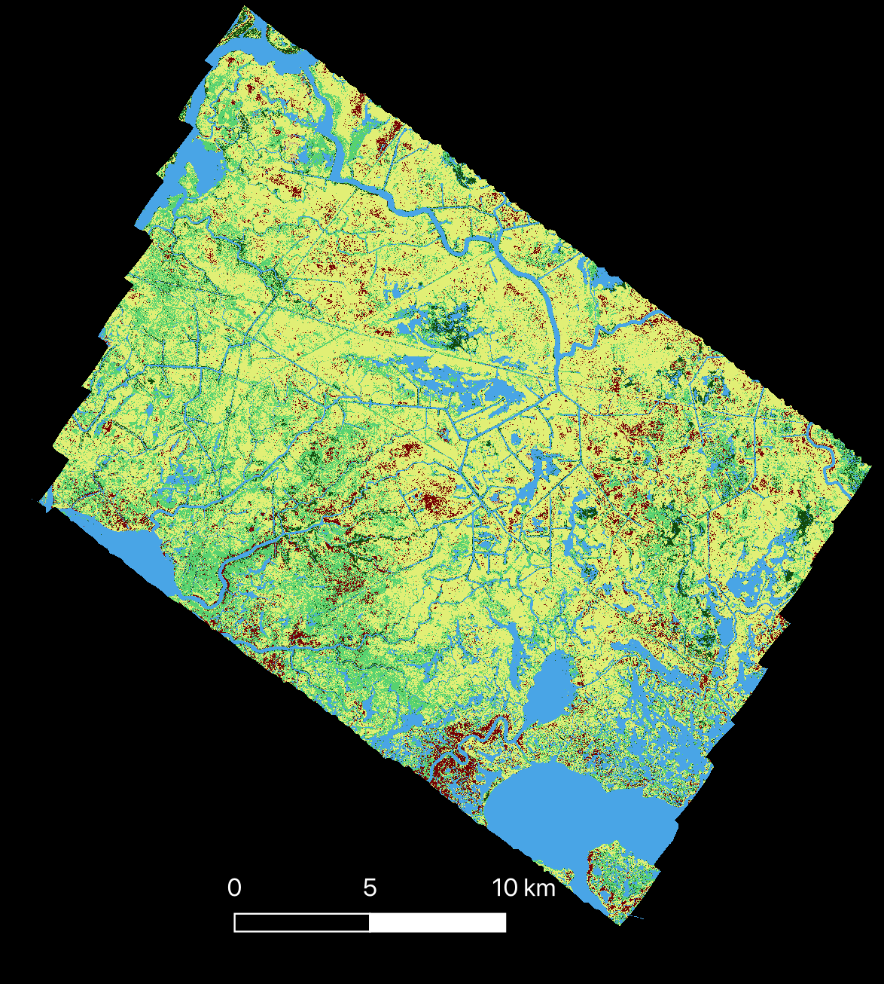
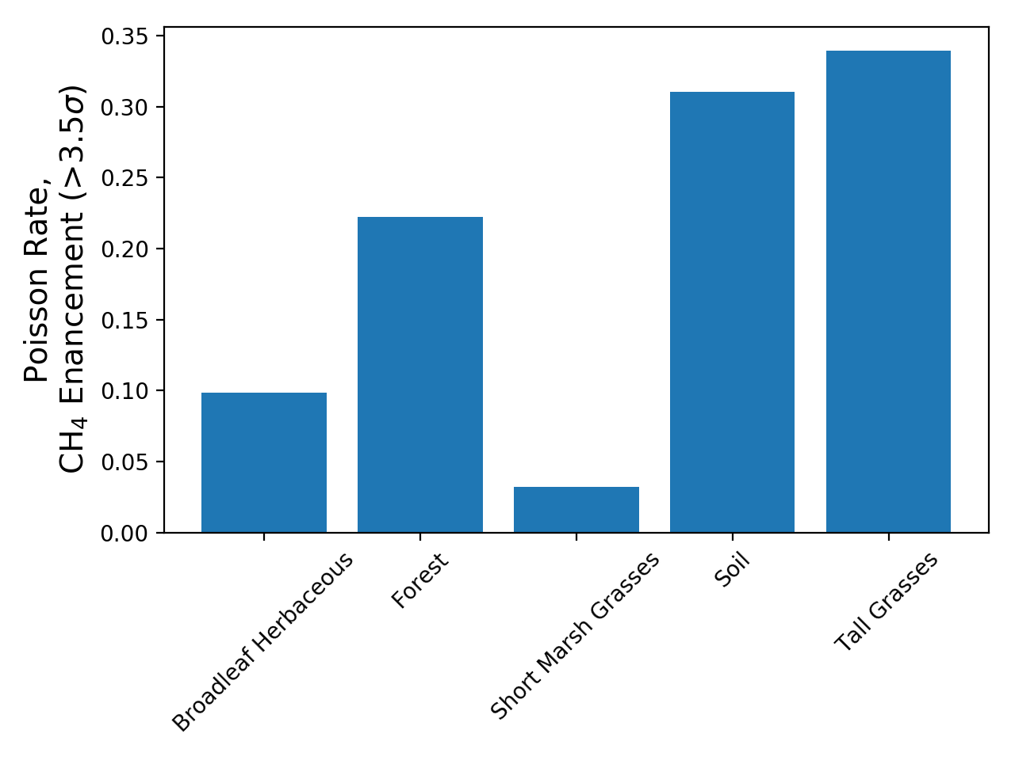
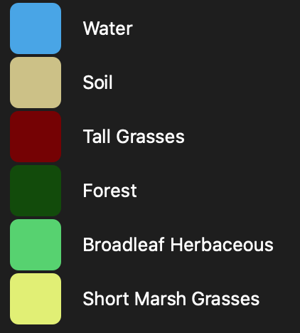
Methodology:
Vegetation Mapping
Vegetation mapping discriminates important plant classes associated with different apparent methane enhancement distributions
Spectral library compiled from USGS Spectral Library v7 samples (Kokaly et al. 2017) and pixel spectra coinciding with Louisiana’s Coastwide Reference Monitoring System (CRMS) stations
Partial Least Squares Discriminant Analysis (PLS-DA)
Poisson rates for CH₄ enhancement pixels show the prevalence of increased methane output by class
$$Poisson Rate= \frac{n enhanced pixels}{n all pixels in class or bin}$$
Forest
Phragmites australis (Tall Grasses)
Broadleaf Herbaceous

Slide 5
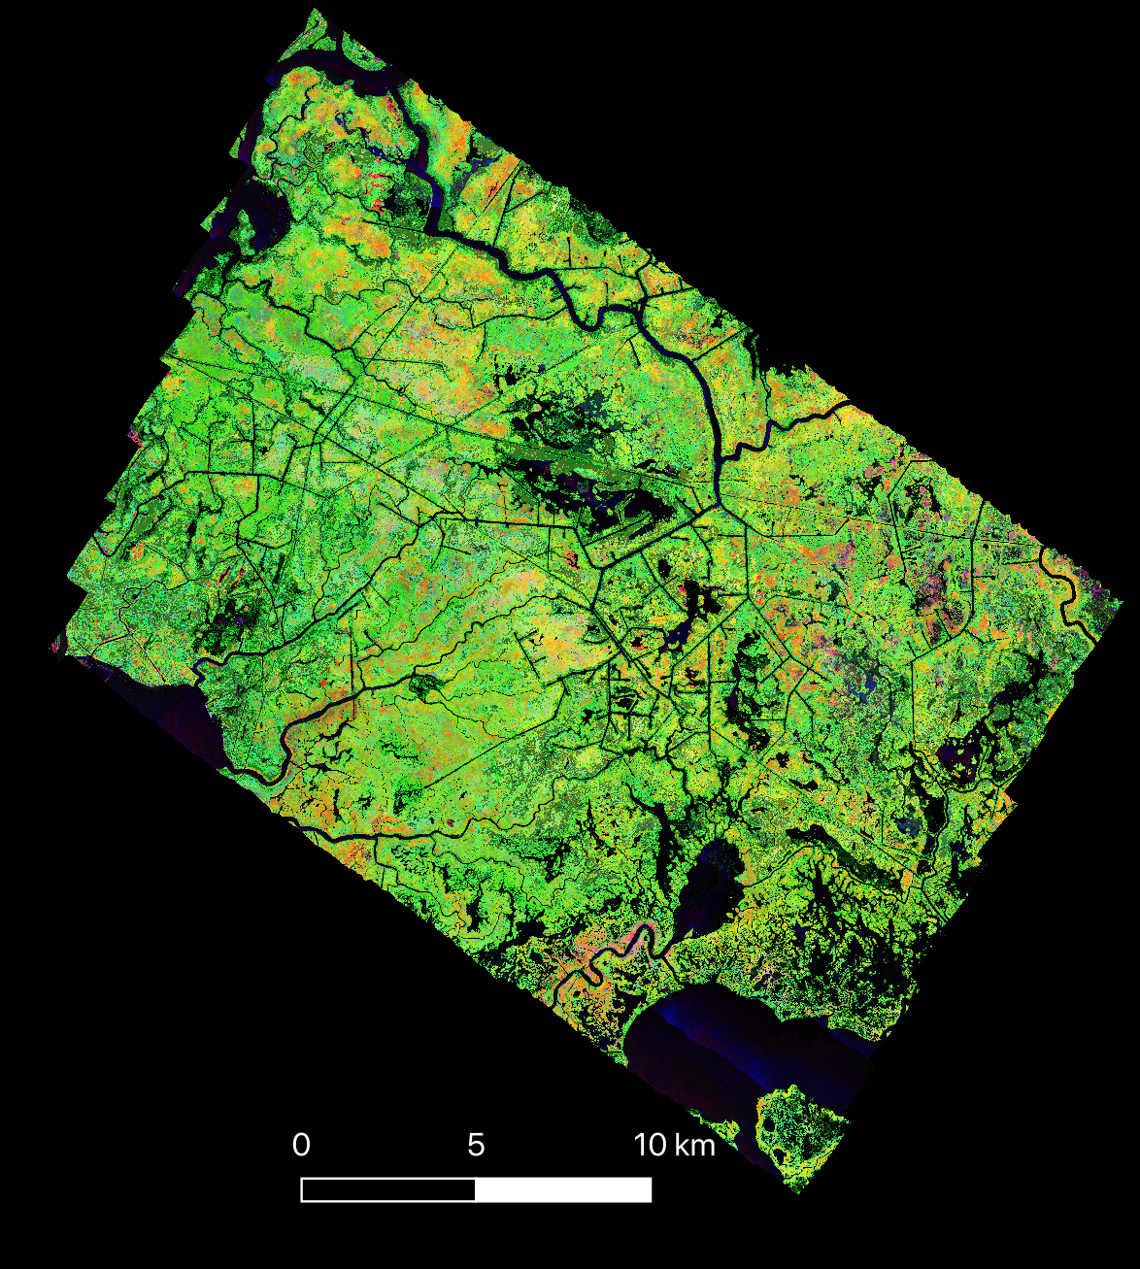
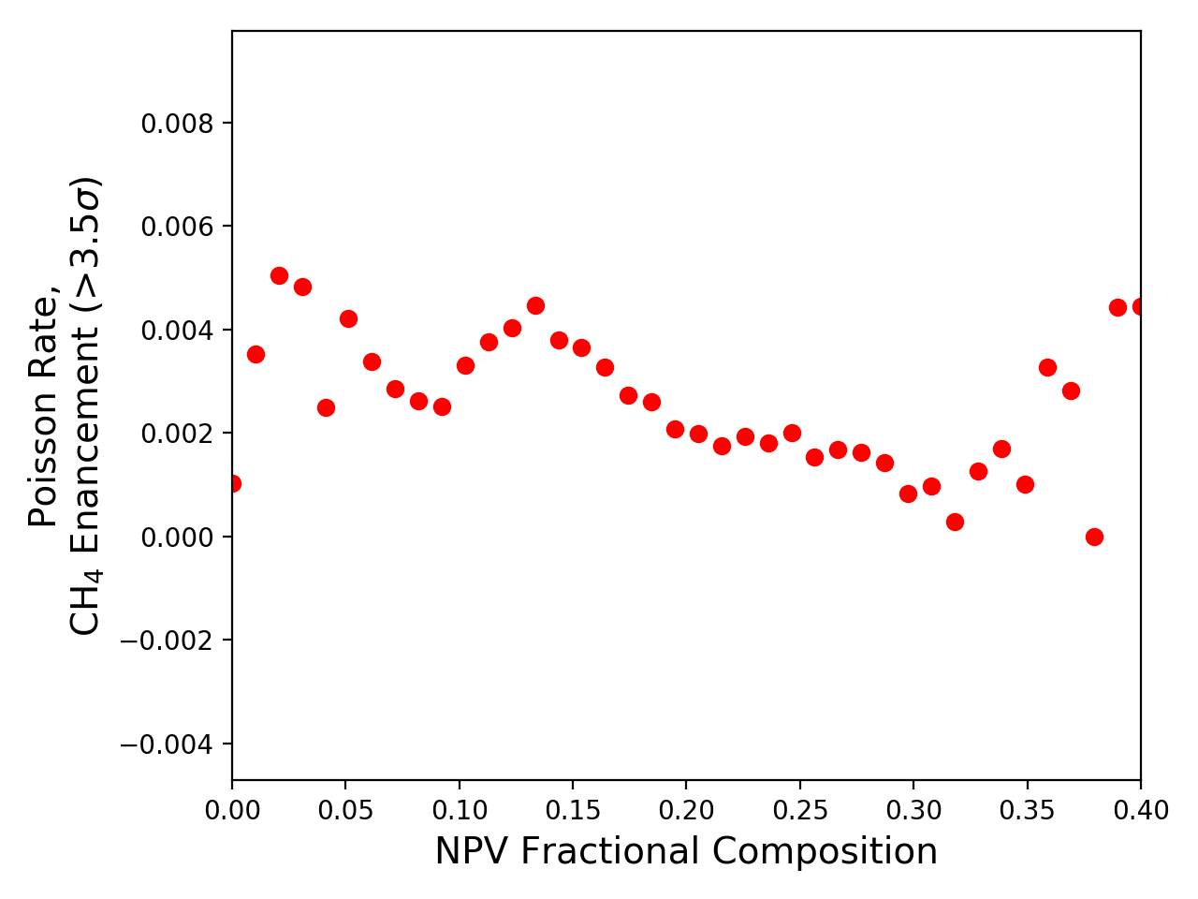
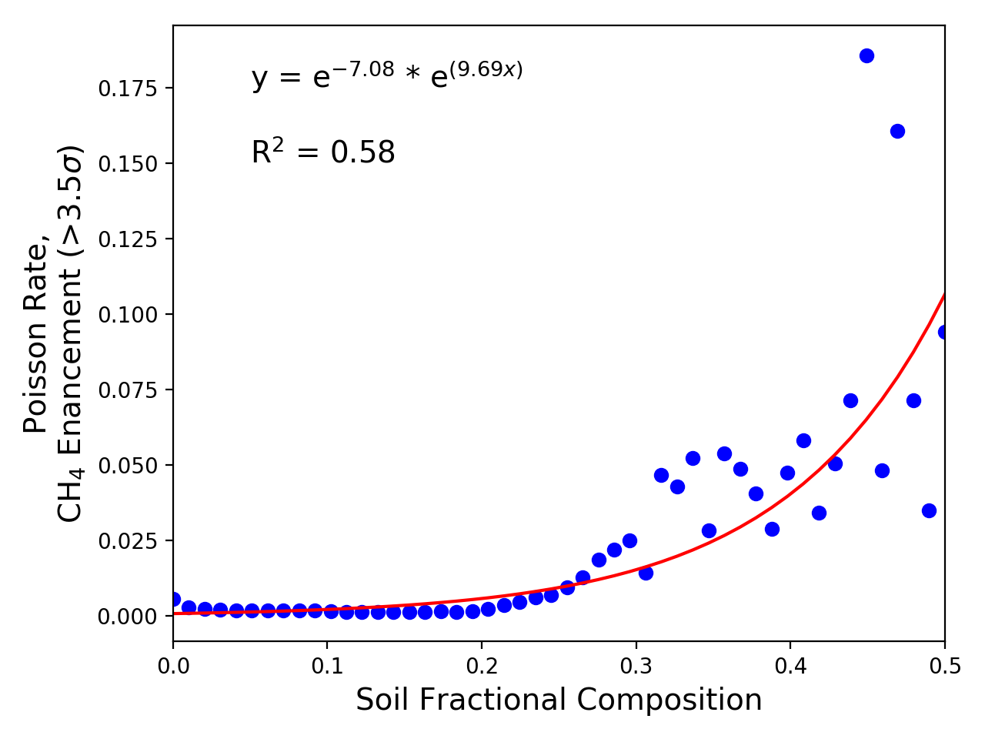
Methodology:
Fractional Composition
Multiple Endmember Spectral Mixture Analysis (MESMA) of the AVIRIS-NG mosaic based on the spectral library estimates per-pixel fractional composition of green vegetation (GV), non-photosynthetic vegetation (NPV), and soil
Poisson rates were calculated for binned fractions of NPV in the tall grasses and soil:
Tall grasses do not show a significant relationship between enhanced methane output and NPV fraction, though they do peak at low (greener) and high (dead or senescent) fractions
Poisson rate increases with more soil being exposed
GV
NPV
Soil

Slide 6
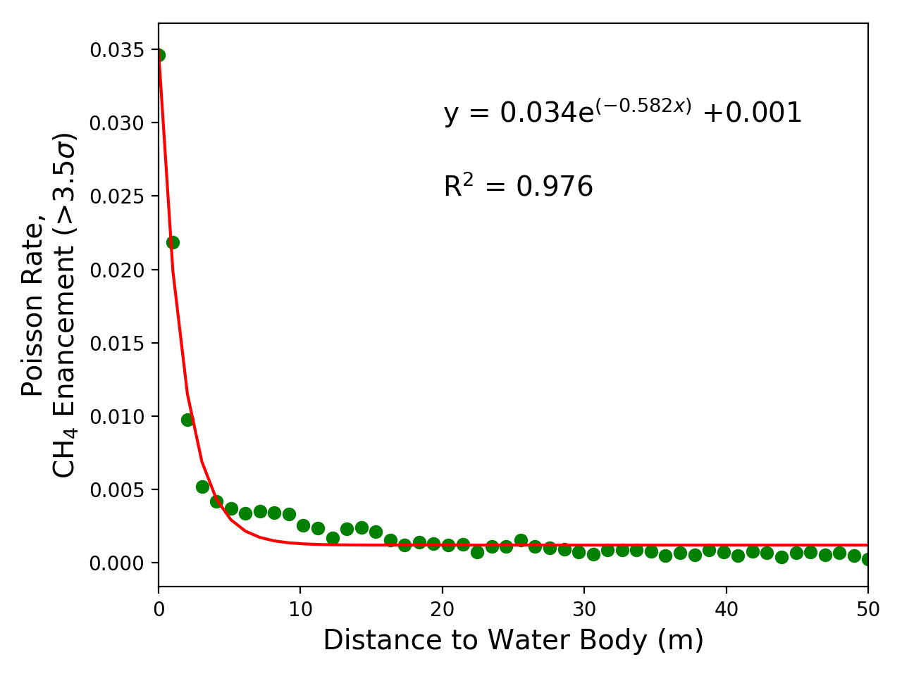
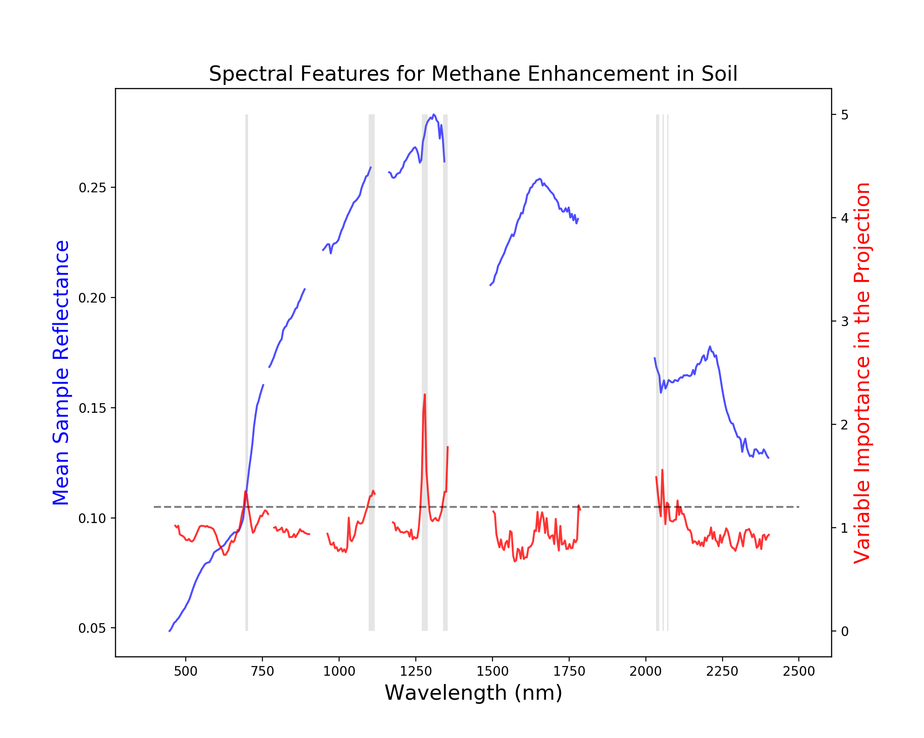
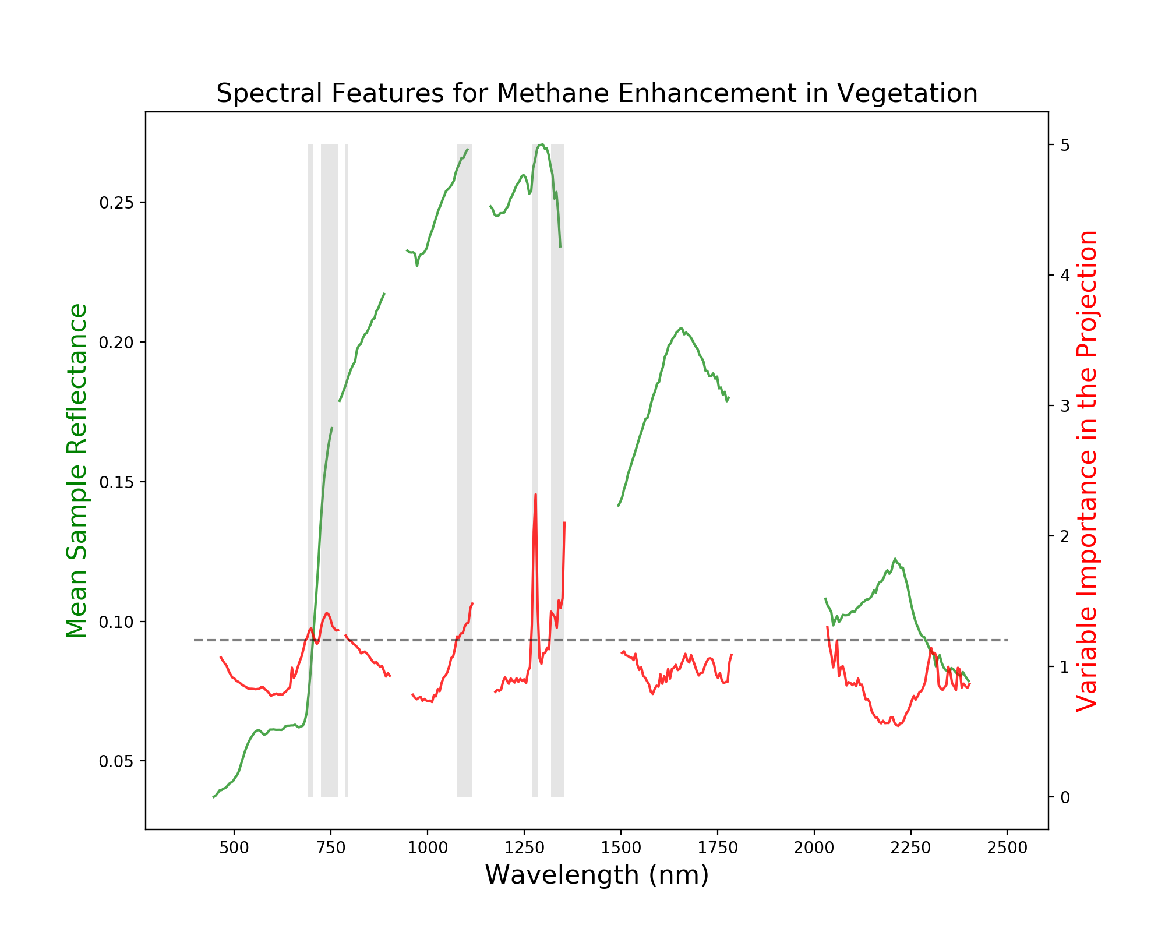
Results:
Spatial and Spectral Analysis
CH₄ enhancement Poisson rates were calculated for binned distances to water for tall grasses, revealing a strong power law relationship
A higher water table causes a low redox environment with more methanogenesis
Tall grasses such as Phragmites australis have aerenchyma (spongy tissues) that can exchange gases with the root zone, allowing methane to be transmitted through the plant
PLS models of soil and tall grasses (trained with CH₄ enhancement vs. non-enhancement pixel spectra) show spectral features most associated with increased methane output
Variable Importance in the Projection (VIP) highlights features associated with chlorophyll and water content
Red Edge (organic matter presence)
Water content
Red Edge (photosynthetic activity)
Water content

Slide 7
Conclusions
AVIRIS-NG can detect natural methane emitting features in coastal wetland environments
Tall grasses such as Phragmites australis have a higher prevalence of enhanced methane emission than other vegetation types in Louisiana’s coastal wetlands
There is a very strong exponential relationship between proximity to water and methane enhancement rates due to higher methanogenesis occurring in high local water tables, where the grasses can then transmit methane to the atmosphere
Spectral analysis corroborates this by highlighting photosynthetic activity and water absorption features as being closely associated with methane enhancement
Soils show high methane enhancement rates similar to tall grasses, with an exponential relationship between exposed soil cover and methane enhancement rate.
This study can be built on with future AVIRIS-NG campaigns by coinciding with ECOSTRESS data and examining the relationship between evapotranspiration/plant stress and wetland methane emissions. This also has implications for NASA’s Surface Biology and Geology mission, which will enable repeatable methane detection at broader spatial scales.
Acknowledgements
Delta-X (https://deltax.jpl.nasa.gov/)
NASA Postdoctoral Program
Louisiana Coastal Protection and Restoration Authority; Coastwide Reference Monitoring System
Kokaly, R.F., Clark, R.N., Swayze, G.A., Livo, K.E., Hoefen, T.M., Pearson, N.C., Wise, R.A., Benzel, W.M., Lowers, H.A., Driscoll, R.L., and Klein, A.J., 2017, USGS Spectral Library Version 7 Data: U.S. Geological Survey data release, https://dx.doi.org/10.5066/F7RR1WDJ.

