Slide 1
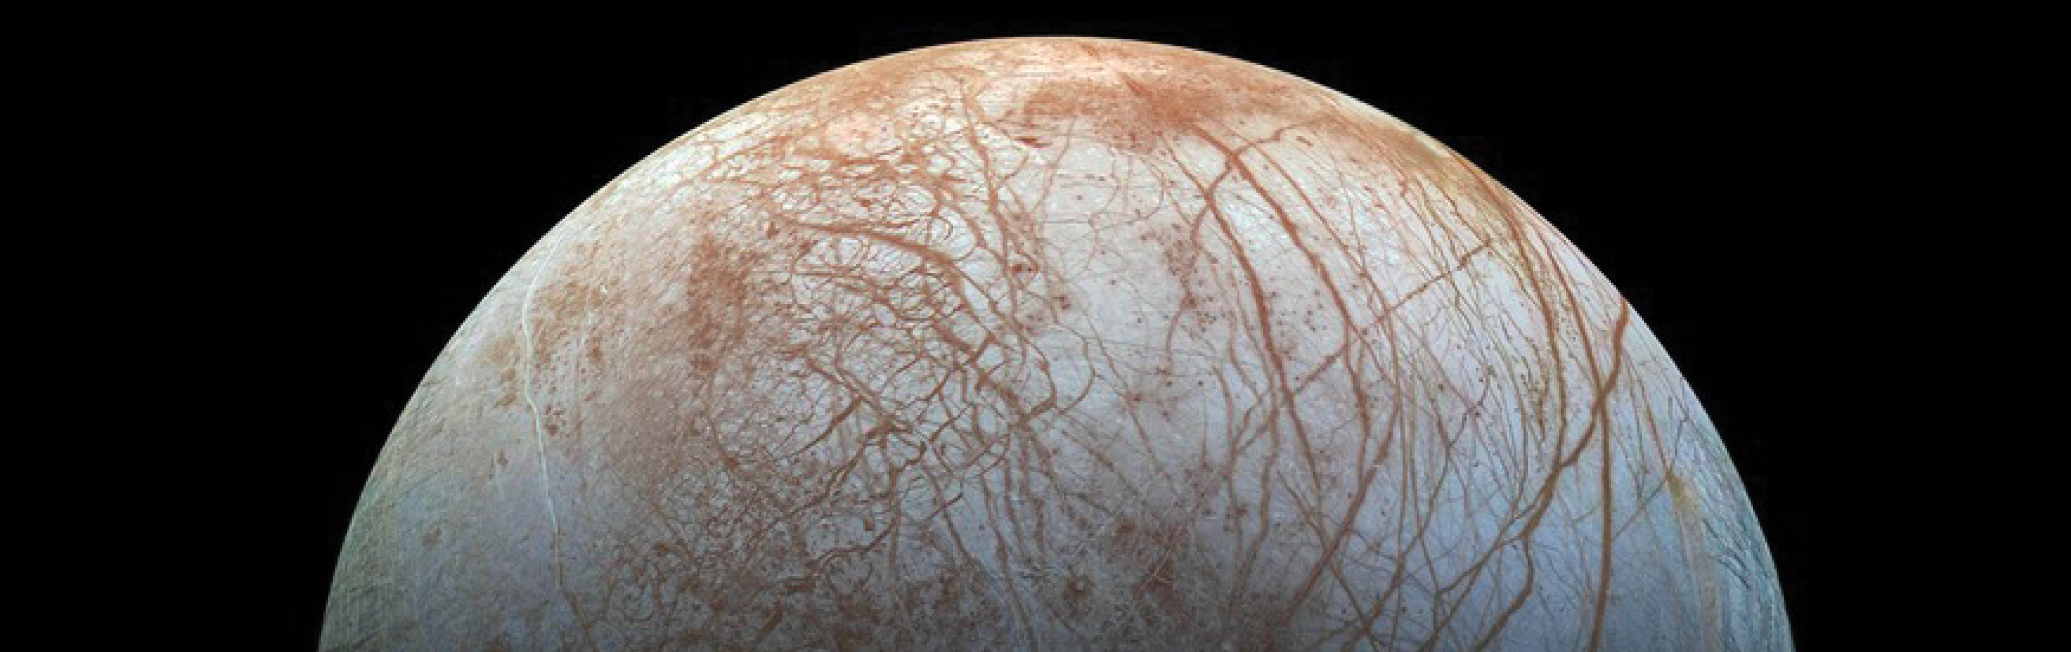

Europa Geologic Mapping: Results and Implications
2020 Postdoc Research Day Presentation Conference
Erin J. Leonard
Organization: 3223
Advisor: Dave Senske (3204)
Postdoc Program: JPL
CL#20-5142

Slide 2
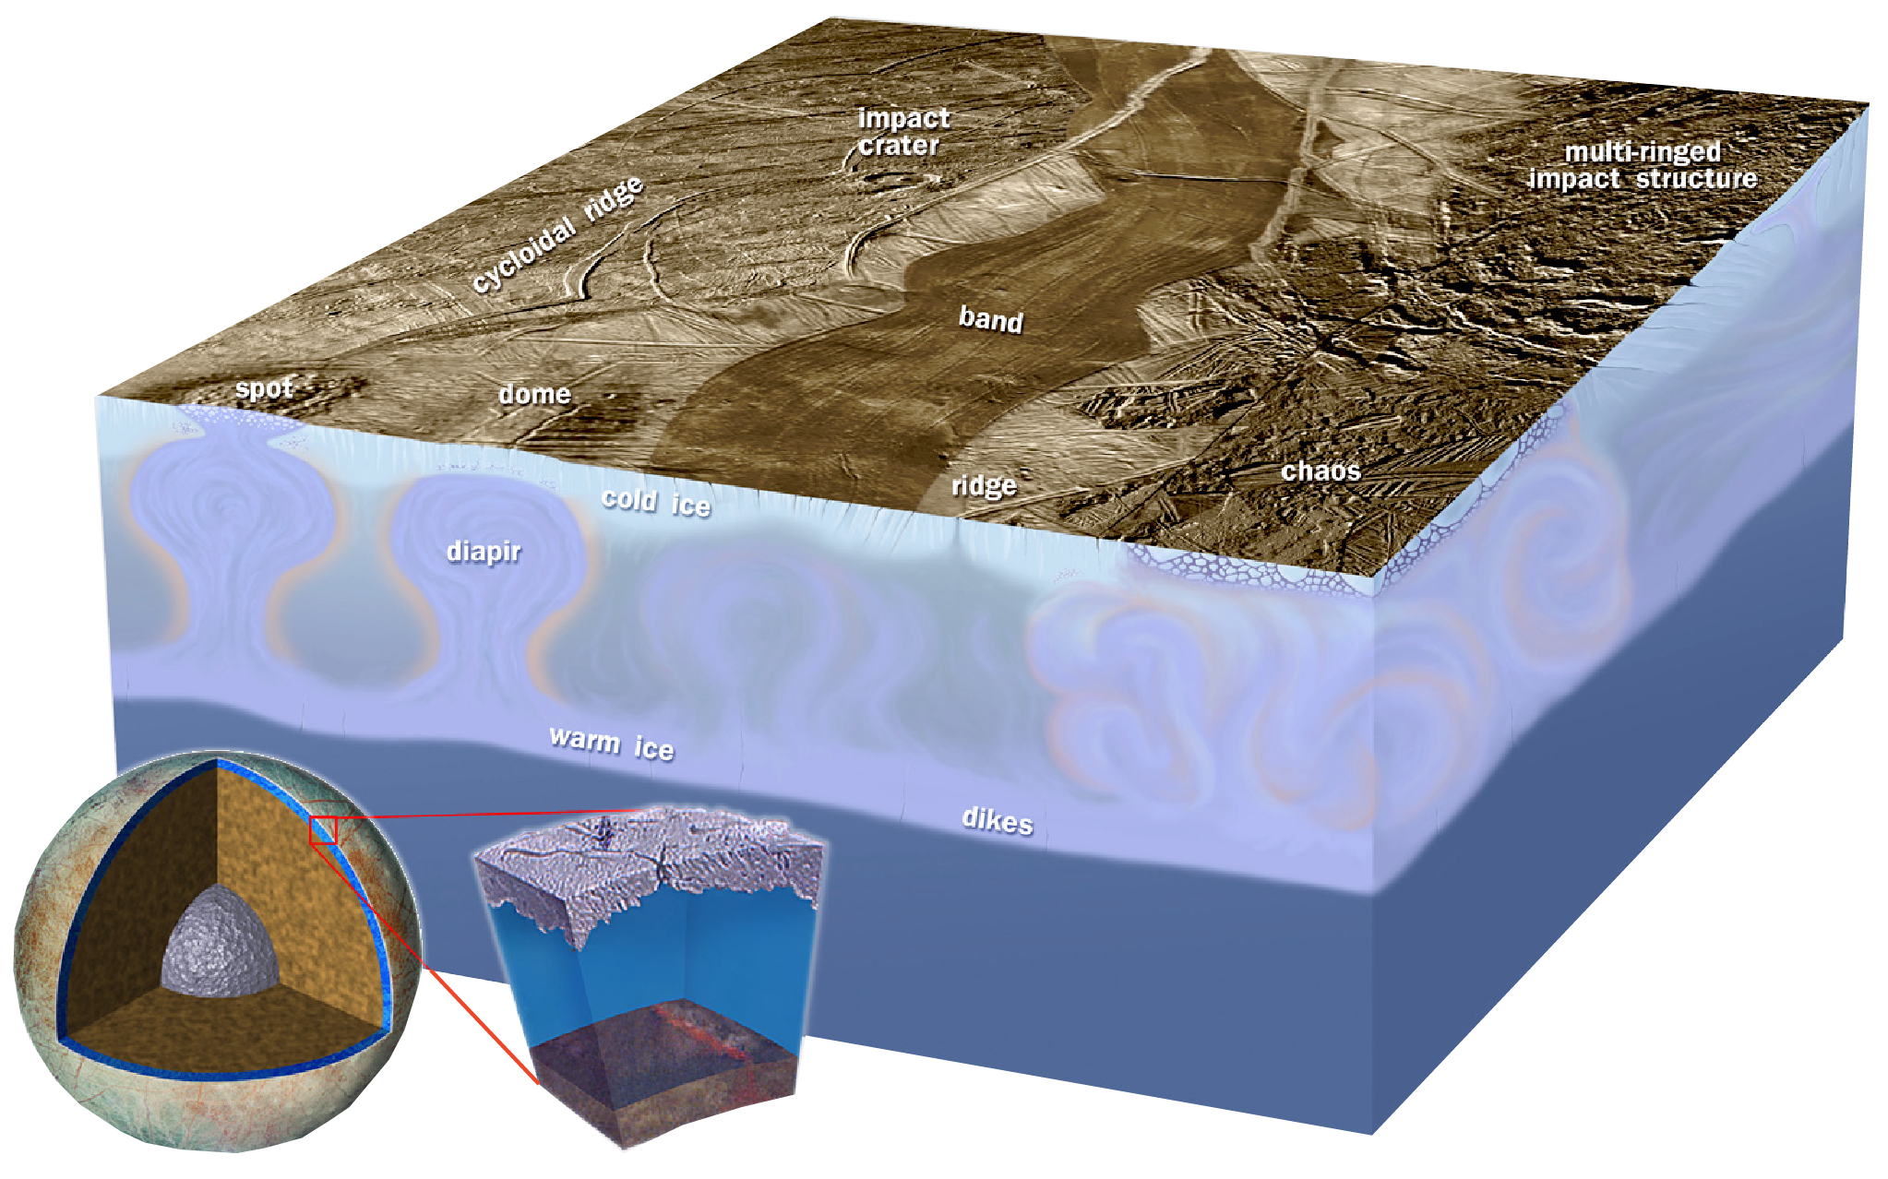
My work uses mapping, observations, and statistical analysis to constrain surface feature formation mechanisms and determine implications for Europa’s interior and evolution
Introduction
Europa
One of Jupiter’s four main moons
Contains a subsurface ocean underneath its ice-shell (Kivelson et al., 2000)
Surface is covered in enigmatic features and barely any craters
Geology as a window to the interior

Slide 3
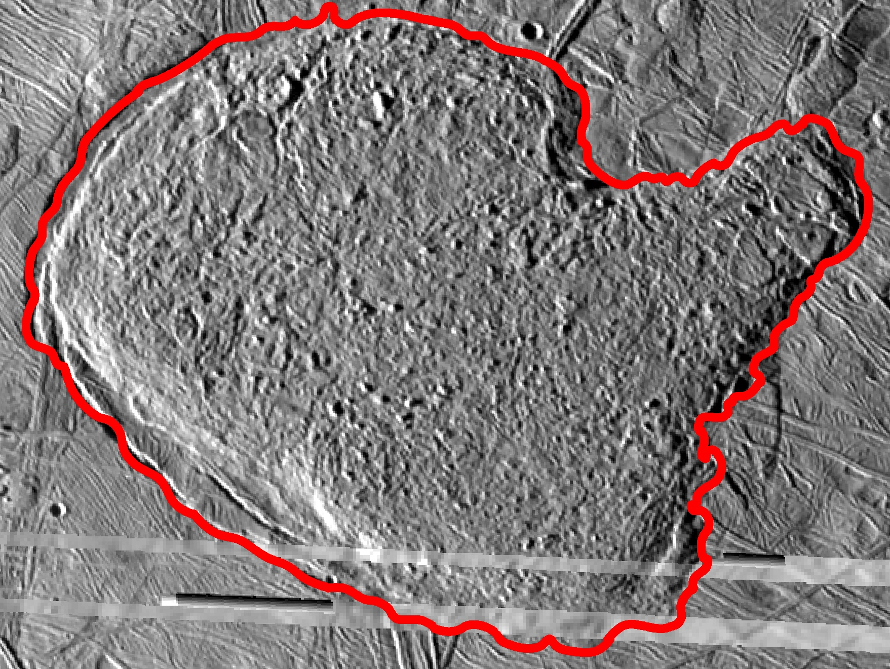
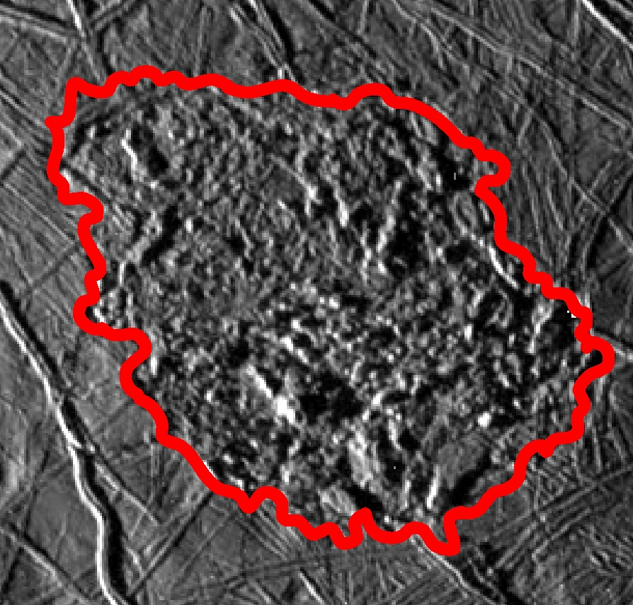
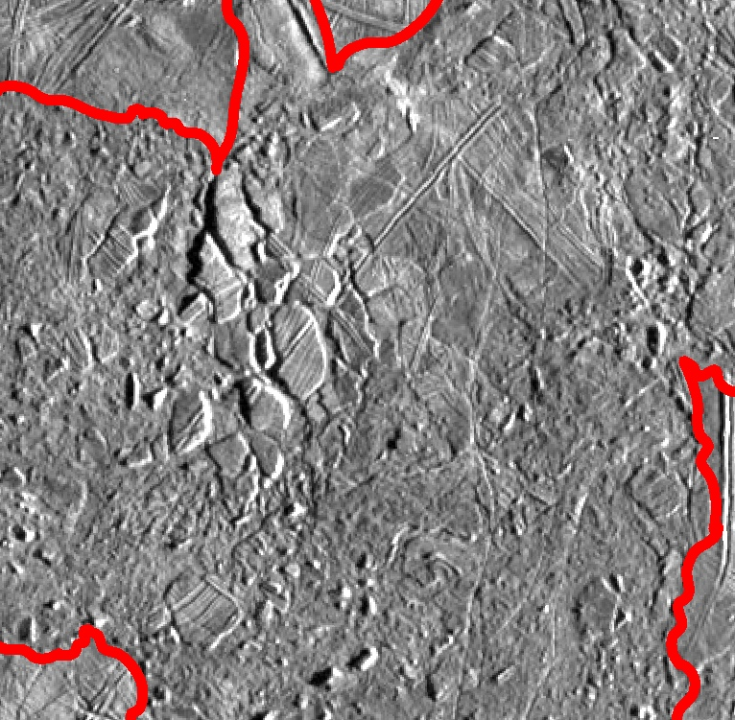
Background and Motivation
Chaos
Blocks of pre-existing terrain within a matrix
Range of sizes – 100s of km across to <10 km (microchaos)
One of the youngest features on Europa’s surface
Interaction with the subsurface ocean?
  Diapirism (e.g., Pappalardo et al., 1998)
  Melt-lens collapse (e.g., Schmidt et al., 2011)
  Melt-through (e.g., Greenberg et al., 1999)
30 km

Slide 4
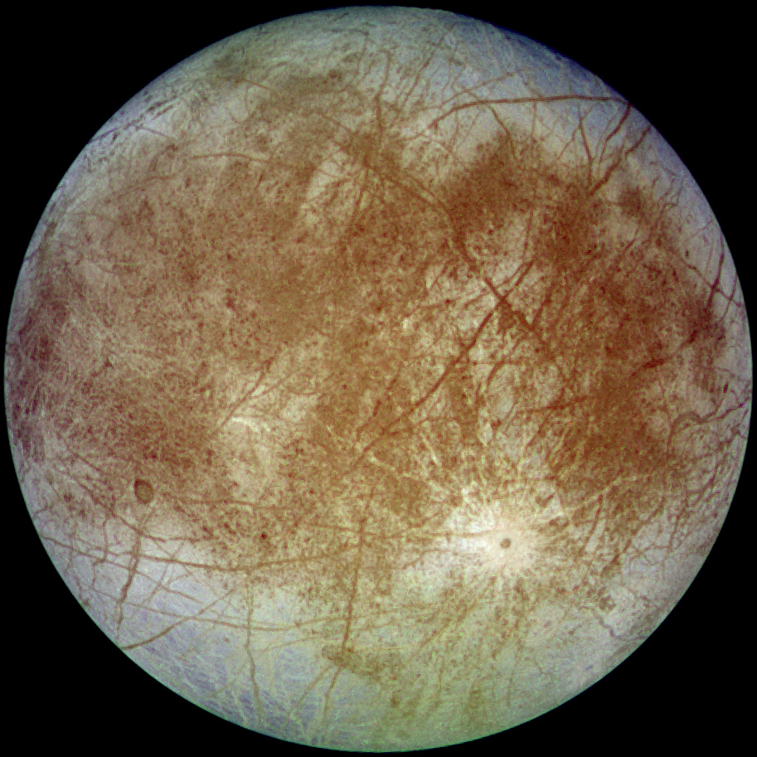
Methodology
Geologic Mapping - All geologic mapping is performed in ArcGIS
Created the first United States Geologic Survey (USGS) Global Geologic Map of Europa (1:15M) – coauthored by D. Senske (JPL) and D. A. Patthoff (PSI)
Creating the first consistent set of regional geologic maps (1:2M)
Geologic maps tell us about relative ages of the features (i.e., stratigraphic relationships) and provide new observational constraints on feature formation
Statistical analysis – All statistics are performed in ArcGIS or Matlab
Clustering analysis – determines level of clustering among spatially distributed points
P-test – determines if two values are statistically different
Pearson’s Test – determines if two variables are correlated (e.g., an increase in one corresponds to an increase in the other)
Statistical analyses tells us which observations of the geologic features are statistically significant and should be used to constrain models or lead to interpretation.

Slide 5
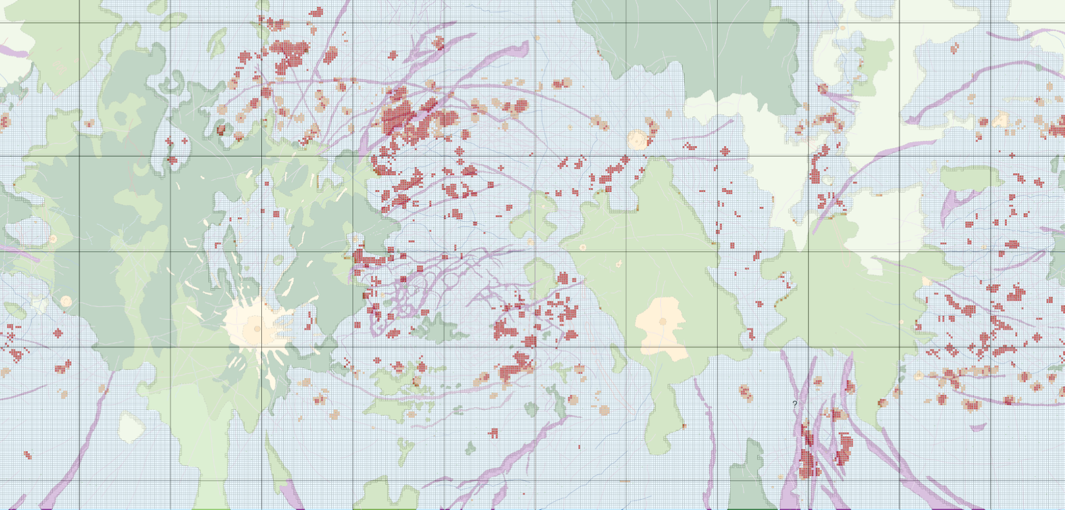
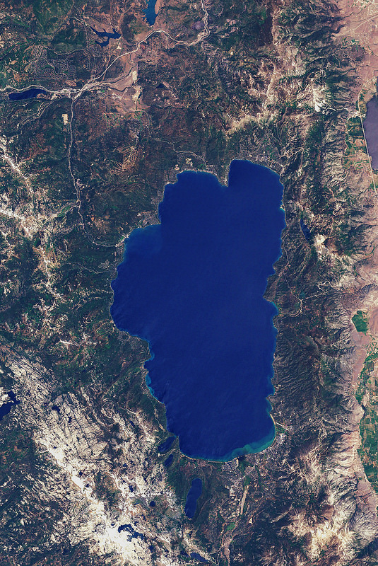
Results: Global Map – Microchaos Spatial Distribution
60ºN
Lake Tahoe
(Image credit: nasa.gov)
Global microchaos distribution
So What?
30ºN
0º
30ºS
Some clustering of microchaos appears near Band junctions which could indicate increased heat flux and thinner ice shell.
60ºS
90º E
180º
90º W

Slide 6
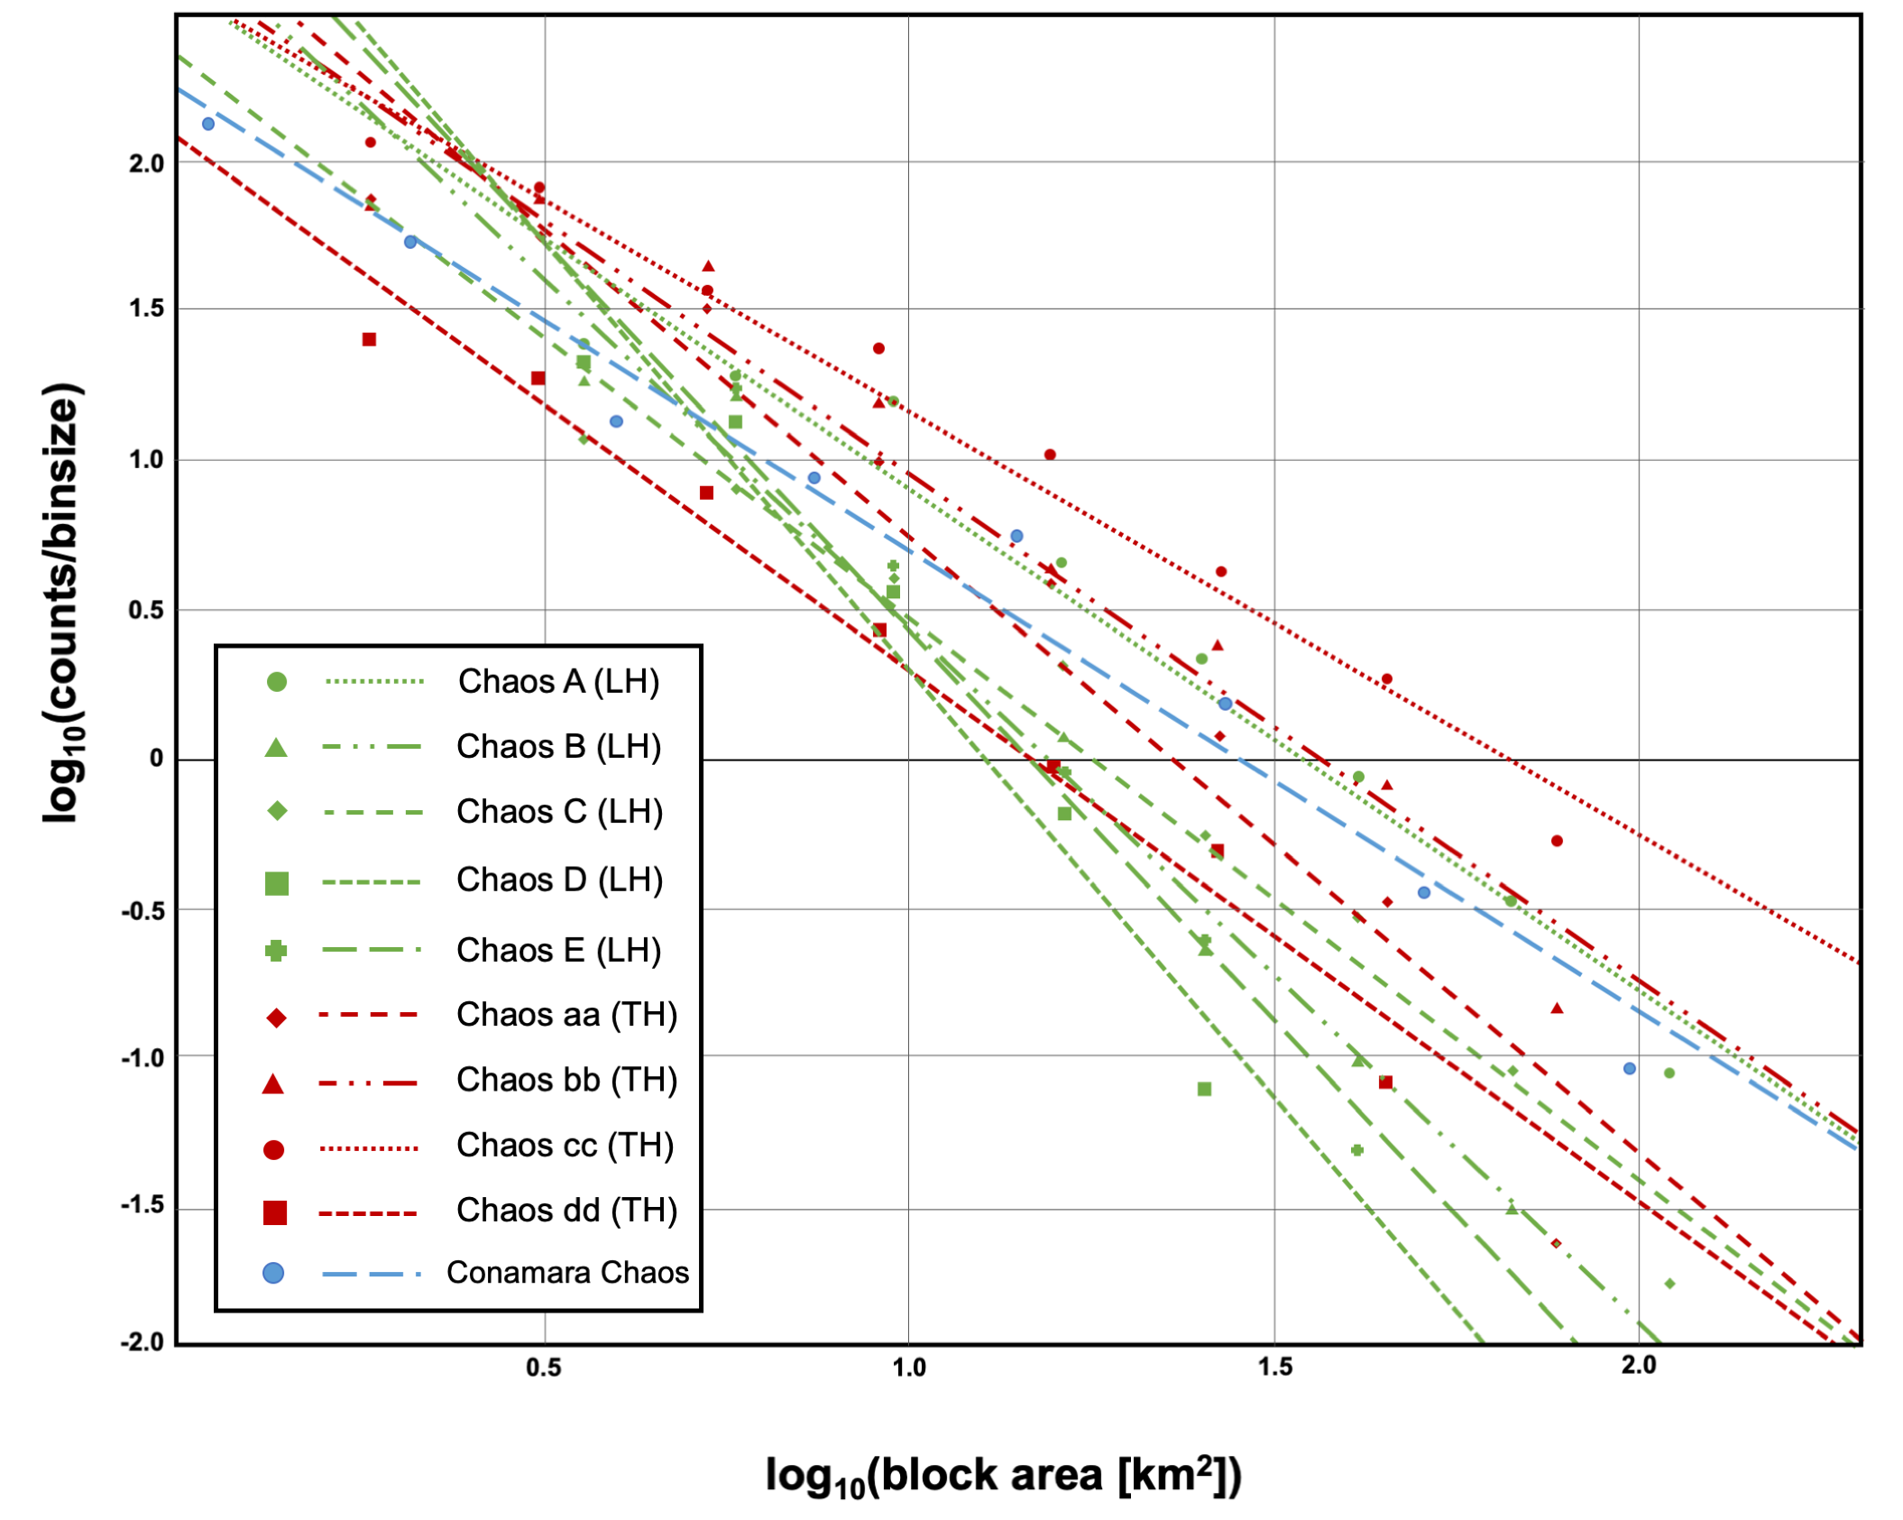
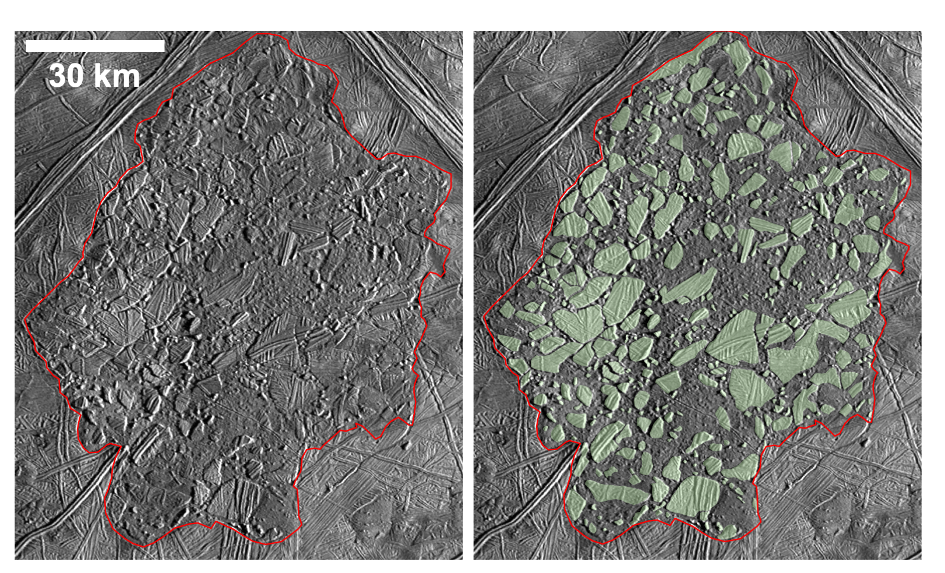
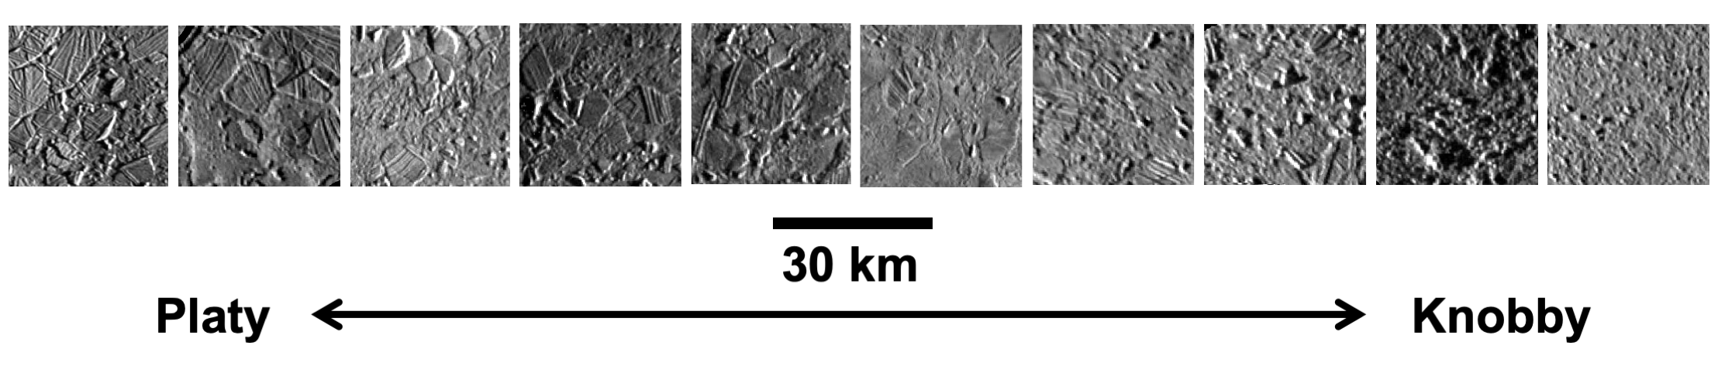
Results: Regional Mapping – Chaos Block Size Distributions
Block formation is a scale-independent process
Block size distribution slope, which is statistically different between chaos features (p-test), correlates with morphology (Pearson’s test)
  Quantifying morphology
  Varying slopes provide constraints on chaos formation
Map all blocks of pre-existing terrain within a chaos feature
Find area of each block
Plot size distribution of blocks
Shallower slope
Steeper slope

Slide 7
Accomplishments and Next Steps
Accomplishments
Global Geologic Map of Europa – DONE, accepted by the USGS
Global map analysis (e.g., microchaos clustering) – manuscript in prep
Regional mapping – started, more regions to be mapped
Regional mapping analysis (e.g., chaos block size distributions) – manuscript in prep
Next Steps
Complete and submit manuscripts (global microchaos clustering; regional chaos block size distributions)
Complete regional mapping and write up observations and analyses

Slide 8
Publications and Acknowledgements
First Author Journal Articles:
E. J. Leonard, S. Howell, A. Mills, D. A. Senske, R. T. Pappalardo (in prep). Bringing Order to Chaos: Relating Morphology to Chaos Formation on Europa. Geophysical Research Letters.
E. J. Leonard, D. A. Patthoff, and D. A. Senske (in prep). The Europa Global Geologic Map: Global Analysis of Surface Features.
E. J. Leonard, D. A. Patthoff, and D. A. Senske (accepted). The Europa Global Geologic Map. United States Geologic Survey.
E. J. Leonard, Yin, A., and Pappalardo, R. T. (2020). Ridged Plains on Europa Reveal a Compressive Past. Icarus.
First Author Conference Abstracts/Presentations:
E. J. Leonard, D. A. Senske, and D. A. Patthoff (2020). Pwyll Antipodal Deposits on Europa?. AGU Fall Meeting. Oral presentation on December 13th, 2020.
E. J. Leonard, D. A. Patthoff, and D. A. Senske (2020). Geologic Mapping of Europa at Global and Regional Scales. Oral presentation at the USGS Planetary Mappers Meeting (virtual), June 2020.
E. J. Leonard, S. Howell (2020). Compositional Variations within Europa’s Ice Shell: Implications for Surface Geology. Oral presentation delivered at LPSC Spring Meeting in The Woodlands, TX, March 2019.
E. J. Leonard, D. A. Senske, and D. A. Patthoff (2019). Mapping Europa at the Regional Scale: Comparing Chaos Morphologies in Moytura Regio and Conamara Chaos. AGU Fall Meeting. Poster presentation on December 13th, 2019.
E. J. Leonard, D. A. Senske, and D. A. Patthoff (2019). Geologic Mapping of Europa at Global and Regional Scales. Oral presentation at EPSC/DPS in Geneva, Switzerland. September 2019.
E. J. Leonard, D. A. Patthoff, and D. A. Senske (2019). Geologic Mapping of Europa at Global and Regional Scales. Oral presentation at the USGS Planetary Mappers Meeting, June 2019.
Thank you to Dave Senske, Robert Pappalardo, Sam Howell, Alyssa Mills, Alex Patthoff, and the Postdoc Office
Contact me at Erin.J.Leonard@jpl.nasa.gov

