Slide 1
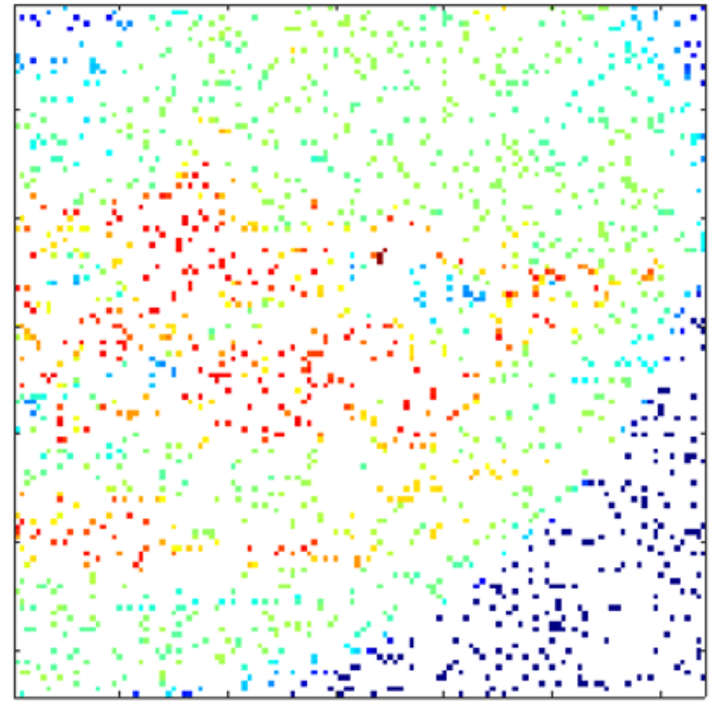
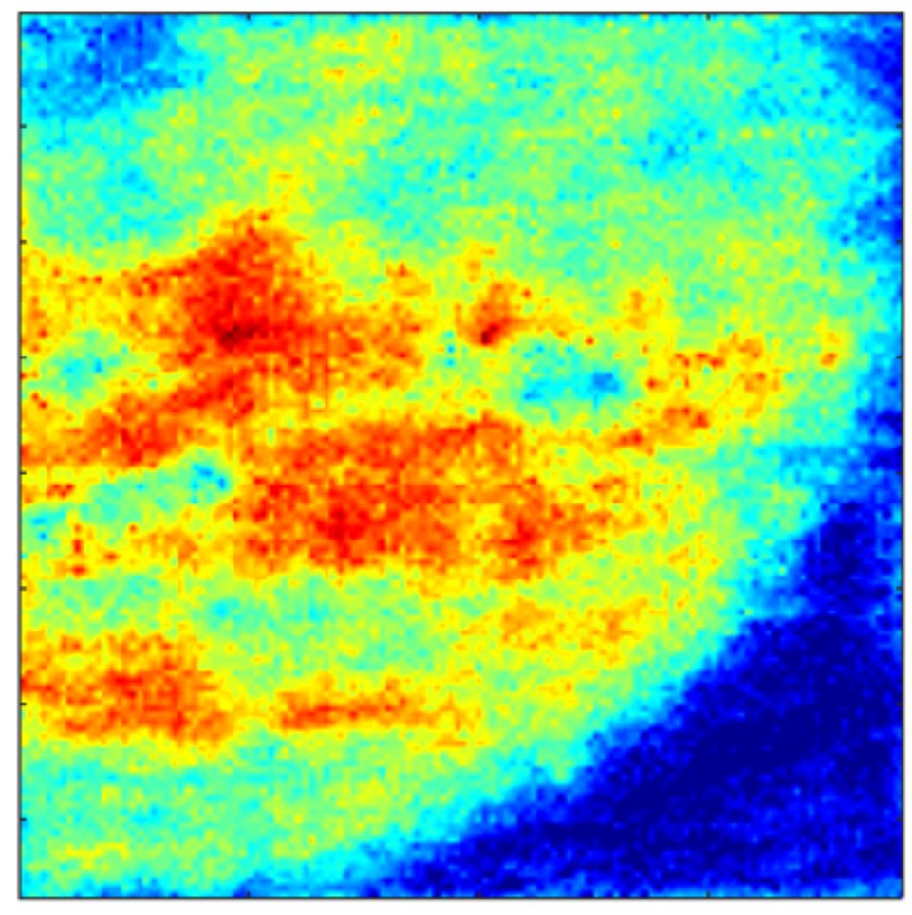
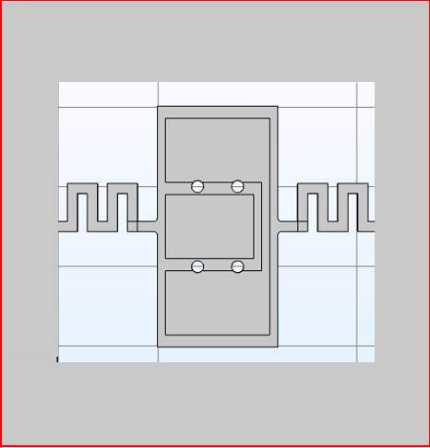
IR Imaging using Sparse Microresonator Arrays and Compressed Sensing
Sparse Array of Pixels
(90% of the pixels are missing)
Reconstructed IR Image
Single Pixel
IR Radiation Sensitive
Microresonator
Sparse Data Collection
Data Recovered
2020 Postdoc Research Day Presentation Conference
M. Bulut Coskun
Organization: 389R
Advisor: Mina Rais-Zadeh (389R)
Postdoc Program: JPL

Slide 2
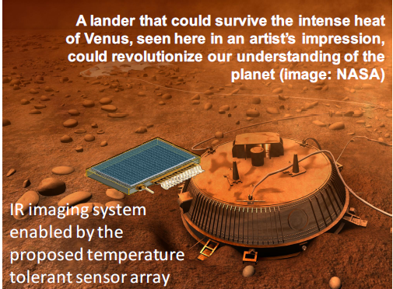
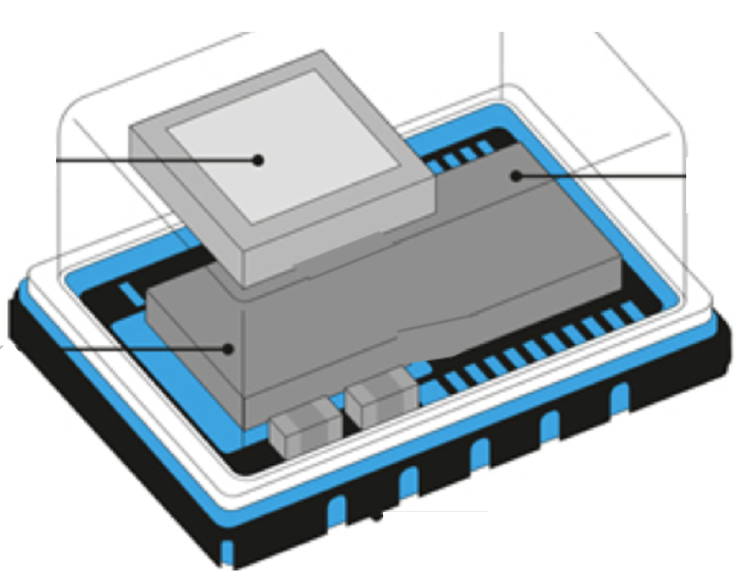
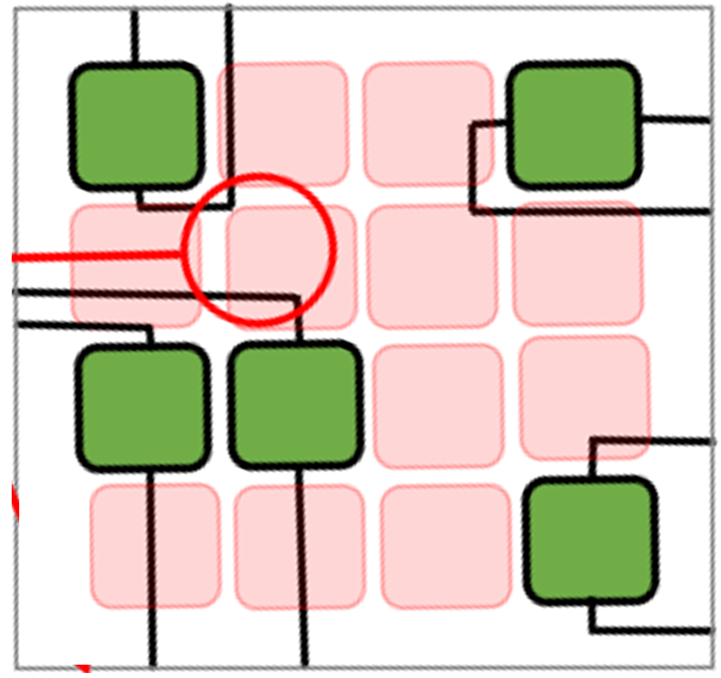
Introduction
(a) The Ultimate Goal:
The project aims to develop an instrument capable of taking infrared (IR) images in harsh environments (high radiation and high temperatures up to 500°C) using a sparse array of resonant-based micromechanical devices.
(b) Why Sparse Arrays?
(c) Outline:
Sparse sensor arrays, by definition have reduced number of elements enabling,
Pixel design
Sparse array construction
Compressed sensing
Test and recovery procedure
Results
Discussion and future work
Reduced power
consumption
Less complex
electronics
Easier signal routing
and densely placed pixels
at the expense of moderate post-processing time.
1

Slide 3
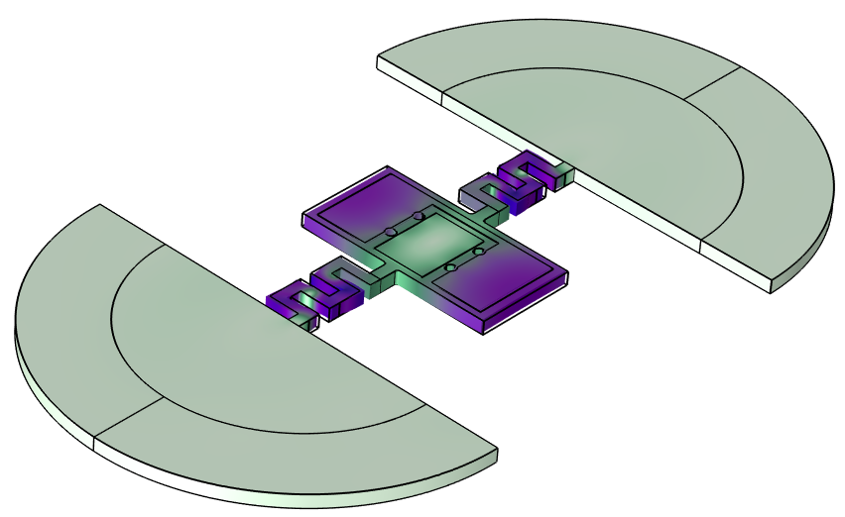
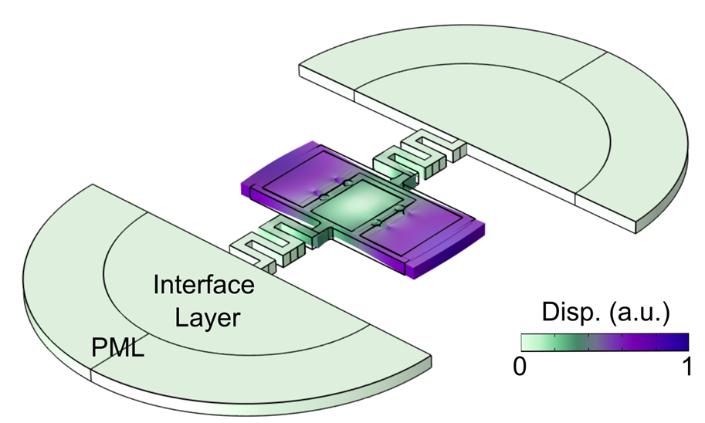
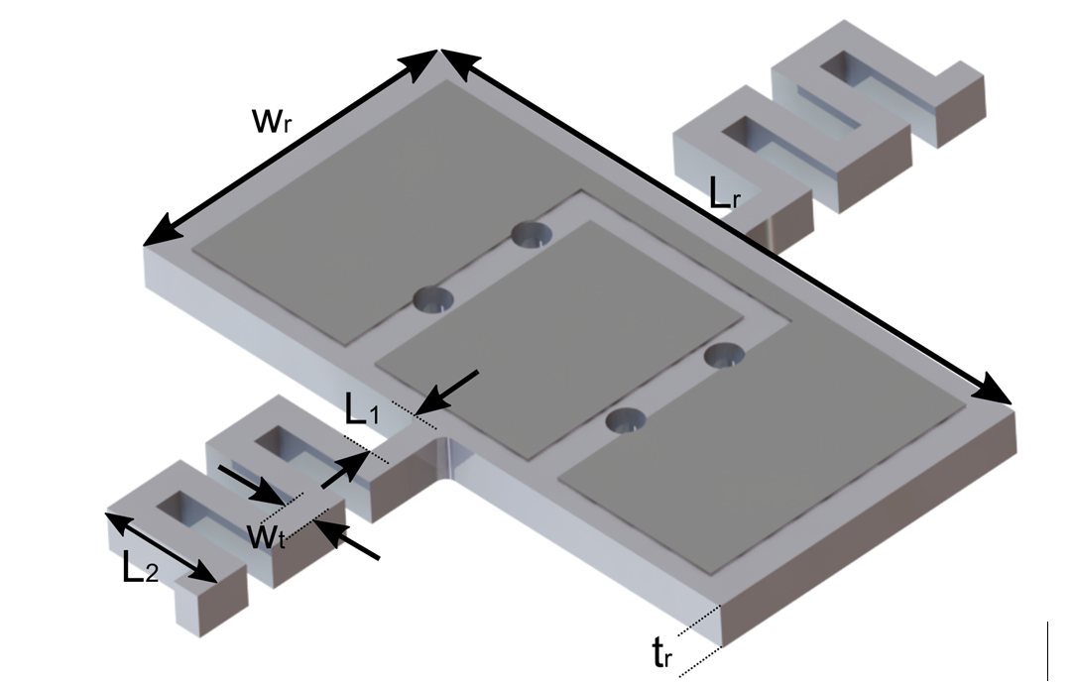
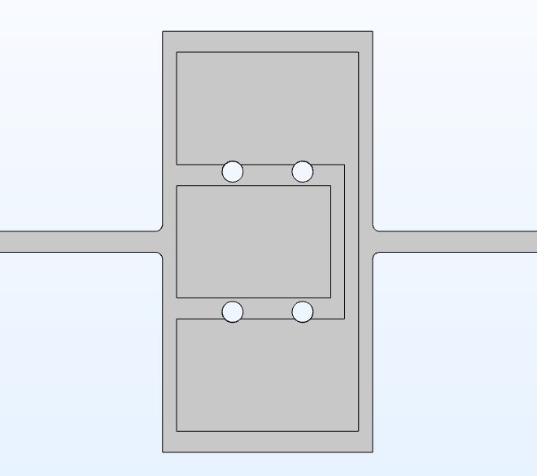
Pixel Design
Tether Optimization to Maximize the Q-Factor
High-loss design
Losses minimized via FEA
Tether geometry affects both mechanical and thermal parameters.
Length Extensional Mode: f_{res} = 57.1 MHz
Analysis of the Thermal Design Parameters
GaN
Straight Tether
Meandering Tether
Meandering Tether Design provides higher:
Thermal Resistance,
Sensitivity, and
NETD.
Finalized Design Parameters
Parameter | Description | Value
L_{r ­} | Resonator Length | 60 μm
w_{r} | Resonator Width | 30 μm
t_{r} | Resonator Thickness | 4 μm
L₁ L₂ W_{t} Q_{an} | Tether Length 1 Tether Length 2 Tether Width Anchor loss limited Q | 4.5 μm 15 μm 3 μm 1.29 x10⁷
Total Length (μm) | 28.5 | 76.5
Ther. Resistance (K/W) | 9146 | 24519
Time Constant (μs) | 201 | 540
2

Slide 4
Sparse Array and Compressed Sensing
Sparse Pixel Array
Here the goal is to use the incomplete data obtained from m number of resonators (pixels) and recover the complete image comprises n pixels, where n >> m.
The problem can be mathematically formulated as an underdetermined system of equations as follows:
y_{mx1} = Φ_{mxn} x_{nx1}
Collected Sparse Data
Data to be recovered
Matrix Representing the Array Layout
Measurement Matrix
A solution can be obtained by min‖x‖₁ s.t. y = Φ x
1
0
0
0
0
0
1
0
To guarantee the existence and uniqueness of the solution, X has to be sparse, and Φ has to satisfy the Restricted Isometry Property (RIP).
X can be transformed into a different domain, where it is sparse (e.g. FFT, DFT etc.).
Randomly constructed measurement matrices have a high probability to satisfy RIP.
0
1
0
0
0
0
0
1
3

Slide 5
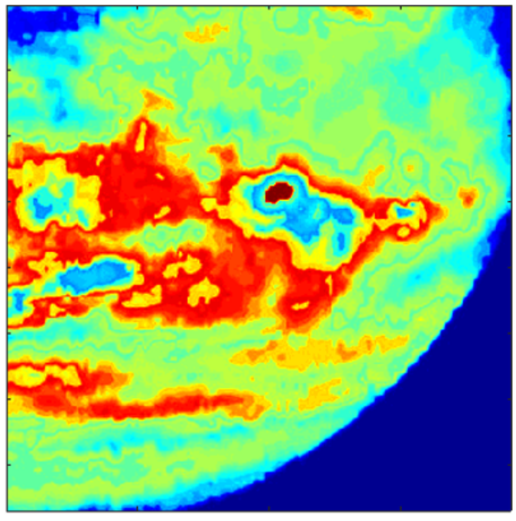
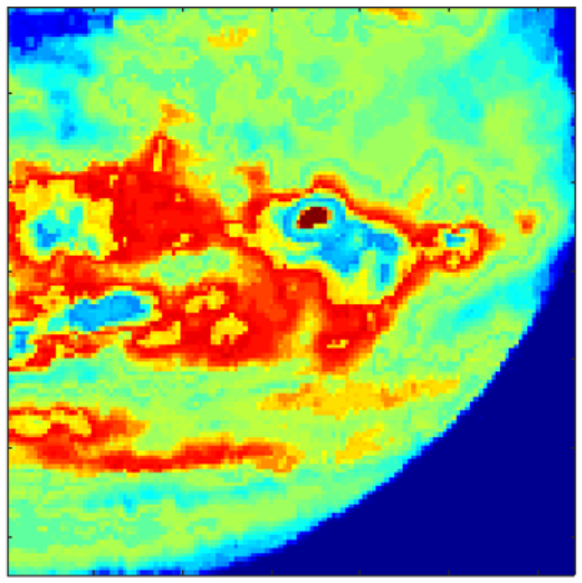
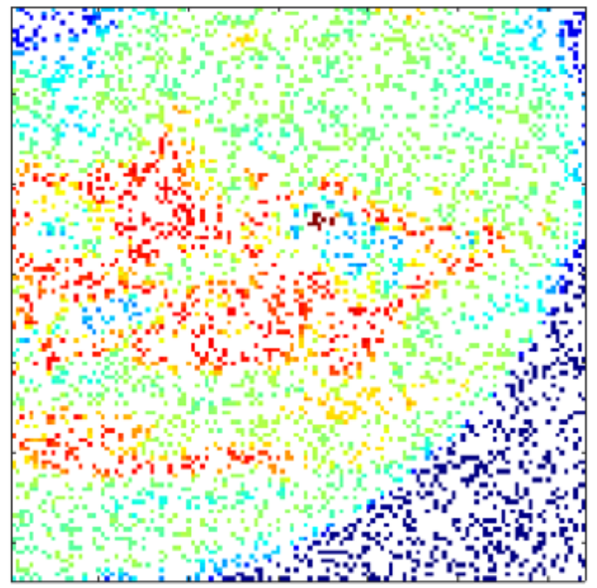
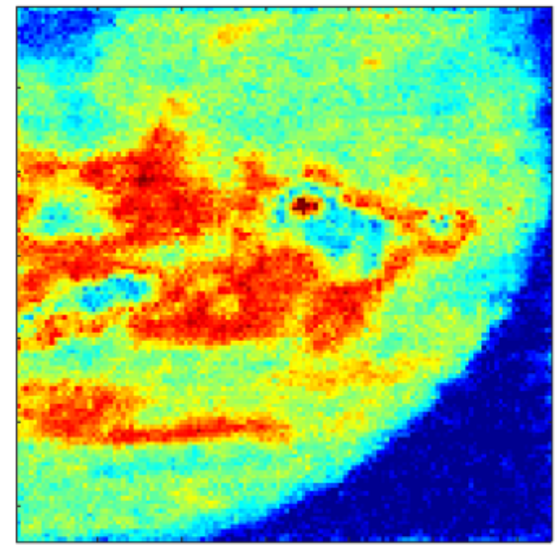
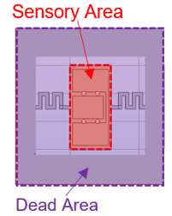
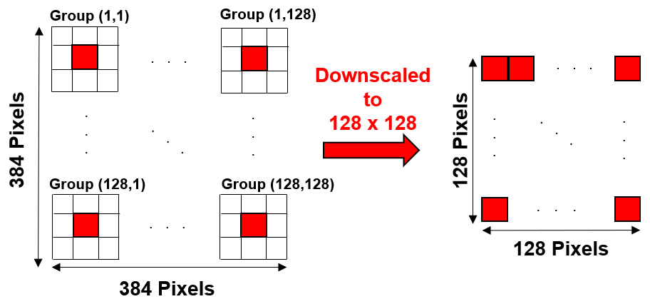
Test and Recovery Procedure
STEP 1
STEP 2
STEP 3
STEP 4
Downscaled the TI to take the fill factor into account.
Construction of the sparse array, and Φ.
l1-magic toolbox is used to reconstruct the image.
Test Image (TI) is obtained. (credit:NASA/JPL)
384x384
128x128
Sparse Data Collection
(128x128 array with 25% density )
Pixel Fill Factor (FF) and Image Preprocessing (STEPS 1-2)
FF=0.11
4
FF=0.1

Slide 6
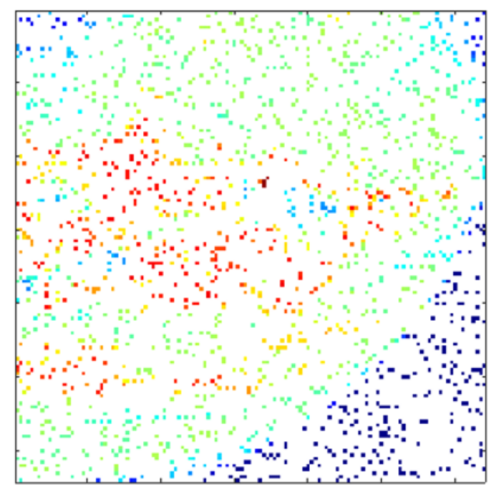
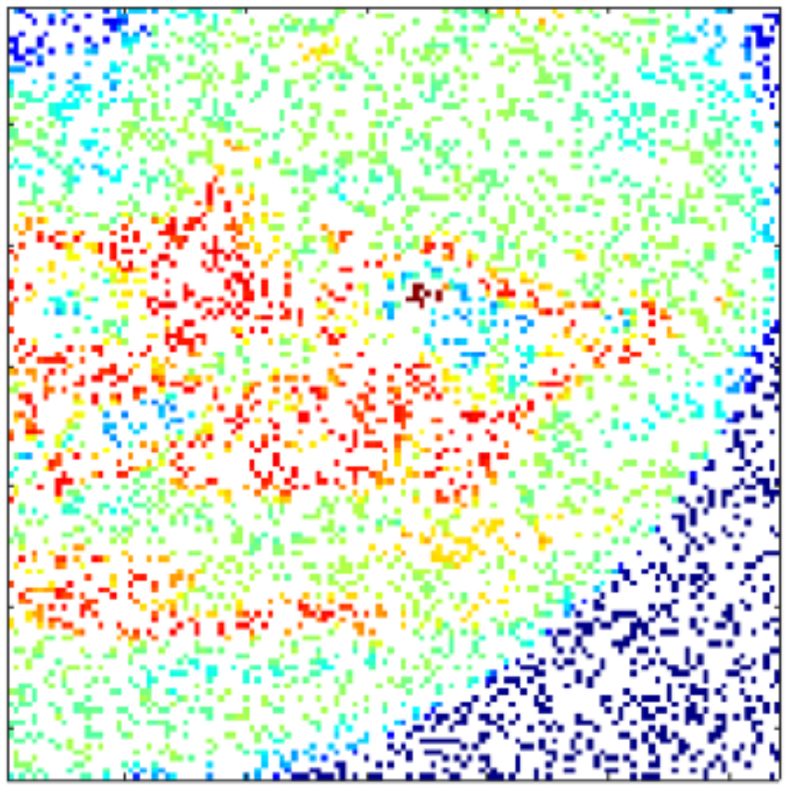
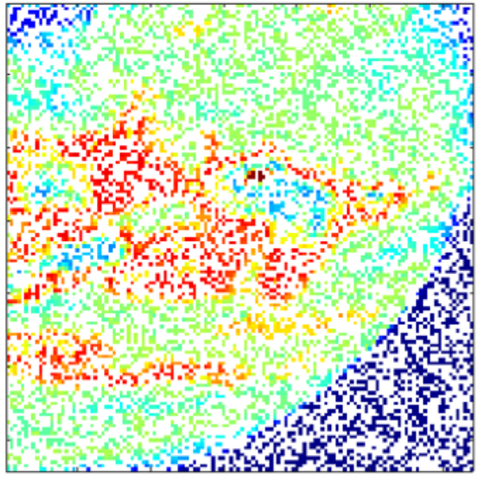
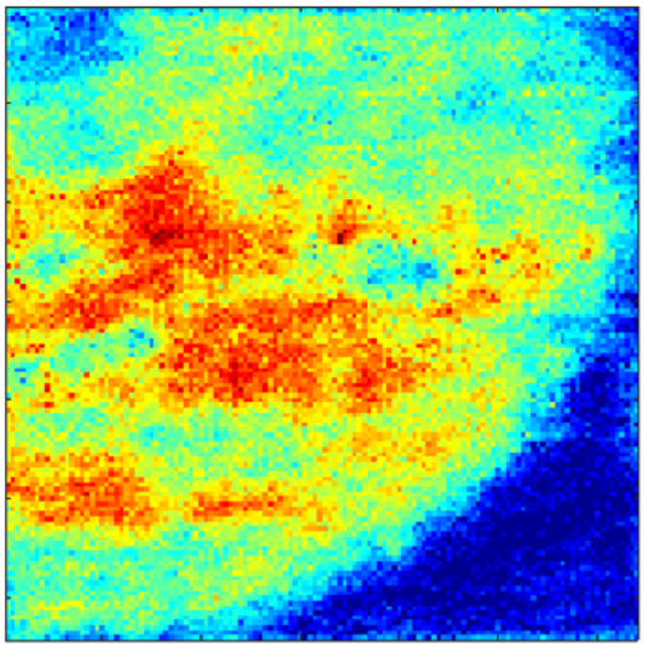
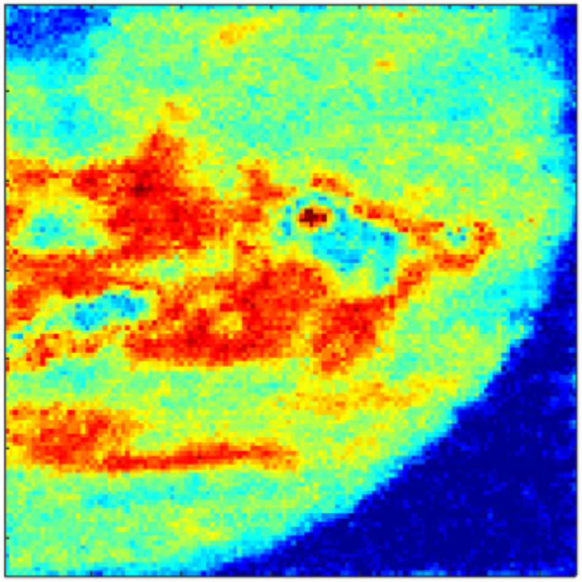
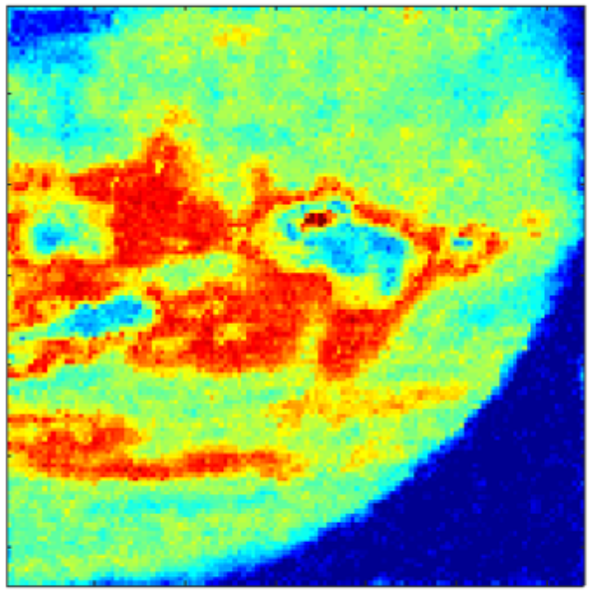
Arrays with Different Densities
Density 10%: Outlines around the large and medium sized features are distinguishable. Acceptable correlation coefficient. Relatively high error.
Test Image
Density 25%: Improved clarity on small and medium sized features, and substantial increase in the correlation coefficient.
Density: 10%
Density: 25%
Density:37.5%
Density 37.5%: Smaller details are revealed, the edges get sharper and correlation coefficient and the recovery error are further improved.
Sparse Data Collection by 128x128 Arrays
Performance Metrics
Array Density (%) | Correlation Coefficient | Recovery Error
10 | 0.9045 | 0.19
25 | 0.9629 | 0.12
37.5 | 0.9785 | 0.08
Reconstructed Images
“1” represents a perfect positive correlation, and “0” indicates no correlation.
5
INCREASING ARRAY DENSITY

Slide 7
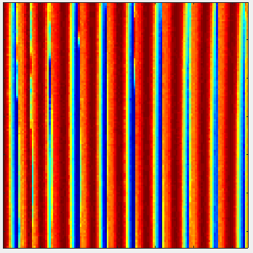
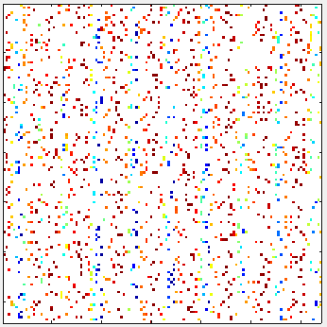
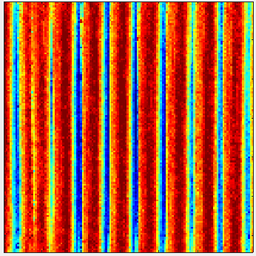
Conclusion and Future Work
Case 1
Case 2
Additional Discussion:
Reported performance metrics are image-dependent, hence the recovery performance can be substantially improved, while working on a test image with large features and less details.
Test Image
Increasing the array size, while keeping the density the same, also yields improved performance for the given field of view (FOV).
Density: 10%
Future work
Future work will focus on fabrication, and characterization of the proposed arrays.
Constructed Images
Publication:
M.B. Coskun, M. Rais-Zadeh, “IR Imaging using Sparse Microresonator Arrays and Compressed Sensing”, in preparation for The 34th International Conference on Micro Electro Mechanical Systems (IEEE MEMS 2021).
Recovery Error | 0.19 | 0.08
Correlation Coef. | 0.9045 | 0.9653
6

