Slide 1
2020 Postdoc Research Day Presentation Conference
Drought-enhanced rapid subsidence in the Central Valley and the impact to the California Aqueduct
Megan M Miller
Organization: 334
Advisor: Cathleen E Jones
Postdoc Program: JPL
Notes:
Hello, I am Megan Miller, a postdoc working with Cathleen Jones in the Radar Science and Engineering. I’ve been monitoring and modeling subsidence in the Central Valley related to groundwater withdrawal. Some of the deformation occurs close to the California Aqueduct, which is hazardous to the infrastructure that brings water from northern to southern California.

Slide 2
Introduction
Abstract
California’s Central Valley has a dry climate and is prone to drought, yet it is host to vast areas of farmland which depend a complex aquifer system for irrigation. Groundwater fluctuations are coupled with surface deformation, which poses a hazard to the California Aqueduct and compels us to carefully monitor land deformation in the Valley.
NASA's UAVSAR L-band synthetic aperture radar acquired 31 high resolution radar images between May-2013 and Nov-2018. These are used to develop a time series of vertical displacement and identify and track a rapidly forming subsidence feature. We examine UAVSAR in combination with extensometer measurements, leveling surveys, Sentinel-1A results, concurrent water levels, well construction reports, aquifer material characterization, and environmental conditions. We offer insight into subsurface properties and mechanics, estimate the permanent loss of aquifer storage, and identify additional data that would aid water management.
Central Valley
Notes:
On the right, the Central Valley is highlighted in yellow. The aqueduct is the blue line running NW to SE.

Slide 3
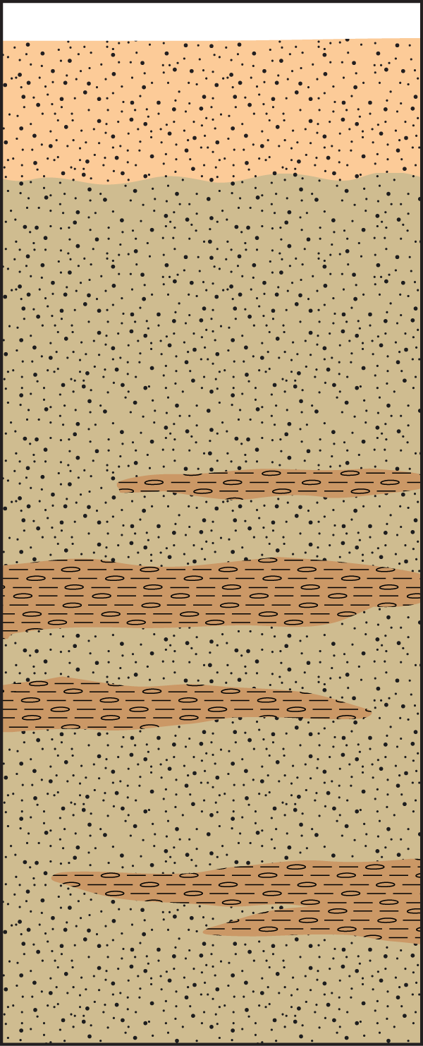
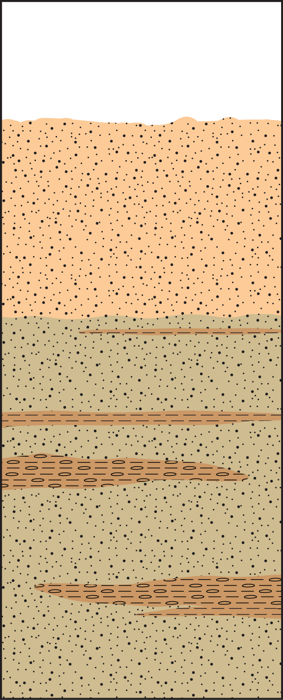
$$Elastic$$
$$Inelastic$$
Problem Description
Groundwater withdrawal leads to both elastic (left) and inelastic (right) deformation as pore pressure changes.
Deformation along the aqueduct can reduce flow rates, capacity, storage, erosion protection, reliability, and cause expensive repairs.
Deformation occurs gradually over large areas.
Pumping well locations and well level records can be sparse and incomplete.
By observing deformation over time, identifying and monitoring the progression of subsidence features can aid in understanding subsurface processes
$$Before$$
$$After$$
Notes:
In the animation on the left the land surface, the water level, and the pore spaces expand and contract elastically. On the right, the land subsides once water is drawn down beyond an inelastic threshold, and the grains rearrange permanently.

Slide 4
Methodology
Radar interferometry of UAVSAR acquisitions → vertical deformation time series
Validation via satellite radar interferometry time series and results from precise leveling surveys along the aqueduct
Model subsidence feature and aquifer properties

Slide 5
Results – New subsidence feature
Vertical deformation maximum is -103.75 cm (over 5.5 years)
Subsidence feature affects ~10.5 km of the aqueduct
Subsidence feature surface area extends over 29 km²
Permanent volume storage loss is 7122 m3/day or 2840 Olympic size swimming pools over 2.7 years

Slide 6
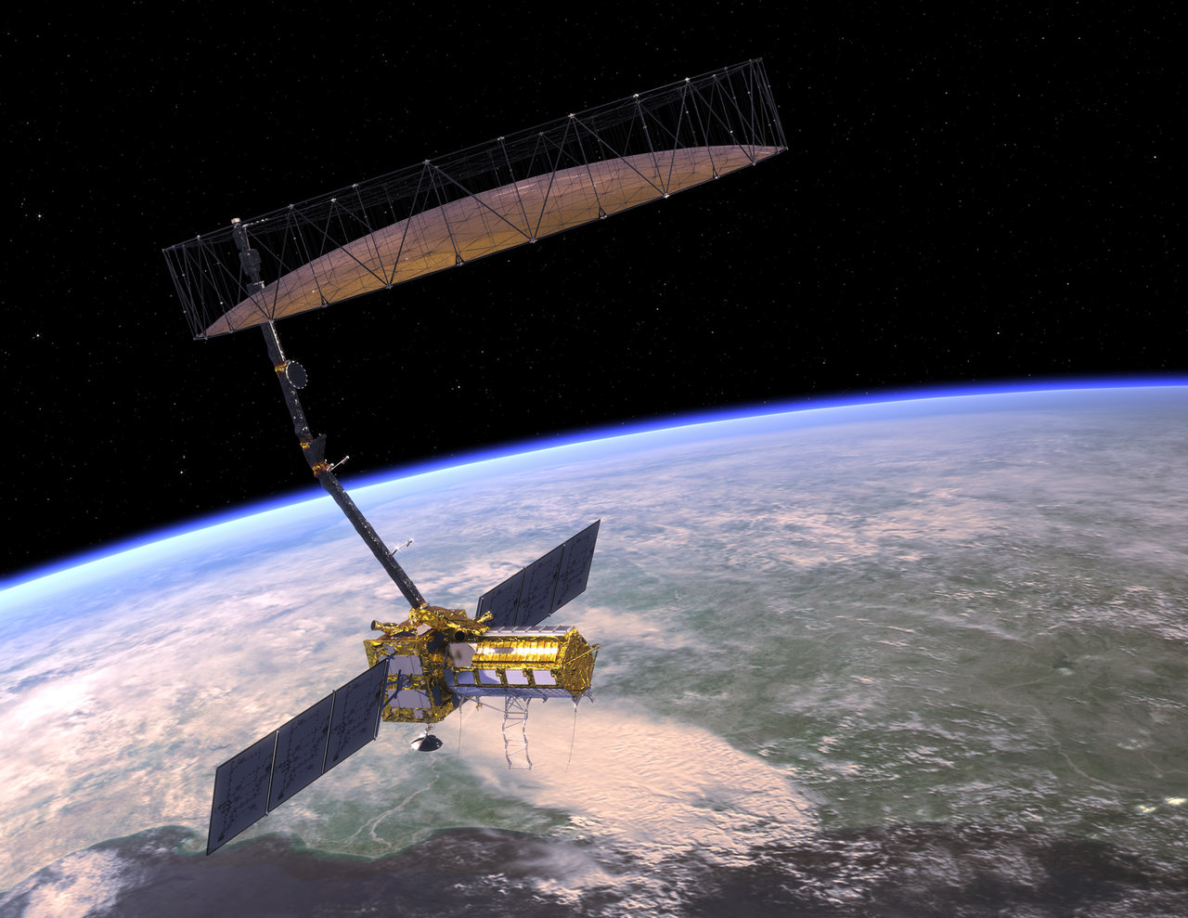
Publications and Acknowledgements
Miller, M., & Jones, C. (2020). Drought-induced rapid subsidence in the Central Valley and its impact on the California Aqueduct. In EGU General Assembly Conference Abstracts (p. 10733).

