Slide 1
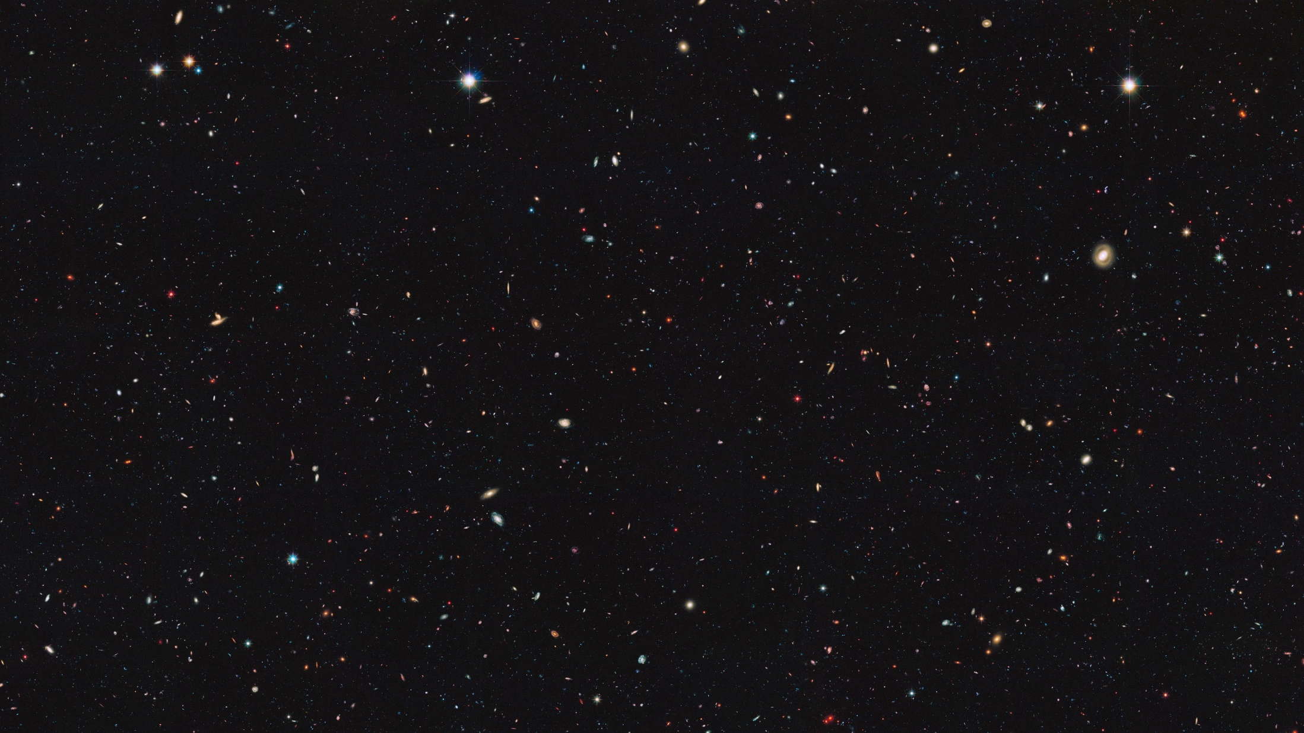
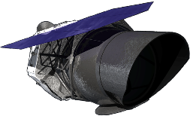
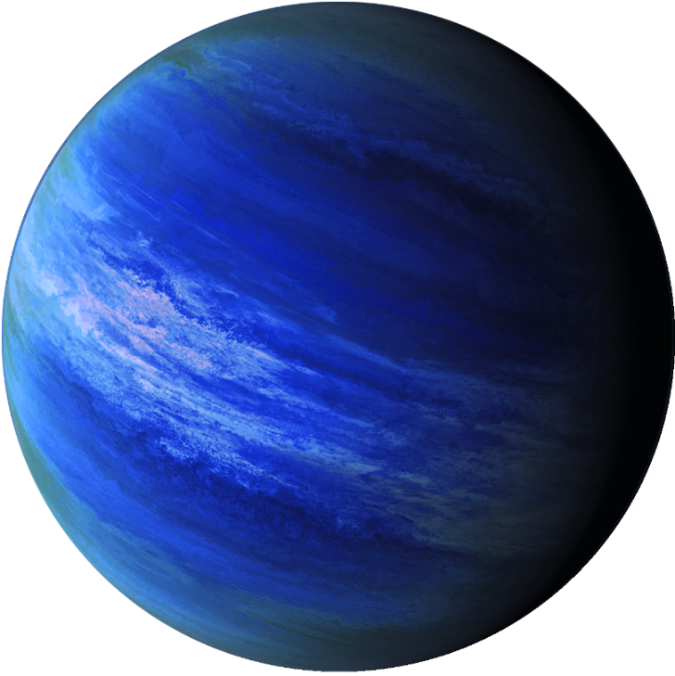
The decision to implement the Nancy Grace Roman Space Telescope mission will not be finalized until NASA's completion of the National Environmental Policy Act (NEPA) process. This document is being made available for information purposes only.
Optimization of photon counting sensors for direct exoplanet imaging
2020 Postdoc Research Day Presentation Conference
Nathan Bush, JPL Postdoctoral Fellow, 389N
Supervisor: Patrick Morrissey
© 2020. California Institute of Technology. Government sponsorship acknowledged.

Slide 2
These slides have automatic audio and timed animations. Please do not click until a tick appears at the bottom right of the screen.
Enjoy!

Slide 3
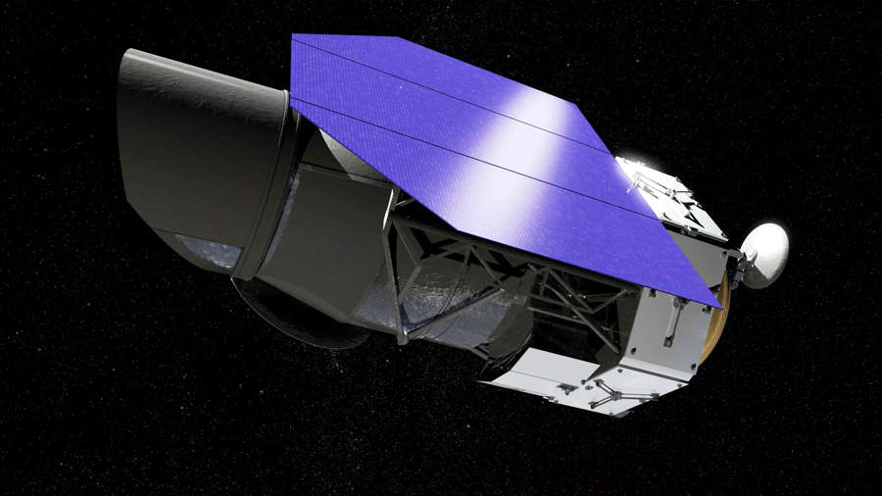
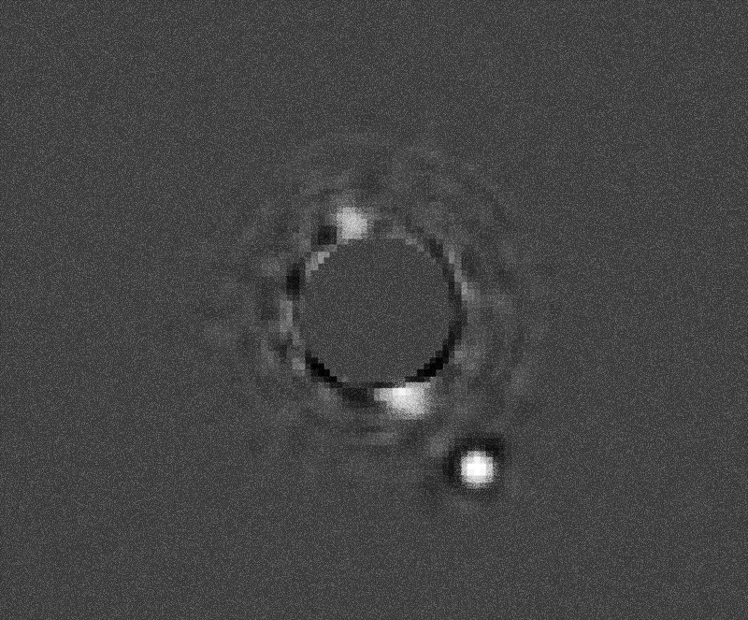
Introduction
Direct planet imaging offers the best means to identify and characterize a habitable planet analogue.
Roman
The Nancy Grace Roman Space Telescope will have an onboard coronagraph capable of imaging planets with properties similar to those within our own solar system.
Planet Signal
The fraction of light reflected by planets is incredibly small; up to a billion times less than the parent star.
Highly sensitive detectors are needed to image the planet signals – they must be able to detect single optical photons.
Blocked Starlight
¹Image taken from Gemini planet imager, http://www.gemini.edu/node/12113, Image credit: Processing by Christian Marois, NRC Canada.

Slide 4
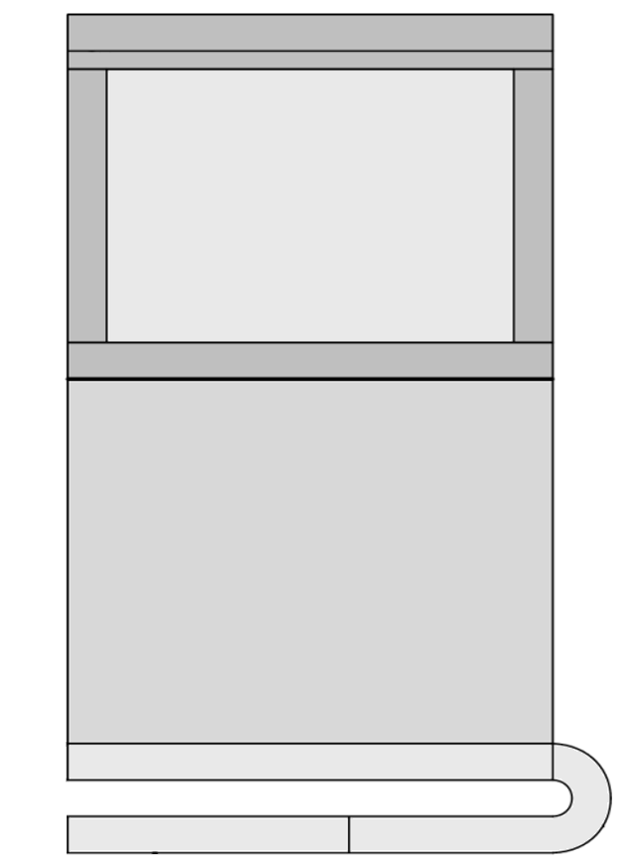
Detecting Planet Signals
Detector
Image Area
The coronagraph detectors contain individual photo-sensitive elements (pixels) that collect the planet signal.
Image Pixel
10 V
10 V
0 V
0 V
0 V
0 V
Timed voltage pulses applied to each pixel electrode move the charge towards the output.
Electron Multiplication (EM) gain increases the signal size prior to the output and allows detection of faint planet signals.
The detectors are called Electron Multiplying Charge Coupled Devices (EMCCDs)
= signal
EM Register
EM Register
1000 e⁻
1e⁻
Output
Signal Amplification
100e⁻ noise (RMS)

Slide 5
Cosmic Ray Contamination
Cosmic Ray
In space, charged particles will pass through the EMCCD and deposit signal.
For the coronagraph, we expect a few events per cm² per s. On average 2000 e⁻ are deposited per event.
These signals are also amplified and quickly saturate the EMCCD register pixels, resulting in ‘tails’ that follow the initial event.
These tails can limit the time the detector spends accumulating planet signal.
Image Pixel
+
+
-
+
-
+
-
+
-
+
-
+
-
-
= signal
Primary event
Charge tail

Slide 6
Capping Cosmic Ray Signals
Image Area
Image Area
The sensor has an additional feature called a dump gate, normally used to flush all unwanted signal.
Dump Gate
We can tailor the voltage pulse applied to the dump gate so that it drains away most of the large cosmic ray signals, but leaves small planet signals unaffected.
Top-Down View
Customized Pulse
Normal operation
Only a small fraction of the cosmic ray signals (100 e⁻ max) reaches the EM register.
This significantly reduces the size of the tail, and hence the fraction of the frame that is lost.

Slide 7
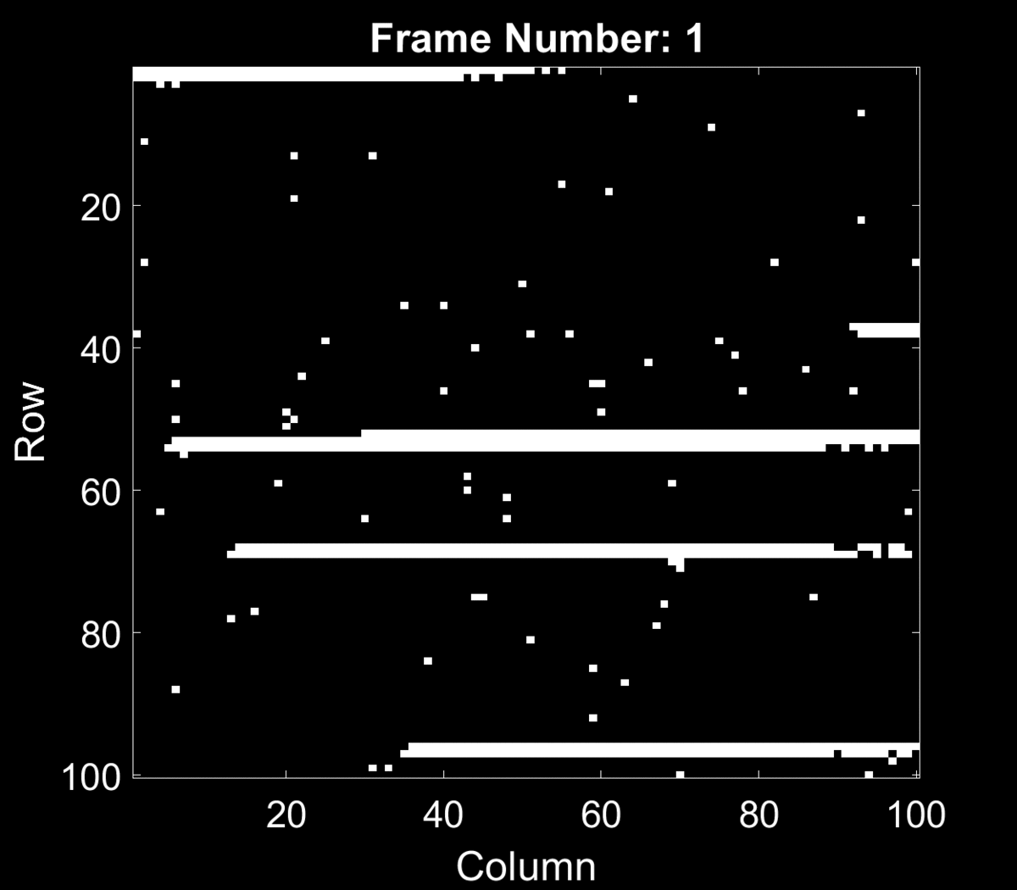
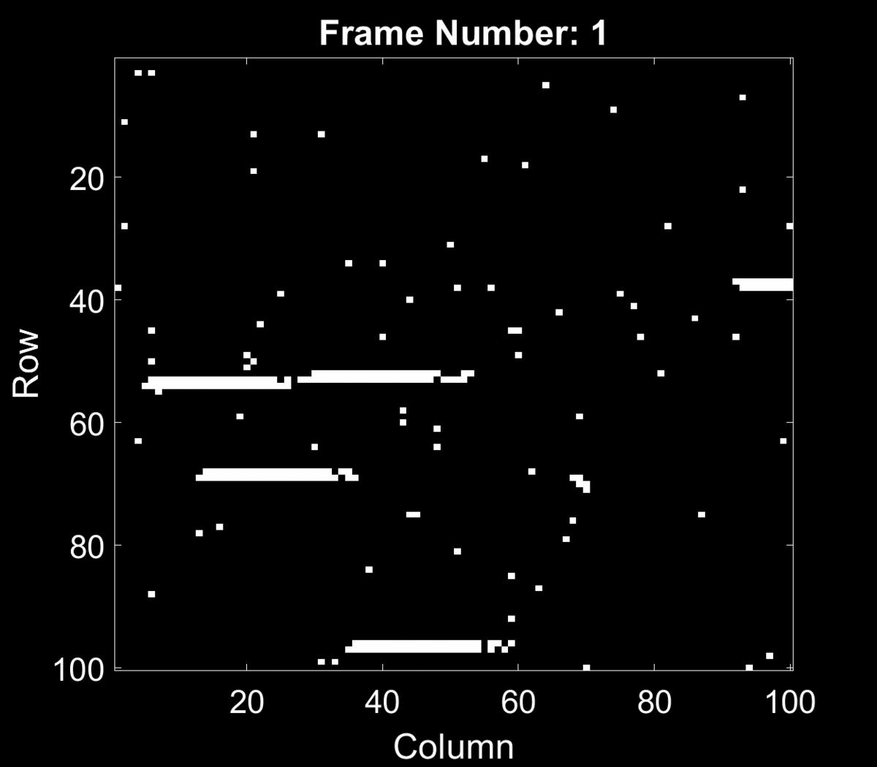
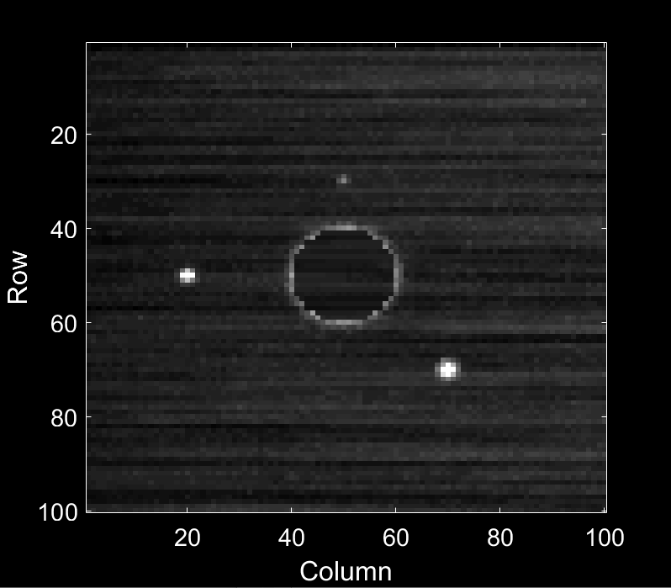
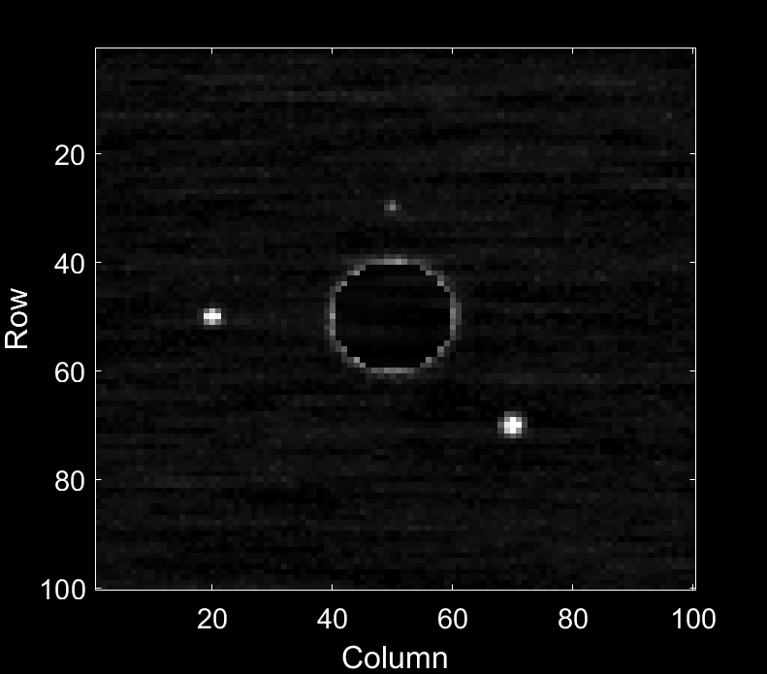
Results of Dump Gate Pulsing
Standard Operation
Dump Gate Pulse Applied
*Planet scenes are simulated for a visual comparison and not indicative of CGI performance. Integration time 200s. Particle rate: 3 cm⁻²s⁻¹

Slide 8
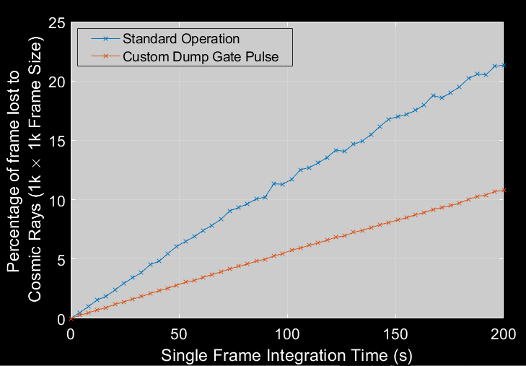
Results of Dump Gate Pulsing
Side by side image simulations based on experimental cosmic ray tail data predict a reduction in frame contamination of up to 50% using this technique.
Experimental results using X-ray events as example cosmic rays support the finding.
X-ray event Data (same color scale)
50% reduction
No Pulse
With Pulse

Slide 9
Summary
This research has resulted in a novel operating mode for EMCCDs where frame contamination due to cosmic rays can be significantly reduced.
As a result, the single-frame integration time of the sensor can be increased, reducing the time taken to detect planet targets for future instruments that use these sensors.
Publication:
Controlling EMCCD charge handling capacity through customized clocking N. Bush et al; (prep) for SPIE Astronomical Telescopes and Instrumentation 2020.
Nathan.Bush@jpl.nasa.gov

