Slide 1
Detection and characterization of anthropogenic explosion: Beirut case study
2020 Postdoc Research Day Presentation Conference
Detection and characterization of anthropogenic explosion: Beirut August 04, 2020 case study
Principal Investigator: Olusegun Jonah (335)
Co-Is: Attila Komjathy, Siddharth Krishnamoorthy, Panagiotis Vergados (335)
Postdoc Program: NASA POSTDOCTORAL PROGRAM (NPP)

Slide 2
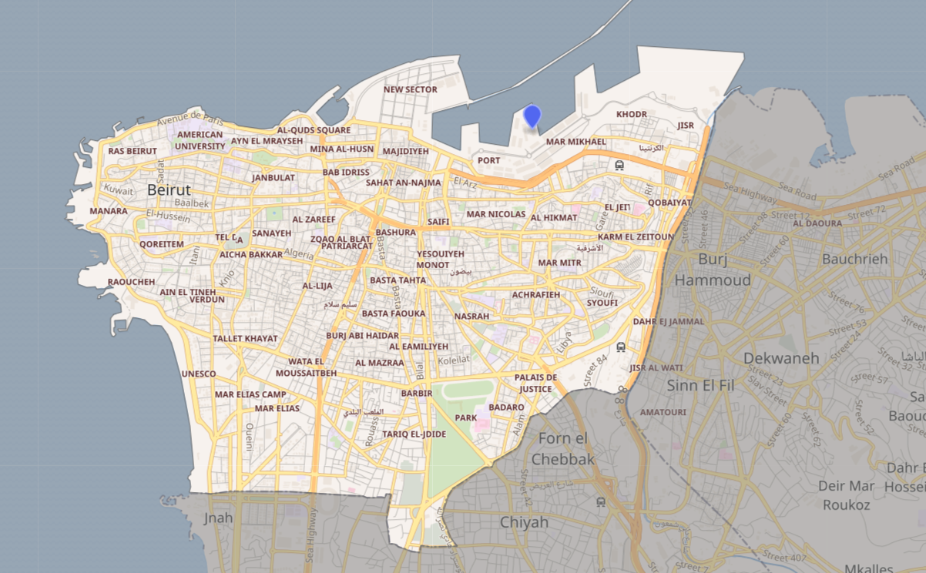
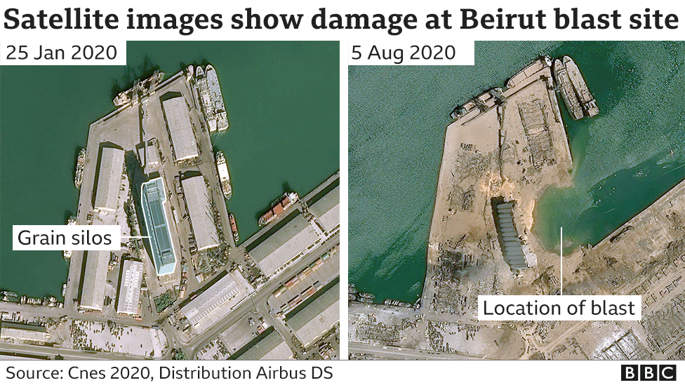
Introduction:
August 04 2020 Beirut explosion
The Beirut explosion was one of the biggest non-nuclear explosion ever
According the Univ. Sheffield, the explosion is estimated to be equivalent to 1500 tones of TNT.
The Ammonium nitrite gas combined with fuel-oil created an explosion that caused a shock wave to ripple across the city and generated acoustic waves that propagate through the atmosphere.
This blast was felt at more than 160 mi away and caused at least 190 deaths, 3 missing, 6,500 injuries, $10 – 15 billion property damage and rendered 300,000 people homeless.

Slide 3
Problem Description and Motivation
This kind of sizable explosion causes acoustic gravity waves (AGWs) which travel vertically upward to ionospheric heights (top panel figure) and induces plasma density perturbation. Since neutral density decrease with altitude, AGWs grow in amplitude (bottom panel figure) to conserve energy (Meng et al., 2019).
Acoustic waves generated by surface explosion propagate through the ionosphere disturbing densities which may impact electromagnetic waves such as GNSS signals, potentially causing signal degradation.
The goal of this study is to understand the coupling between the lower and upper atmosphere resulting from AGW seeded by explosion.
The study aim to identify/detect the ionosphere perturbation caused by the Beirut explosion and provide information that can help detect such anthropogenic or nuclear bomb explosions in the ionosphere.
This study will be useful for developing a coupled atmospheric-ionosphere model that can lead to future prediction of ionospheric response to similar events.
Lastly, JPL recognizes the importance of this topic as part of assessment and mitigation of geo-hazard and anthropogenic explosions
Huang et al. (2016)
Jonah et al. (2016)

Slide 4
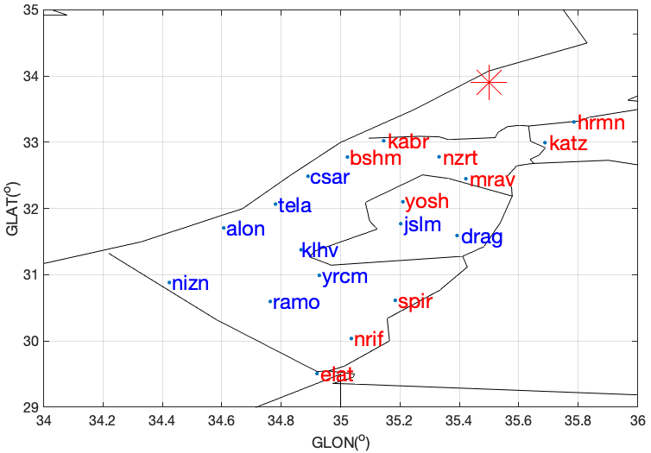
Methodology
GNSS Station Distribution Around Epicenter
We exploit the increased spatial coverage of the station observing signal of global navigation satellite system (GNSS) around the globe.
The total electron content (TEC) derived from the GNSS observables were obtained from Madrigal network. A total of 22 GNSS stations of 30-sec resolution data were processed to estimate TEC and differential TEC.
We band-pass filtered carrier-phase derived TEC observations using a Butterworth filter. The bandpass was selected to be between 1.5 and 3 mins.
Example of the procedure are shown in the figure on the right.
Top figure represents the distribution of GNSS receivers around the explosion. The bottom panel represents the example of signal identification from the explosion.

Slide 5
Results: GPS Observations
3 Days Before
The Figure from top to bottom shows 3 day before the Beirut explosion, the day of the explosion and day after the explosion.
We observed strong signal in the ionosphere after 10 to 15 min of the explosion as shown in the middle panels. The red dash line represents the onset of the explosion.
This signal is not present in the other control days represented in the top and bottom panels.
Note: we used 3 day before because kp index was > 3 for the 2 days preceding the event.
10 – 15 min
Day of Event
Day After

Slide 6
PRN locations around the explosion
Results: GPS Observation
The explosion-induced signal can also be viewed clearly in the contour plot as it arrived in the upper atmosphere.
The top panel shows coordinates of the PRNs centered around the time of explosion. Bottom panel shows the identification of the event’s signal in the ionosphere. The red dash line represents the onset of the explosion at UT 15.08.

Slide 7
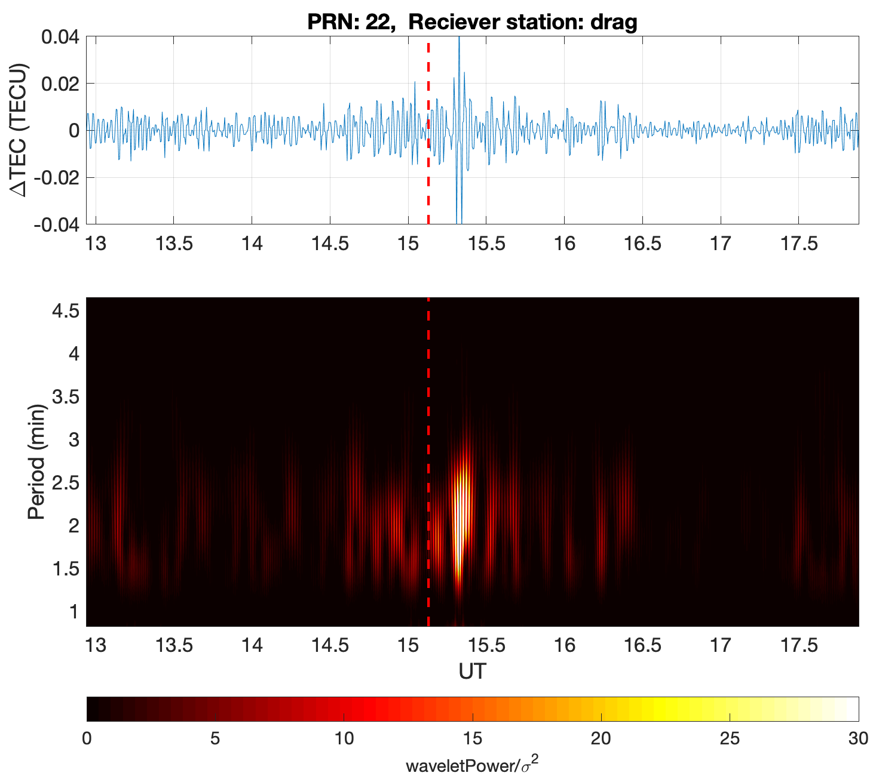
Wavelet analysis
We performed the spectral wave analysis via Continuous Wavelet Transform with 95% confidence level.
This allowed us to identify the dominant period and confirm the wave perturbation observed in the signal.
The top panels are the explosive induced signal while the bottom panels represents wave analysis.
A dominant period of 2.5 min was observed consistently in all PRN and receiver station analyzed.
~2.5 min
~2.5 min
~2.5 min
~2.5 min
~2.5 min
~2.5 min
~2.5 min

Slide 8
Results:
GLONASS Observations
Similar waves were detected from GLONASS observations and spectral analysis was performed as shown in the figure.
Similar periodicity was observed however, larger amplitude was observed in GLONASS data compared to GPS data.
Finally, common to all wave detected in this study, velocity of ~400 to ~600 m/s was observed and the direction of wave propagation was found to be southward of the epicenter.
~2.5 min
~2.5 min
~2.5 min
~2.5 min
~2.5 min
~2.5 min
Wavelet power/σ ²

Slide 9
CONCLUSION
Using GNSS measurement, we detected and characterized the response of the ionosphere to the Beirut explosion that occurred on August 04, 2020.
We used method of frequency decomposition tool to see detail information contained in our data.
We identify acoustic gravity wave signature 10 to 15 mins after the explosion, with an amplitude of 0.04 TECU for GPS observable and 0.2 TECU for GLONASS observables, The waves were moving with the velocity of ~400 to 600 m/s in the southward direction to the epicenter.
Spectral analysis was performed and a ~2.5 min periodicity was observed common to GNSS network observables used in the study.
Finally, It is expected that this kind of sizable explosion will impact the ionosphere, this study confirm this expectation, and further demonstrates the presences of coupling between the lower and upper atmosphere as a result of anthropogenic explosion.
~2.5 min
~2.5 min
~2.5 min
~2.5 min
~2.5 min
~2.5 min

Slide 10
References and Acknowledgements
References:
Bressan, David. "Beirut Explosion Generates Seismic Waves Equivalent Of A Magnitude 3.3 Earthquake". Forbes.
BBC news: Beirut explosion: What we know so far. https://www.bbc.com/news/world-middle-east-53668493.
Huang, C. Y., Helmboldt, J. F., Park, J., Pedersen, T. R., & Willemann, R. (2019). Ionospheric Detection of Explosive Events. Reviews of Geophysics, 57, 78–105. https://doi.org/10.1029/ 2017RG000594
Jonah, O. F., E. A. Kherani, and E. R. De Paula (2016), Observation of TEC perturbation associated with mediumscale traveling ionospheric disturbance and possible seeding mechanism of atmospheric gravity wave at a Brazilian sector, J. Geophys. Res. Space Physics, 121, 2531-2546, doi:10.1002/2015JA022273.
Livescience: Beirut blast was one of the biggest non-nuclear explosions ever. https://www.livescience.com/beirut-explosion-biggest-non-nuclear.html
Meng, X., Vergados, P., Komjathy, A., & Verkhoglyadova, O. (2019). Upper atmospheric responses to surface disturbances: An observational perspective. Radio Science, 54. https://doi.org/10.1029/2019RS006858.
Wikipedia: 2020 Beirut explosion. https://en.wikipedia.org/wiki/2020_Beirut_explosion.
Future Study:
We intend to carry more case studies.
Use multiple instruments to further investigate the detail of this type of surface wave and improve our understanding of the atmospheric coupling .
Other wave properties such as wavelength will be derived.
Acknowledgements:
This research was supported by an appointment to the NASA Postdoctoral Program at the NASA Jet Propulsion Laboratory, administered by Universities Space Research Association through a contract with NASA.

