Slide 1
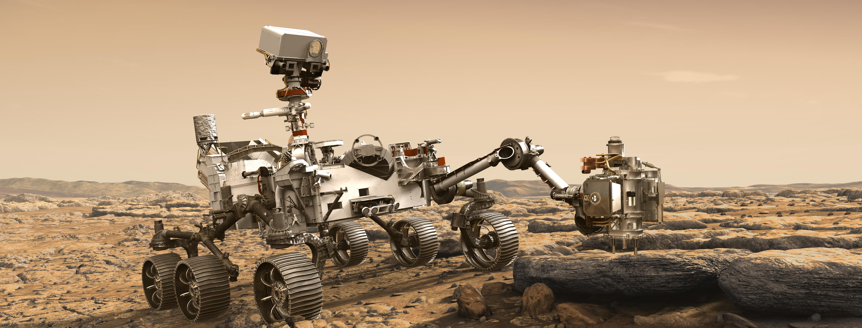
Image credit: NASA/JPL-Caltech
Deep-UV Raman Spectroscopy for Planetary Science
Joseph Razzell Hollis
Organization: 3225
Advisor: Luther Beegle (3200)
Postdoc Program: JPL
Notes:
Hello, my name is Joseph Razzell Hollis, I am a third year postdoc working in the Ocean Worlds and Astrobiology group, where I have been studying how we can use deep-UV Raman spectroscopy for planetary science missions such as Mars 2020. This presentation is a short introduction to the work I have done over the past few years.

Slide 2
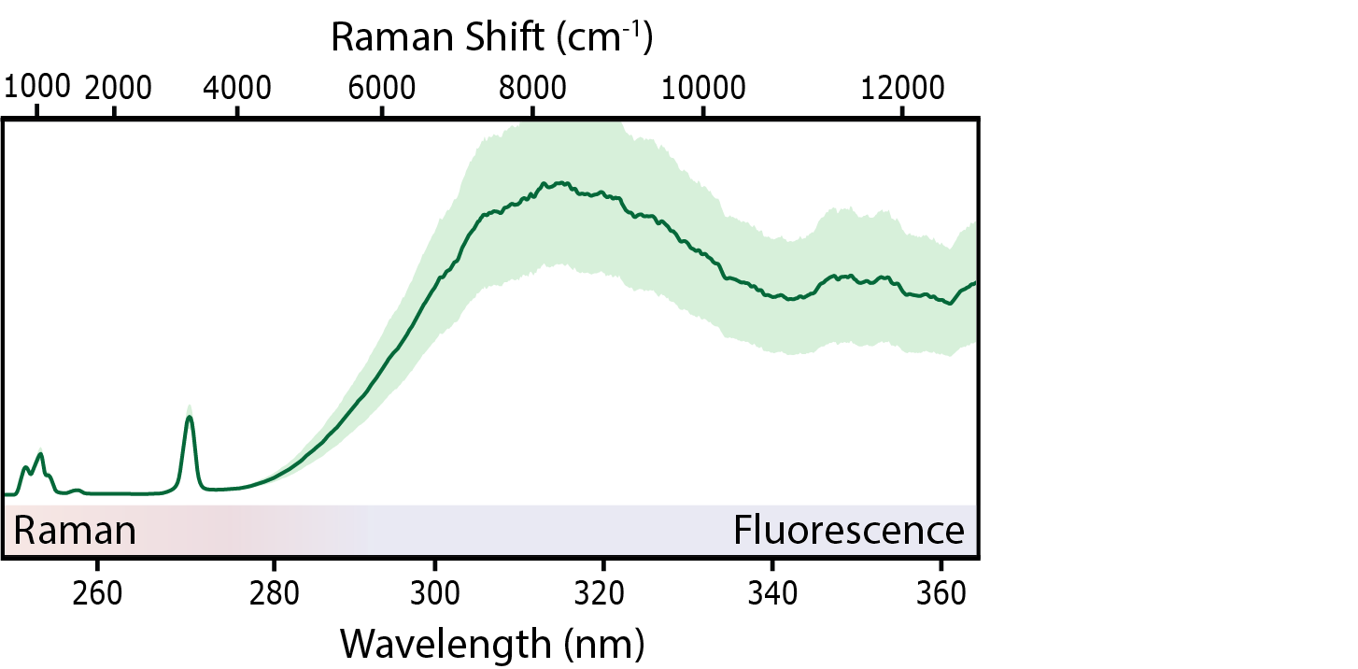
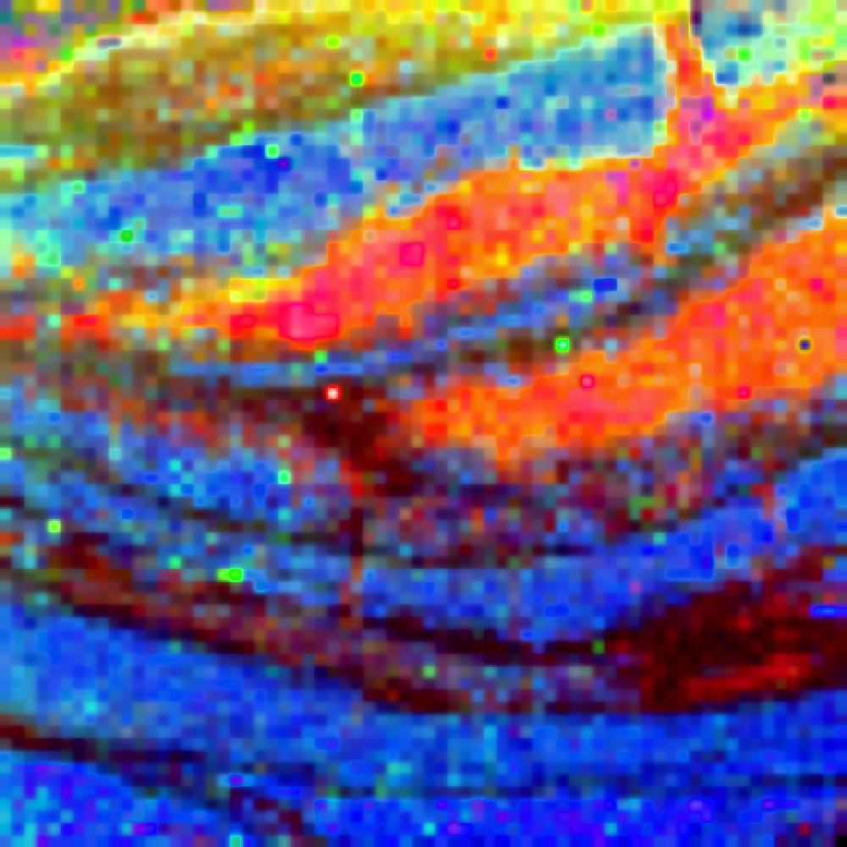
Introduction
SHERLOC
Abstract
The Perseverance rover will land on Mars in February 2021 and begin its search for “biosignatures”, organic molecules that may be evidence of past or current life on the red planet.
To achieve this goal, Perseverance is equipped with an instrument named SHERLOC that will use deep-ultraviolet spectroscopy to detect and identify minerals and organic molecules
Scanning Habitable Environments with Raman & Luminescence for Organics and Chemicals
Fluorescence Spectroscopy
Highly sensitive to aromatic organic molecules
Detection limit of <1 ppm
WATSON Image
Organics
Chert
Raman Spectroscopy
Detects molecular vibrations, specific to chemical structure
Also reveals mineralogy
Dolomite
ACI Image (12x16 mm)
Notes:
The Mars 2020 rover, now known as Perseverance, is tasked with looking for biosignatures, organic molecules that may be the chemical products or remains of biological processes. One of the tools the rover will use in this search is an instrument named SHERLOC, which stands for Scanning Habitable Environments with Raman and Luminescence for Organics and Chemicals. We will scan abraded rocks for fluorescence, the light emission of aromatic molecules, and then identify those molecules by their Raman peaks, which are highly specific to chemical structure.

Slide 3
The Challenge
Building A Spectral Library
DUV Raman is a fairly new technique, reference spectra are not readily available or understood
Need to assemble a SHERLOC library for all Mars-relevant minerals and possible biosignatures
Organics
Minerals
Aromatic Hydrocarbons
Aliphatics
Condensed Carbon
Borates
Carbonates
Sulfates
Silicates
Phosphates
Perchlorates
Recognizing Biosignatures
How do we define a biosignature as detected by SHERLOC?
How will these biosignatures change over time on Mars?
Intense UV at the surface may damage organic material!
Notes:
Deep-UV Raman is a relatively new technique, which means that we don’t have a full understanding of how different molecules will appear in our spectra when we detect them. To this end, I have been building a spectral library, a database of standard spectra for many organic molecules and minerals that are of interest to the search for life on Mars. These include the nucleobases that form DNA, the amino acids that form proteins, as well as polycyclic aromatic hydrocarbons and carboxylic acids. But we also need to understand how we can recognize the more complex biosignatures produced by living organisms, and how those biosignatures may change over millions of years on Mars’ surface.

Slide 4
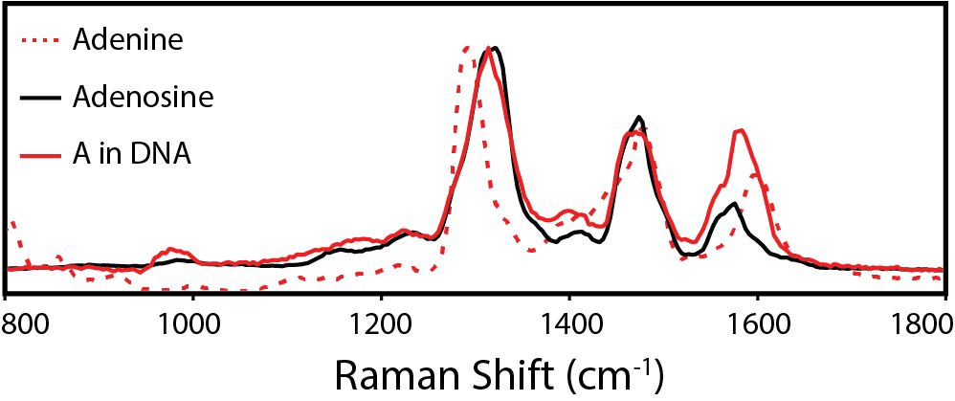
Detecting and Identifying Biosignatures
Life produces an enrichment of many complex molecules that cannot be explained by abiotic processes
What Constitutes A Biosignature?
Raman signature of E. coli cells made up of peaks from 8 aromatic molecules
Includes components of DNA/RNA, and protein
Represents ~22% of cellular mass
➜ detecting chemical diversity!
Cellular Composition by mass
Cell spectrum can only be deconvoluted using nucleotide spectra (e.g. adenosine)
➜ detecting chemical complexity!
Nucleotides have not been found in meteorites
➜ signature is distinct from abiotic material!
Samples provided by Haley Sapers (Caltech/JPL)
Notes:
Generally speaking, a biosignature can be considered an enrichment of many complex organic molecules that cannot be explained by non-biological processes. If we were to find a sample containing living cells, such as E. coli, we get a complicated Raman spectrum that is a combination of peaks from 8 distinct aromatic molecules, namely the 5 nucleobases that form the cell’s DNA and RNA, and 3 aromatic amino acids from its proteins.
The sensitivity of deep-UV Raman to chemical structure is shown in the difference in spectra between a simple nucleobase like adenine, and a more complex form like adenosine. When we tried deconvoluting the cellular spectrum, we found that we could only get a good fit using the nucleotides as components, as they are more representative of the structures found in DNA and RNA. What’s more, while the simple nucleobases like adenine have been found in meteorites, nucleotides have not. So, this would be a great biosignature to find on Mars: we can observe its chemical diversity, its chemical complexity, and it is distinct from organic material known to form abiotically.

Slide 5
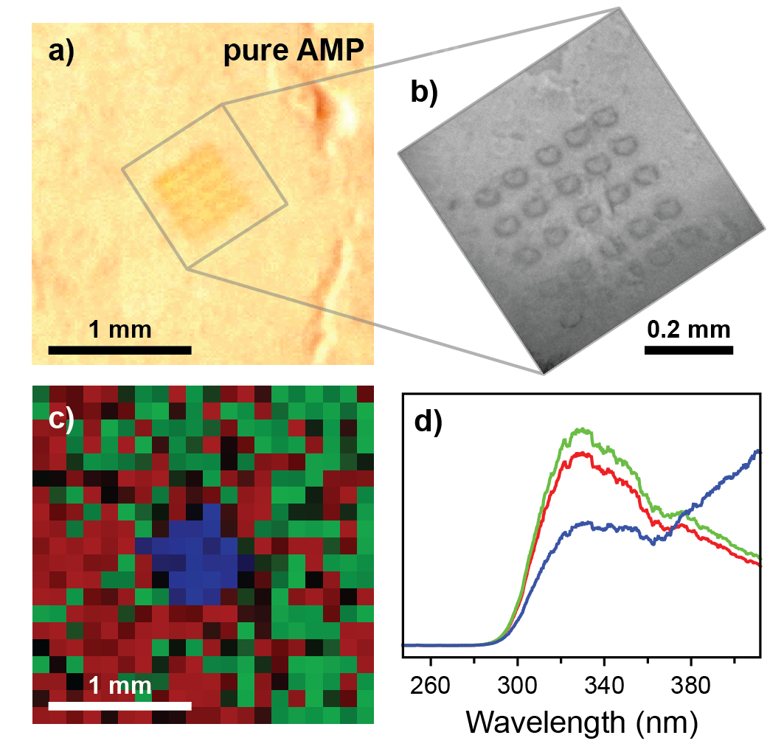
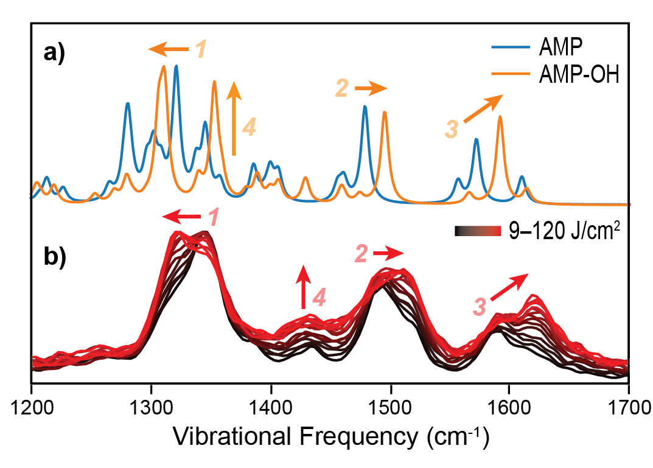
UV Degradation and Preservation
Prolonged UV exposure of a key organic (adenosine monophosphate)
Equivalent to ~6 sols of ambient UV at Mars’ surface
Produces visible discoloration, loss of fluorescence signal at ~330 nm
➜ photochemical degradation of adenine unit
When adenosine is mixed with clay (montmorillonite):
Raman changes observed, fluorescence instead increases at ~400 nm
➜ no loss of adenine unit, but minor alteration occurs
Samples provided by Teresa Fornaro (Carnegie/INAF) and William Rapin (Caltech/Sorbonne)
DFT simulations by Jess Wade (Imperial)
What’s going on?
Raman changes for AMP in clay consistent with hydroxylation of adenine unit
Clay appears to prevent further degradation
➜ Clay is a valuable target for detecting preserved organics!
Notes:
The surface of Mars receives approximately ten times as much harmful UVB and UVC radiation as Earth does. So when Perseverance abrades a rock to expose fresh organic material, how long might a potential biosignature last before it is no longer detectable? When we repeatedly exposed a sample of adenosine to our UV laser, simulating 6 sols worth of ambient UV on Mars, we saw a discoloration of the exposed area along with a loss of fluorescence, indicating that the adenine unit had been broken.
When we mixed adenosine with montmorillonite clay, we no longer saw a loss of fluorescence, but an increase at longer wavelengths as well as changes in Raman peaks, suggesting that the structure of the adenine had been altered rather than broken.
DFT simulations of possible products showed that the Raman changes are consistent with formation of hydroxy-adenosine, We propose that this is an intermediate step in adenosine’s degradation, and that presence of clay inhibits further degradation. This agrees with other reports that clays are an effective preserver of organic material, and should be considered a high value target for SHERLOC measurements.

Slide 6
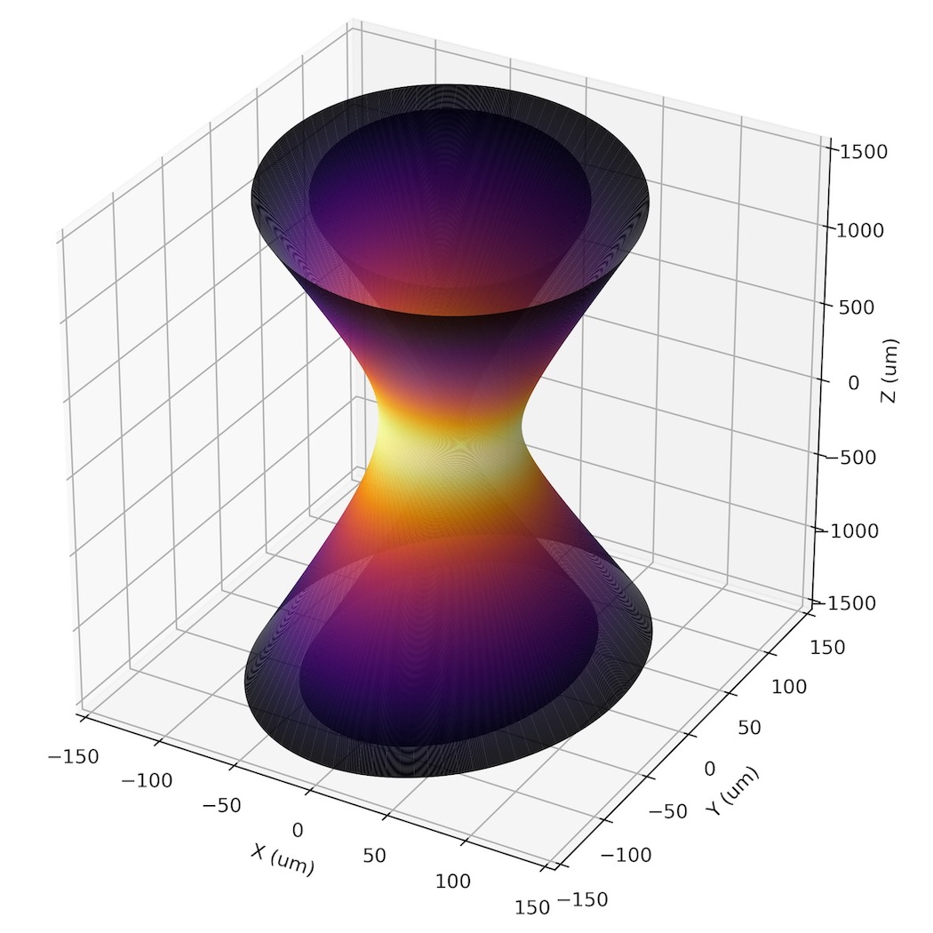
What Next
Can we estimate concentration from Raman intensity?
Must account for instrument parameters, laser beam dimensions
Concentration will help us understand how significant a biosignature is
➜ comparison to expected yield from abiotic processes
Will allow us to predict the specific detection limit for different organic molecules
➜ will be influenced by UV absorption from surrounding minerals!
Publications
Sapers et al. (2019). “The Cell and the Sum of Its Parts: Patterns of Complexity in Biosignatures as Revealed by Deep UV Raman Spectroscopy.” Front. Microbiol. 10, 1–15. doi:10.3389/fmicb.2019.00679.
﻿Razzell Hollis et al. (2020a). “An Optical Model for Quantitative Raman Microspectroscopy.” Appl. Spectrosc. 74 (6), 684-700. doi:10.1177/0003702819895299.
Razzell Hollis et al. (2020b). “Deep-Ultraviolet Raman Spectra of Mars-Relevant Evaporite Minerals under 248.6 nm Excitation.” Icarus 351, ﻿114067. doi:﻿10.1016/j.icarus.2020.113969
Razzell Hollis et al. (2020c). “Detection and Degradation of Adenosine Monophosphate in Perchlorate-Spiked Martian Regolith Analog, by Deep-UV Spectroscopy.” Astrobiology (under review)
and 3 others
Notes:
The next step for improving our understanding of deep-UV Raman is to develop a means to estimate the concentration of organic molecules from their Raman intensities. This will involve quantifying how sample properties and instrument parameters determine the signal we measure, and how it might be further affected by scattering and absorption by surrounding minerals. A working model will allow us to predict the limits of SHERLOC’s sensitivity on a sample by sample basis, and provide a more quantitative interpretation of potential biosignatures on Mars.
Most of the work I have mentioned during this presentation has now been published, or will be very soon. I would like to finish by thanking the members of the SHERLOC science team, particularly my supervisor Luther Beegle, as well as my colleagues and collaborators at JPL and beyond. Thank you for listening.

