Slide 1
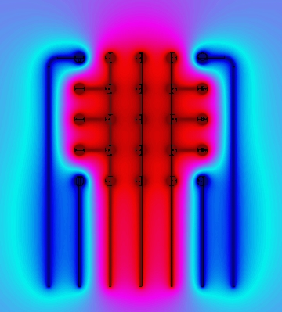
A numerical modeling of electrostatic radiation shields
2020 Postdoc Research Day Presentation Conference
Bohoon Kim
Organization: Planetary Mass Spectrometry (389T)
Advisor: Dragan Nikolic and Frank Maiwald
Postdoc Program: JPL Postdoctoral Fellow

Slide 2
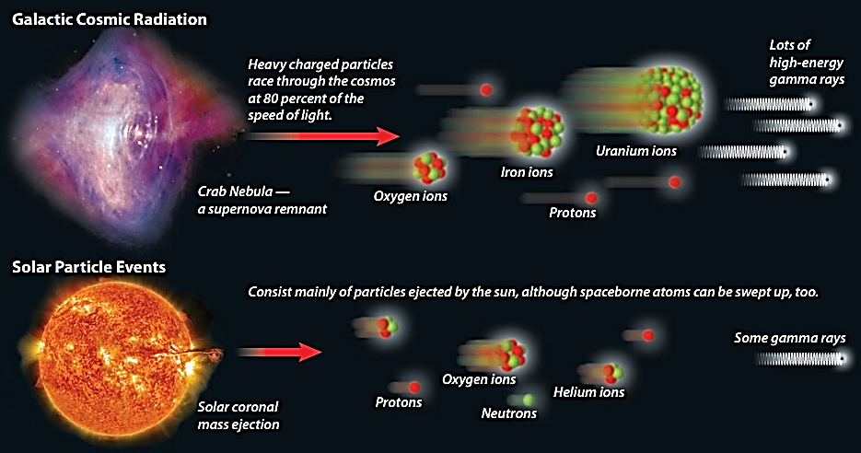
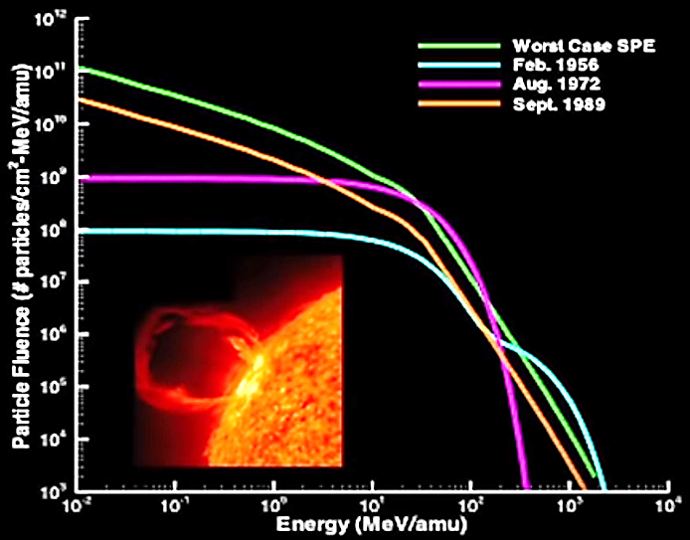
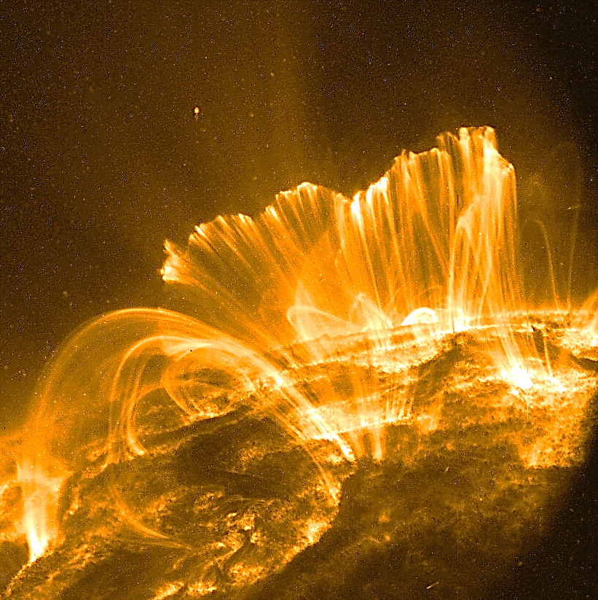
Introduction – Radiation Sources in Deep Space
Sources: NASA SOHO solar observatory, NASA Hubble and Chandra images
Sources: NASA Langley Research Center
Two types of environment of concern: Galactic Cosmic Radiation (GCR) and Solar Particle Events (SPE)
GCR : Highly charged, energetic protons originating outside the solar system
SPE : Low to medium energy protons associated with coronal mass ejections
Radiation Syndrome

Slide 3
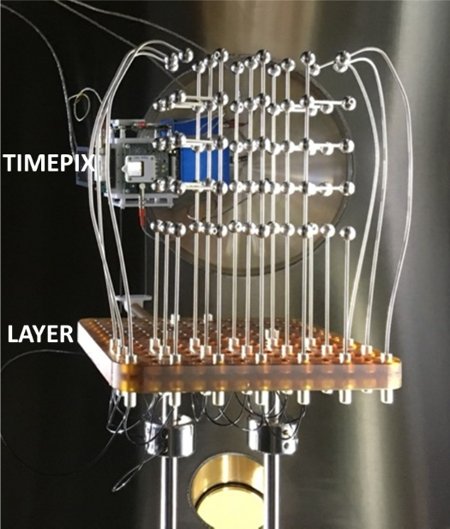
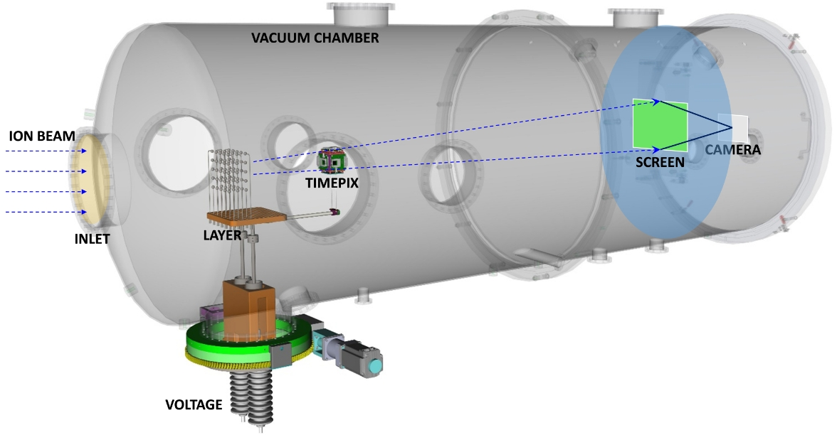
Objectives
To simulate the motion of charged ions through an arbitrary highly-charged electrostatic shielding system for interplanetary human spaceflight
[ION BEAM Experiment]

Slide 4
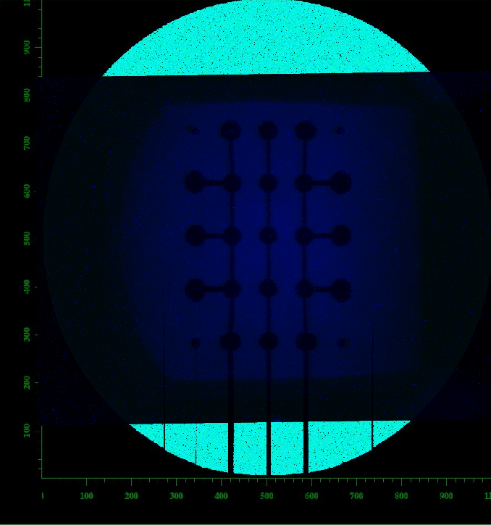
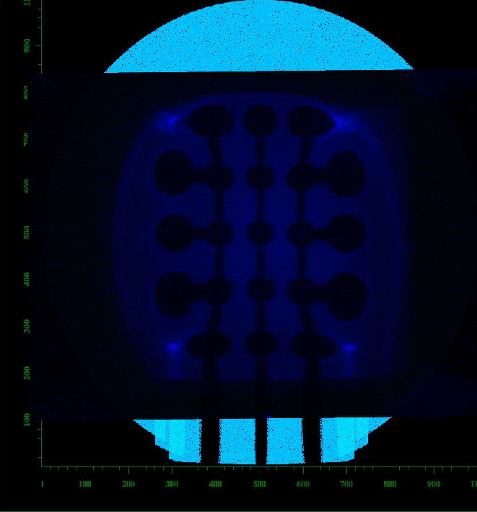
Experimental and Numerical Comparison
Cal.
Cal.
Exp.
Exp.
[-10 kV & +2 kV]
[-50 kV & +30 kV]
[1 Layer at 45 deg : 6 MeV H⁺]

Slide 5
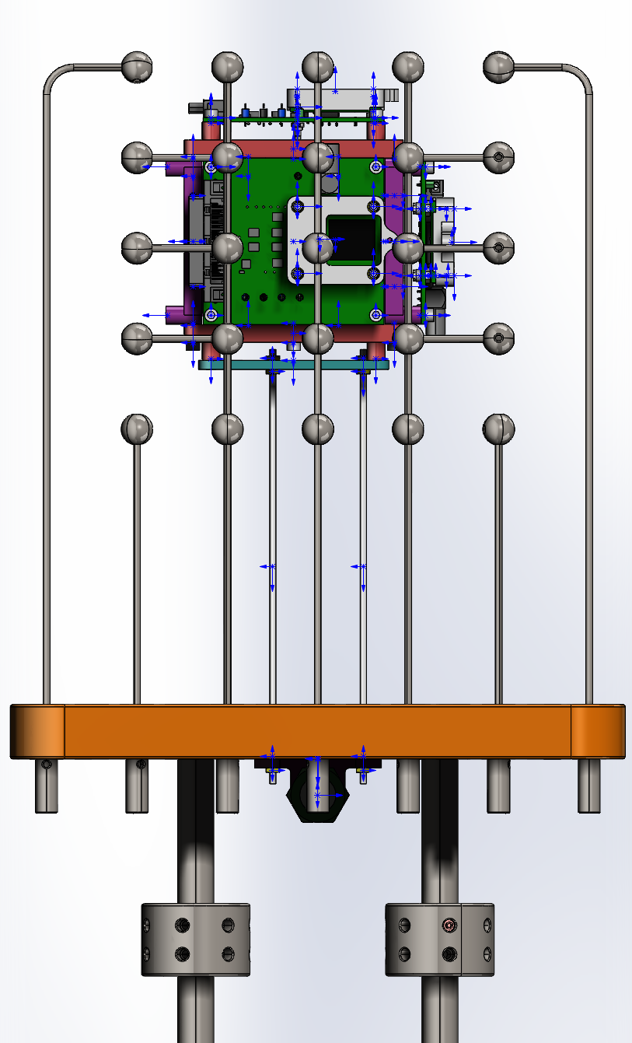
Timepix Measurement (pixel particle detector)
[Fluorescent screen]
[Timepix screen]
2 MeV
22.5 MeV
6 MeV
Central electrode
As the voltage increases, ions are gradually pushed to the right, widening the area of the safe zone.

Slide 6
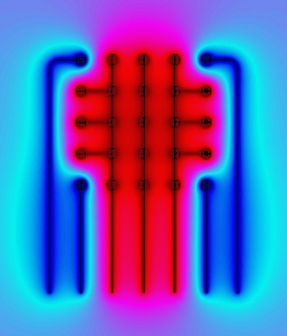
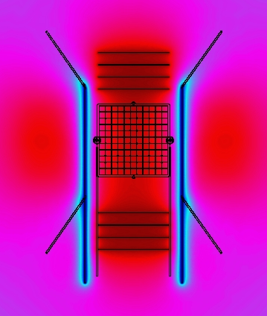
Shielding Effect
-50kV
50kV
-50kV
[Electrode Array]
Electrode Array
-50kV
50kV
-50kV
Grid Structure
Grid structure has similar performance as the electrode array but with 3 times lower stored charge, and can be foldable with small transportation volume.
[Grid Structure]

Slide 7
Shielding Effect
Ion Beam
Position1
Position2
Grid
Timepix
Position1
Timepix
Position2
Timepix
Position3
Position3
60%
Shielding efficiency of up to 60% was obtained on the timepix screen at the distant position 3. (Dispersion effect of ion beam according to distance)

Slide 8
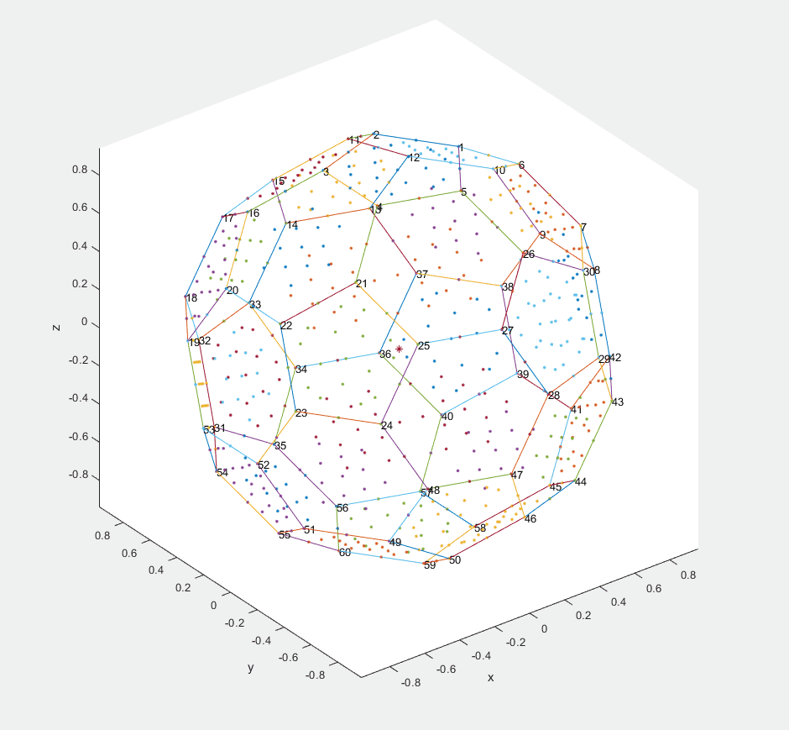
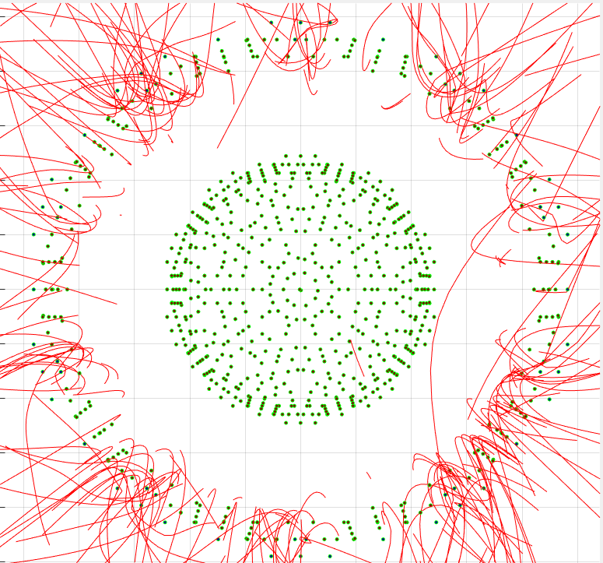
Conclusions – Future work
Van de Graaff generator (up to 5 megavolts)
3D structure to shield all directions
+50 kV -50 kV
IONS : 2 MeV H⁺
+500 kV -500 kV
+5000 kV -5000 kV
Buckminster-fullerene stacked in two layers

