Slide 1
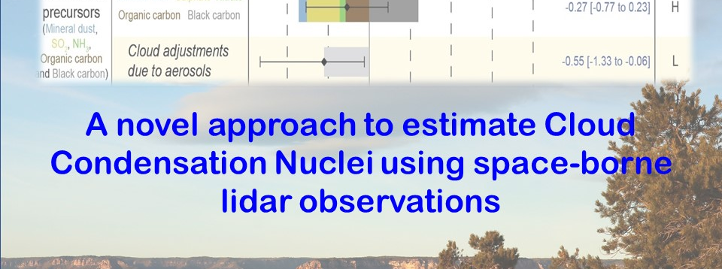

2020 Postdoc Research Day Presentation Conference
Piyushkumar N. Patel
Organization: Earth Science / Aerosols and Clouds (329J)
Advisor: Jonathan H. Jiang (329J)
Postdoc Program: NPP

Slide 2
Introduction
Abstract
Atmospheric aerosol particles significantly modulate the radiation budget, cloud properties (by serving as Cloud Condensation Nuclei – CCN) and overall climate of Earth-atmosphere system. Aerosol/cloud-mediated change in climate forcing appears to be dominant factor of uncertainty in quantifying atmospheric drivers of changing climate due to anthropogenic perturbation. This make essential to have an accurate and quantitative knowledge of aerosol properties and their capability of serving as CCN at a global scale is fundamental to advance our understandings of aerosol-climate interactions. Our inability to do so introduce a highest uncertainty regarding aerosol-cloud interactions and their climate forcing. This can be addressed by developing a novel approach to monitor aerosol properties and their contributions in the climate forcing over a range of temporal and spatial scales. The present work offers a new approach to estimate CCN concentrations using space-borne lidar observations and model simulations. Overall, the results shed new light on the aerosol monitoring from the space, which may provide an important input to the present climate models to reframe the representation of aerosol-cloud interactions.

Slide 3
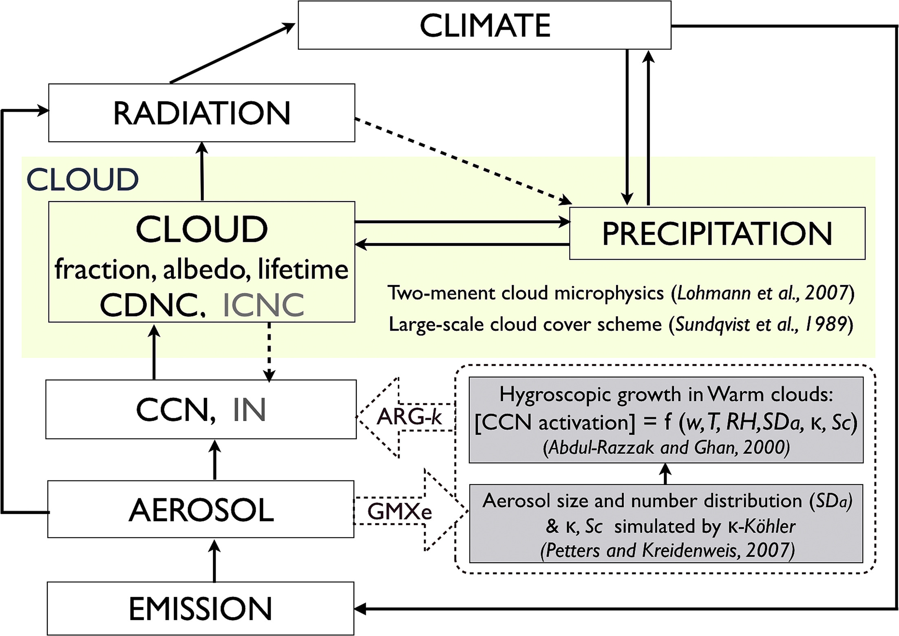
Problem Description
Presently, Aerosol Optical Depth (AOD) is a sole parameter to represent aerosol and their contribution in the changing climate from the space, which has multiple drawbacks and limitations as follows:
Various issues and limitations: (Andrea, 2009; Kapustin et al., 200; Boucher and Quass, 2013; Liu and Li, 2014; references therein)
Chang et al., (2017)
uncertainty in size distribution and solubility
aerosol swelling in the humid environment
AOD/AI does not provide involved aerosol components / chemical compositions
AOD is a bulk property and doesn’t represent vertical distribution of aerosol
AOD doesn’t provide the information of CCN
Therefore, limitations and the uncertainties involve in the aerosol perturbed climate forcing has inspired my research towards the further development and utilization of space-borne observations to derive the detail and important information that further improve the aerosol-climate field.

Slide 4
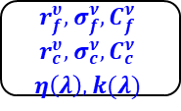
Methodology
Input
Calculation
Output
Mie Code
Generate LUTs
β´₅₃₂ , σ´_{532,} β´₁₀₆₄ , σ´_{1064 and Size Parameters}
κ-Köhler theory
Predefined aerosol models
Determine critical radius at various supersaturation ratio
$$r_{f}^{υ}, σ_{f}^{ν}, C_{f}^{ν}$$
$$r_{c}^{υ}, σ_{c}^{ν}, C_{c}^{ν}$$
$$η\left(λ\right), k(λ)$$
Find the smaller solution using LUTs
CCN estimation
Aerosol optical properties
(β₅₃₂ , σ_{532,} β₁₀₆₄ , σ₁₀₆₄)
CALIPSO / CALIOP
Hygroscopic enhancement factor
Validation with in-situ observations
Hygroscopicity Parameter (κ)
Part: 1
Construction of LUTs with aerosol size parameters and simulated aerosol optical properties
Part: II
CCN estimation and validation

Slide 5
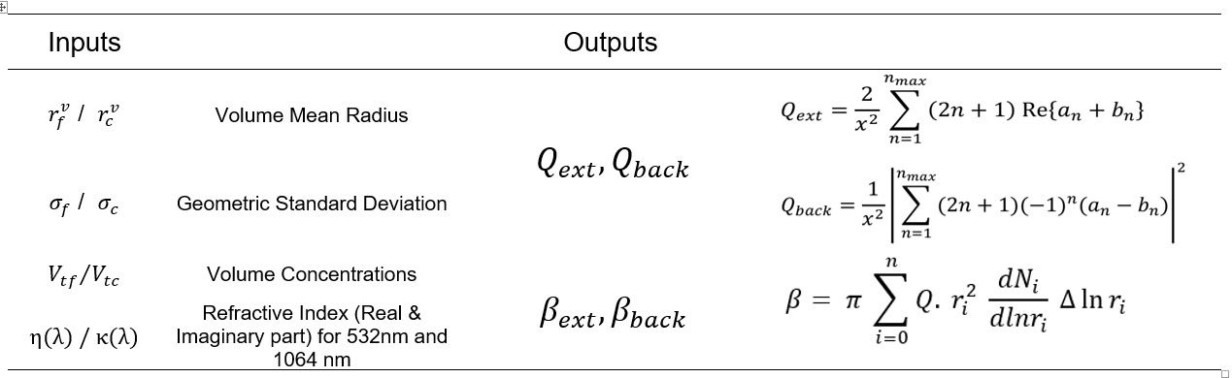
Mie Code Simulations
(1)
Parameters representing the volume concentration can be transformed to parameters for the number concentration through the Eq. (1-3) (Horvath et al., 1990):
(2)
(3)

Slide 6
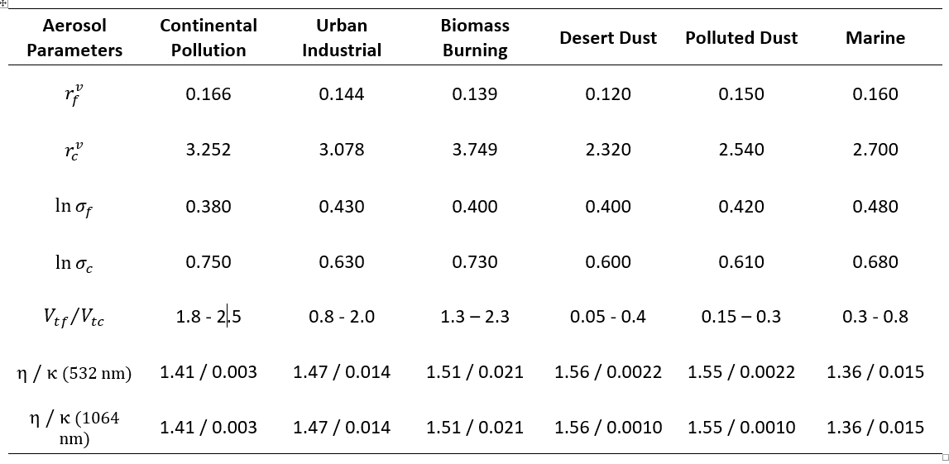
Predefined Aerosol Models
Dubovik et al., (2002)
Veselovskii et al., (2004)
Torres et al., (2017)

Slide 7
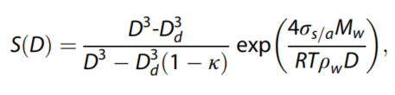
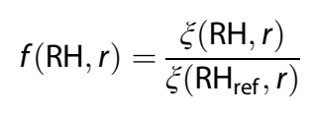
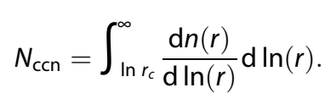
CCN Estimation:
κ-Köhler theory will be used to determine the critical radius for CCN activation at various critical supersaturation (Petters & Kreidenweis, 2007) using aerosol size parameters.
The aerosol the aerosol size distribution is affected by aerosol hygroscopic characteristics particularly in the high moist environment or near cloud base. Therefore, the wet size distribution will be corrected to dry size distribution by using the hygroscopic enhancement factor using relative humidity (RH)- dependent aerosol property.
Finally, the CCN concentrations will be calculated by integrating the aerosol size distribution over a range of critical radius at various supersaturations.
(4)
(5)
(6)

Slide 8
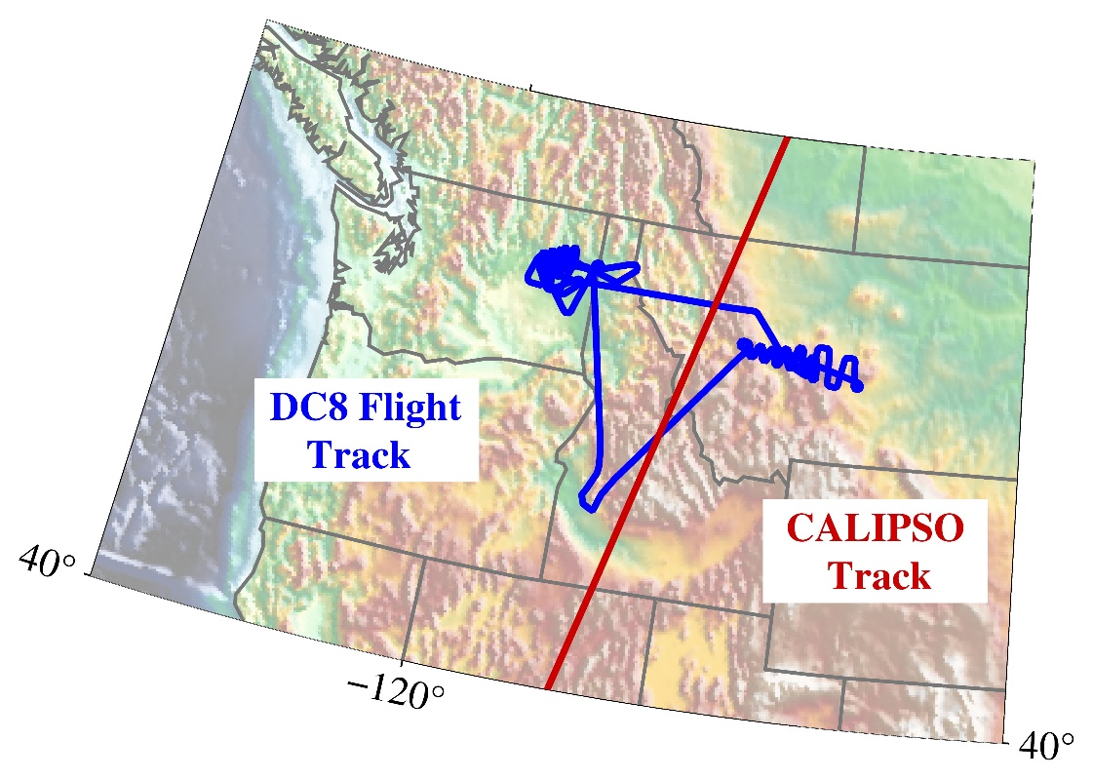
Results
Part-I Outcomes
Constructed LUTs using Mie simulations are used over air-borne (FIREX-AQ) and space-borne (CALIPSO) lidar observations to derive aerosol number concentrations.
Data Sets
Date: : 2019-08-06
FIREX-AQ Campaign observations (NASA DC8 flight) from DIAL Instrument-based aerosol optical properties.
CALIPSO satellite: CALIOP-derived aerosol optical properties

Slide 9
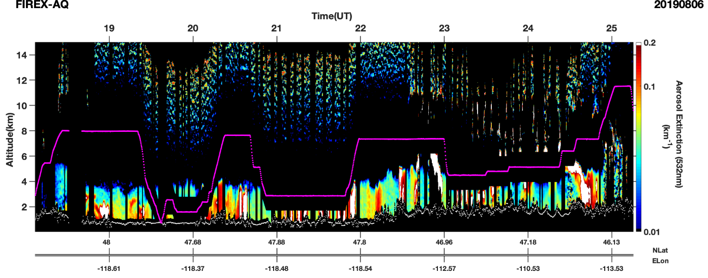
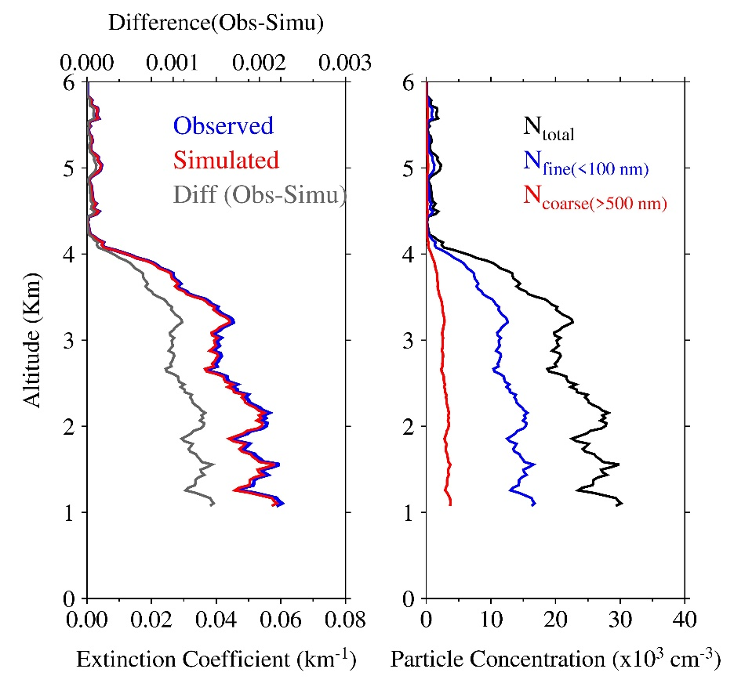
Flight-Based Result
Extinction coefficient :
Relative Percentage Difference : 3.56%
Columnar Integrated particle concentrations:
N_{total} = 68.8 x 10⁴ cm⁻³
N_{fine} = 29.3 x 10⁴ cm⁻³
N_{coarse} = 5.1 x 10⁴ cm⁻³

Slide 10
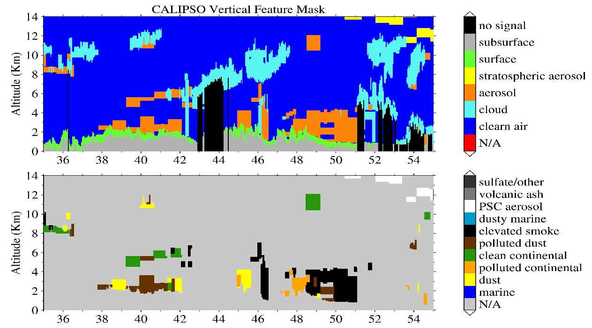
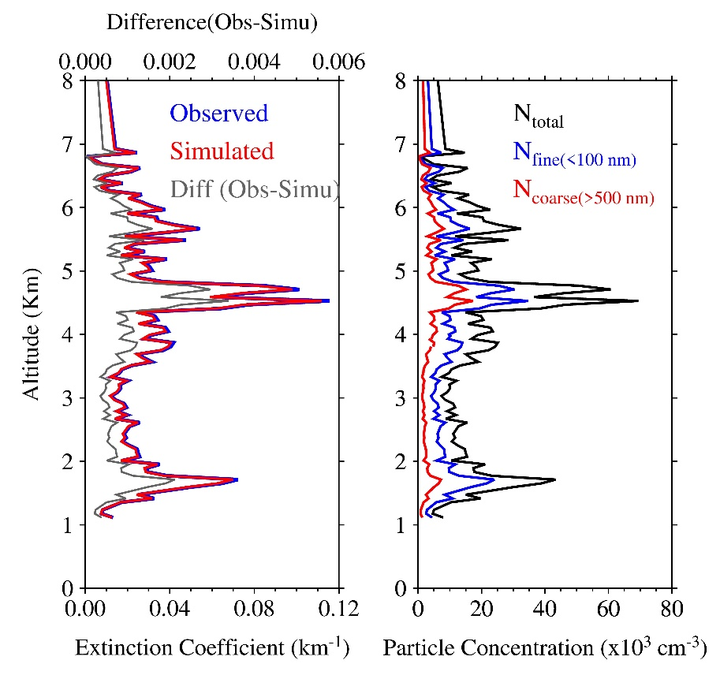
CALIPSO-Based Result
Extinction coefficient :
Relative Percentage Difference : 6.73%
Columnar Integrated particle concentrations:
N_{total} = 93.1 x 10⁴ cm⁻³
N_{fine} = 37.5 x 10⁴ cm⁻³
N_{coarse} = 7.1 x 10⁴ cm⁻³

Slide 11
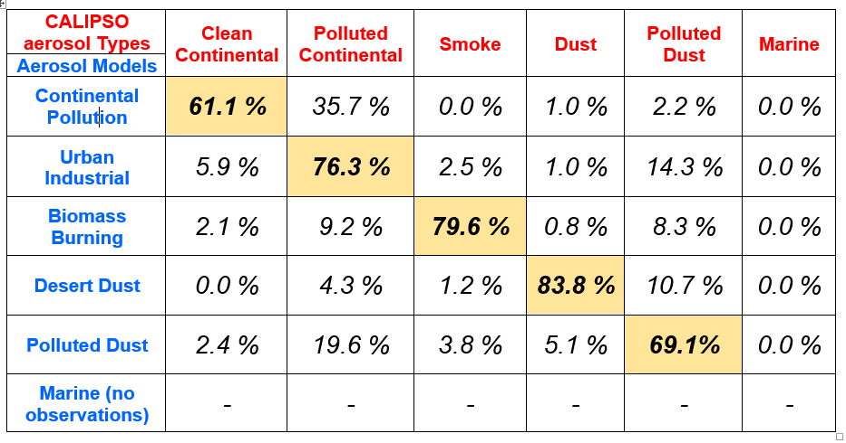
Confusion Matrix of aerosol types

Slide 12
Significance & Future Steps
A development of an innovative algorithm for the estimation of CCN concentration using space-borne lidar measurements in the present study will provide an improved high-resolution benchmark dataset of CCN concentrations. This will advance the understandings towards aerosol-cloud interactions and improve the parameterization in the present climate model.
The present study also provides an additional space-based vertically-resolved quantitative aerosol information along with Aerosol Optical Depth (AOD), which could be crucial to understand the spatio-temporal variability of aerosol particles and their role in the climate change
CCN is a main source of uncertainty in climate forcing. There is no space-born measurements available for CCN number concentration at present. Therefore, the present work will further extend to derive the information of vertically-resolved Cloud Condensation Nuclei (CCN) number concentration (as describes in part-2 of methodology section). We believe that the outcomes of this study would help improve resolving the discrepancy in aerosol-induced perturbations between models and observations
This study targets fundamental scientific questions on global distributions of CCN concentrations and their impacts on cloud properties using space-borne lidar measurements. The outcomes will be decisive for improved quantitative estimate of climate forcing due to anthropogenic impacts. It will be beneficial to the inter-governmental agencies in developing strategies to mitigate regional and global impacts of anthropogenic pollutions and their impact on global climate system.

Slide 13
Publications and Acknowledgements
Patel, P.N. and Jiang. J. H., “Characterization of aerosol cloud condensation nuclei activation under different environment conditions: particle size distribution and hygroscopicity”, (under preparation).
Patel, P.N, and Jiang. J. H., “A novel approach to study aerosols from space using space-based lidar observations”, (under preparation).
This work is supported by NASA - Jet Propulsion Laboratory and Universities of Space and Research Association. We would like to express our gratitude to the Jet Propulsion Laboratory for providing recourses. We greatly acknowledge the FIREXAQ and CALIPSO science team for the provision of data sets.

