Slide 1

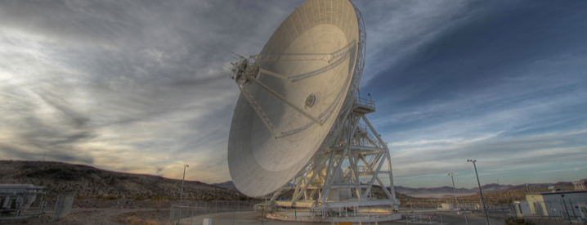
2020 Postdoc Research Day Presentation Conference
Sean Mulholland Miniature Space Optical Clock (mSOC) Tech Demo
Organization: 332J
Advisor: Nan Yu (332J)
Postdoc Program: NPP
Notes:
Hello, I’m Sean Mulholland, I’m a second-year NPP postdoc working with Nan Yu in 332J.
In this presentation I’m going to tell you about my research in designing a miniature optical atomic clock for space.

Slide 2

Tutorial Introduction
Abstract
Precision atomic clocks are the critical system for modern position, navigation and timing such as GPS.
New, more stable and accurate clocks will significantly improve the deep space navigation in precision, robustness and autonomy, as well as enabling new science measurements for tests of fundamental physics and detection of dark matter ultra-light fields.
Recently, the clock research community has invented new type of atomic clocks that tick at optical frequencies (100s of THz) rather than a quartz oscillator based clocks at 10s of MHz. The optical clock technology has revolutionized the clock precision advancement exponentially (chart on right).
$\sim$1000x better per decade
10x better per decade
The chart show the revolutionary advancement of the optical clock approach to the precision of atomic clocks over the years. Microwave clocks have been improving at 10x per decade and leveled off at 1e-16 level, while the optical clocks have been improving one hundred times faster, and surpassed the microwave clocks down to 1e-18 level. (Courtesy of R. Godun, NPL)
Notes:
Atomic clocks are critical to GPS and position, navigation ,and timing systems.
More stable atomic clocks will improve these applications and enable new science missions - such as detecting dark matter.
Recently, a new generation of atomic clock has been developed that uses an optical frequency reference.
Counting an optical frequency at 100s of teraherz has a massively higher data rate than what is possible conventional microwave atomic clocks.
If we look at the chart on the right, [click] we see that laboratory optical atomic clocks have been getting almost 1000 times better per decade and have overtaken microwave atomic clocks.
If the improvement continues, gravitational time dilation that shifts the clock frequency by 10^-18 per centimeter near the ground will make earthbound clocks expensive height sensors. To keep improving we’ll need to go to space.

Slide 3
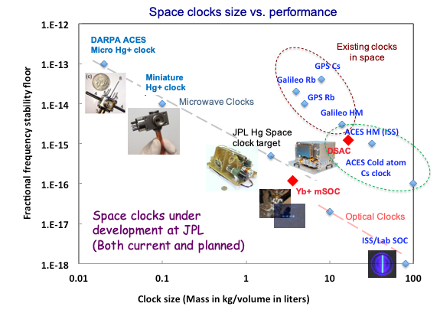


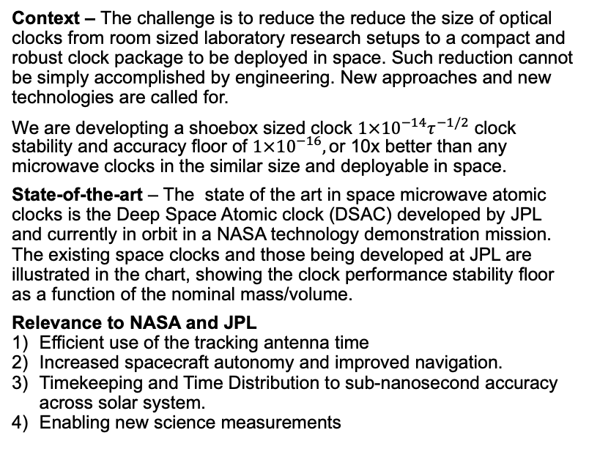
Problem Description
Context – The challenge is to reduce the reduce the size of optical clocks from room sized laboratory research setups to a compact and robust clock package to be deployed in space. Such reduction cannot be simply accomplished by engineering. New approaches and new technologies are called for.
We are developting a shoebox sized clock $1×{10}^{−14}τ^{−1/2}$ clock stability and accuracy floor of ${1×10}^{−16},\text{o}$r 10x better than any microwave clocks in the similar size and deployable in space.
State-of-the-art – The state of the art in space microwave atomic clocks is the Deep Space Atomic clock (DSAC) developed by JPL and currently in orbit in a NASA technology demonstration mission. The existing space clocks and those being developed at JPL are illustrated in the chart, showing the clock performance stability floor as a function of the nominal mass/volume.
Relevance to NASA and JPL
Efficient use of the tracking antenna time
Increased spacecraft autonomy and improved navigation.
Timekeeping and Time Distribution to sub-nanosecond accuracy across solar system.
Enabling new science measurements
Hg+ space clock Physics Package
mSOC will be similar size to DSAC but will have 10x performance
The chart shows the space atomic clock stability floors at various nominal size and mass. Dashed circled ones at upper right are the existing space clocks including the JPL newest DSAC in orbit. Others are clocks being developed at JPL.
Notes:
The problem that we are addressing is to reduce the size of optical clocks from room-sized behemoths that live in laboratories and require a team of PhD students to operate to shoebox sized devices that can be flown in space - without the students.
The state-of-the-art well summarized by the chart on the right, size is on the x-axis and performance is on the y-axis. Existing clocks in space are in the top-right [click].
The current state of the art is the Deep Space Atomic Clock developed at JPL. By moving to an optical atomic clock we aim to improve performance by 10x in a smaller size. [click]
A clock with this performance and size could be integrated on many future missions, allowing autonomous navigation, very long baseline interferometry and tests of general relativity.

Slide 4
Methodology
Approach
Adopt the method of optical clock to surpass any microwave clocks capable to deliver today.
Focus on the tradeoff of performance vs size, power and complexity with the goal of x10 improvement over the SOA.
Intelligent choice of single trapped Yb+ as the atomic reference, requiring less power and size.
Leverage JPL’s expertise as well as external investments and research results for the final product
Innovation and advancement
We are focusing on the breakthroughs in miniature trap vacuum systems at JPL stemmed from a DARPA micro clock program and extend it to laser-cooled single trapped Yb+ ions.
- no active pumping with ion lifetime in 100s of days.
Miniature clock laser performing at the fundamental thermal noise limit.
Leverage the chip-based optical frequency comb being vigorously developed in DARPA programs
Ultimately use Photonics-Integrated-Circuit (PIC) approach for laser and optical systems
Envisioned single trapped Yb+ clock approach diagram: atomic reference with a cc-sized vacuum tube, clock laser stabilized to a micro resonator, lasers on photon-integrated-circuit, and optical frequency comb divider on chip.
Notes:
Optical clocks work by locking a laser to an atomic transition, because optical frequencies are too fast to count with electronics, a frequency comb is used to divide the stabilzed light down to microwave frequencies.
Our approach to make a miniature space optical clock is to base the system around singly trapped, laser cooled ytterbium ions in ultra high vacuum.
As well as being an almost perfectly isolated quantum system, we have chosen this approach because single ion clocks require very low power lasers and electronics.
The chart on the right is a simple system diagram showing the main components of our clock. [CLICK]
At the heart of the clock is the physics package that comprises the ion trap and vacuum system.
JPL has had great success in miniaturizing ion trap vacuum packages through a DARPA program – achieving state of the art trap lifetimes for buffer gas cooled ions.
We aim to use this know-how to make a cubic-centimeter-scale ion trap vacuum package for an optical clock with no active pumping. This will be the smallest physics package for laser-cooled ions that we know of. [CLICK]
We’ll use a whispering gallery-mode-resonator, or miniaturized Fabry-Perot cavity for the optical local oscillator. [CLICK]
Compact and transportable optical frequency combs are being aggressively funded by many research agencies including DARPA and we hope to take advantage of the developments. [CLICK]
For the laser sources and optics we ultimately plan to use Photonic integrated circuits to reduce the size, weight, and power

Slide 5
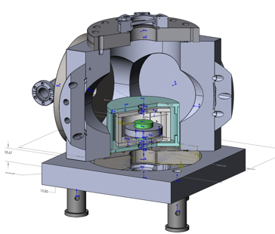
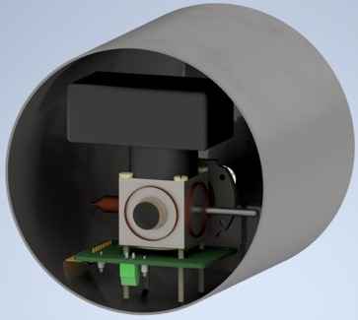
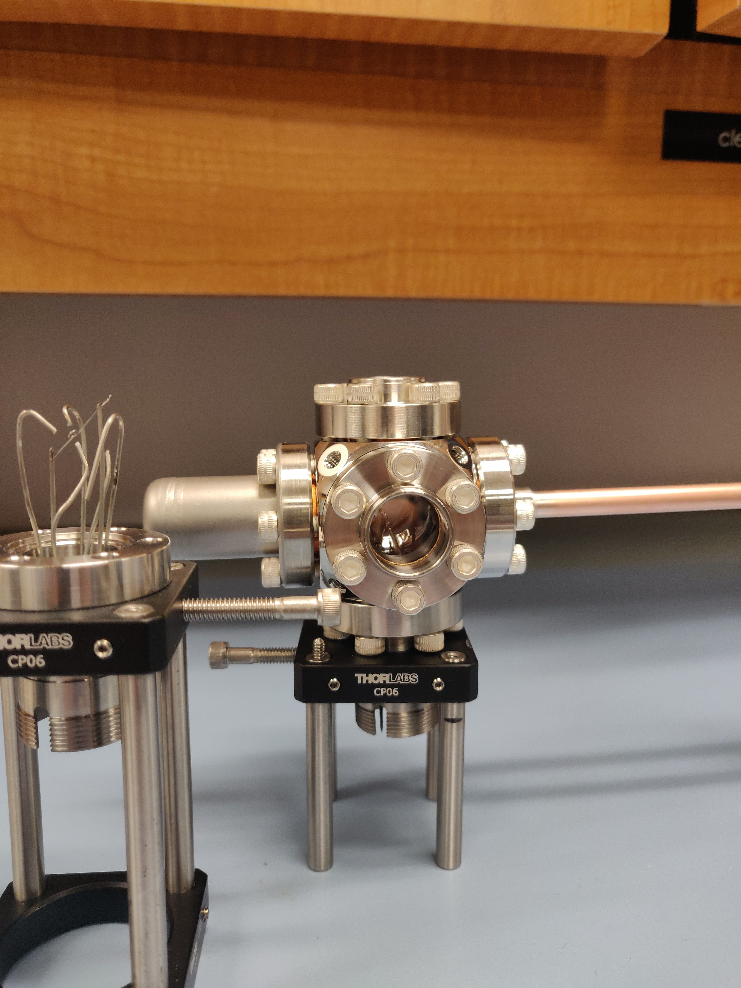
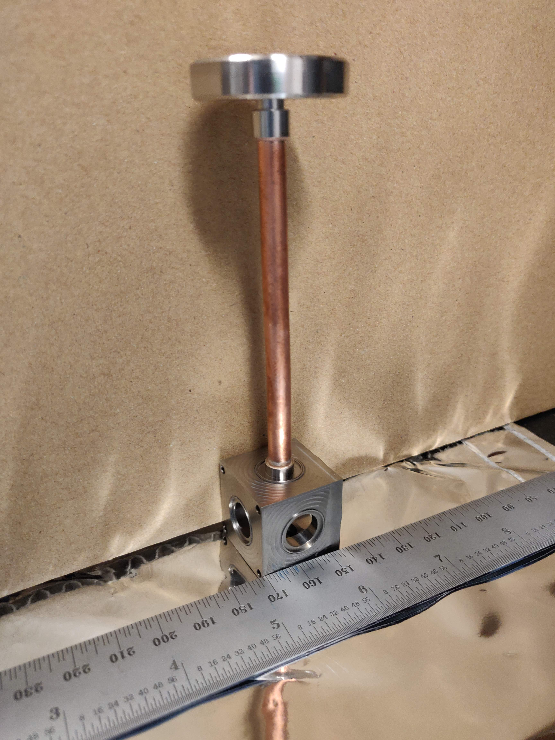
Results
Breadboard laser for ion trapping and cooling.
Compact COTS vacuum package built.
COVID-19 allowed us to bring forward design work
Miniature welded physics package designed and fabricated.
Compact Fabry-Perot cavity designed in collaboration
laser system
30mm
Notes:
To test this approach of making a miniaturized optical clock I’ve built up a testbed system.
The picture on the left shows the breadboard laser system. [click] This comprises of lasers at 370, 399 , 760 and 935nm. The 370 and 935 nm lasers are required for laser cooling, the 399nm laser is used to ionize the atoms and the 760nm laser prevents the ion from getting stuck in an inactive metastable state.
The optics below the laser sources are used to generate the necessary beams for ion trapping and laser stabilization. For the IR lasers we have used all fiber coupled components, these are harder to come by at UV wavelengths, so we used free space components for our breadboard setup.
If you’ve seen an atomic physics laser setup before you’ll appreciate that even our breadboard system is very small and simple. [click]
The next photo along shows a prototype physics package made with commercial off the shelf components, I used this system to inform my design of an even more compact and capable welded vacuum system that I’ve just begun fabricating. Shown in the next picture, along with a render of how it will look with an attached detector, electronics, fiber launcher and magnetic shield.
I also ran some simulations on the frequency locking servo and collaborated with Wei Zhang of 335E to design a small Fabry Perot cavity that is as compact as possible and will still allow us to reach our stability targets. Our cavity is the smallest ULE cavity that we are aware off.
A smaller cavity has a higher fundamental noise limit but is easier to thermally control and is less sensitive to vibrations, as well as being more compact.
The cavity is shown here inside the off the shelf vacuum system that we will use for testing.

Slide 6
Thanks for listening!
Any questions or like to hear more?
Email me at:
sean.mulholland@jpl.nasa.gov
Sean Mulholland – 2020 Postdoc Research Day Presentation Conference
Notes:
That concludes my brief talk on my work this year. Thanks for attending my presentation and please reach out to me if you have any questions.

Slide 7
Slideshow instructions
Can change title image
Can add slides to template
Audio must align with slides
Each PI must submit a power point presentation, accompanied by a 3-7 minute audio, providing a broad context for the slide presentation. Each slide presentation must include all elements provided in the FY 20 Template. PIs may locate their Presentation Number here. Please refer to audio upload instructions and additional instructions on the respective RTD and SURP websites.
The slides along with the audio must be submitted to the Unlimited Release System by Friday, September 25th, 2020. Click here for URS submittal instructions.
A PDF copy of the slide presentation must be submitted separately to the OCSCT Portal by Friday, September 25th, 2020.
Each cleared slide audio presentation must be submitted to the Spark Research Presentation Conference campaign site (to be launched in October) by Monday, November 2nd, 2020.

Slide 8
Tutorial Introduction
Abstract
(Plain language description in tutorial form, designed for the non expert in the field. Maximum 200 hundred words and one graphics/cartoon.)

Slide 9
Problem Description
Context (Why this problem and why now)
SOA (Comparison or advancement over current state-of-the-art)
Relevance to NASA and JPL (Impact on current or future programs)

Slide 10
Methodology
Formulation, theory or experiment description
Innovation, advancement

Slide 11
Results
Accomplishments versus goals
Significance
Next steps

Slide 12
Publications and References

