Slide 1
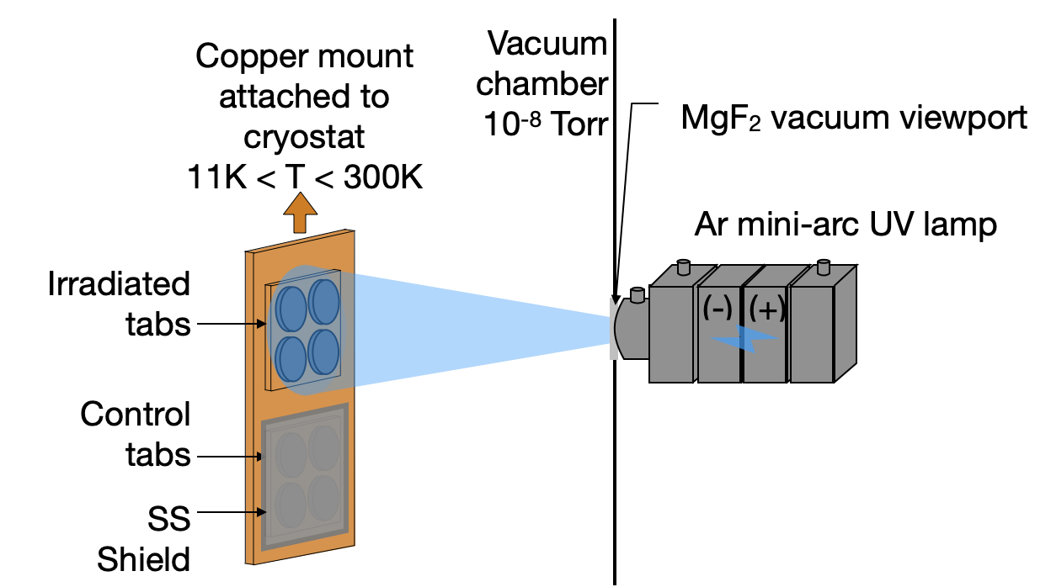

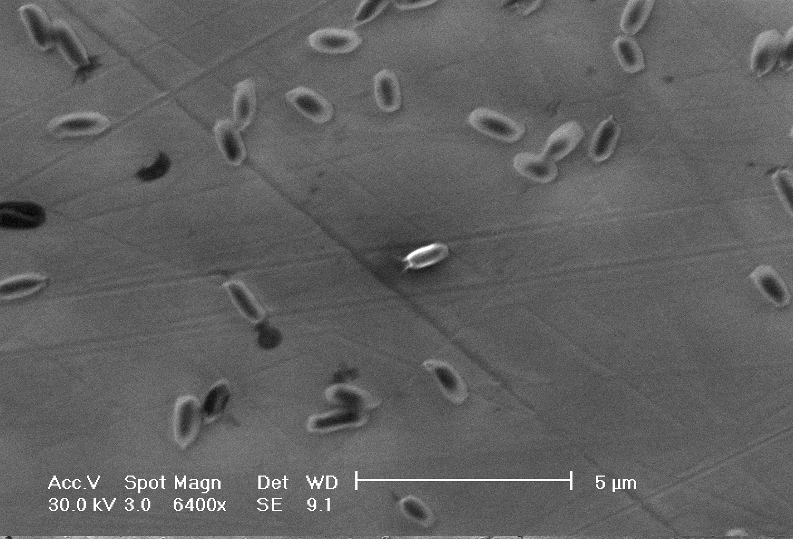


Viability of Bacterial Spores under Ocean Worlds
Icy Surface Conditions
Edith Fayolle (3227)
JPL postdoc 9/17 - 9/20
Enceladus’ surface by Cassini, NASA/JPL-Caltech/Space Science Institute
Aaron Noell (389U), Paul Johnson(322), Robert Hodyss (3227), Adrian Ponce (1850)
Reference herein to any specific commercial product, process, or service by trade name, trademark, manufacturer, or otherwise, does not constitute or imply its endorsement by the United States Government or the Jet Propulsion Laboratory, California Institute of Technology.
Notes:
My name is Edith Fayolle And I was a postodoc at JPL From September 2017 to September 2020 in the laboratory studies group of the Planetary science section.
One of my research interest deals with the survival of microorganism Under ocean world surface conditions.
In this presentation I will show you results on the survival of bacterial spores under solar like UV photons irradiation at temperatures relevant to Ocean Worlds like Europa and Enceladus.

Slide 2
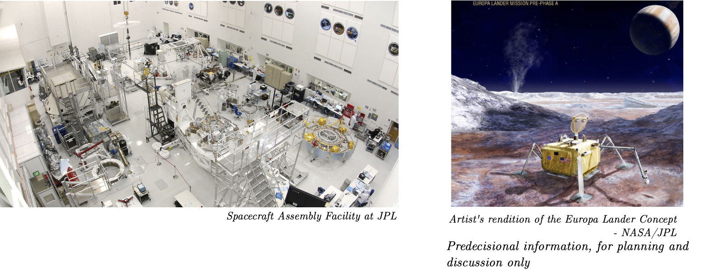
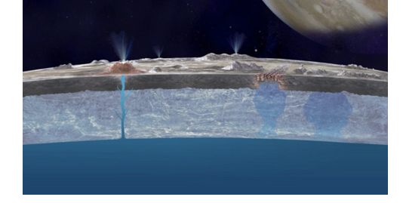
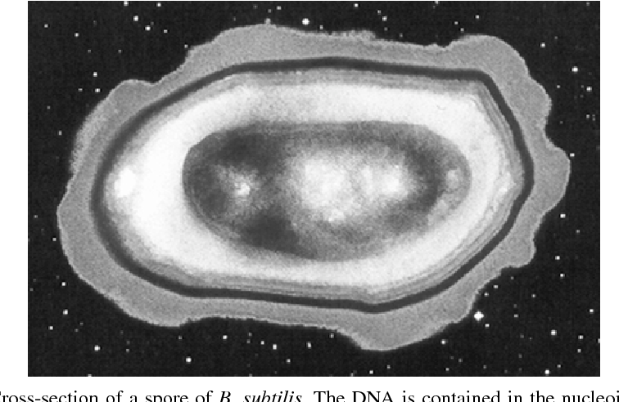
Can microorganisms survive at the surface/near-surface of icy worlds:
i) if brought to the surface from sub-surface
oceans via geological processes?
ii) if they unintentionally remain on spacecrafts?
Artistic view of the Europa surface-ocean connection, NASA/JPL-Caltech
Spacecraft assembly facility at JPL
Enceladus’ plumes, NASA/JPL-Caltech
Artist’s rendition of the Europa Lander Concept, NASA/JPL-Caltech, predecisional information for planning and discussion only
Conditions encountered on icy world surfaces:
Low average temperatures <100K,
Radiations (Solar UV-photons, energetic particles)
Chemicals in the ice
Bacterial spores: highly resilient life form
Notes:
There are two main motivation to study for microorganism survival at conditions encountered on the surface of ocean worlds.
First, worlds like Europa or Enceladus are great targets to search for life else where than on Earth since their Subsurface oceans in contact with a rocky more may create hospitable conditions a for life to develop. Geological processes such as cryovolcanism or plumes followed by redeposition may bring some of the ocean content up to the surface where potential future mission may be able to detect them. But would living organisms be able to survive the radiation conditions and the extremely low temperatures found at the surface of these worlds? We are talking about 100K for Europa and 60K for Enceladus and radiations that include accelerated charged particles and UV photons coming from the Sun, irradiating the surface of these bodies which have very tenuous atmospheres.
A second motivation to study microorganism survival under ocean World surface conditions has to do with planetary protection. If a spacecraft would visit such world, could microorganism unintentionally left on hardware be viable and potentially live under such extreme conditions?

Slide 3
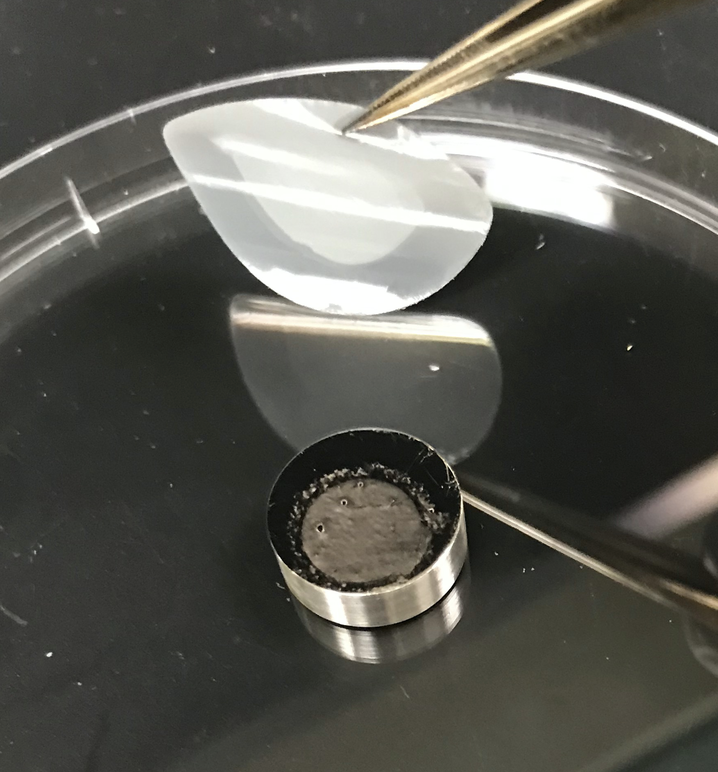
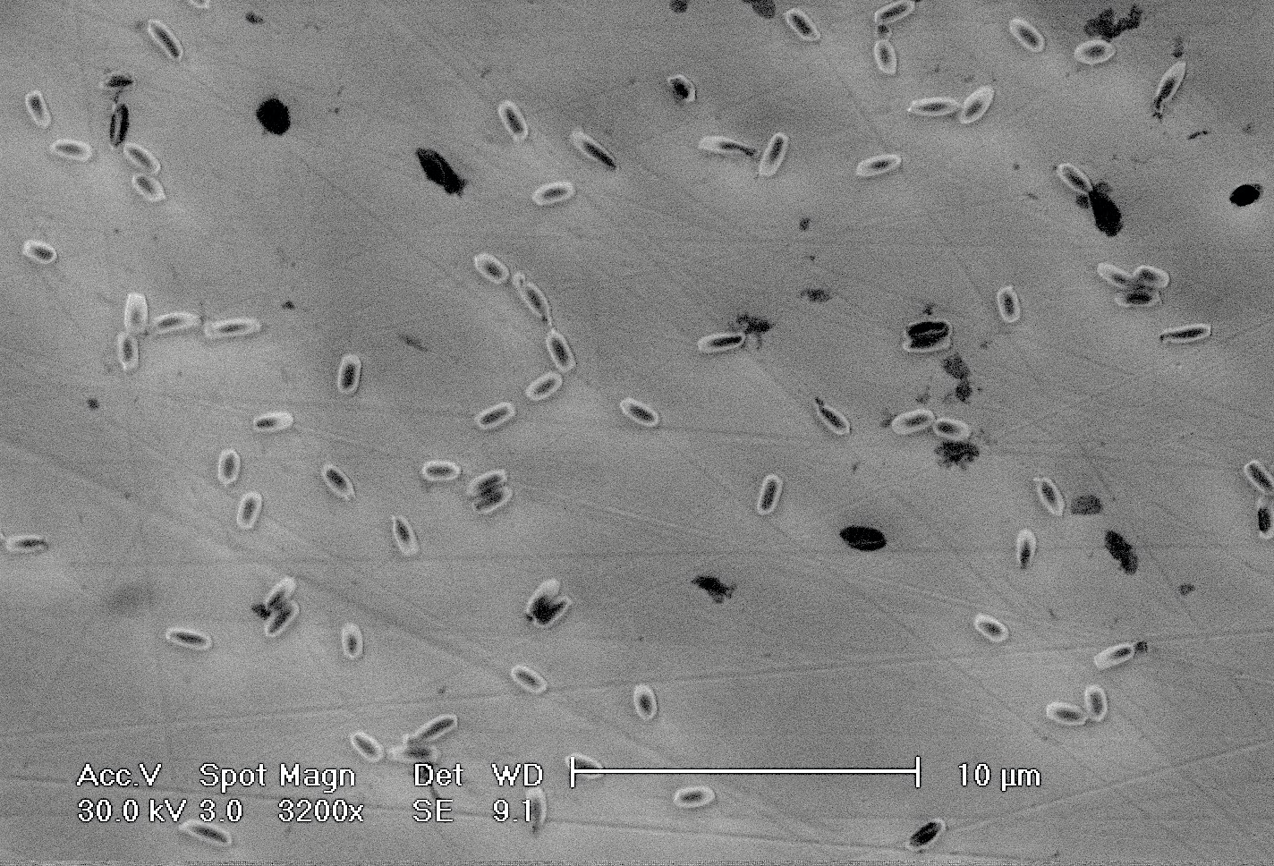
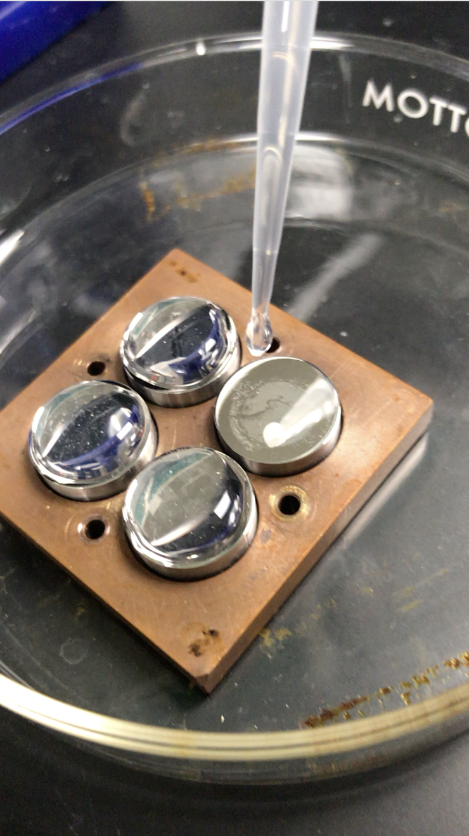
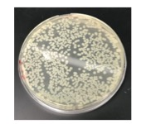
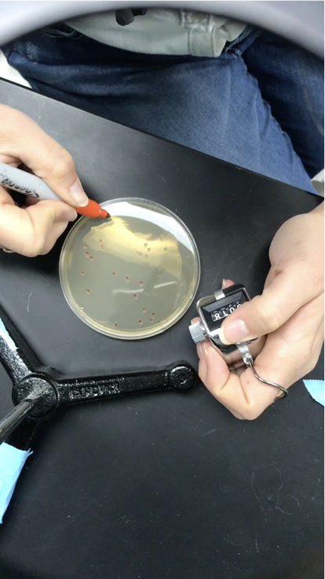
Reproducing Icy World conditions in the laboratory
to test spore viability
1/ Spore deposition onto tabs in the
sub-monolayer regime
2/ Cooling and irradiation under vacuum
ESEM image of spores on coupons
Bacillus Subtilis
3/ Recovery and counting the survivors via plate cultures
Notes:
To answer this we simulate the temperature and radiation conditions encountered at the surface of ocean worlds Like Eupoa or Enceladus in the laboratory and use extremely resistant microorganisms from Earth, like bacterial spores, as proxies to evaluate endemic life form survival. Bacterial spore, like Bacilus subtilis used here, are also the standard microorganisms employed for planetary protection studies.
To quantify survival , we grew a stock of bacillus subtilis spores, deposit them at the surface of stainless steel coupons using a technique allowing us to spread them onto the surface and avoid clumping and self shielding. We then attach these coupons at the tip of a cryostat that can cool them down to temperatures as low as 10K in a vacuum chamber. We irradiate them using, for the results I will show you here, UV photons coming from a broad band lamp which has a spectrum is similar to that of the Sun. Then we retrieve them and count how many bacterial spores survived after a certain dose of photon at the specific temperature by culturing them onto agar plates. We actually use two sets of coupons, a set that is irradiated and a set that is shielded and that we use as controls. We do these irradiation for various amount of times at chosen temperature to obtain survival kinetics curves.

Slide 4
Low temperatures increase spore viability under Sun-like UV-irradiation but spores do not significantly survive when in direct sunlight
Lamp flux multiplied by exposure time
Ratio of surviving spores after irradiation over the controls
Fayolle et al, Astrobiology, 2020
Notes:
This what these survival kinetics series look like: on the y axis you have the ratio of spores that survived the irradiation over the controls versus the UV fluence, so the lamp flux multiplied by the time.

Slide 5
Low temperatures increase spore viability under Sun-like UV-irradiation but spores do not significantly survive when in direct sunlight
Fayolle et al, Astrobiology, 2020
Notes:
These are the surviving fractions, for example here at 100K.

Slide 6
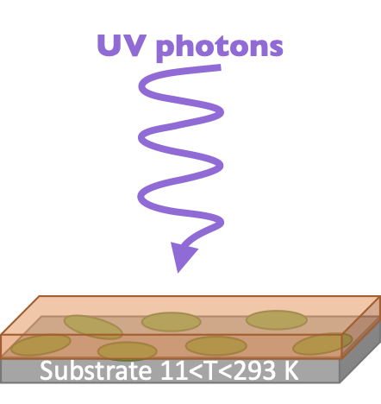

Low temperatures increase spore viability under Sun-like UV-irradiation but spores do not significantly survive when in direct sunlight
UV photons
Spores 11<T<293 K
Fayolle et al, Astrobiology, 2020
Notes:
This what these survival kinetics series look like: on the y axis you have the ratio of spores that survived the irradiation over the controls versus the UV fluence, so the lamp flux multiplied by the time. This is what the survival kinetics look like when the spores are irradiated at room temperature, 200, 100, 60, 25 and 11K.

Slide 7
Low temperatures increase spore viability under Sun-like UV-irradiation but spores do not significantly survive when in direct sunlight
Spore survival increases by orders of magnitude at 11K compared to room temperature
UV photons
Spores 11<T<293 K
Fayolle et al, Astrobiology, 2020
Notes:
A first interesting point is that survival increases at low temperatures. It may be surprising at first but makes sense since the spores are deactivated upon UV irradiation through DNA damages and the chemical reactions that create these damages are slowed down at low temperature. So bacillus subtilis spore may survive longer at the low temperatures encountered on Ocean Worlds but looking at the numbers, for Europa with its averaged 100K temperature 99.9% is the spores would be deactivated after a photon dose of 200 J.m-2. Given the flux of solar photon irradiating Europa at the equator, this that it would take less than 10 minutes. For Enceladus with 60K temperature and being further away from the Sun it would about 30 minutes to deactivate 99.9% of the spores. So despite the higher survival rate at low temperature, microorganism at the surface of ocean world in direct sunlight would be deactivated very quickly, which is interesting from a planetary protection point of view. From a life detection angle it means that viable microorganisms would do need to be search for on the surbsurface.

Slide 8
Low temperatures increase spore viability under Sun-like UV-irradiation but spores do not significantly survive when in direct sunlight
Spore survival increases by orders of magnitude at 11K compared to room temperature
99% of the spores in direct sunlight would
be deactivated in <10min at Europa and
<30min at Enceladus
Europa
Enceladus
UV photons
Spores 11<T<293 K
Fayolle et al, Astrobiology, 2020
Notes:
So bacillus subtilis spore may survive longer at the low temperatures encountered on Ocean Worlds but looking at the numbers, for Europa with its averaged 100K temperature 99.9% is the spores would be deactivated after a photon dose of 200 J.m-2. Given the flux of solar photon irradiating Europa at the equator, this that it would take less than 10 minutes. For Enceladus with 60K temperature and being further away from the Sun it would about 30 minutes to deactivate 99.9% of the spores. So despite the higher survival rate at low temperature, microorganism at the surface of ocean world in direct sunlight would be deactivated very quickly, which is interesting from a planetary protection point of view. From a life detection angle it means that viable microorganisms would do need to be search for on the surbsurface.

Slide 9
Low temperatures increase spore viability under Sun-like UV-irradiation but spores do not significantly survive when in direct sunlight
Spore survival increases by orders of magnitude at 11K compared to room temperature
99% of the spores in direct sunlight would
be deactivated in <10min at Europa and
<30min at Enceladus
UV photons
Spores can be shielded by micron-thick layers of absorbers, e.g. SO₂ observed on Europa
Spores and SO₂100K
Fayolle et al, Astrobiology, 2020
Notes:
Though we may not have to look that deep in the subsurface since some molecules that make up these ocean worlds can absorb uv photon efficiently. water, a major component of these icy surface, does not efficiently absorb solar photons, but other species like sulfur dioxide detected on Europa do and can shield potential microorganisms from solar photons. for instance We observed more than two order of magnitude increase in bacillus subtilis survival at 100K after adsorbing only a micron thick layer of SO2 molecules on top of the spores.

Slide 10
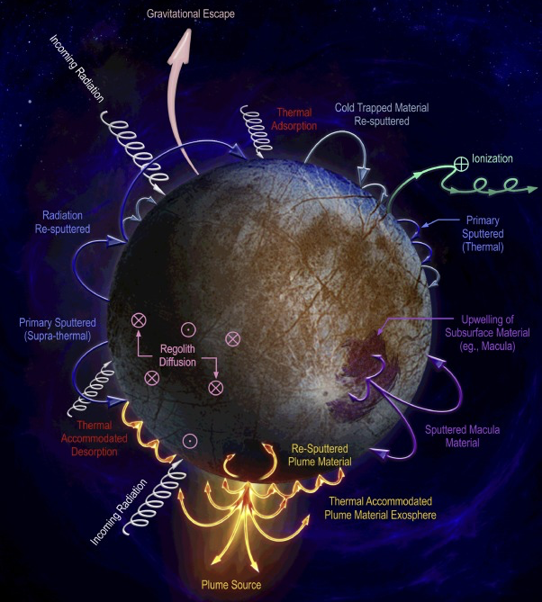
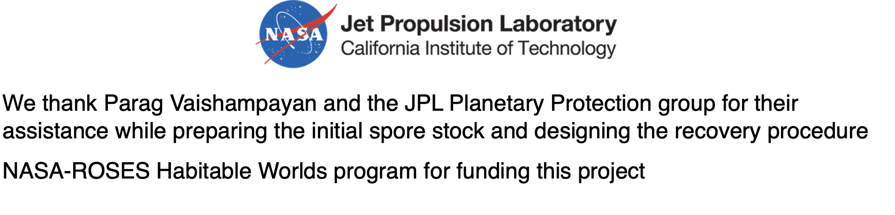
The impact of electron irradiation, ice chemistry, and long irradiations on bacterial spores at low temperatures still needs to be explored
Putting constraints on microorganisms behavior
under surface conditions helps set requirements for potential future
life searching missions on Ocean Worlds.
We thank Parag Vaishampayan and the JPL Planetary Protection group for their assistance while preparing the initial spore stock and designing the recovery procedure.
We acknowledge the NASA-ROSES Habitable Worlds program for funding this project.
Notes:
The results I showed you here are of course a first step towards a broader understanding of microorganism behavior at the surface of ocean world and we are currently studying bacillus subtilis spore viability, this time upon electron irradiation, as is quite relevant for the surface Europa. And looking towards the future, since it seems that microorganisms get deactiviated quite quickly, the question is now: what happens to these microorganisms when they are submitted to radiations for very long periods of time. Do they get morphological damages, do they get broken up into pieces and large molecules
and if so, what are they ?
If everything goes well, the PI of these studies, Aaron Noell from section 389 as well as a couple of us in section 322 will hopefully be able to provide some of these answers in the next couple of years and help guide potential future life searching missions on Ocean Worlds.

