Slide 1
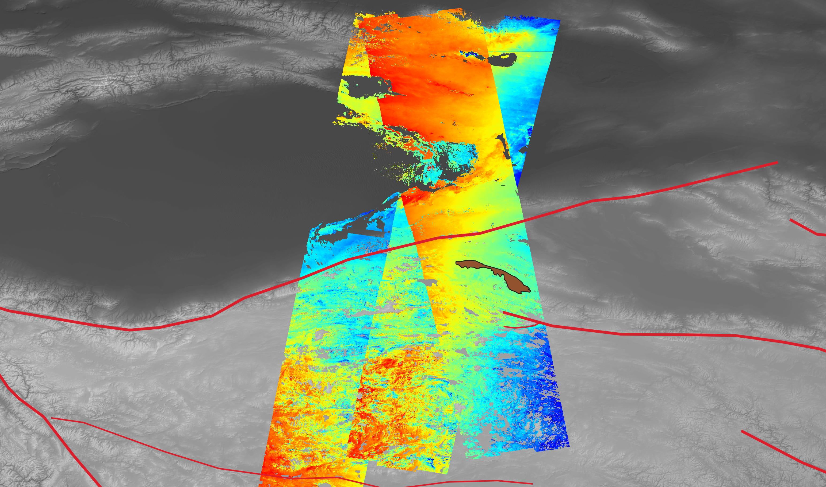
2020 Postdoc Research Day: Tectonic Deformation and Surface Processes of the Tibetan Plateau from Sentinel-1 InSAR Data
Dr. Robert Zinke¹ (Program: NPP)
Advisors: Gilles Peltzer¹, Eric J. Fielding¹
Collaborators: Simran S. Sangha¹,
David P. S. Bekaert², Susan Owen¹,
and the ARIA Team
¹329A, ²334H

Slide 2
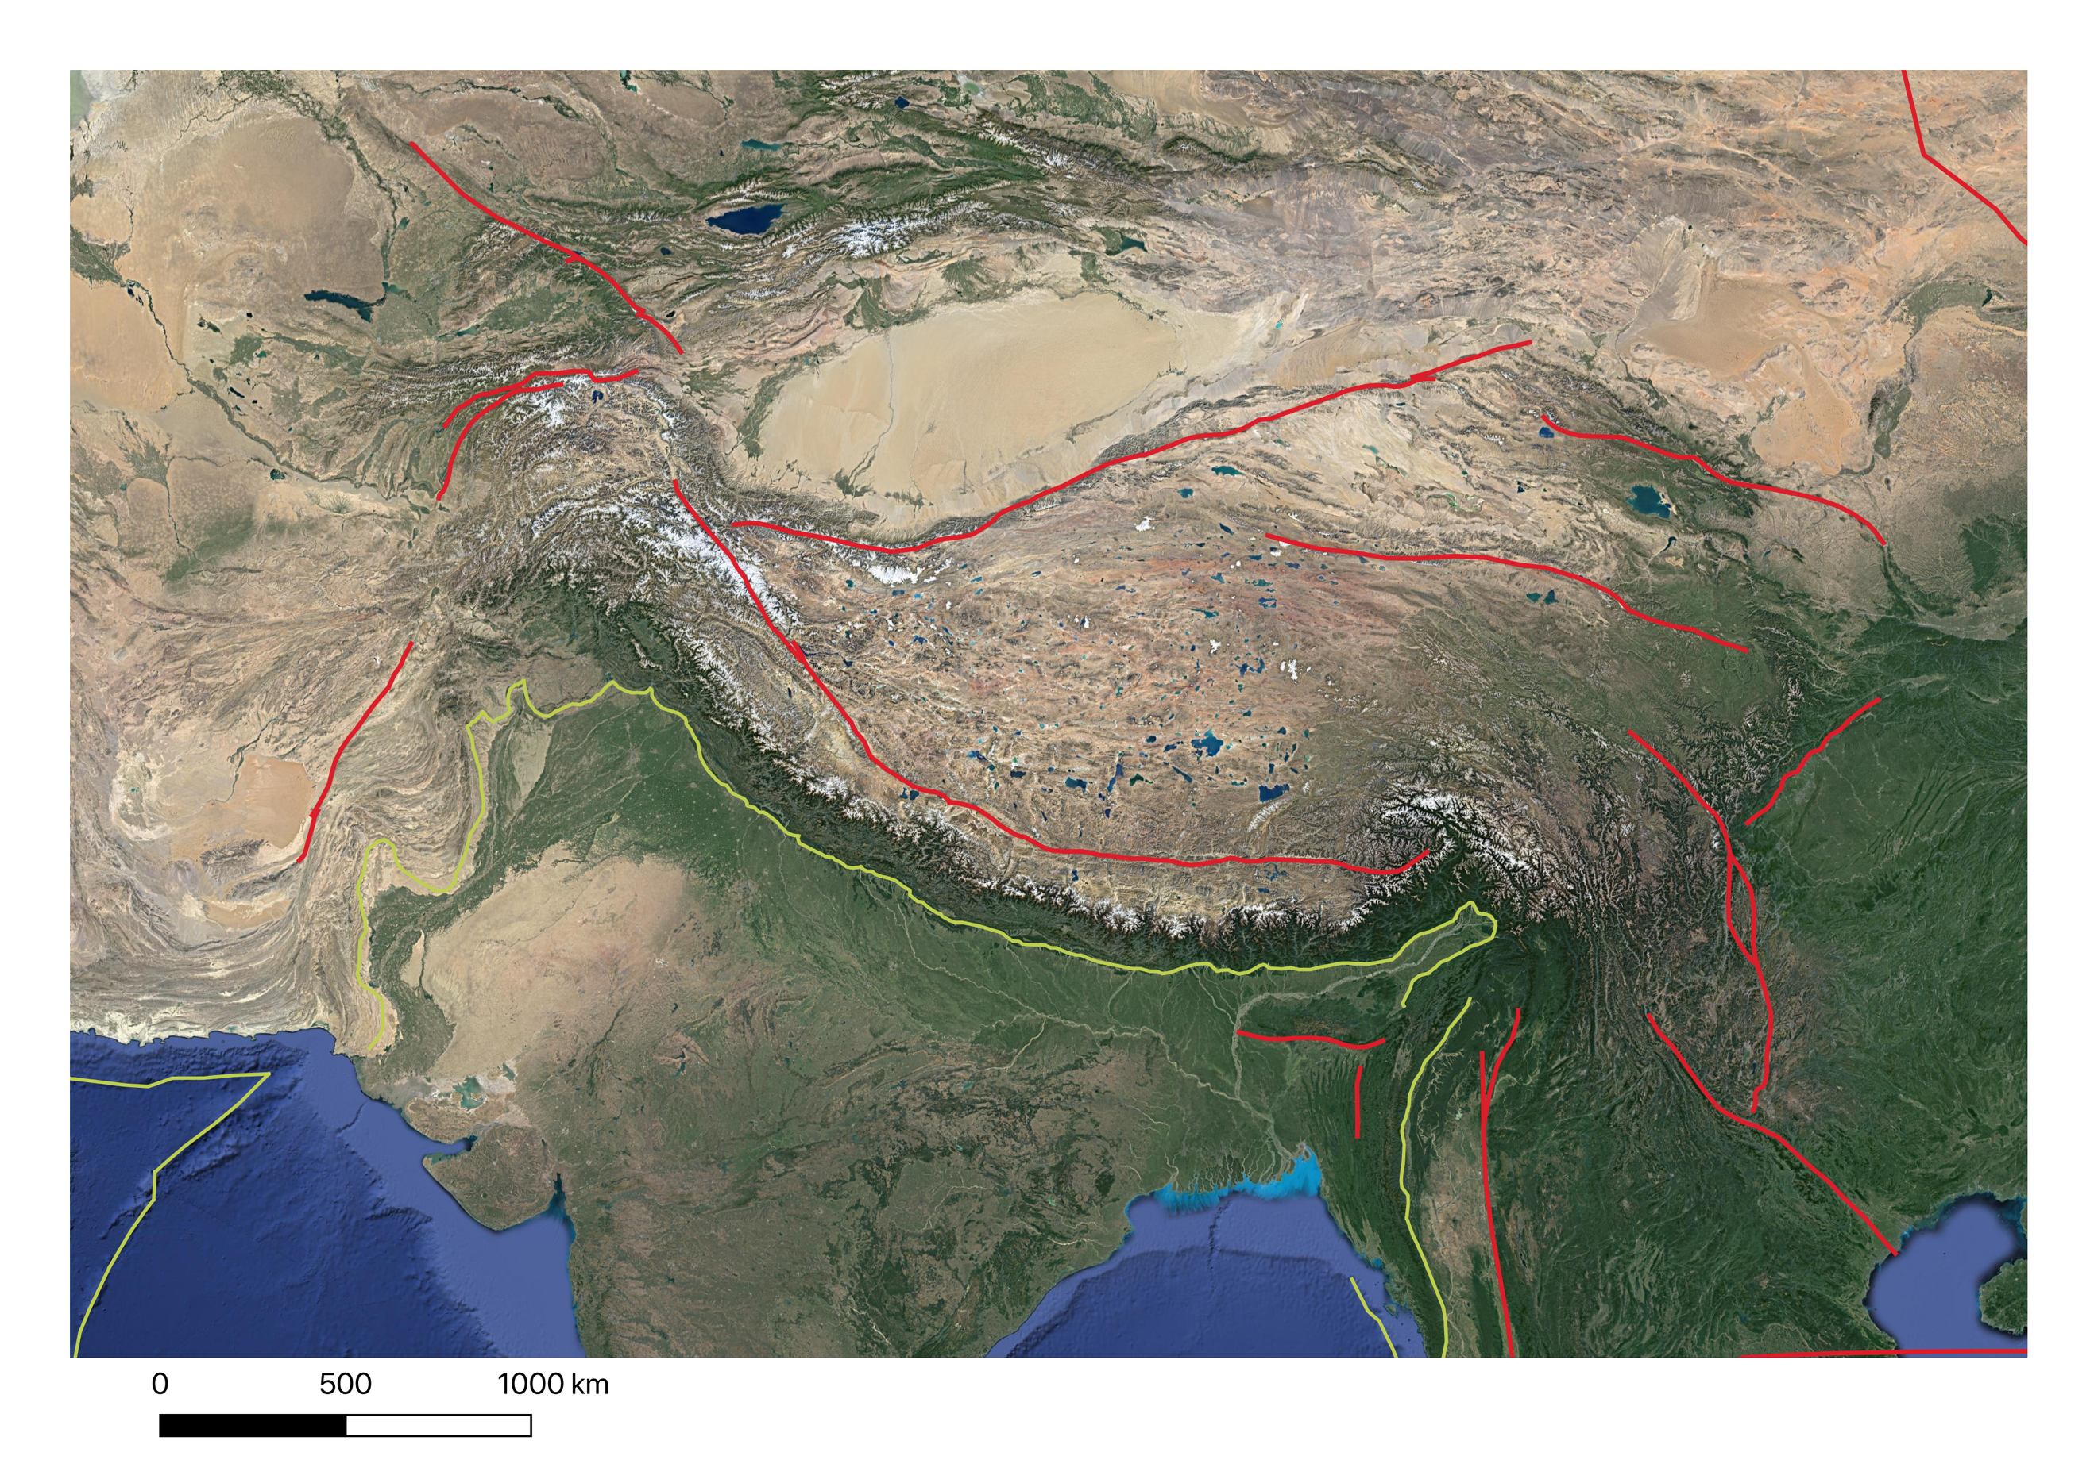
Motivation – The India-Eurasia tectonic collision
STABLE EURASIA
TIBET
INDIA
Convergence rate: ~4–5 cm/yr
We measure Earth surface deformation across the Tibetan Plateau to better understand the processes driving the tectonic and hydrological activity of the region.

Slide 3
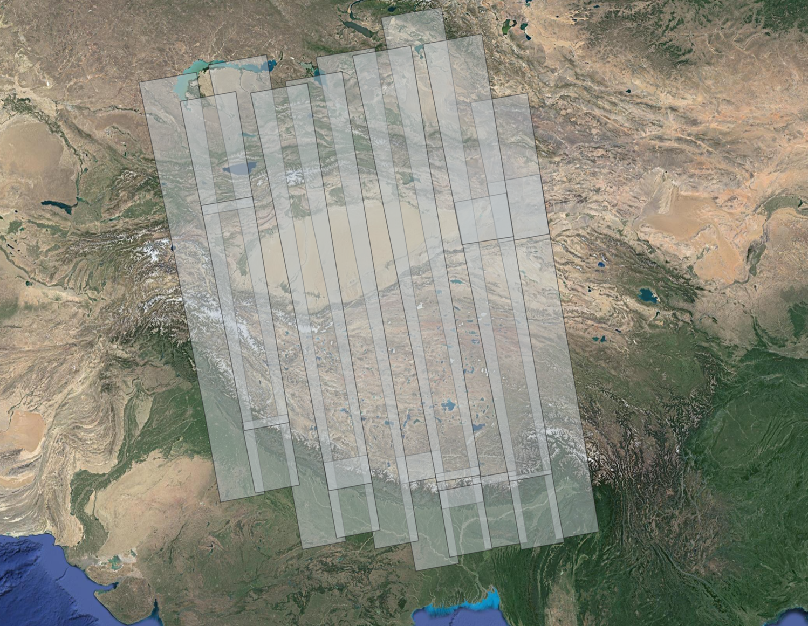
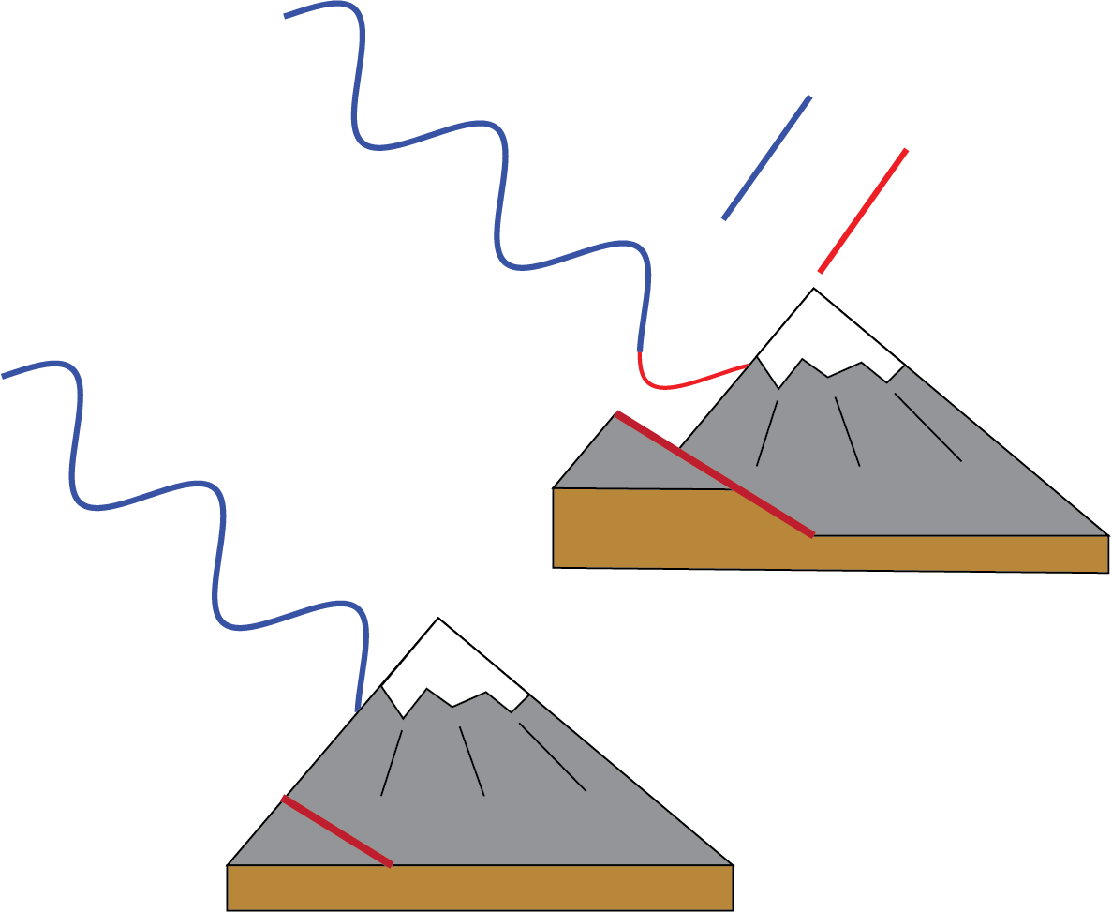
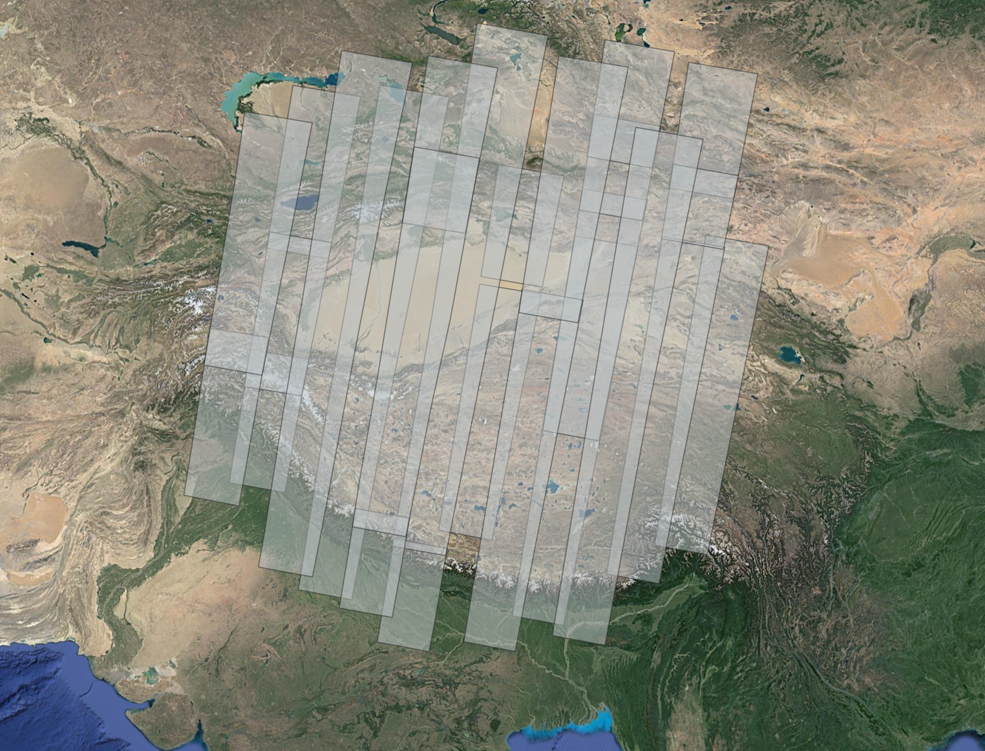
Platform and data
Pass 2
Ascending passes
$$∆φ$$
Pass 1
Descending passes
ESA Sentinel-1 radar measurements
Data from the European Space Agency (ESA)
Satellite model from https://blogs.fu-berlin.de/reseda/sentinel-1/
Notes:
What is InSAR
What does it tell us
Why are ascending and descending important
Why has no one done this before

Slide 4
InSAR velocity maps
We use the NASA/JPL ARIA standardized products and toolbox to process 23,000 interferograms

Slide 5
Geophysical impact - Tectonic faults
Overlapping tracks allow us to measure east-west horizontal motion across earthquake faults.

Slide 6
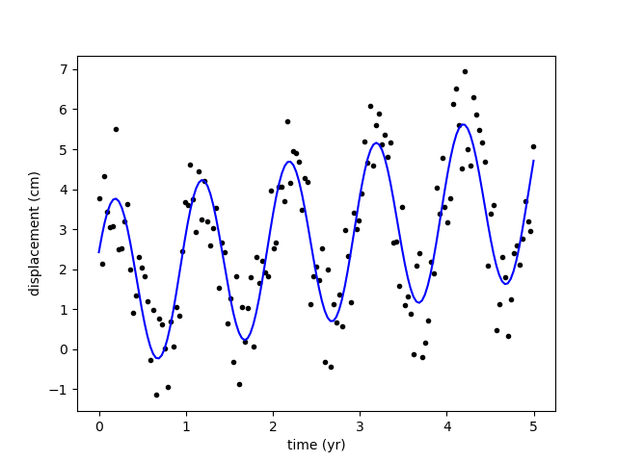
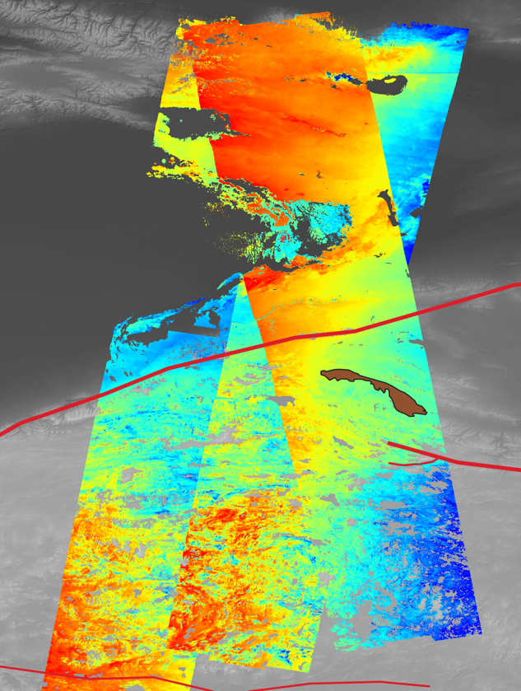
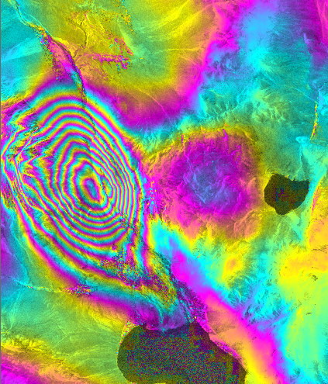
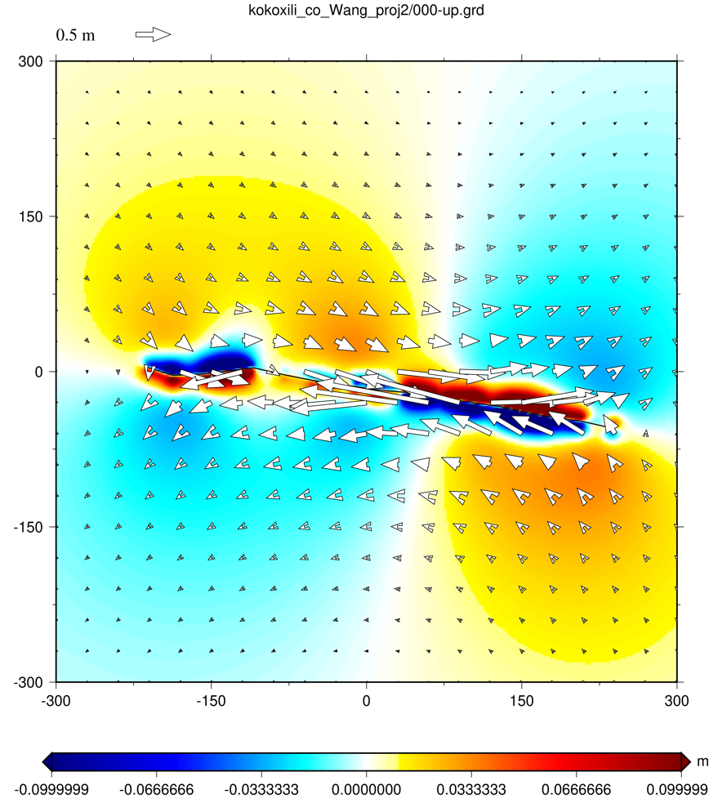
Future directions and publications
Timeseries analysis based on all available data
Separation of seasonal and tectonic signals
Probing of crustal properties combining InSAR observations and numerical models
Inferring slip at depth due to earthquakes within a regional context
Questions? Contact Robert.Zinke@jpl.nasa.gov

