Slide 1
Impacts of Amazon forest degradation on ecosystem water stress
Marcos Longo
marcos.longo@jpl.nasa.gov
Organization: 329G
Advisor: Sassan Saatchi (329G)
Postdoc Program: NPP
2020 Postdoc Research Day Presentation Conference
© 2020. All rights reserved.

Slide 2
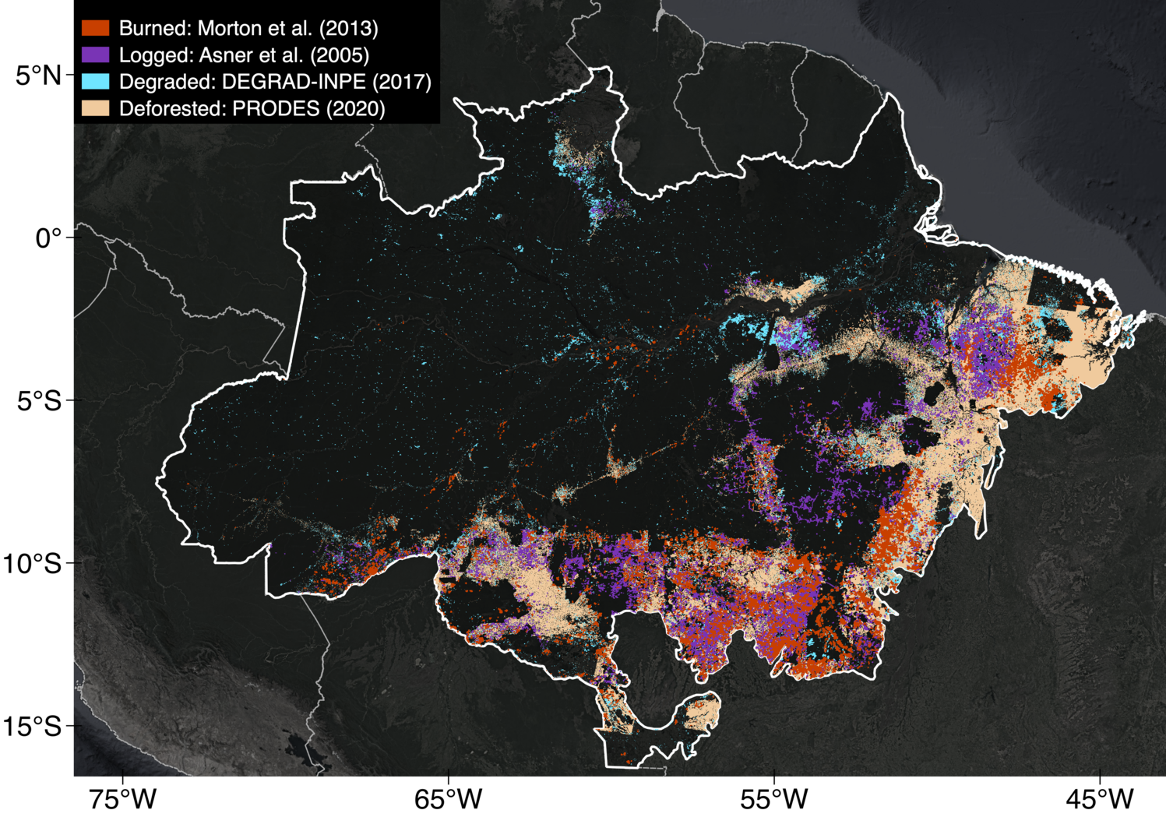
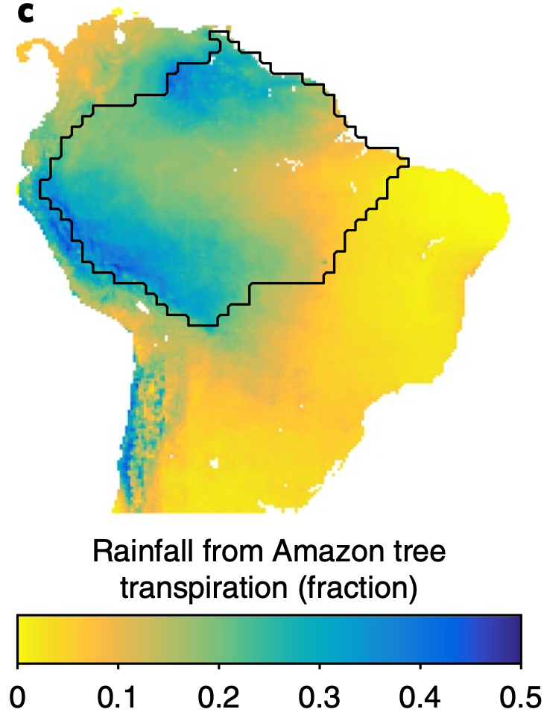
Introduction
Burned: Morton et al. (2013)
Logged: Asner et al. (2005)
Degraded: DEGRAD-INPE (2017)
Deforested: PRODES-INPE (2020)
ET Trend – GLEAMv3
(1980–2018)
Arc of deforestation
Saatchi, Longo et al. (in prep.)
Staal et al. (2018) Nat. Clim. Change
Amazon evapotranspiration (ET): significant role on climate across South America
ET decreases since 1980 over the Eastern and Southern Amazon
Arc of deforestation: areas with pervasive deforestation, degradation, and fragmentation

Slide 3
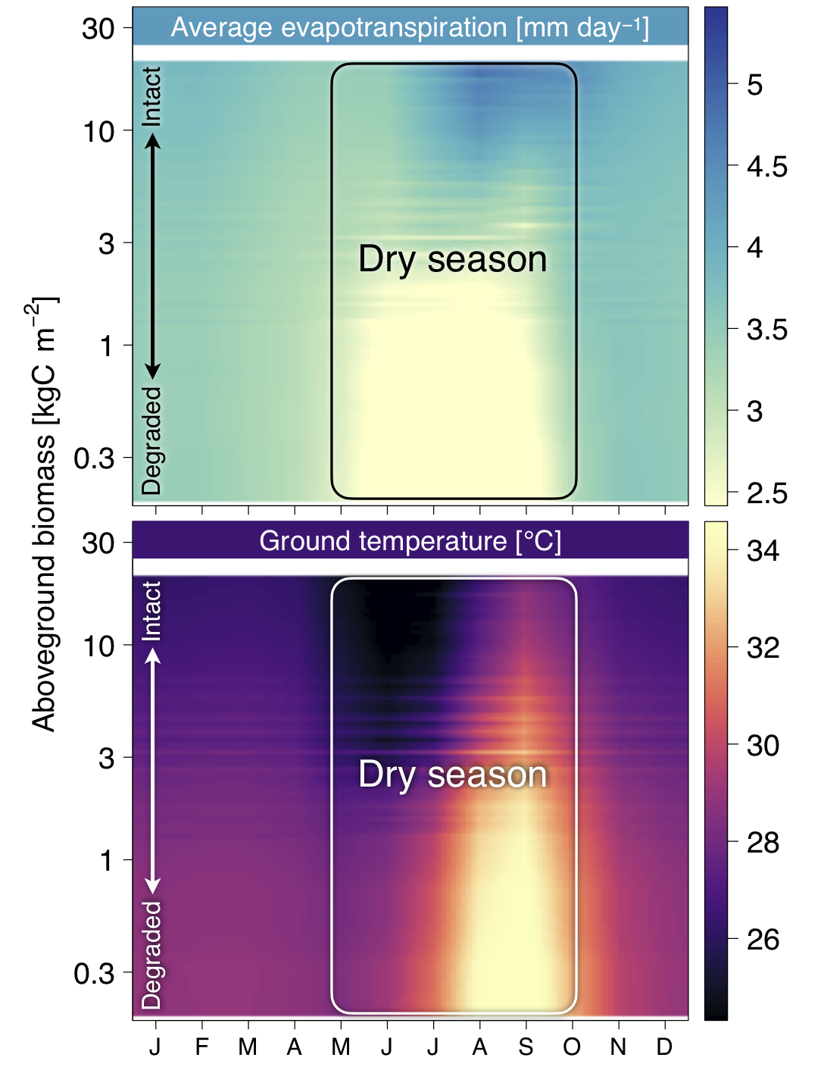
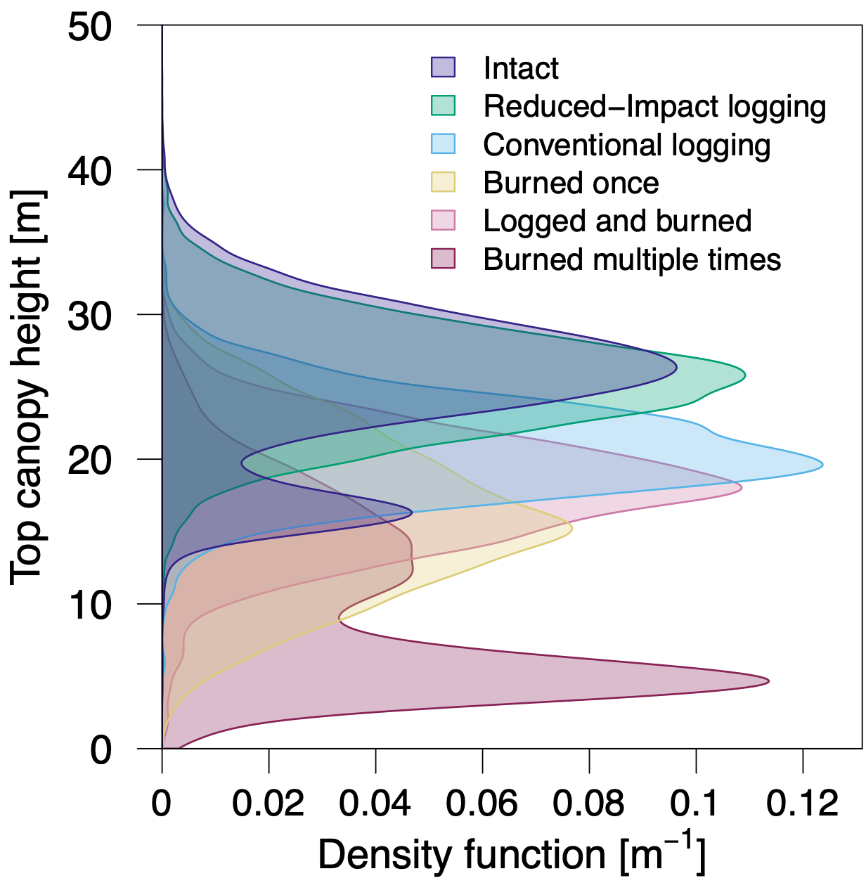
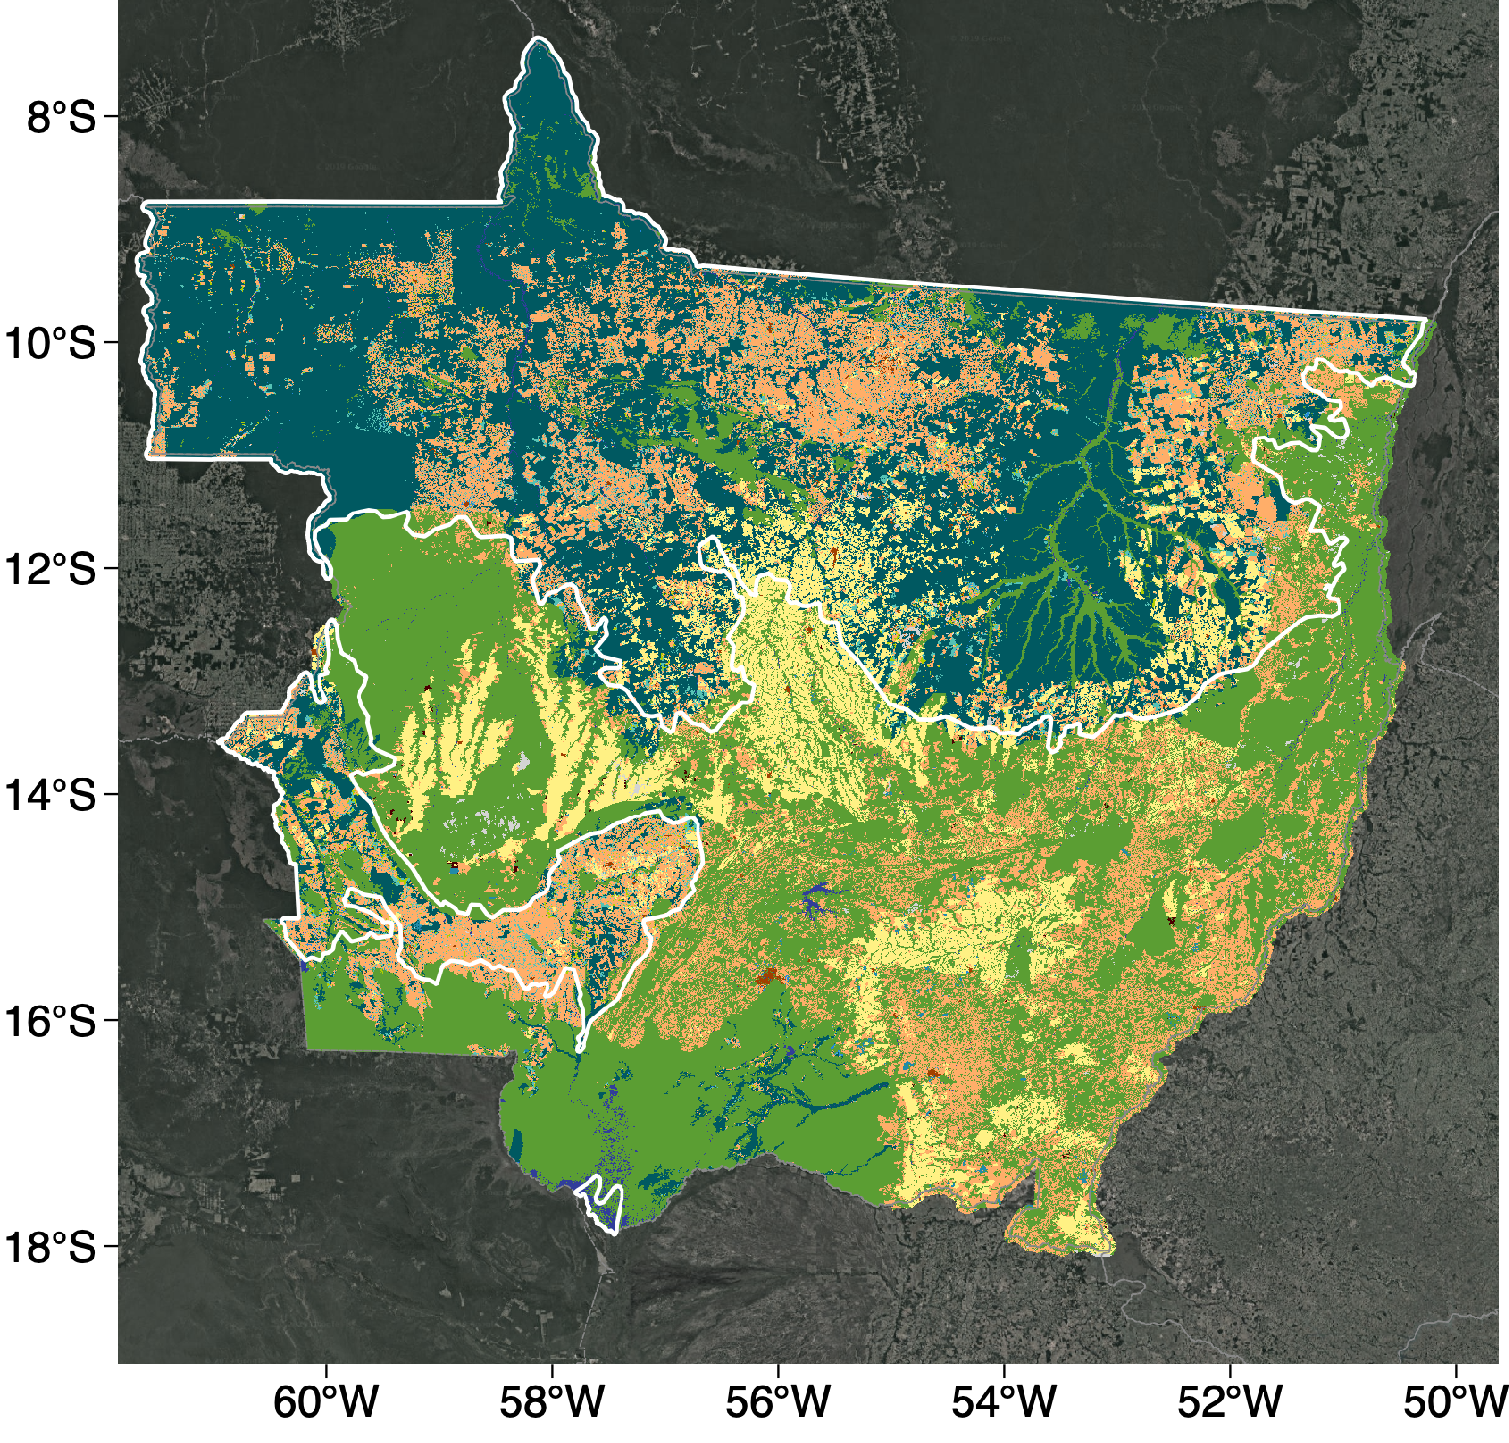
Forest degradation impacts on structure and ecosystem function
Study region
Mato Grosso State
Amazon
Data from Longo et al. (2016)
Glob. Biogeochem. Cycles
Mato Grosso: widespread degradation, 55% of remaining forests within 2km from edge
Degradation causes substantial impacts on forest structure
Results from models suggest large impact of degradation on ET and Tground
Can we observe these effects from remote sensing?
Longo et al. (2020)
J. Geophys. Res.-Biogeosci.

Slide 4
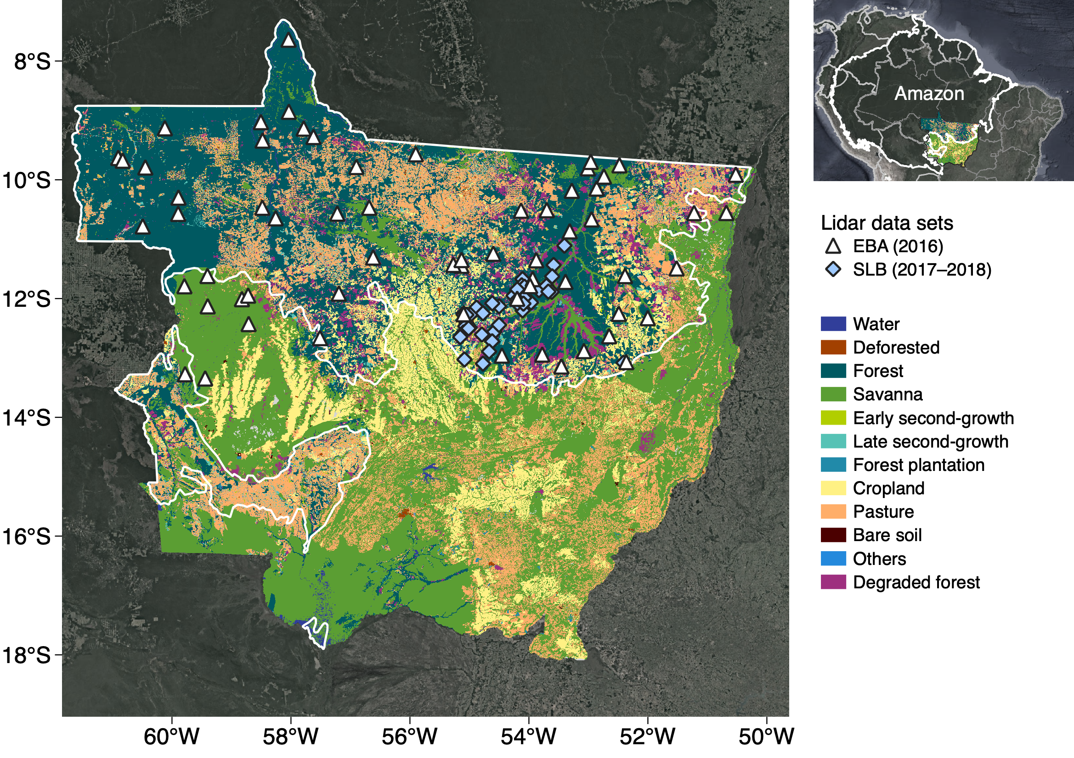
Material and methods
ECOSTRESS (https://ecostress.jpl.nasa.gov)
Data period |  | July–September 2018 (dry season)
Spectral bands |  | 1 NIR band: 1.6 µm (geo-location/clouds)
 |  | 5 TIR bands: 8.29–12.09 µm
Spatial resolution |  | Most science products 70×70 m
Products | L2 | Land Surface Temperature (LST)
 | L3 | Evapotranspiration (ET)
 | L4 | Water Use Efficiency (WUE), Evaporative Stress (ES)
ECOSTRESS image selection:
Cloud-free data over lidar samples
Data from 11–15 LT
Eliminate L3/L4 data with discontinuities
Reprojected all data layers to 70×70 m grids coincident with lidar
Random Forest models to identify strong drivers of variability of LST, ET, ES:
500 trees
15,000 random samples, cross-validation using 49,000–94,000 entries
Analysis of importance (MSE increment)
Airborne lidar
Additional data
ERA5 (Hersbach et al. 2020)
Hourly data to match ECOSTRESS
Surface variables at 0.1° resolution
Temperature, humidity, wind, radiation
SoilGrids (Hengl et al. 2017)
Machine-learning product
Soil properties at 250-m resolution
Soil texture and depth to bedrock
Disturbance (INPE 2020)
Deforestation (PRODES, 1997–2018)
Degradation (DEGRAD, 2007–2016)
Land use classes (TerraClass, 2014)
EBA-INPE (2016): 45,000 ha
Sustainable Landscapes (2017/8): 10,500 ha
Canopy and terrain metrics at 70-m resolution
Mean, roughness, skewness
Gap fraction
Topographic position index

Slide 5
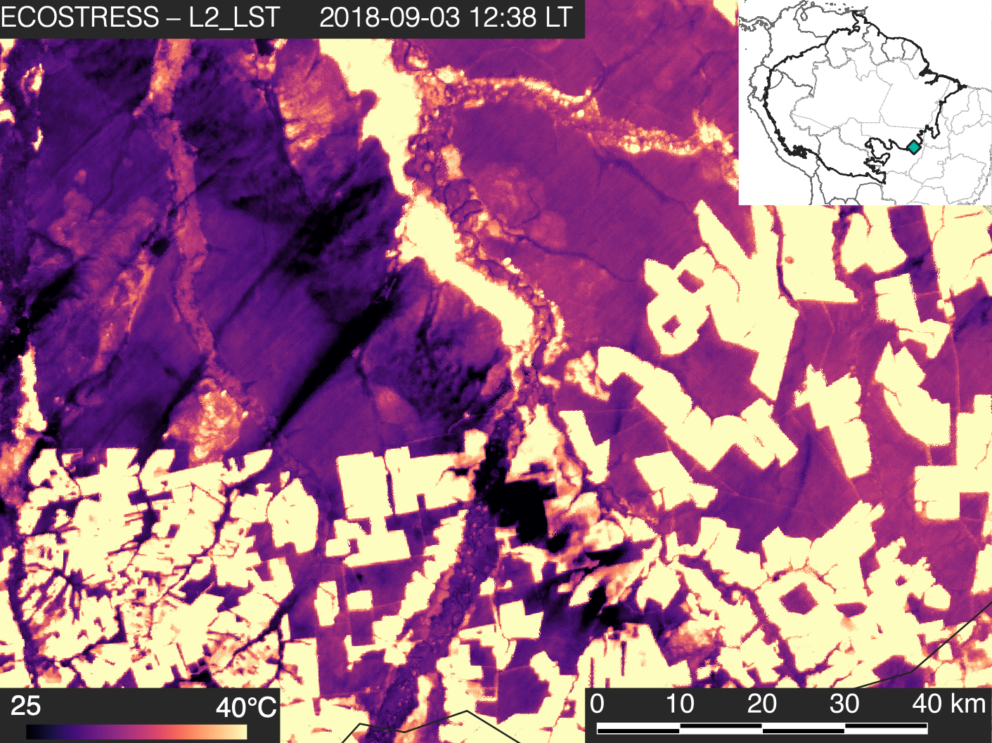
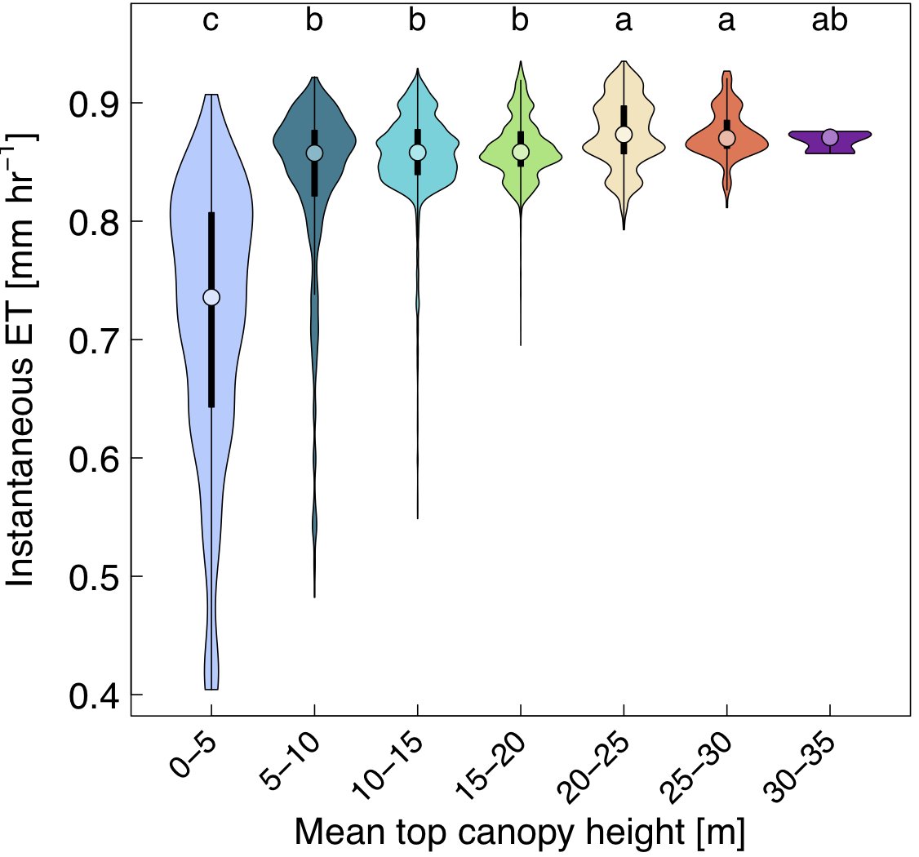
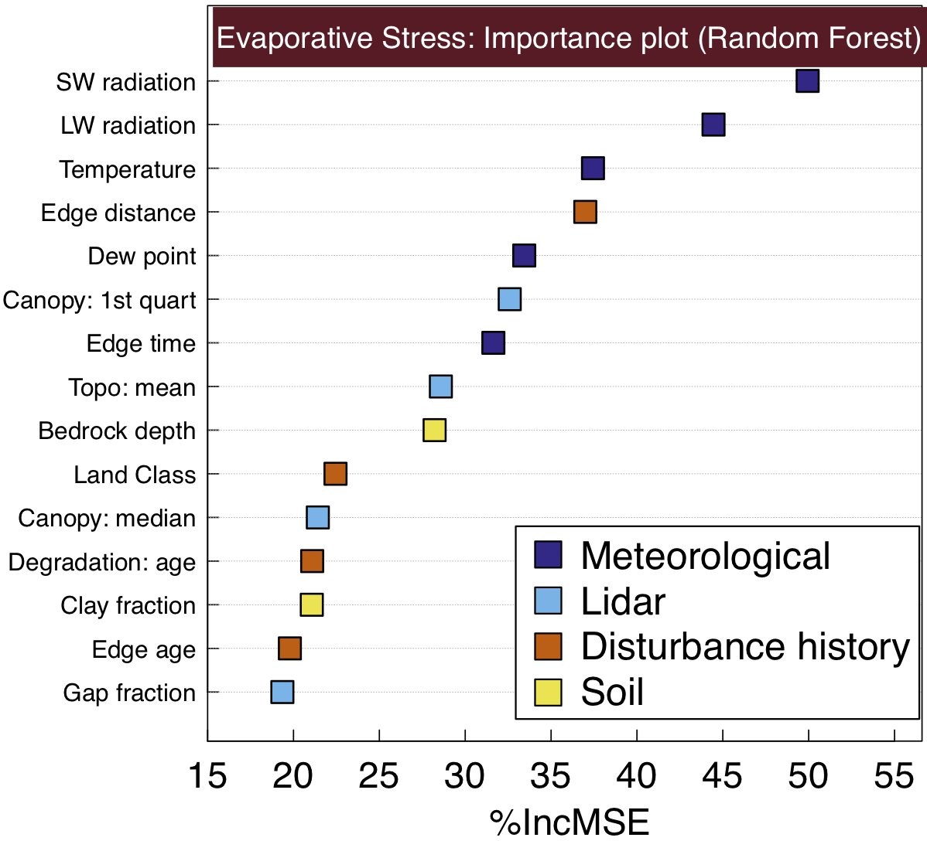
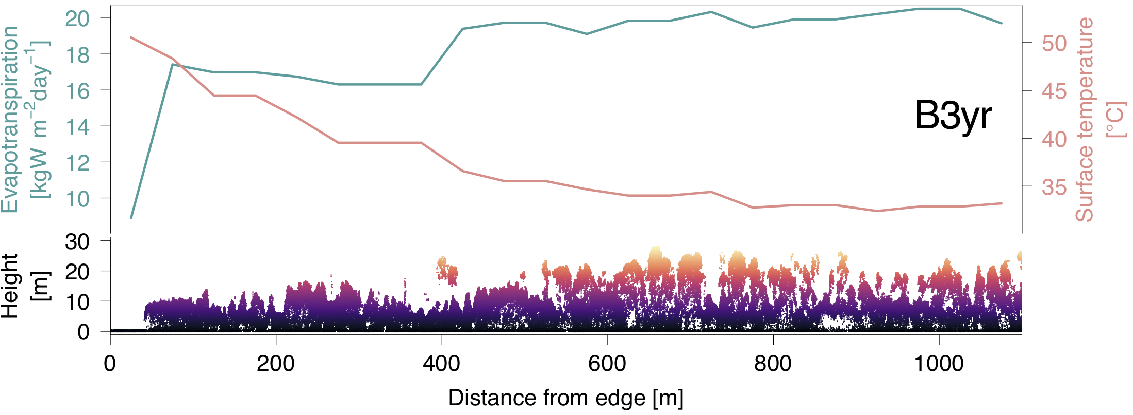
Results
Intact forest
2-yr old
Burn scars
Deforestation
Spatial patterns of LST and ET driven by deforestation and degradation:
Deforestation (9–20°C) and degradation (1-8°C) warmer than old-growth forests
Pronounced forest edge effect on LST and ET up to 600 m
Effect of forest structure on ET stronger in shorter canopies
Variability in evaporative stress (ES) predicted from Random Forest:
Strongest: Radiation
Temperature nearly as important as the distance to edge
Humidity nearly as important as the canopy structure

Slide 6
Publications
Peer-reviewed publications
Longo M, Saatchi SS, Keller M, Bowman KW, … 2020. Impacts of degradation on water, energy, and carbon cycling of the Amazon tropical forests. J. Geophys. Res.-Biogeosci. 125: e2020JG005677. doi:10.1029/2020JG005677.
Ferraz A, Saatchi S, Longo M, Clark DB. 2020. Tropical tree size demography from airborne lidar. Ecol. Appl. 30: e02154. doi:10.1002/eap.2154.
Huang M, Xu Y, Longo M, Keller M, … 2020. Assessing impacts of selective logging on water, energy, and carbon budgets and ecosystem dynamics in Amazon forests using the Functionally Assembled Terrestrial Ecosystem Simulator. Biogeosciences Discuss. doi:10.5194/bg-2019-129, in press.
Paul-Limoges E, Wolf S, Schneider FD, Longo M, … 2020. Partitioning evapotranspiration with concurrent eddy covariance measurements in a mixed forest. Agric. For. Meteorol. 280: 107786. doi:10.1016/j.agrformet.2019.107786.
Silva Junior CHL, Aragão LEOC, Anderson LO, Fonseca MG, …, Longo M, Saatchi SS. 2020. Persistent collapse of biomass in Amazonian forest edges following deforestation leads to unaccounted carbon losses. Sci. Adv. 6: eaaz8360. doi:10.1126/sciadv.aaz8360.
Longo M, Knox RG, Medvigy DM, Levine NM, … 2019. The biophysics, ecology, and biogeochemistry of functionally diverse, vertically and horizontally heterogeneous ecosystems: the Ecosystem Demography model, version 2.2 – part 1: Model description. Geosci. Model Dev. 12: 4309–4346. doi:10.5194/gmd-12-4309-2019.
Longo M, Knox RG, Levine NM, Swann ALS, … 2019. The biophysics, ecology, and biogeochemistry of functionally diverse, vertically and horizontally heterogeneous ecosystems: the Ecosystem Demography model, version 2.2 – part 2: Model evaluation for tropical South America. Geosci. Model Dev. 12: 4347–4374. doi:10.5194/gmd- 12-4347-2019.
Longo M, Keller M. 2019. Not the same old(-growth) forest. New Phytol. 221: 1672–1675. doi:10.1111/nph.15636.
de Almeida CT, Galvão LS, Aragão LEOC, Ometto JPHB, …, Longo M. 2019. Combining LiDAR and hyperspectral data for aboveground biomass modeling in the Brazilian Amazon using different regression algorithms. Remote Sens. Environ. 232: 111323. doi:10.1016/j.rse.2019.111323.
Scaranello MAS, Keller M, Longo M, dos Santos MN, … 2019. Estimation of coarse woody debris stocks in intact and degraded forests in the Brazilian Amazon using airborne lidar. Biogeosciences 16: 3457–3474. doi:10.5194/bg-16-3457-2019.
Publications in review or near submission
Meunier F, Verbeeck H, Cowdery EM, Schnitzer SA, …, Longo M, … 2020. Unraveling the relative role of light and water competition between lianas and trees in tropical forests: a vegetation model analysis. J. Ecol. In review.
Saatchi S, Longo M, Xu L, Yang Y, … 2020. Increasing vulnerability of tropical forests to emerging stressors. In prep. Sci Adv.
Restrepo-Coupe N, Albert LP, Baker I, Longo M, … 2020. Understanding water and energy fluxes in the Amazonia: Lessons from an observation-model intercomparison. Glob. Change Biol. In review.
Conferences (first-author)
2020. Amazon forest structure mediates drought impacts on carbon uptake and evapotranspiration. In: AGU Fall Meeting, Online, 688390.
2020. The impacts of Amazon forest degradation and fragmentation on energy, water, and carbon cycles. In: EGU General Assembly, Online, EGU2020-4801 (highlight). doi:10.5194/egusphere-egu2020-4801.
2019. How does forest structure control temperature and water fluxes in the Amazon? In: AGU Fall Meeting, San Francisco, CA, USA, 508929.
2019. Forest degradation impacts on water, energy and carbon cycles, and response to severe droughts in the amazon. In: NASA Terrestrial Ecology Science Team Meeting, College Park, MD, PS18.
2019. Degradation of amazon forests affects energy, water, and carbon cycles: Insights from an integrated remote-sensing and modeling analysis. In: 56th ATBC Annual meeting, Antananarivo, Madagascar, PTS/030.
2018. Tropical forest structure modulates flammability and response to extreme droughts in the Amazon. In: AGU Fall Meeting, Washington, DC, USA, 427911.
Acknowledgements
329G: Kevin Bowman, Kerry Cawse-Nicholson, António Ferraz, Joshua Fisher, Gregory Halverson, Michael Keller, Sassan Saatchi,
Fabian Schneider, Liang Xu
External: Paulo Brando, Victoria Meyer, Paul Moorcroft, Jean-Pierre Ometto, Ekena Pinagé

