Slide 1
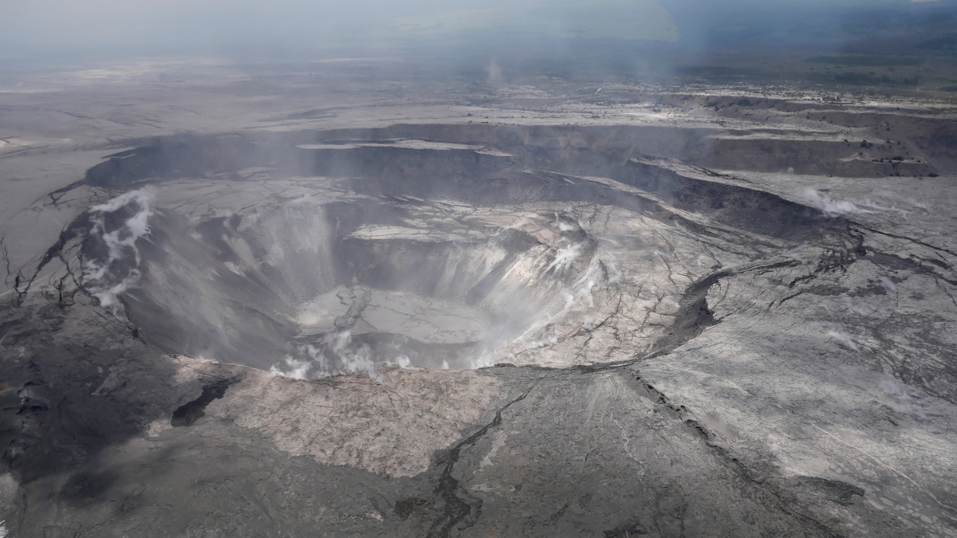

Credit: K. Anderson (USGS)
Dynamics of Large Effusive Eruptions Driven by Caldera Collapse
Alberto Roman
Organization: JPL (329A)
Advisor: Paul R. Lundgren (329A)
Postdoc Program: NPP

Slide 2
Abstract
The largest effusive basaltic eruptions are associated with caldera collapse and are manifest through quasi-periodic ground displacements and moderate sized yet the mechanism governing their dynamics remains elusive. In this work we provide a new physical model to understand these processes, which accounts for both the quasi-periodic stick-slip collapse of the caldera roof and the long term eruptive behaviour. We show that it is the caldera collapse itself that sustains large effusive eruptions, and that triggering caldera collapse requires, in turn, topography generated pressures. The model is consistent with data for the 2018 Kilauea eruption and allows us to estimate for the first time, the properties of the plumbing system. The results reveal that two reservoirs were active during the eruption and constrain their connectivity. Compared to the model, the Kilauea eruption stopped after producing slightly more than 60% of its potential collapses, possibly due to the presence of the second reservoir. Finally, we show that this physical framework is generally applicable to the largest instrumented caldera collapse eruptions of the past fifty years.

Slide 3
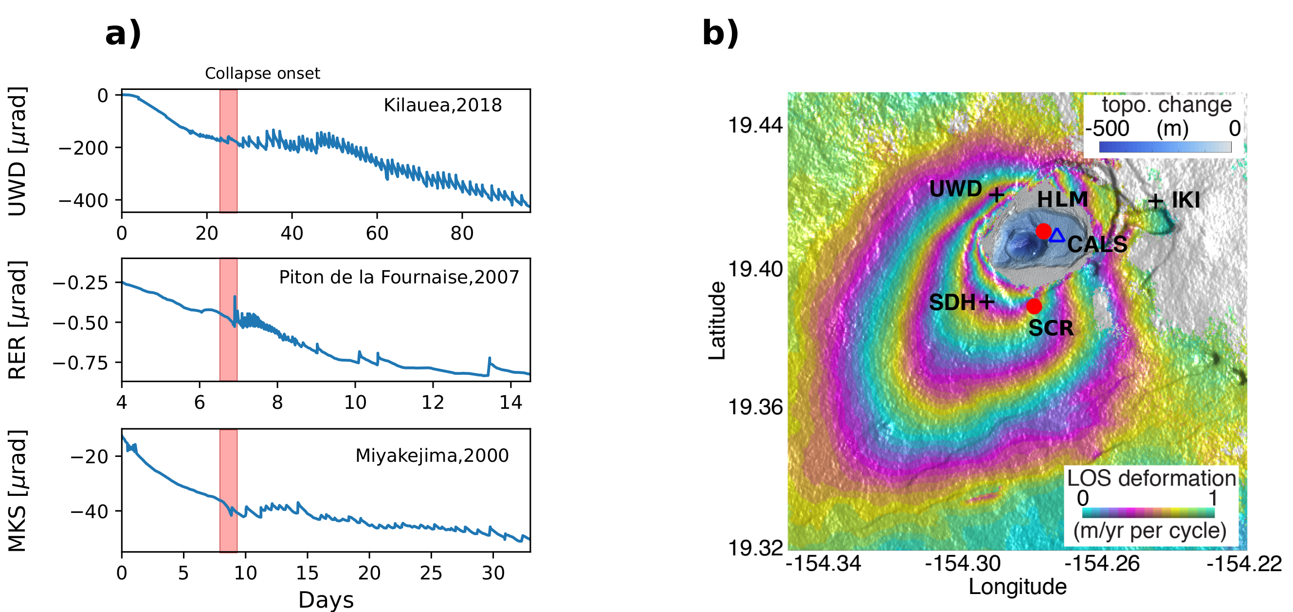
Caldera Forming Eruptions: Surface Deformation

Slide 4
Model of caldera collapse
Model set-up
Friction vs Gravity driven eruptions
We solve analytically mass and momentum conservation for a coupled piston-elastic reservoir. We find that the system can be described by two regimes: friction dominated and gravity dominated ( both shown on the right).

Slide 5
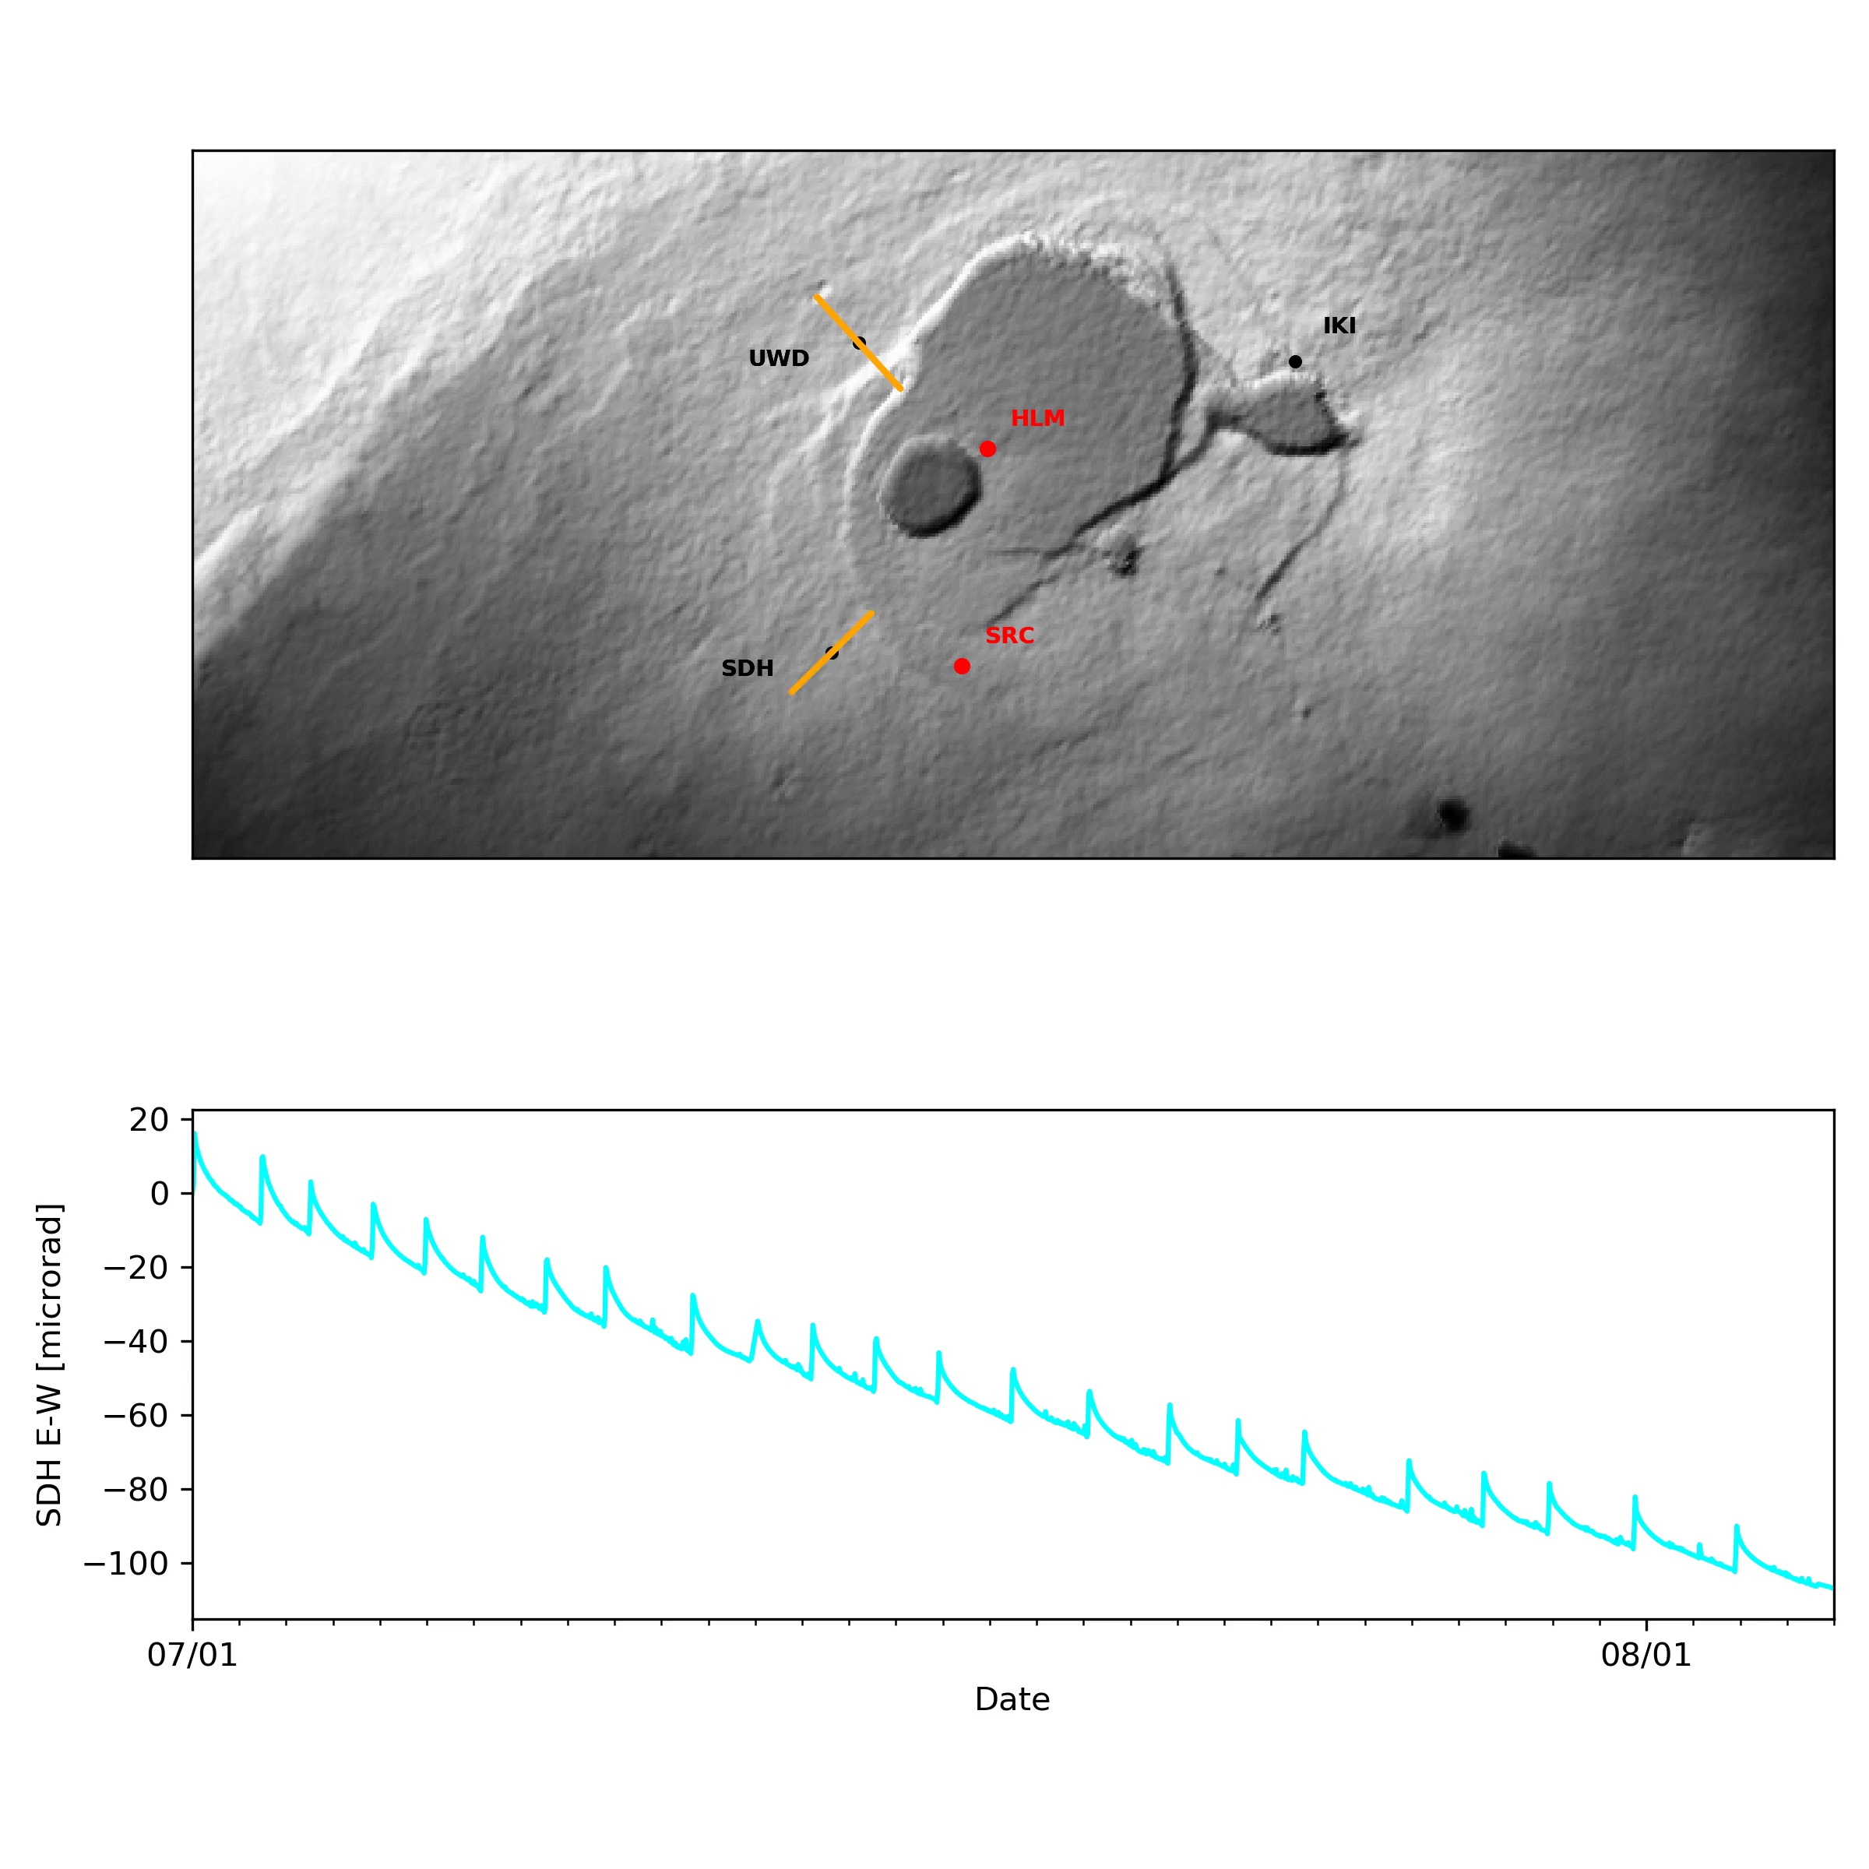
Application of the Model to the 2018 Kilauea Eruption – Evidence for Two Reservoirs
Sentinel-1
HLM
HLM
SCR
SCR
HLM
HLM
SCR
SCR
HLM
SCR

Slide 6
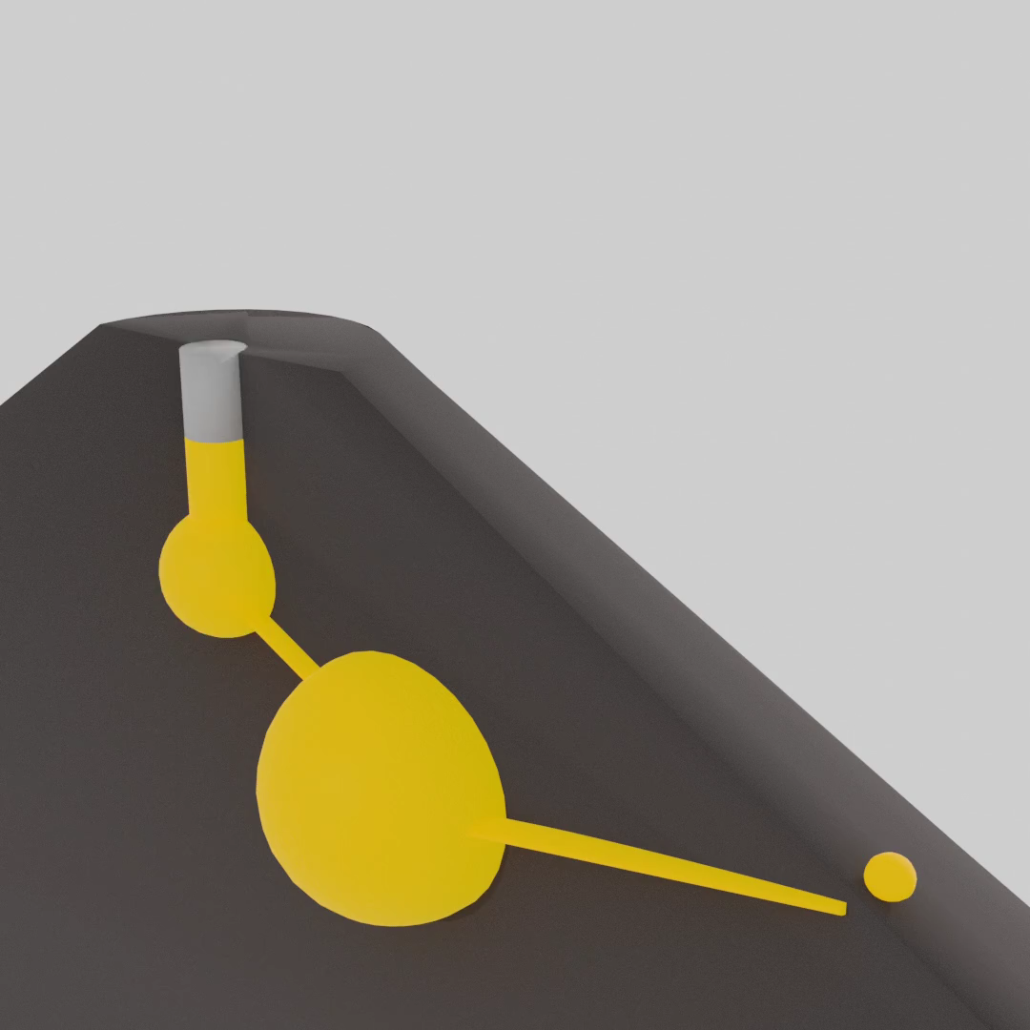
Application to the 2018 Kilauea Eruption
HLM reservoir
SCR reservoir
Volume HLM : 8-9 km³
Volume SCR : 8-50 km³
Conduit Eruption : 3-6 m
Conduit Connection: 1-10 m

Slide 7
Comparison with other eruptions

Slide 8
Acknowledgements
I acknowledge the Hawaiian Volcano Observatory (HVO) for providing tiltmeters and GNSS data. This work has been supported by the NASA-USRA NPP fellowship.
Publications
A. Roman and P. R. Lundgren, Dynamics of Large Effusive Eruptions Driven by Caldera Collapse, Nature, Under Review

Slide 9
Captions of the audio comments
Slide 1
Hi and welcome to this presentation entitled “Dynamics of large effusive eruptions driven by caldera collapse”. My name is Alberto and I am an NPP postdoc here at JPL. We are going to talk about volcanoes, and more specifically about calderas. Calderas are large depressions found on the summit of volcanic edifices on Earth, but also on other planets such as Venus or Mars. The purpose of this work is to build a new physical model to understand caldera forming eruptions. We show that the model is consistent with geodetic data from 2018 Kilauea eruption, which produced the spectacular crater that you see in the picture. To conclude we demonstrate that our findings generally apply to the largest instrumented effusive eruptions of the last 50 years.
Slide 3
Let’s first examine the geodetic signal of caldera forming eruptions. In figure A you see tilt measurements during eruptions of three different volcanoes that resulted in the collapse of the caldera. First of all, we notice that these eruptions generate a long term deflation of the volcanic edifice. This is evident from the negative net tilt variation, but also from InSAR data. shown in Figure B. Second, we see that when the collapse begins, we have the appearance of a striking, quasi-periodic signal, characterized by very rapid inflation events lasting few seconds followed by slow deflation periods, lasting from few hours to few days. Inflation is coincident with slip of the caldera block along annular faults, whereas deflation corresponds to periods during which the block sticks. For Kilauea, the cycle repeated 62 times and produced a net topographic change up to 500 m, shown in Figure B.

Slide 10
Slide 4
We would like to answer some fundamental questions, such as what is generating the inflation deflation cycles, or how many cycles we can expect once the collapse has started. To answer these questions, we set-up a simple model, shown on the left. It consists of a piston, representing the caldera block, foundering in an elastic reservoir which is feeding the eruption though a conduit.We solve analytically conservation of mass and momentum for this coupled system. We find that the problem is controlled by two dimensionless parameters and that, depending on their values, volcanic eruptions, can be in between two end-member regimes: one, that is friction controlled, and the other that is gravity controlled. In both cases, the pressure evolution in the reservoir, and piston position, qualitatively reproduce the quasi-periodic signal, the long term deflation and the stick and slip behaviour observed during caldera collapse.
Slide 5
We apply the model to the 2018 Kilauea eruption. A careful analysis of InSAR data reveals that two reservoirs were deflating during eruption, one located in the proximity of the northeastern edge of the Halemaumau crater, that we’ denote HLM, and another just south of the southern caldera rim, that we will call SCR. We performed a Bayesian inversion of Sentinel-1 both ascending and descending data to estimate their precise locations. We find that HLM has a depth of about 900 meters, whereas SCR is at about 3.2 km. The original data, the model predictions and the residual are shown on the Figure A. The locations of the reservoirs obtained from the inversion is shown by the two black dots. We analyzed the variation of tilt directions during the eruption, which is shown in the movie. As you can see, the direction at station SDH and IKI initially switches from one source location to the other, but eventually settles in the SCR direction. These observations motivated the extension of the piston collapse model to the case in which two reservoirs are connected in series, shown in Figure B. In. the application to Kilauea, the shallow reservoir represents HLM whereas the deep reservoir represent SCR.

Slide 11
Slide 6
Using the two reservoir model, we invert tilt and GNSS data. For the latter we use the CALS station, which was located on the collapsing block, and which we assume to track the position of the piston as function of time. Part of the data is expressed as function of the collapse number, whereas for the tilt variation during stick we use a stacked signal consisting of 19 cycles. There is a very good agreement between the model and the observations, with minor discrepancies that are within the posterior uncertainties. The posterior distribution of the main parameters is shown in the histogram. This is the first time that the volumes and the connectivity of the reservoirs of Kilauea are estimated in a consistent way. This allows us to propose a conceptual model for the 2018 eruption, shown on the movie on the right.
Slide 7
To the test the model against the other caldera forming eruptions, we have compared the timing in between collapse events. As you can see there is a reasonable agreement between the theory and the data. For some eruptions such as, Fernandina or Piton de la Fournaise there is an initial misfit that we suggest is related to the escape of gas from the system, a process that is not accounted for in the model. For Kilauea the agreement is very good and the results suggest that the eruption stopped at about 60% of the value predicted by the theory. We suggest that this happened because the connection between the upper and the lower reservoir shut off during to the progressive depressurization of the system, which prevented the collapse in the upper reservoir to go to completion. This work demonstrates how we can use a combination of simple physical models with space and ground based observations to constrain the processes operating during large volcanic eruptions. Ongoing research aims to integrate other datasets in the inversion, such as measures of effusion rates. This is expected to improve the constraints of some important parameters of the plumbing system of the volcano. Thank you for listening.

