Slide 1
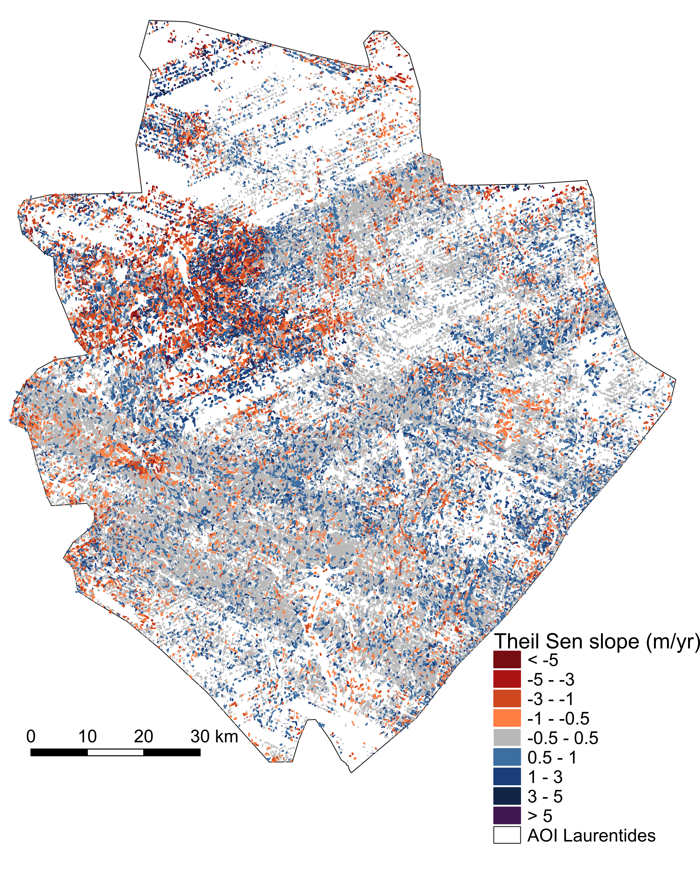
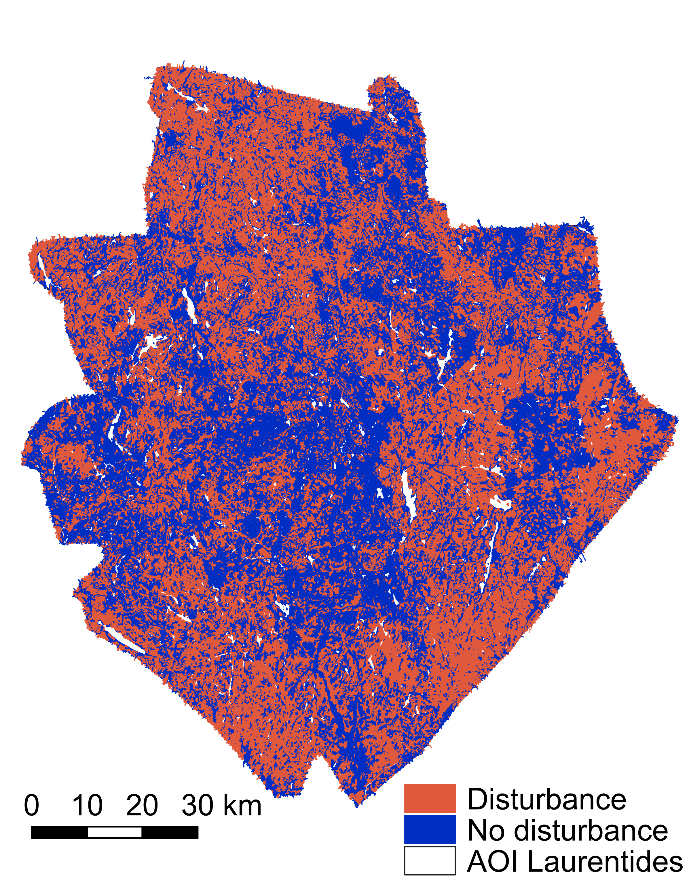
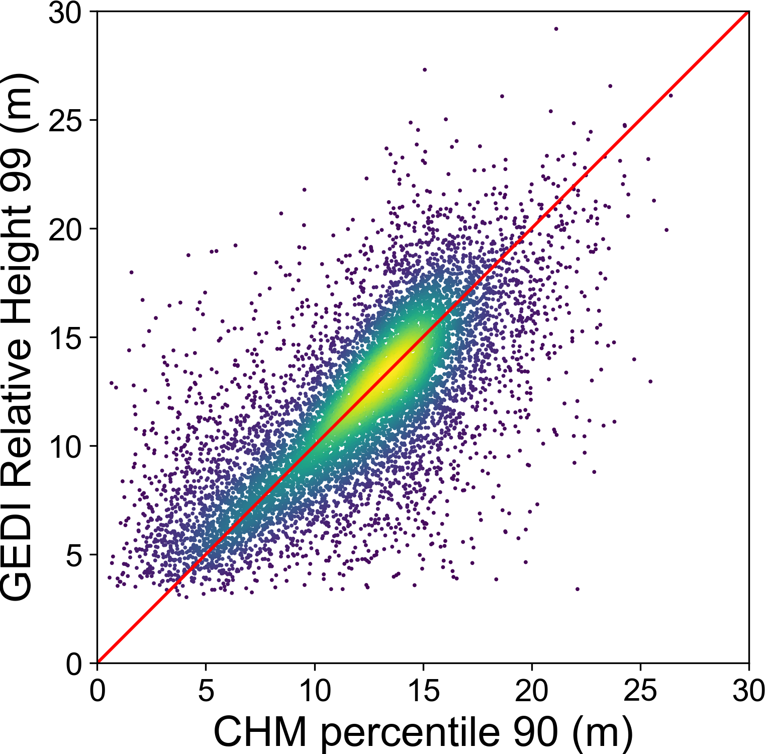
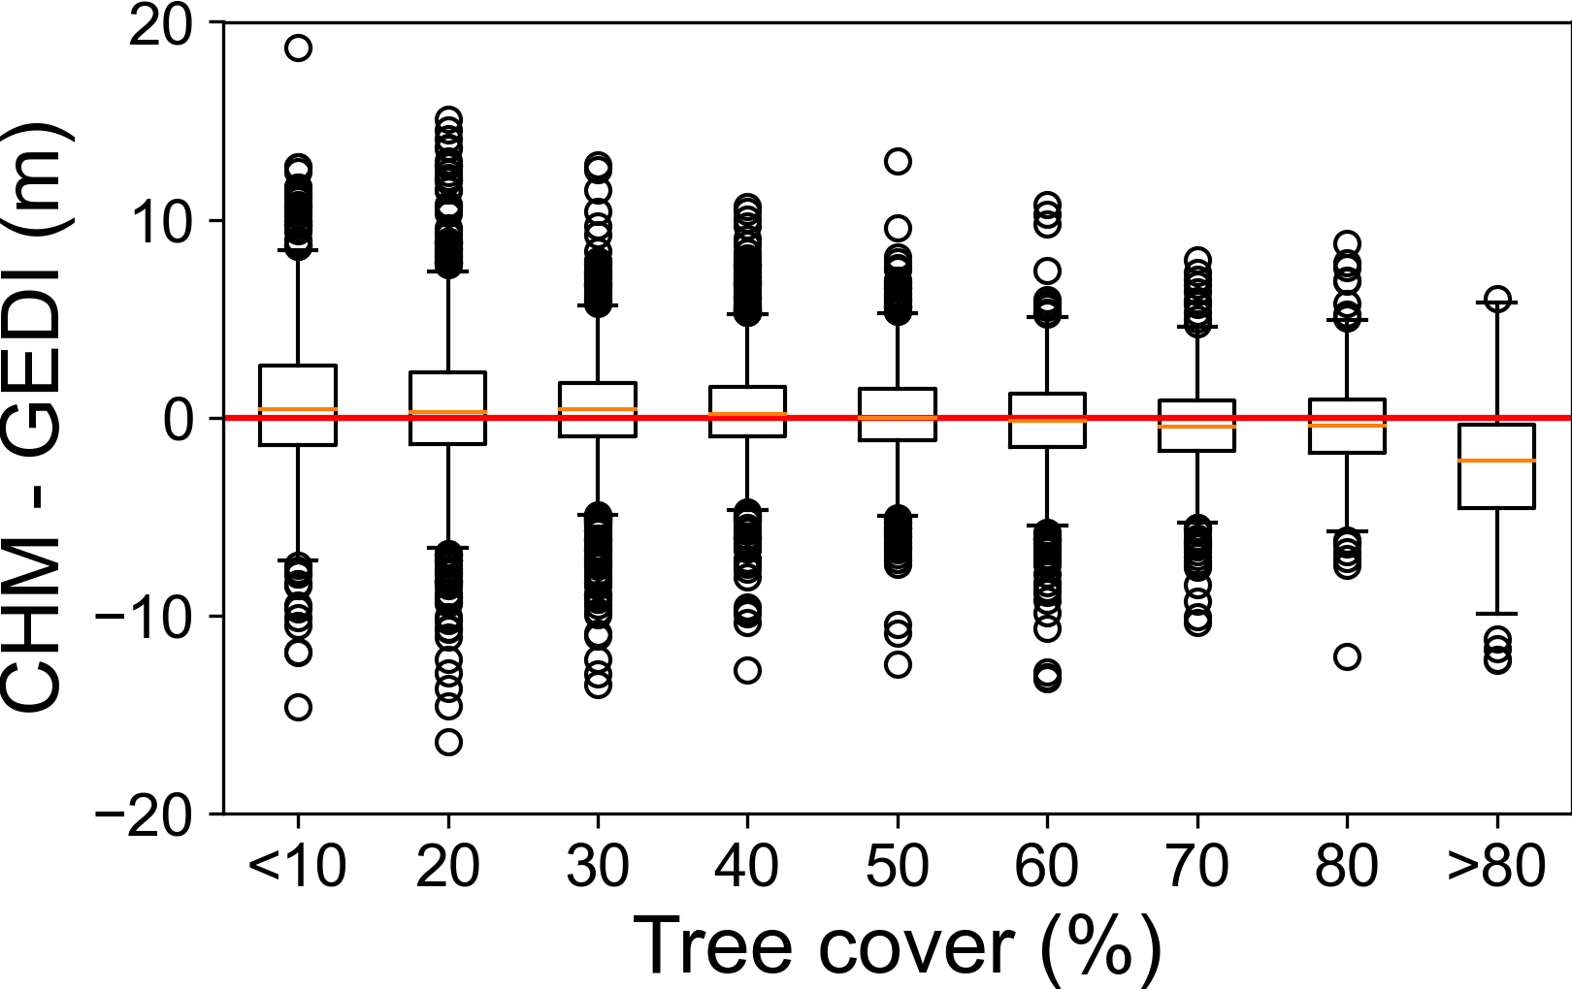
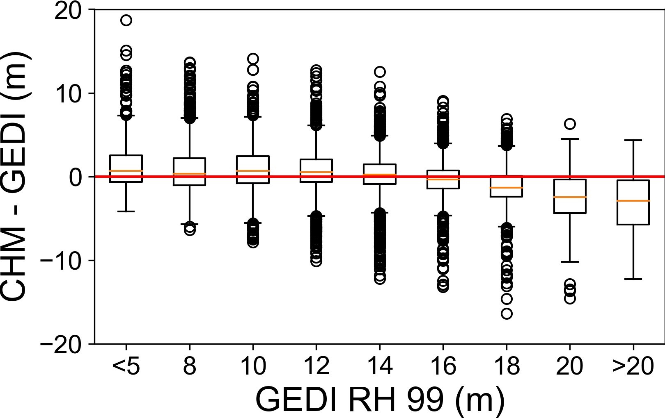
National Aeronautics and Space Administration
Estimation of tree growth rates with GEDI data
Authors: Adriana Parra, JPL Postdoctoral Fellow (334F)
Marc Simard, Senior Scientist (334F)
Abstract
Tree growth refers to rates of change in the dimensions of a tree, typically evaluated as changes in tree diameter or height. Estimating tree growth rates is vital for assessing biomass production and changes in carbon sequestration. NASA’s Global Ecosystems Dynamic Investigation (GEDI) provides valuable information on vertical structure of forests which can be used to estimate tree growth rates. This analysis focuses on the Laurentides Wildlife Reserve in Canada, an area dominated by boreal and temperate forest, with large availability of in-situ, airborne LiDAR and GEDI data. The disturbance regime of the reserve is composed of natural and anthropogenic perturbations that result in a heterogeneous landscape with spatial variation in tree growth rates.
Objectives
We aim to 1) evaluate the accuracy of the GEDI’s canopy height values in the area of study and, 2) detect tree growth rates at the forest stand level, defined as the change in canopy height per year.
Methods
Input data:
GEDI data Level 2A and Level 2B v002
Airborne LiDAR data - Government of Québec.
Forestry data at the stand level - Government of Québec.
Tree growth rates in the Laurentides Wildlife Reserve
The reserve is overall stable i.e., with no significant changes in canopy height for the evaluated years (~2013 to ~2021).
Data preprocess
Stable: 62%
Tree growth: 24%
Tree cover loss: 14%
LiDAR
CHM raster
CHM percentiles
Average data to
Forest Stand level
GEDI
Laser Footprint
RH values
Filtered data
Accuracy Assessment with same year data
Filtering using different quality flags
Best fit:
GEDI RH 99
CHM 90th percentile
Tree growth analysis
CHM 90th %tile
Initial canopy height
Years: 2013, 2015, 2016, 2017, 2018, 2019
Canopy height
Time Series
GEDI RH 99
Canopy height
Theil-Sen slope:
Stable forest stands
Tree growth
Tree cover loss
Years: 2019, 2020, 2021
GEDI canopy height accuracy
N =9649
Tree growth | Disturbance occurrence | Possible explanation
Stable | No disturbance | Forest stand has reached the maximum canopy height
Stable | Disturbance | Repeated disturbances limit the maximum canopy height the disturbance occurred a long time ago and the stand reached its maximum height
Not stable | Disturbance | Rate of tree growth is related to a recorded disturbance
Not stable | No disturbance | Rate of tree growth could be related to environmental conditions not recorded disturbances
Next steps
Evaluate the environmental factors controlling growth.
Estimate biomass budget and rates of production/loss.
Evaluate the effects of disturbances on tree growth.
CORR | 0.73 | MAE (m) | 2
RMSE (m) | 2.9 | BIAS (m) | 0.13
National Aeronautics and Space Administration
Jet Propulsion Laboratory
California Institute of Technology
Pasadena, California
www.nasa.gov
Author Contact Information:
adriana.s.parra@jpl.nasa.gov
Acknowledgments:
We thank the Government of Québec for the airborne LiDAR and forestry data of the Laurentides Wildlife reserve.
Poster Number: PRD-EB#015
Copyright 2022. All rights reserved.

