Slide 1
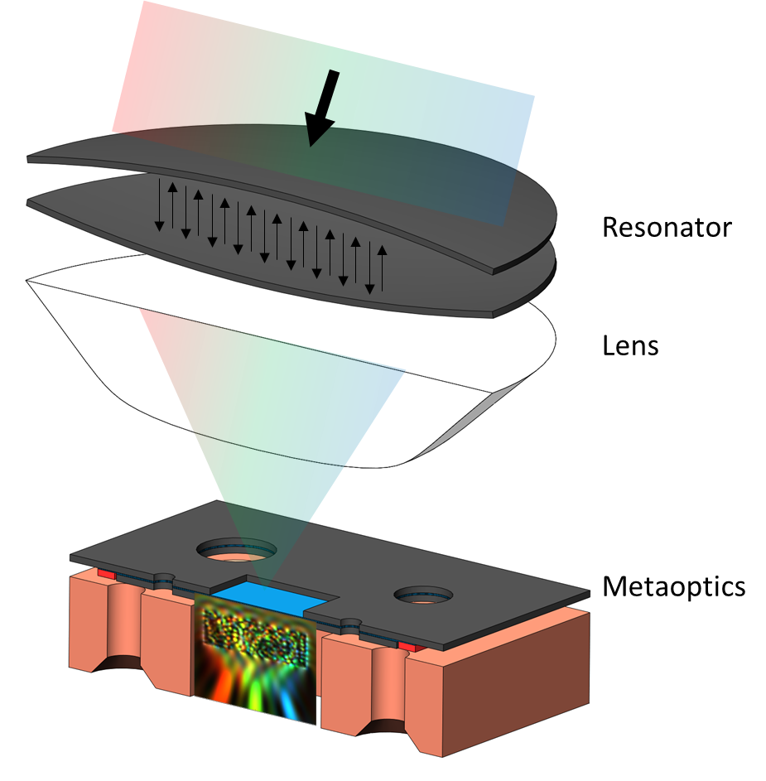
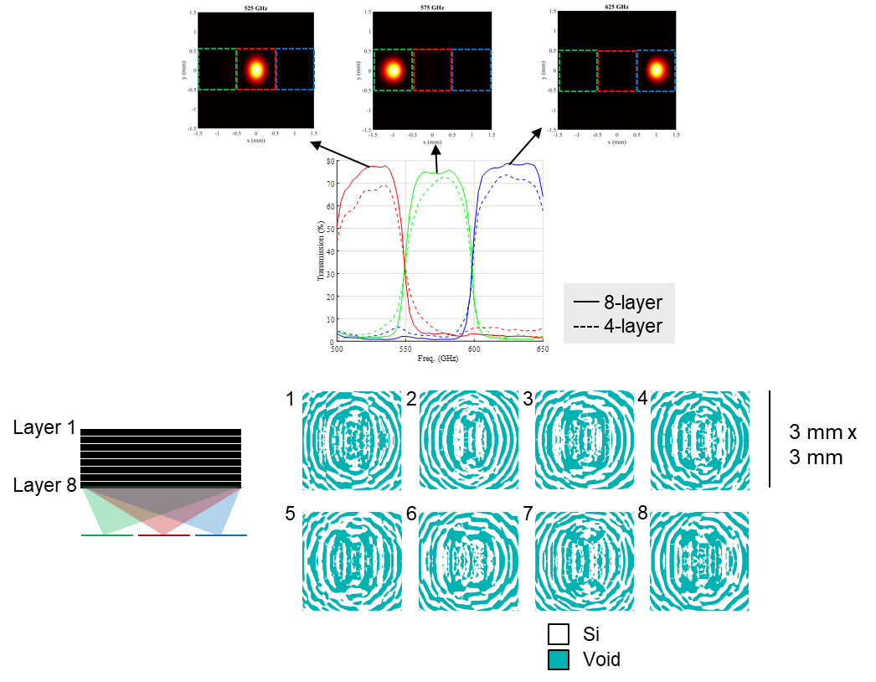
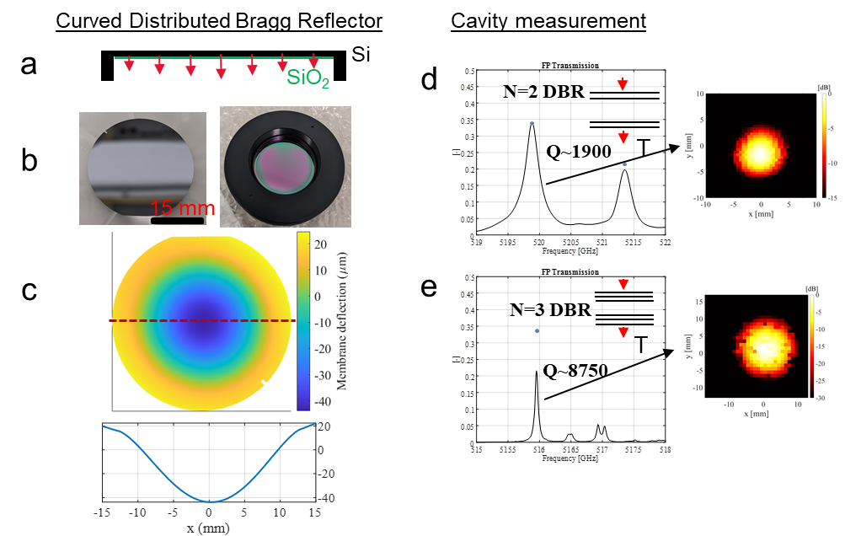
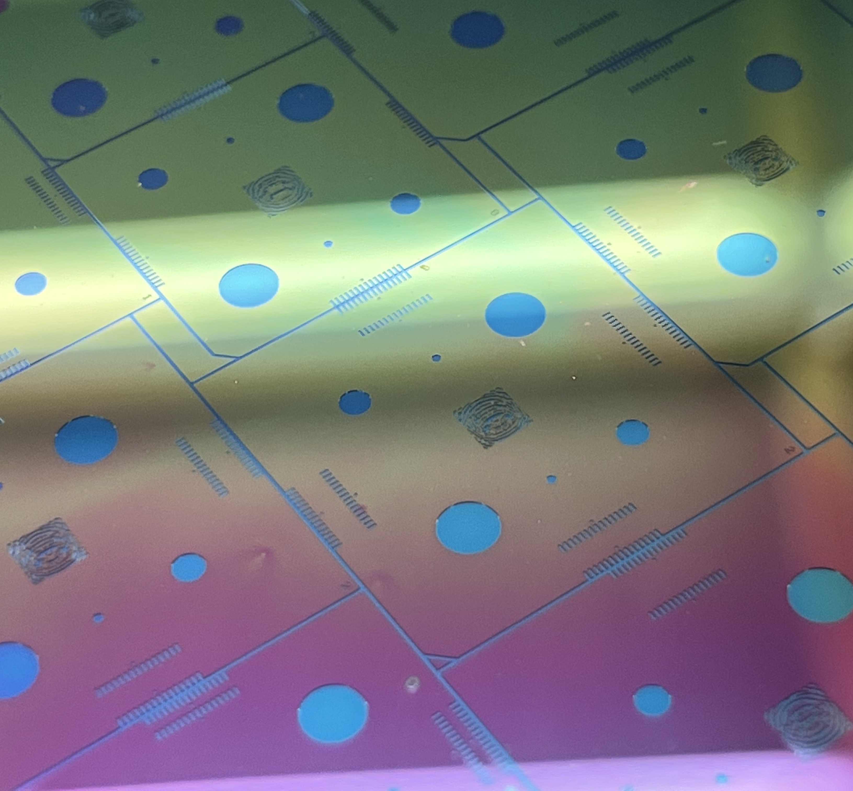
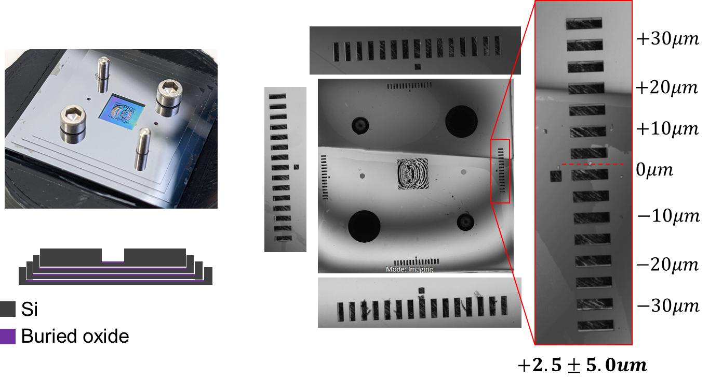
National Aeronautics and Space Administration
Volumetric Metaoptics For Compact And Low-Power Spectroscopy
Author: Conner Ballew, NASA Postdoctoral Fellow (386H)
Sven van Berkel (386), Subash Khanal (386), Jacob Kooi (386), Paul Goldsmith (3266), Leslie Tamppari (3222), Goutam Chattopadhyay (386)
Target specifications:
10⁴-10⁵ spectral resolution
500 – 650 GHz bandwidth
High efficiency
Very few, efficient components
Low power
Piezoelectric nanopositioner for tuning resonator
Compact
30 mm x 30 mm x 30 mm
Curved distributed Bragg reflectors allow resonator to be small
Metaoptics element is wavelength-scale
Metaoptics design
The metaoptics are designed by optimizing an electromagnetic figure-of-merit (FoM) with respect to permittivity. The scale of such an optimization is extremely large, easily exceeding 10 million dimensions even for devices that are only a few wavelengths to a side. This is made possible by adjoint-based inverse design algorithms for efficient gradient computation. The permittivity of the device is iteratively adjusted using the gradient information, while constraints are imposed to ensure fabricability.
The purpose of the metaoptics here is to spectrally bin the output of the resonator, sorting each resonance to its own detector. Unlike a grating, the output beam within a given bin does not shift continuously as the frequency changes which eliminates the need for large propagation lengths and densely packed detector arrays.
This design technique is extremely versatile:
It allows any set of input fields to be mapped to any set of output fields.
Fabrication constraints such as minimum feature size control and full connectivity of the Si is imposed here.
The performance of a device can be improved by adding more layers
Objectives
Fabricate a tunable Fabry-Perot (FP) cavity with 10⁵ spectral resolution, capable of being tuned with piezoelectric nanopositioners.
Develop powerful inverse-design algorithms to optimize the shape of a multi-layer Silicon device (volumetric metaoptics) that sorts all output resonances to their own unique direct detector.
Develop the techniques to fabricate and assemble the multi-layer metaoptics device. The individual layers are only 40 μm thick, making assembly non-trivial.
Couple the FP-cavity and metaoptics with a lens, and integrate with a detector array to form the full spectrometer.
Cavity design
The FP-cavity is made by placing two mirrors at a distance. The mirrors are made of alternating λ/4 layers of Si and air, which are known as distributed Bragg reflectors. Furthermore, the mirrors are curved by depositing a thin layer of SiO₂ on the Silicon membrane, thus deflecting them through thin-film stress. This confines the cavity mode to small mode sizes while retaining high quality factors (i.e. spectral resolution).
Figure 3. The simulated metaoptics device. The red, green, and blue curves correspond to the power transmission through the pictured red, green, and blue apertures. The dashed lines are for a 4-layer device, while the solid are for an 8-layer device showing an efficiency improvement due to the increased degrees of freedom in the design. The index profiles for the 8-layer device are shown. The individual layers are 3 mm × 3 mm, with a thickness of 40 um.
Fabrication
Small feature sizes are important even in the dimension that the devices are stacked (i.e. the layer thickness). We pattern the individual layers on 40 um SOI wafers using deep reactive ion etching (DRIE), then remove the handle layer beneath the device with precise dimensioning (also through DRIE). The size of the remove handle layer precisely matches the size of the subsequent wafer, thus allowing all devices to be precisely stacked.
Figure 1. Fabrication and measurement results of the FP cavity. a) The curvature of the DBR mirror elements is obtained by depositing SiO₂. b) Photos of the front and back (mounted in optical adapter) of a DBR element. c) The curvature of the mirror element, measured in the Zygo Zemapper. d) A cavity is formed with two DBRs mirrors, each made of N=2 Si-air layers. The Q-factor of the fundamental Gaussian is ~1900. e) The number of DBR layers increased to 3, and the Q increased to ~8750.
Outlook
Using the algorithms and fabrication techniques developed here, this platform can be used to address many other exciting problems in terahertz technology. Future efforts will focus on:
Extremely efficient filters with sharp cutoffs
Compact polarization-controlling devices
Active devices, such as beam scanners
National Aeronautics and Space Administration
Jet Propulsion Laboratory
California Institute of Technology
Pasadena, California
www.nasa.gov
Publications:
Volumetric Metaoptics For Compact And Low-Power Spectroscopy, IRMMW-2022
Algorithmic Design of Terahertz Silicon Metaoptics, ISSTT 2022
Author Contact Information:
Conner Ballew, (626)-319-5892, conner.ballew@jpl.nasa.gov
Clearance: CL#22-5613
Poster Number: PRD-T#018
Copyright 2022. All rights reserved.

