Slide 1
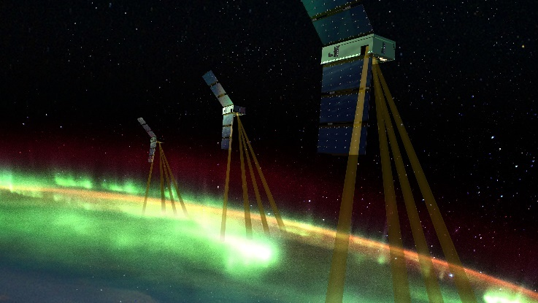
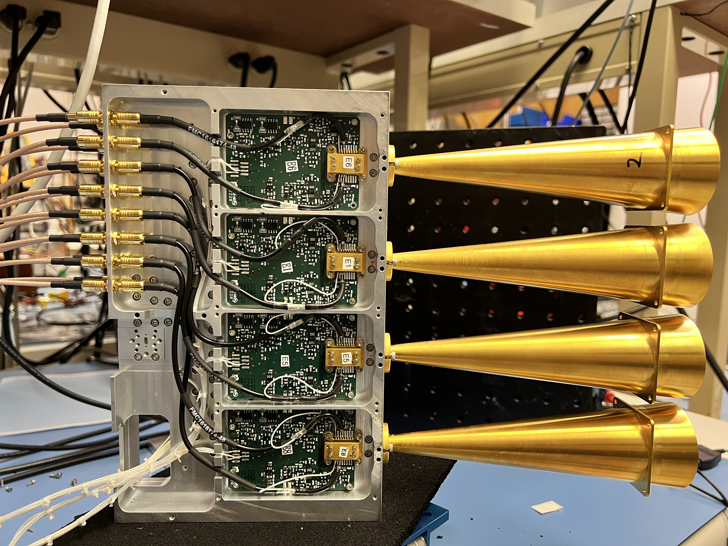
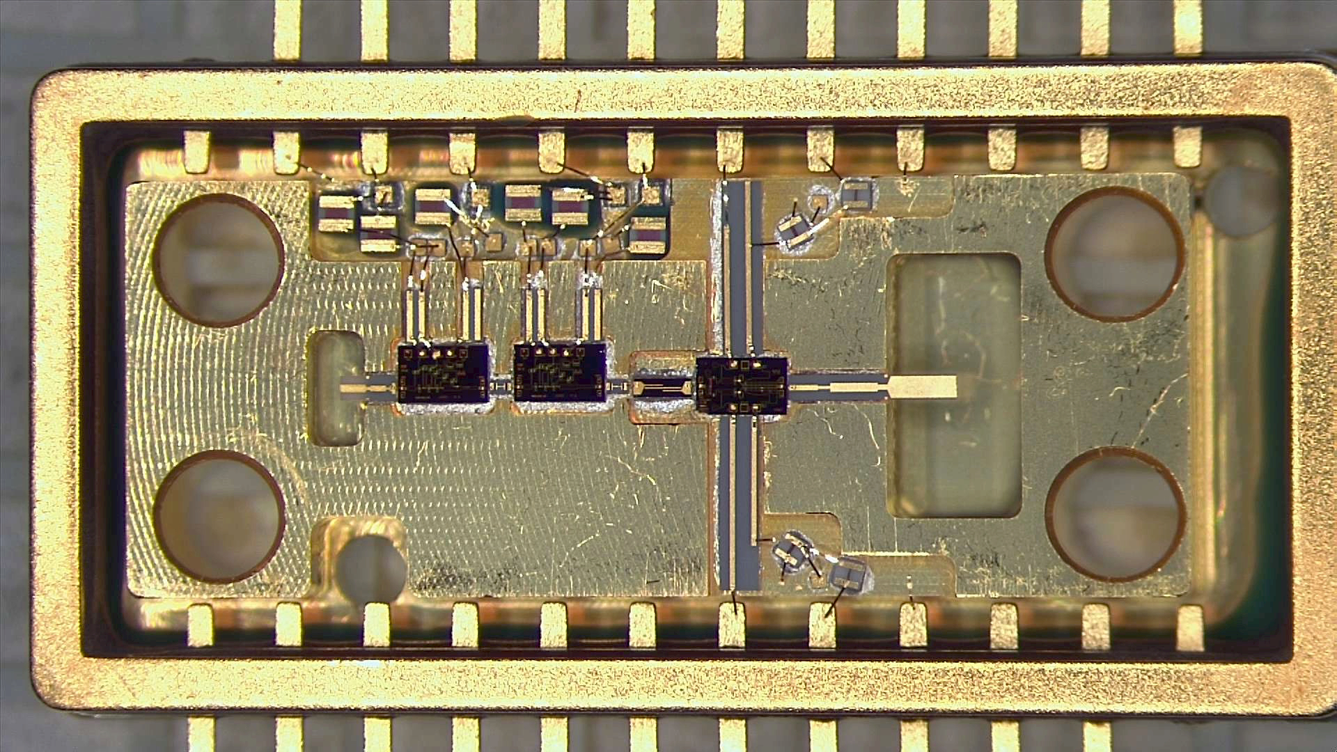
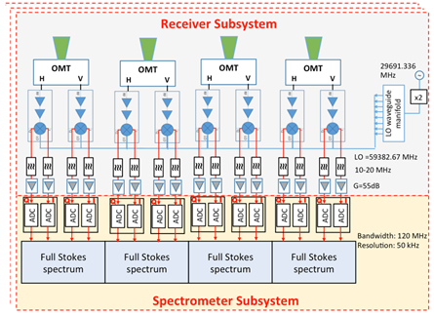
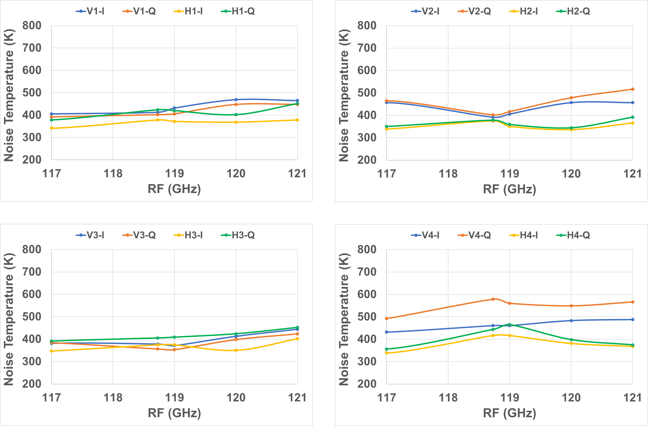
National Aeronautics and Space Administration
Fully-polarimetric Millimeter-wave Spectrometers for Measurement of Earth's Magnetic Field
Author: Dristy Parveg (386F), JPL Postdoctoral Fellow
Isaac Ramos (386F), Seth Sin (386F), Daniel Wenkert (398D), and Pekka Kangaslahti (386F)
Project Overview
Benefits to JPL and NASA
The objectives of this research are to develop and demonstrate an array of four fully-polarimetric millimeter-wave radiometers/spectrometers operating at 118.75 GHz which will improve the sensitivity of instrument that will globally map the ionospheric electrojets by observing Earth’s magnetic field using Zeeman splitting of oxygen molecule absorption line.
This will develop the low cost, low power, and low mass polarimetric mmWave array receivers that will not require cooling to meet the sensitivity requirements.
This project will develop the technology for the second-generation mission after EZIE.
Test Data
V4
V3
RF module
V2
Fig. 1. Artist’s conception of the Johns Hopkins APL-led Electrojet Zeeman Imaging Explorer (EZIE) NASA mission. EZIE will study the auroral electrojet, which are electrical currents flowing about 60 to 90 miles above the poles that link the beautiful aurora to the Earth’s magnetosphere, and which responds to solar activity and other drivers. This space weather mission is scheduled to launch in 2024. JPL is building the instruments (MEM). Credit: NASA/Johns Hopkins APL.
V1
Instrument development concept
Fig. 3. Four-element dual-pol receiver LO Manifold plate and the horn antennas. The LO signal is distributed inside manifold plate as are the incoming signals from the antenna horns split in OMTs to the two polarizations. An inside view of the one of eight RF front-end module is shown.
V1 and H1
V2 and H2
V3 and H3
V4 and H4
Fig. 2. Block diagram of a 4-element dual-pol receiver subarray. The Receiver Subarray has four polarimetric receivers, each of which consists of a feedhorn, an OMT, two receiver modules, two LO feeds, and four IF chains (two pairs of I & Q outputs) with near baseband (10-20 MHz) filtering and amplification. The IF signals from the 8 receivers are fed into an FPGA-based spectrometer for digitization and spectral sampling.
Fig. 4. Noise temperature data from all the I and Q channels (16-channels) of the four-element dual pol receiver system.
We have developed a 4-element dual-pol receiver subarray at 118.75 GHz consisting of 8 receiver modules
Receiver module consists of two MMIC LNAs, a high-pass filter, and a sub-harmonic I-Q MMIC mixer
WR-15 LO waveguide manifold plate is used to split a single LO signal to 8 outputs for LO to the receiver modules
I- and Q-signals are amplified, digitized and input to the FPGA-based spectrometer
4-element dual-pol receiver system consisting of 8 receiver modules was built and tested
Measured receiver noise temperature is 400 K ~ 600 K
Four Stokes parameters and spectral response of the receiver system will be tested with a digital back-end
Publications: D. Parveg, et.al., “Fully-polarimetric Millimeter-wave Spectrometers for Measurement of Earth's Magnetic Field,” in IEEE Transactions on Microwave Theory and Techniques, (in preparation)
Contact Information: Dr. Dristy Parveg
dristy.r.parveg@jpl.nasa.gov
Cell: +1 626 298 1093
National Aeronautics and Space Administration
Jet Propulsion Laboratory
California Institute of Technology
Pasadena, California
www.nasa.gov
Poster Number: PRD-T#004
Copyright 2022. All rights reserved.

