Slide 1


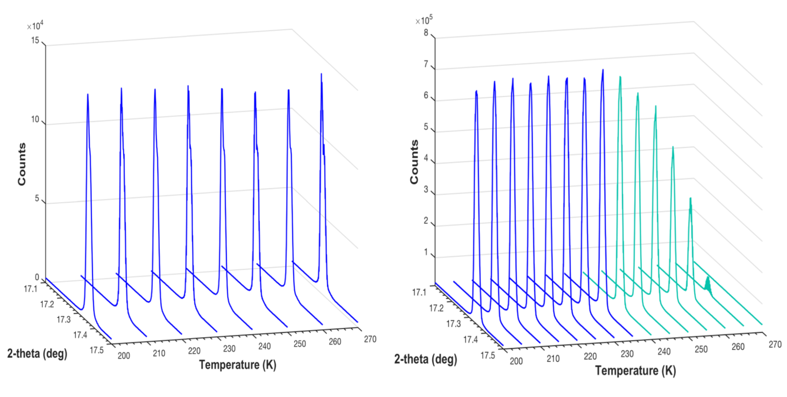
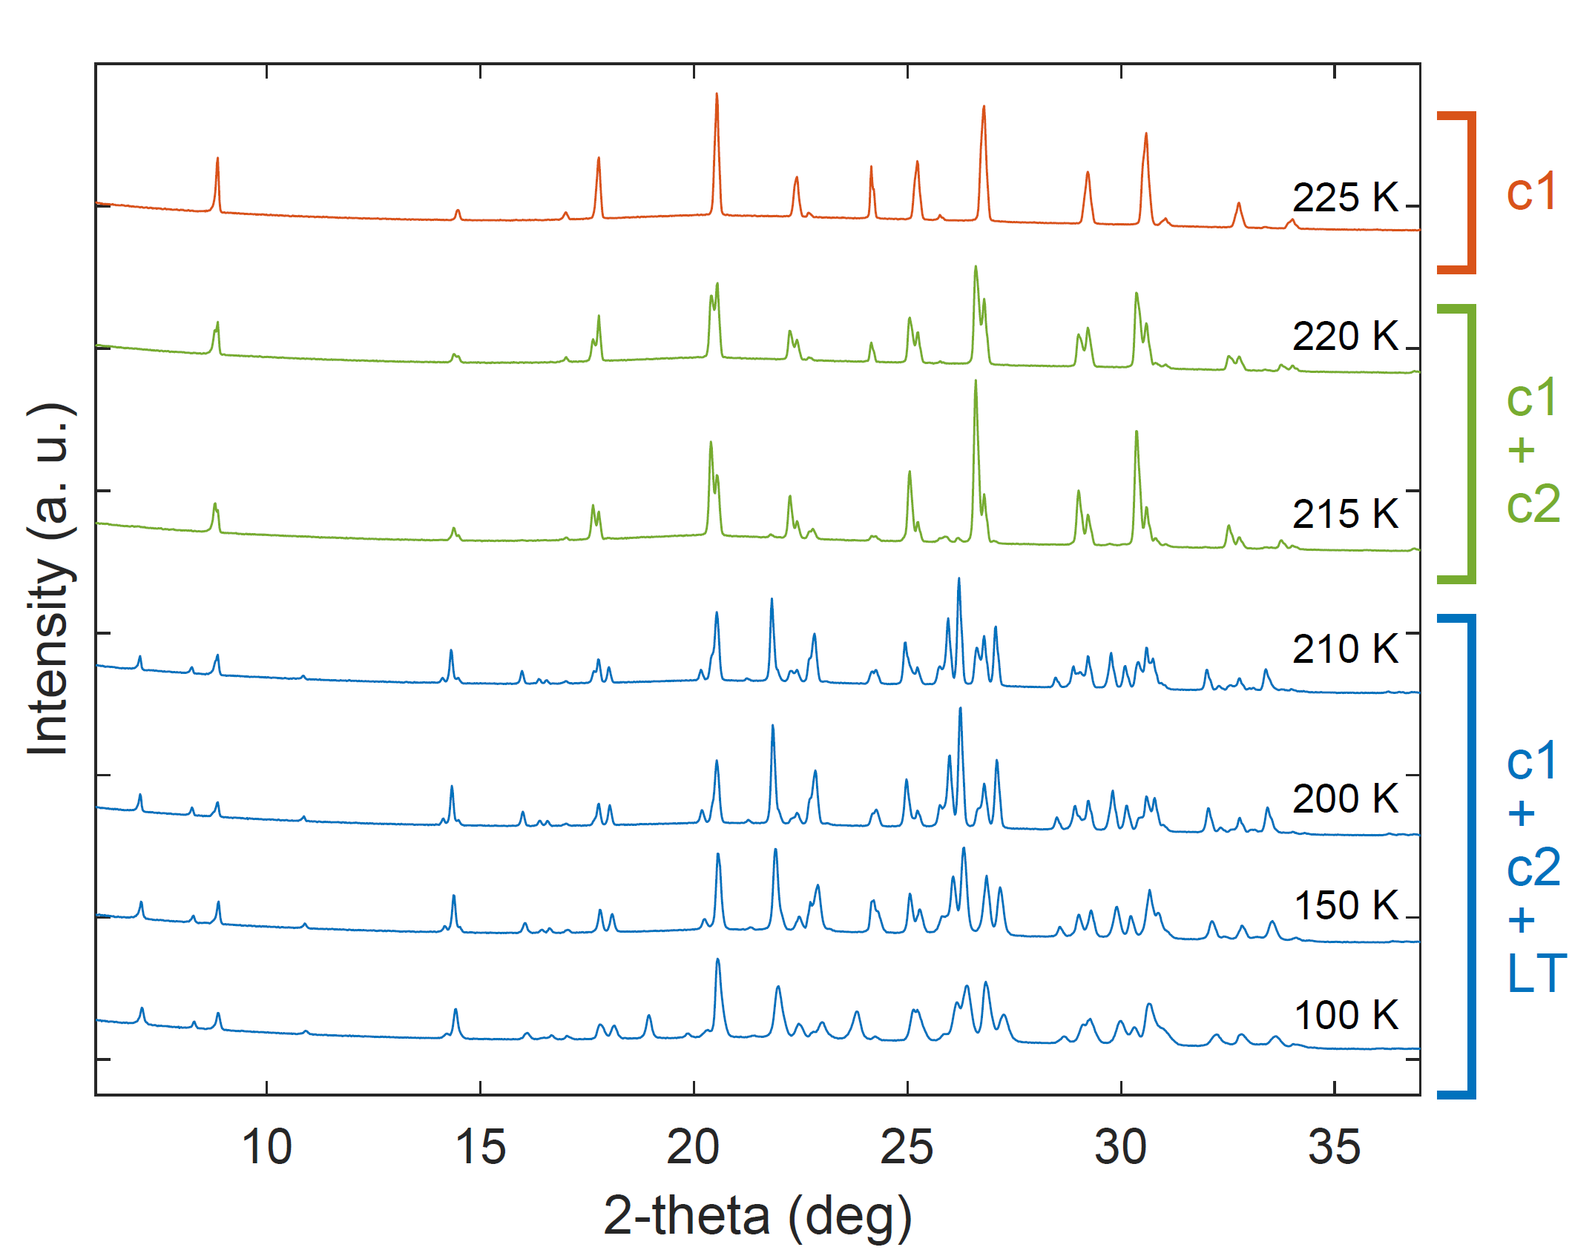
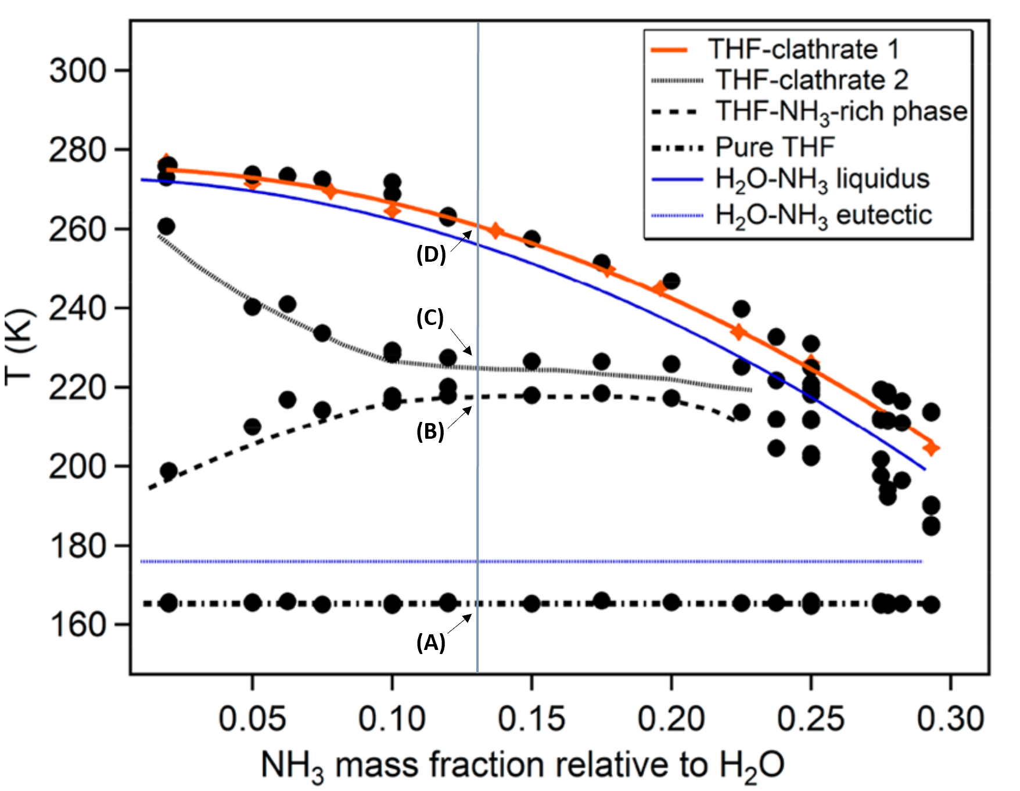
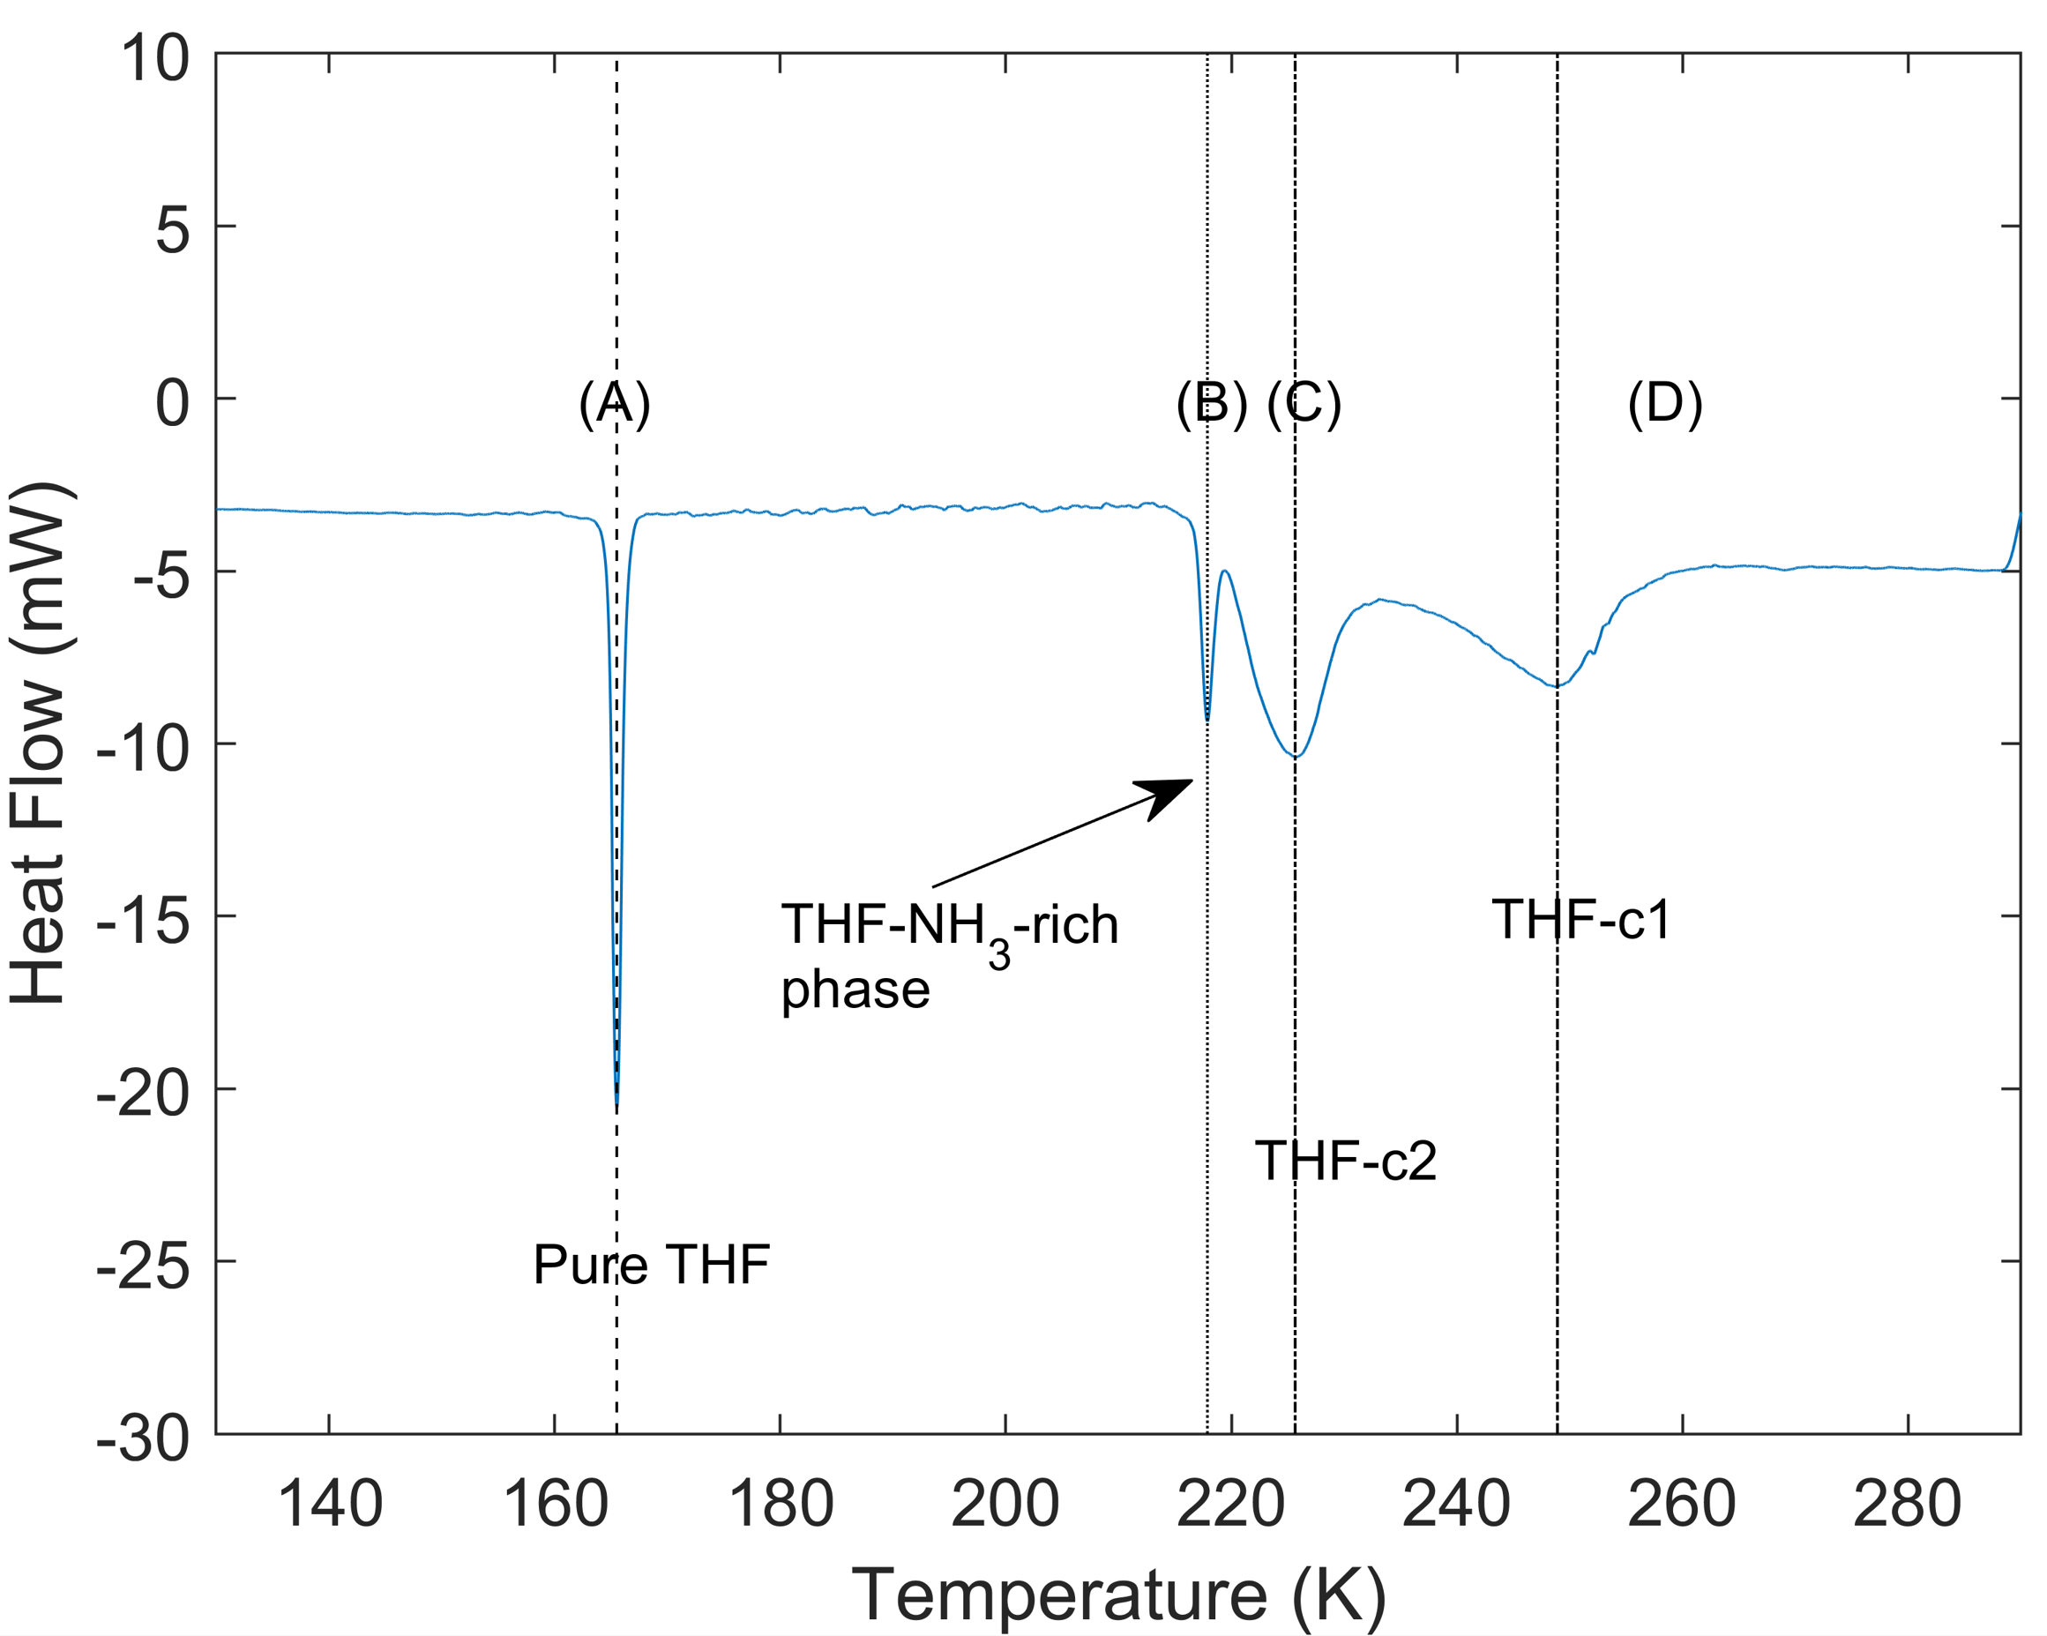
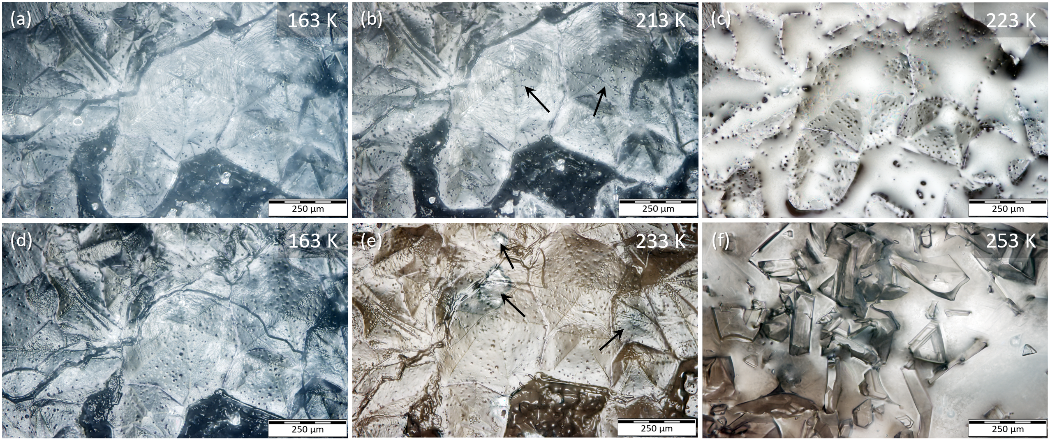


National Aeronautics and Space Administration
Experimental and Modelling Studies on the Phase Behavior of Clathrate Hydrates in the Presence of Ammonia
Elodie Gloesener, JPL Postdoctoral Fellow (3224)
Mathieu Choukroun (3224), Tuan H. Vu (3227), Helen E. Maynard-Casely (ANSTO), Ashley G. Davies (3223), Arnaud Desmedt (Université de Bordeaux), Christophe Sotin (Nantes Université)
Image credit: NASA/JPL/University of Arizona/University of Idaho
Results
Introduction
The goals of this work are to couple laboratory and modelling studies to quantify the effects of ammonia on clathrate hydrates stability and provide new constraints on the structure and composition of the new THF-NH₃-rich phase (Fig. 1) reported by Muñoz-Iglesias et al. (2018).
Experimental studies (Vu et al., 2014; Muñoz-Iglesias et al., 2018; Petuya et al., 2020) have shown that ammonia promotes partial dissociation of THF and CH₄ clathrates.
In Titan’s subsurface, NH₃-bearing liquids may interact with methane clathrates and could induce their dissociation. This process could be an important contributor to the replenishment of atmospheric methane.
Figure 2: Synchrotron XRD data collected at various temperatures for the H₂O-THF (left) and H₂O-THF-NH₃ (3 wt% NH₃ - right) systems (λ = 1.0005 Å). In the presence of NH₃, THF clathrate peaks decrease progressively in the range 230-270 K.
Our XRD results (Fig. 2) in the temperature range between 200 and 270 K show the partial dissociation of THF clathrates in aqueous solutions of ammonia in agreement with Raman spectroscopy (Vu et al., 2014) and calorimetry (Muñoz-Iglesias et al., 2018) data.
Our experimental data confirm the phase diagram of the H₂O-THF-NH₃ system (Fig. 1, left) with multiple phase transitions.
  Upon cooling of the aqueous THF-NH₃ solution, our calorimetry (Fig. 1, right) and XRD (Fig. 3) data confirm the crystallization of two generations of THF clathrates (THF-c1 and THF-c2).
  A third stage of crystallization is observed below 215 K (Fig. 3) with the appearance of new diffraction peaks that we assign to the unknown THF-NH₃-rich phase, which is referred to as the low temperature (LT) phase.
    The refined unit cell suggests a trigonal symmetry (space group P3) with lattice parameters a = b = 12.2514 Å, c = 12.4372 Å, and a resulting volume V of 1628 Å³.
Figure 1: Phase diagram of the H₂O-THF-NH₃ system under superstoichiometric THF conditions from Muñoz-Iglesias et al. (2018) (left) and thermogram of the system at 13 wt% NH₃ (right). A negative heat flow value indicates an endothermic reaction such as melting or clathrate dissociation.
Figure 3: Diffraction patterns of the ternary H₂O-THF-NH₃ system with 13 wt% NH₃ (λ = 1.5406 Å) as temperature increases (top) and with Pawley refinement of the data at 90 K (bottom). Tick marks indicate reflections from the sII clathrate, solid THF and low temperature (LT) phase. The stability region of the LT phase is located below 215 K where additional XRD peaks at low angles are seen.
Methods
Samples:
  H₂O-THF-NH₃ (3 and 13 wt% NH₃).
Experimental techniques:
  Raman spectroscopy.
  Differential scanning calorimetry.
  (Synchrotron) cryogenic X-ray diffraction (XRD).
Thermodynamic model:
  Van der Waals and Platteeuw model.
  The effect of ammonia is taken into account by expressing the activity coefficient of water based on the Margules equation (Choukroun and Grasset, 2010).
  Simulations of the CH₄ clathrate dissociation pressure.
Conclusions
Ammonia has the same effect on THF and CH₄ clathrate hydrates as on water ice I_{h} in terms of depression of the melting / dissociation point.
The partial dissociation of methane clathrates in Titan’s upper icy shell may start at temperatures
as cold as 200 K.
The new THF-NH₃-rich phase is observed below 215 K in our XRD and calorimetry data (no Raman characteristic features usable, just fluorescence). Synchrotron XRD resolution is required to fully solve its structure.
Figure 4: Microscope images at 20x magnification for THF clathrate in a 13 wt% (with respect to water) solution of NH_{3.}
Figure 5: Dissociation temperature of methane clathrate hydrate in the presence of ammonia simulated with our model and comparison with experimental equilibrium data at 50 and 100 bar (Petuya et al., 2020).
The different phase transitions of the system are seen in microscope images:
  At 163 K (Fig. 4a), the THF-c1, THF-c2, and LT phases are present.
  As temperature increases, the melting of the LT phase is initiated first (indicated by arrows in Fig. 4b).
  At 223 K (Fig 4c), the LT phase has entirely melted and released the liquid THF, which then flows to the bottom of the sample. This prevents the LT phase from forming at the top of the sample when the temperature decreases again (Fig. 4d).
  At 233 K, the melting of THF-c2, located under the THF-c1 layer, is in progress (indicated by arrows in Fig. 4e).
  Finally, the partial dissociation of THF-c1 is initiated as temperature increases and at 253 K (Fig. 4f), they are in equilibrium with the liquid phase.
Our simulated dissociation temperatures for CH₄ clathrates decrease with ammonia concentration, in agreement with experimental data (Fig. 5).
National Aeronautics and Space Administration
Jet Propulsion Laboratory
California Institute of Technology
Pasadena, California
www.nasa.gov
Publication:
Gloesener, E., Choukroun, M., Vu, T. H., Maynard-Casely, H. E., Desmedt, A., Davies, A. G., and Sotin, C. Experimental study on the phase behavior of the ternary H₂O-THF-NH₃ system under cryogenic conditions: Implications for the destabilization of methane clathrate hydrates on Titan, in preparation.
References: ○ Choukroun and Grasset, 2010. J. Chem. Phys. 133, 144502 ○ Muñoz Iglesias et al., 2018. ACS Earth Space Chem. 2, 135-146 ○ Petuya et al., 2020. ChemComm 56, 12391-12394 ○ Van der Waals and Platteeuw, 1959. Adv. Chem. Phys. 2, 1-57 ○ Vu et al., 2014. J. Phys. Chem. B 118, 13371-13377.
Author Contact Information: elodie.d.gloesener@jpl.nasa.gov
(626) 298-3037
Poster Number: PRD-P#007
Copyright 2022. All rights reserved.

