Slide 1
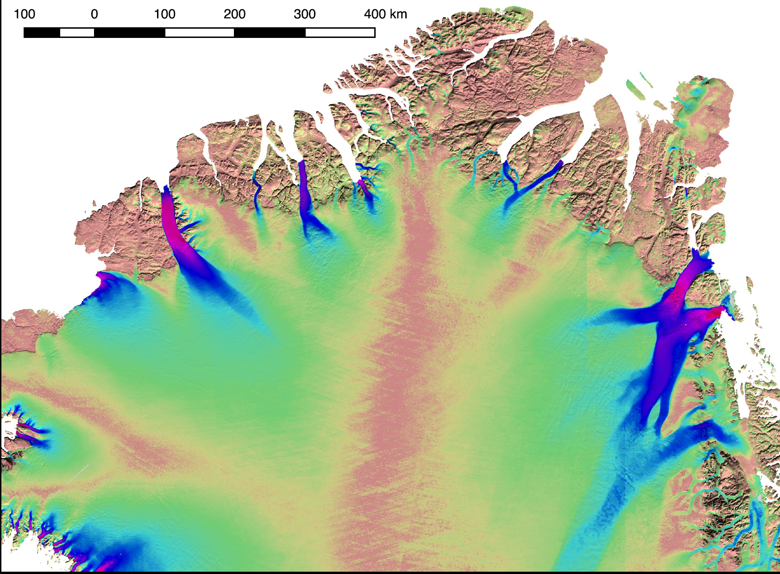
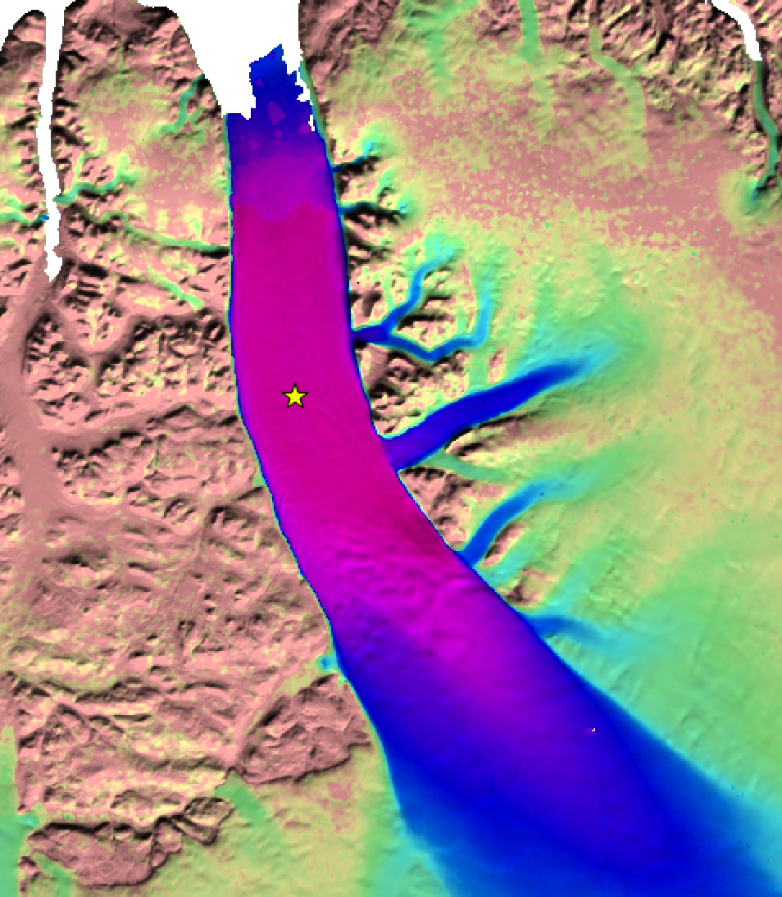
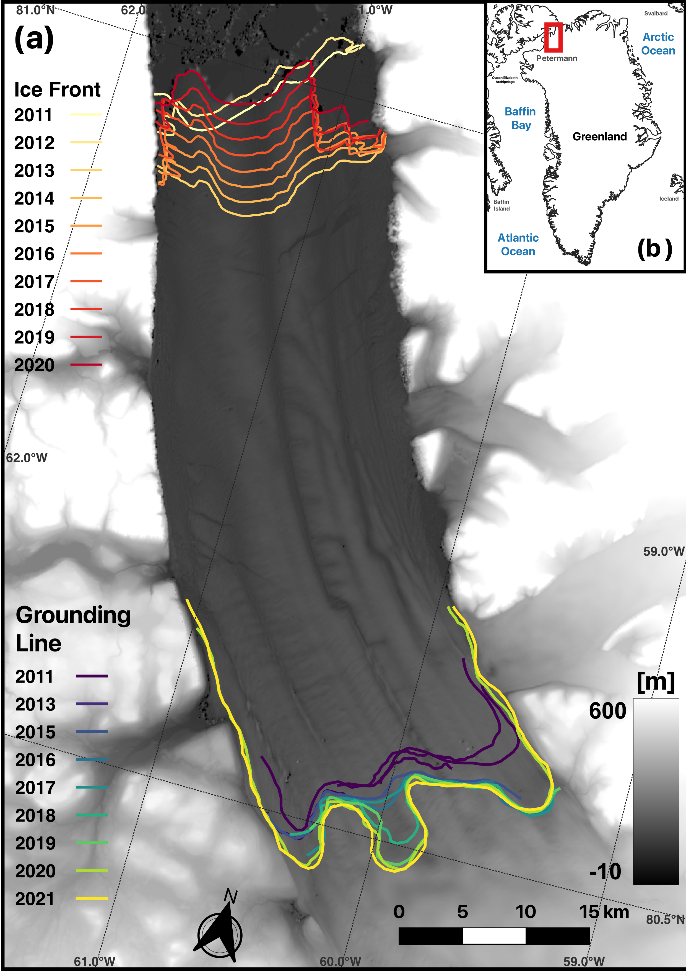
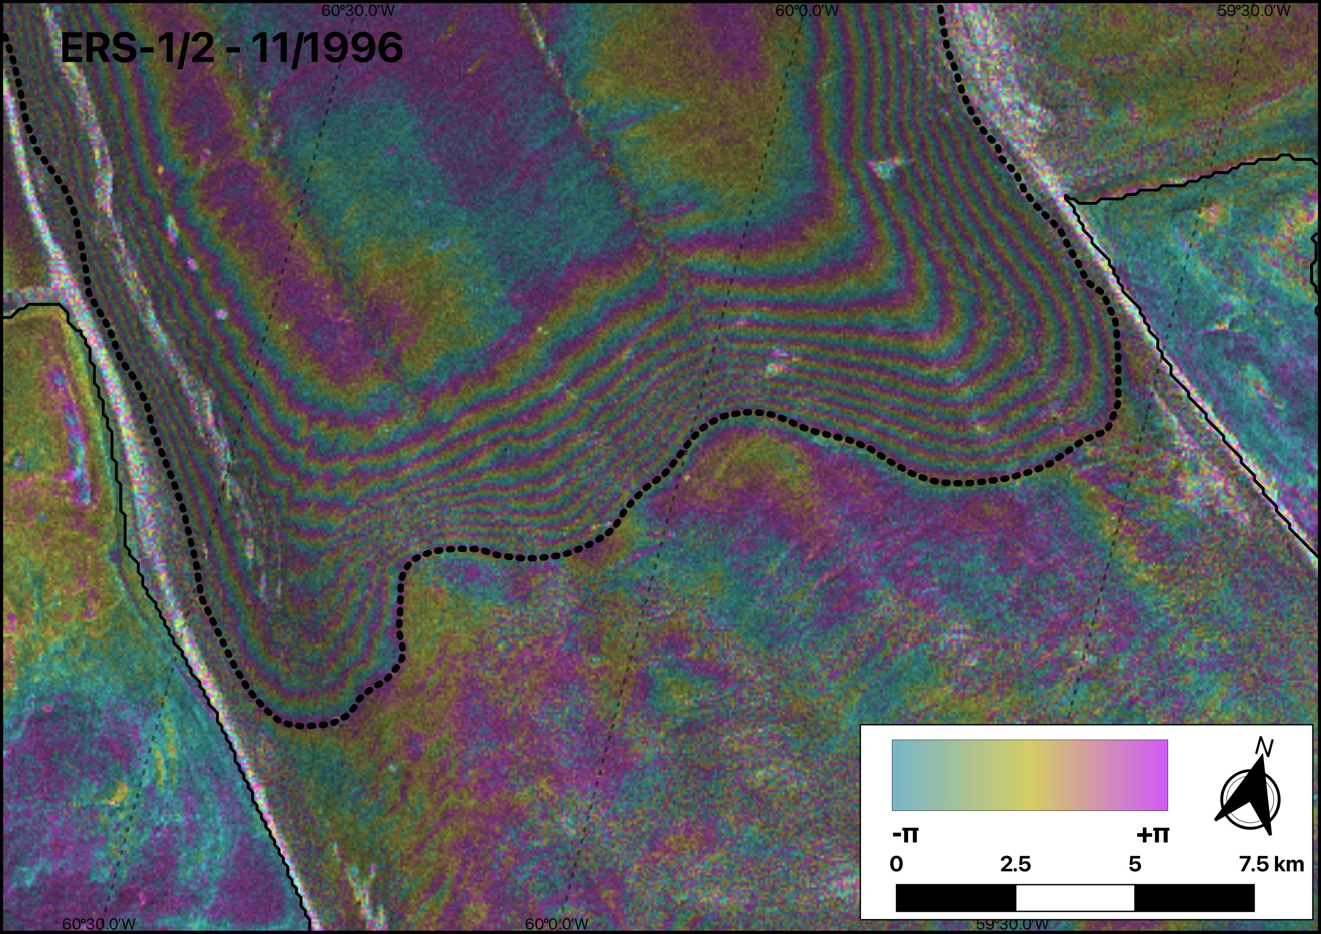
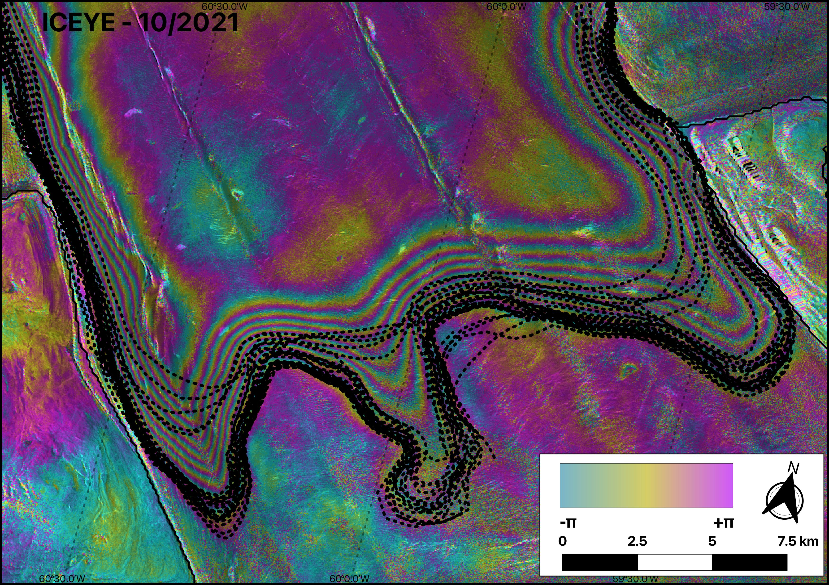
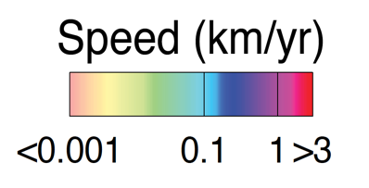
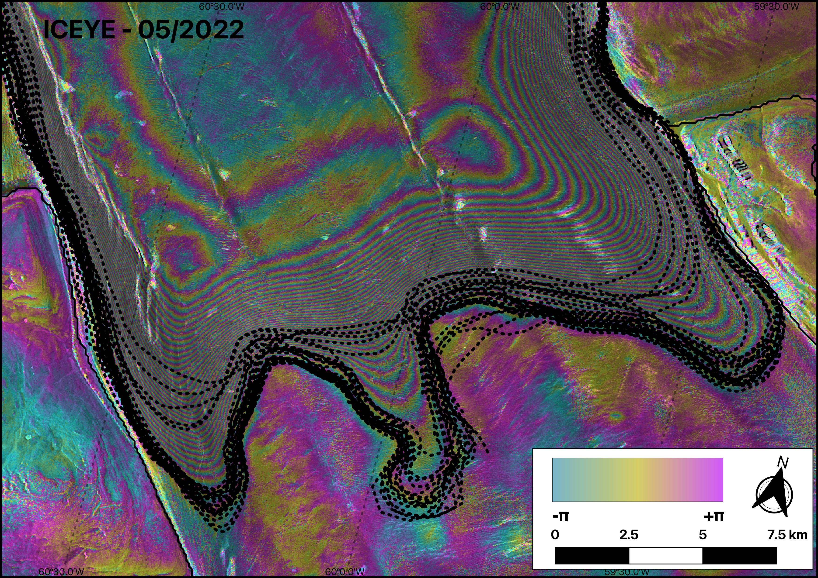
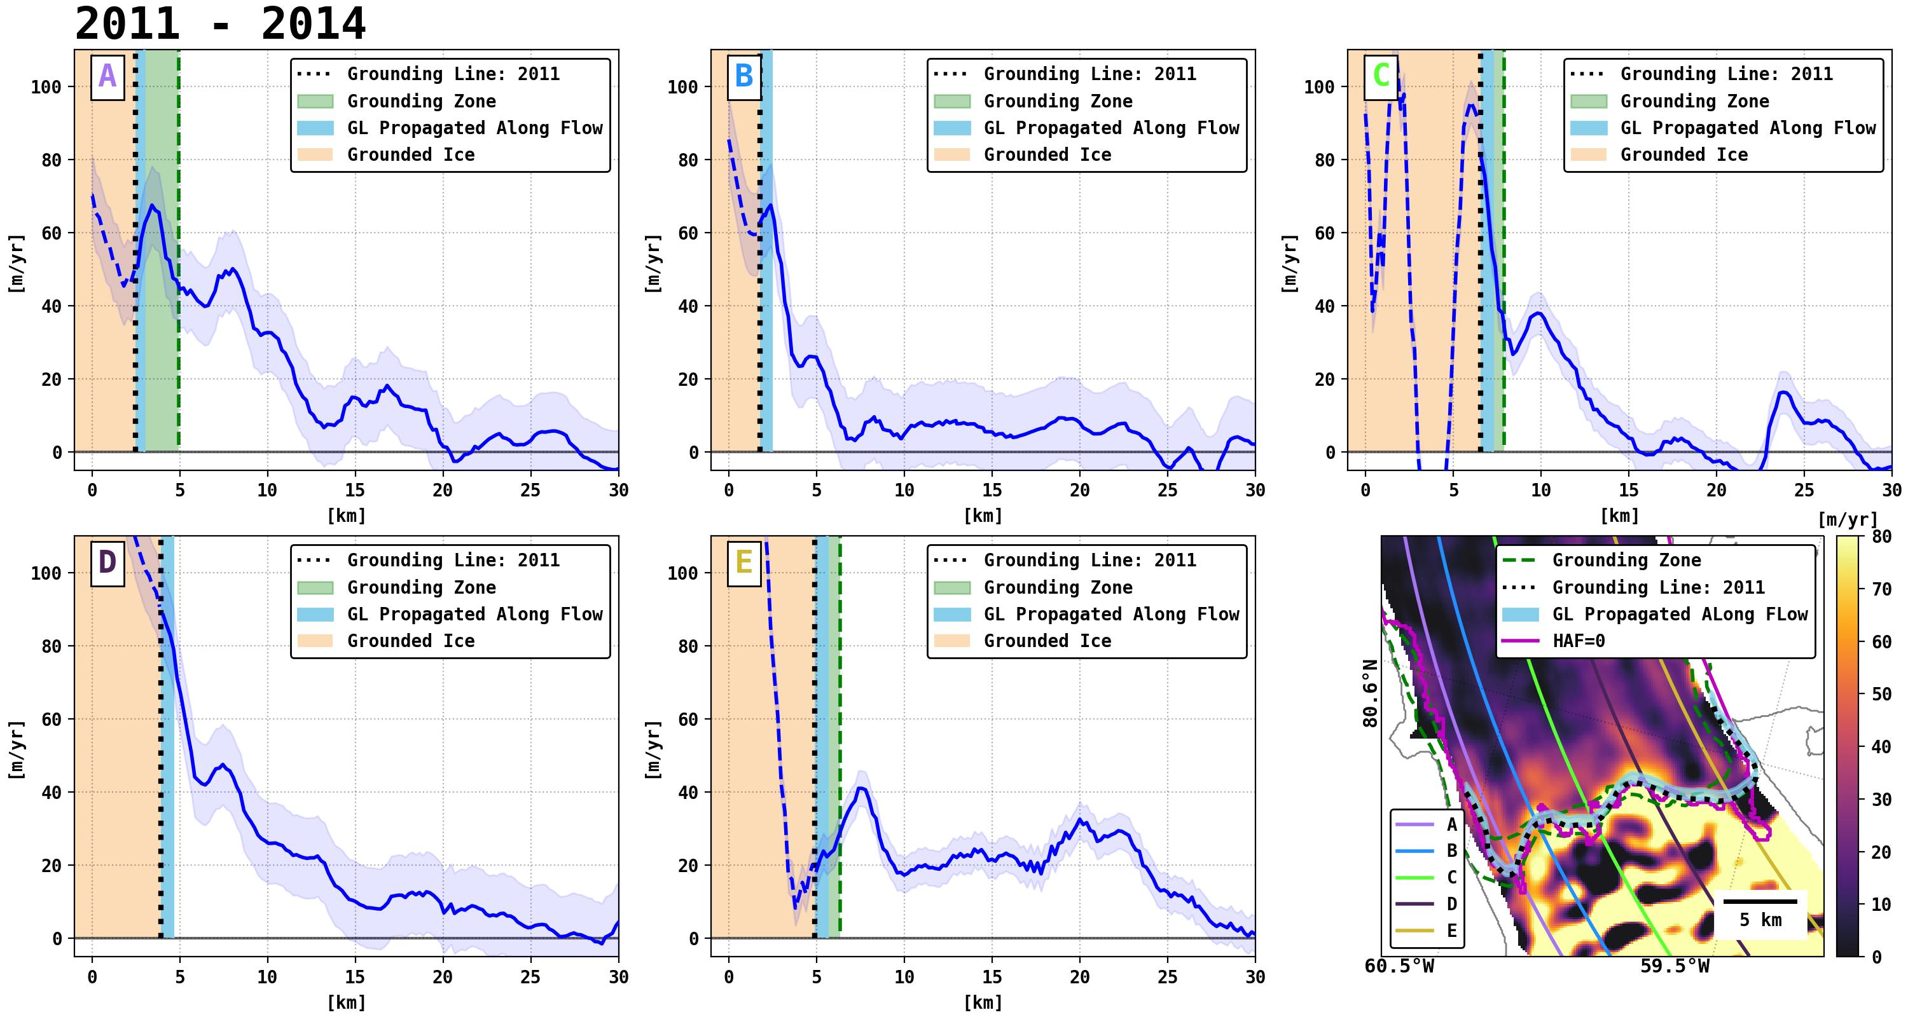
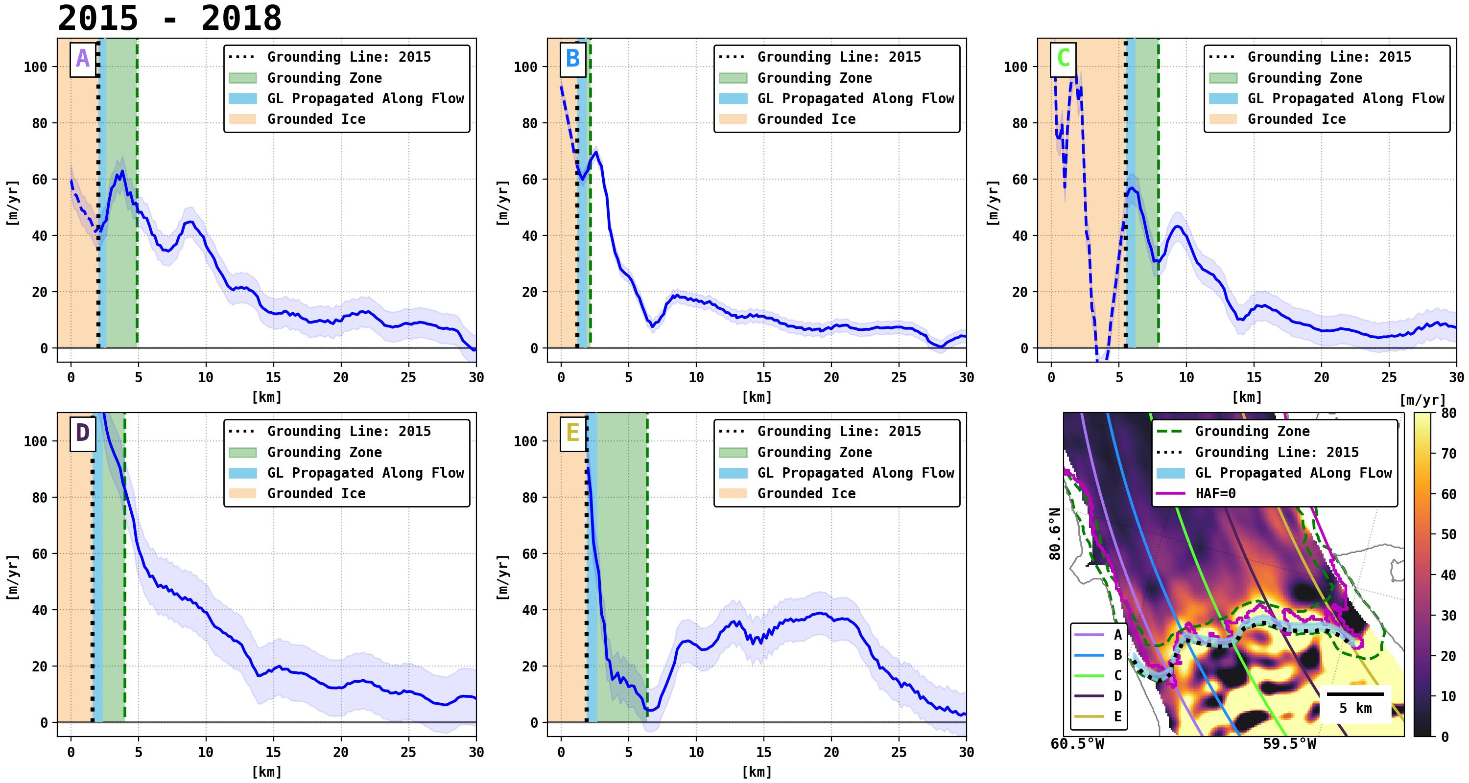
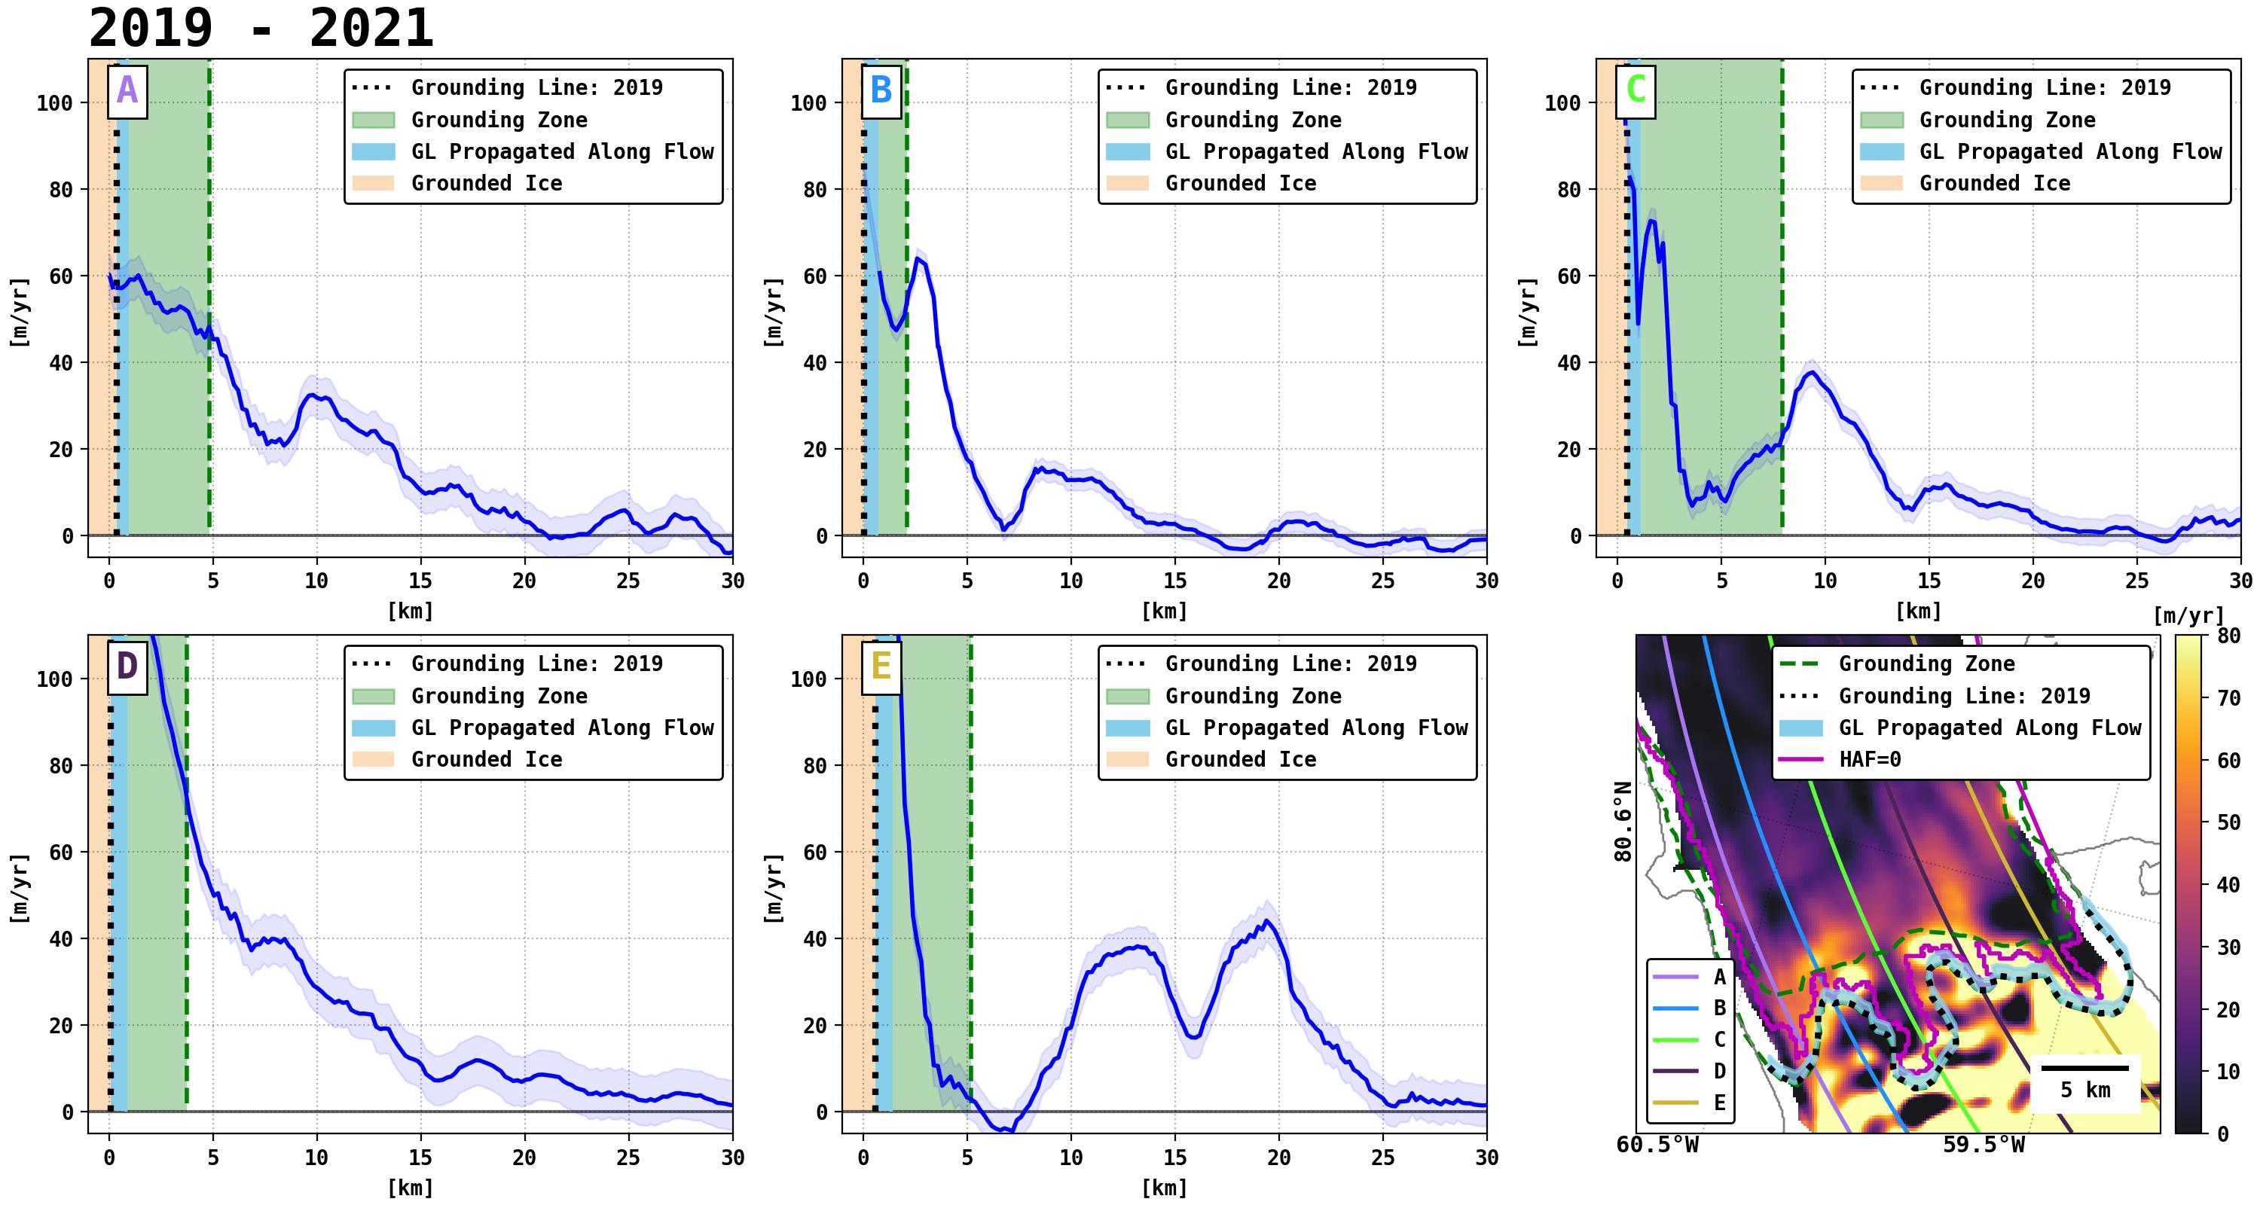
National Aeronautics and Space Administration
Ice-shelf basal melt and dynamics of Petermann Glacier, Greenland from high-resolution InSAR data.
Author: Enrico Ciracì, NASA Postdoctoral Fellow (334)
Advisor: Eric Rignot (334)
Introduction
Results
(b)
(c)
Petermann Gletscher (80° 45′ 0″ N, 60° 45′ 0″ W)
(d)
Sensor | Data Coverage
ERS-1/2 | 1996, 2011
Sentinel-1ab | 2013 - 2018
Cosmo-SkyMed | 2013, 2020 - 2021
ICEYE-X6 | 2021 - 2022
Petermann Gletscher (PG) terminates in one of the most extensive remaining ice tongues of the Greenland Ice Sheet. The glacier is grounded 600 meters below sea level on a down-sloping bed at risk of becoming a significant contributor to sea level during the 21st century.
Recent observations documented that, after decades of near-zero mass balance and a steady grounding line position, the glacier transitioned to a phase of grounding line retreat and accelerated ice flow in 2017 [1, 2, 3].
Increased basal melt due to warming ocean temperatures has been identified as the principal physical mechanism driving the retreat, but the exact details have not been quantified yet.
Figure 2: (a) Long-term migration of the grounding zone and ice front of PG between 2011 and 2022. Results are overlaid on regional topography extracted from TanDEM-X data. (b- d) Grounding Zone of PG measured by differencing consecutive 1-day interferograms computed using data from the European Remote Sensing satellite (ERS-1/2) and the ICEYE-X6 constellations. Table 1: Datasets used to derive time series of grounding line migration and their temporal coverage.
Data and Methods
Interferometric Processing:
SLC-1
Initial Offsets
SLC-2
Dense Offsets Map
(a)
(b)
RSLC-2
Figure 3: Average bottom melt rates estimated for the periods: 2011-2014 (a), 2015-2018 (b), 2019-2021 (c). Melt rate values measured along the longitudinal profiles A to E are reported in blue. The origin of the x-axis indicates the distance with respect to the glacier’s grounding line measured in 2022. The vertical black dotted line shows the intersection between each sampling profile and the grounding line measured during the first year of the considered period. The green area indicates the grounding zone extension. The orange area indicates grounded ice. The light-blue bar is obtained by propagating pixels belonging to the grounding line along the direction of ice flow for a 1-year period. The right limit of the bar defines the domain of validity of our estimates (which assume hydrostatic equilibrium of ice).
-
Flat Earth
Interferogram A
Topography
-
(a)
Diff. Interferogram A
-
Diff. Interferogram B
(b)
Double Difference
Figure 1: (a) Grounding line mapping from differential satellite radar interferometry [4, 5]. (b) Double Difference interferogram generated using data from the ICEYE-X6 constellation (May 2022).
Submarine Melt rates Estimation in a Lagrangian Framework:
(c)
$\dot{b}=−\left(\frac{Dh}{Dt}+\left(h−d\right)\left(∇∙\overline{u}\right)\right)\left(\frac{ρ_{w}}{ρ_{w} −ρ_{i}}\right)+\dot{a }$ (1)
Conclusions
We estimate average annual subglacial melt rate values ($\dot{b}$) by solving the Ice Shelf Mass Conservation equation in a Lagrangian Framework (equation 1) [7, 8].
We measure changes in ice elevation (${Dh}/{Dt}$) by employing time series of time-tagged digital elevation models from the TanDEM-X mission available for 2011 – 2021.
We use reconstructed Surface Mass Balance ($\dot{a}$) output products from the Regional Atmospheric Climate Model version 2.3 (RACMO2.3) [8].
We document ice velocity and flow divergence by employing velocity products from Rignot et al. [9].
InSAR observations indicate that the grounding line of PG retreated 4 km, 7.5 km, and 4.5 km in the western, central, and eastern sectors, respectively, during the last decade. In the central sector, however, the accelerated retreat only started in 2017, producing 70% of the total retreat up to this day.
Using data from the TanDEM-X mission, we document changes in basal melt during the same period. We measure high melt rate values, with peaks > 60 meters per year inside the grounding zone, with stable values until 2016. After 2016, we find changes in melt rates in the central part of the glacier, where most grounding line migration took place. Within the newly formed cavity, ice melt decreased progressively to 40 m/yr. We attribute the reduced melt regime (40 vs. 60 m/yr) in the cavity due to more complex ocean circulation in the cavity. Near the end of the observation period, however, when the cavity becomes more open, the melt rate increases again to 60 m/yr. Overall, the high melt rates we measure in the grounding zone call into question the common assumption of zero melt at the grounding line used by ice sheet models. The higher melt rates make the glacier more sensitive to a warming of the ocean waters, which in turn will increase projections of sea level rise from the Greenland Ice Sheet.
National Aeronautics and Space Administration
Jet Propulsion Laboratory
California Institute of Technology
Pasadena, California
www.nasa.gov
Publications:
Ciracì, E., E. Rignot, B. Scheuchl et al., Melt rate in the grounding zone of Petermann Glacier during a retreat, Proc. Nat. Acad. Sci., in preparation.
References:
Rignot, E., 1998. Hinge-line migration of Petermann Gletscher, north Greenland, detected using satellite-radar interferometry. Journal of Glaciology, 44(148), pp.469-476.
Hogg, A.E., Shepherd, A., Gourmelen, N. and Engdahl, M., 2016. Grounding line migration from 1992 to 2011 on Petermann glacier, North-West Greenland. Journal of Glaciology, 62(236), pp.1104-1114.
Millan, R., Mouginot, J., Derkacheva, A., Rignot, E., Milillo, P., Ciraci, E., Dini, L. and Bjørk, A., 2022. Ongoing grounding line retreat and fracturing initiated at the Petermann Glacier ice shelf, Greenland, after 2016. The Cryosphere, 16(7), pp.3021-3031
Rignot, E., Mouginot, J. and Scheuchl, B., 2011. Antarctic grounding line mapping from differential satellite radar interferometry. Geophysical Research Letters, 38(10).
Milillo, P., Rignot, E., Mouginot, J., Scheuchl, B., Morlighem, M., Li, X. and Salzer, J.T., 2017. On the short-term grounding zone dynamics of Pine Island Glacier, West Antarctica, observed with COSMO-SkyMed interferometric data. Geophysical Research Letters, 44(20), pp.10-436.
Shean, D.E., Joughin, I.R., Dutrieux, P., Smith, B.E. and Berthier, E., 2019. Ice shelf basal melt rates from a high-resolution digital elevation model (DEM) record for Pine Island Glacier, Antarctica. The Cryosphere, 13(10), pp.2633-2656.
Wilson, N., Straneo, F. and Heimbach, P., 2017. Satellite-derived submarine melt rates and mass balance (2011–2015) for Greenland's largest remaining ice tongues. The Cryosphere, 11(6), pp.2773-2782.
Noël, B., van de Berg, W.J., Lhermitte, S. and van den Broeke, M.R., 2019. Rapid ablation zone expansion amplifies north Greenland mass loss. Science advances, 5(9), p.eaaw0123.
Rignot, E. and Mouginot, J., 2012. Ice flow in Greenland for the international polar year 2008–2009. Geophysical Research Letters, 39(11).
Author Contact Information: enrico.ciraci@jpl.nasa.gov
Poster Number: PRD-EA#007
Copyright 2022. All rights reserved.

