Slide 1
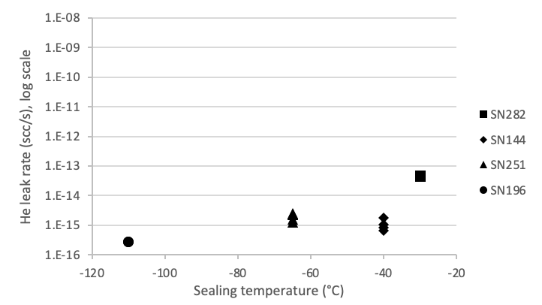
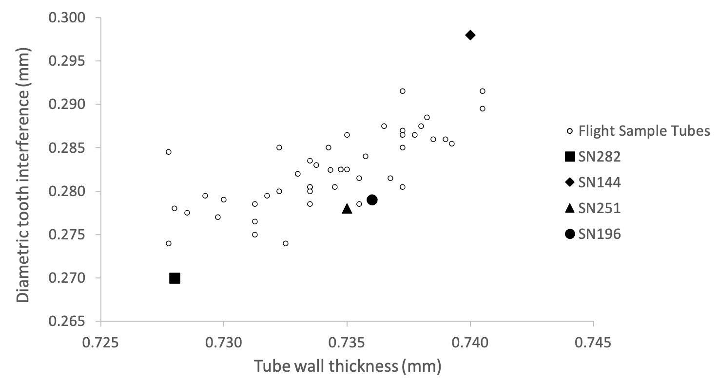
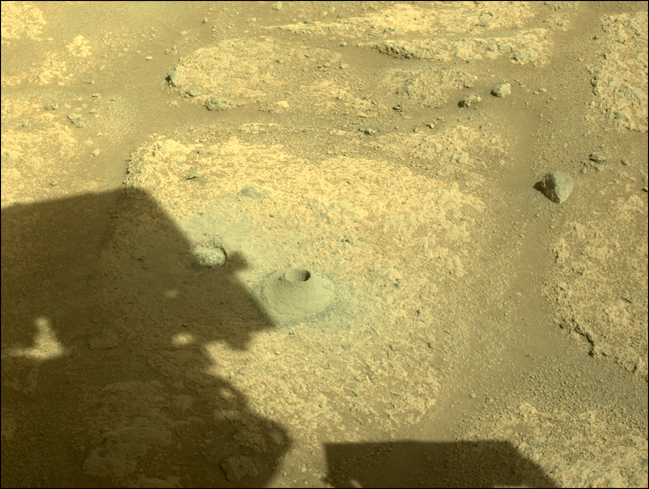
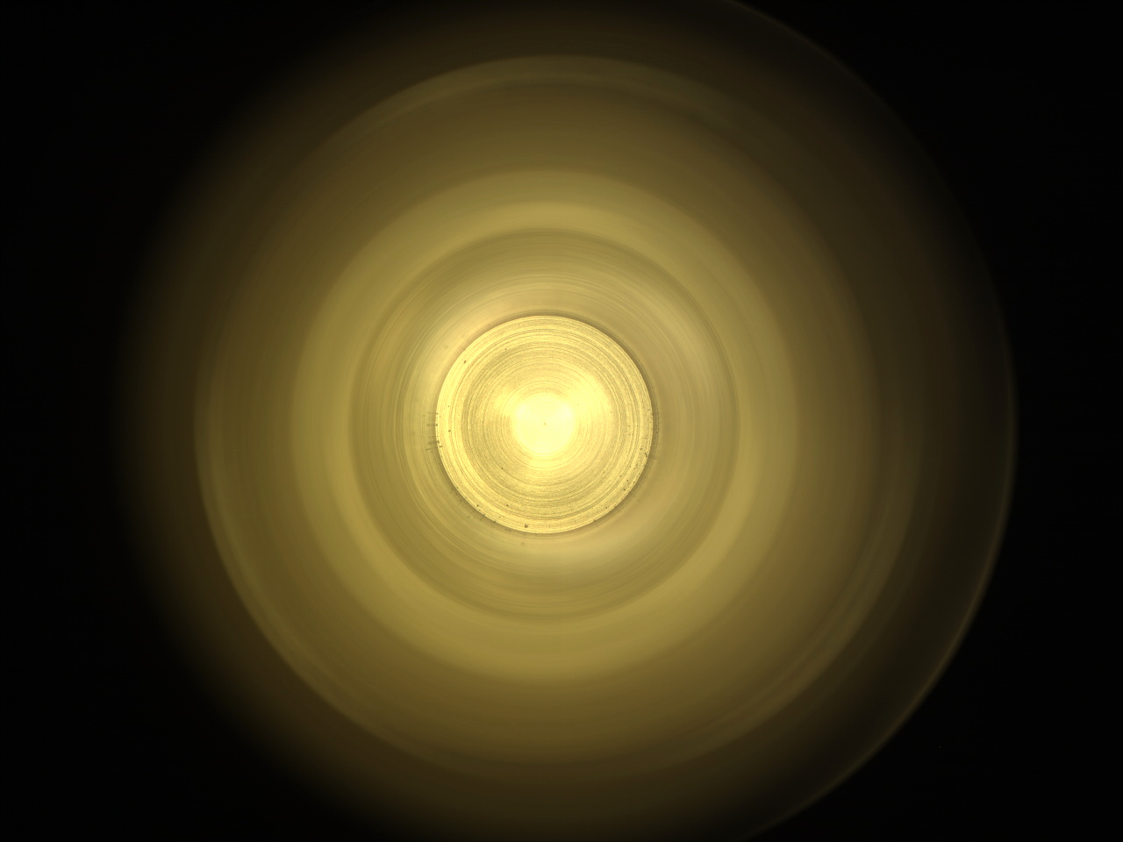
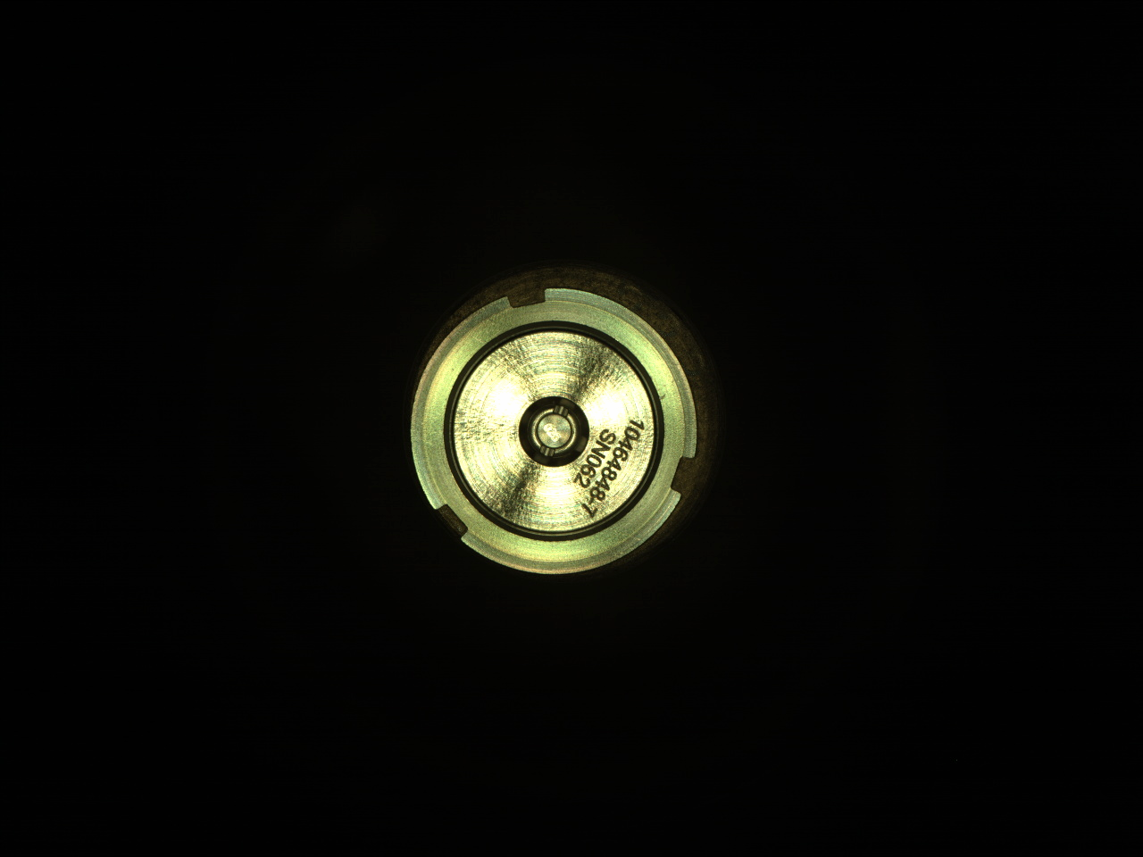
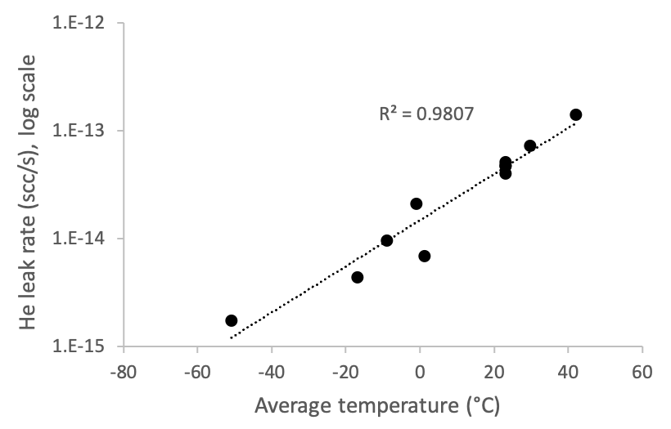
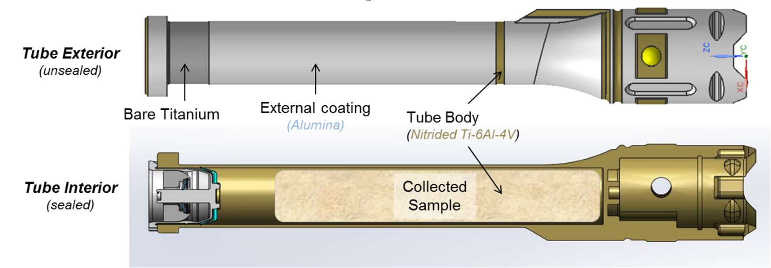
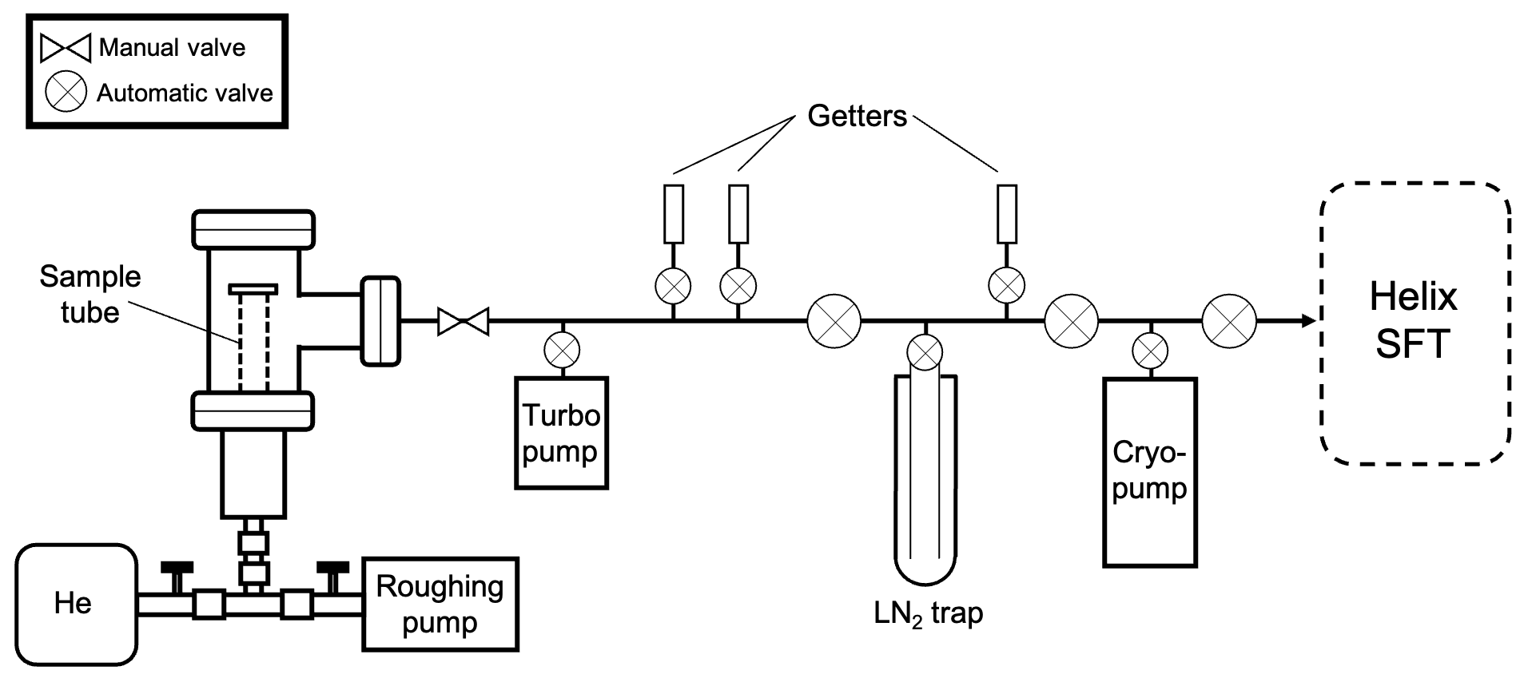
National Aeronautics and Space Administration
Helium Leak Rate Measurements of Flight-Like Sample Tubes in Preparation for Potential Mars Sample Return
Author: Jeff Osterhout, JPL Postdoctoral Fellow (3223)
Kenneth Farley (4300), Meenakshi Wadhwa (4080)
Introduction
Samples of rocks, regolith, and atmosphere are currently being collected by NASA’s Perseverance rover for their potential retrieval and future return to Earth. Helium (He) leak rates measured for hermetically sealed sample tubes have typically been no greater than ~10⁻¹⁰ scc/s, which is the detection limit of commercial He leak detectors. However, concerns remain about potential sample loss, contamination, and/or chemical alteration for He leak rates at 10⁻¹⁰ scc/s, thus requiring a more sensitive technique for establishing leak rates below this value.
Objectives
This study was performed to establish the He leak rates of several sealed sample tubes which are similar to those onboard the Perseverance rover, and to obtain an approximate detection limit for leak rates approaching 10⁻¹⁶ scc/s. Also, to measure changes to the sample tube leak rate with varying temperatures.
Materials
Four (4) flight-like sample tubes w/ paired seals (SN282, SN144, SN251, and SN196)
Variations in design:
Sealing temperature (°C)
Tube wall thickness (mm)
Diametric tooth interference (mm)
Methods
Each sample tube was filled with ~1 atm of He gas and subjected to static accumulation of He at room temperature for a minimum of ~12 h. Leak rates for SN282 were measured at several different temperatures (from -80 to +50 °C). Following gas purification within a vacuum line, ⁴He amounts were measured using a Thermo Helix split flight tube (SFT) mass spectrometer.
Results
M2020 hermetic-seal requirement
Commercial He leak detector limit
He leak rates of four sample tubes measured at room temperature (top) range from ~5$×$10⁻¹⁴ to ~3$×$10⁻¹⁶ scc/s. Sample tube 282 was analyzed at relatively high and low temperatures (bottom) and yielded He leak rates that varied from ~1$×$10⁻¹³ to ~2$×$10⁻¹⁵ scc/s, respectively.
Seal
Tube
interior
ROUBION
(atmosphere sample)
SN282
NASA/JPL-Caltech
Conclusions
Our results support previous findings with data suggesting that the Mars 2020 sample tube seals are likely to be characterized by very low He leak rates, roughly 3 to 6 orders of magnitude below the previously used detection limit of 10⁻¹⁰ scc/s. Thus, leaks can be ignored for most practical applications.
Seal cup
Headspace gas
Katz et al. (2018)
The decision to implement MSR will not be finalized until NASA’s completion of the National Environmental Policy Act (NEPA) process. This document is being made available for information purposes only.
National Aeronautics and Space Administration
Jet Propulsion Laboratory
California Institute of Technology
Pasadena, California
www.nasa.gov
Publications:
Osterhout, J.T., Farley, K. A., Wadhwa, M., Treffkorn, J., Kulczycki, E. Helium leak rate measurements of hermetically sealed sample tubes in preparation for Mars Sample Return. (In prep).
Author Contact Information:
jeffrey.t.osterhout@jpl.nasa.gov
(626) 372-4497
Poster Number: PRD-P#021
Copyright 2022. All rights reserved.

