Slide 1
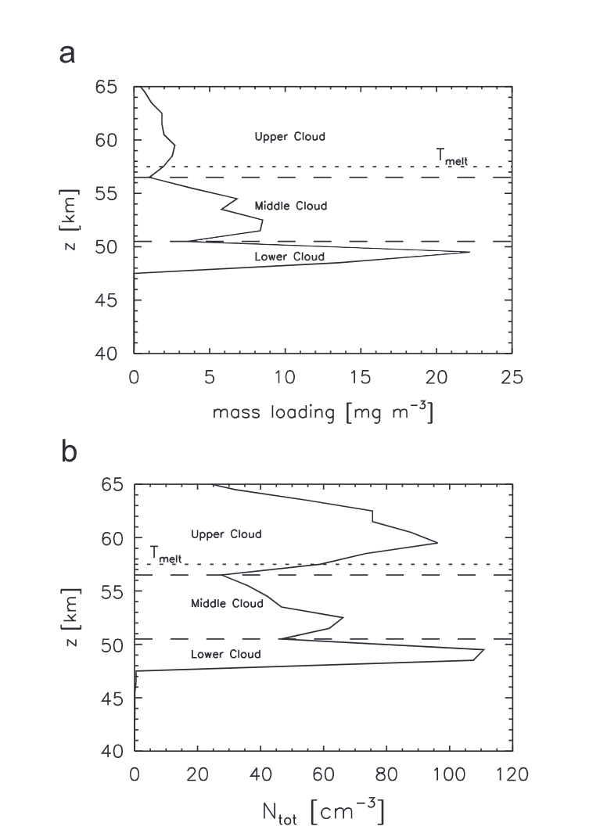
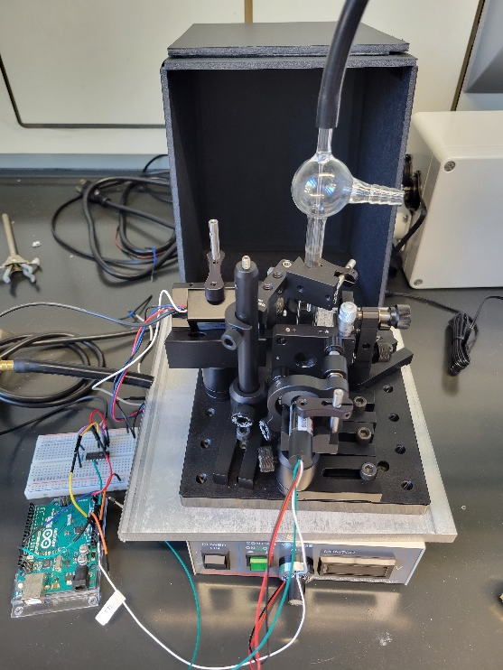
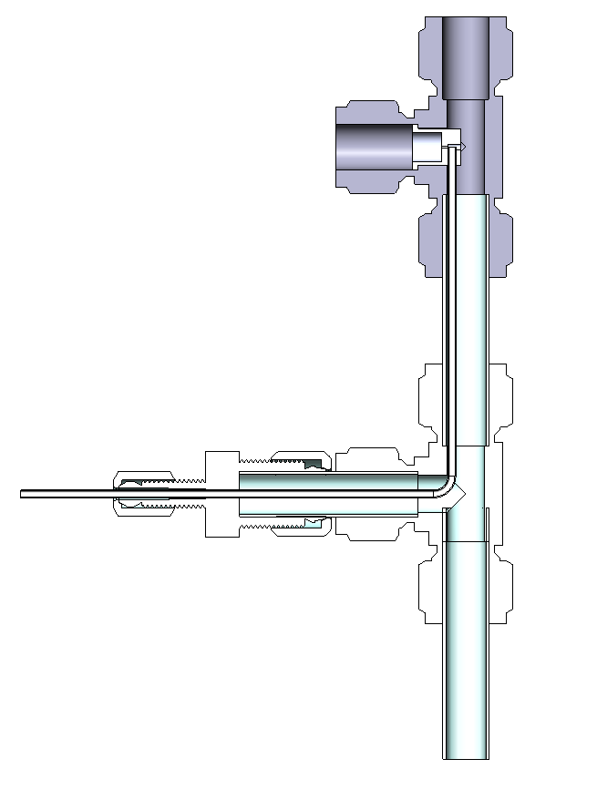
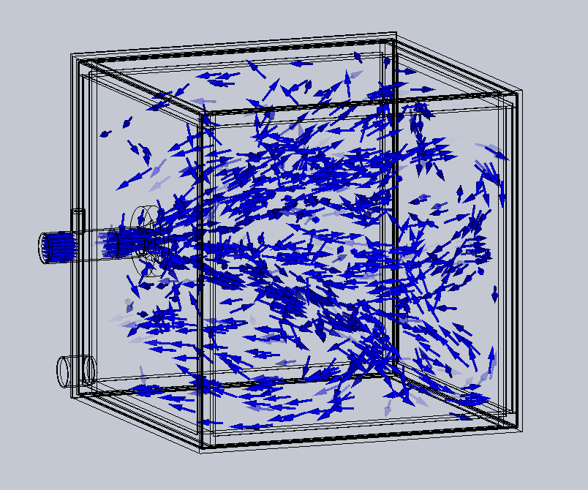
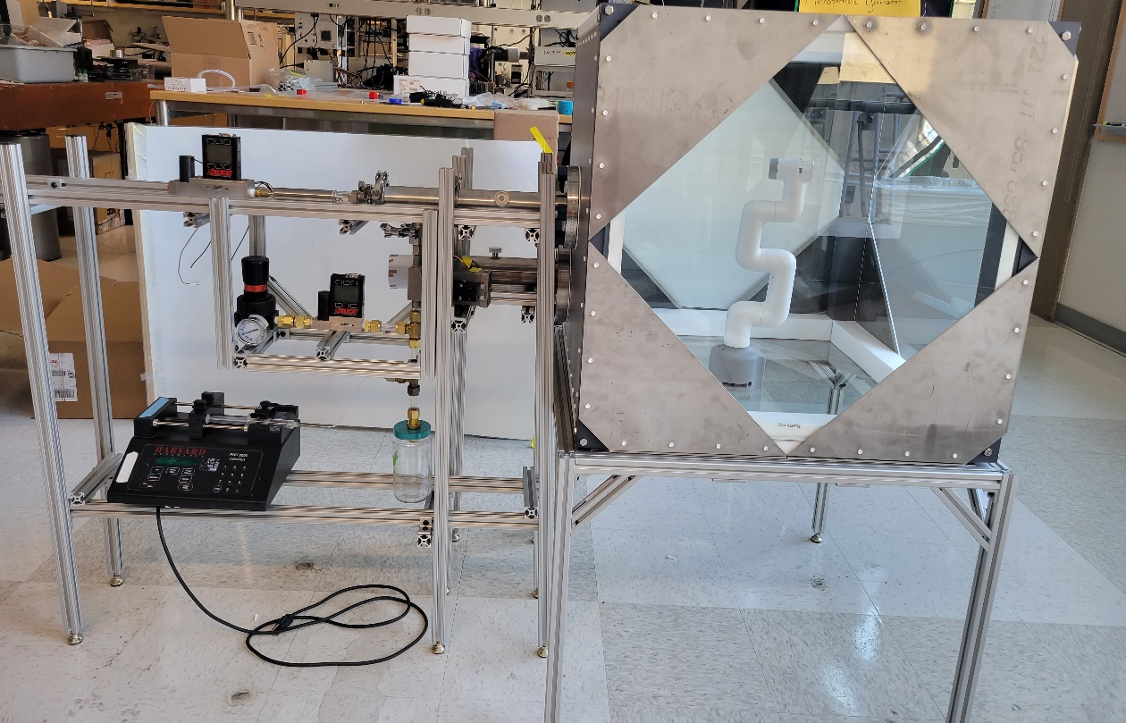
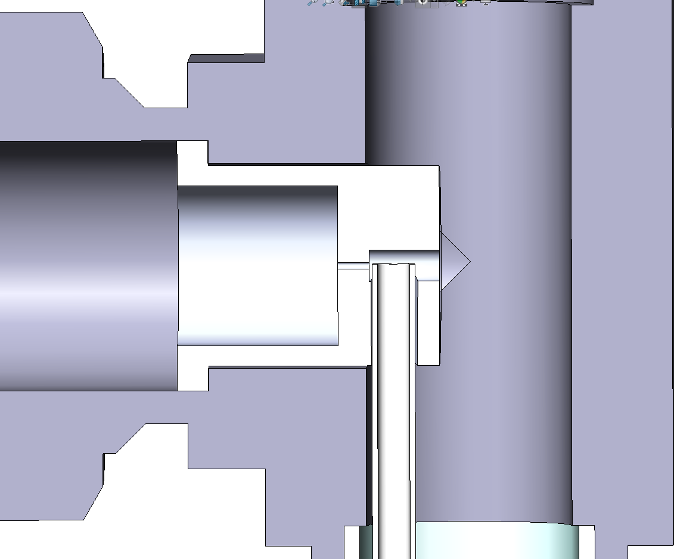
National Aeronautics and Space Administration
Development of a Venus Cloud Chamber for Aerobot Instrument testing
Author: Joseph Salazar, JPL Postdoctoral Fellow (353)
Principal Investigator: Michael Pauken (353), William Warner (353), Abdul Majeed Azad (353), James Denman (353), Bryan McEnerney (353), Joshua Hessel (353), Rick Flagan (Caltech)
Background/Objectives
Optical Particle Spectrometer
Venus contains an atmosphere comprised of CO_{2­} and Sulfuric acid clouds/Haze
A facility is needed for testing instruments, sensors, components and materials in an environment that emulates the Venus atmosphere
The facility includes: sulfuric acid aerosol generation that mimic the particle size, mass distribution, acid concentration, bulk gas composition, and temperature of the Venus atmosphere
This facility will create a testing source for the Venus Aerosol Mass Spectrometer
Photo multiplier tube to detect light refracted from particles
Glass aerosol inlet and sheath flow
Mounted Flat Top Holographic Diffuser
Amplifier to increase signal voltage
Arduino Board used as an A/D converter and laser controls
405 nm laser
Voltage controller from PMT
To ensure that the aerosol concentration is similar to the Venus atmosphere, a sulfuric acid resistant optical particle spectrometer is being developed
Chamber Development
0.035” Orifice
Sulfuric acid aerosols
0.035” Orifice creates a high velocity jet to nebulize the sulfuric acid
Small droplets exit though the top
Clean, Dry compressed Air
Sulfuric acid intake
Sulfuric acid is drawn up though low pressure zone
The sulfuric acid aerosols in Venus’s clouds are simulated by generating the aerosols using a sulfuric acid resistant nebulizer
The charged aerosols are neutralized by soft x-rays
Neutralized aerosols are mixed with heated N_{2­} or CO_{2­} ­to the proper concentration
The aerosol/air mixture enters the chamber through the center of a C-276 Hastelloy (a nickel-based alloy resistant to acid) panel through an aerosol flow distributor
The chamber is comprised of glass plates, Teflon supports and C-276 Hastelloy panels
The gas and aerosols exit the chamber through a port on the bottom corner of the chamber, neutralized with a CaCO₃ filter and exhausted to the laboratory vent system
Excess Sulfuric Acid
Large droplets hit the wall and drip down
The Venus sulfuric acid aerosols are simulated using an aerosol generator design to be resistant to sulfuric acid. Aerosols are generated by a 0.035” nozzle which creates a high velocity jet that breaks up the liquid sulfuric acid to aerosols. The large aerosols hit the backwall and fall to the waste while the small aerosols exit though the top and enter the chamber.
Significance
Further Work
The Venus Cloud Chamber will allow for testing and operations of components from the Venus Aerobot in a simulated Venus environment.
These test will ensure that the instrumentation and components will operate as expected and are sufficiently resistant to the Venus atmosphere.
Add the heating component to the test chamber
Test prototype solar arrays for robustness to sulfuric acid aerosols
Test the Venus Aerosol Mass Spectrometer ability to identify trace elements in sulfuric acid
National Aeronautics and Space Administration
Jet Propulsion Laboratory
California Institute of Technology
Pasadena, California
www.nasa.gov
Publications:
Pauken, M., Salazar, J., Baines, K., Flagan, R., Gao, P.,
McGouldrick, K., Cantrell, W., Byrne, P., Akwaboa, S., The Planetary Cloud Aerosol Research Facility, 19th International Planetary Probe Workshop, Santa Clara, CA, 2022.
Author Contact Information:
Email: Joseph.Salazar@JPL,Nasa.gov
Poster Number: PRD-P#011
Copyright 2022. All rights reserved.

