Slide 1
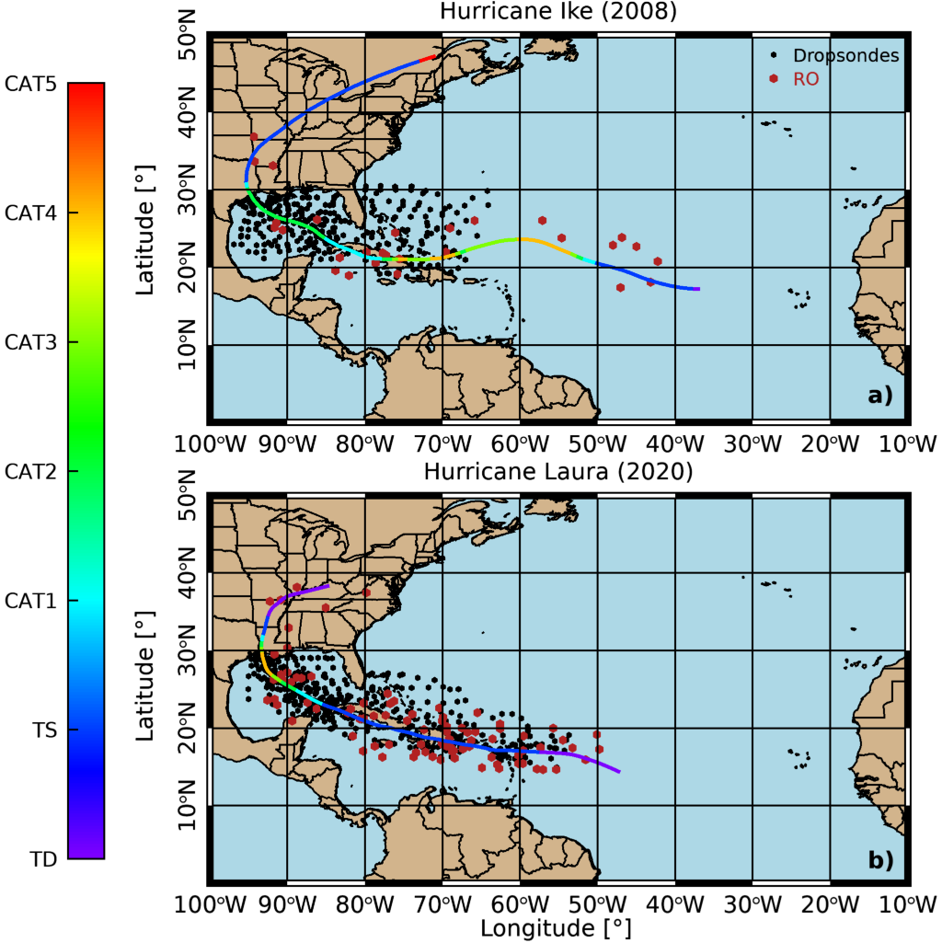
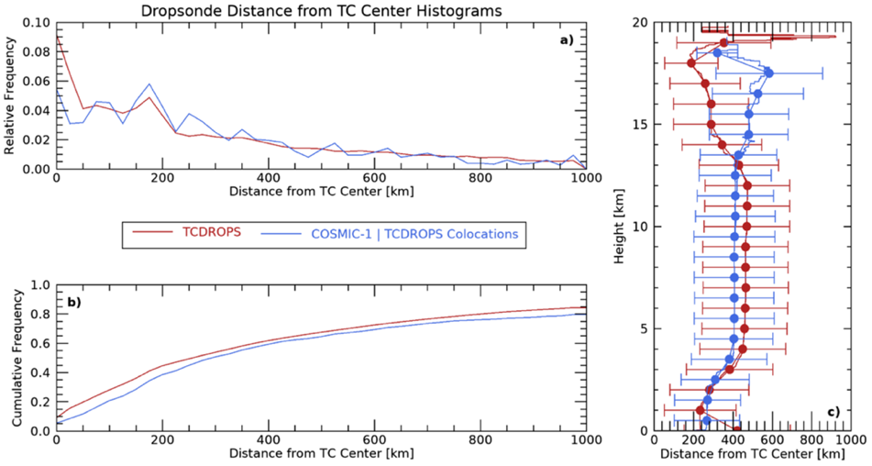
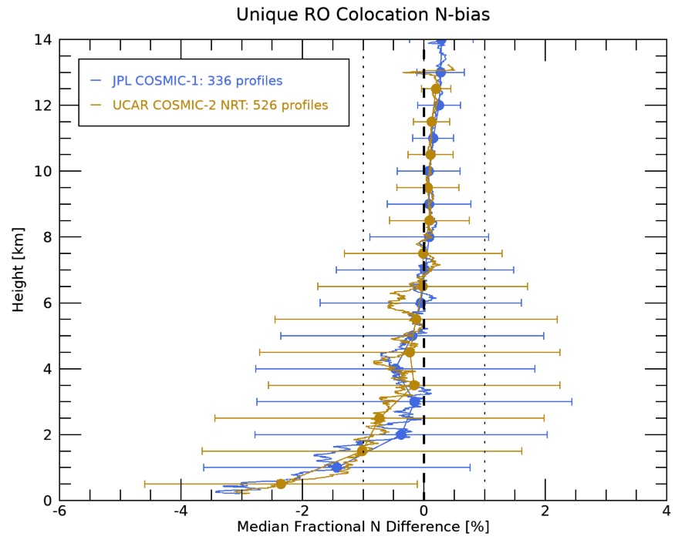
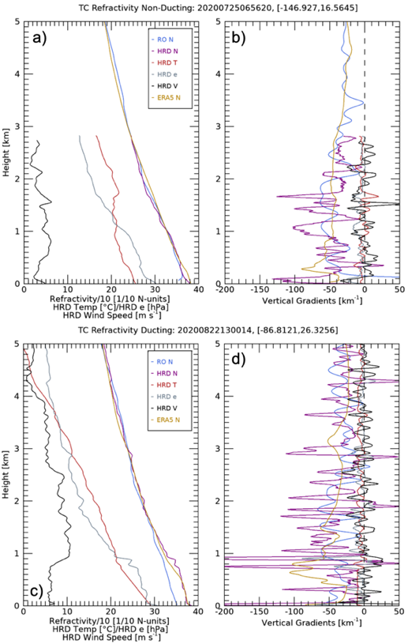
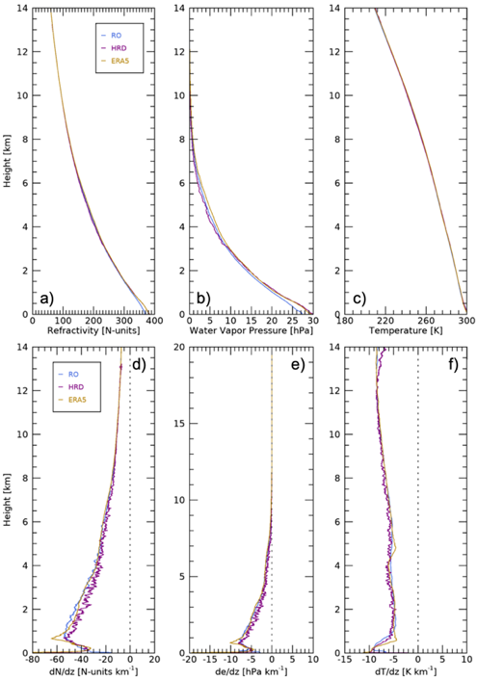
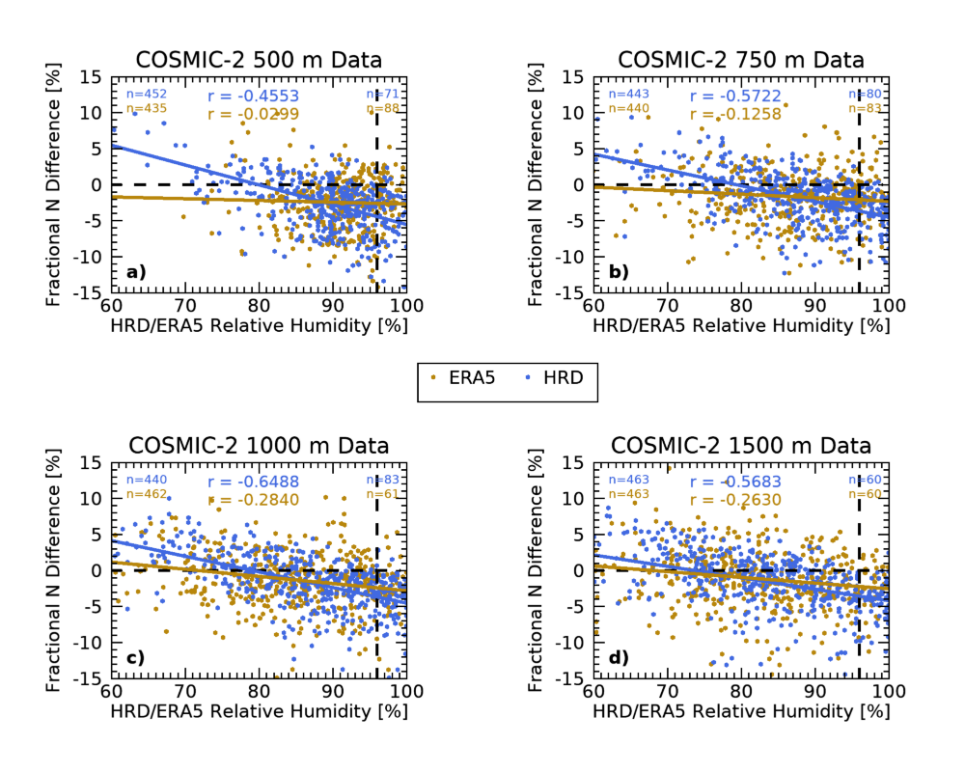
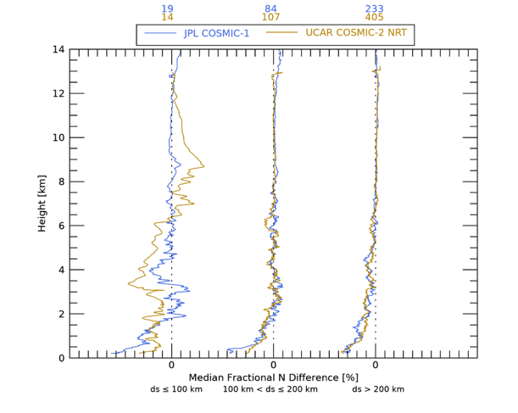
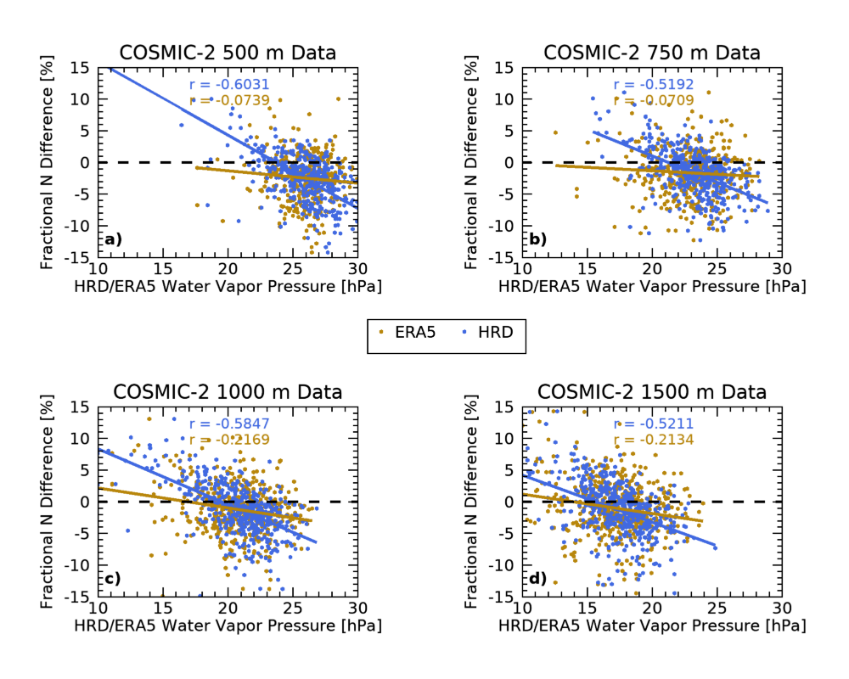
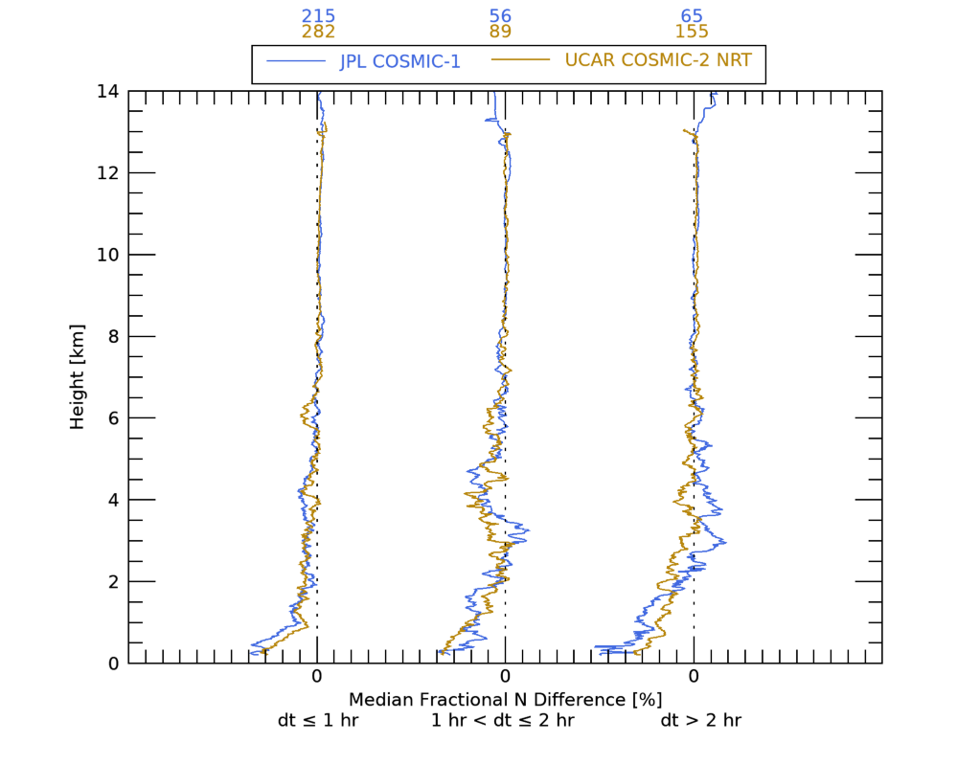
National Aeronautics and Space Administration
Assessing the Quality of GNSS Radio Occultation Observations in Tropical Cyclones
Kevin J. Nelson, NASA Postdoctoral Fellow, Jet Propulsion Laboratory, California Institute of Technology
Chi O. Ao, Research Technologist, Jet Propulsion Laboratory, California Institute of Technology
Feiqin Xie, Texas A&M University - Corpus Christi
Jonathan Zawislak, NOAA Hurricane Research Division & University of Miami
1. Introduction
Long-range tropical cyclone (TC) forecasts remain one of the biggest numerical weather prediction challenges
Vertical profiles of middle-troposphere in TCs limited to in-situ dropsondes passing through from higher altitudes
Important thermodynamic and dynamic processes thought to occur here
GNSS radio occultation (RO) is insensitive to clouds and precipitation, providing a unique opportunity for observing TC vertical structure
COSMIC-2 launched in 2019, tropical samples increase
Previous studies use GNSS RO to study TCs, but do not consider observation quality relative to ground-truth
GNSS RO profiles can be assimilated in to TC forecast ensembles to provide longer lead times for civilians and improve TC intensity estimates
2. Data and Methodology
GNSS RO retrievals from COSMIC-1 (JPL) and COSMIC-2 (UCAR NRT) colocated with in-situ dropsondes (TCDROPS) within 300 km and 3 hrs
TCDROPS data provides global dropsondes from both TC reconnaissance flights and observations from field campaigns (e.g., HS3, PREDICT)
Dropsonde data corresponds to NOAA best track data (e.g., MSW, MCP)
ERA5 model reanalysis used to supplement infrequent observations and provide data in sparse locations
Data/Sensor(s) | Geophysical Variable | Note/Algorithm
TCDROPS (2006-2021) | ASPEN QC’d dropsonde profiles | TCDROPS created by Dr. J. Zawislak
COSMIC-1 (2006-2019) COSMIC-2 (2020-2021) | Refractivity, Temperature, Water Vapor Pressure | JPL COSMIC-1 UCAR COSMIC-2 NRT
ERA5 Model Reanalysis (2006-2021) | Refractivity, Temperature, Water Vapor Pressure, Wind Speeds | Temporal: 3-hourly Spatial: 0.25° x 0.25°
3. Thermodynamic Observations
53% of dropsondes launched within 300 km of TC center
Neutral atmosphere refractivity given as: $N= a_{1}\frac{P}{T}+ a_{2}\frac{P_{w}}{T^{2}}$
Radio ducting present when: ${dN}/{dz}<−157 N\text{−}units {km}^{−1}$
Radio ducting (ducting) occurs frequently within TCs, particularly within the eye and in subsidence regions between rainbands; approximately 72/67% for COSMIC-1/COSMIC-2 colocations, respectively
4. Radio Occultation Observation Bias
Refractivity (N) bias is less than 1% between 2 and 14 km (top right)
N-bias does not appear to be influenced by colocation criteria (bottom right)
N-bias positively correlates with moisture content (left)
N-bias vs. Relative Humidity
Colocation Distance Difference (ds)
N-bias vs. Water Vapor Pres.
Colocation Time Difference (dt)
5. Conclusions
GNSS RO observations have very low N-bias above 2 km, making it perfect for vertical profiling, particularly in middle- and upper-troposphere
Assessment of reasons for N-bias below 2 km has a variety of potential factors
Dropsonde relative humidity sensor wetting causing humidity overestimation?
Radio ducting causes RO underestimation of refractivity
Connection between fractional N-bias and moisture content under investigation
6. Future Work
Use GNSS RO to examine thermodynamic vertical structure of TC middle-troposphere as it has not been well-sampled to date and determine role in (rapid) intensification
Use GNSS RO to characterize the TC boundary layer (TCBL)
Assess the frequency of radio ducting in TCs and how it might affect GNSS RO observations in TCs
National Aeronautics and Space Administration
Jet Propulsion Laboratory
California Institute of Technology
Pasadena, California
www.nasa.gov
Publications:
Nelson, K. J., F. Xie, C. O. Ao, and J. Zawislak, 2022: Assessing the Quality of GNSS Radio Occultation Observations in Tropical Cyclones. J. Geophys. Res. Atmos., In prep.
Author Contact Information:
JPL Phone #: (818) 354-2347
JPL Email: kevin.j.nelson@jpl.nasa.gov
Poster Number: PRD-EA#008
Copyright 2022. All rights reserved.

