Slide 1
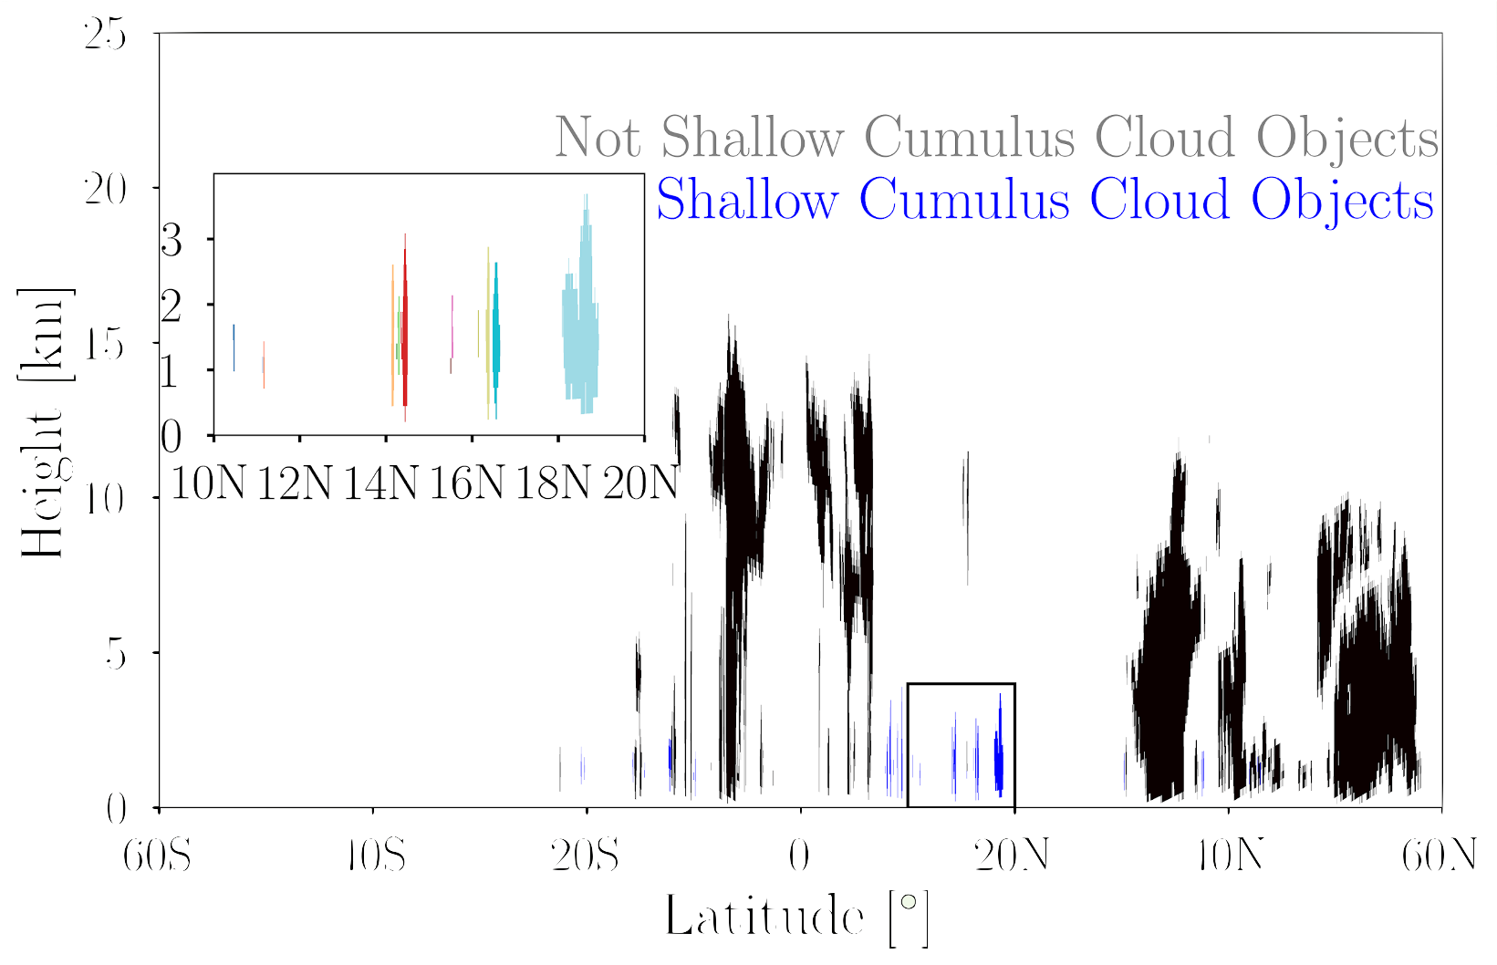
National Aeronautics and Space Administration
Inferring the Sensitivity of Warm Rain Efficiency to Cloud Size and the Environment using A-Train Observations
Author: Kevin Smalley, JPL Postdoctoral Fellow (329J)
Anita Rapp (Texas A&M University) and Matthew Lebsock (329J)
1. Motivation
Expectation: Warm rain may be more likely in larger shallow clouds or a moister environment.
Reason: The influence of entrainment on updrafts decreases.
Implication: More efficient conversion from cloud water to precipitation as cloud size and moisture increases.
2. Data
3. Results
Region: Global Oceans between 60N and 60S
Timeframe: June 2006 – December 2010
CloudSat Products
Raw Reflectivity
Modeled Reflectivity
Rain Water Path (W_{p})
Freezing Level
MODIS Products
Cloud Water Path (W_{c})
ECMWF Products (ECMWF-AUX)
Environmental Moisture
Lower Tropospheric Stability (LTS)
Sea-Surface Temperature (SST)
WRR increases with both cloud size (depth and extent) and environmental moisture, but changes are dominated by cloud size.
Entrainment Influences?
Droplet size should decrease from base to top in raining clouds
Radar reflectivity is a function of drop size to the 6th Power
The vertical gradient in reflectivity (VGZ) shifts from positive to negative during the non-raining to raining transition
2. Methods
Label Contiguous Cloudy Regions as Cloud Objects
Remove Land Cloud Objects
Remove Non-Raining Cloud Objects
Expectation: VGZ will shift from negative to positive from cloud base if cloud cores become more protected from entrainment, and the magnitude will depend on cloud size
Cloud Top Heights < Freezing Level
LTS < 18.55 K
Not Shallow Cumulus Cloud Objects
20
4
Shallow Cumulus Cloud Objects
3
15
2
1
Height [km]
0
18N
VGZ increases from cloud core to edge, and has a larger negative magnitude at cloud center when clouds are larger
10
10N
14N
5
4. Main Takeaway
0
40S
0
20N
40N
60N
Increases in WRR and changes in VGZ with cloud size (i.e. extent and top height) suggest larger shallow cumulus have more protected cores resulting in larger droplets that are more efficient at scavenging cloud water.
60S
20S
Latitude [º]
Warm Rain Efficiency (WRR) = $\frac{W_{P}}{W_{C}}$
National Aeronautics and Space Administration
Jet Propulsion Laboratory
California Institute of Technology
Pasadena, California
www.nasa.gov
Paper Link
Poster Number PRD-EA#001:
Author Contact Information:
Phone Number: 818-393-1842
Email address: kevin.m.smalley@jpl.nasa.gov
Copyright 2022. All rights reserved.

