Slide 1
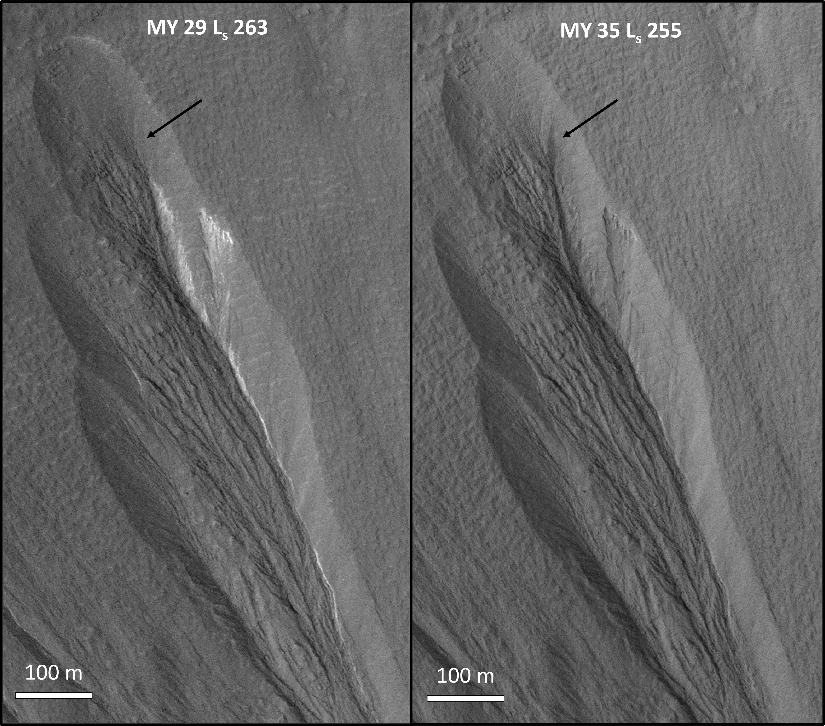
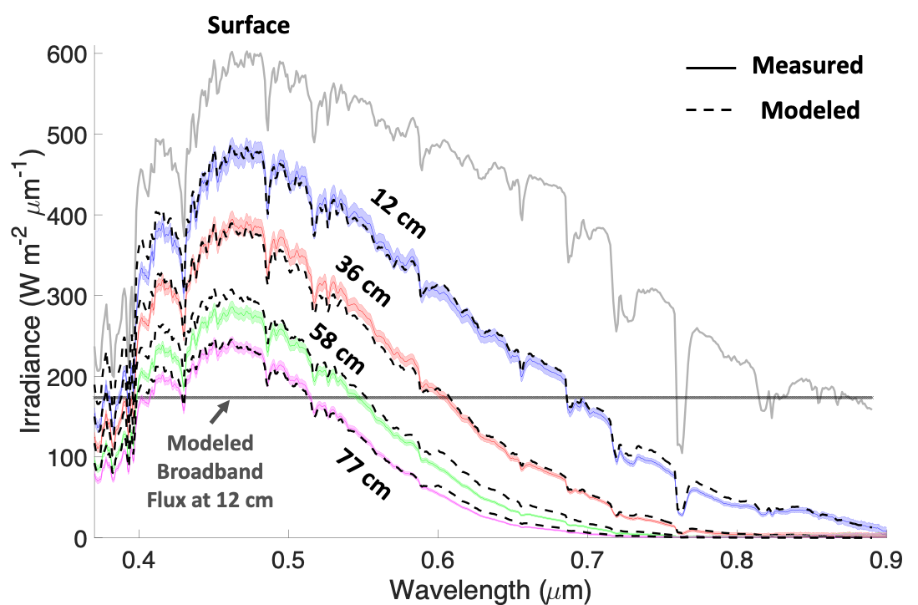
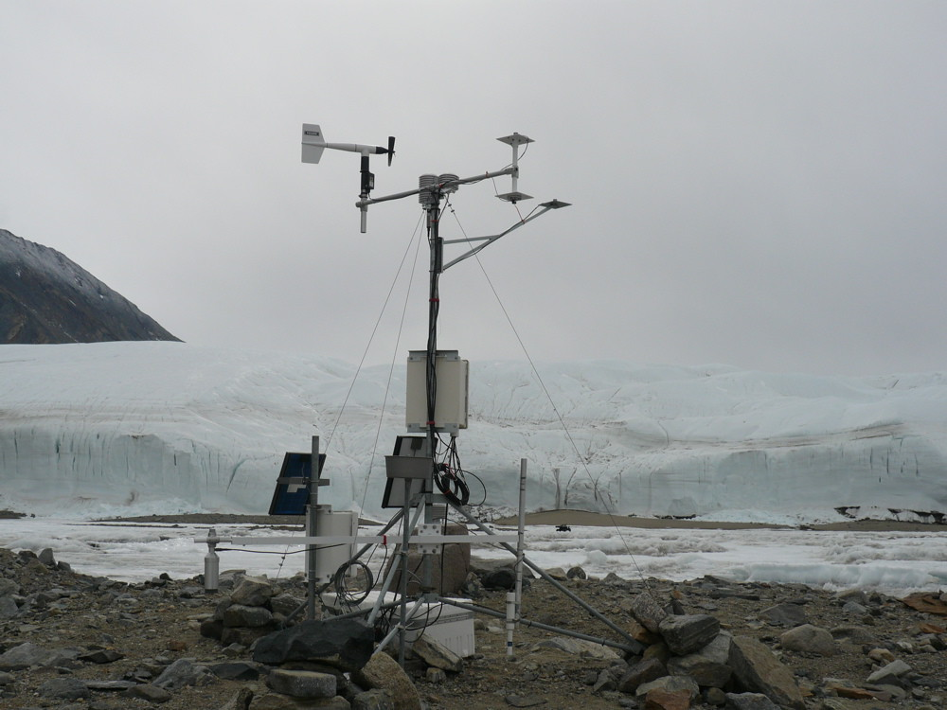
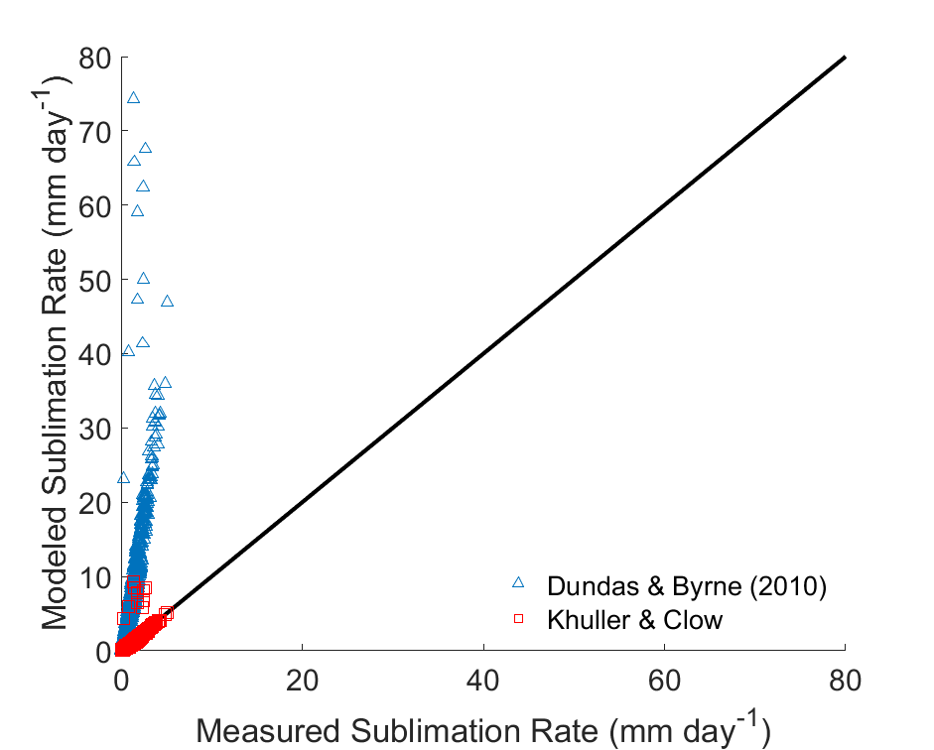
National Aeronautics and Space Administration
Advances in Modeling the Energy Balance of H₂O Ice on Mars:
Implications for Present-Day Liquid Water
Aditya Khuller, JPL Postdoctoral Fellow (3980)
Gary Clow (CU), Phil Christensen (ASU) & Steve Warren (UW)
J. Background
New ~50 m slump
IV. Significance of Results/Benefits to NASA/JPL
H₂O ice exposed between 30°–60° latitude on Mars contains <∼1% dust¹
Repeat images show that this ice disappears over a few Mars Years
However, the exact lifetime of the exposed ice and whether this ice is melting to produce subsurface liquid water, is currently unknown
Exposed Ice
The presence or absence of near surface liquid water is key to:
the evolution of martian geology
potential past or extant life
future robotic and human exploration on Mars
a
Comet 67P, during outburst
II. Objectives
Figure 1. Dusty H₂O ice disappearing over
six Mars Years (MY). The black arrow indicates a ~50 m slump that was not present in MY 29. Whether the ice melted and/or sublimated is currently unknown. We will assess whether liquid water is being produced within similar mid-latitude ice exposures.
Determine the energy balance of ice on Mars
Provide improved estimates of ice sublimation rates
Constrain the conditions under which martian ice can melt in the shallow subsurface (top few meters)
a
Figure 2. Modeled spectral solar irradiance at various depths in comparison with measurements made in glacier ice⁴. Existing martian ice models assume that the irradiances below the surface are zero or simply use a broadband extinction value, which can lead to errors up to ~10 K in subsurface heating.
III. Approach & Results
Developed first radiative transfer model for dusty martian snow and glacier ice²
-> Validated against in-situ measurements that shows that the H₂O ice excavated at the Phoenix landing site is dusty snow
Developed new, unified model to predict atmospheric turbulent fluxes and evaporation/sublimation rates on any terrestrial planetary body³
-> Model shows up to ~5x better agreement with measurements compared to methods commonly used on Mars
b
Values along this 1:1 line indicate perfect agreement between measured and modeled values
V. Future Work
Incorporate new solar and turbulent flux models into existing terrestrial snow model⁵
Conduct studies on martian ice and subsurface liquid water habitability
Will submit manuscript on new martian ice thermal model
Figure 3. (a-b) Modeled vs. measured sublimation rate of a perennially H₂O ice-covered lake in the Dry Valleys of Antarctica.
Publications:
Khuller, A.R. & Clow, G.D. (in revision). Turbulent Fluxes & Evaporation/Sublimation Rates on Earth, Mars, Titan, and Exoplanets
Khuller, A.R., Clow, G.D., Christensen, P.R., Warren, S.G. (in prep.). An Improved Model of Ice Melt and Sublimation on Mars: Implications for Present-Day Liquid Water
Khuller, A.R., Warren, S.G, Clow, G.D., Christensen, P.R., Perl, S. (in prep.). Photosynthesis on Mars Within Lakes and Oceans Covered by Snow and Ice
Author Contact Information:
akhuller@jpl.nasa.gov; 520-450-7199
National Aeronautics and Space Administration
Jet Propulsion Laboratory
California Institute of Technology
Pasadena, California
www.nasa.gov
References: 1. Khuller & Christensen (2021), JGR. 2. Khuller et al. (2021), JGR. 3. Khuller & Clow (in revision). 4. Cooper et al. (2021), TC. 5. Jordan (1991), CRREL.
Clearance Number: CL#00-0000
Poster Number: PRD--P-030
Copyright 2023. All rights reserved.

