Slide 1
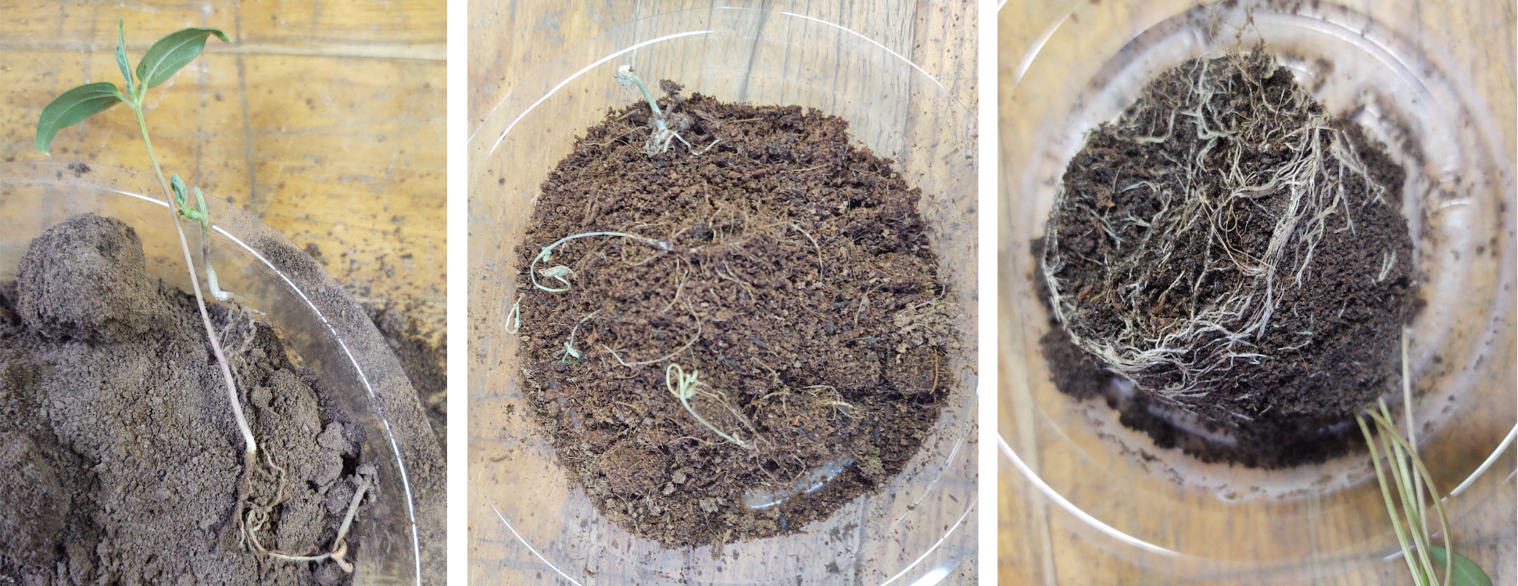
National Aeronautics and Space Administration
Intentionally applied organisms for regolith-based agricultural systems and implications for planetary protection
Author: Laura E. Fackrell, NASA Postdoctoral Fellow (353N)
Nitin Singh (353N) and Kasthuri Venkateswaran (353N)
Introduction
Phase 1: Regolith and Soil Like Substrates
Crewed missions beyond low Earth orbit present a unique and complex set of challenges for planetary protection. There has been significant effort to detect and identify microorganisms that occur on spacecraft surfaces to understand their potential to survive extraterrestrial and clean room conditions. Much of this work focuses on organisms that occur incidentally or inevitably on spacecraft surfaces¹. Just as essential are microorganisms intentionally introduced as living components to life support systems and other bioreactor technologies. Microorganisms may play important roles in the function of life support technology and behavior of biogeochemical cycles (C, N, O, P, etc.) within these closed systems. In this poster, I present a concept approach of the 1st phase of my project examining the implications of intentionally applied microorganisms relevant to off-world agriculture. The 1st phase focuses on producing viable growth mediums from regolith and inedible plant waste
Figure 1 RB-SLS: Images of plants growth in mixtures of regolith simulant and organic soil amendments. These soil amendments and regolith alone were poor mediums with challenges for root penetration and maintaining proper soil moisture conditions. However, the two combined at appropriate ratios provided normal root development. Similar growing mediums could be constructed by combining organic amendments produced from organic amendments sourced from inedible plant waste and regolith sourced from the planet surface.
However, SLS also has drawbacks including nonhomogeneous porosity and permeability resulting in nonideal water uptake and distribution. Preliminary experiments demonstrate that the combination of the two may provide an improved medium. Thus, the first phase of this project explores the application of various beneficial microorganisms used to process plant waste into SLS and combined with regolith simulants to produce productive growth mediums useful to future lunar (and Martian) habitats.
The viability of the resulting mediums will be evaluated by measuring lignin-cellulose-hemicellulose ratios, C/N ratios, overall nutrient profiles, and growth experiments to evaluate plant response. The implications to planetary protection will be accessed through bioinformatic analysis including DNA extraction and PCR. Subsequent phases will focus on growth experiments with legume/rhizobia in this regolith-based SLS and nitrogen cycle modeling that help to answer the overall goals of the project.
References: ¹Smith, et al. (2017), Astrobiology (17), 253-265; ²Clauwaert, et al. (2017), Prog. Aerosp. Sci. (91), 87-98; ³Gros, et al. (2005), Adv. Sp. Res. (36), 1312-1318.
Phase 1: Regolith and Soil Like Substrates
Agricultural systems on the Moon will be important for many aspects of crew life including food production, mental and emotional well-being, and life support systems that supply oxygen and clean water. Bioregenerative life support systems (BLSS) provide an independent means of food production essential to sustainable extraterrestrial habitats. For BLSS to be truly sustainable closed loop system, they will need to be able to use in-situ resources and recycle waste². Neither of these functions exists in current life support systems on the ISS.
Lunar regolith provides readily accessible material to include in growth mediums. However, regolith used alone in its raw state does not provide an adequate growth environment. Inedible plant waste is also a readily accessible material and may even represent some of the highest volumes of waste produced. Soil-like substrates (SLS) sourced from inedible plant. waste(rice and wheat straw) has been demonstrated as a viable growth mediums.³
National Aeronautics and Space Administration
Jet Propulsion Laboratory
California Institute of Technology
Pasadena, California
www.nasa.gov
Publications:
Fackrell, L.E. , 2023 expected, Constructing regolith-based soil-like substrates in off-world agricultural systems: in preparation for submission to Life Sciences in Space Research
Author Contact Information:
(913) 307-6510
laura.e.fackrell@jpl.nasa.gov
Poster Number: PRD-P#013
Copyright 2022. All rights reserved.

