Slide 1
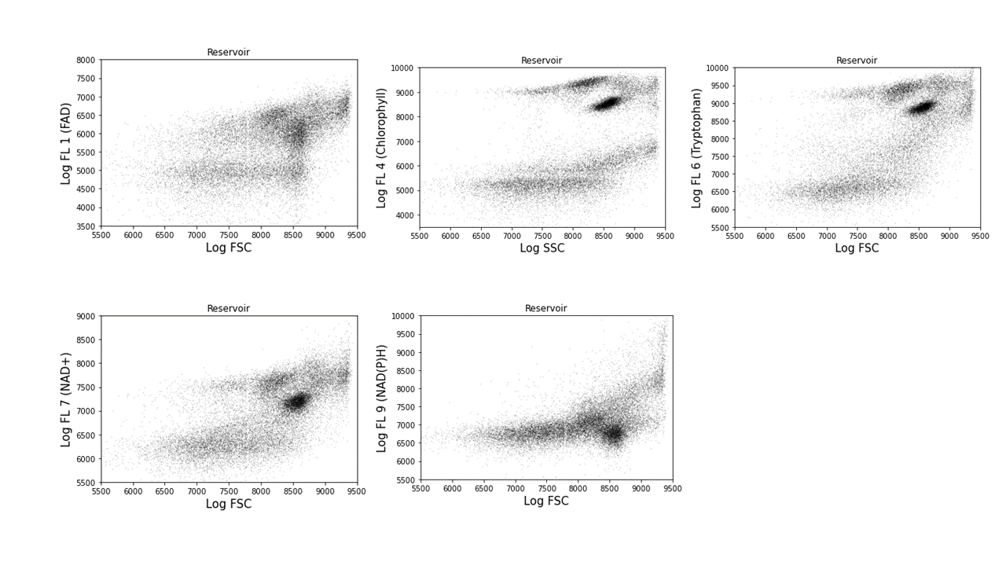
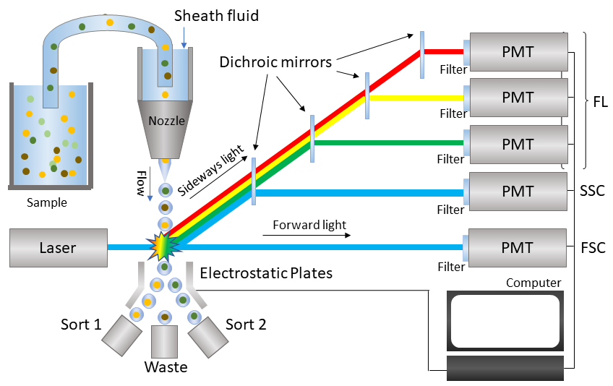
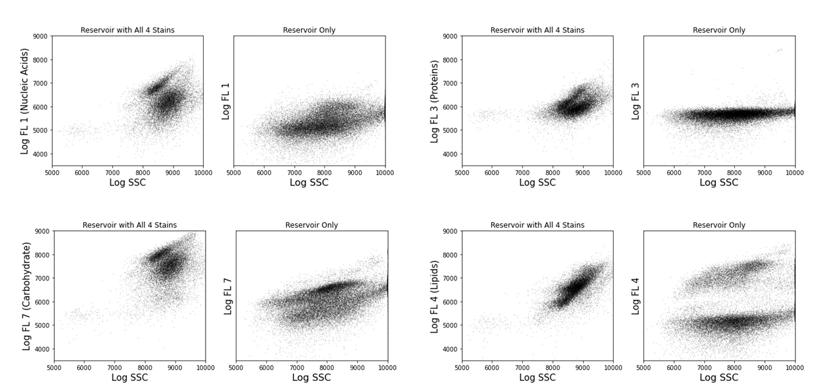
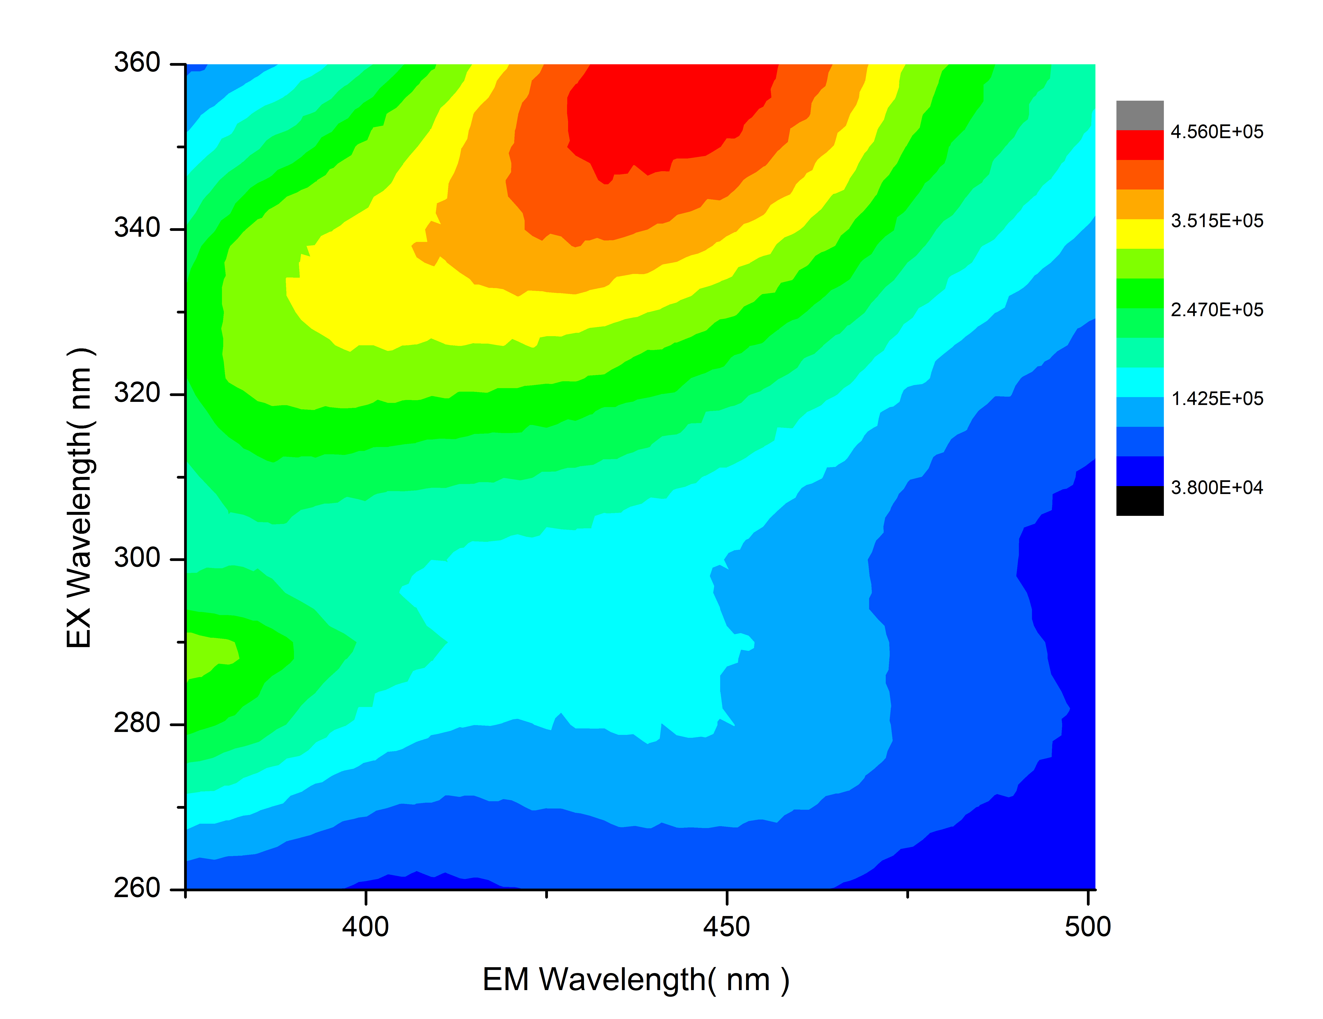
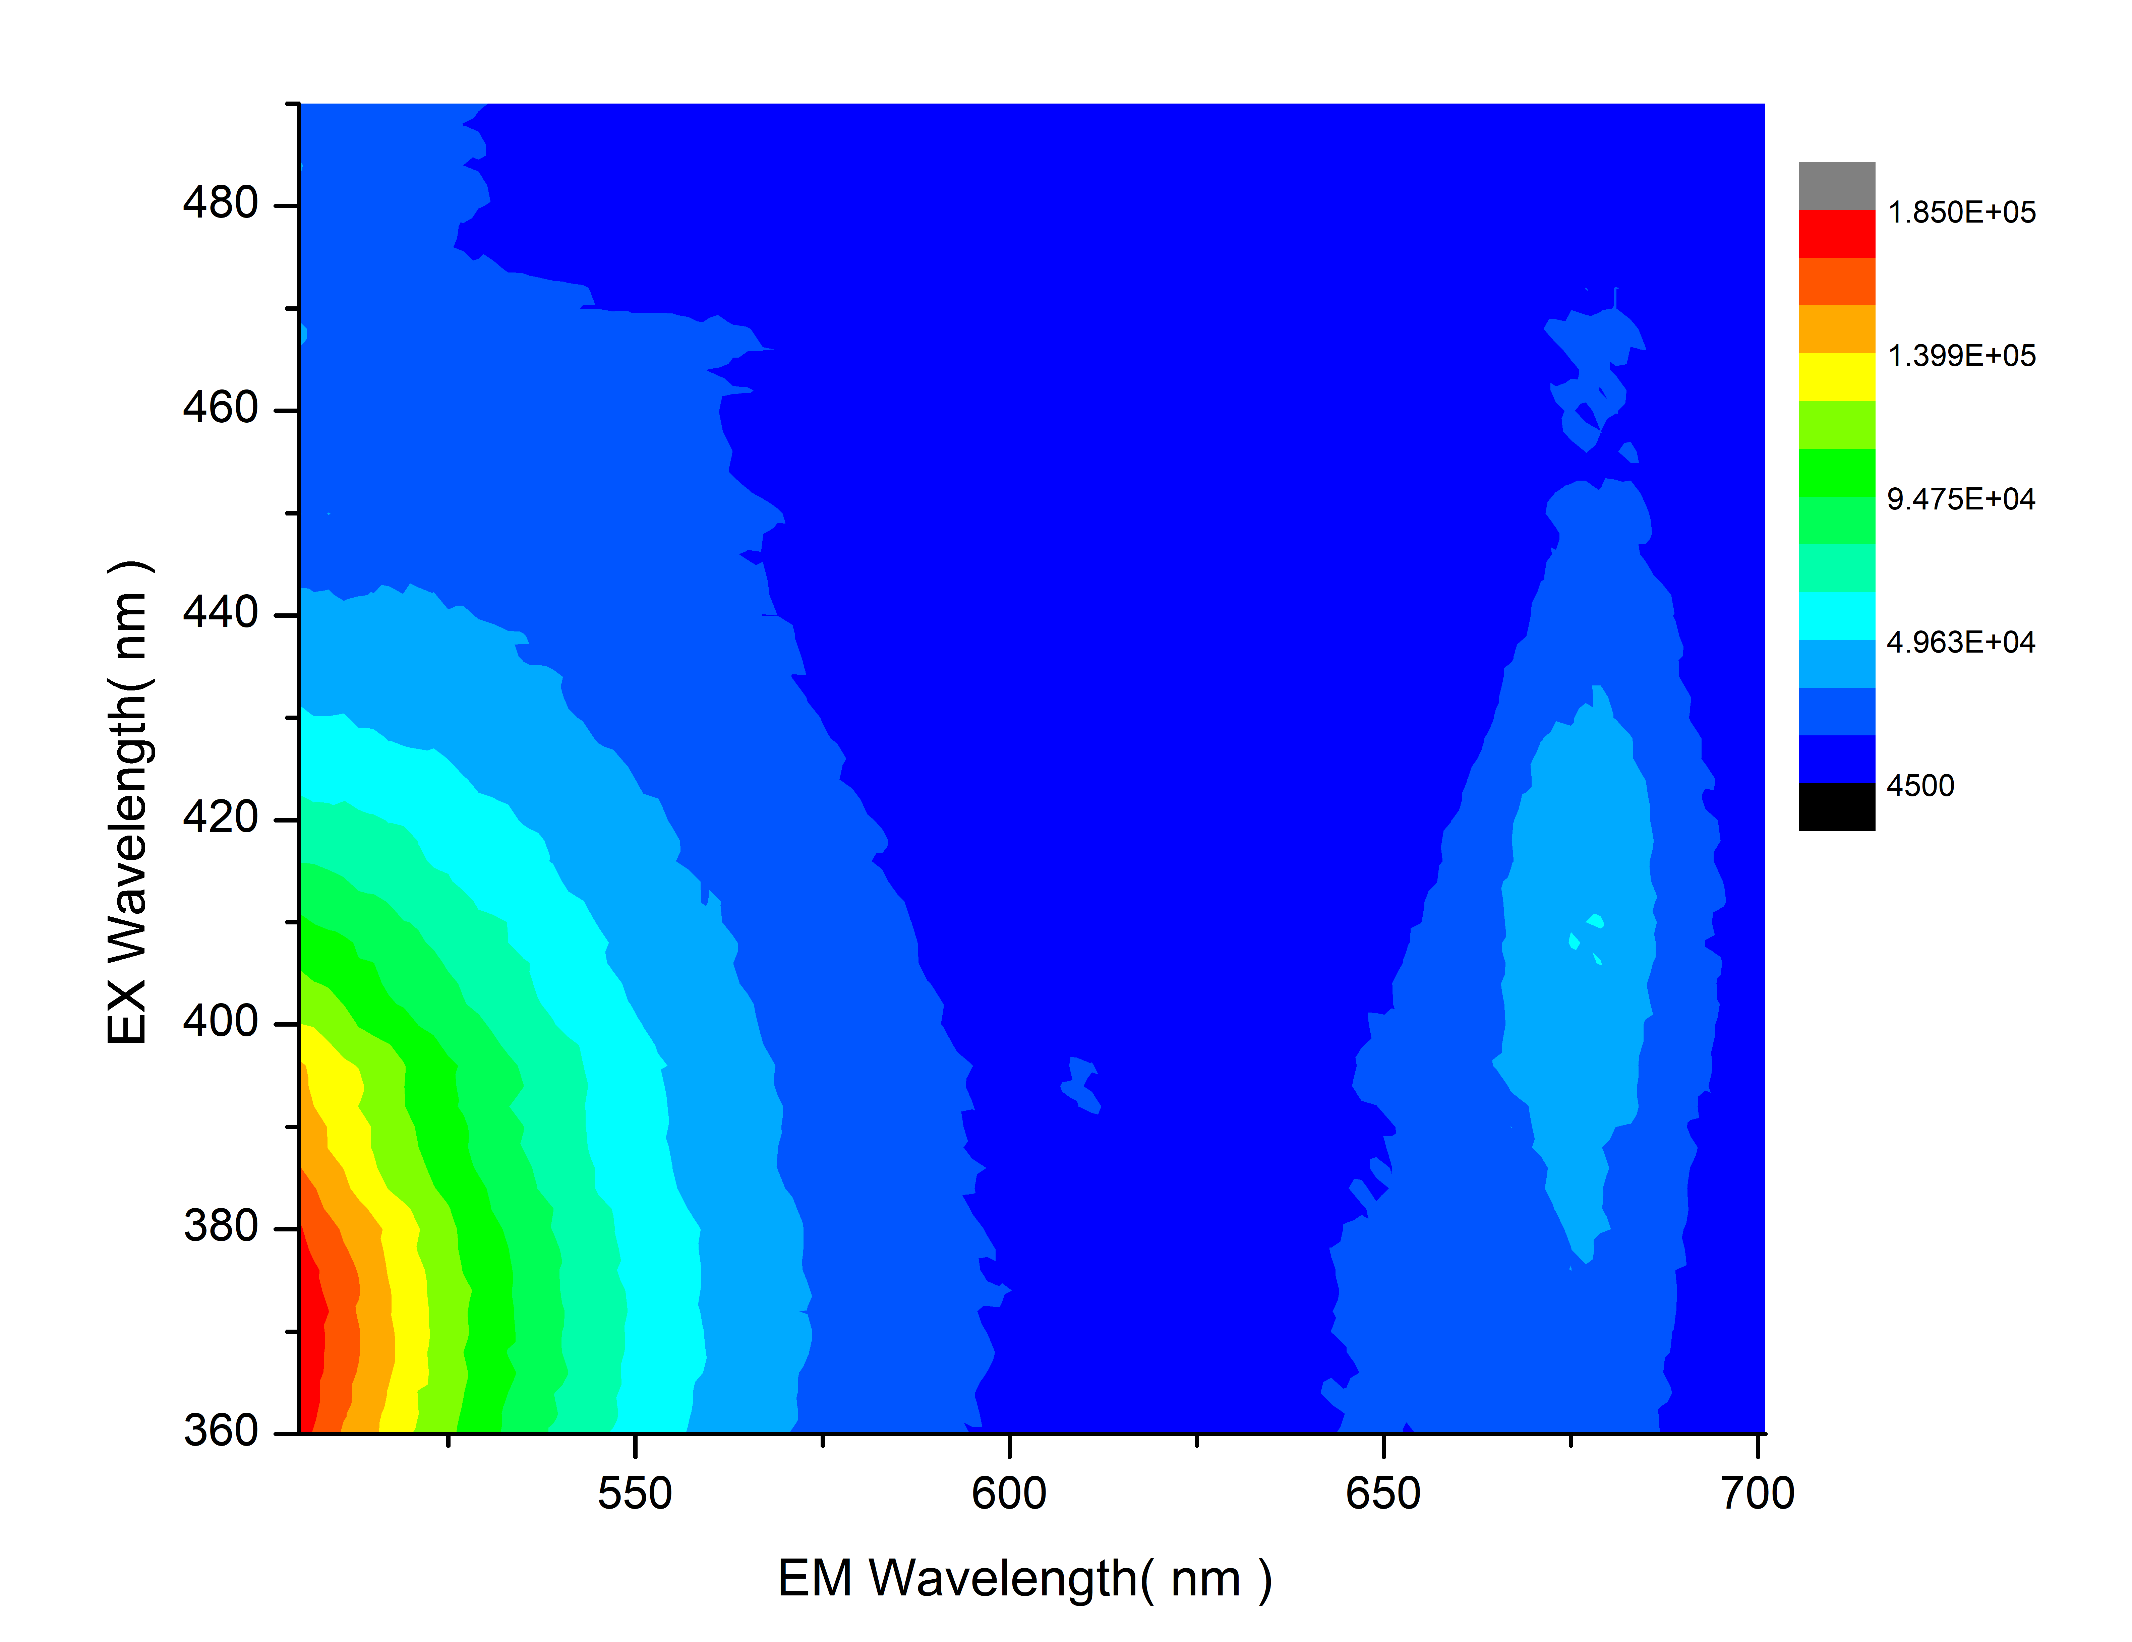
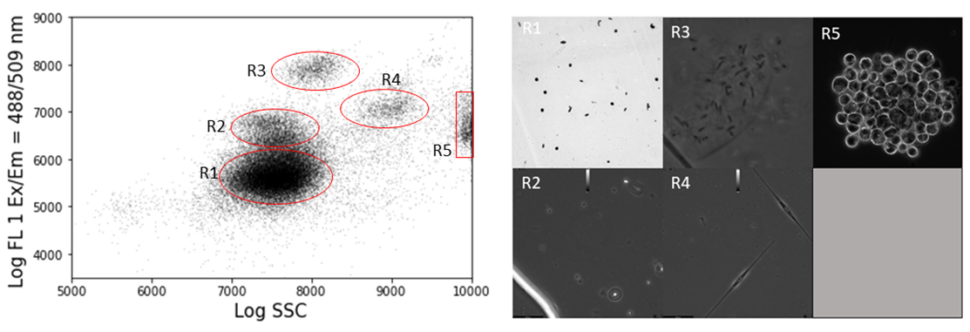
National Aeronautics and Space Administration
Life Detection on Icy Moons Using Flow Cytometry
Author: Matthew L. Wallace (389R), NASA Postdoctoral Fellow
Co-Authors: Nicholas Tallarida (389R), Wayne Schubert (352N), and James Lambert (389R)
Searching for life on Icy Moons
Life on icy worlds is likely to be: | Detection analysis requires: | Flow cytometry:
Rare, <300 cells/ml | High-throughput concentration | 50 ml/hr, up to 10,000x concentration
Microscopic, 0.2-3 µm | Optical sensing | Laser excitation, scattered light and fluorescence detection
Hidden among abiotic particles | Composition-specific sorting | Sorts particles by size, granularity, and fluorescence
Flow Cytometry
Intrinsic fluorescence and forward scatter (FSC) of a sample taken from a freshwater reservoir. Each scatter plot shows fluorescence from a specific biomarker. Clusters are visible, and each cluster represents a specific organism or type of organism. The clusters are in similar locations across the scatter plots, but with some variation, showing that different amounts of the different biomarkers are in each organism.
Exogenous Fluorescent Stains
Nucleic Acids (SYTO-9)
Proteins (SYPRO Orange)
Carbohydrates (Calcofluor)
Lipids (Di-4-ANEPPS)
Schematic of flow cytometry. The sample is enmeshed in a sheath fluid and the particles run past an interrogation point one at a time, where they are illuminated with a laser beam. Scattered and fluorescent light from the particles may pass through many different paths of dichroic mirrors and filters, where it is detected by photomultiplier tubes (PMTs). After passing the interrogation point, the particles may be sorted based on their properties for downstream instrument analysis. This schematic shows 1 laser and 5 PMT channels; our cytometer utilized three lasers and 11 PMT channels..
Intrinsic Fluorescence
Comparison of stained reservoir sample (left side of each pair of plots) with unstained sample (right side of each pair). Each pair of plots represents the fluorescence channel corresponding to the biomarker on each vertical axis. All four biomarkers are easily identified in the sample with the use of stains.
Tryptophan
NAD+
NAD(P)H
FAD
Chlorophyll
NAD(P)H
Clustering and Sorting
FAD
Tryptophan
NAD+
Chlorophyll
NAD(P)H
Detection, sorting, and microscopy of unknown organisms in a sample taken from the Salton Sea. Each region (R1 – R5) shown on the left corresponds to a region on the right. The cytometer was highly effective in sorting the organisms by cluster. A cytometry instrument on an icy moon lander could sort the organisms by cluster, then examine them with a downstream microscope. In this sample, R1 contains bacteria, R2 is unknown, R3 contains bacteria, R4 contains diatoms, and R5 contains algae.
Fluorimetry (excitation-emission matrices) of a sample from the Salton Sea. The horizontal axis shows the emission wavelength, the vertical axis shows the excitation wavelength, and the color shows the relative emission intensity. The fluorescent peaks of the five intrinsically fluorescent biomarkers are clearly visible and are labeled on the plots.
National Aeronautics and Space Administration
Jet Propulsion Laboratory
California Institute of Technology
Pasadena, California
www.nasa.gov
Publications:
Life Detection on Icy Moons Using Flow Cytometry and Intrinsic Fluorescence, in preparation
Life Detection on Icy Moons Using Flow Cytometry and Exogenous Fluorescent Stains, in preparation
Author Contact Information:
Matthew Wallace, (818) 354-2085, matthew.l.wallace@jpl.nasa.gov
Poster Number:
Copyright 2022. All rights reserved.

