Slide 1
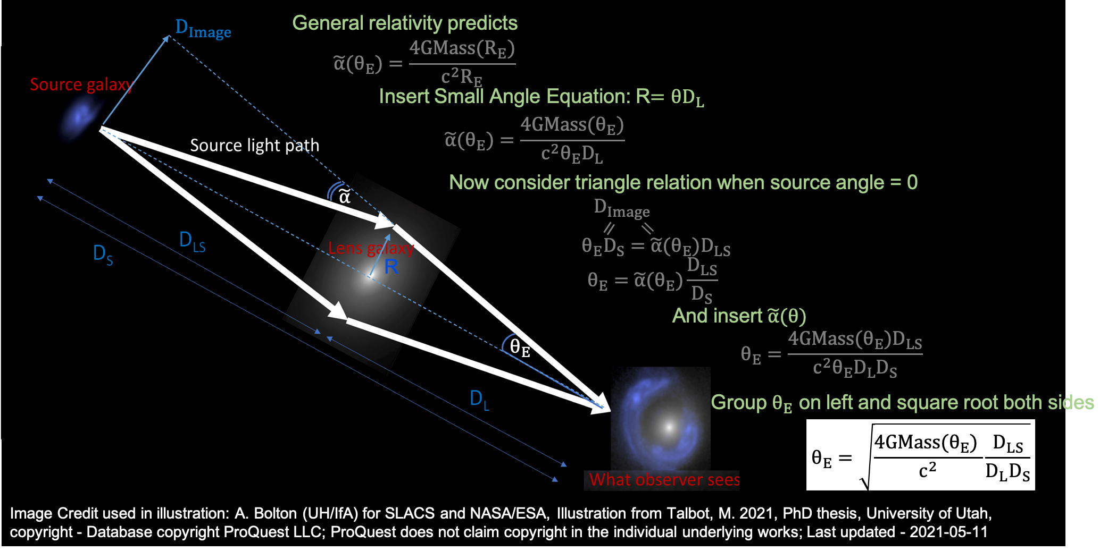
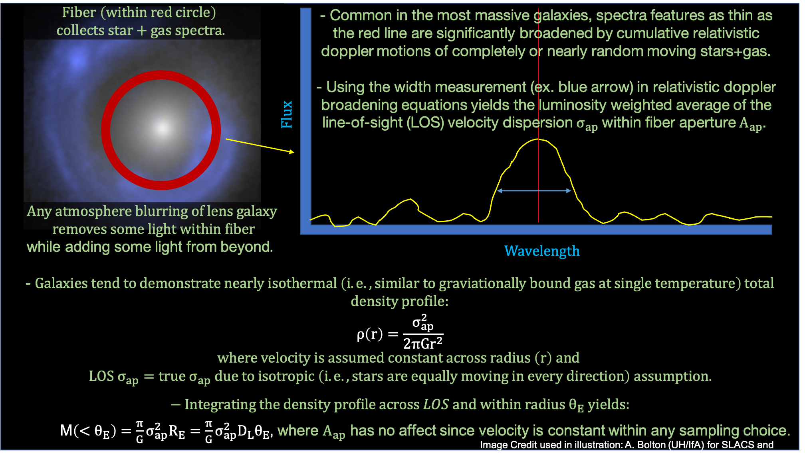
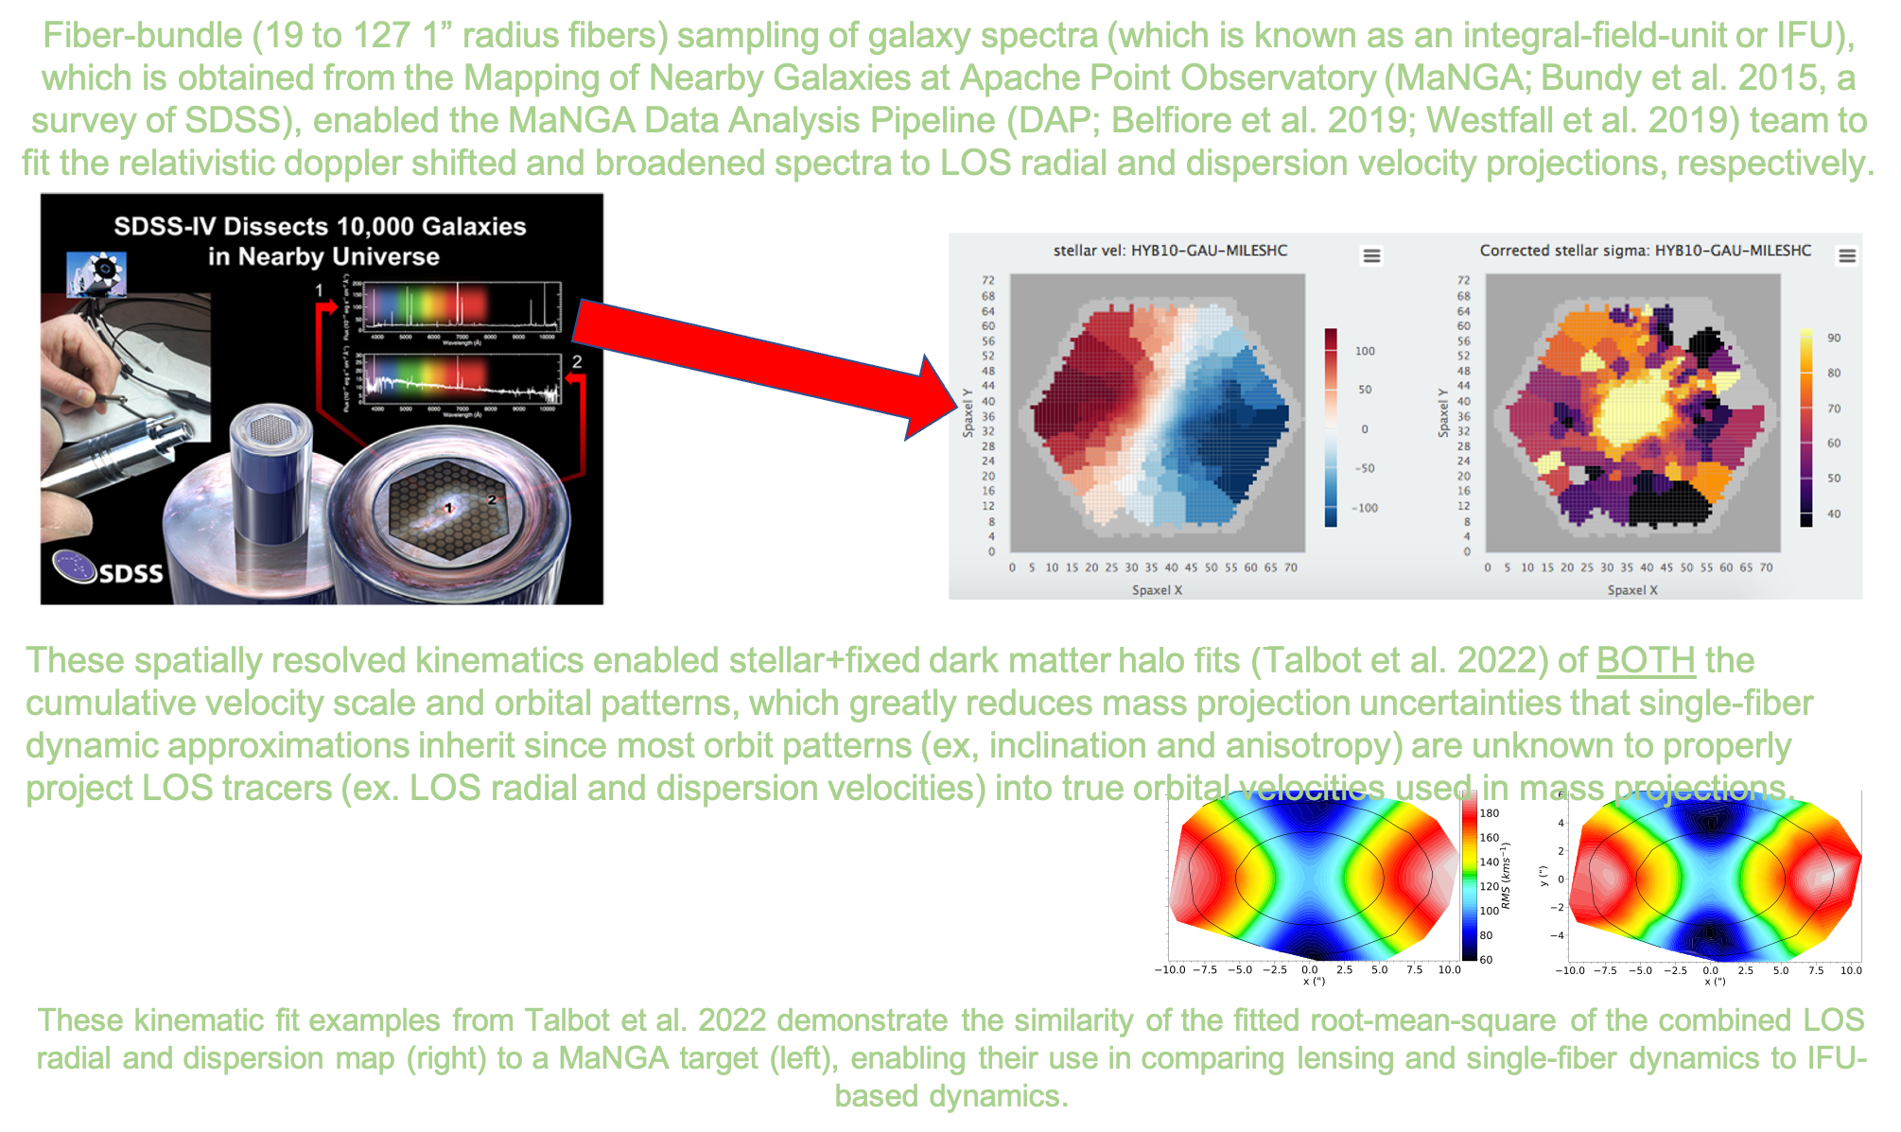
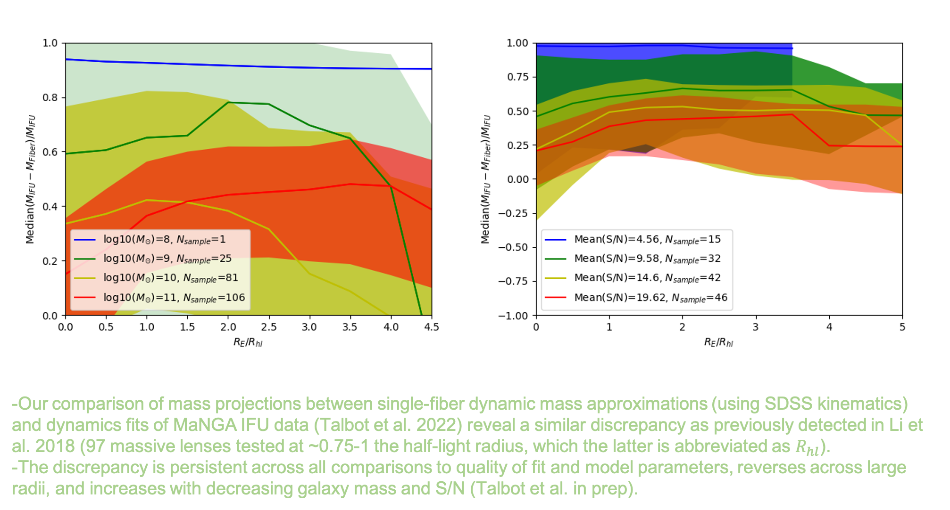
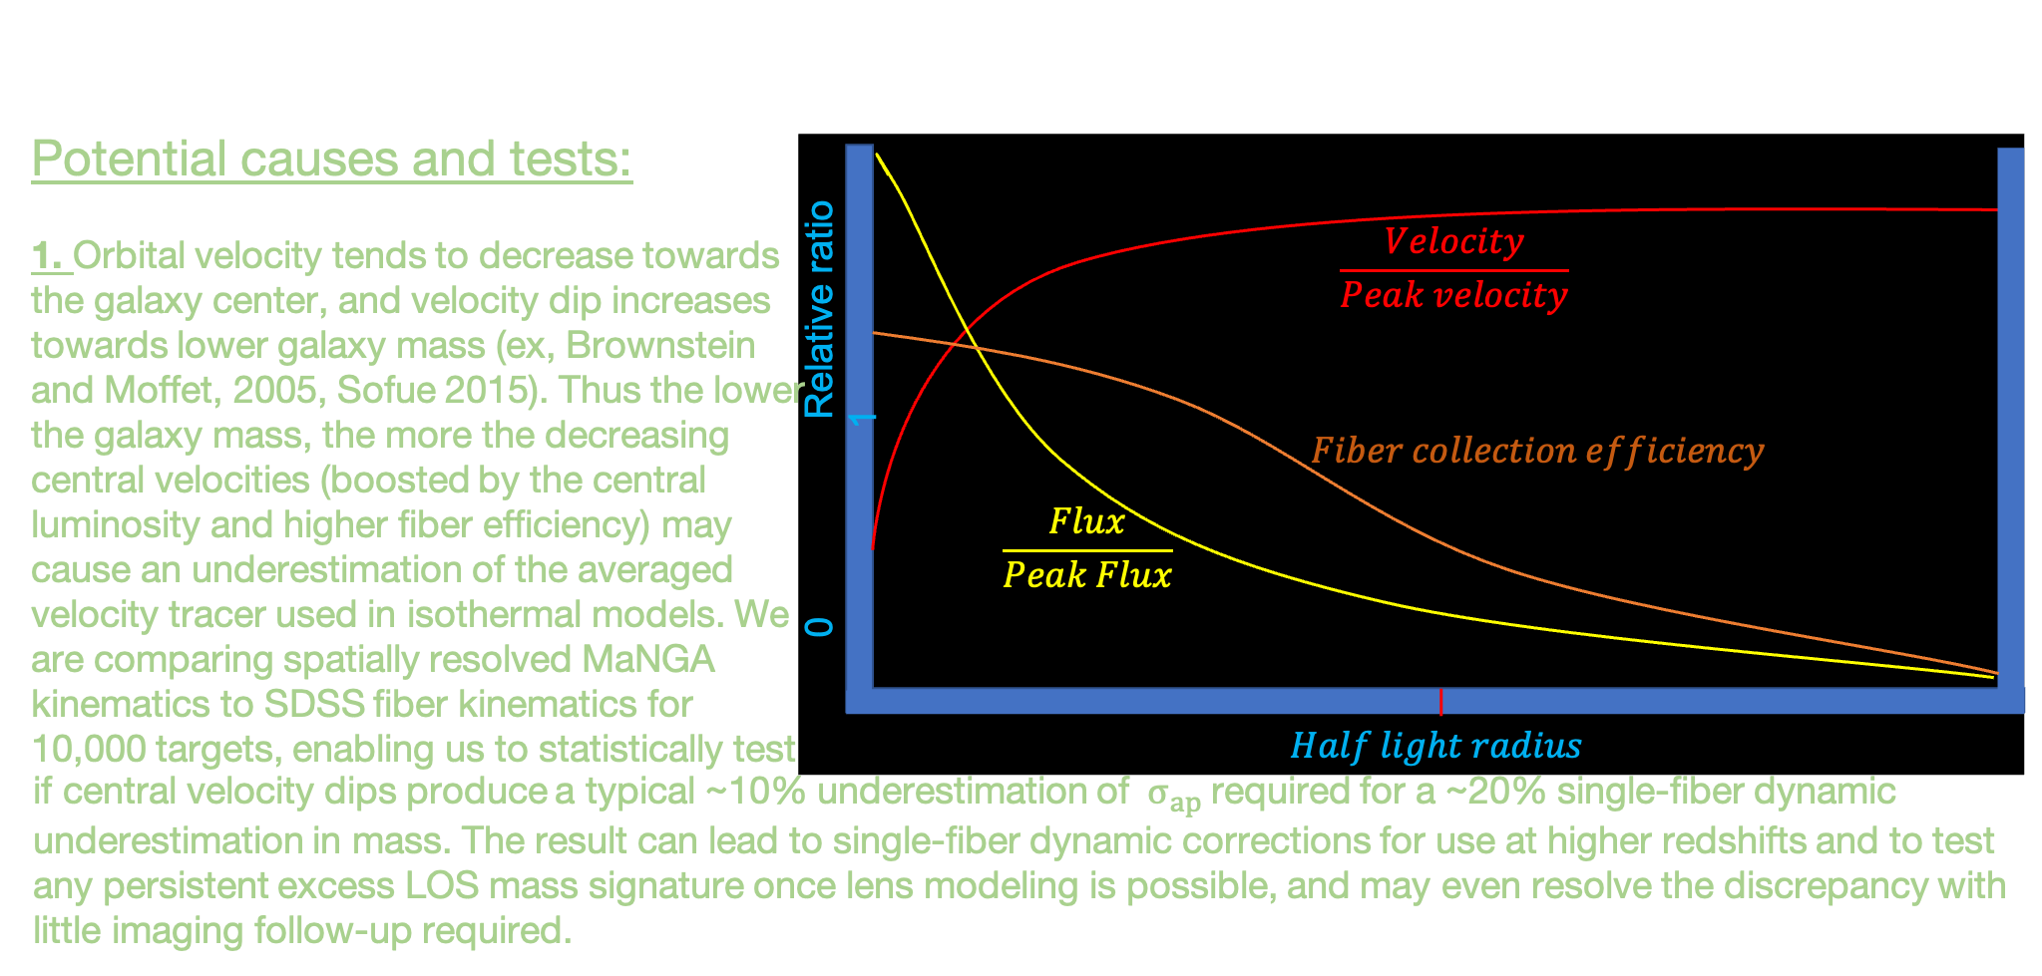
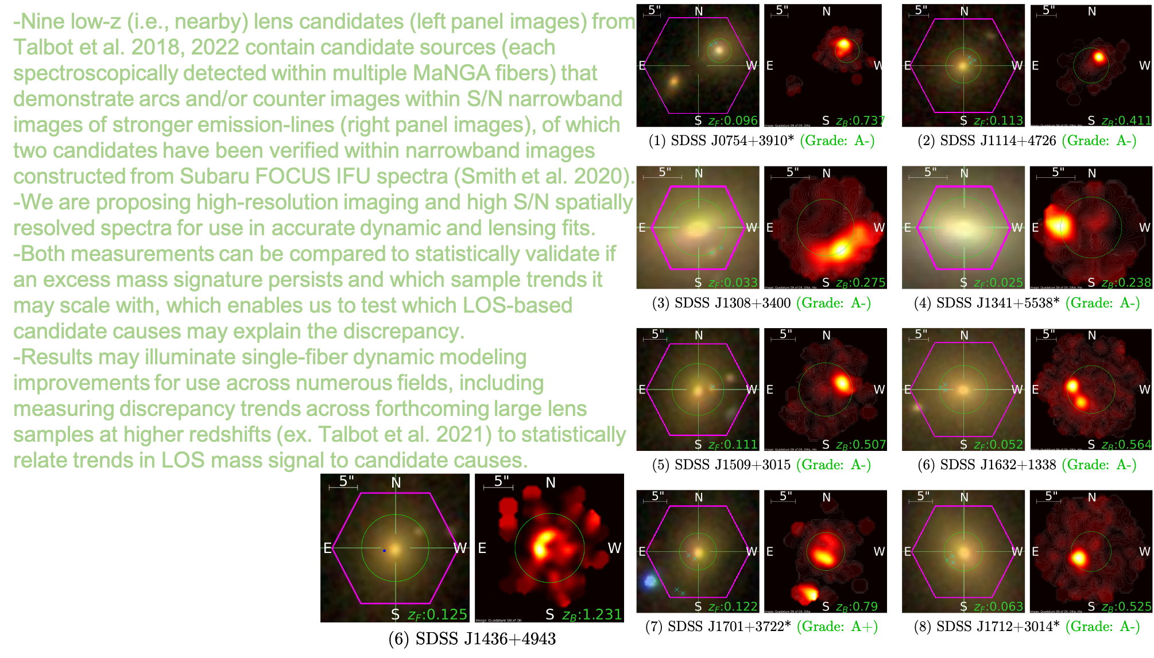
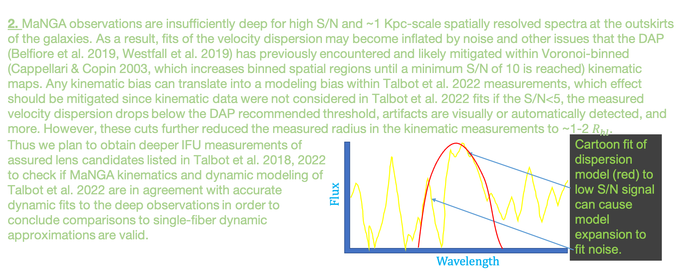
National Aeronautics and Space Administration
Investigating the Lens-Dynamic Mass Discrepancy
Michael Talbot, NASA Postdoctoral Fellow (326)
Discrepancy in Mass Measurement Methods At Cosmological Distances
Only two direct mass measurements are available at such extreme distances (redshifts of z~>0.1) where the angular size of galaxies is ~1/3600 of a degree to the observer:
Measurements using strong galaxy-scale gravitational lenses Measurements using velocity signature from a single fiber
MEASUREMENTS DISAGREE!
Lensing mass is typically 21% MORE massive than single-fiber dynamic mass approximations (Li et al. 2018), which unknown issue challenges numerous past, current, and future lens and dynamic research.
Spatially Resolved Spectra of Nearby Galaxies Enable Investigation of Discrepancy
New Data for Investigation
Single-fiber vs IFU Dynamics
Follow-up to Test lens vs single/IFU Dynamics
National Aeronautics and Space Administration
Jet Propulsion Laboratory
California Institute of Technology
Pasadena, California
www.nasa.gov
Publications:
Talbot et al. 2018, MNRAS, 477, 195.
Talbot et al. 2021, MNRAS, 502, 4617
Talbot, M. 2021, PhD thesis, University of Utah, copyright - Database copyright ProQuest LLC; ProQuest does not claim copyright in the individual underlying works; Last updated - 2021-05-11
Talbot et al. 2022, MNRAS, 515, 4953
Author Contact Information:
626-429-7468, mtalbot@jpl.nasa.gov
Poster Number: PRD-A#011
Copyright 2022. All rights reserved.

